Slide 1

Learning heuristics for playing Mastermind
By: alon Lapid

Slide 2
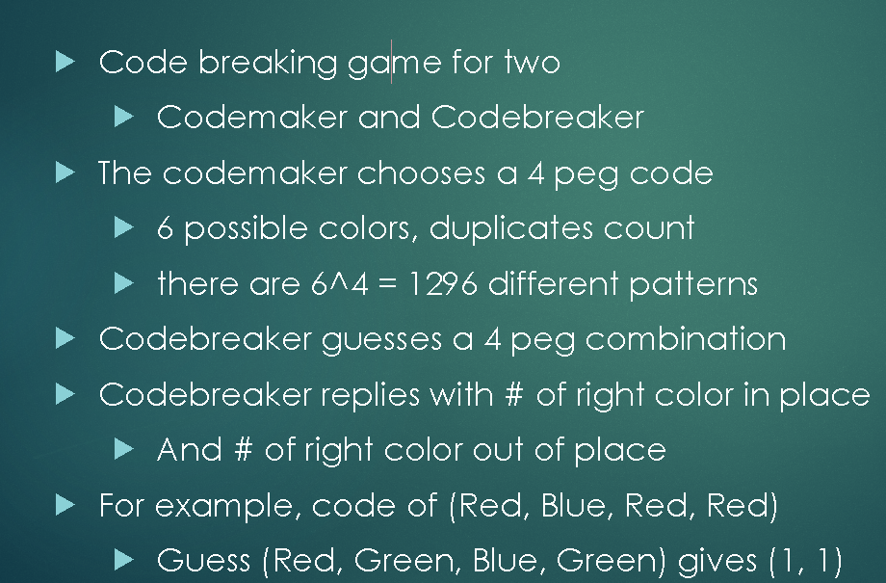
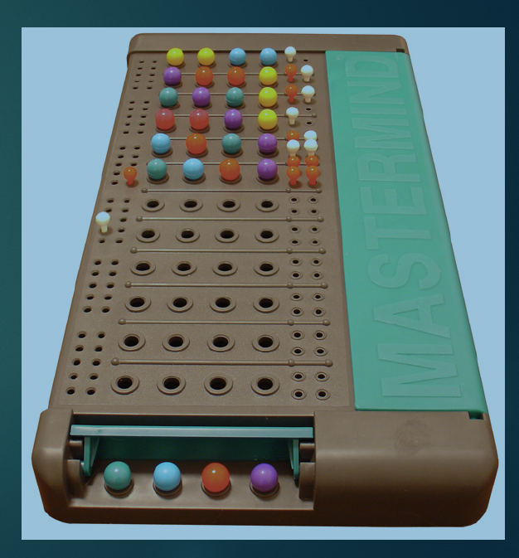
Mastermind game

Slide 3
Why this is a cool project ?
Popular game that is easy to understand but hard to play optimally
We can try to “learn” a good play strategy by using AI techniques we learned in class
We can compare our learned strategy to academic work in this space Knuth method for playing master mind
We can easily generate training examples by simulating games
It is challenging because the state space is pretty big (many different lists of possible candidates)

Slide 4
Project goals
Write a python program that plays the Mastermind game and guess a code(4 slots 6 colors) chosen by the user
Implement the simplest strategy of candidate’s elimination by randomly picking a qualified candidate ( a candidate that can win)
Implement Knuth method for playing master mind
Use NN to find good heuristics for playing mastermind
Compare the 3 methods in terms of average time to guess a number and max time to guess a number over many automated runs

Slide 5
Project high level design and resource assignments
Get the basic Mastermind playing program working – 1 or 2 programmers
Implement the Knuth algorithm\heuristic - 1 programmer
Create heuristic using NN or other technique - 1 or 2 programmers
Running simulations and producing scores for the different heuristics – 1 programmer

Slide 6
Schedule and checkpoints
Checkpoint 1 : Get the framework working and play the game given arbitrary candidate scoring heuristic – only a random qualified candidate picking heuristic implemented
- Checkpoint 2 : Implement Knuth and NN heuristics
Final: Presenting the full work and results for all strategies

Slide 7
Checkpoint 1 update
Created masterminds game simulator
The simulator creates a full strategy game tree from an arbitrary master mind play policy
The simulator run a strategy tree against all codes and capture statistics (worst case to win, average case)
Implemented professor Knuth’s mastermind playing policy and was able to reproduce professor Knuth’s performance (5 guess worst case to win,4.476 on average to win)
Started to implement the NN based strategy

