Slide 1
Create MS Teams App
Gilles Tanko

Slide 2
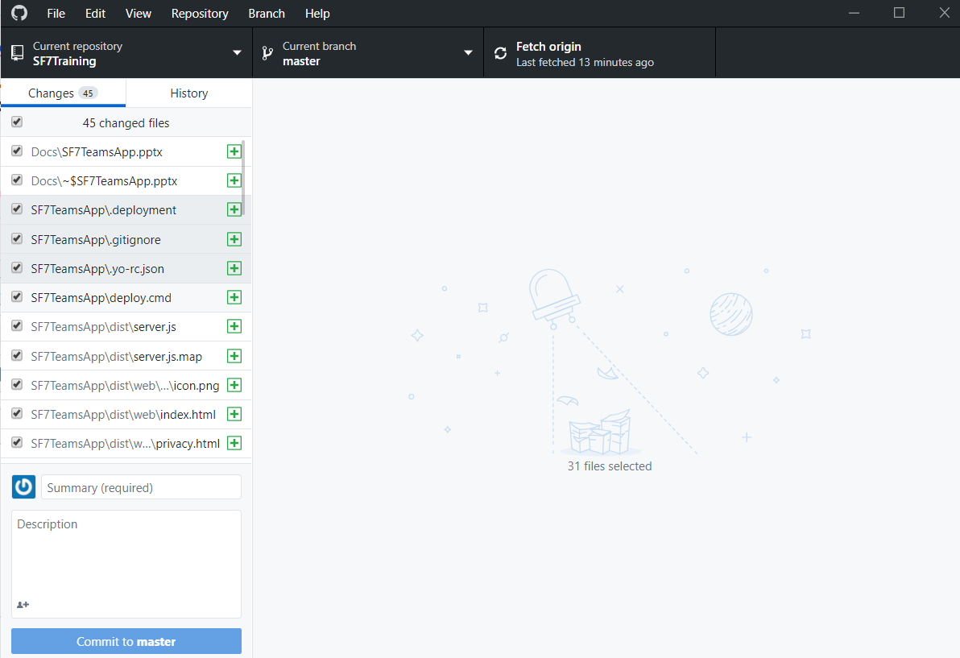
Create a GitHub Reposition
Teh Public repository for trainings:
https://github.com/giltanks/SF7Training
Install GitHub Desktop
Close repository SF7Training

Slide 3
Setup Environment for Teams development
Install Yeoman and Gulp
Open a Command Prompt window and execute the following:
npm install yo gulp-cli --global
To install Yeoman generator for Microsoft Teams apps execute the following command:
npm install generator-teams --global
Setup Environment for Teams development

Slide 4
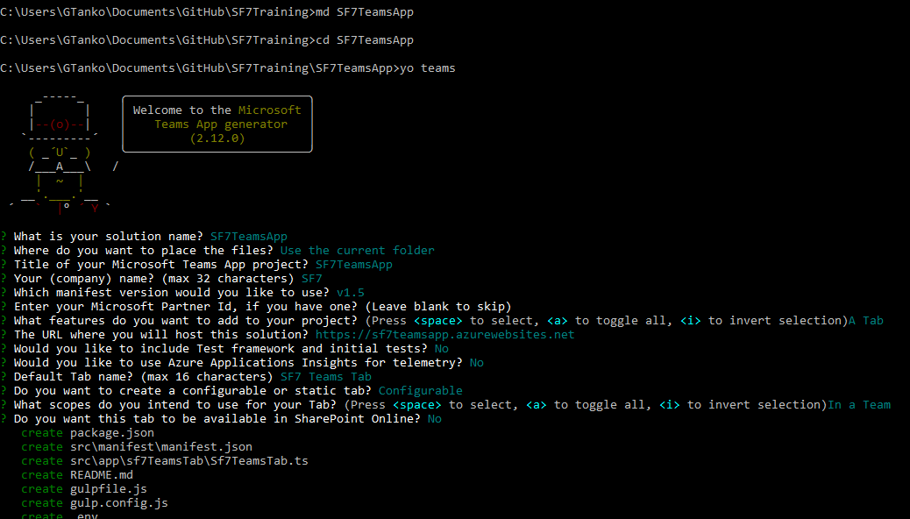
Create a Directory
Open the commandshell: start→cmd
Cd to Local Github Repository
Create a folder: md SF7TeamsApp
Create a Teams Project: Yo Teams

Slide 5
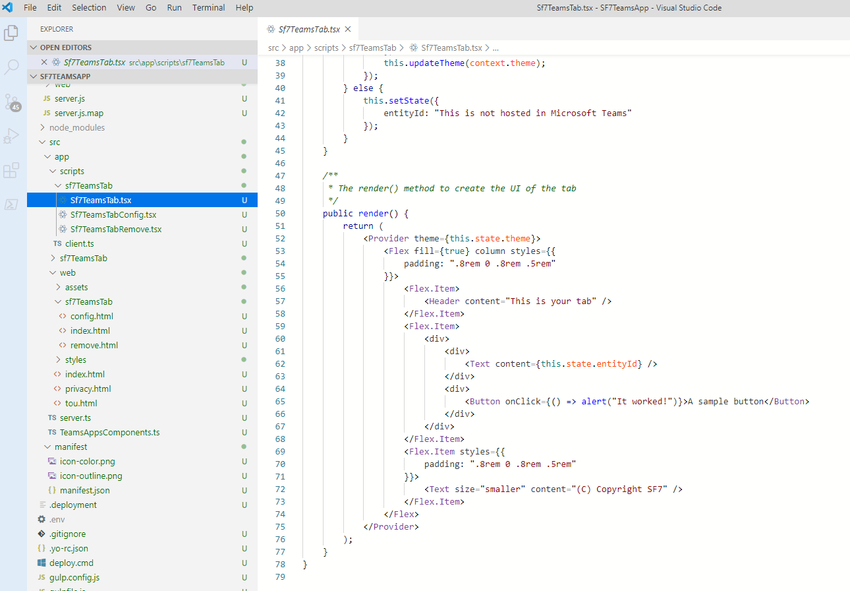
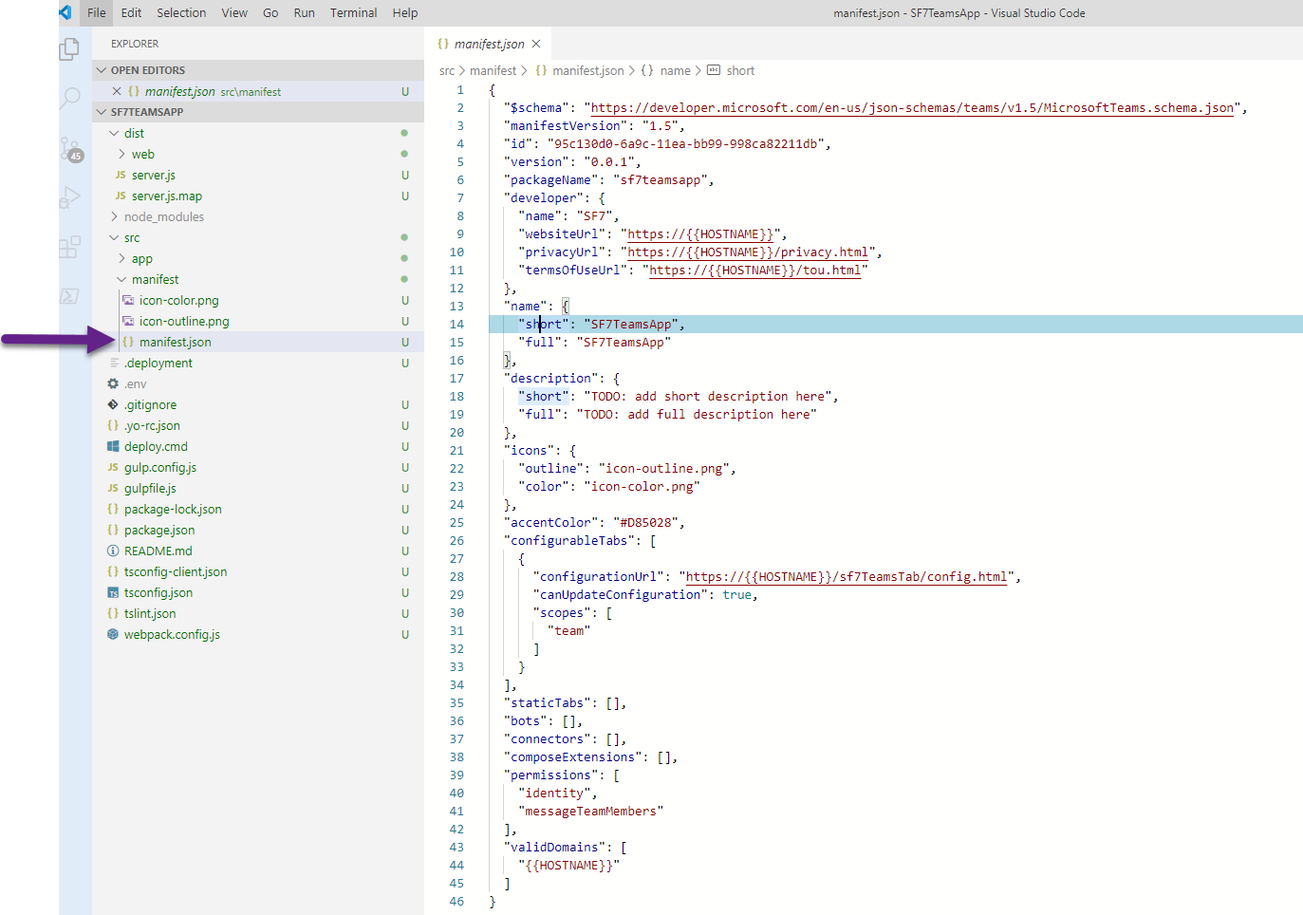
Open the project in VS code
In the cmd shell type: Code .

Slide 6
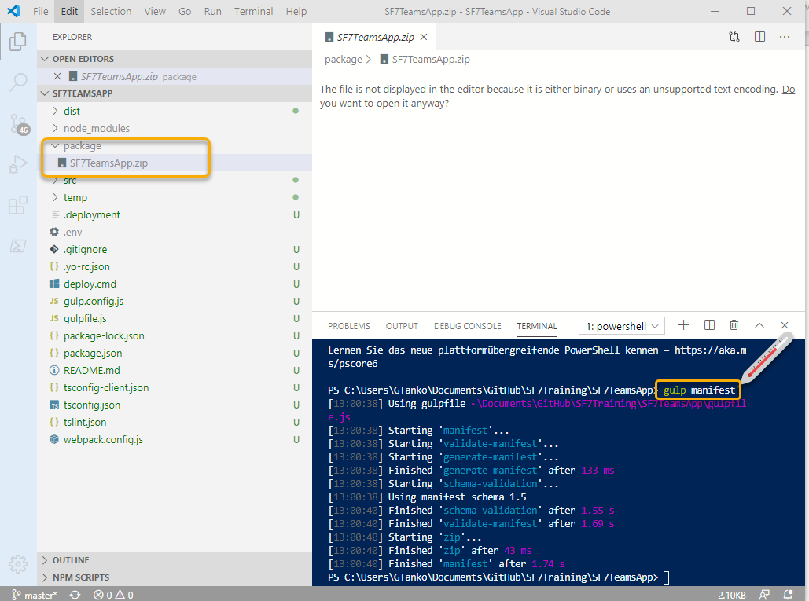
Build and test
Open Terminal in Visual Studio Code. From the Visual Studio Code ribbon select Terminal > New Terminal.
Create the manifest by executing the command: gulp manifest
This will validate the manifest and create a zip file in the ./package directory.

Slide 7
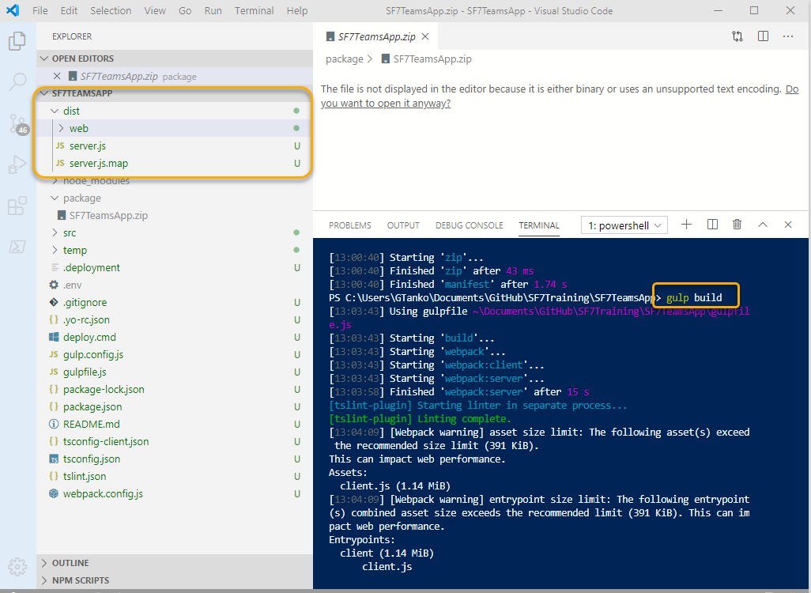
Build Solution
Gulp build will to build the solution.

Slide 8
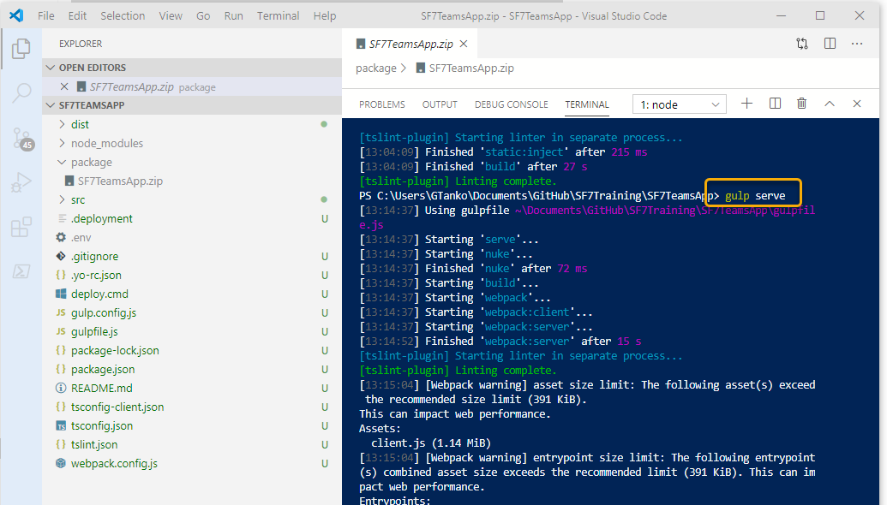
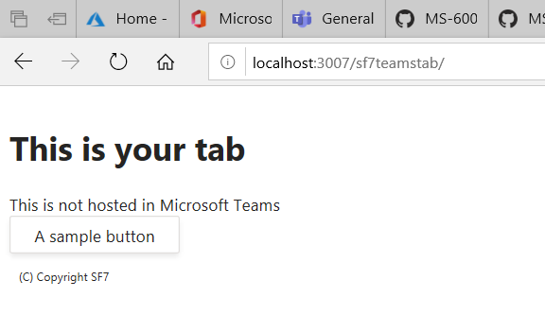
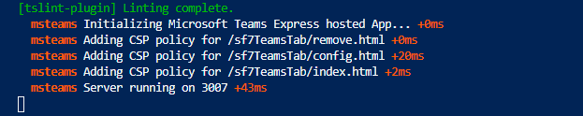
Run the App
Gulp serve

Slide 9
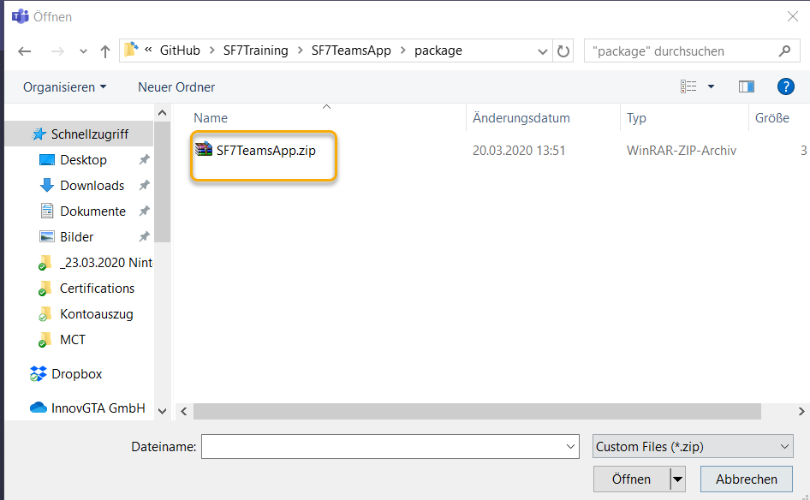
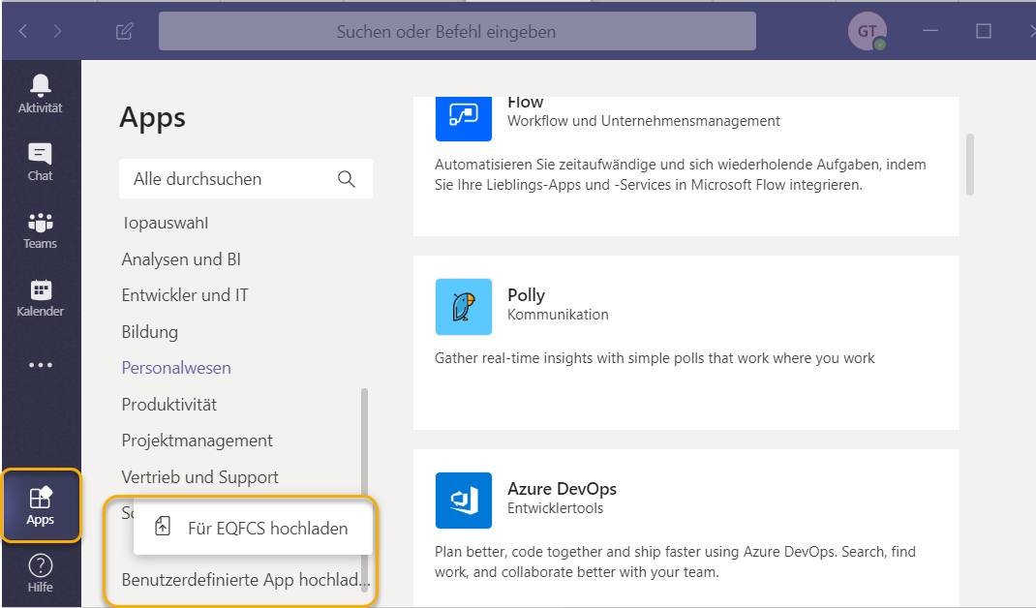
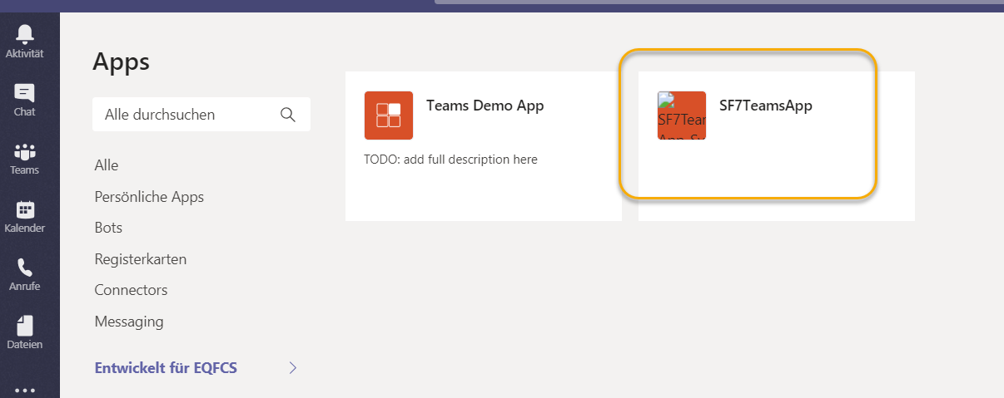
Run the App in Teams
Run the following code: gulp ngrok-serve

Slide 10
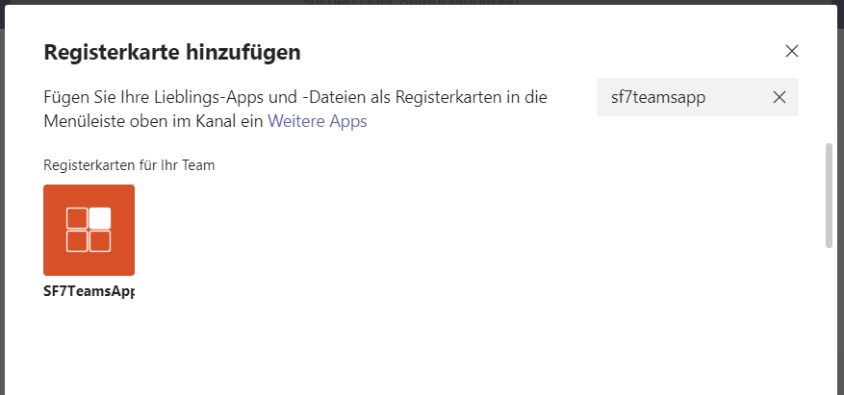
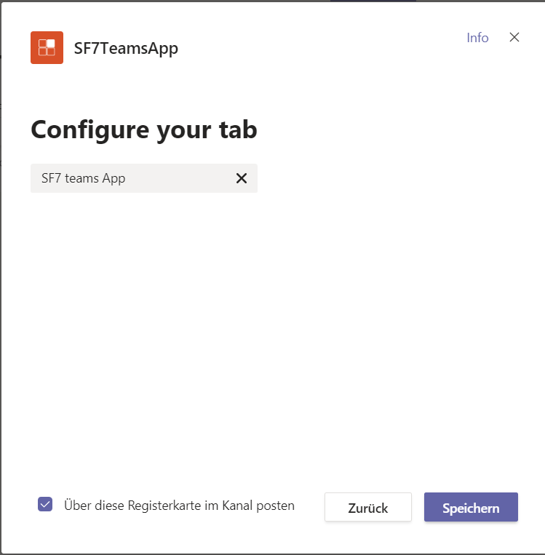
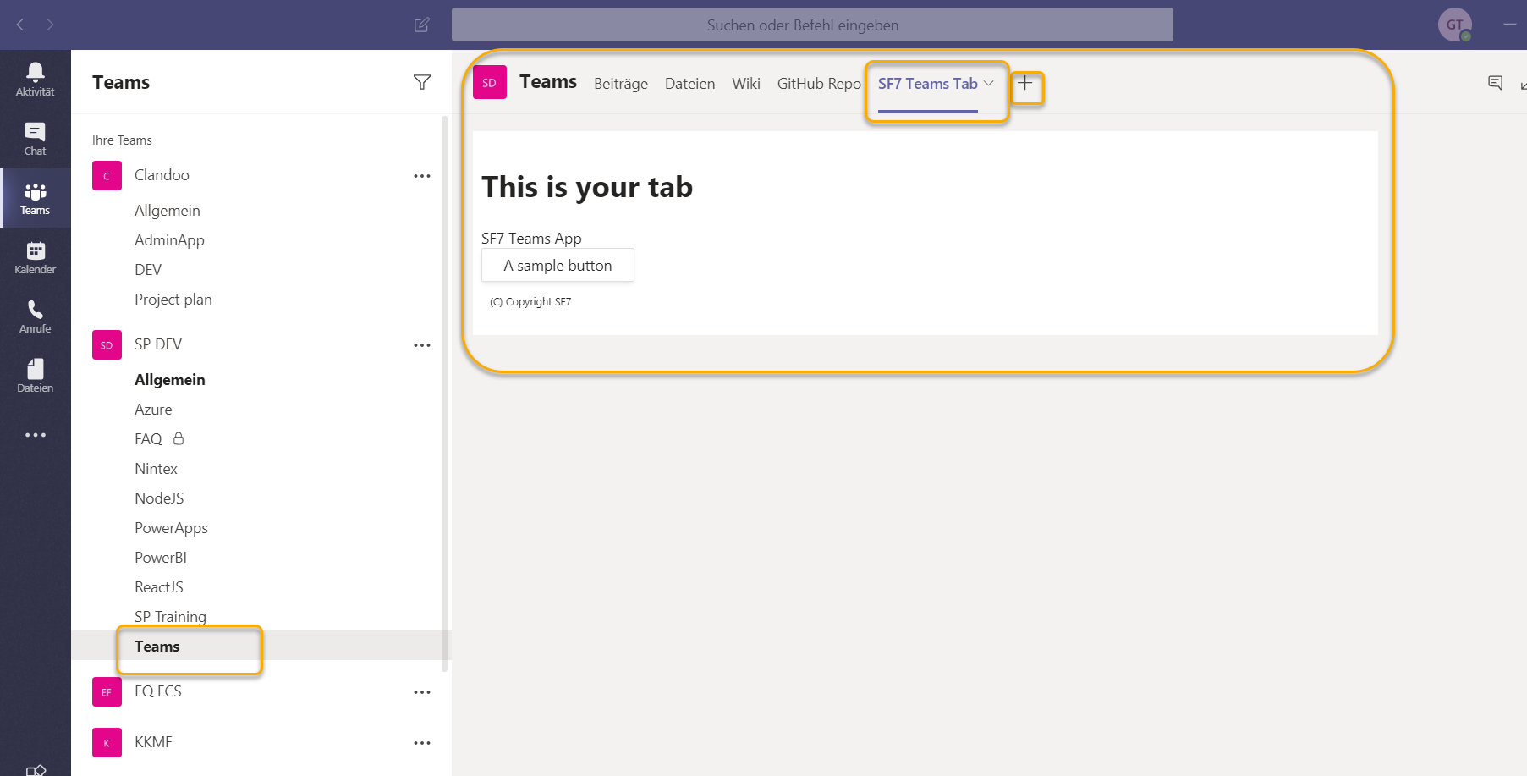
Add App to Channel

