Slide 1
From Callback Hell to Async Heaven – Promises!
August 2014

Slide 2
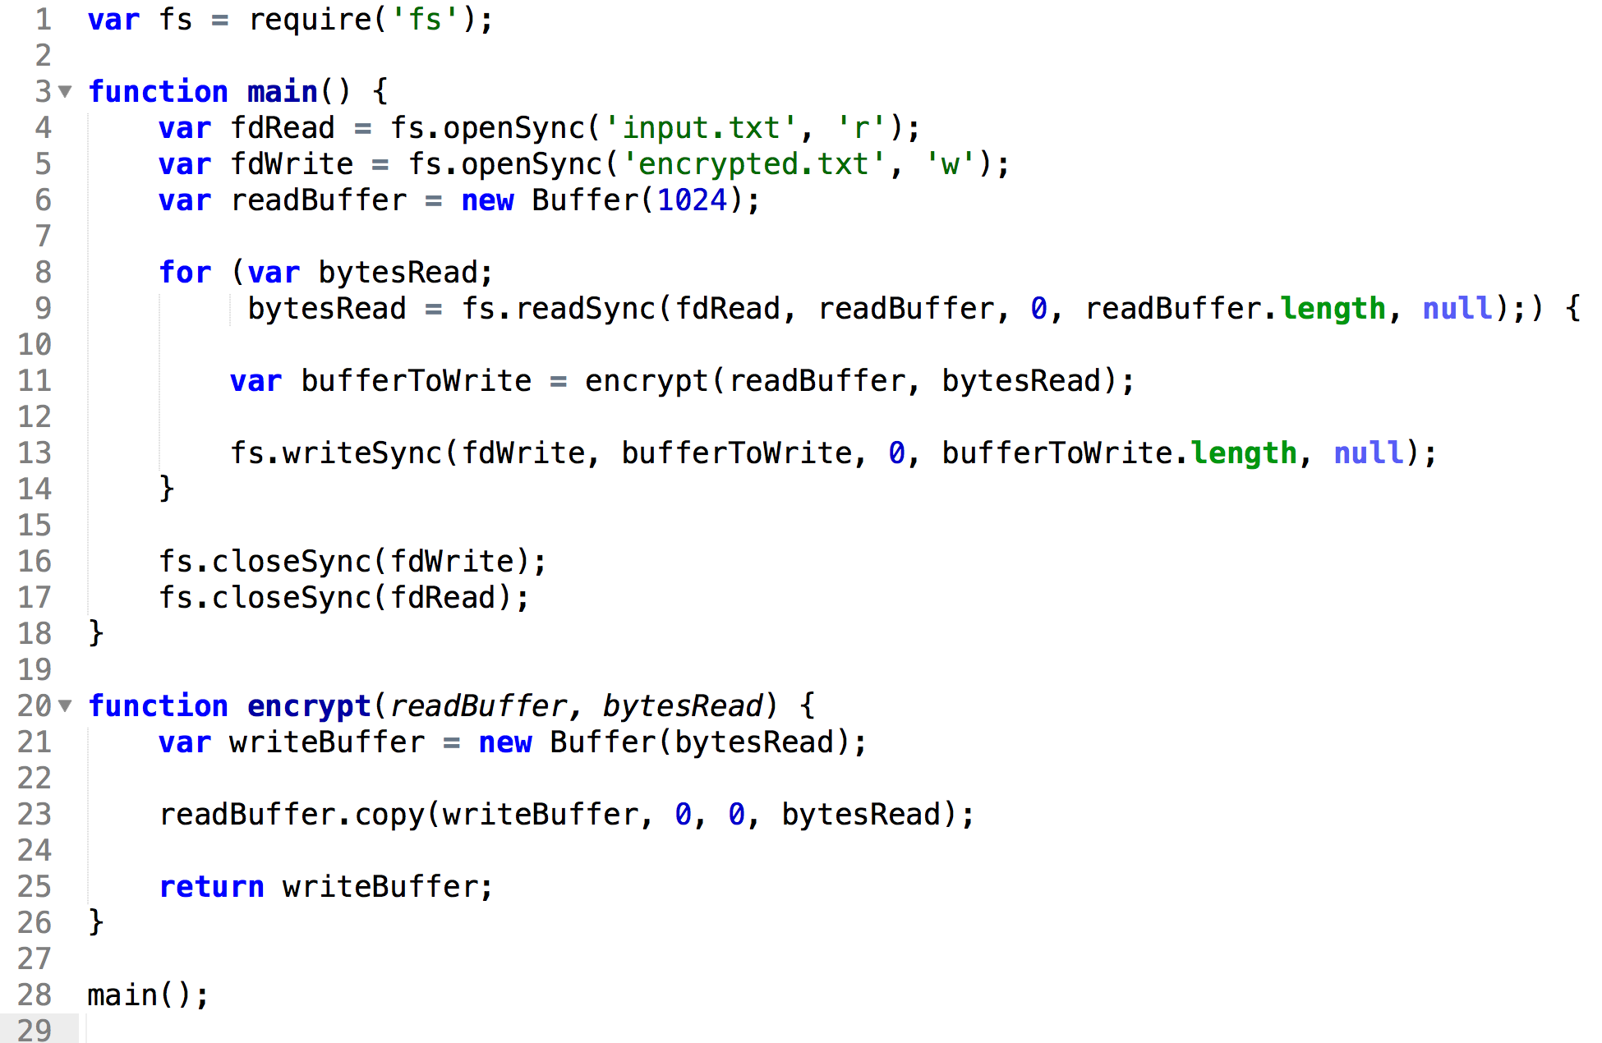
Code, As God Intended

Slide 3
Focusing on the Main Code

Slide 4
The Good and the Bad
Good?
Simple
Readable
Debuggable
Bad?
Holds thread for a long time
I.E. Not Async Code

Slide 5

So How Do we Release The THREAD?

Slide 6
Let’s Remind Ourselves How Callbacks Work

Slide 7
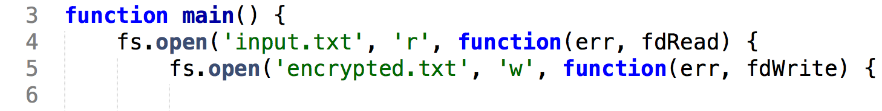
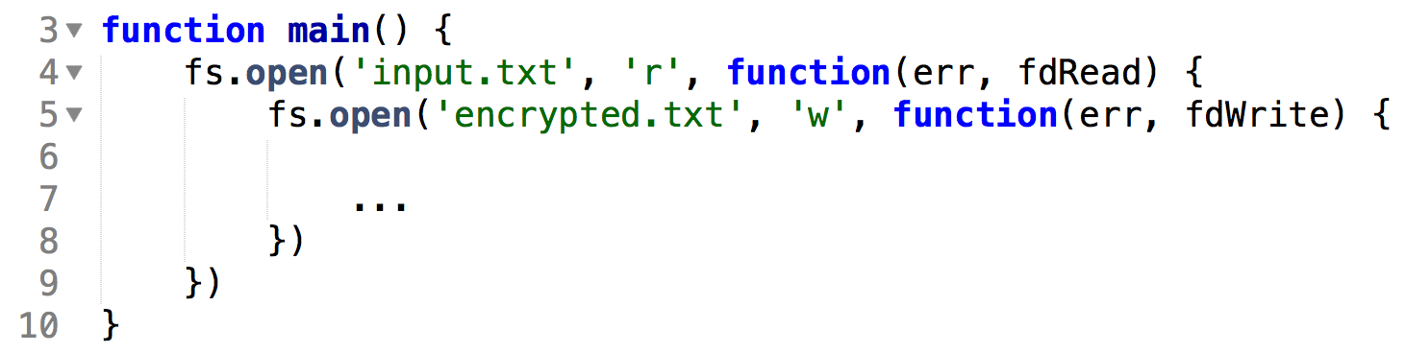
Doesn’t Look Too Bad…
But, Unfortunately!

Slide 8
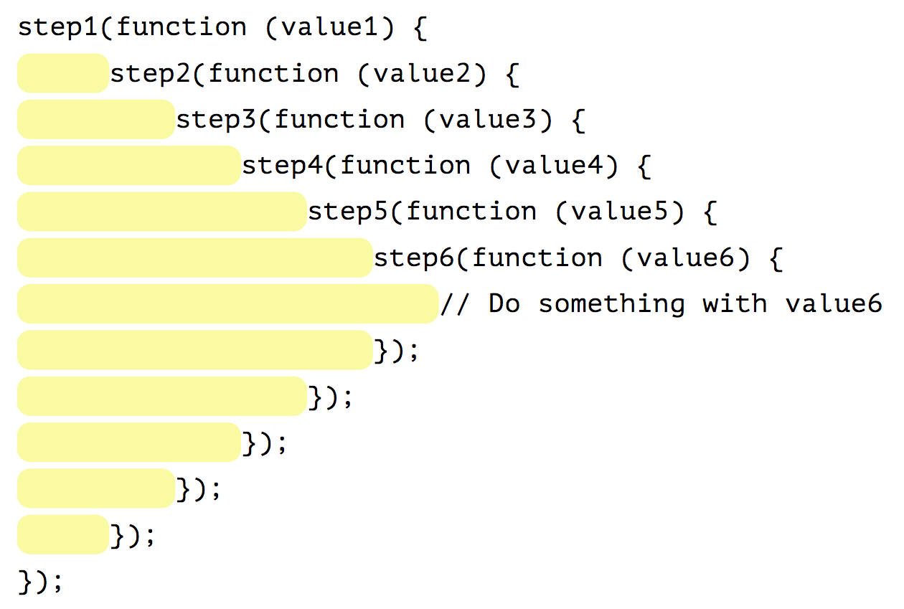
The Pyramid of Doom!
Or As I Call It…

Slide 9

The Pit of Despair!

Slide 10
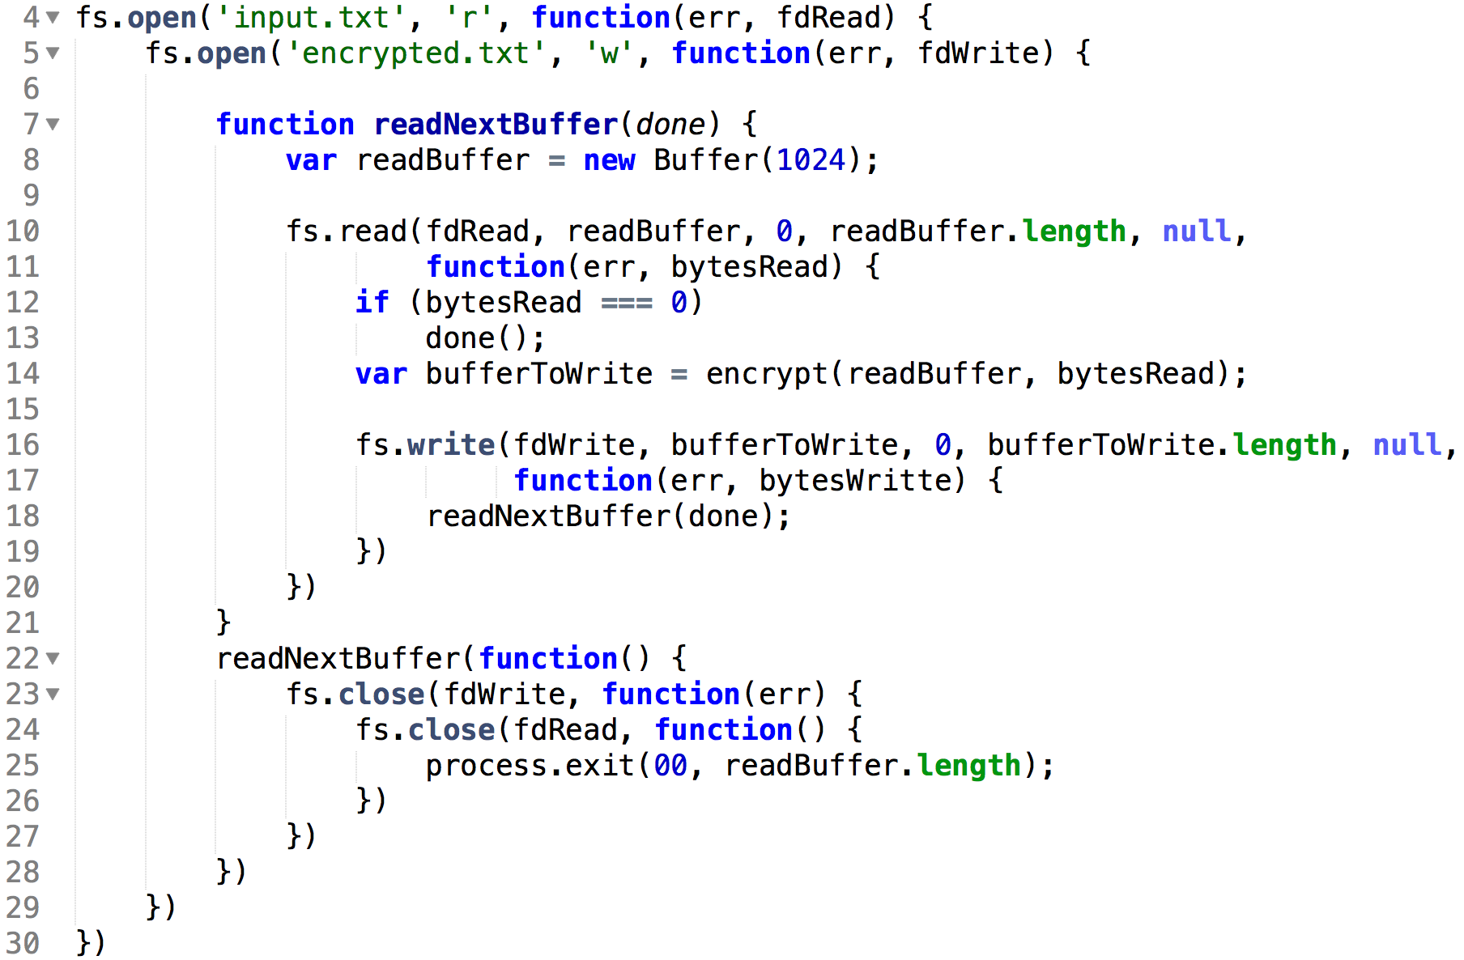
And It Gets Worse!
In Callback Hell
There Are No Loops!

Slide 11
But I Promise – It Gets Better

Slide 12
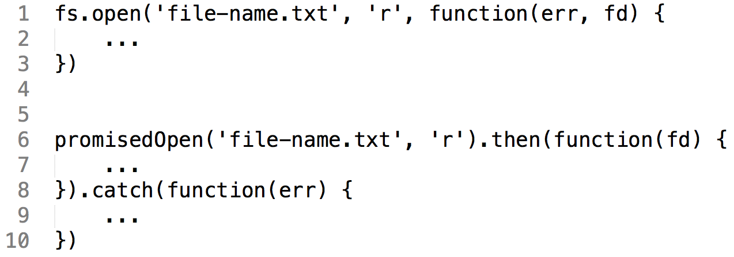
Promises Instead of Callbacks

Slide 13
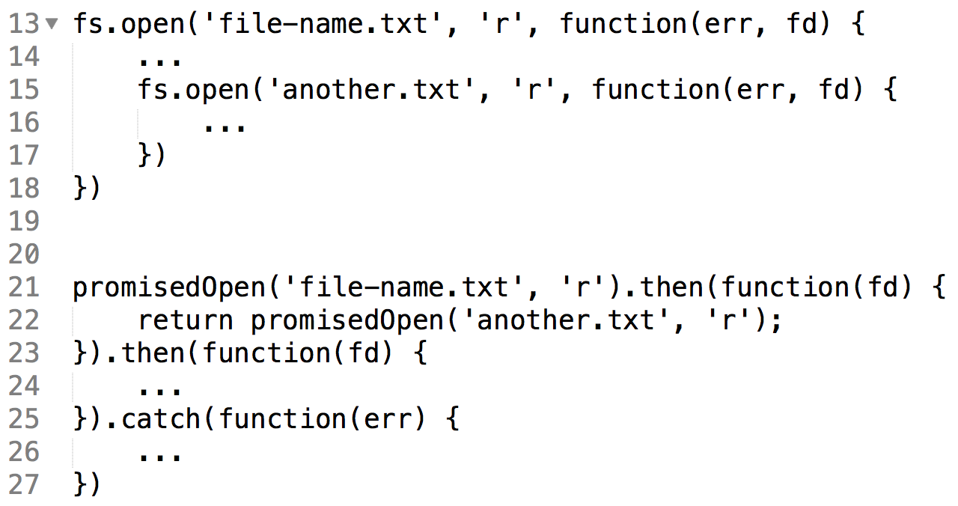
Chaining Promises
The Pit of Despair - Solved!

Slide 14
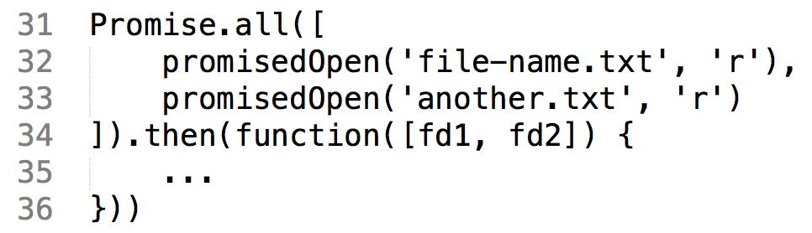
Easy Concurrency
ES6!

Slide 15
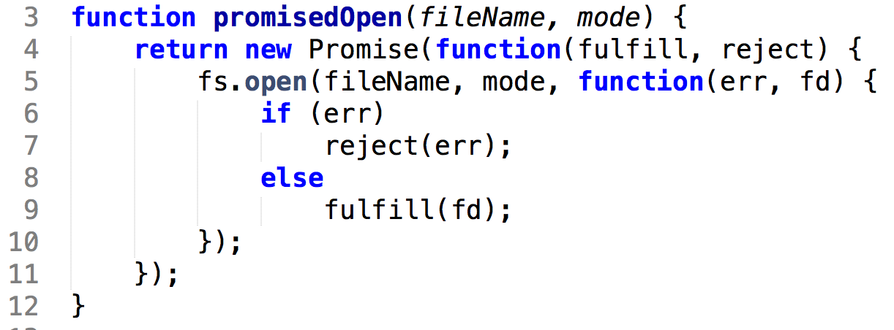
So How Do We Write promisedOpen?
Oh, My Head Hurts!

Slide 16
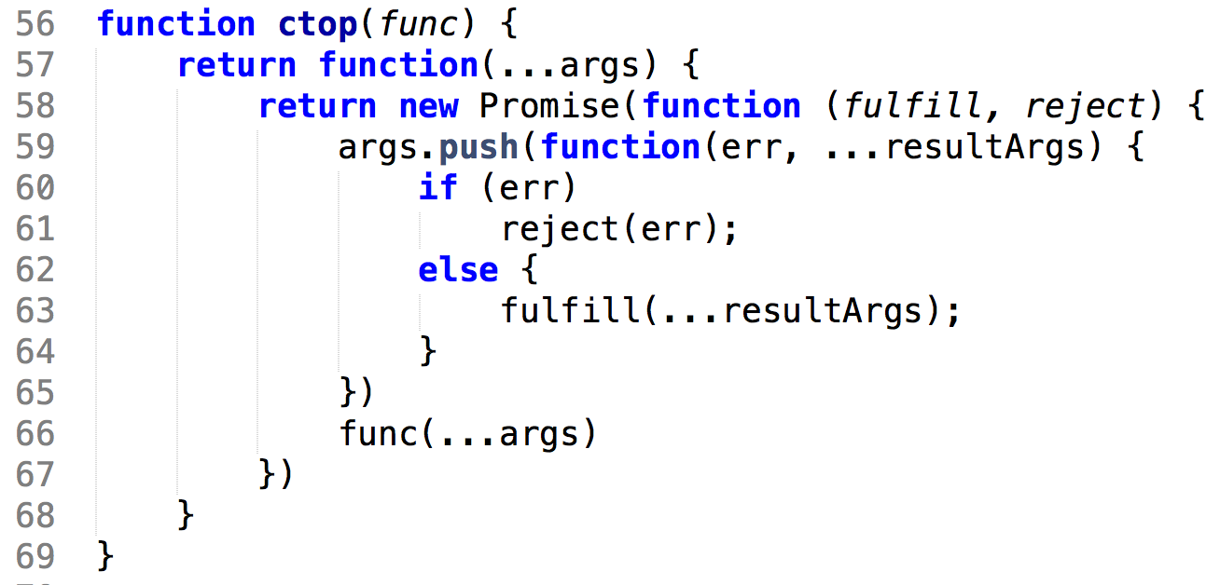
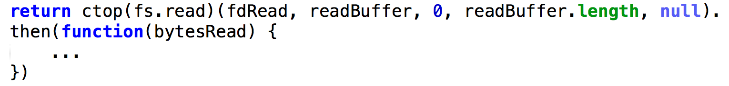
Generalizing Across All Node Functions
ES6!

Slide 17
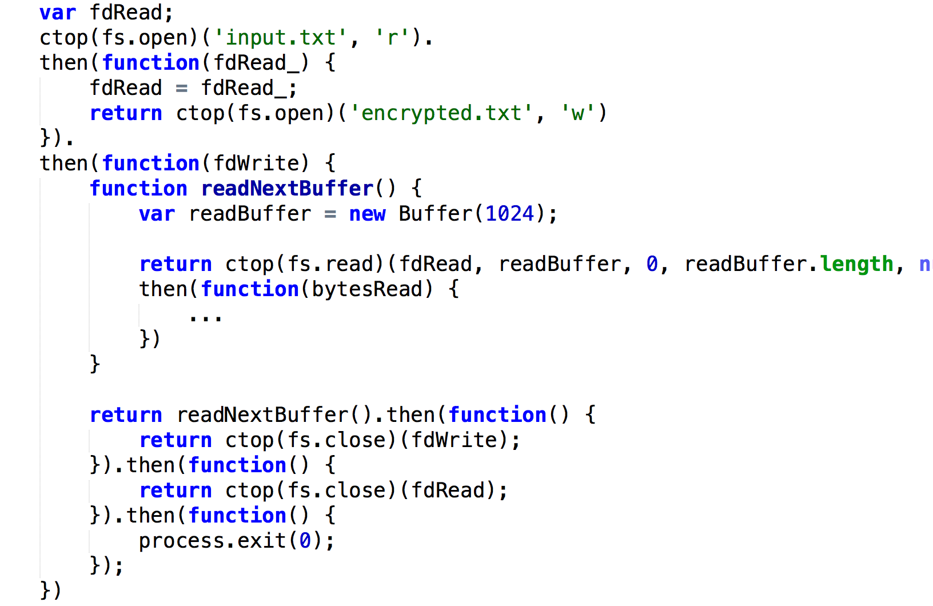
So Where Does This Take Us?
Ugh…
Close, But No Cigar!
Still no loop

Slide 18
Promises Are Values That Represent Execution
So What’s the Big Deal?

Slide 19
Promises Must Be Kept – Onward To Async Heaven!

Slide 20
But Let’s Yield To A Little Detour

Slide 21
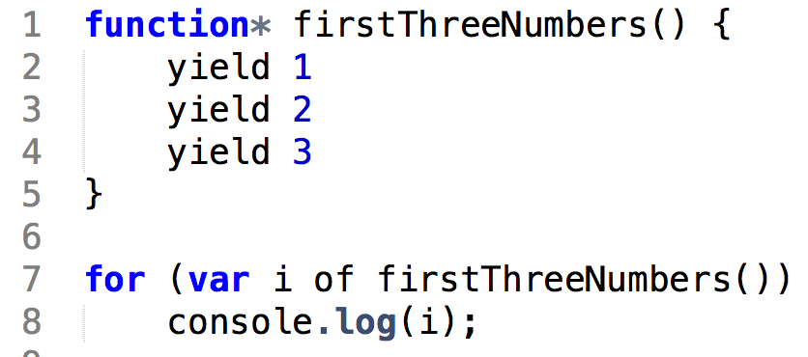
Generator Functions
Only ES6!

Slide 22
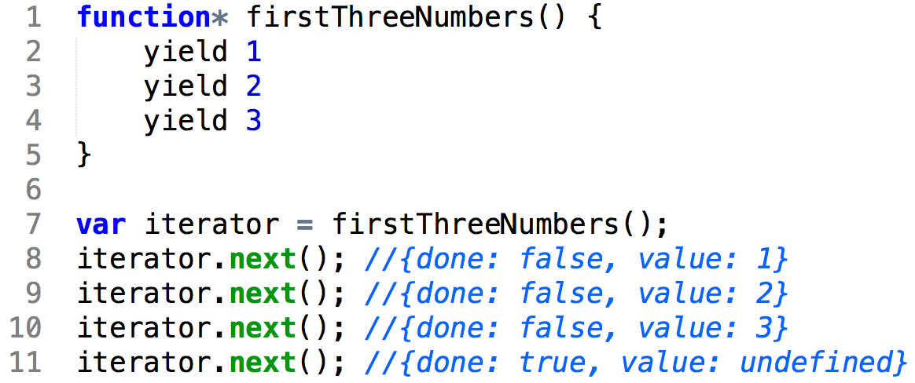
Iterator Protocol

Slide 23
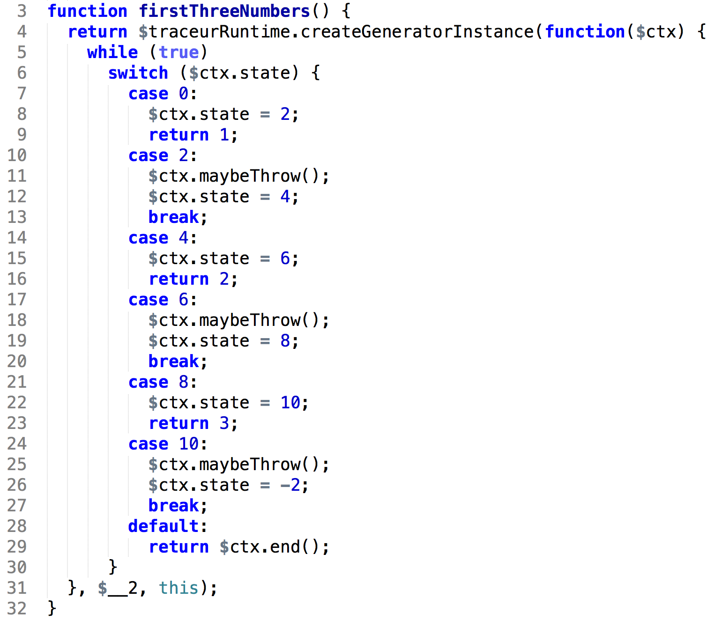
Behind The Scenes
Just Don’t Think About it!

Slide 24
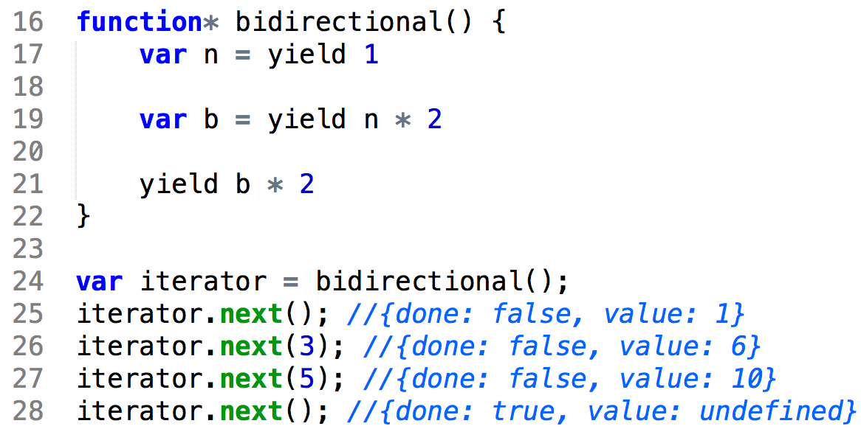
Bi-Directional Protocol
Co-Routines

Slide 25

This Is Where It Becomes Mind-Boggling

Slide 26
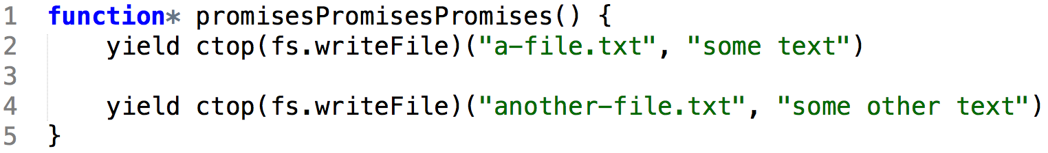
Can We Fulfill The Promise?

Slide 27
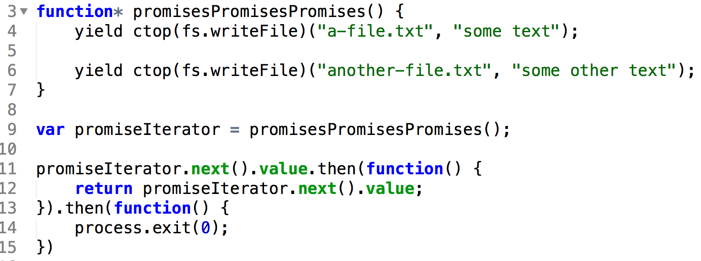
Sure!

Slide 28
And This?

