Slide 1
Does life have any meaning?

Slide 2
What is the meaning of life?
Write what you think the meaning of life is on a piece of paper. You can use a maximum of 30 words.
Pass your paper to other students in the class who can write why they agree or disagree with what you wrote.
When your get you paper back, read the comments and circle those you agree with.
Has your opinion changed?
Would you change your answer to the question?

Slide 3
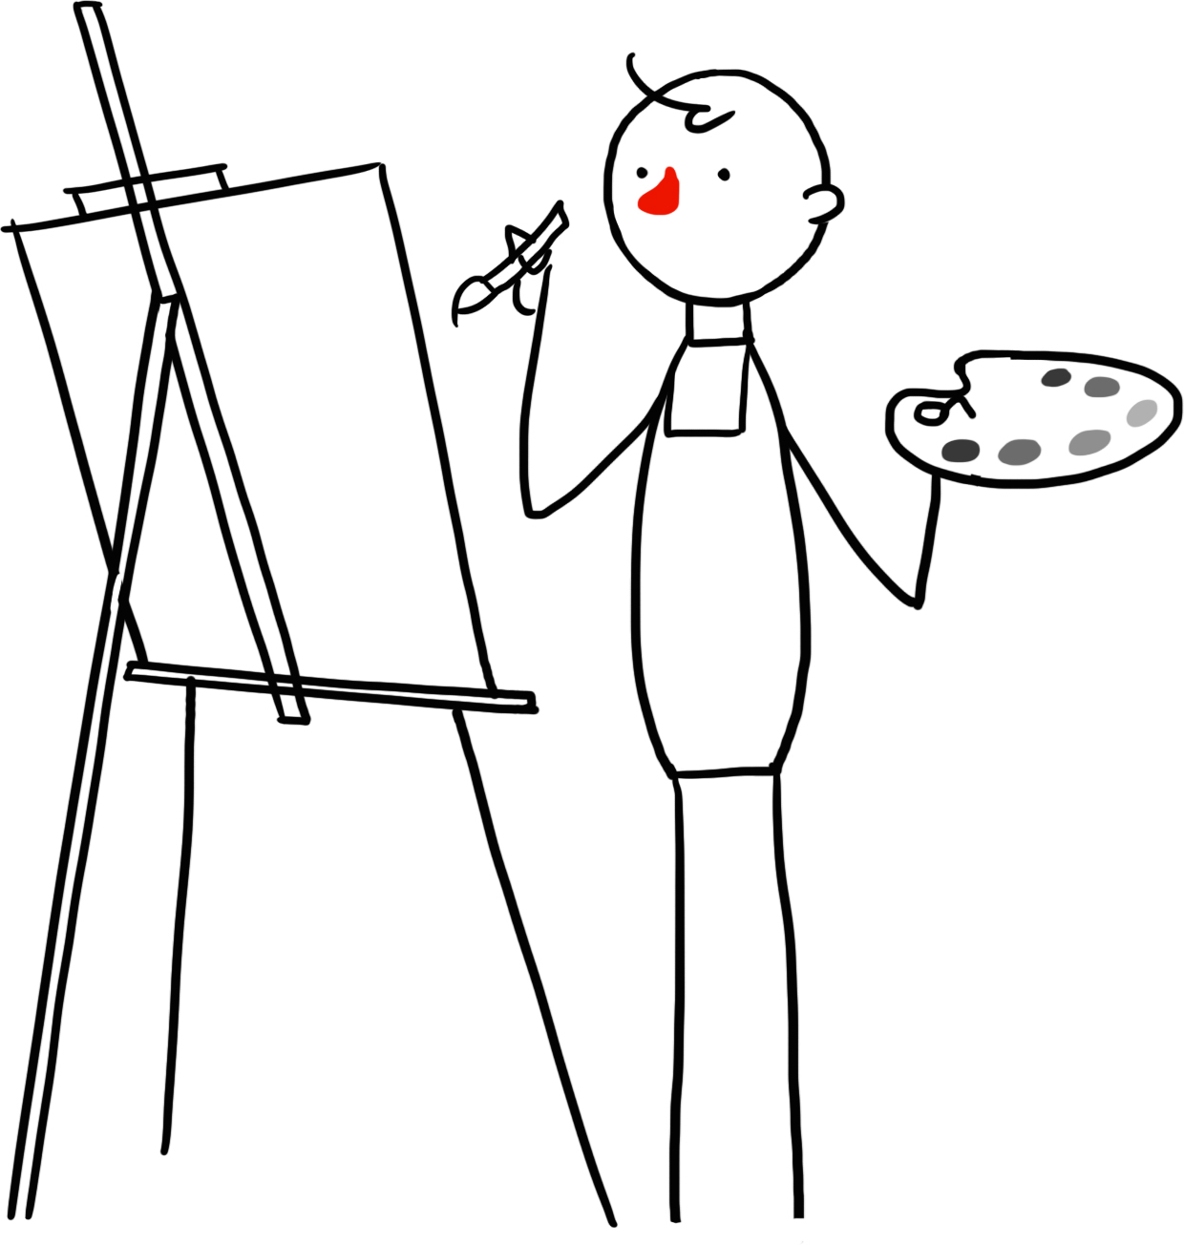
What do humanists think about the question?
There is no ‘ultimate’ meaning of life.
We must create our own meanings in life –
make our lives meaningful.
Some prefer to ask the questions, ‘How should I live?’ or ‘What is the good life?’

Slide 4
Questions:
What is the meaning of life?
How can I make my life meaningful?
What matters in life?
How should I live my life?
What is the good life?
Do all these questions mean the same thing?
Are any of them easier to answer than others?

Slide 5

Possible ingredients of a good life
Keeping healthy
Enjoying bodily pleasures like food and drink
Making money and gathering possessions
Forming good relationships with others
Being part of a community
Appreciating beauty and wonder
Curiosity, exploration, and discovery
Using and developing your talents
Contributing to human knowledge about human beings and the world
Working to create and build things that will benefit humankind
Taking care of the natural world and other living things
Being good to yourself
Helping others
Following god’s will or religious texts

Slide 6
Ingredients of the good life
Take it in turns to pick an ingredient that you feel makes your life meaningful.
Order the ingredients according to how important they are (most important at the top, least important at the bottom).
Underline or highlight any ingredients that you think are necessary for a good life (something that your life cannot be meaningful without).
Underline or highlight in a different colour any ingredients that you think are sufficient for a good life (something that would make your life meaningful even if you didn’t have any of the other ingredients).
Extension questions:
Did you disagree with anyone else on anything? Why?
Does everyone need the same thing to make their life meaningful?
Can any of the ingredients make everyone’s life meaningful?
Would a humanist and a religious person agree or disagree on the ingredients of a good life?

Slide 7
What do humanists think about the good life?
There is not one single answer to the question of what makes a good life.
It is up to us to decide.
It may change throughout our lives.
Knowing that can give us a sense of freedom and relief.
Humanists are not, however, relativists.
‘Any such life would have two general characteristics: that it feels good to live, and that it is more beneficial than not on its impact on others.’
A. C. Grayling on the good life

Slide 8


The British Humanist Association
The absence of an afterlife makes this life more important and meaningful than it would be if we had another life to live after it.

Slide 9
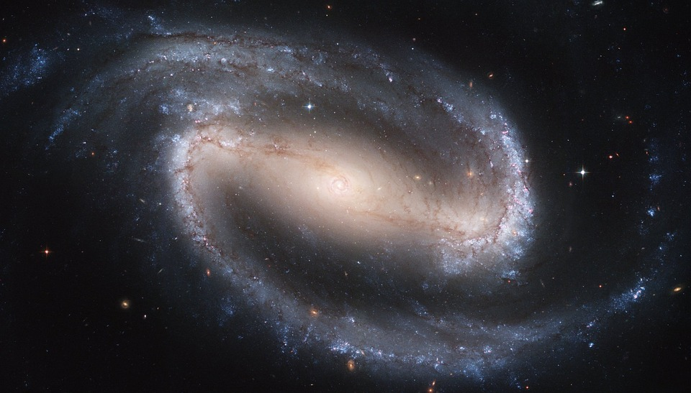
The universe is vast and ancient.
If you believe it is without purpose, would that make you feel small, unimportant, and insignificant in the grand scheme of things?

Slide 10
Humanists still believe human beings are special: as far as we know, we are the only things in this universe capable of understanding it.
And we are all still part of something bigger than ourselves: we are part of humanity, human history, and the natural world.

Slide 11

Quotes
Read, and think about the quotes.
1) Find a quote that you like. Explain why.
2) Find a quote you disagree with. Explain why.
3) Find a quote that could also be expressed by a religious person.
4) Find a quote that could not be expressed by a religious person.

Slide 12
Possible criticisms
Humanists just want to eat, drink, be merry, and have a good time.
If there is no bigger meaning or purpose, then there is no hope for those for whom life is full of suffering and pain.
What consolation can Humanism offer when our plans fail, when our relationships fall apart, or when our community is corrupted?
Humanism is overly optimistic: we can’t all live happy and fulfilling lives.
If one day all human beings will be dead and gone, then why should we contribute to the good of humanity if it is all for nothing in the long run?

Slide 13
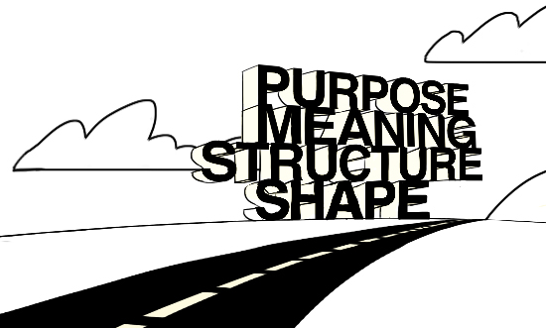
What do you think the good life is?
Imagine yourself in the future. What would it take for you to feel like you’ve lived a full and meaningful life?
Use what you have learned to write a letter to your future-self describing what you feel is a meaningful life and detailing what you hope you will have achieved in the future.
Questions to help you:
What goals might you have achieved?
What talents might you have cultivated?
What connections might you have made with other people?
How might you have contributed to human knowledge?
What might you have done to contribute to the good of humanity?
How might you help make the world a little better than it is today?
How will you ensure you are comfortable with who you are?

Slide 14
Humanist responses
How might a humanist respond to these questions and statements about meaning in life?
Without a god or an afterlife, life has no ‘ultimate’ meaning.
What is the good life?
Humanists are just relativists: you think it’s OK to live however you want.

Slide 15
understandinghumanism.org.uk
Understanding Humanism
39 Moreland Street
London
EC1V 8BB
British Humanist Association (registered charity 285987) ©2015

