Slide 1

Predictions for quality control system
Candidate assignment
BY Gil Zeevi

Slide 2
Introduction
The task: Predicting based on historical data whether a product will be functioning or defective.
The challenge: analyzing and learning a relatively small dataset in order to learn the process features and predict correctly.
Prior/domain knowledge: Can’t be assessed as there is no description on each of the given features. Hence, will result in correlative suspicious features and difficulty in handling outliers

Slide 3
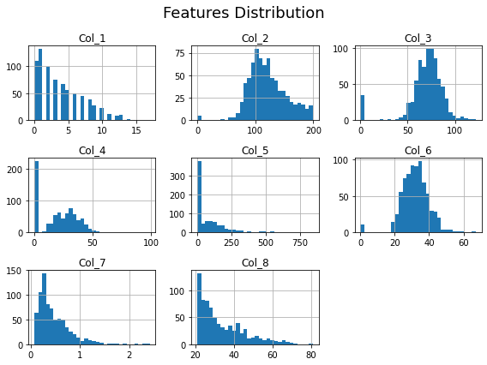
Exploratory Data Analysis
The data consists of 756 instances with 8 features and 1 target feature. The target consists of 65% instances predicted as ‘0’ and 35% predicted as ‘1’
 | Col_1 | Col_2 | Col_3 | Col_4 | Col_5 | Col_6 | Col_7 | Col_8 | Result
count | 756 | 755 | 754 | 754 | 754 | 754 | 756 | 756 | 756
mean | 3.85 | 121.08 | 69.11 | 20.55 | 79.67 | 31.99 | 0.47 | 33.29 | 0.35
std | 3.37 | 32.06 | 19.50 | 15.94 | 115.44 | 7.89 | 0.33 | 11.77 | 0.48
min | 0 | 0 | 0 | 0 | 0 | 0 | 0.078 | 21 | 0
25% | 1 | 99 | 64 | 0 | 0 | 27.3 | 0.244 | 24 | 0
50% | 3 | 117 | 72 | 23 | 30.5 | 32 | 0.3745 | 29 | 0
75% | 6 | 141 | 80 | 32 | 126.75 | 36.575 | 0.62925 | 41 | 1
max | 17 | 199 | 122 | 99 | 846 | 67.1 | 2.42 | 81 | 1
The data hold several entries with N/A entries. Values will be imputed by 2 nearest instances
Null Entries
Col_1 0
Col_2 1
Col_3 2
Col_4 2
Col_5 2
Col_6 2
Col_7 0
Col_8 0

Slide 4
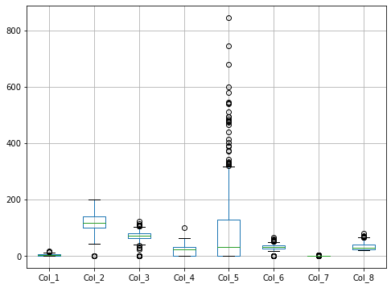
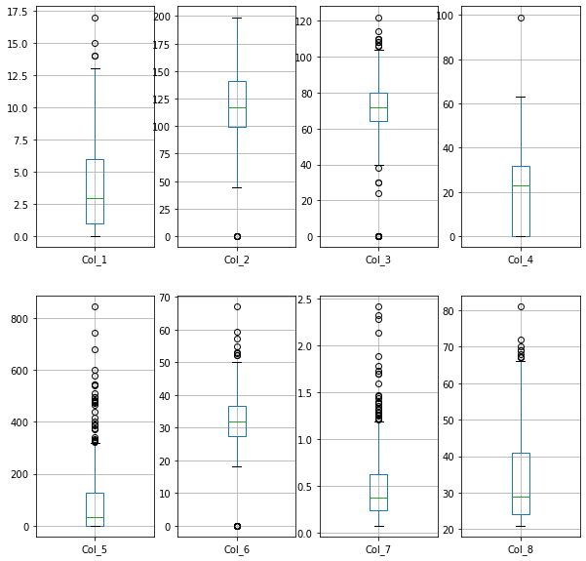
Outliers handling
Given no previous knowledge on the features, removing outliers, which are many according to the boxplots presented here, may cause harm and remove significant information.

Slide 5
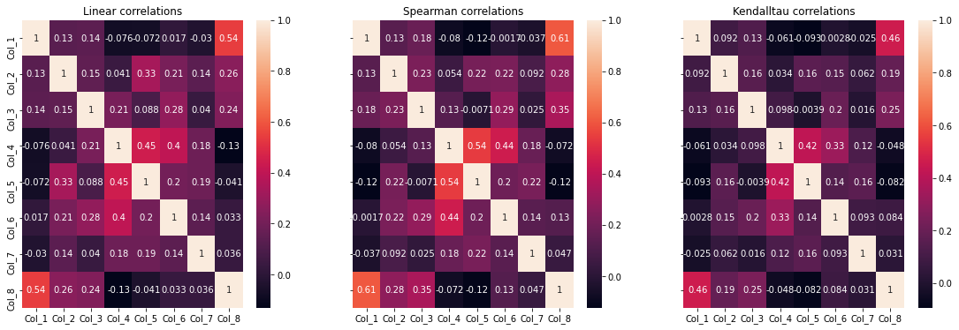
Features correlation
Inspecting several correlation methods, suggests that there are some correlative features, hence there should be a specific subset of features that will produce better results than just learning the full 8 features

Slide 6
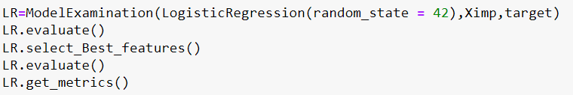
Building a predictive pipeline
I will suggest in the attached notebook a predictive pipeline which will get as an input any predictive model. The pipeline will do the following:
Splitting the dataset into train and test datasets, 80-20 split.
Selecting the best subset of features using Forward and Backward selection methods which are greedy and inefficient at large scale on one hand but adequate for this specific dataset due to its small size and relatively small number of features.
Evaluating Auc, Accuracy and Plotting the Roc curve of the inspected model.
This pipeline will assist in inspecting different models as it will automate the inspection process and allow to find the most fitting model to achieve high accuracy

Slide 7
Applying simple ML models
As the data is relatively small, a simple approach should be firstly considered. I will suggest the following simple yet strong classical machine learning models:
Naïve Bayes - based on applying Bayes’ theorem with the “naive” but bold assumption of conditional independence between every pair of features given the value of the class variable. Sounds rather simplified but usually does magnificent job as a classifier for small dataset.
Logistic regression - Data is fit into linear regression model, which then be acted upon by a logistic function, called Sigmoid, predicting the target categorical dependent variable.
Decision Tree - A decision tree is a flowchart-like structure in which each internal node represents a "test" on an attribute, each branch represents the outcome of the test, and each leaf node represents a decision taken after computing all attributes. The paths from root to leaf represent classification rules.

Slide 8
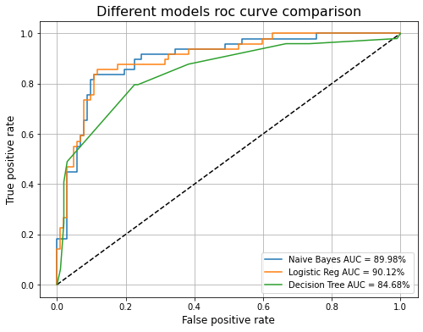
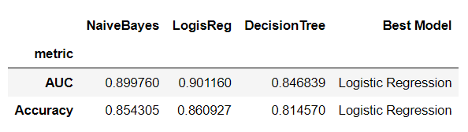

Applying simple ML models - results
Its possible to see that Logistic regression performs pretty well on the data where there are only 3 useful features needed:
Naïve bayes is also a suitable candidate as it performs almost as Logistic regression with only two features:

Slide 9
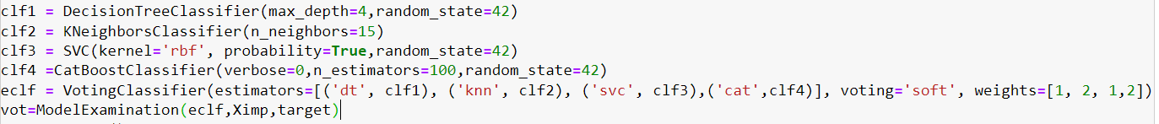
Improving results using Ensemble methods
Now, to give a small boost to results, its possible to use ensemble method. I will present Voting Classifier in particular.
The main idea behind it is to combine conceptually different machine learning classifiers and use a majority vote or the average predicted probabilities to predict the class labels. Such a classifier can be useful for a set of equally well performing model in order to balance out their individual weaknesses.

Slide 10
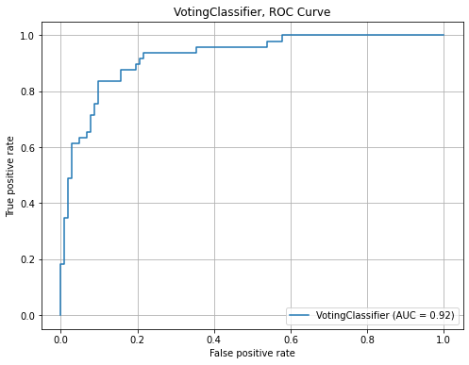
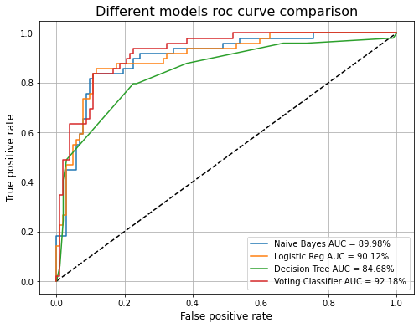
Improving results using Ensemble methods
This time, more features were used in order to perform an ensemble of different ML models in order to improve a bit the predictions.

