Slide 1
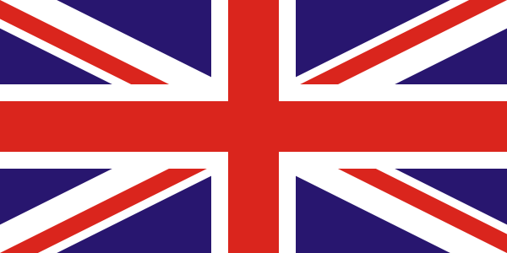
Great Britain
Gimadutdinov 09-712
Notes:
*

Slide 2
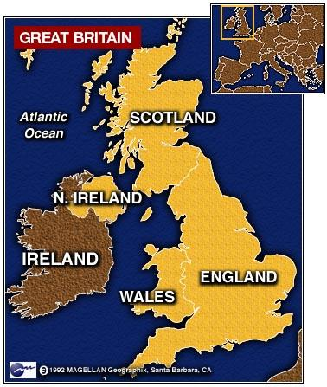
Regional division

Slide 3
The U.K.
The United Kingdom of Great Britain and
Northern Ireland
Four countries:
-England
-Wales
-Scotland
-Northern Ireland
Every part has own emblem, flag, capital

Slide 4
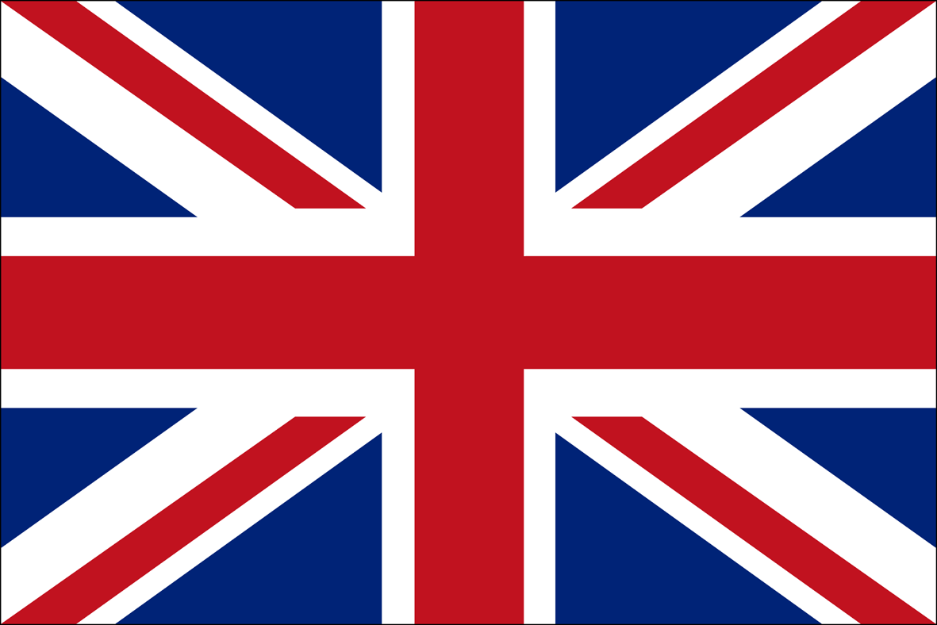

Slide 5
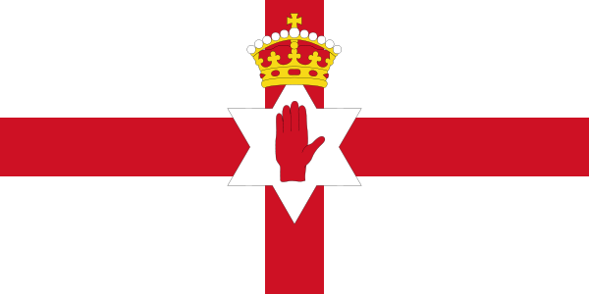
Flag of Northern Ireland

Slide 6

Flag of Scotland

Slide 7
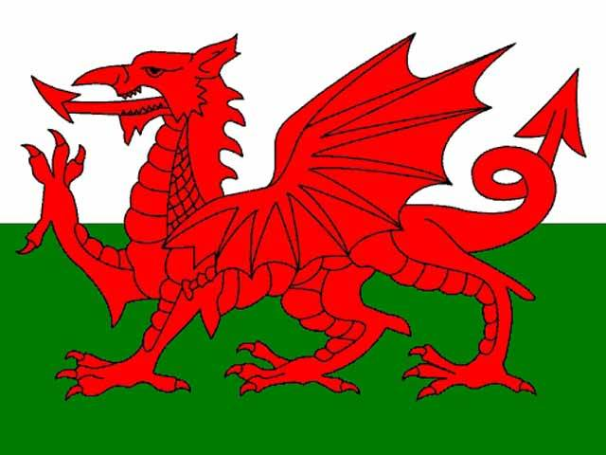
Flag of Wales

Slide 8
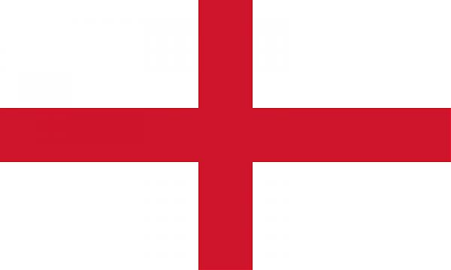
Flag of England

Slide 9
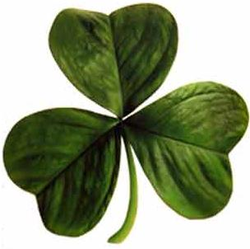

Emblem of Northern Ireland

Slide 10
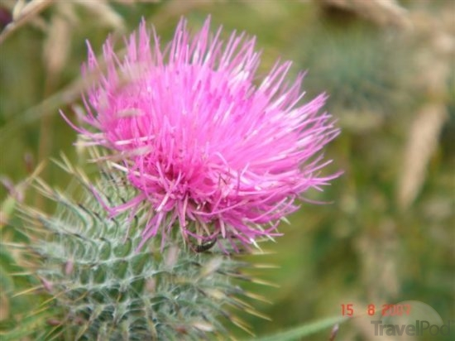
Emblem of Scotland

Slide 11

Emblem of Wales

Slide 12

Emblem of England

Slide 13
The capitals of countries are:
Northern Ireland-Belfast
Scotland-Edinburgh
Wales-Cardiff
England-London

Slide 14
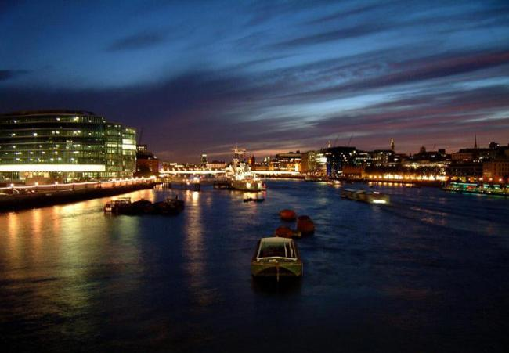
Rivers
The longest rivers are Severn and Thames
Notes:
*

Slide 15
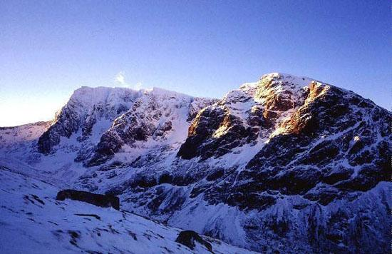
Mountains
Tle highest mountains with the highest mountain Ben Nevis are The Highlands of Scotland

Slide 16
Population
More than 60 million
Main ethnic groups – English, Scottish, Irish, Welsh and other minority groups
Languages – main language is English, other languages are Welsh, Scottish and Irish Gaelic
The largest cities are London, Bristol, Birmigham, Cantebury, Exeter, Leicester, Manchester, Leeds, Edingurg and Glasgow

Slide 17
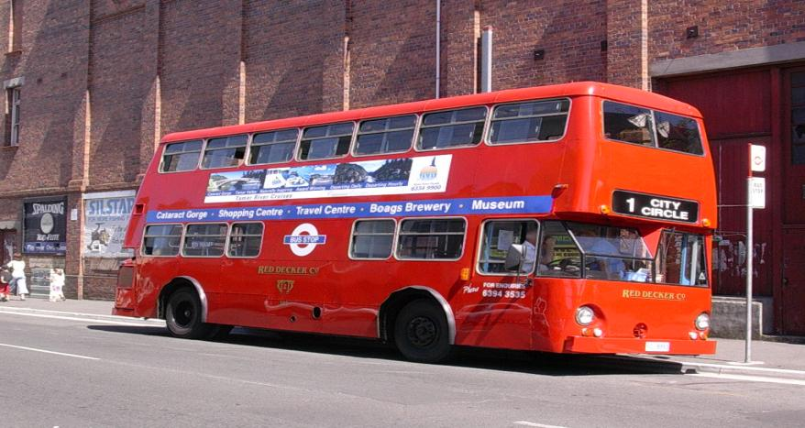
London – the city of traditions and exciting places
Red double-deckers – traditionaly means of transport

Slide 18
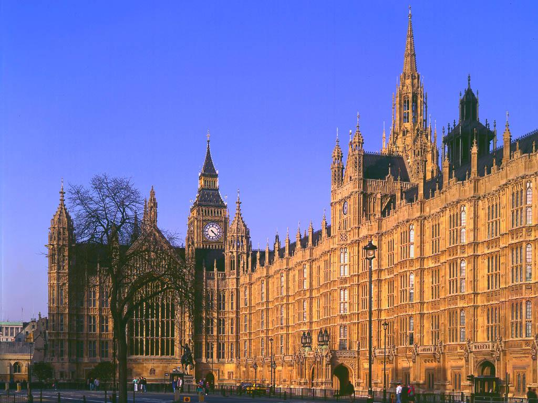
The Houses of Parliament Fascinating neo-gothic architecture

Slide 19
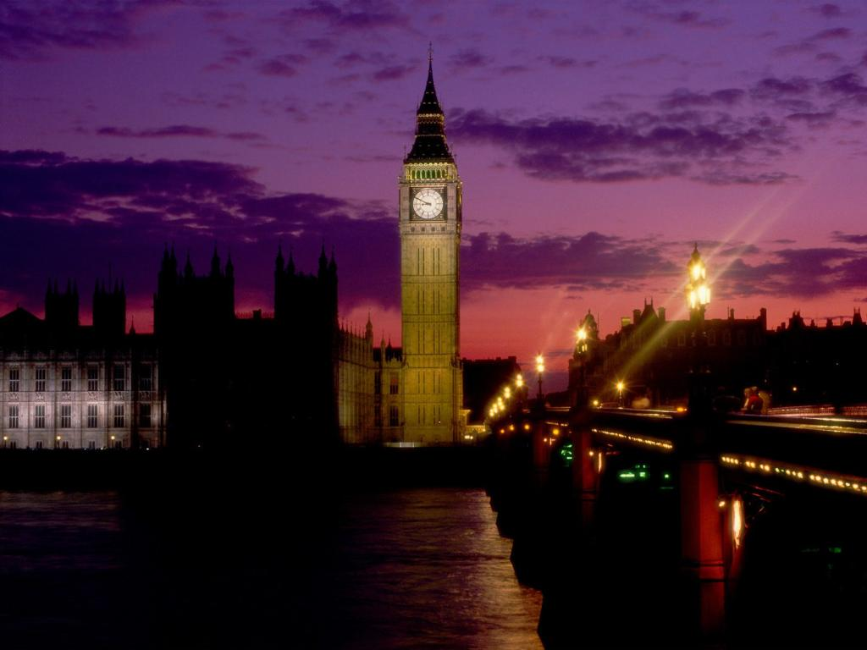
Big Ben – Symbol of London

Slide 20
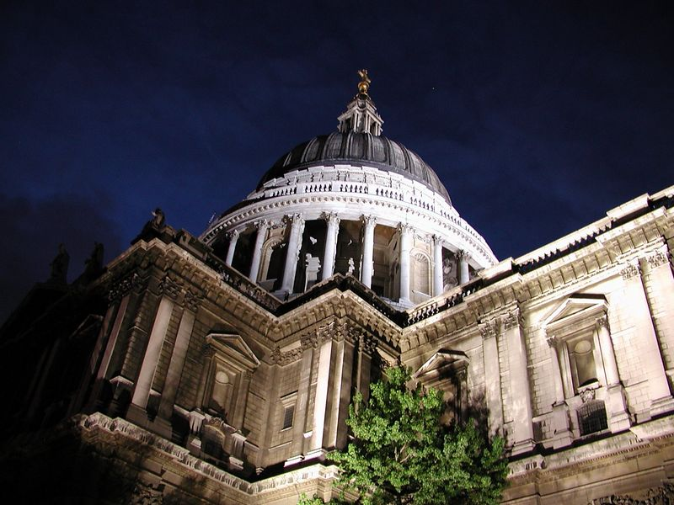
St. Paul´s Cathedral – One of the largest cathedrals in the world

Slide 21
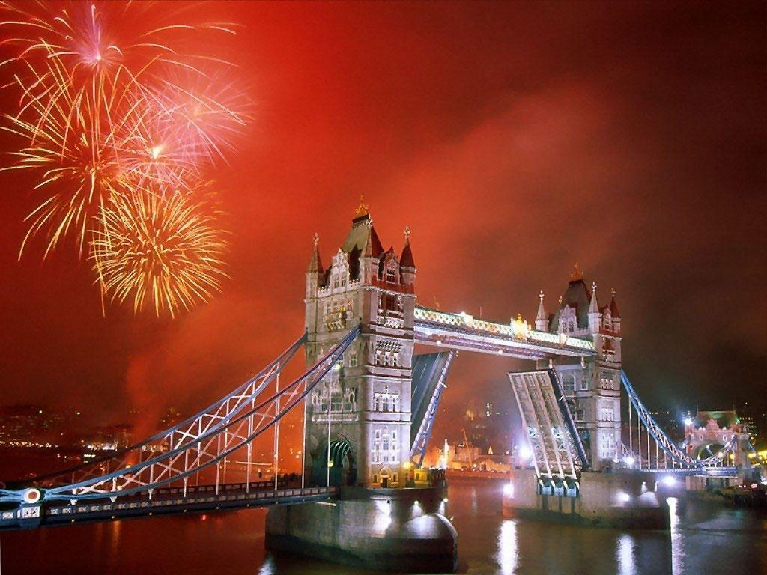
The Tower Bridge – beautiful monument above Thames

Slide 22
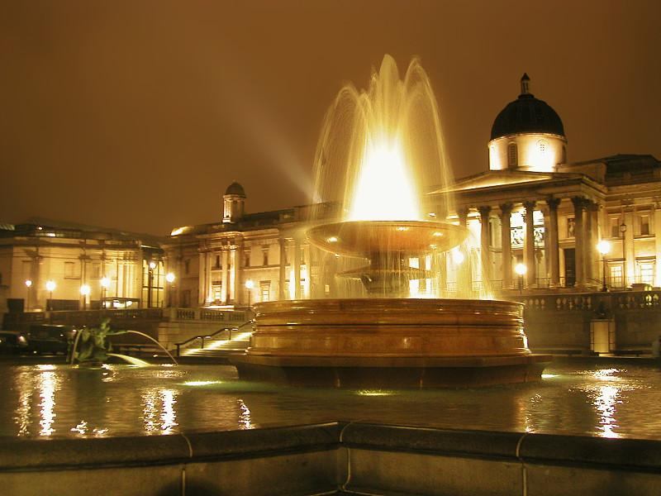
Trafalgar Square – victory of admiral Nelson

Slide 23
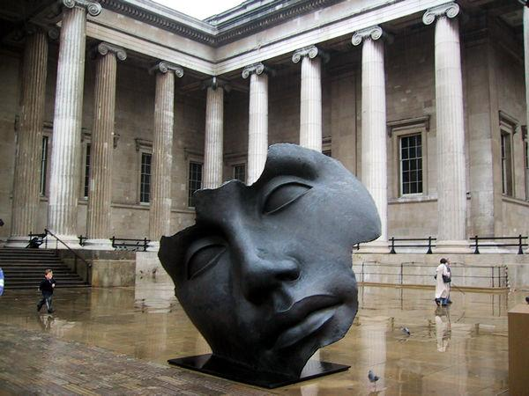
The British Museum – The largest museum in the world

Slide 24
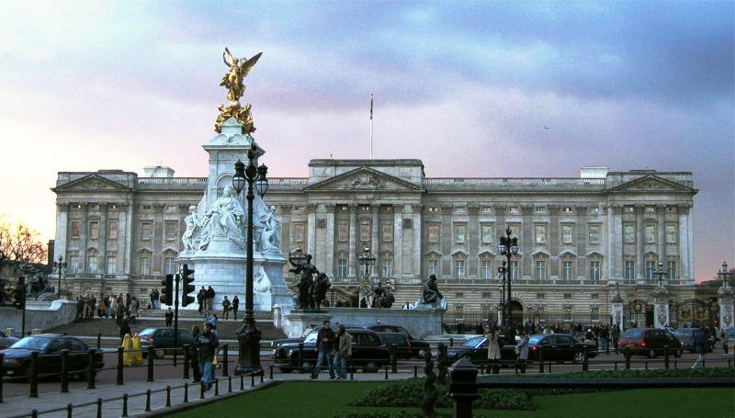
Buckingham Palace – The Queen´s residence

Slide 25
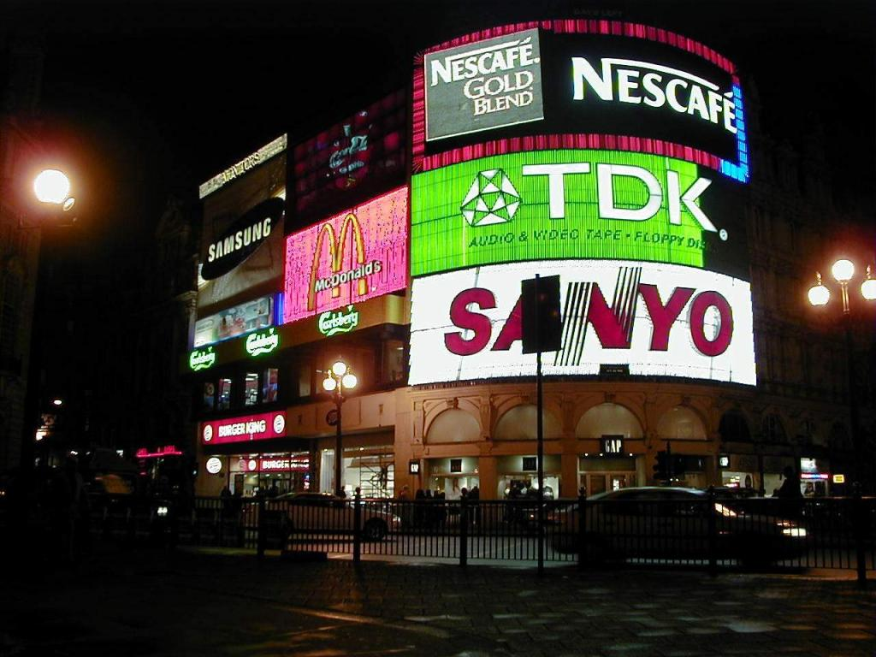
Piccadilly Circus – One of the most famous shopping centres

Slide 26
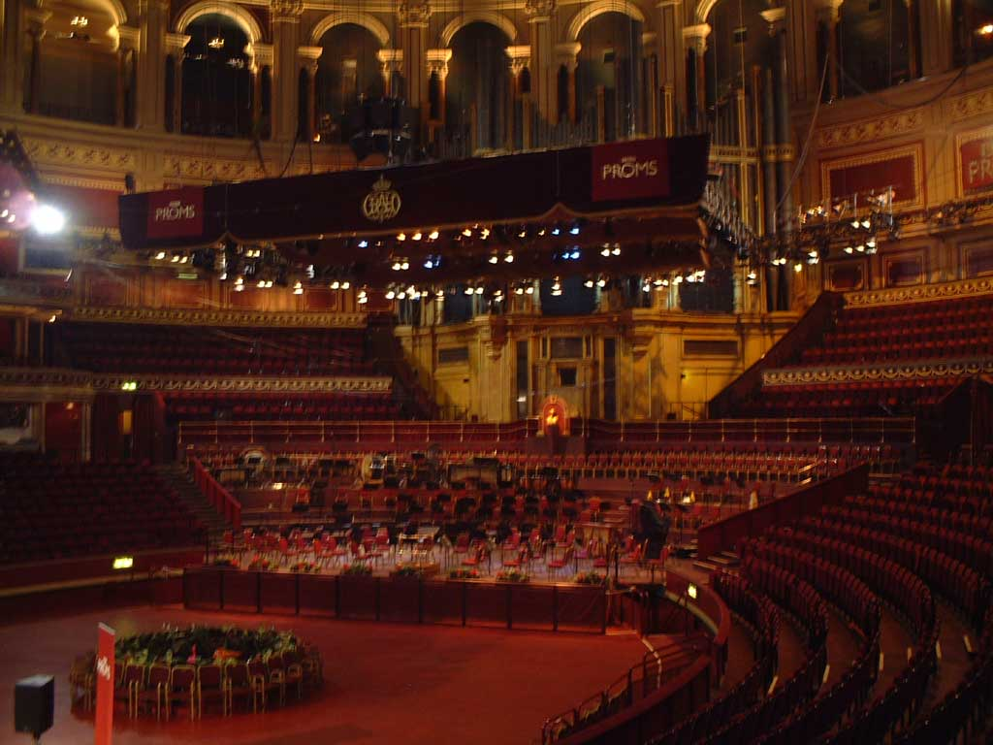
Royal Albert Hall – Place for the best musicians

