Slide 1
E-Commerce Analysis
Marius Gisler

Slide 2

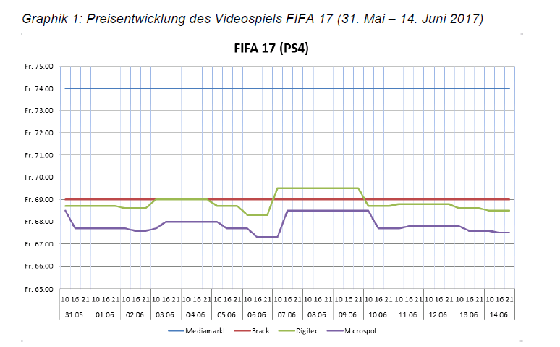




How do the prices of selected products fluctuate during the time before christmas?
Notes:
Analyse price movements

Slide 3



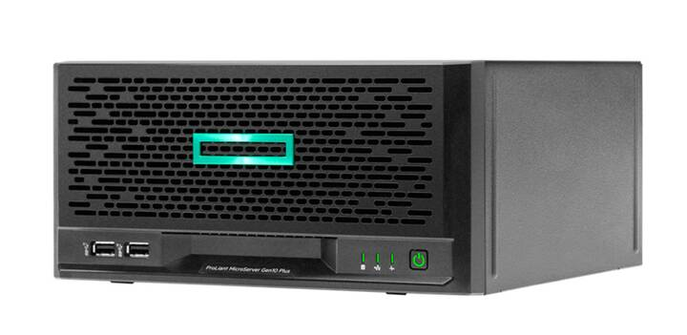

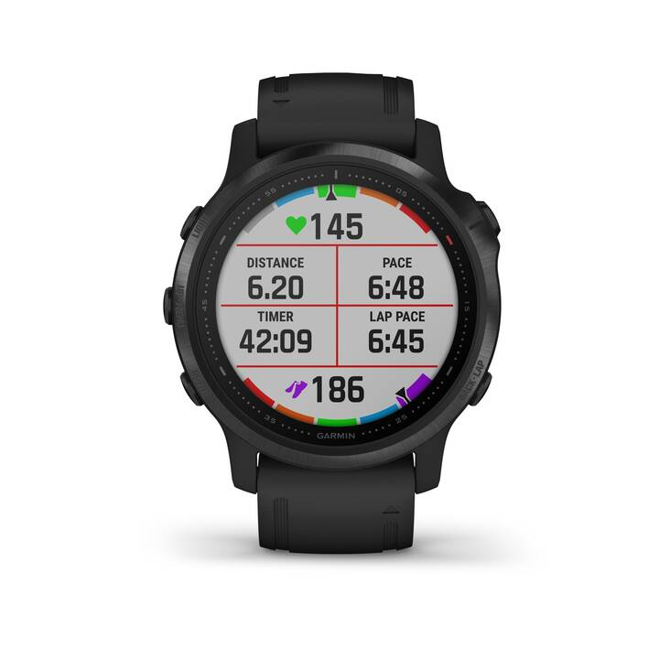

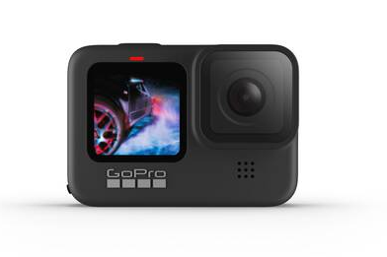
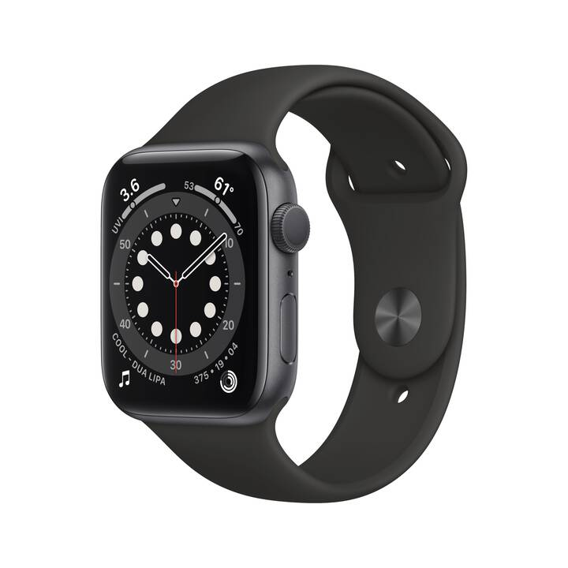



25.11.2020
27.11.2020
30.11.2020
14.12.2020

Slide 4
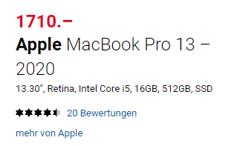
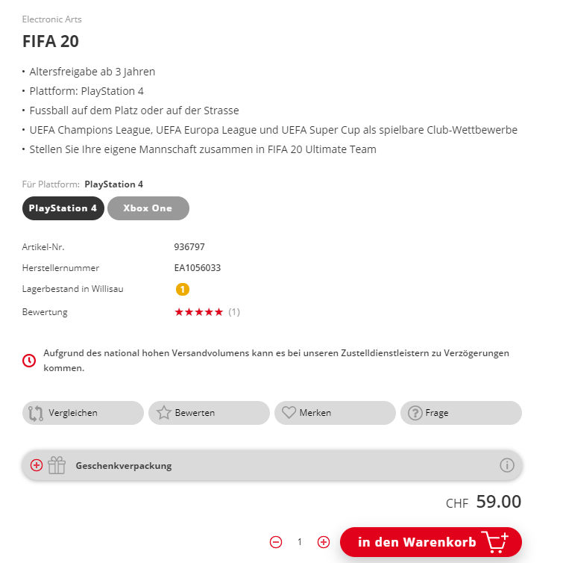
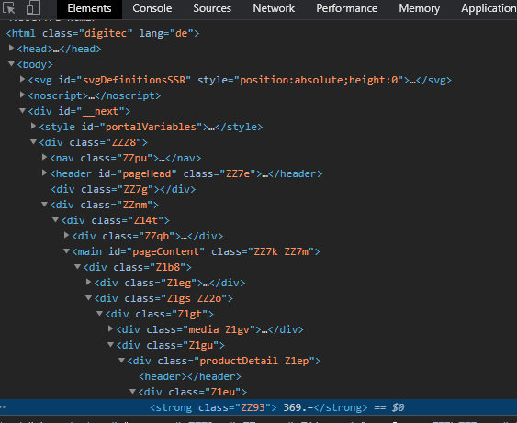
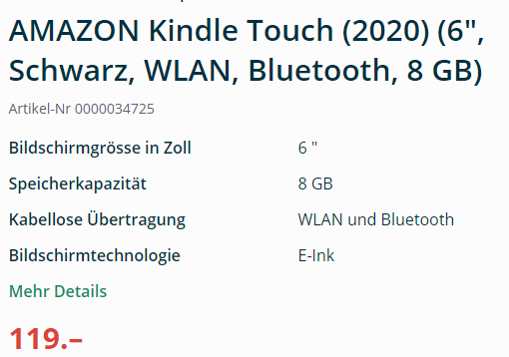


Slide 5
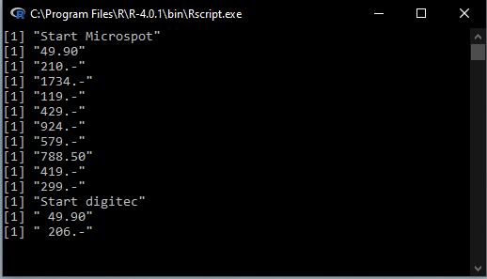






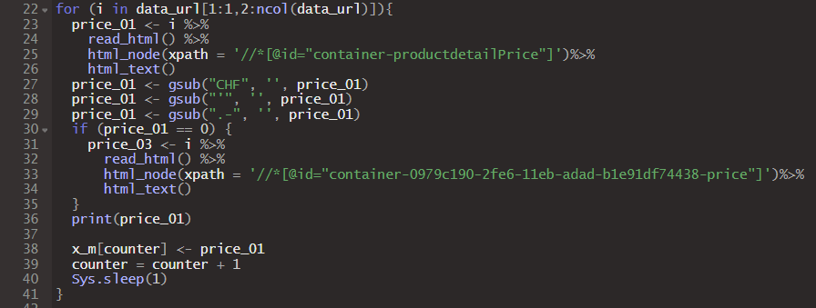

Code
Automate
Visualise

Slide 6
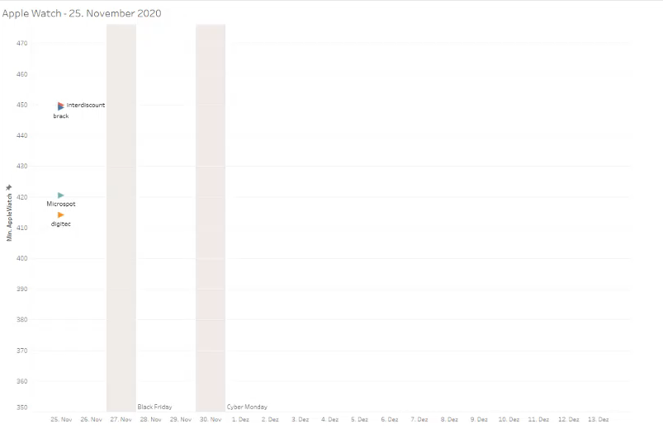
Overall Ranking – Price Leader
Microspot 119 times
Digitec 55 times
Brack.ch 32 times
interdiscount 11 times
INSERT CHART

Slide 7
112 Overall Price changes
- 263.40 CHF Overall Price decrease from start to end
- 1.157% Overall Price decrease from start to end
33
289.60 CHF
- 5%
16
48.90 CHF
0.01%
36
+ 1.00 CHF
+ 0%
27
+ 74.10 CHF
+ 0.01%

Slide 8
9 out of 40 price decreases
- CHF 330 highest absolute decrease (lasted for 1h)
- 42 % highest relative decrease
→ Bigger sample next time to prove results
0 price decreases on cyber Monday
8 out of 40 price increases
+ 100% PS4 FIFA 20 (digitec)
→ Bigger sample next time to prove results (some tendency)

Slide 9
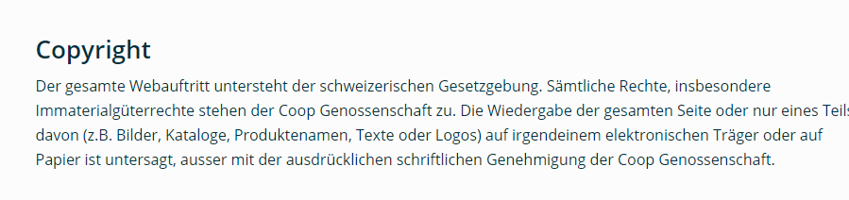
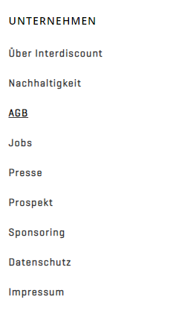
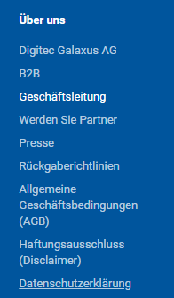
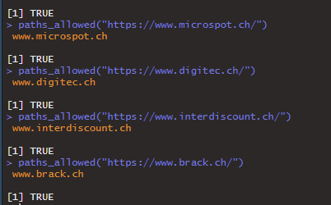
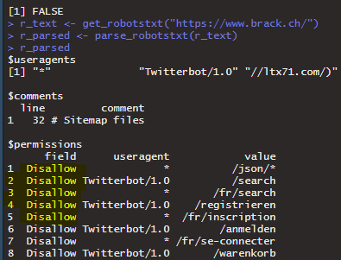
- Data publicly available
- Scientific purpose
- No economic intent

Slide 10
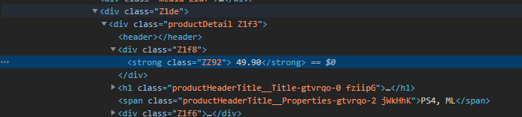
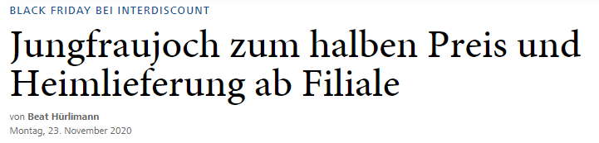
Challenges
Digitec changed CSS selectors
Interdiscount site breakdown Black Friday
Interdiscount dropped product

Slide 11
Q&A

