Slide 1
Final Project
Matan Gilon, Practicum100

Slide 2
Retail Test
In the next analysis I will test the data of 31 store of one chain, between December 2016 to March 2017. I will see wich store has the highest number of customers and sales; study the distribution during a given period and see if there are any differences between "loyal program" customers and ordinary customers.
Since one of the shops of that store has a significantly higher number of sales and customers I ran to study twice, once with this specific store included and once no included.
There is also a lack of customers ID, therefore the study can only give results of purchases made by people or (as members of the loyal program or not) or total numbers of visits (actual transactions) in a store but cannot show behaviore of a specific customer.

Slide 3
Retail - Conclusion
It appear both "Loyal" and not-"Loyal" groups have the same distribution in a period of three months.
There is a sharp decline during Christmas in both groups (None but a few sales in Christmas Evening). Shop 0 has a significantly higher number of customers than to other outlets (about 37,000 sales, whereas none of the other outlets passed 3,000 sales for each).
Shop 0 might be a comparatively big store, while the others are much smaller. Nevertheless, Shop 0 did not change the distribution between loyal program customers an none-loyal program customers.
It is not clear in this test what are the store’s benefits from Loyal Program.

Slide 4
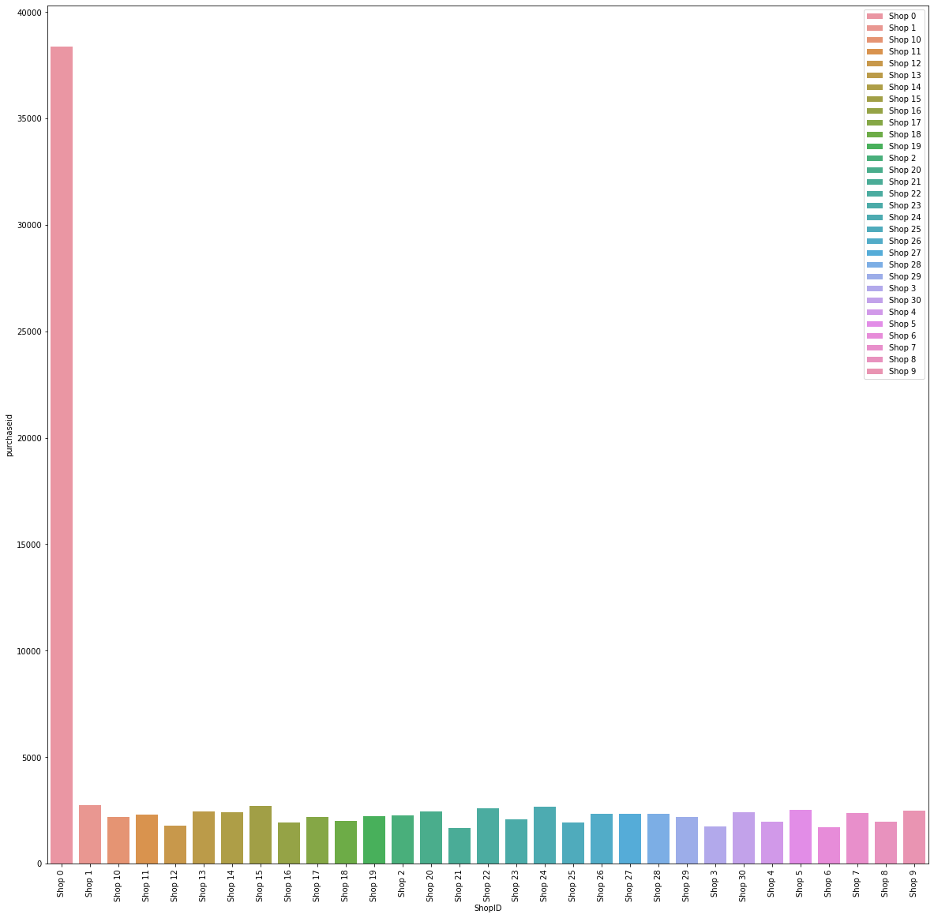
Product by shops
When comparing all shops together, Shop 0 has significanly higher number of product sales.

Slide 5
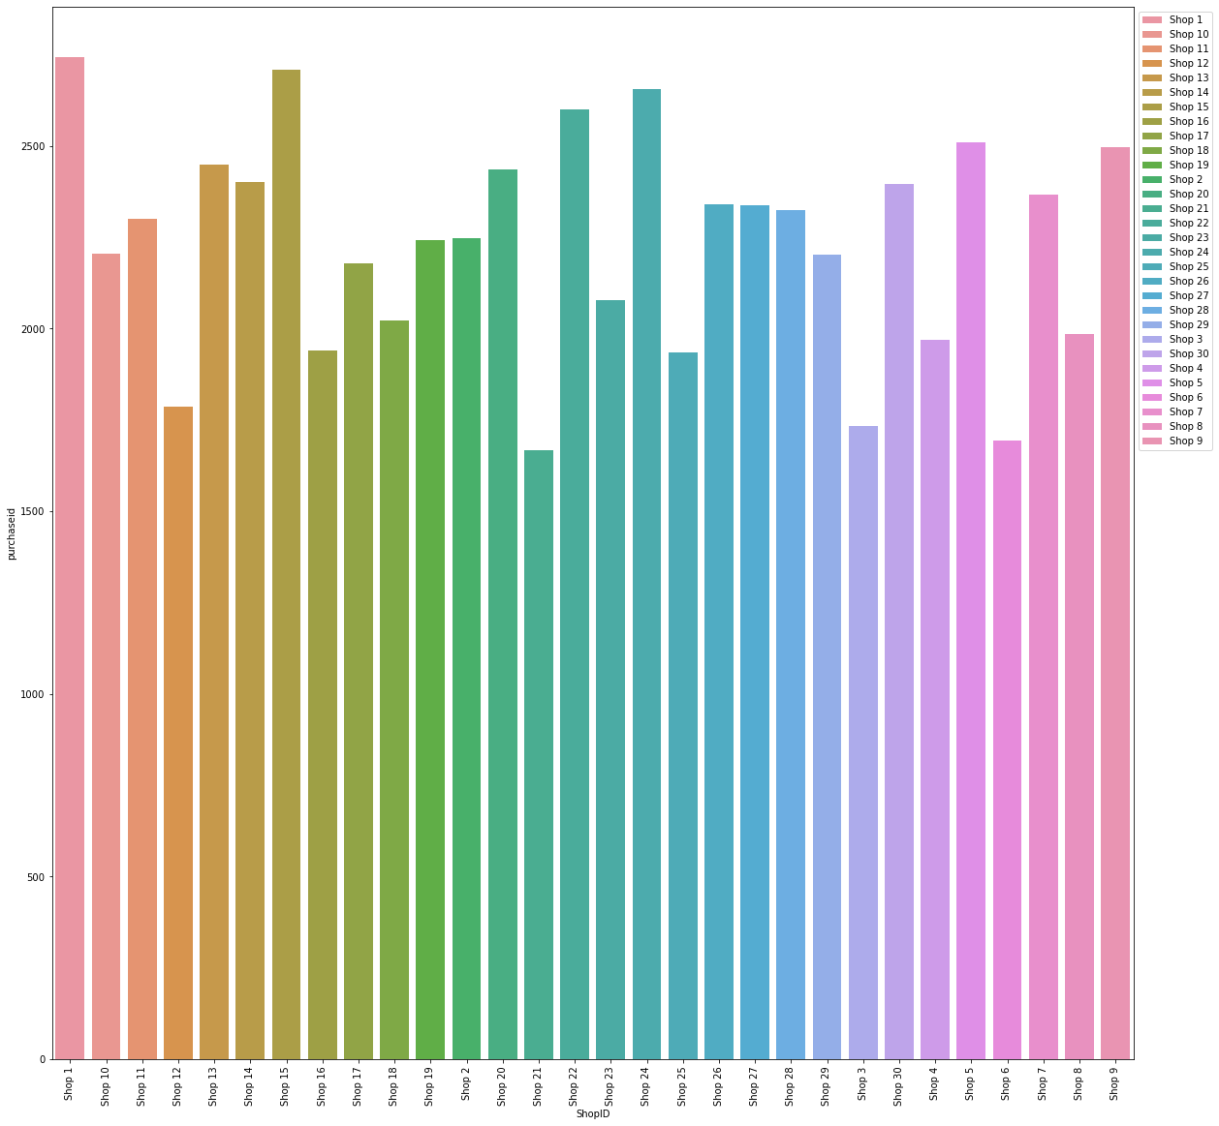
Product by shops
Removing Shop 0 enables us to look closer at the other stores which closer amount of product sold.

Slide 6
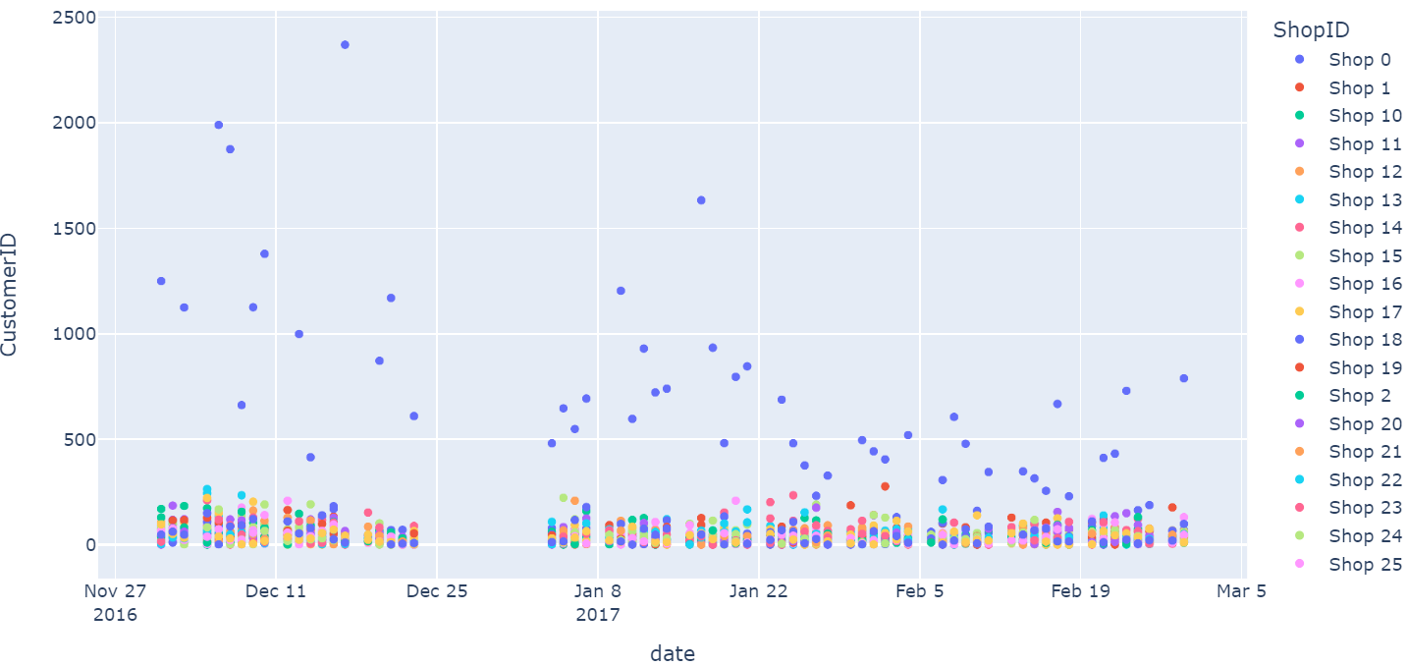
Buying Customers by Day between Dec 16 to March 17
Many people visiting (and purchasing) come to Shop 0.
We cannot tell Wether it is one person each visit or the same persons visiting twice, due to lack of customers IDs.

Slide 7
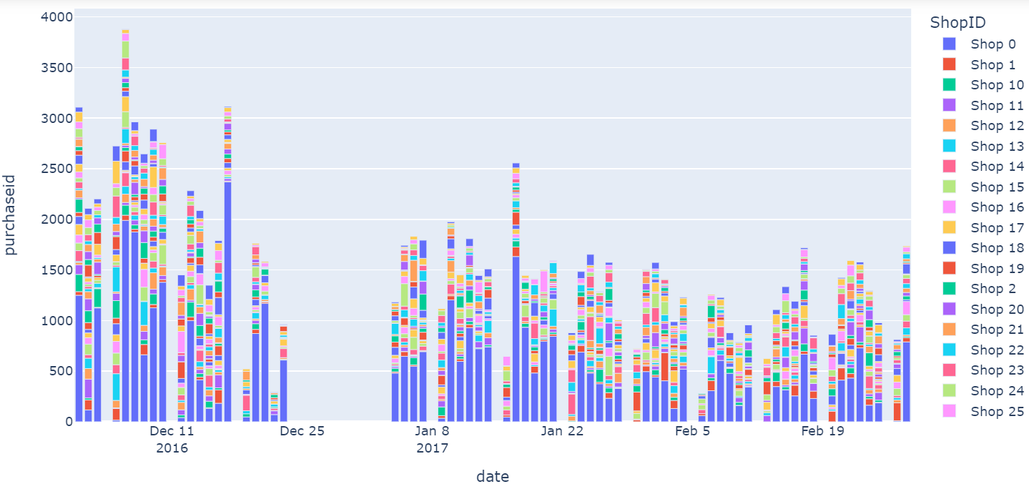
Product Sales by Day between Dec 16 to March 17
Shop 0 has the ghighest number of sold products.
There is no activity at all during Christmas and weekends.

Slide 8
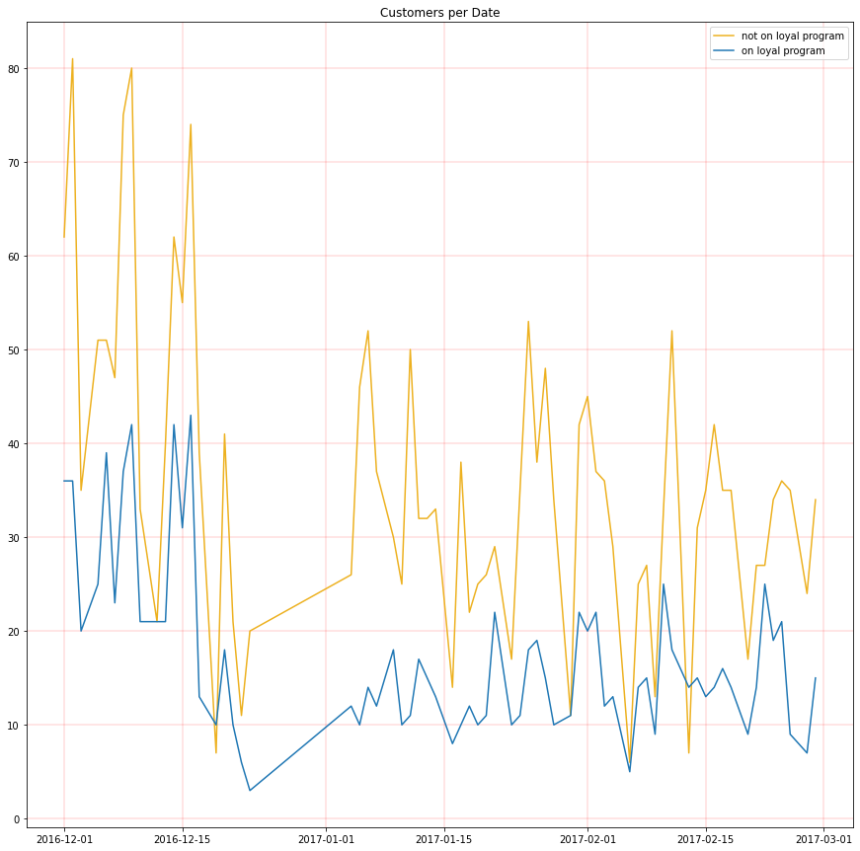
Loyal Program VS ordinary customers
There are much more ordinary customers than program customers who buy on a daily basic.

Slide 9
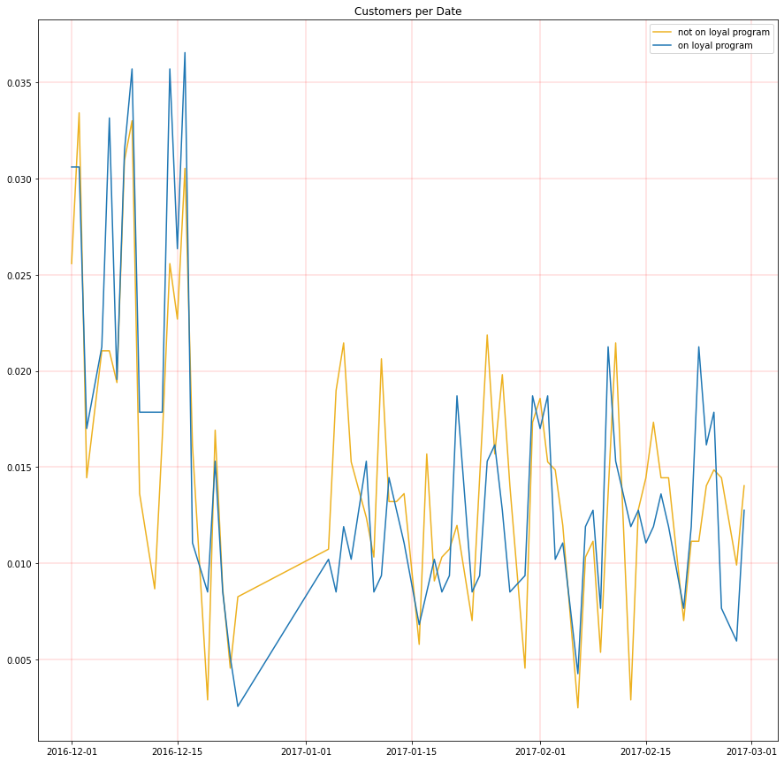
Loyal Program VS ordinary customers
When looking into the daily customers by the portions of their groups (program members among program members and ordinary among ordinary), it seems the distribution is the same.

Slide 10
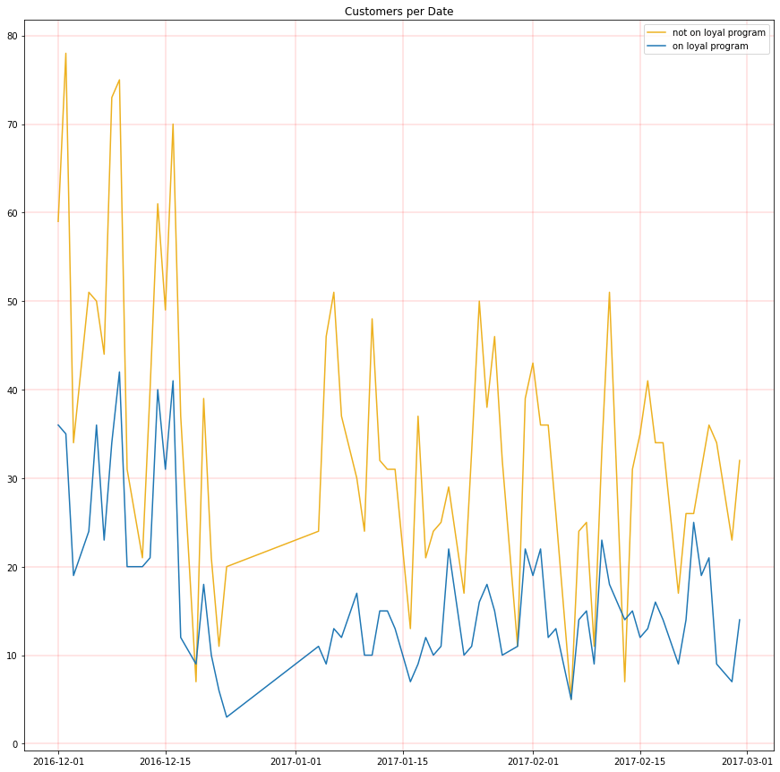
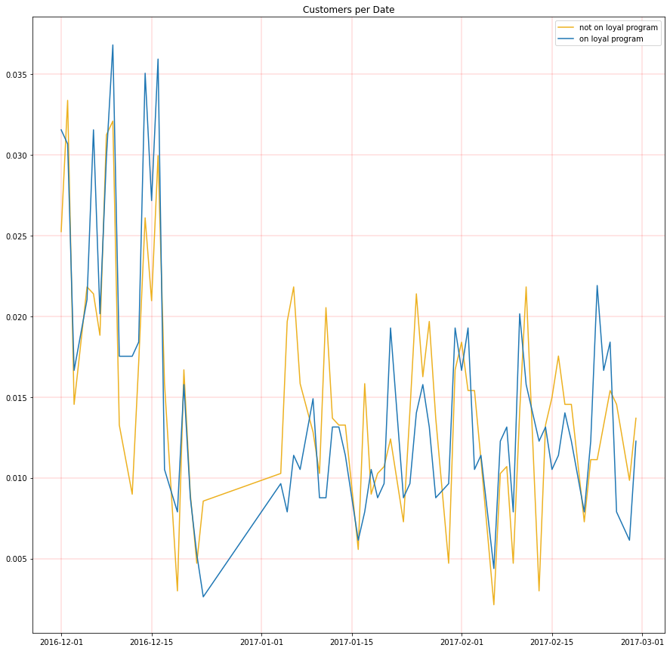
Removing 0 Shop
After removing Shop 0, the significantly higher in terms of sales, the differences seem to be the same .

Slide 11
Tableu dashboard link:
https://public.tableau.com/app/profile/matang2324/viz/Final_DASH/ShopIDDashboard?publish=yes

