Slide 1
How many talkers, not how loud:
a multi-talker masking panel in a feature-gain attention model
Lab meeting · model reproduction of Griffith, Hess & McDermott (2026, Nat. Hum. Behav.)
Selective-listening model · 600 targets × 7 conditions × 5 SNRs · RTX 3070

Slide 2
BACKGROUND
A model of selective listening via feature gains
• Question: can a trained neural model reproduce the successes AND failures of human selective listening?
• The model listens to two 2-s sounds: a CUE (a sample of the target voice) and a MIXTURE (target + distractors).
• It must report the target speaker's middle word (800-word vocabulary).
• Mechanism — feature gain: the cue computes per-feature gains g = θ1 + (1-θ1)·σ(θ2·(m_cue - θ3)),
  – applied element-wise to the mixture features — passing cue-strong features, suppressing cue-weak ones.
• θ are learned and FROZEN. We only run inference — no training.
2

Slide 3
TASK
The word-recognition task
• CUE: 2 s of the target talker (says: attend to THIS voice).
• MIXTURE: target talker + N distractor talkers, diotic (no spatial cues).
• Output: one of 800 words = the target's middle word.
• Scoring:
  – is_exact — predicted word == target's anchor word (accuracy).
  – conf_anchor / conf_sent — predicted a distractor's word (confusion; conf_sent = paper's Fig 2e criterion).
• All stimuli RMS-normalised to the training input level (0.02).
3

Slide 4
CONTEXT
Starting point: single-distractor results already reproduced
• Fig 2a — accuracy rises monotonically with SNR (same-sex single distractor): 26 → 88 %.
• Fig 2b — different-sex distractor is easier than same-sex, at every SNR.
• Fig 2e — confusions rise as SNR falls; higher for same-sex. Direction correct, but magnitude 4–5× below paper.
• Root cause of the 2e gap (diagnosed): old distractors were random → their middle word usually out-of-vocabulary,
  – so the model could not output it even when it 'heard' it. → fixed here with an anchored distractor pool.
• This talk: add a NEW variable on top — the NUMBER of distractor talkers.
4

Slide 5
THE QUESTION
This study: does talker NUMBER matter, at fixed masker energy?
• Human hearing: more competing talkers → harder, even when total masker energy is held constant.
• That extra difficulty is INFORMATION masking (more confusable voices), not ENERGY masking (louder).
• Prediction to test in the model:
  – accuracy: 1 talker > 2 > 4 ≳ 8-talker babble at every SNR.
  – no_distractor stays high (≈ 88 %).
• Design principle throughout: hold total masker energy fixed so only 'how many voices' varies.
5

Slide 6
DESIGN 1/3
Design: conditions & nested sampling
• Conditions: no_distractor / 1 / 2 / 4 / 8-talker babble + ISSN control.
• SNR: -9, -6, -3, 0, +3 dB for masker conditions; no_distractor is a single +∞ point.
• Within-item: the SAME 600 targets are re-mixed in every condition × SNR → differences come from the condition, not the sample.
• Nested sampling: each target draws a fixed set d1…d8; 2-talker = d1,d2; 4-talker = d1..d4; babble = d1..d8.
  – → '2-talker' is literally '1-talker plus one more person'. The only thing that changes is the count.
6

Slide 7
DESIGN 2/3
Design: target-to-total-masker SNR isolates the variable
• Each distractor is RMS-aligned, then SUMMED into one total masker.
• The whole masker is scaled so 10·log10(P_target / P_masker) = SNR; mixture = target + masker.
• → 1 / 2 / 4-talker have IDENTICAL total masker energy at a given SNR.
• So any accuracy difference between them CANNOT be loudness — it is 'more confusable voices'.
• Verified line-by-line against the authors' code (per-distractor align → sum → scale). Matches.
• N=1 reduces exactly to the already-reproduced single-distractor case → built-in check.
7

Slide 8
DESIGN 3/3
Two safeguards added before running
• Gender balancing (fixed a real confound):
  – random draws made P(≥1 same-sex distractor) climb with N (50% → 99.6%). Sex is a large effect →
  – would masquerade as a talker-number effect. Fix: alternate d1..d8 by sex → same-sex count exactly 0.5/1/2/4.
  – Verified across all 600 targets: zero jitter, nesting intact, no self / duplicate speakers.
• 1-talker split into one_same / one_diff (can't be 50/50) — also gives free Fig 2a / 2b anchors.
• ISSN control condition: spectrally-matched stationary noise — GAPLESS and CONTENTLESS —
  – separates information masking from 'glimpsing' into masker gaps.
8

Slide 9
METHODS
Methods at a glance
• Evaluation stimuli: 600 target items + anchored distractor pool (1200 recordings / 1200 speakers, sex-balanced).
• 7 conditions × 5 SNRs (+1 no_distractor) × 600 targets = 18,600 forward passes.
• Frozen author checkpoint; inference only; cochleagram front-end + feature-gain CNN.
• Hardware: RTX 3070 Laptop (CUDA) — full run ≈ 40 min; 0 items skipped.
• Corpus note: stimuli cut from Common Voice (see Limitations).
9

Slide 10
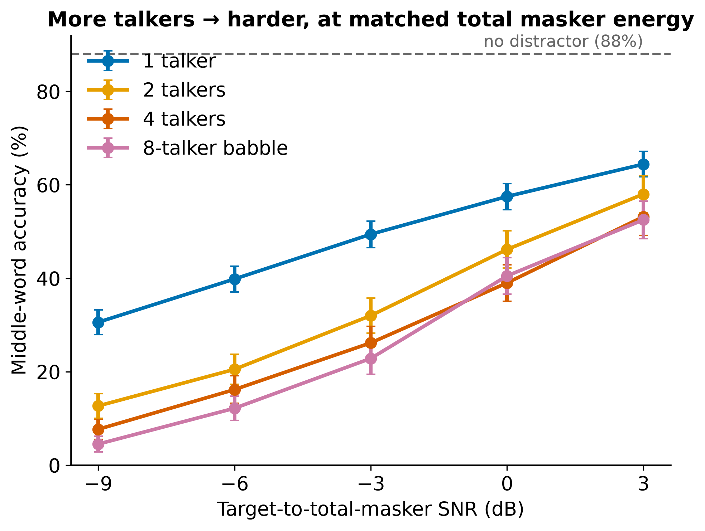
RESULTS
Result 1 — talker number matters, at matched energy
• 1 > 2 > 4 ≳ babble at every SNR (4 ≈ babble only at 0 dB — the '≳').
• Every curve rises with SNR.
• no_distractor = 88 % (dashed) — matches the prior anchor exactly.
• Same total energy across 1/2/4 → difference is the number of voices.
10

Slide 11
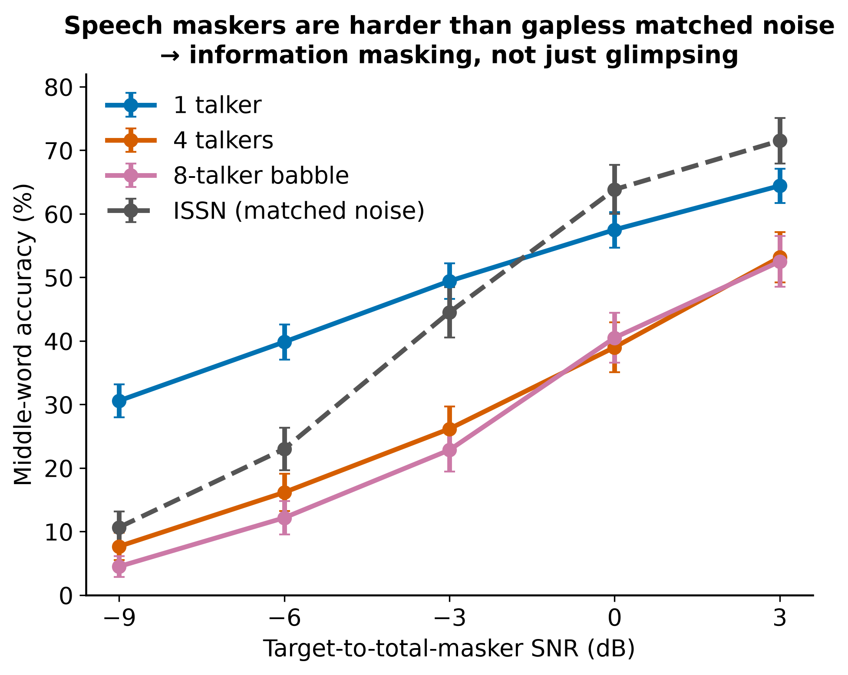
RESULTS
Result 2 — evidence for information masking (ISSN)
• 4-talker & babble are HARDER than ISSN at every SNR,
  – even though ISSN is gapless and speech has gaps.
• If glimpsing drove it, speech would be EASIER than noise — it isn't.
• → positive evidence for information masking, not explained by gaps.
• 1-talker crosses ISSN (easier at low SNR): glimpsing dominates with a single sparse talker.
11

Slide 12
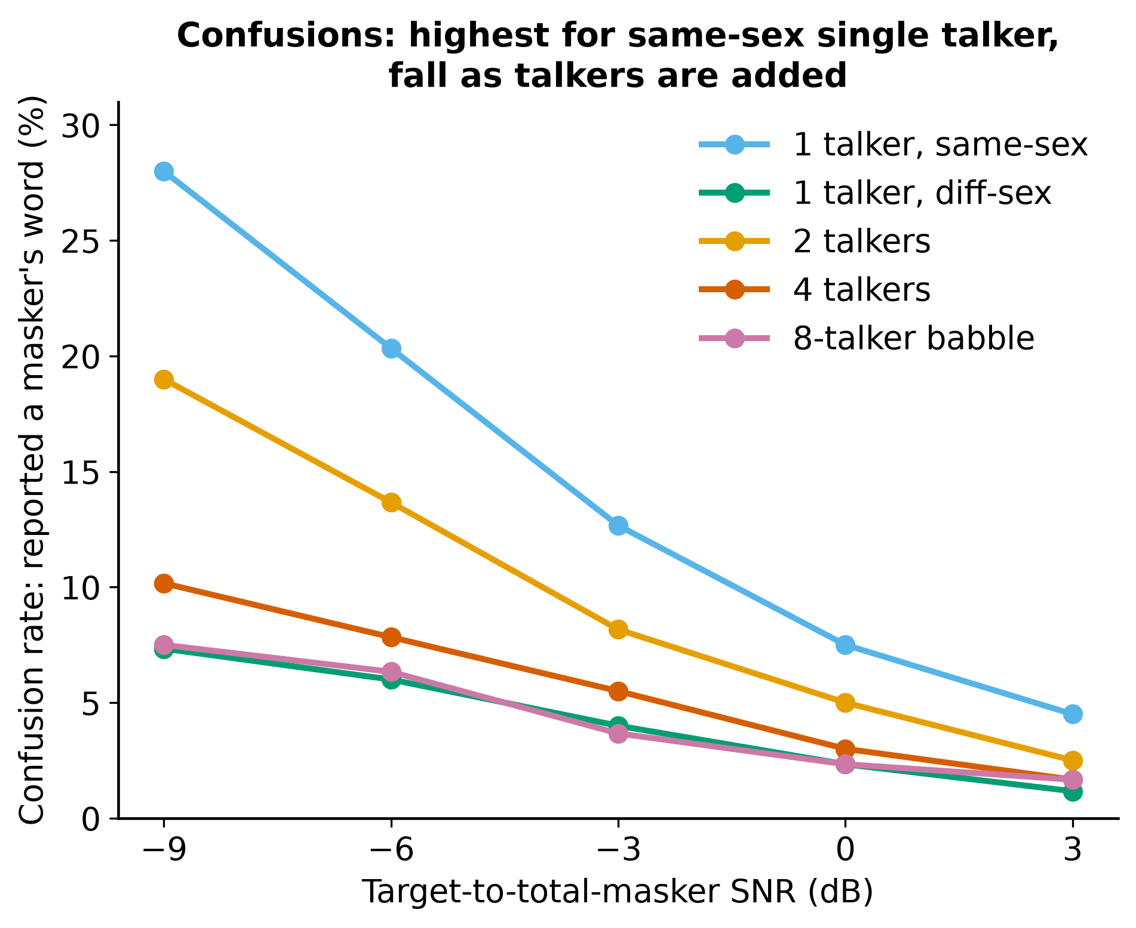
RESULTS
Result 3 — confusions, and one surprise
• As expected: confusions rise as SNR falls;
  – same-sex single talker highest (28 % at -9 dB) ≫ diff-sex (7 %).
• Anchored pool raised confusion far above the old 4–5×-underestimate.
• SURPRISE: confusion FALLS as talkers are added (opposite to our pre-registered criterion).
  – Sensible: fixed energy split over more voices → no single word is clearly heard.
12

Slide 13
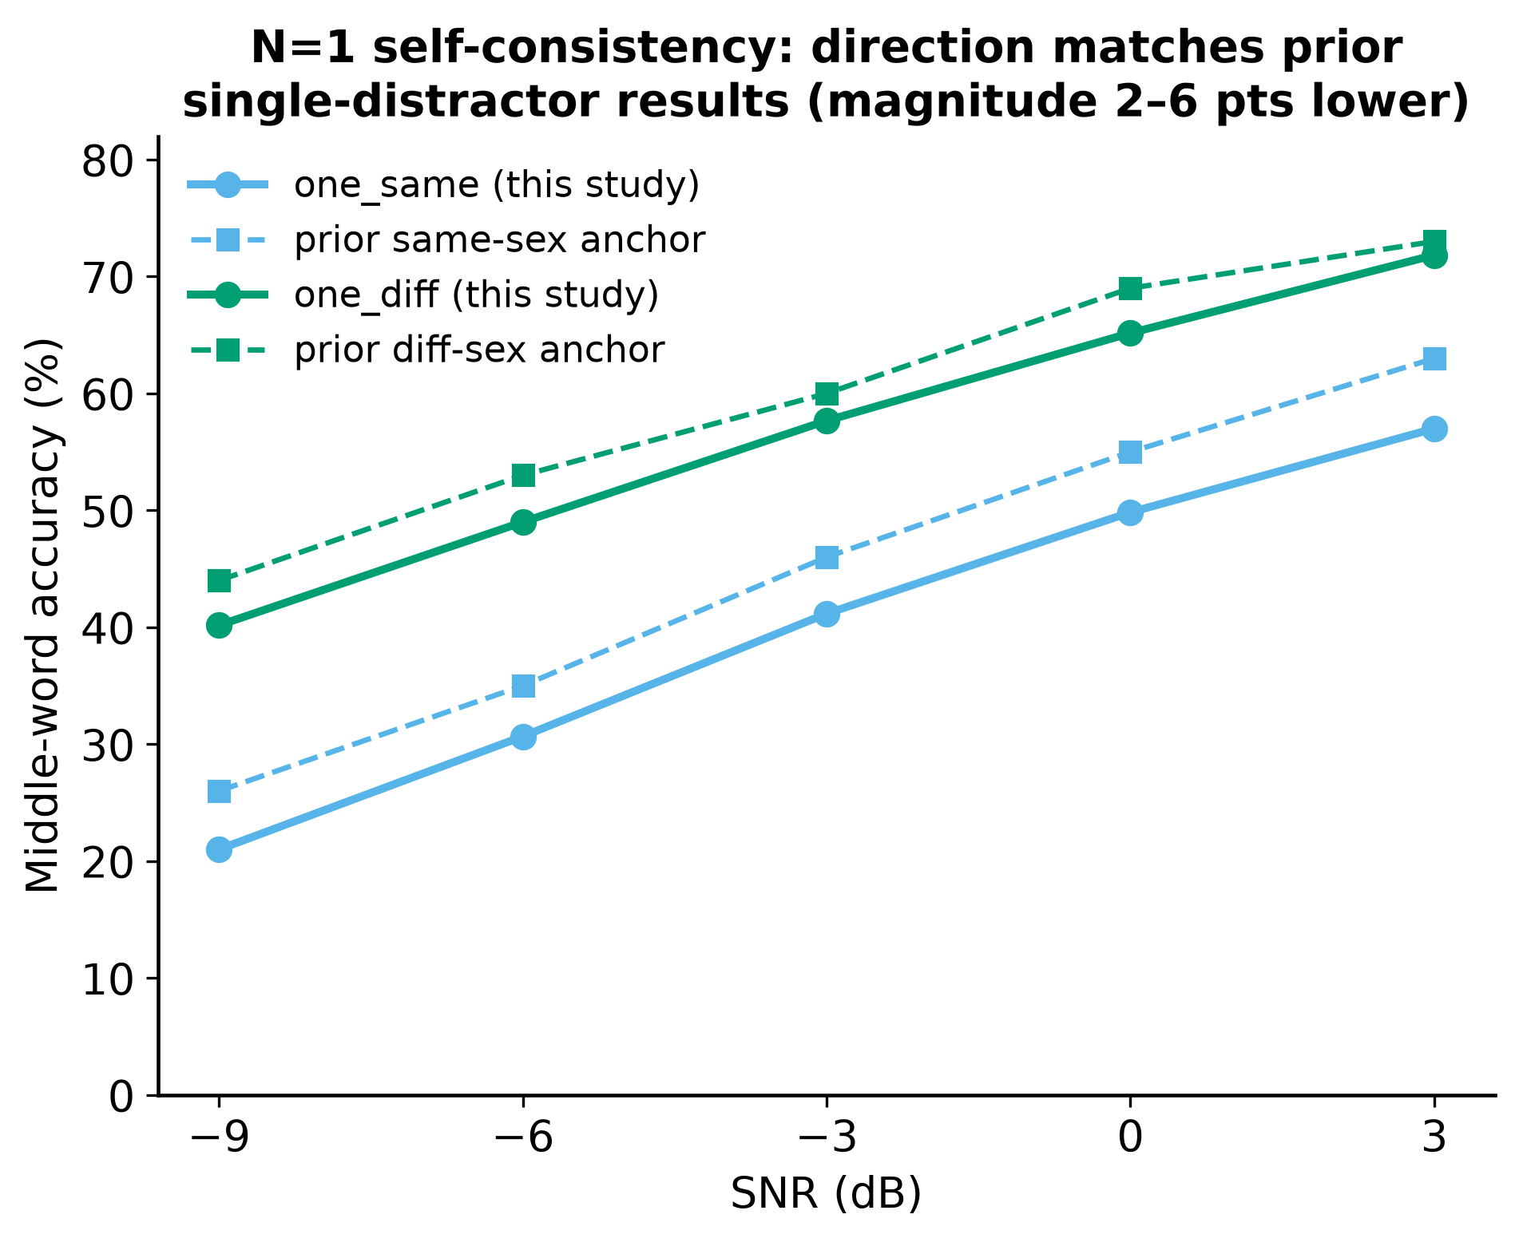
VALIDATION
Self-consistency checks
• no_distractor = 88.0 % — matches the +∞ anchor exactly.
• one_same / one_diff track the prior single-distractor curves,
  – 2–6 points lower (expected: different, anchored distractor pool).
• Direction and shape reproduce → the GPU pipeline is trustworthy.
13

Slide 14
LIMITATIONS
Limitations — honest boundaries
• Corpus mismatch (CV ≠ SWC):
  – our eval stimuli are Common Voice; the paper's Experiment 1 uses Spoken Wikipedia (SWC).
  – Different pause habits → different silence ratio → shifts effective vs nominal SNR (x-axis calibration).
  – CV is also the model's TRAINING corpus → we test in-domain; the paper tests cross-corpus generalisation.
  – → within-panel talker-number trend is unaffected; absolute magnitudes / direct Fig 2e comparison are not.
• Confusion vs talker number came out opposite to the stated criterion (reported above, not hidden).
• babble = 8 talkers summed online (paper uses pre-made files) — a deliberate, nesting-preserving choice.
14

Slide 15
OUTLOOK
Next steps
• Quantify the corpus effect: measure silence ratio + effective SNR on our CV stimuli (CPU-only) —
  – turns 'how much of the gap is x-axis miscalibration' into a number.
• Consider rebuilding the eval set from SWC (Feather et al. filtering) for a faithful magnitude comparison.
• Statistics: mixed-effects model of accuracy with effective SNR as covariate → isolate residual information masking.
• Report confusion-direction result as a genuine model prediction to check against human data.
15

Slide 16
SUMMARY
Take-homes
• The model shows a clean talker-number effect at fixed masker energy: 1 > 2 > 4 ≳ babble.
• The ISSN control gives positive evidence for information masking — not explained by glimpsing.
• Self-consistency holds (no_distractor 88 %; N=1 reproduces prior curves).
• Two honest caveats: CV≠SWC corpus mismatch (magnitude/x-axis), and confusion falls with talker number.
• Pipeline is validated and fast (40 min / full run) — ready for the corpus-quantification follow-up.
16

