Slide 1
Reproducing Human Selective-Listening Trends
with a Pretrained Feature-Gain Model
Distractor sex + number of distractors — Common Voice evaluation set
Griffith, Hess & McDermott (2026, Nature Human Behaviour)
Group meeting · Model inference only (no training) · Goal: trend direction, not exact values

Slide 2
MOTIVATION
Can a gain-based model explain selective listening?
The human problem
At a noisy party we can follow one voice and ignore others.
The model (Griffith et al. 2026)
Applies a learned feature gain that boosts features matching a cue voice and suppresses the rest.
The claim
One optimized gain mechanism predicts BOTH successes and failures of human listening across many conditions.
Our task
Feed the authors' pretrained checkpoint our own Common Voice test set and check whether the behavioral trends reproduce.
The task, per trial
1. Cue — a sample of the target voice
2. Mixture — target + distractor(s)
3. Report the target's middle word
(from an 800-word vocabulary)
Parameters are frozen — we only run inference, so no training data is needed.

Slide 3
METHOD
Building the evaluation set — one shared pipeline
1
Force-align
torchaudio MMS_FA
word-level timestamps
2
Pick anchor
in-vocab middle word
centered slice
3
Slice 2.5 s
model crops to 2 s
diotic (L = R)
4
Mix @ SNR
-9…+3 dB, +inf
RMS-normalize 0.02
5
Infer + score
checkpoint prediction
exact / confusion
Anchor = the paper's rule: pick the target word first, then cut a slice centered on it
• Structural constraints: cue & target = same speaker / different recordings; distractor = different speaker; speaker-disjoint; gender-balanced targets.
• Model validity check: 88.6% middle-word accuracy on clean speech (chance = 0.1%).
• Verified in every run: the +inf (no-distractor) point lands at ~88%.

Slide 4
PART 1
Distractor sex · a single competing talker

Slide 5

PART 1 · RESULT
Accuracy rises with SNR; different-sex is easier
What reproduces
• Monotonic rise with SNR (both lines).
• Different-sex > same-sex at every masked SNR.
• Gap = +9 to +18 points (3.4–6.8 sigma, error bars do not overlap).
• Lines converge to ~88% at +inf — no distractor, sex no longer matters.
within-item, N=599/597, diotic
= paper Fig 2a (same-sex line) + Fig 2b (both lines)

Slide 6
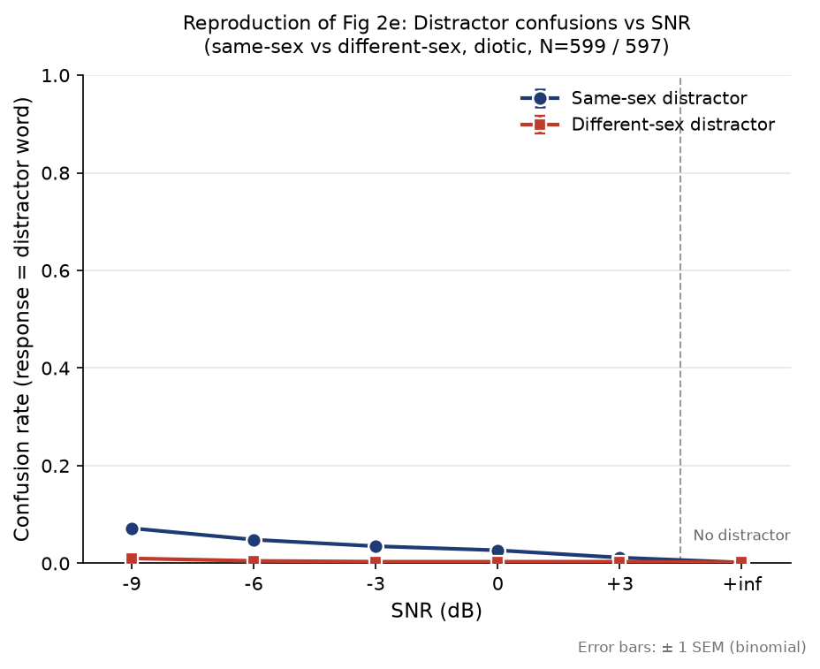
PART 1 · RESULT + PROBLEM
Confusion trend reproduces — but magnitude is too low
Confusion = model reports a distractor word
Direction correct:
• lower SNR → more confusion
• same-sex confuses more than different-sex
But 4–5x too low vs the paper
Root cause: distractors were picked at random, so their middle word is usually NOT in the vocabulary — the model cannot output it even if it hears it.
→ This is exactly what Part 2 fixes.

Slide 7
PART 2 · NEW
Number of distractors · 1 / 2 / 4 talkers + babble

Slide 8
PART 2 · THE QUESTION
Does talker NUMBER matter, at fixed masker energy?
Human hearing: more competing talkers → harder, even when total masker energy is held constant.
That effect is information masking — being confused by other voices, not simply drowned out by energy.
So the design must hold total masker energy CONSTANT while varying only the number of voices.
Prediction under test: if the feature-gain model captures information masking, accuracy should fall as talkers are added — at matched energy.
N=1 of this experiment reduces exactly to Part 1's single-distractor case — a built-in check.

Slide 9
PART 2 · DESIGN (1/3)
Conditions & nested sampling
Conditions
no-distractor · 1 · 2 · 4 · 8-talker babble · + ISSN control
SNR: -9…+3 dB for maskers; no-distractor is a single +inf point.
Within-item
The SAME 600 targets are re-mixed in every condition × SNR → differences come from the condition, not the sample.
Nested sampling
Each target draws a fixed set d1…d8; two = d1,d2; four = d1–d4; babble = d1–d8.
→ 'two-talker' is literally 'one-talker plus one more person'. Only the count changes.
Anchored distractor pool
Every distractor recording also carries an in-vocab anchor word, sliced like the target.
• 1,200 recordings / 1,200 speakers
• male 600 / female 600
• 0 overlap with target speakers
• 534 distinct anchor words
Now the model CAN output a distractor word → confusion becomes measurable.

Slide 10
PART 2 · DESIGN (2/3)
Target-to-total-masker SNR isolates the variable
• Each distractor is RMS-aligned, then SUMMED into one total masker.
• The whole masker is scaled so 10·log10(P_target / P_masker) = SNR; mixture = target + masker.
• → 1 / 2 / 4-talker have identical total masker energy at a given SNR.
• So any accuracy difference between them CANNOT be loudness — it is 'more confusable voices'.
• Verified line-by-line against the authors' code (per-distractor align → sum → scale). Matches.
• N=1 reduces exactly to the already-reproduced single-distractor case → built-in check.

Slide 11
PART 2 · DESIGN (3/3)
Two safeguards added before running
Gender balancing — a real confound
Random draws made P(≥1 same-sex distractor) climb with N: 50% → 99.6%.
Sex is a LARGE effect (Part 1) — it would masquerade as a talker-number effect.
Fix: alternate d1…d8 by sex → same-sex count exactly 0.5 / 1 / 2 / 4.
Verified across all 600 targets: zero jitter, nesting intact, no self / duplicate speakers.
ISSN control condition
Spectrally-matched STATIONARY noise — gapless and contentless.
Separates information masking from 'glimpsing' into gaps between words.
If glimpsing drove the effect, speech (which has gaps) would be EASIER than gapless noise.
Also: 1-talker split into one_same / one_diff → free Part-1 (Fig 2a/2b) anchors.

Slide 12
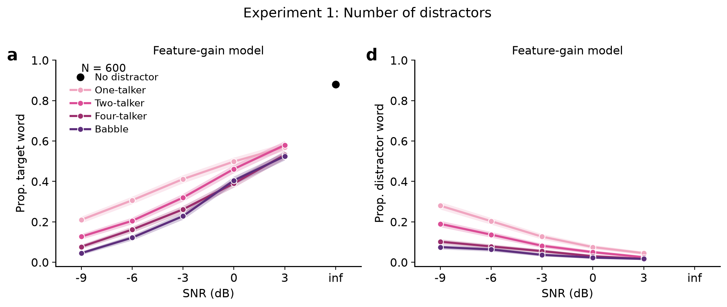
PART 2 · RESULT
Number of distractors — paper-matched colors
Accuracy (left): monotonic in SNR; one > two > four ≈ babble; +inf ≈ 88%. Confusion (right): highest for a single same-sex talker, falls as talkers are added.
N = 600, within-item · colors match paper Fig 2 (pink → purple)

Slide 13
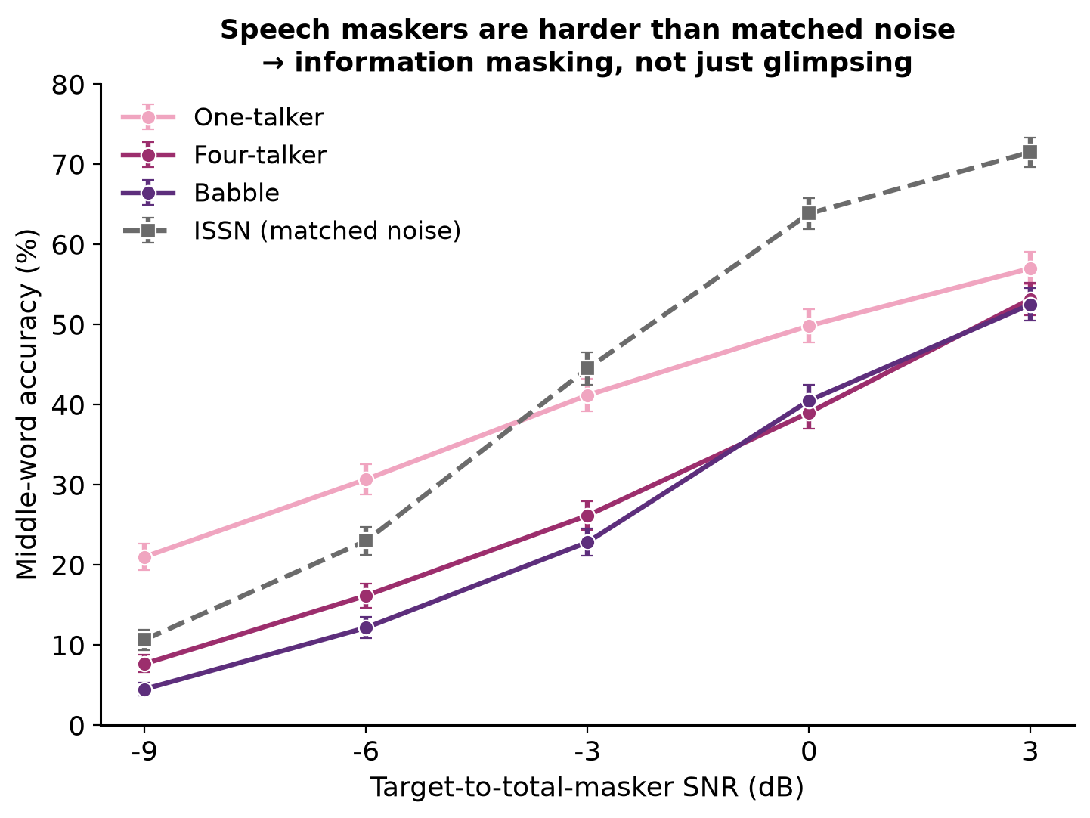
PART 2 · RESULT 2
Speech maskers beat matched noise → information masking
ISSN = spectrally-matched stationary noise (gapless, no words)
• 4-talker & babble are HARDER than ISSN at every SNR.
• Yet ISSN is gapless and speech has gaps — if 'glimpsing' drove it, speech would be EASIER. It isn't.
• → positive evidence for information masking, not just gap-listening.
• 1-talker crosses ISSN (easier at low SNR): a single sparse voice leaves gaps to glimpse through.

Slide 14
PART 2 · RESULT 3
The anchored pool fixed the confusion underestimate
Before (random)
7.2%
same-sex confusion @ -9 dB
After (anchored)
28.0%
same-sex confusion @ -9 dB
Paper
~41%
target for this condition
From 5.7x too low to 1.5x too low — the root-cause diagnosis was correct.
An honest reversal: confusion is HIGHEST for a single same-sex talker and DROPS as talkers are added — opposite to our pre-registered guess, but consistent with the paper. With many voices the masker becomes noise-like, so the model emits garbage rather than a specific distractor word.

Slide 15
VALIDATION
Self-consistency checks — why we trust the pipeline
• no-distractor = 88.0% — matches the +inf anchor from Part 1 exactly.
• one_same / one_diff track the Part-1 single-distractor curves, 2–6 points lower (expected: a different, anchored distractor pool).
• N=1 reduces to the single-distractor case that was already reproduced — direction and shape hold.
• Gender balancing verified across all 600 targets: exact same-sex counts, nesting intact, no self/duplicate speakers.
→ The GPU pipeline is trustworthy: the new results rest on checks that all passed.

Slide 16
SUMMARY
What reproduced
Model validity (clean)
88.6% vs 0.1% chance
Accuracy vs SNR
monotonic rise, both experiments
Different-sex > same-sex
+9 to +18 pts, 3.4–6.8 sigma
More talkers → harder
one > two > four ≈ babble
Confusion direction
lower SNR & same-sex → more
Confusion magnitude
fixed 7.2% → 28% (paper ~41%)

Slide 17
LIMITATIONS
Honest boundaries
Corpus mismatch (CV ≠ SWC) — the biggest one:
  • our stimuli are Common Voice; the paper's Experiment 1 uses Spoken Wikipedia (SWC).
  • different pause habits → different silence ratio → shifts effective vs nominal SNR (x-axis calibration).
  • CV is also the model's TRAINING corpus → we test in-domain; the paper tests cross-corpus generalization.
  • → within-panel talker-number trend is unaffected; absolute magnitudes / direct Fig 2e comparison are.
• Confusion vs talker number came out opposite to our stated criterion (reported, not hidden).
• babble = 8 talkers summed online (paper uses pre-made files) — a deliberate, nesting-preserving choice.
• Trend reproduction, not exact values (by design); diotic only — no spatial / noise / harmonicity yet.

Slide 18
OUTLOOK
Next steps
• Quantify the corpus effect: measure silence ratio + effective SNR on our CV stimuli — turns 'how much of the gap is x-axis miscalibration' into a number.
• Consider rebuilding the eval set from Spoken Wikipedia (paper's filtering) for a faithful magnitude comparison.
• Statistics: mixed-effects model of accuracy with effective SNR as a covariate → isolate residual information masking.
• Report the confusion-direction result as a genuine model prediction to check against human data.
• Longer term: train the model ourselves and test whether the same effects emerge.

Slide 19
One frozen gain mechanism reproduces both experiments' trends —
and fixing the evaluation set recovered the confusion signal.
Thank you — questions?

