Slide 1
Automated Checklist System
MEMPIN, Neil Anthony G.
VELASCO, Gimel David F.

Slide 2
Background of the Project
Automated Checklist System

Slide 3
Background of the Project
In colleges and universities, checklists are used to track the progress of a particular student in the courses that he is taking. Found in a checklist of a course are a list of all subjects that needs to be finished by the student.

Slide 4
Background of the Project
For a very long time, instructors make use of the pen-and-paper to fill out the checklist of the students that he/she advises. Since this process takes too much time and inconsistencies and mistakes can happen, an automated checklist system is viable.

Slide 5
Objective of the Project
Automated Checklist System

Slide 6
Objective of the Project
The objective of this database is to ensure a precise, updated, reliable and safe data system for the advisers to use so as to address to their advising needs and the students' full progress and status. This is for the convenience of both the adviser and advisee. This is so that instead for an adviser to keep folders and papers to store in their cabinets, they would be able to have a database that is well-kept and is not prone to any physical data loss such as fire, water or the likes.

Slide 7
Database Schema
Automated Checklist System

Slide 8
Database Schema
Tables
admin
advises
allcourses
checklist
course_equiv
course_prereq
course_quali
instructor
offeredcourses
prog_elec
reportofgrades
req_ge
school
student
takescourses

Slide 9
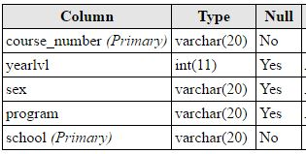
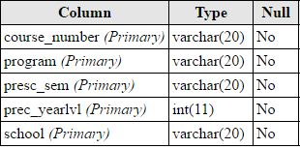

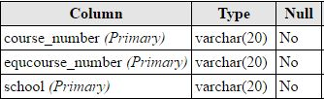
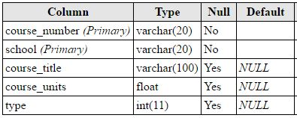
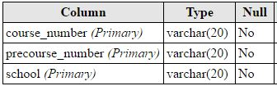
Database Schema
course_quali
checklist
admin
course_equiv
allcourses
course_prereq

Slide 10
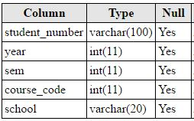
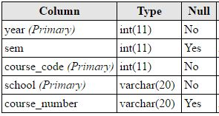
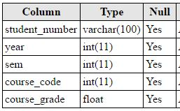
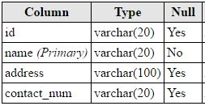
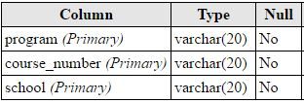
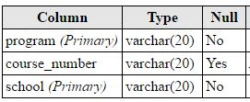
Database Schema
takesCourses
offeredCourses
reportofgrades
school
prog_elec
req_ge

Slide 11
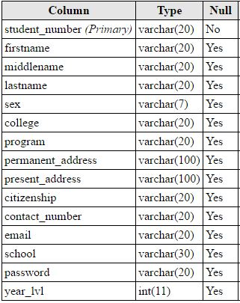
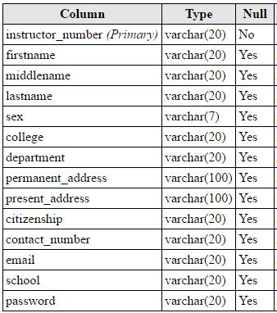
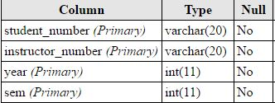
Database Schema
student
instructor
advises

Slide 12
Levels of Access
Automated Checklist System

Slide 13
Levels of Access
Types of Users
I. Student Access
- CRUD System Functionalities
- views his checklist
- views his report of Grades (per semester)
- update personal student information

Slide 14
Levels of Access
Types of Users
II. Adviser Access
- CRUD System Functionalities
- can view all of the checklist of the students that he/she advises
- can view all of the ROG of the students that he/she advises
- can insert ROG of a student per semester
- create and update and delete personal instructor information

Slide 15
Levels of Access
Types of Users
III. Admin Access
- CRUD System Functionalities
- can view, add, delete and edit a student in the database
- can view, add, delete and edit an instructor in the database
- can view, add, delete and edit a checklist
- can view, add, delete and edit grades

Slide 16
Demonstration
Automated Checklist System

