Slide 1
March Madness Bracket
Navigating the March Madness User Interface
Chris Montani

Slide 2
March Madness Backstory…
Each year hundreds of teams compete all year to earn the right to secure a spot in the March Madness tournament. The tournament involves 64 teams playing in a single-elimination tournament to determine the men’s National Collegiate Athletic Association Division 1 college basketball national champion for the current season.
The tournament was created in 1939 by the National Association of Basketball Coaches, and was the idea of Ohio State University coach Harold Olsen. It has become one of the most famous annual sporting events in the United States.
The tournament includes champions from 32 Division 1 conferences and 64 teams are selected, ranked and compete one another to be apart of the final four.
The winners of each region advance to the “Final Four” where the national semifinals are played on Saturday and the national championship is played on Monday.
This Tutorial will help the user understand the program while explaining each aspect of the program and how it works.

Slide 3
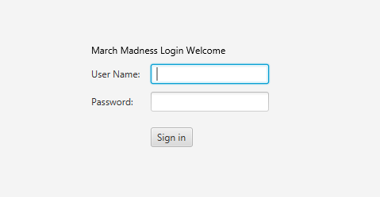
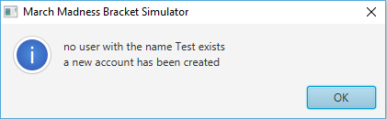
Logging In…
Enter a “Username” and “Password” the program will check if the entered credentials already exists.
If the Username and Password is found the user will be navigated to their already filled/semi-filled bracket.
If the Username and Password is not found the entered Username and Password will be saved and the user will be prompted to start filling out their bracket. Once the user logs out they can now log in with their new credentials previously entered.

Slide 4
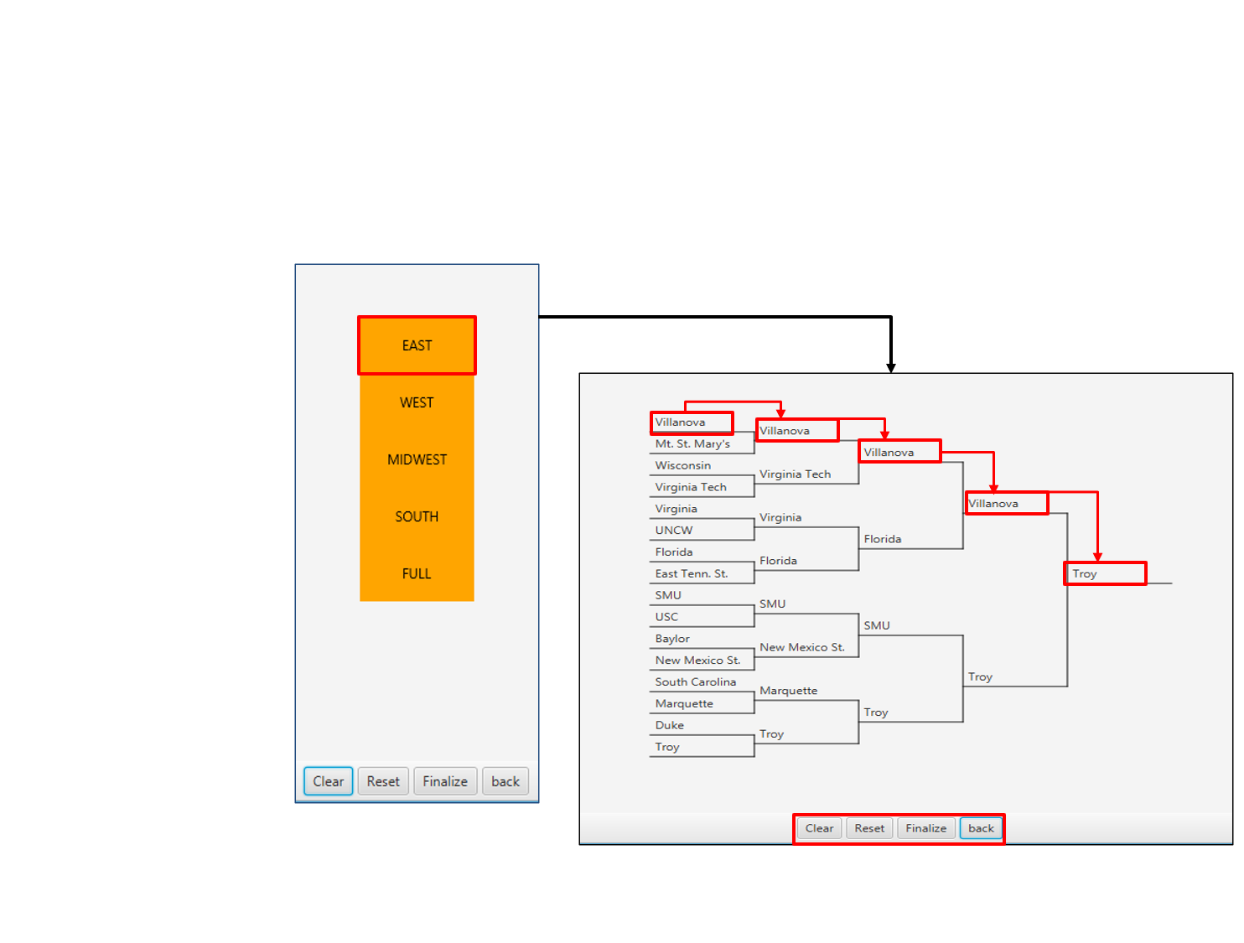
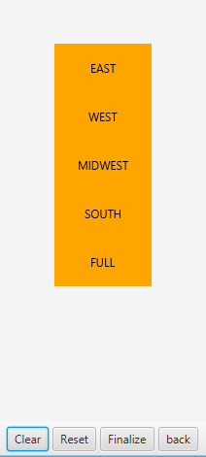
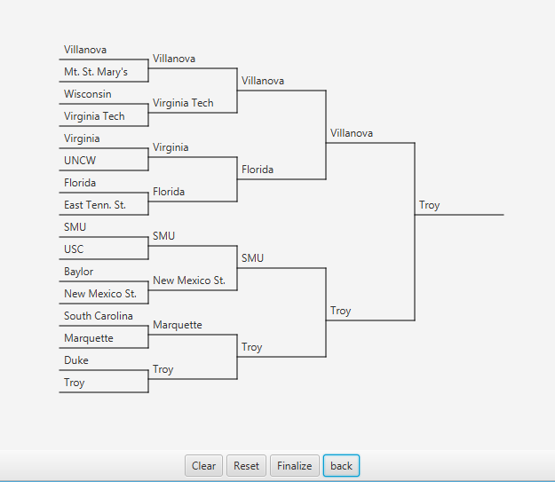
Creating A New Bracket
After creating a new account you will be prompted with the menu to the right, (East, West, Midwest, South and Full) each selection will prompt you to complete a portion of your bracket division by division.
Right-click on a team to display some information about the team in a pop-up window.
To Select a team to move onto the next round, simply click their name. The team will automatically move to the next empty slot in the path. Continue this pattern until all fields are complete.
Continue selecting teams in all of the divisions (East, West, Midwest, South) When the listed divisions above are completed select the “Full” selection. This will navigate the user to their fully filled out bracket. The only area that is not completely filled out is the “Final Four” you can make your final selections in the “Full” menu.
Notes:
4

Slide 5
Creating A New Bracket (cont’d.)
To continue to fill out other divisions select the “back” button.
The clear button will clear the users entire division choices. The Reset button will reset the entire bracket and prompt the user to restart the process of selecting teams.
The login button will take the user back to the login screen if clicked before the bracket is simulated.
Notes:
5

Slide 6
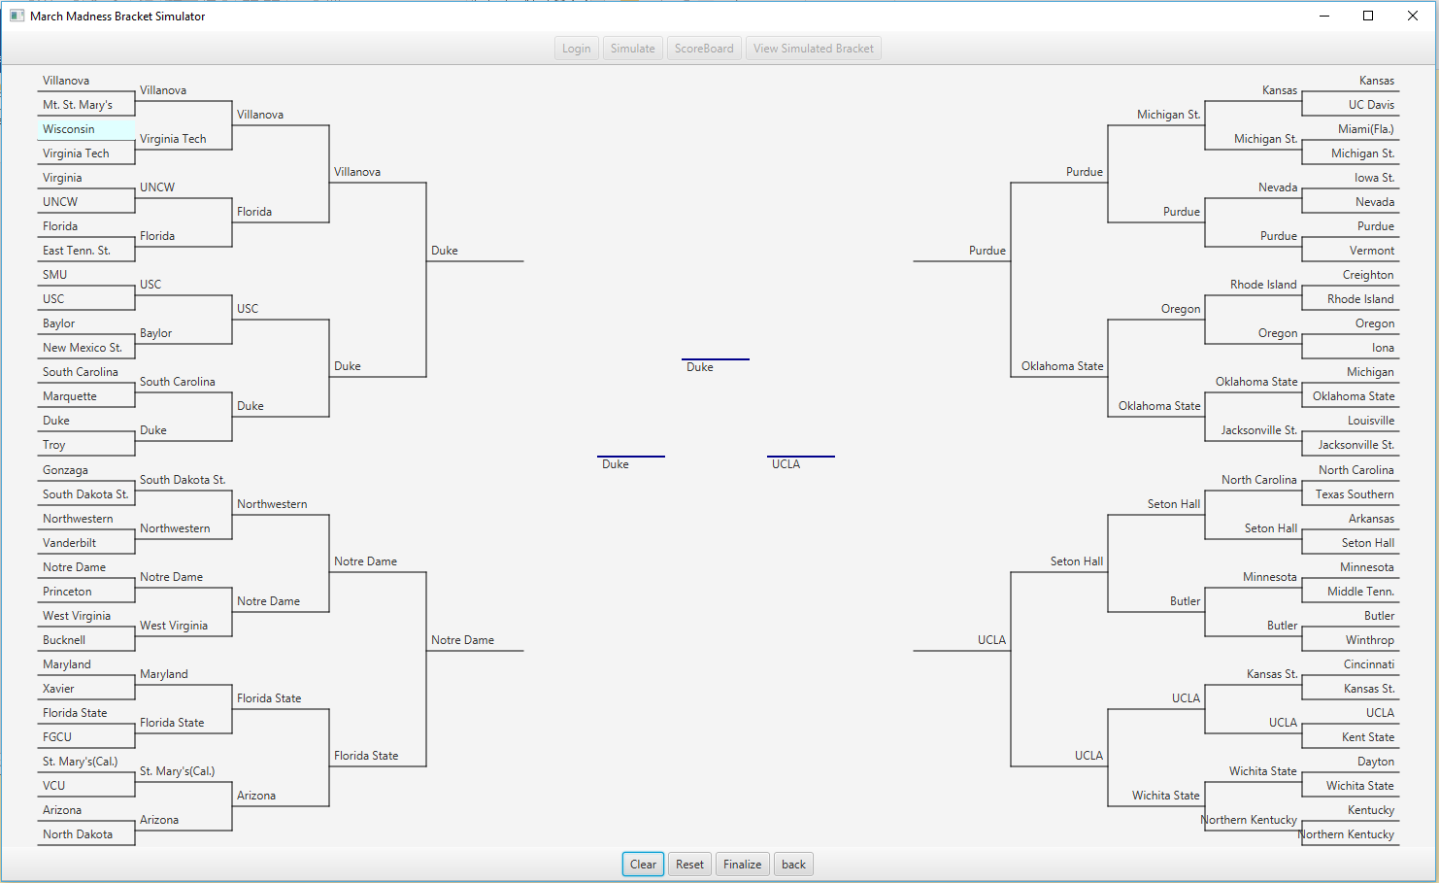
Completed Brackets
Once all fields divisions and the final four are filled out the bracket will be loaded and displayed on the screen after selecting the “Full” option.
Once the user is satisfied with their choices they can select the “Finalize” button which will lock their bracket in. IMPORTANT – Once finalize is selected the user will not be able to make any more edits to their bracket.
Select the “Simulate” button to simulate the tournament. After the user selects this button they will be able to determine which user has won the tournament.
Notes:
6

Slide 7
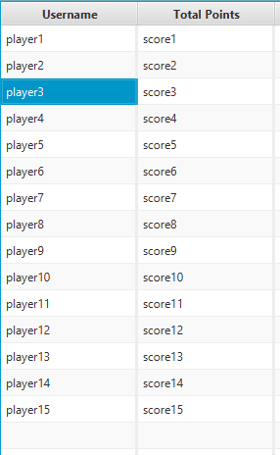
Rankings / User Score
After the simulation is complete the user will be navigated to the Ranking Chart. This will display each individual user scores.
The table is sorted from highest amount of points to the lowest. The winner will be the first name in the list and the loser will be the last name in the list.
From the Ranking window the user can select “View Simulated Bracket” which will display the users bracket so they can view which teams they selected won and which teams lost.

