Slide 1

Text Translation Sequence to sequence
Text2Text: Breaking Language Barriers

Slide 2
Agenda
Dataset
Pre-trained Versus From scratch model
Model Selection
Preparing Model & Tokenization
Model Parameters
Results
Deployment ( API )
Future Enhancement

Slide 3
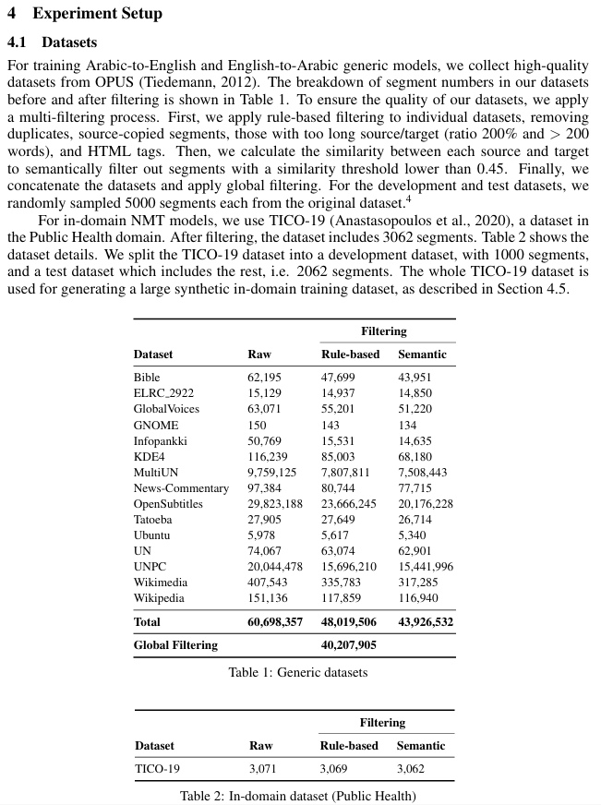

Dataset & Preprocessing
We are using a Global Dataset which is introduced by this paper
cleaned and filtered combination of many publicly available bilingual corpora from the OPUS project, maintained by Jörg Tiedemann from the University of Helsinki.
40 million sentence

Slide 4

Dataset & Preprocessing
The authors started with 60 million sentence pairs and reduced it to 40 million after 3 filtering steps:
🔹 1. Rule-Based Filtering
Duplicate sentence pairs
Sentences where source == target
Sentences with HTML tags
Sentences with very long lengths or length ratio problems source and target lengths differ by >200%, or >200 words)
better-structured, clean data

Slide 5
Dataset & Preprocessing
The authors started with 60 million sentence pairs and reduced it to 40 million after 3 filtering steps:
🔹 2. Semantic Filtering using sentence embeddings:
Kept only pairs where semantic similarity ≥ 0.45
reduces misaligned or incorrect translations

Slide 6

Dataset & Preprocessing
Since Lack of resources on Kaggle we are only using 500k from 40 million

Slide 7


Scratch model vs Pre-trained
But which approach is better to use

Slide 8

Scratch model vs Pre-trained
Best Case for our Condition
Criteria | Train From Scratch | Fine-Tune Pretrained Model
Data Requirement | Very High Maybe more than 10 millions | 100k – 1M is often enough
Compute Power Needed | Very high (multi-GPU clusters, weeks of training) | Low to moderate (1–2 GPUs, a few hours to days)
Performance Quality | Often lower unless massive data and compute available | High, close to or better than state-of-the-art
Training Time | Weeks (depending on model size and resources) | A few hours to a couple of days
Customization | Full control over every layer | Can adjust but not as much as from-scratch models

Slide 9
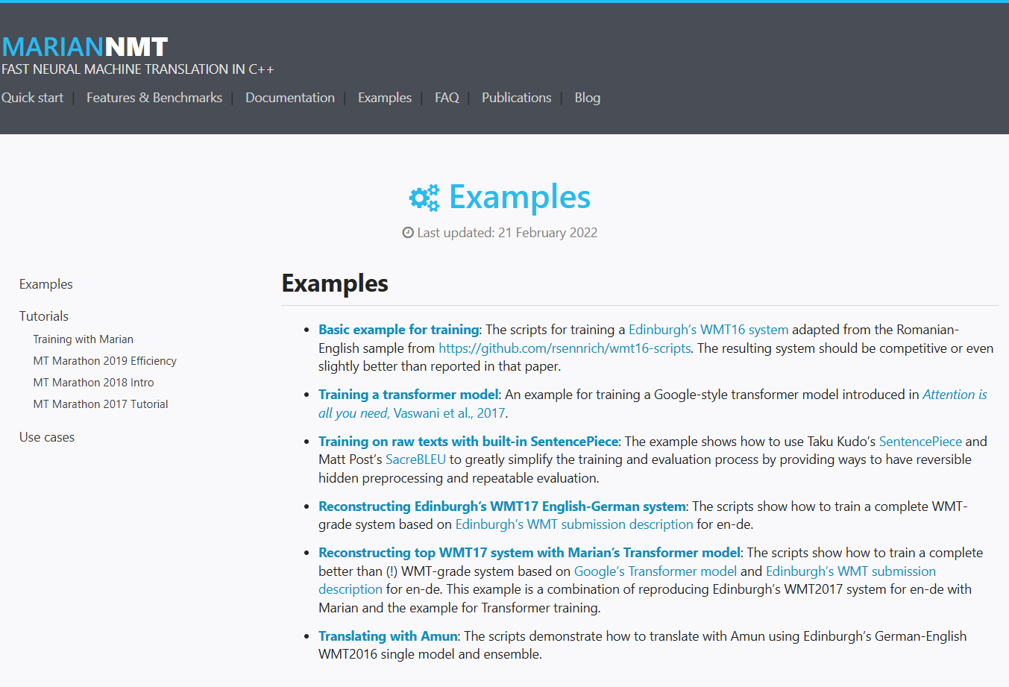
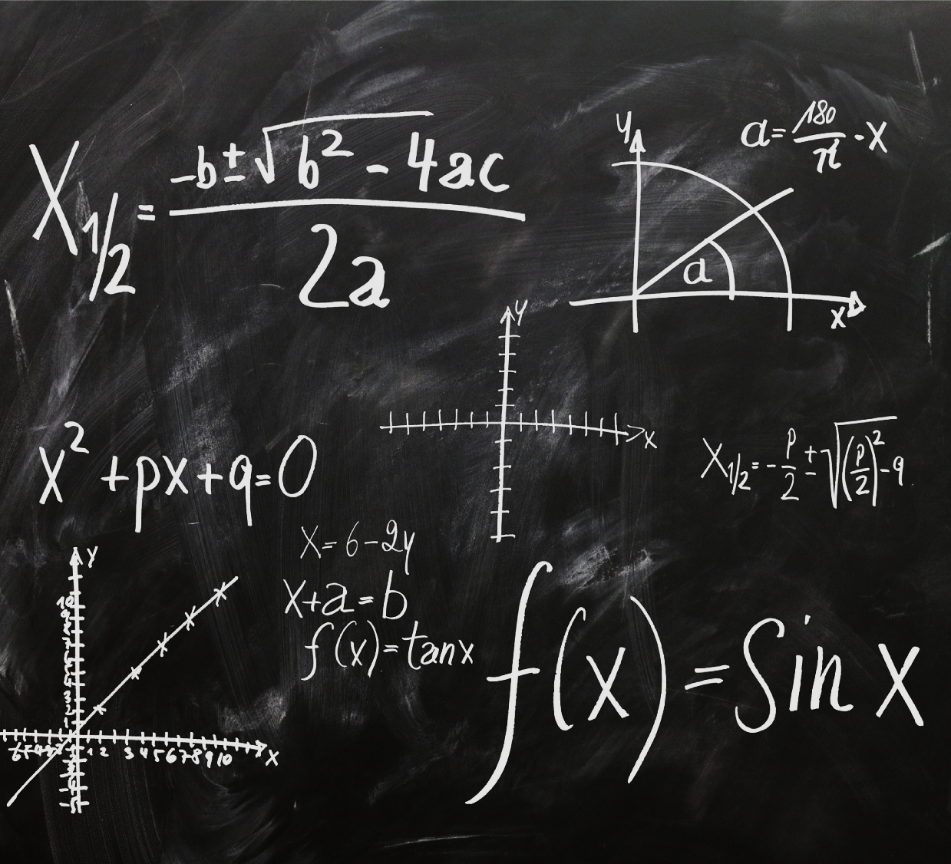
Model selction
Marian NMT Model

Slide 10

Why we use marian-nmt
Marian is implemented in C++, which contributes to fast inference and efficient memory usage.
Runs well on CPUs or low-end GPUs, unlike larger models like mBART or NLLB.
Marian-NMT is purpose-built for machine translation and follows a Transformer architecture (Encoder-Decoder)
Trained on large parallel corpora from the OPUS project, giving good real-world performance.
Comes with high-quality pretrained models for specific pairs like English ↔ Arabic.

Slide 11

Limitation
MarianMT models are trained for one language pair only (e.g., English ↔ Arabic). It can't handle many-to-many translation like mBART or NLLB
No Zero-Shot Capabilities
No Built-in Multilingual Embeddings
Limited by Training Data -> Quality is dependent on the OPUS corpus it was trained on—errors can occur with slang, informal language, or subtitles.

Slide 12

Preparing model’s input & Tokenization
Marian-NMT Model Input’s Expectations
Preprocessing Step | Should You Do It?
Lowercase | ❌ No
Remove punctuation | ❌ No
Add trailing dot | ❌ Not needed
Clean HTML/entities | ✅ Already Done and the data is cleaned and filtered

Slide 13
Preparing model’s input & Tokenization
Prepares Input and Target Sentences: Adds a prefix to the source language text (English) and collects the target language text (Arabic).
Tokenizes Sentences: It tokenizes both the input and target sentences using the tokenizer.
Prepares Inputs for the Model: It structures the tokenized data (inputs, attention mask, and labels) in the format expected by the model for training.

Slide 14


Model’s pARAMETERS
we have added evaluation Steps to Evaluate every 5000 step
L2 regularization on model weights. Helps prevent overfitting.
Use half-precision floating point (16-bit). Speeds up training and reduces memory on GPUs that support it.
Required for translation tasks. Uses model.generate() instead of greedy classification for outputs.
A 99.2% ratio of trainable parameters to total parameters is quite high.

Slide 15


evaluations
BLEU (Bilingual Evaluation Understudy) is a metric to evaluate machine translation quality by comparing a model’s output to one or more reference translations.

Slide 16
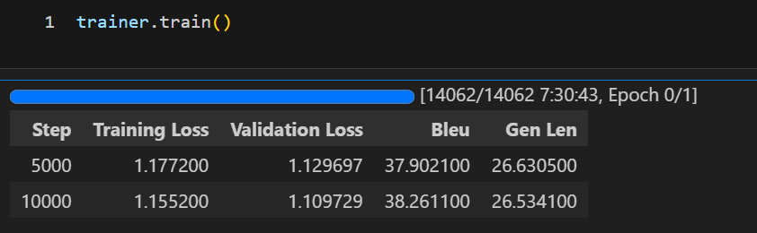

evaluations
Since it was a huge volume of dataset and lack of resources we used only 1 epoch and we got 38 bleu score

Slide 17



Deployment ( API )

Slide 18
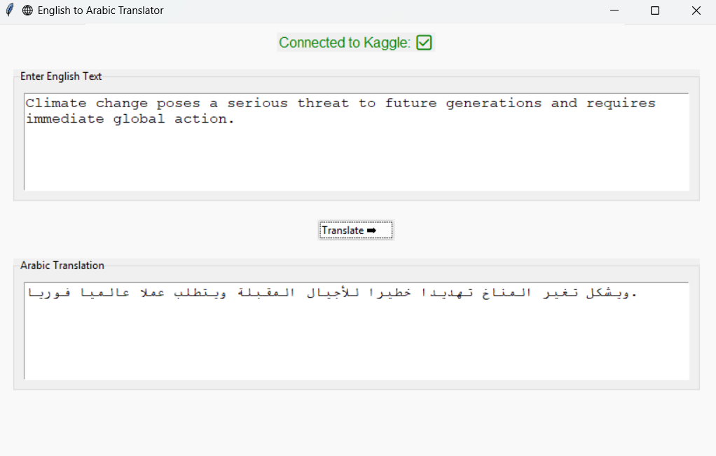
dEMO

Slide 19
🚀 Future Enhancements
Knowledge Distillation: transfer the performance of large, high-accuracy translation models into smaller, faster student models
Integrate edge computing techniques to process translations locally on the device, reducing latency and dependence on cloud servers.
Model Compression for Mobile: Apply model compression techniques

Slide 20

Thanks

