Slide 1
Project 4
West Nile Virus Prediction

Slide 2
Problem Statement
Company
Context
Proposal
City of Chicago and Chicago Department of Public Health
Great Deal of Variation in West Nile Virus in intensity and duration since 2002 in Chicago.
Up to 29%Fatality Rate, depending on Age.
Difficult to Predict and Allocate Resources.
Build a Classification Model:
To Predict Highly Accurately, the Outbreaks of WNV from Mosquitos, based on Environmental and Other Variables.

Slide 3
Exploratory Data
Analysis
Main dataset:
Mosquito trap (date, location, species, number of mosquitos, WNV present)
Weather data:
Weather conditions during the months of test
Spray dataset:
GIS data for spray effort

Slide 4
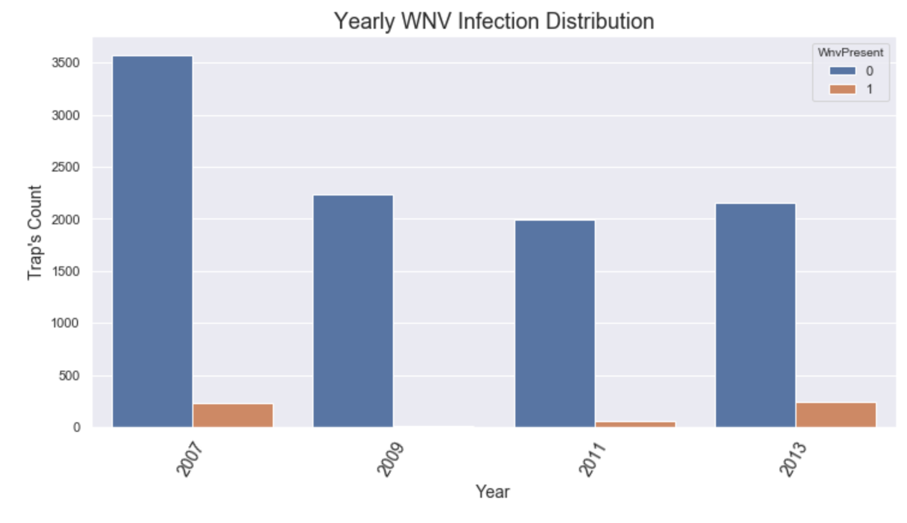
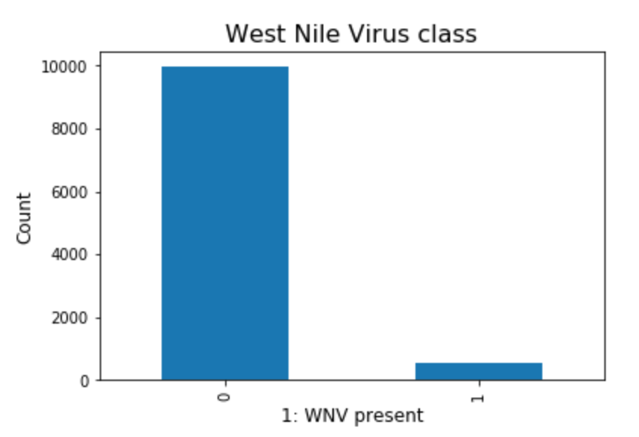
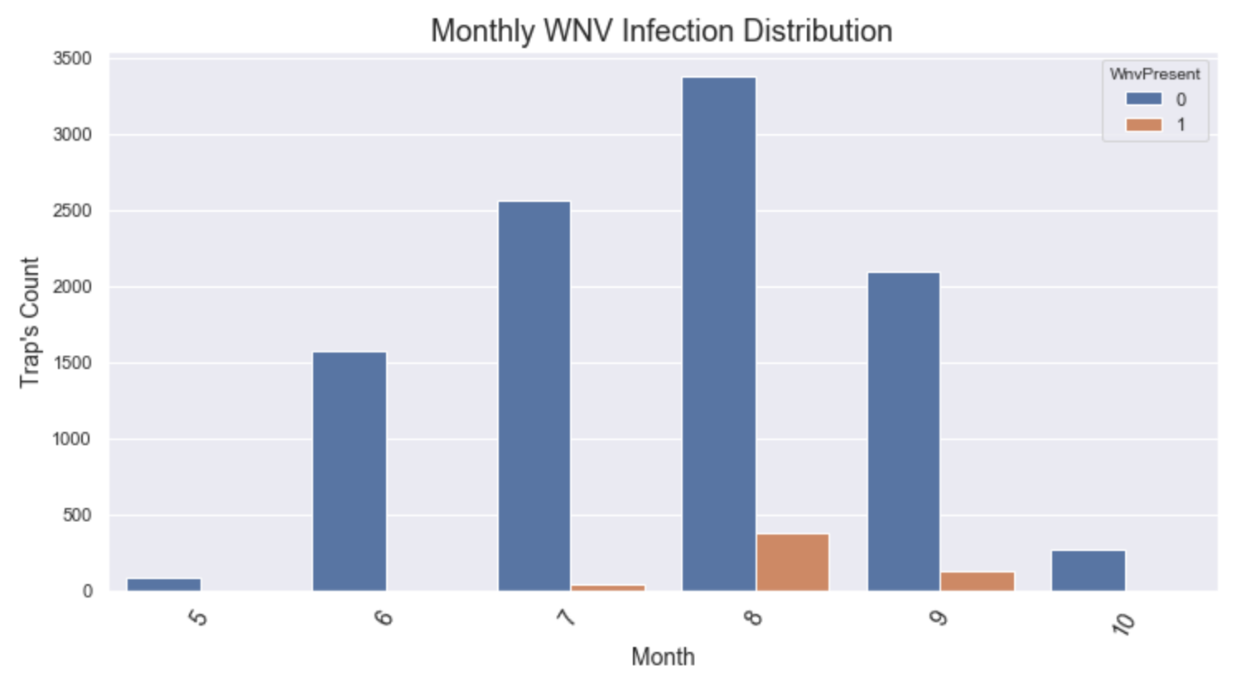
Train data
Wnv Present
Wnv Infection

Slide 5
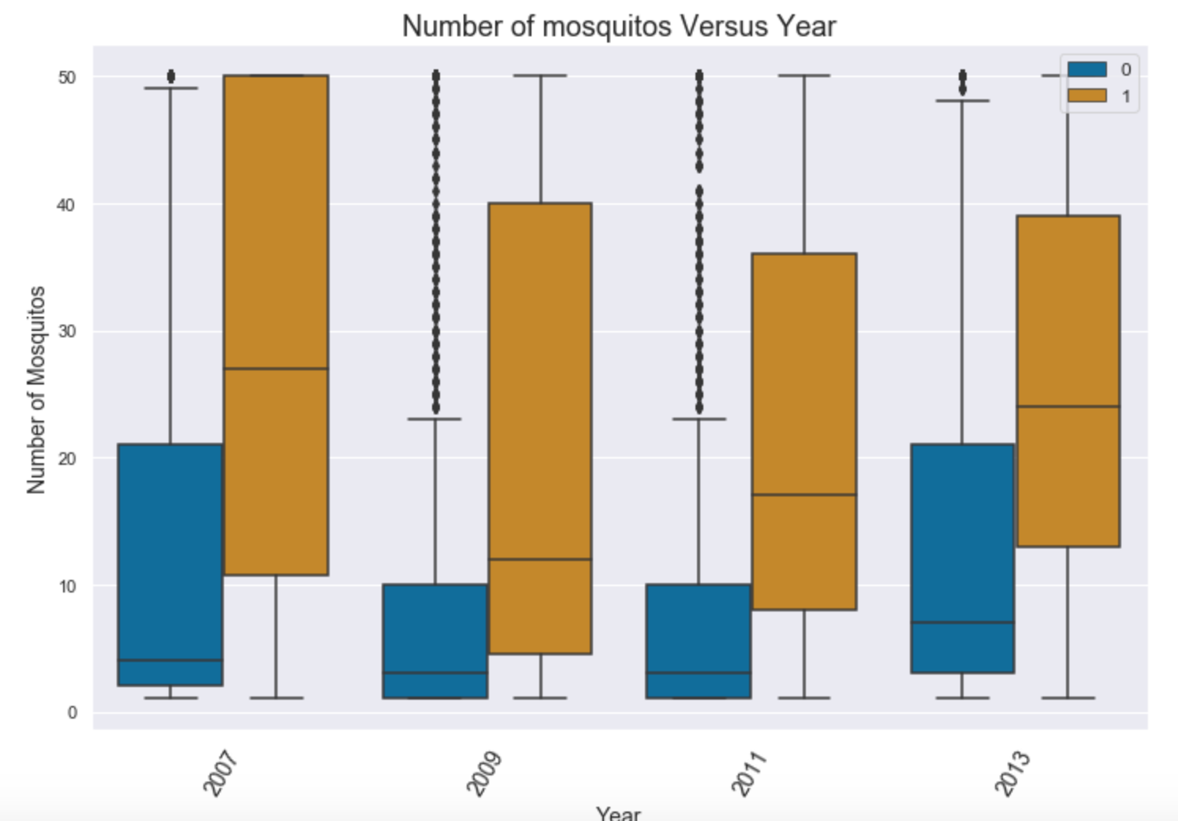
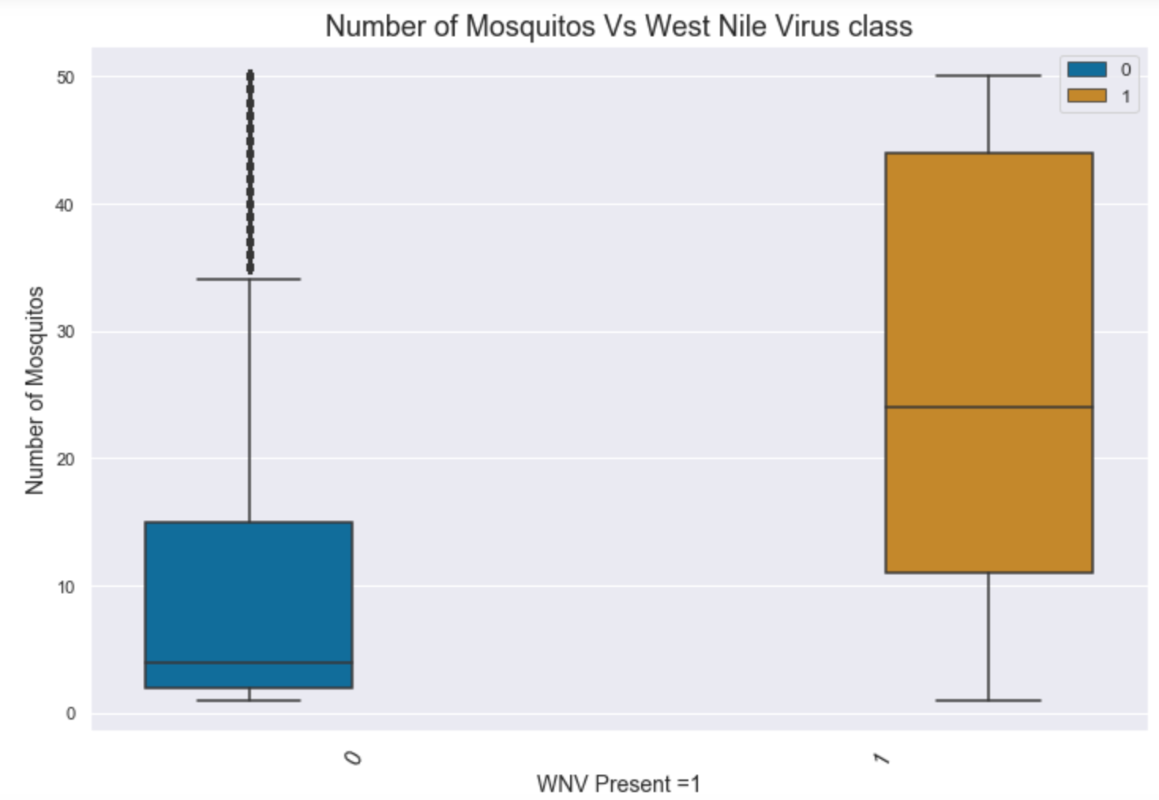
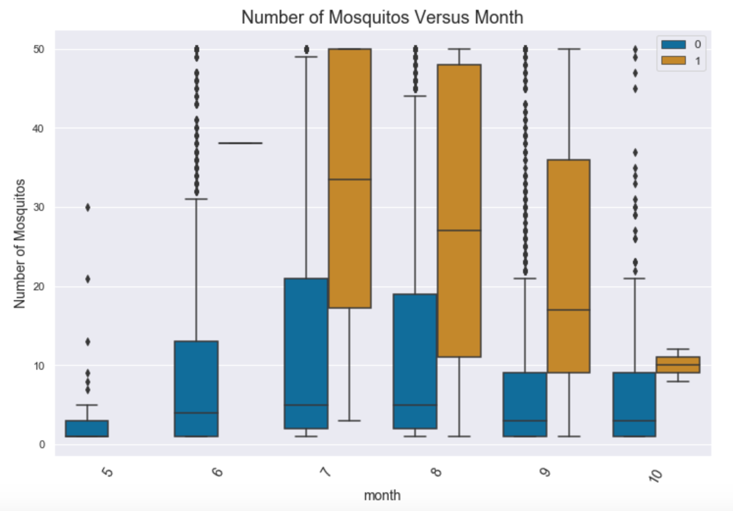
Train data
Number of Mosquitos

Slide 6
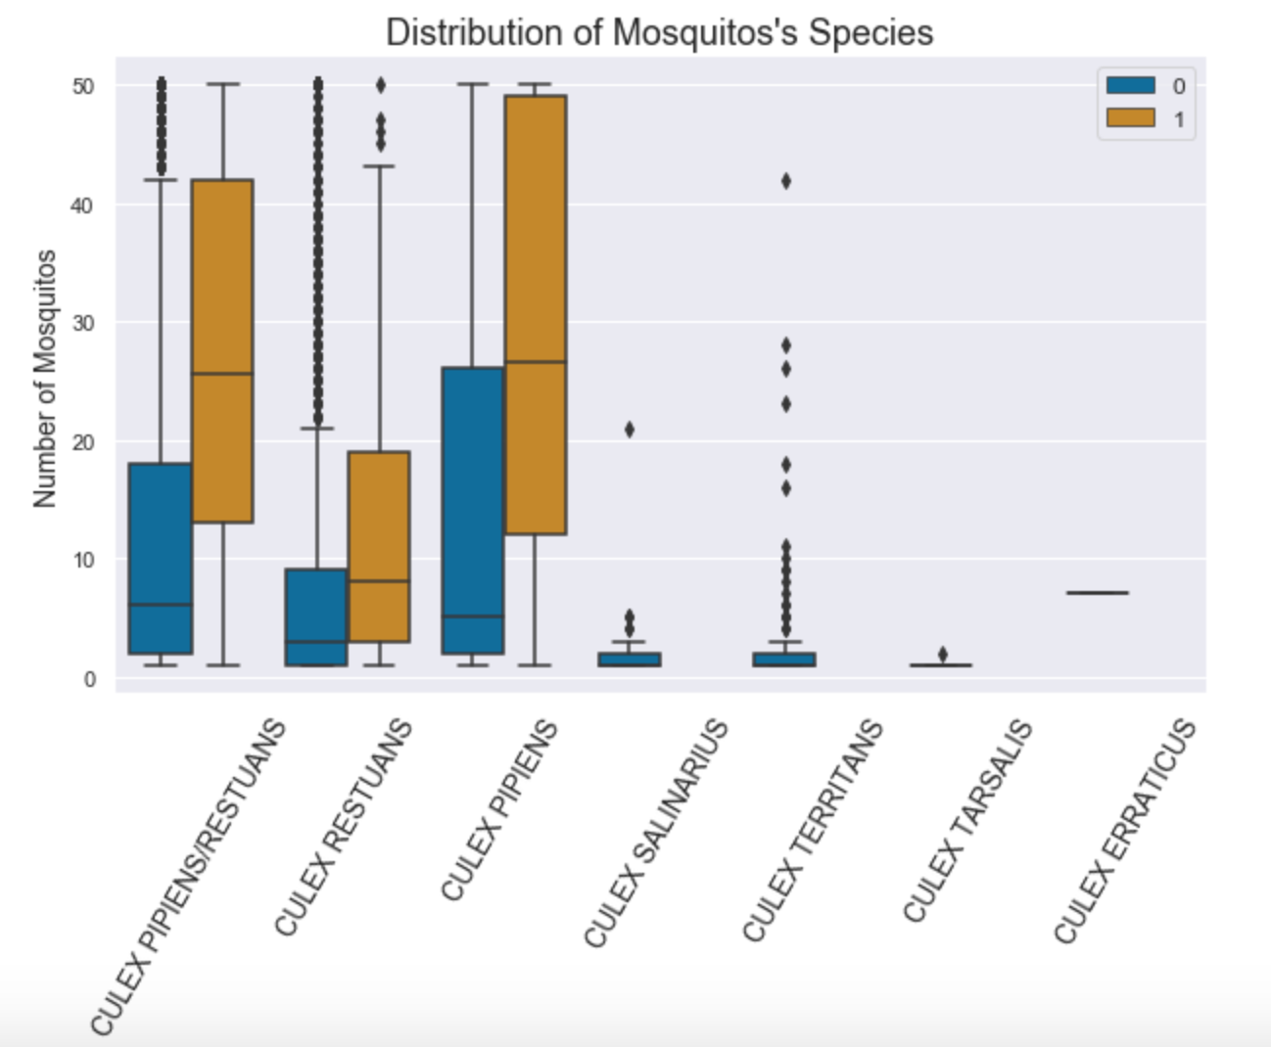
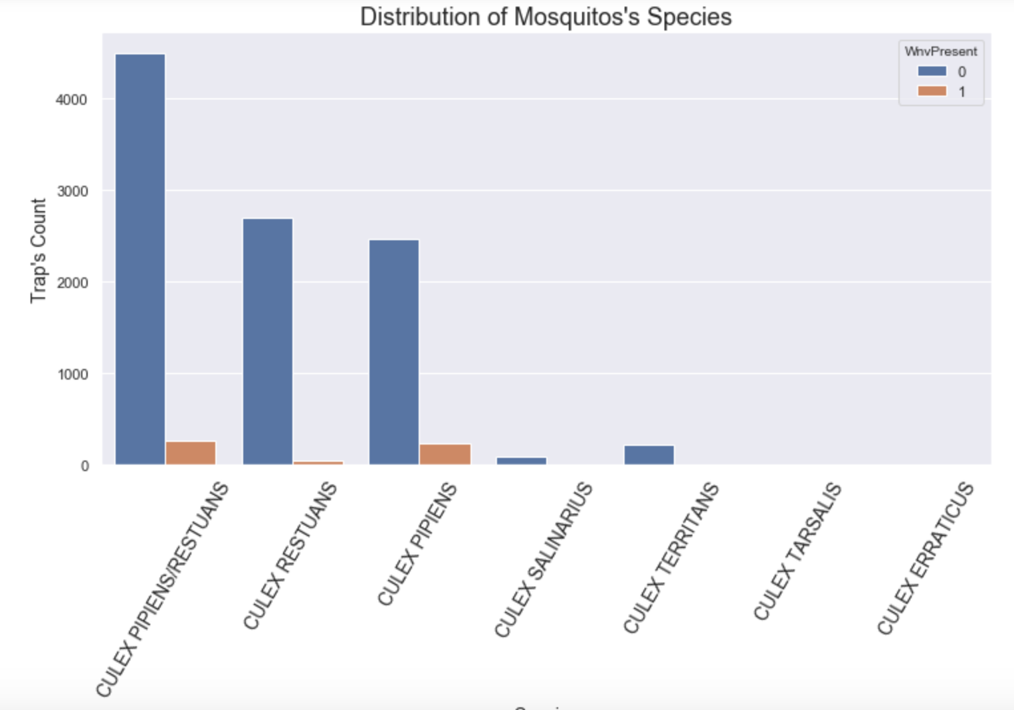
Train data
Species

Slide 7
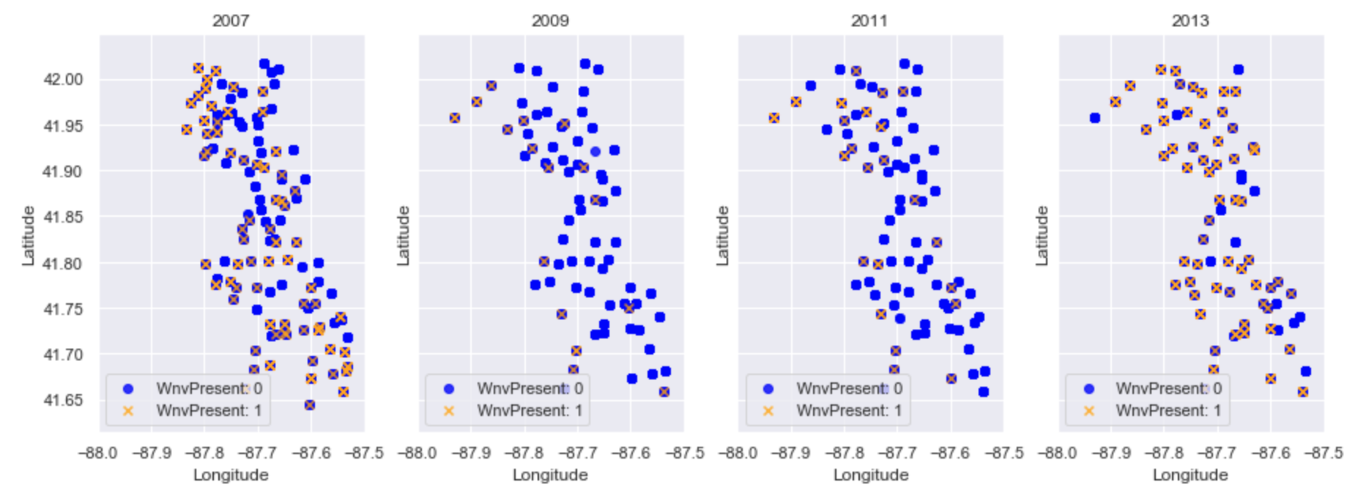
Train data
Location

Slide 8
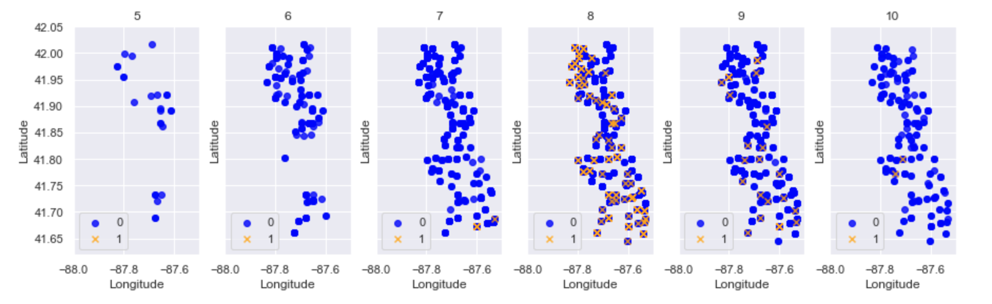
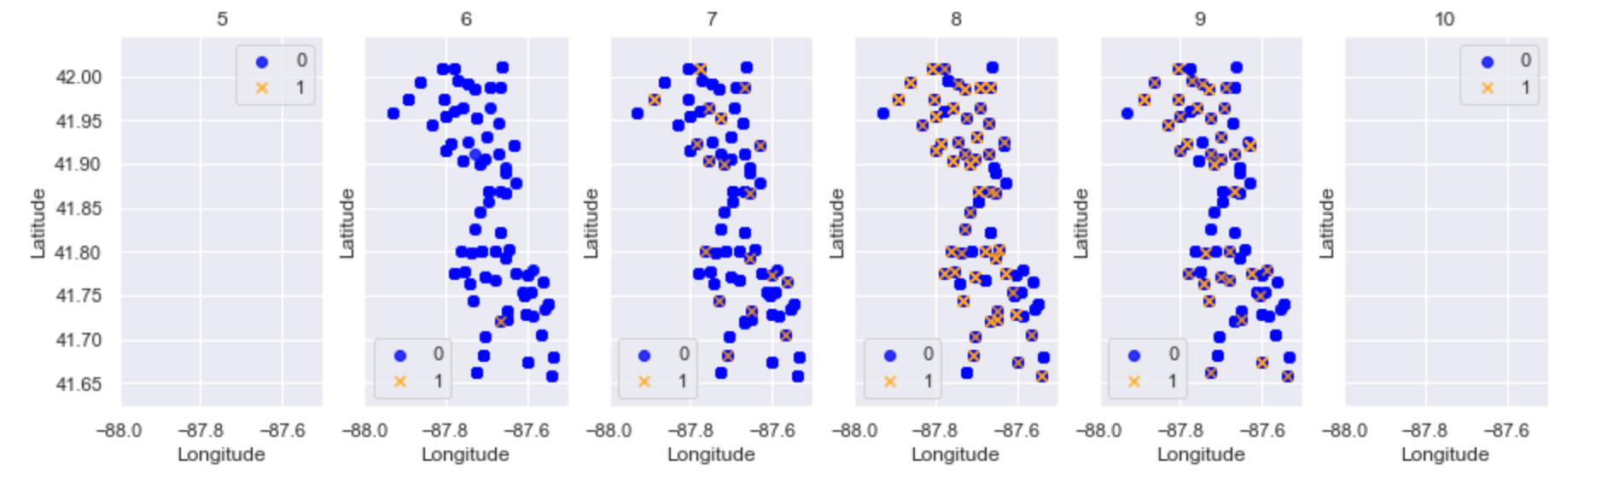
Train data
2007
2013

Slide 9
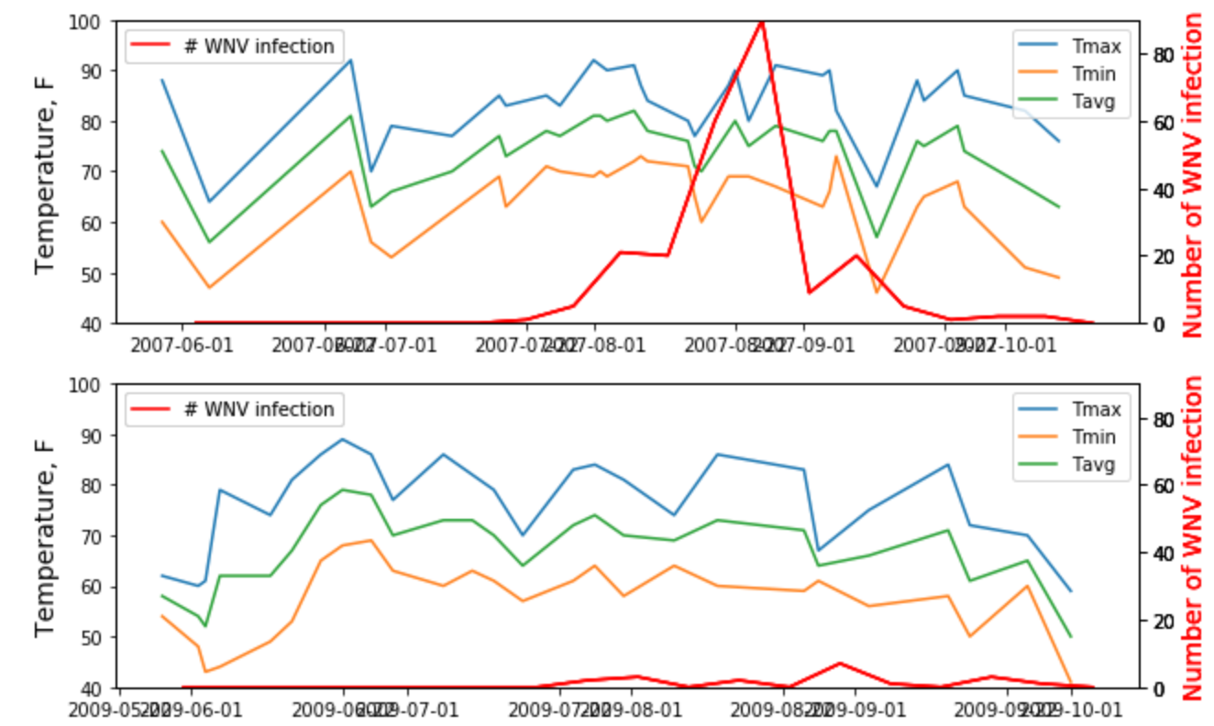
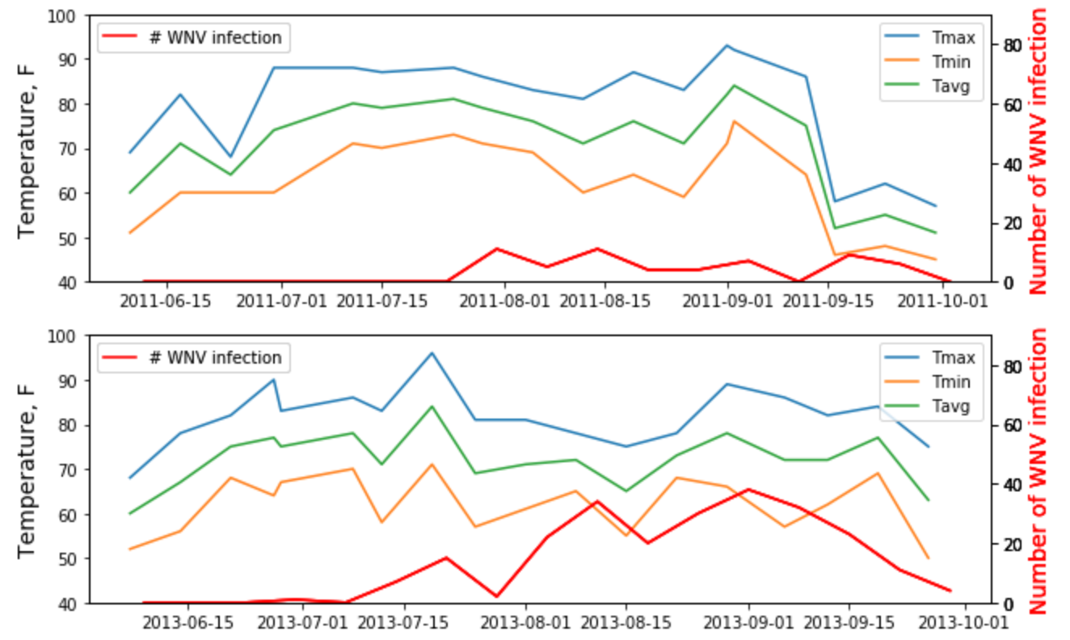
It is believed that hot and dry conditions are more favorable for West Nile virus than cold and wet.
Weather data
Temperature

Slide 10
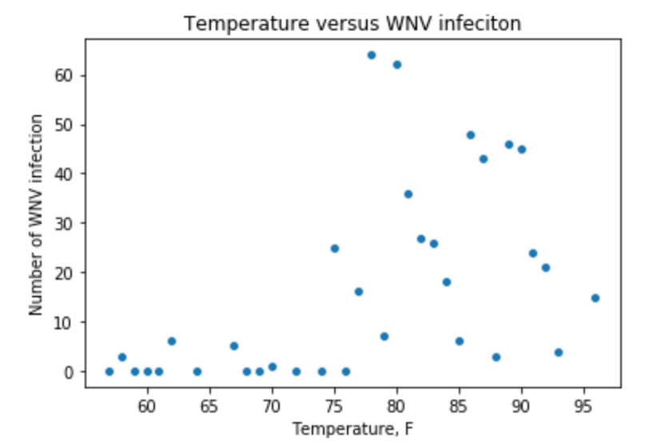
It is believed that hot and dry conditions are more favorable for West Nile virus than cold and wet.
Weather data
Higher Temperature
Higher WNV infection rate
Temperature

Slide 11
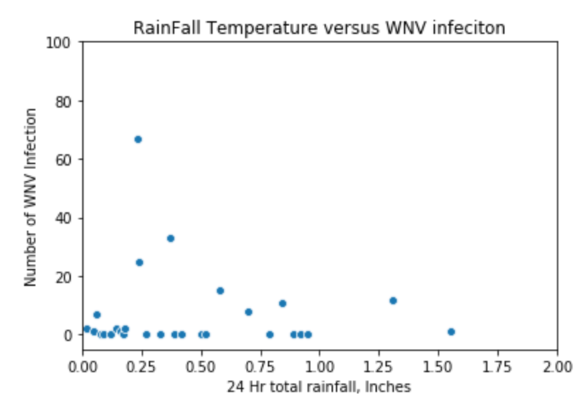
Weather data
Lesser Rainfall
Higher WNV infection rate
Rainfall

Slide 12
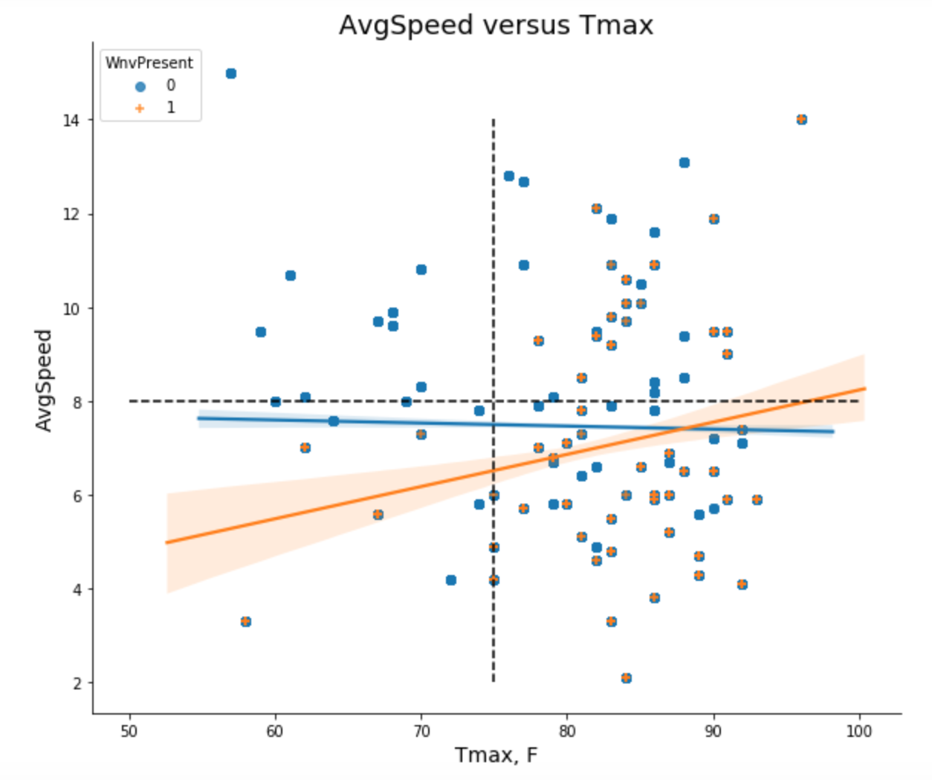
Weather data
Temperature
Wind Speed

Slide 13
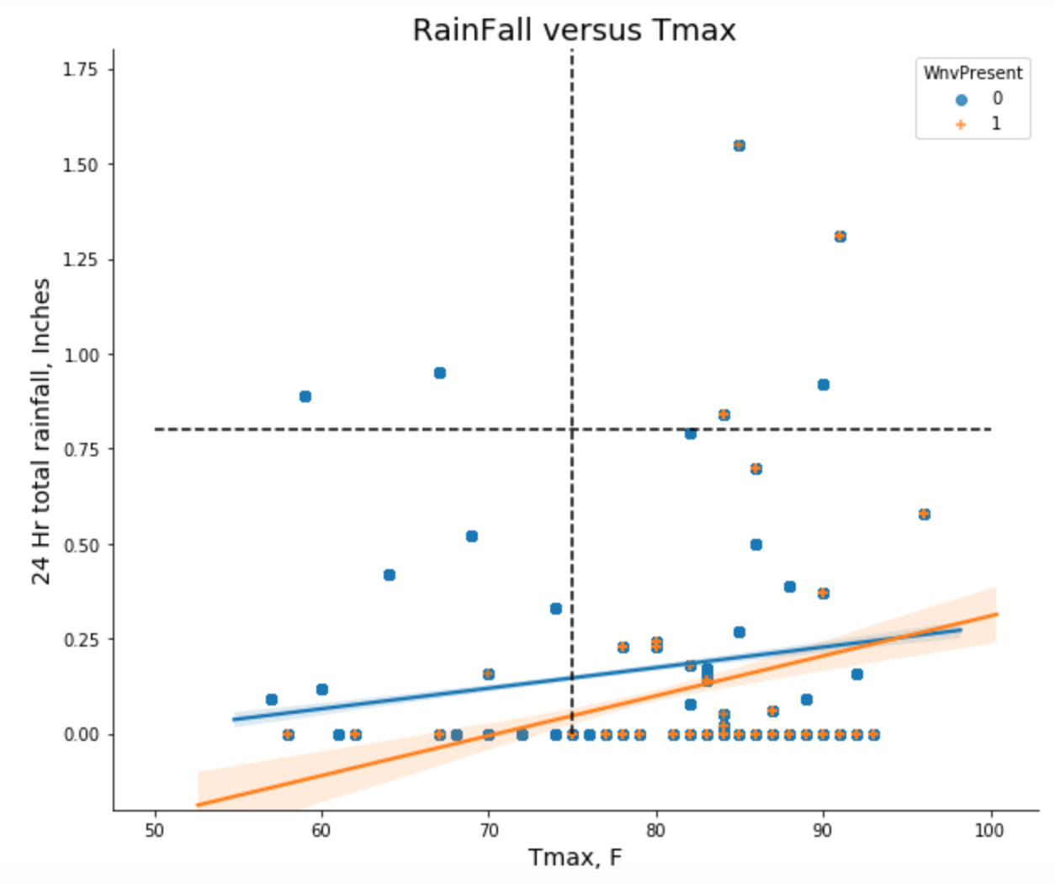
Weather data
Temperature
Rainfall

Slide 14
Predictive Model

Slide 15
Predictive Model
WNV present (1) or NOT present(0)
Model
Classification
Base Model
Main Model
Random Forest
XGBoost

Slide 16
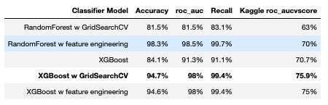
Model Performance

Slide 17
Confusion Matrix
(XGBoost w GridSearchCV)
TP
Correctly predicted as West Nile Virus carrier.
3316
TN
Correctly predicted as non West Nile Virus Carrier
2963
FP
Mispredicted someone as a West Nile Virus carrier.
TYPE I error.
331
FN
Mispredicted someone as a non West Nile Virus carrier.
Type II error.
21

Slide 18
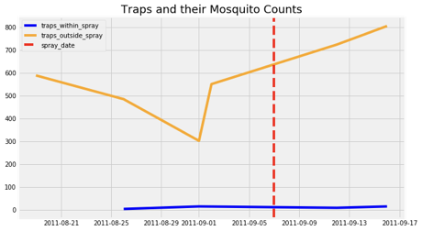
Conclusion – XG Boost Works! Need more Data!

Slide 19
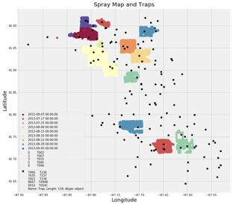
Future – Better Geo-Libraries, ‘Dist from Spray Border’, Time-lag Stationarity Tests!

Slide 20
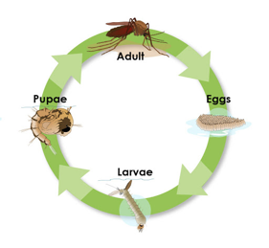
Other Recommendations – 7 Day Cycle

