Slide 1
Chapter 15
CompTIA Tech+
AI

Slide 2
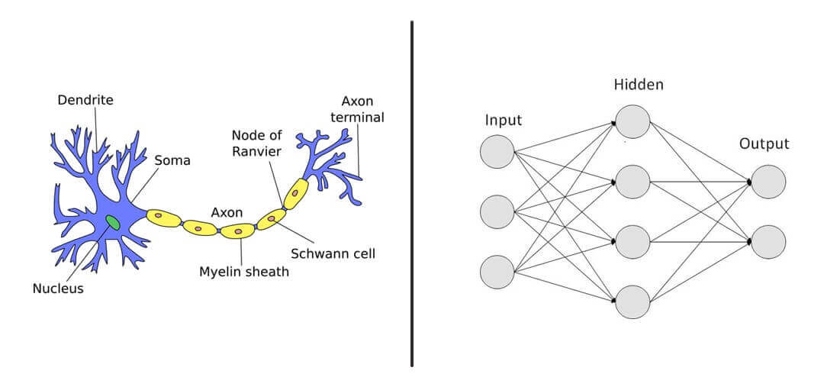
Neural Networks

Slide 3
Artificial Intelligence
We wont see many questions on AI on TECH+
What we will see will entail:
Chatbots
Assistants

Slide 4
AI Chatbots
Designed to mimic human conversations
Can be voice or text
NLP (Natural Language Processing)
Often used for Customer Service
Offer Information or Recommendation

Slide 5
AI Assistants
Also known as Virtual Assistants
More Sophisticated AI
We used them at LCCC for AI Teacher Assistants
These have memory and a purpose
Can be used to integrate into other API’s (Outside information)

Slide 6
Generative AI
This the fastest growing area of AI
Usually trained on LARGE datasets
Text Generation
Image Generation
Music and Audio Generation
Video Generation
https://www.youtube.com/watch?app=desktop&v=Ig1rLSgzmMA

Slide 7
Predictive AI
Data Collection
Data Preparation
Model Training
Model Evaluation
Deployment and Prediction
Great for Sales Forecasting, Product Recommendations
https://www.youtube.com/watch?v=YBJEiWDPyGs

Slide 8
KAHOOT!

