Slide 1
Chapter 5
CompTIA Tech+
Internal System Components

Slide 2
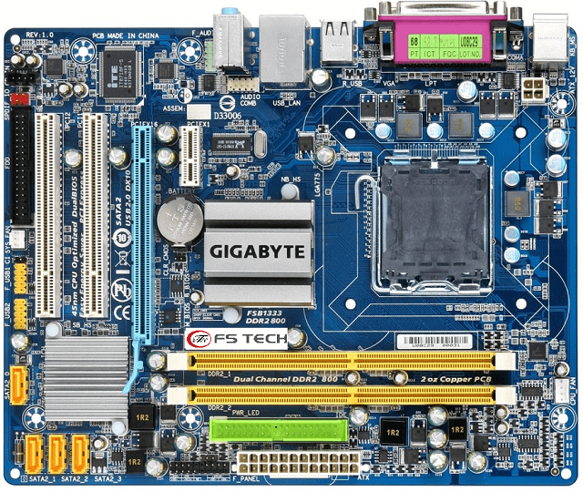
Motherboard or System Board
Central Hub or Backbone of computer
Allows connections to other components
Power Distribution
CPU Socket
Ram Slots
Connectors for Storage
Chipset
Peripheral Connectors

Slide 3
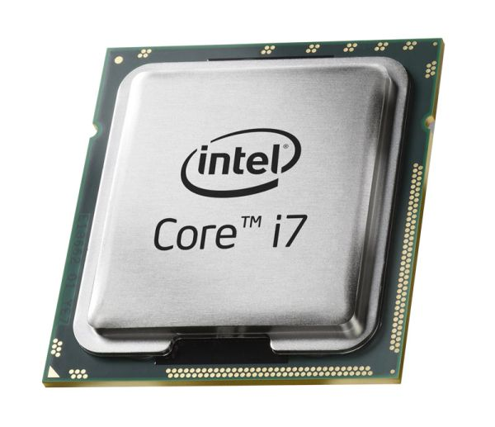
Central Processing Unit (CPU)
Brain of the computer
Fetch Information from RAM
Decode data
Execute Instructions
Writeback
Clock Speed
Cores
Cache

Slide 4
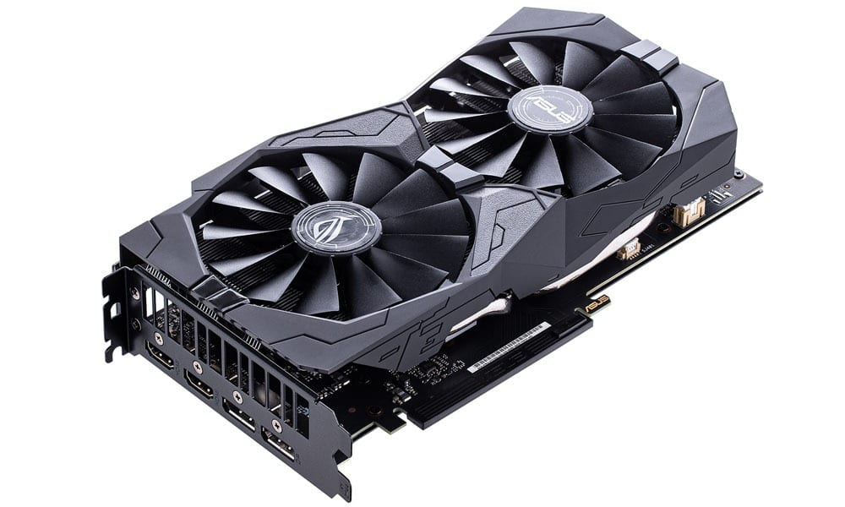
Graphics Processing Unit (GPU)
Specialized for images, videos, and animations to display.
Integrated vs Dedicated
Image Rendering
Parallel Processing
Dedicated vMemory
Lessens load on CPU

Slide 5
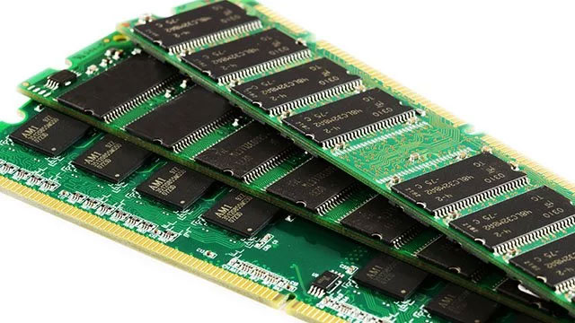
Random Access Memory
Temporary Storage
Volatile Memory
Fast Access Speeds
Random Access
Impact on Performance

Slide 6
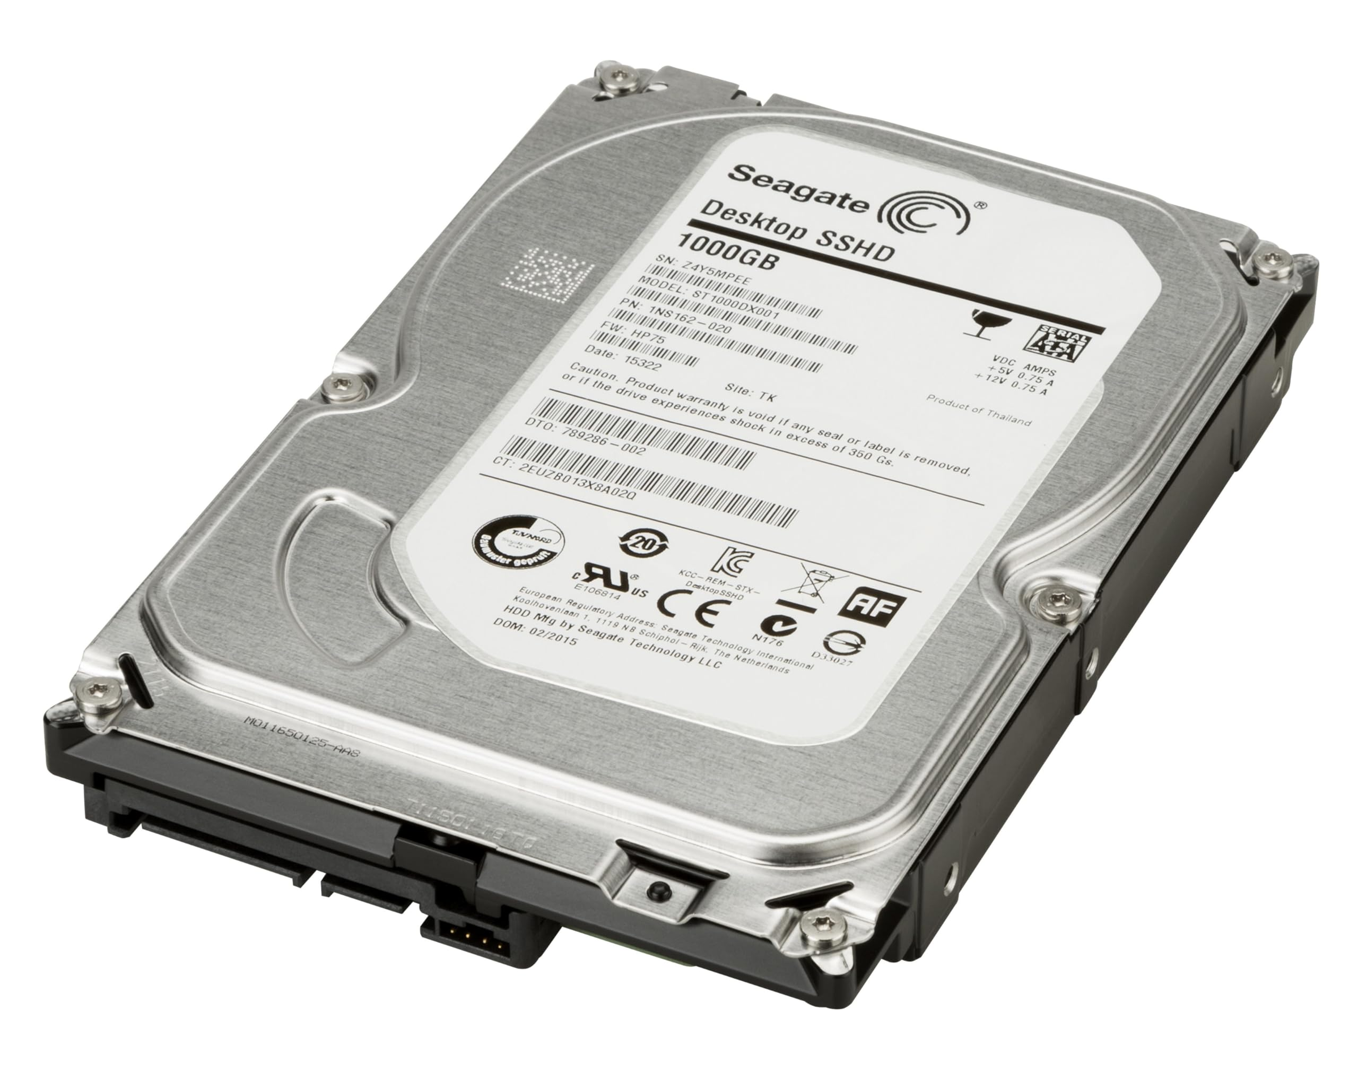
Storage Components
Hard Drives
Long Term Memory
Solid State vs Spindle
Read-Only Memory
Optical Drives
External Flash Drives

Slide 7
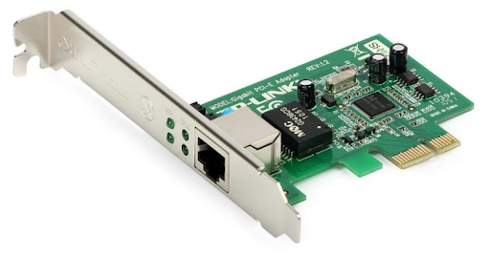
Network Interface Card (NIC)
Connects computer to a network
Wired (RJ45)
Wireless
Can be
  Integrated
  Expansion Card
Needs a MAC (Media Access Control)

Slide 8
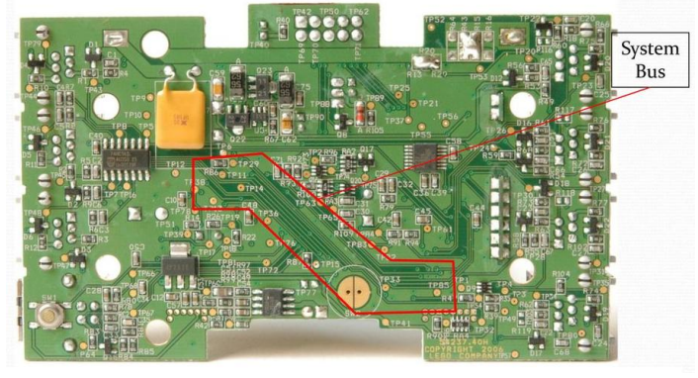
System Bus
Pathways allows data to travel
Data Transfer
Communication Pathways
Data Bus
Address Bus
Control Bus
Bus Speed
Expansion Buses

Slide 9
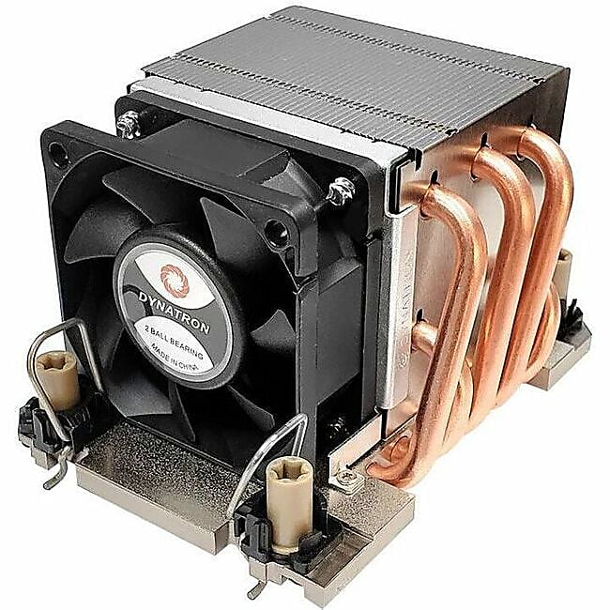
System Cooling
All this processing creates heat
We must find ways to dissipate the heat
Heat Sinks
Fans
Thermal Paste
Liquid Cooling
Airflow

Slide 10
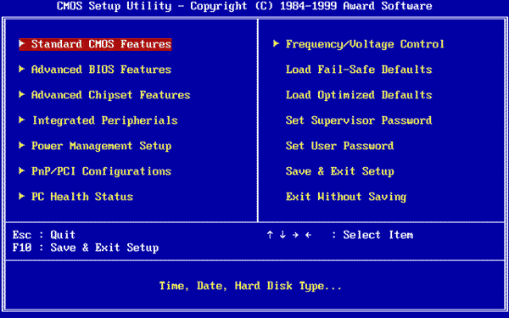
BIOS/UEFI
BIOS (Basic Input Output System)
Post (Power-On Self-Test
Bootstrap Loader
Basic Hardware Initialization
Software we call Firmware
UEFI is faster, newer, and allows security

Slide 11
KAHOOT!

