Slide 1
Chapter 7
CompTIA Tech+
Network Fundamentals

Slide 2
Network Components
Hosts
NICs
Network Devices
Network Media

Slide 3
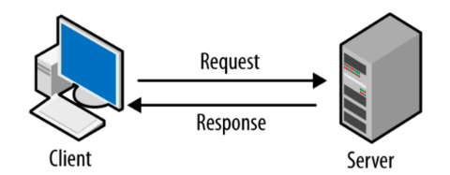
Network Models
Client/Server
Client are devices that request resources from server
Servers are powerful computers that provide resources to a client
Allows Security, and Centralized Mangement

Slide 4
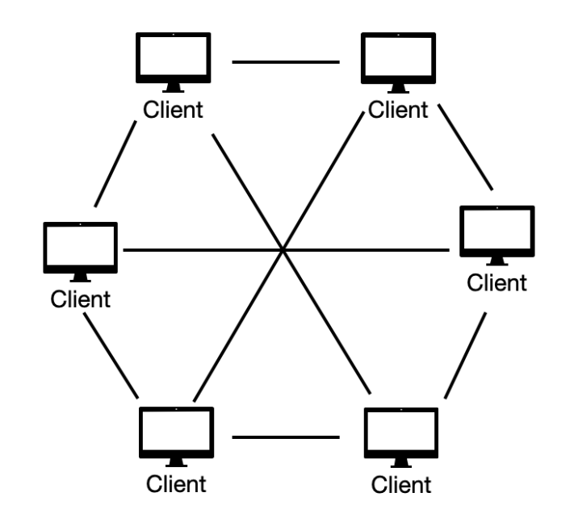
Peer to Peer Model
Any devices can act as the client or server
Allows files to be shared
Easy to Setup
Low Cost
No Single Point of Failure

Slide 5
LAN
Definition: A network that connects computers and devices in a limited area (e.g., home, school, office).
Purpose: Enables sharing of resources like files, printers, and internet access within the same location.
Speed & Performance: High-speed connections (wired or wireless) with low latency and minimal interference.

Slide 6
Key Components (LAN)
Network cables or Wi-Fi access points.
Switches, routers, and sometimes hubs.
Network interface cards (NICs) in computers and devices.

Slide 7
WAN
Definition: A network that connects devices across large distances (cities, countries, or even globally).
Purpose: Connects LANs or other smaller networks, enabling communication over long distances.
Examples: The internet, corporate networks linking branch offices worldwide.

Slide 8
Key Components (WAN)
Routers, leased lines (e.g., MPLS), or internet links.
Network Service Providers (e.g., ISPs or telecoms).

Slide 9
Wired vs Wireless
Advantages:
  Faster speeds (1 Gbps and up).
  More reliable, stable connections.
  Better security (less susceptible to wireless attacks).
Disadvantages:
  Limited mobility – tied to cable connections.
  Installation can be harder or more expensive.
Advantages:
  Easy to connect and move devices.
  Flexible and convenient for users.
  Faster setup (no cables needed).
Disadvantages:
  Lower speeds and more interference.
  Signal range limits and potential security risks.

Slide 10
Protocols
What are Protocols?
Rules or standards that define how data is transmitted and received on a network.
Purpose:
Ensure different devices and systems can communicate effectively.
Manage data formatting, error checking, and delivery.

Slide 11
Common Protocols
HTTP/HTTPS: For web traffic (websites).
FTP/SFTP: For file transfers.
SMTP/IMAP/POP3: For email.
TCP/IP: Foundation of internet communication.
DHCP: Assigns IP addresses to devices automatically.
DNS: Translates names (e.g., google.com) to IP addresses.

Slide 12
Data Packetization
Breaking data into smaller units (packets) for efficient network transmission.
1️⃣ Data is divided into packets.
2️⃣ Each packet has a header (address info) and payload (data).
3️⃣ Packets travel independently to the destination.
4️⃣ Destination reassembles packets in the correct order.

Slide 13
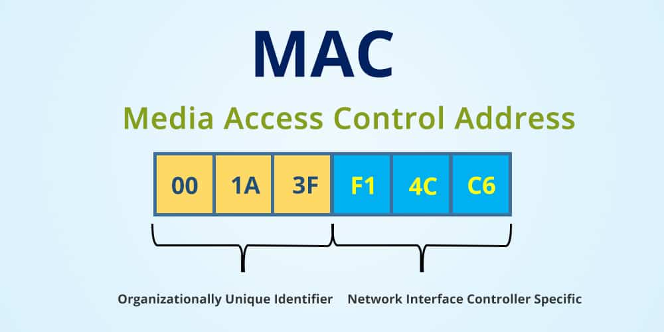
Network Addressing - MAC
What is a MAC Address?
  MAC stands for Media Access Control.
  A unique identifier assigned to network interface cards (NICs).
Format:
  48-bit address (12 hexadecimal digits).
  Example: 00:1A:2B:3C:4D:5E.
Purpose:
  Used for communication within a Local Area Network (LAN).
  Helps devices identify each other on the same network segment.

Slide 14
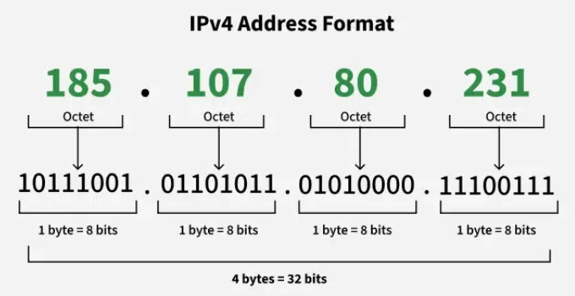
Network Addressing - IP
What is an IP Address?
  Stands for Internet Protocol Address.
  A unique numeric identifier for a device on a network.
Types of IP Addresses:
  IPv4: 32-bit (e.g., 192.168.1.1).
Purpose:
  Identifies devices across networks (both LAN and WAN).
  Routes data packets to the correct destination.
Analogy:
  Like a device’s “mailing address” on the network.

Slide 15
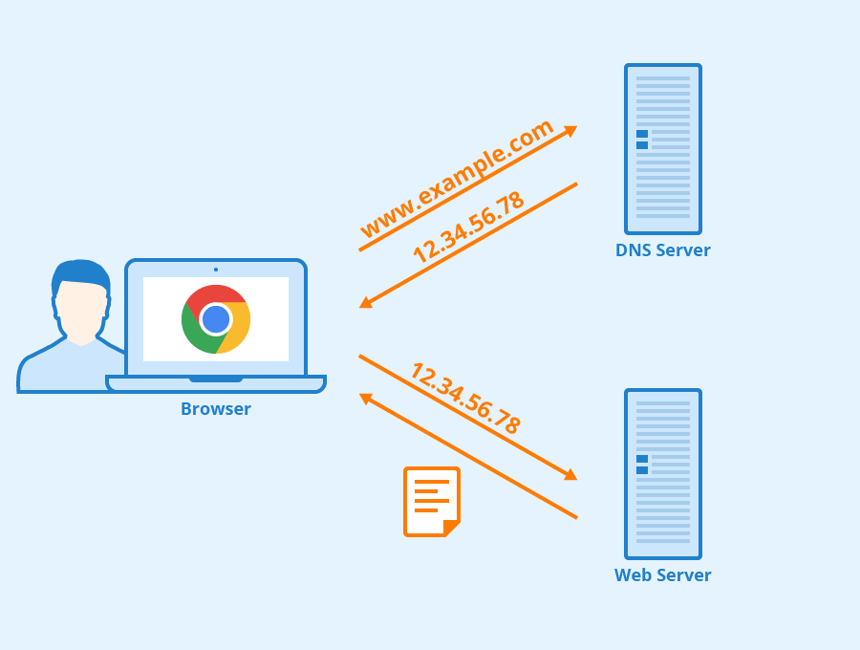
Domain Name System DNS
Translates domain names (like www.example.com) into IP addresses (like 93.184.216.34).
How It Works:
User types a domain name into a browser.
DNS resolver queries DNS servers to find the IP address.
Browser connects to the IP address to load the website.

Slide 16
Accessing Websites
Feature | HTTP | HTTPS
Security | No encryption | Encrypted (TLS/SSL)
Use Cases | Non-sensitive sites | Banking, shopping, logins
Padlock Icon | No padlock in address bar | Padlock icon for secure sites
✅ HTTP (Hypertext Transfer Protocol):
  Used for transferring data between web browsers and servers.
  Data is not encrypted—vulnerable to eavesdropping or tampering.
  Example URL: http://example.com.
✅ HTTPS (Hypertext Transfer Protocol Secure):
  Adds encryption (TLS/SSL) to HTTP for secure data transfer.
  Protects user data (like logins, credit cards).
  Example URL: https://example.com.

Slide 17

Accessing Email
Webmail vs. Email Clients:
Webmail: Accessed through a browser (e.g., Gmail, Outlook.com).
Email Clients: Standalone applications (e.g., Microsoft Outlook, Thunderbird).
Common Email Protocols:
  SMTP (Simple Mail Transfer Protocol): Sends emails from client to server and between servers.
  IMAP (Internet Message Access Protocol): Accesses email messages on a server; keeps messages in sync across devices.
  POP3 (Post Office Protocol 3): Downloads messages to one device and usually deletes them from the server.

Slide 18
KAHOOT!

