Slide 1
Chapter 9
CompTIA Tech+
Operating Systems

Slide 2
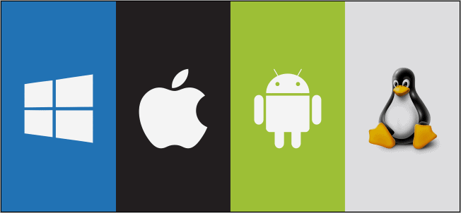
Function of an OS
Central Coordinator
Manages Hardware and Software
Without OS bunch of plastic and metal
Tech+ would like you to know Key components of the OS

Slide 3
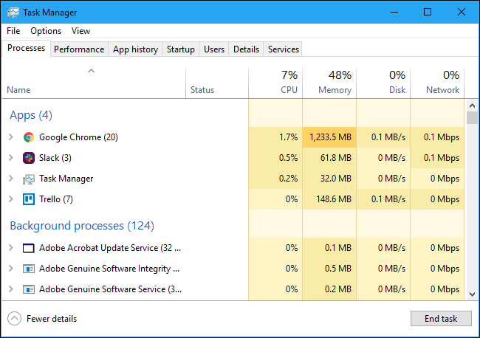
Resource Management
Task and Process Management
Memory Management
Disk Management

Slide 4
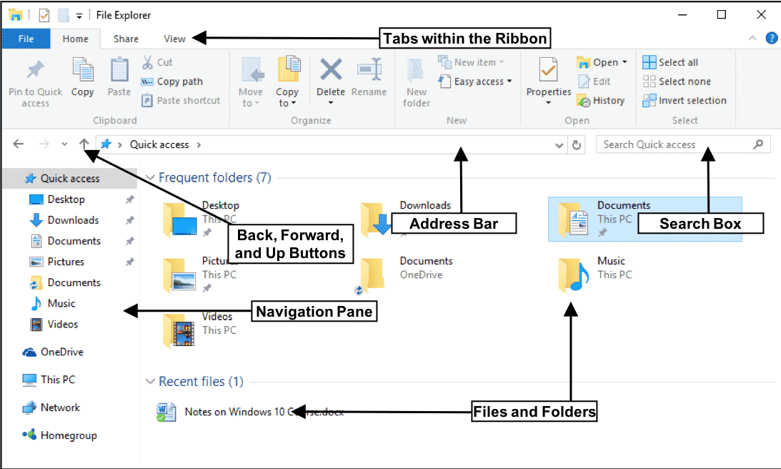
File System Management
Create Files
Delete Files
Organize Files
Read Files
Write Files

Slide 5
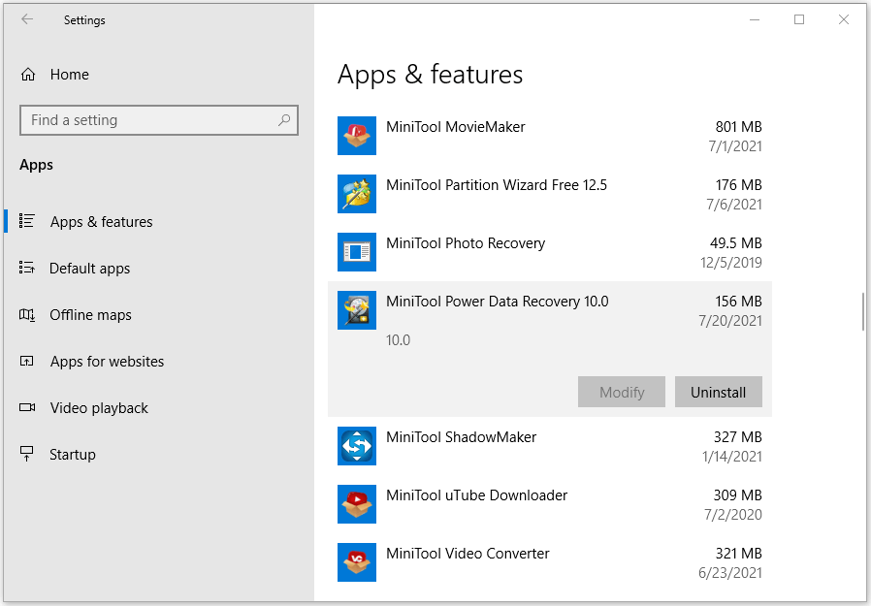
Application Management
Installing Software
Updating Software
Uninstalling Software

Slide 6
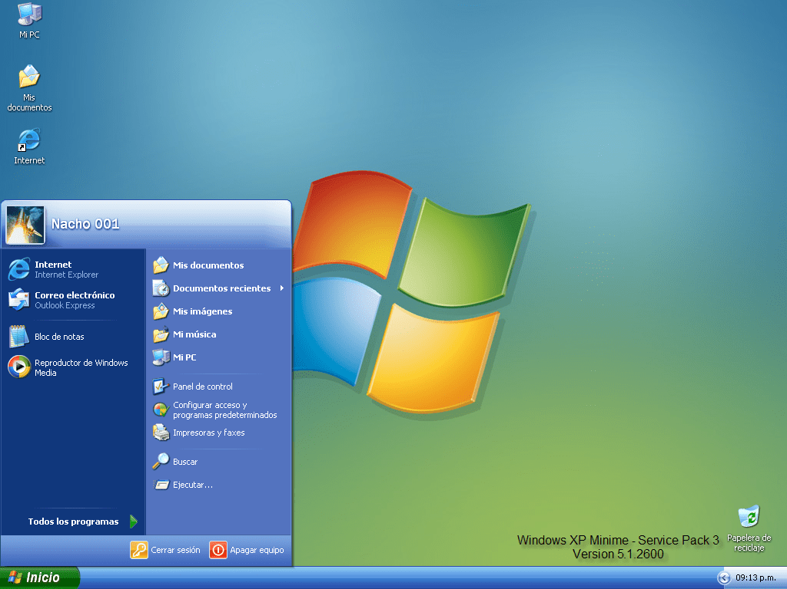
User Interface - GUI
ICONS
Windows
Menu
Mouse

Slide 7
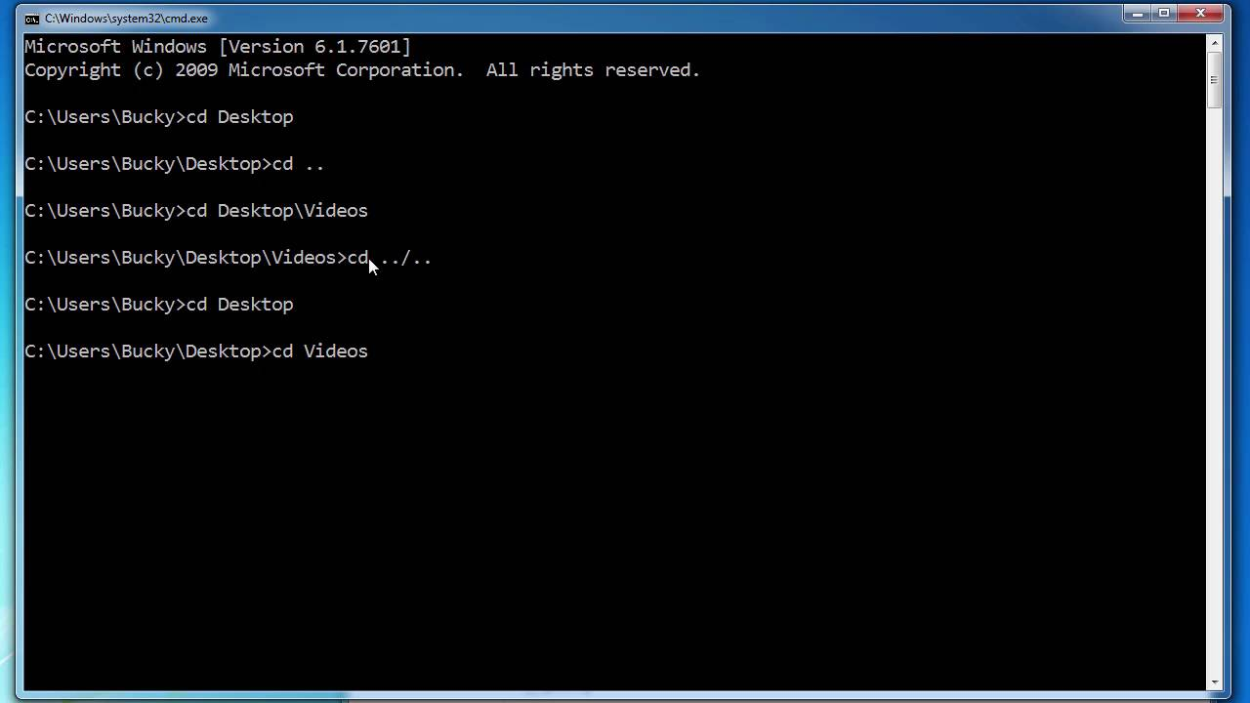
User Interface - CLI
Text Based
Commands
NOT GUI

Slide 8
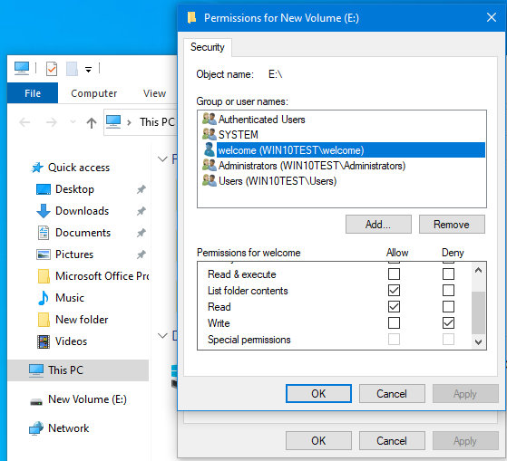
Security and Access Control
User Accounts
Authenticating Users
Enforce Permissions

Slide 9
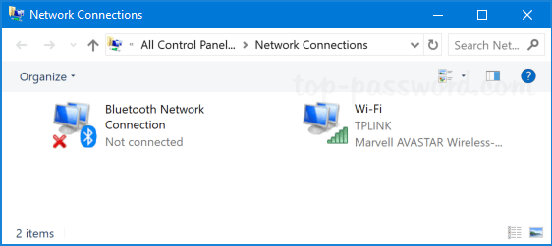
Networking
Connections
Protocols
Network Services

Slide 10
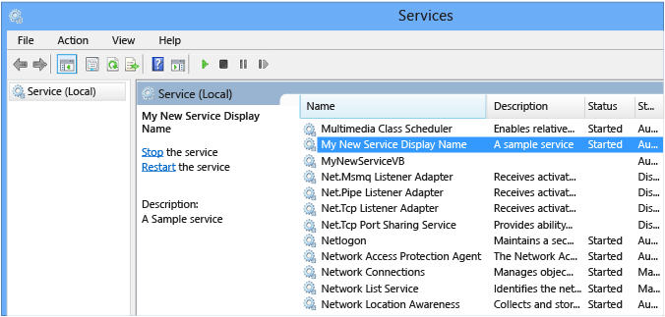
Services Management
Background Services
Programs that perform without USER
Automatic Updates
Network Services
System Monitoring

Slide 11
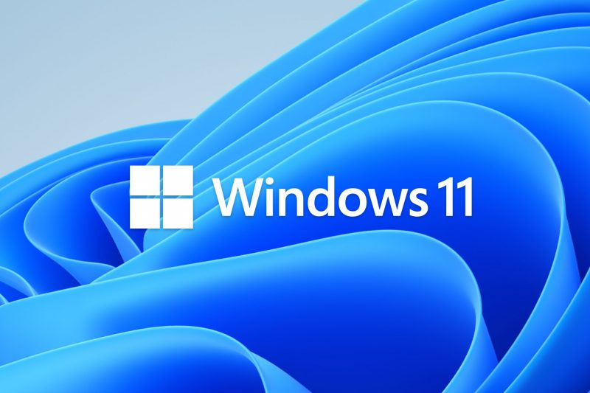
OS Types - Desktop
Personal Computers (desktops and laptops)
GUI ease of use
Support general-purpose
Robust file management

Slide 12
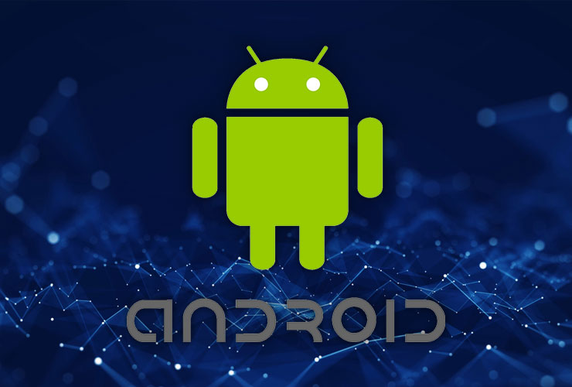
OS Types – Mobile Devices
Touchscreens
Power Efficiency
App Based
Cellular, Wi-Fi, Bluetooth
GPS, Cameras, sensors

Slide 13

OS Types - Serer
Stability
Security
Multiple Client Requests
Advanced Features
Minimal GUI

Slide 14
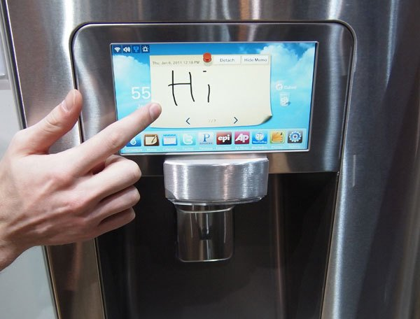
OS Types - Embedded
Limited Resources
Limited Memory
Limited Processing
Highly dedicated
Reliable

Slide 15
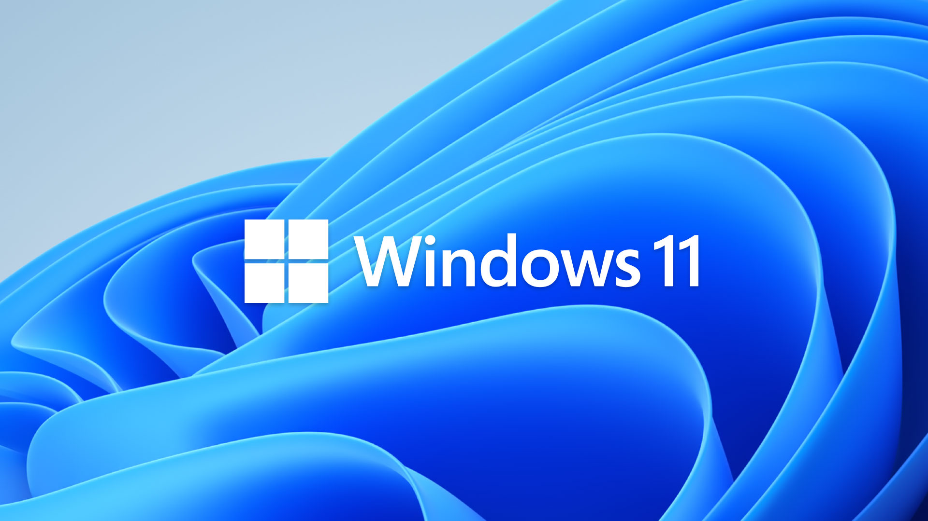
Windows
Wide Hardware Compatibility
Large Software Ecosystems
Different Versions and Editions
User-Friendliness
Integrated Features

Slide 16
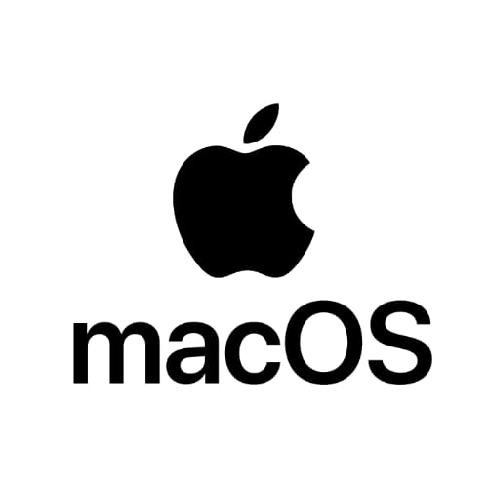
Apple macOS
Exclusive to Apple Hardware
Unix-based Foundation
Ease of Use
Strong Multimedia Capabilities
Ecosystem Integration (iCloud)
Security Focused

Slide 17
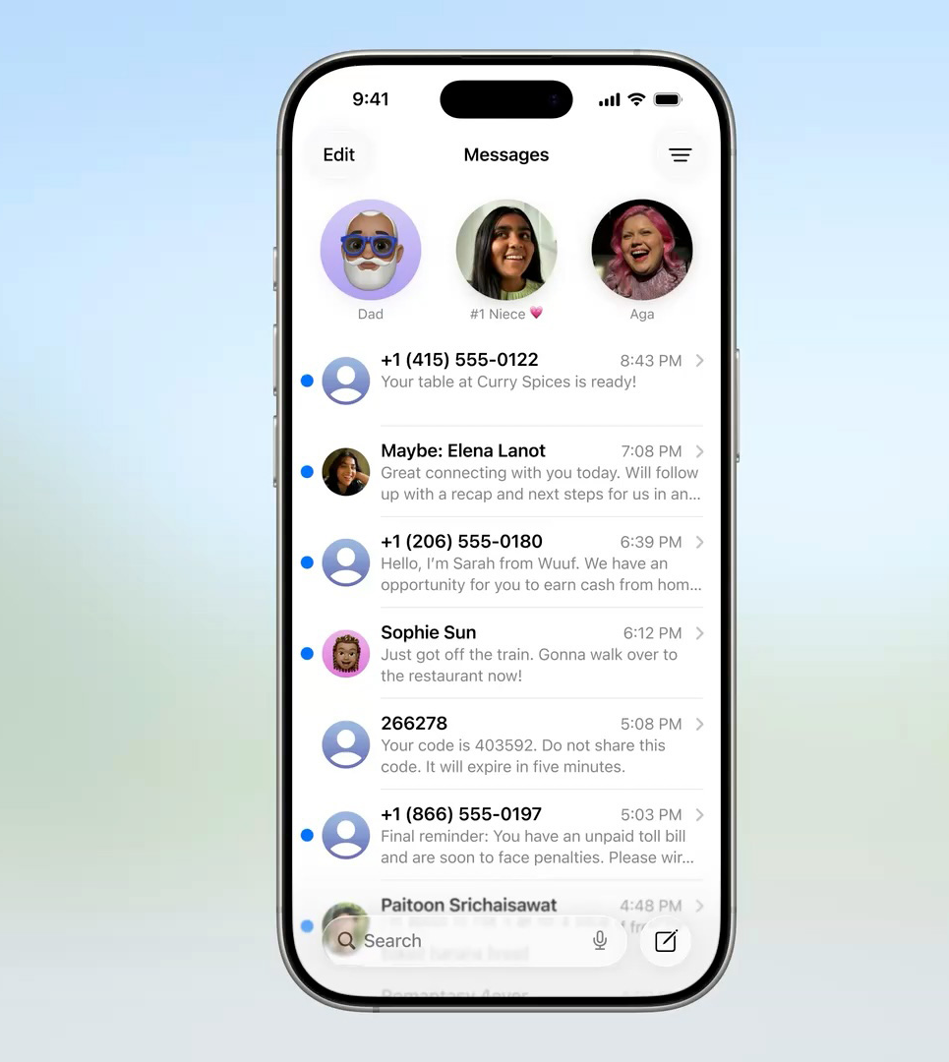
iOS
Touch-Centric Interface
Apple Hardware
App-Based Ecosystem
Ease of Use
Strong Security and Privacy
Regular Updates

Slide 18

Linux
Open Source and Free
Highly Customizable
Versatile
Variety of GUIs
Stability and Reliability
Security
Broad Hardware Support

Slide 19

ChromeOS
Web-Centric
Cloud-Based
Chrome Browser as UI
Fast BOOT
Simple
Automatic Updates
Security Focus

Slide 20
Android
Open Source
Touch-Based Interface
Wide Hardware Variety
App Ecosystem
Customization
Integration with Google

Slide 21
KAHOOT!

