Slide 1
Chapter 10
CompTIA Tech+
Administering Operating Systems

Slide 2
Management Interfaces - GUI
Windows
Control Pannel
Settings App
Task Manager
Disk Management
Device Manager
macOS
System Settings
Activity Monitor
Disk Utility
Linux
Settings Panels
Disk Utilities
Package Managers

Slide 3
Why we like the GUI
Intuitive
Easier to learn
Visual feedback makes it easy to understand

Slide 4
What don’t we like?
Less efficient
Consumes MORE resources
Not always available on server OS

Slide 5
Management Interfaces - CLI
Windows
Command Prompt
PowerShell
macOS
Terminal
Linux
Terminal

Slide 6
Why we like the CLI
Powerful and Flexible
Efficient for Experienced Users
Scripting and Automation
Remote Management
Lower Resource Usage

Slide 7
What don’t we like?
Steeper Learning Curve
Less intuitive for beginners

Slide 8

What is a Process?
Instance of a computer program that is currently running

Slide 9
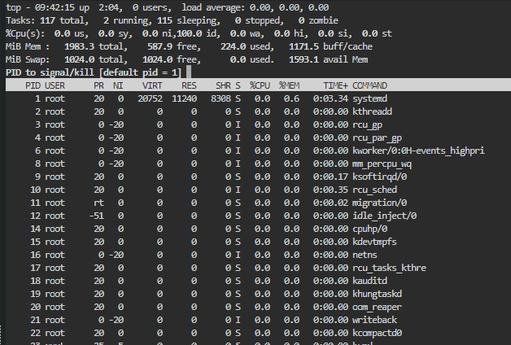
OS manages Processes
Creating and Deleting Processes
Scheduling
Resource Allocation
Synchronization and Communication

Slide 10

What is a service?
type of program that runs in the background, often without a direct user interface

Slide 11
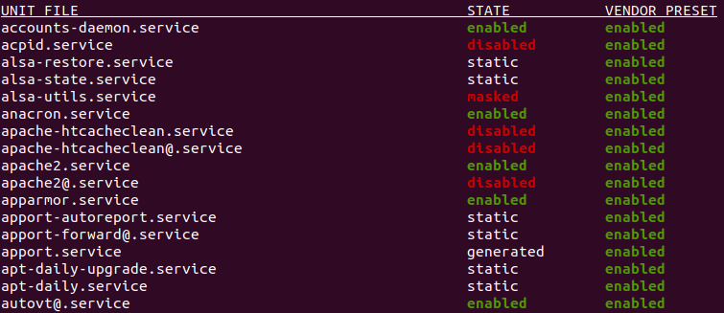
Example of Services
Networking services
Print Spooler
Automatic Updates
Web Servers
Databases

Slide 12
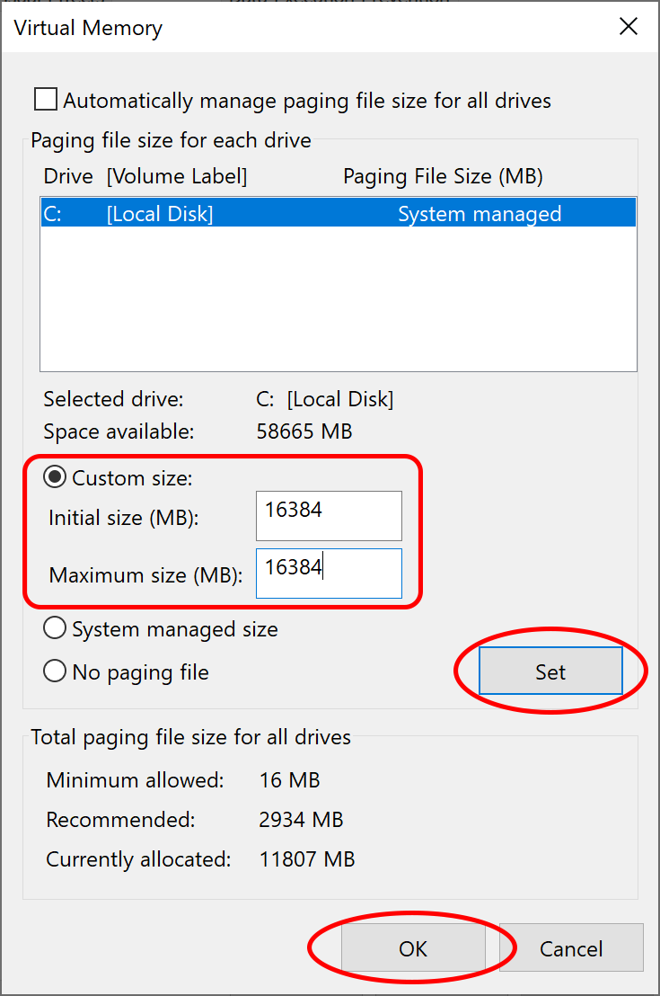
Memory Management
Allocating Memory
Deallocating Memory
Keeping Track of Memory
Virtual Memory
Protecting Memory

Slide 13
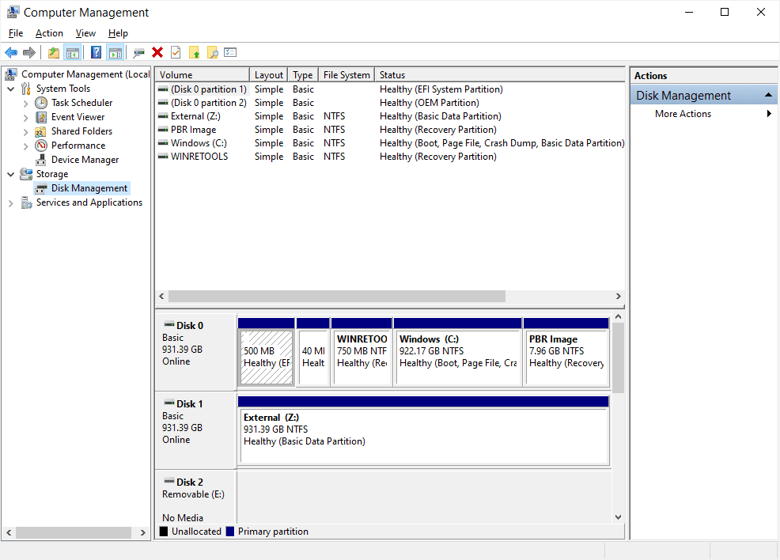
Disk Management
Initializing Disks
Partitioning
Formatting
Assigning Drive Letters
Checking Disk Health

Slide 14
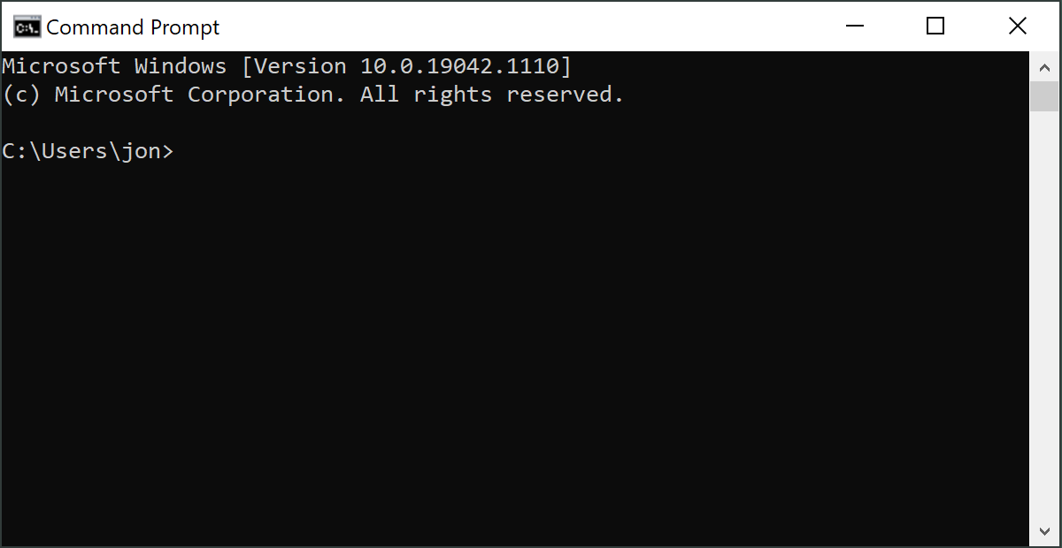
CMD.exe
Windows CLI
Running Basic System Commands
Executing batch files
Use is less powerful than its buddy PowerShell

Slide 15
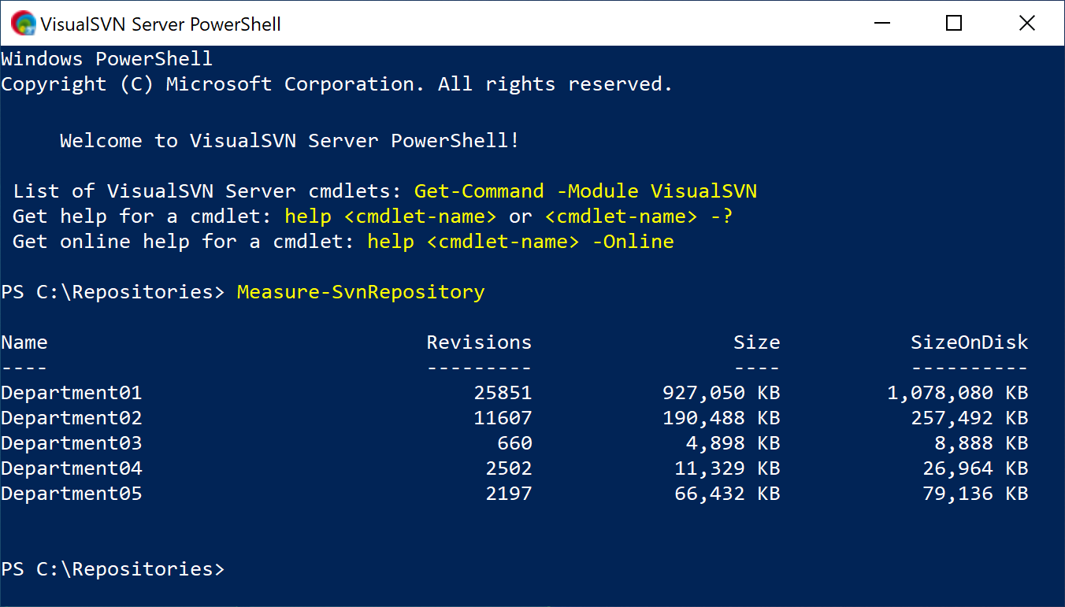
PowerShell
Windows TOOL by default
Can be installed on Linux
Object-Based
Cmdlets
Scripting Language

Slide 16
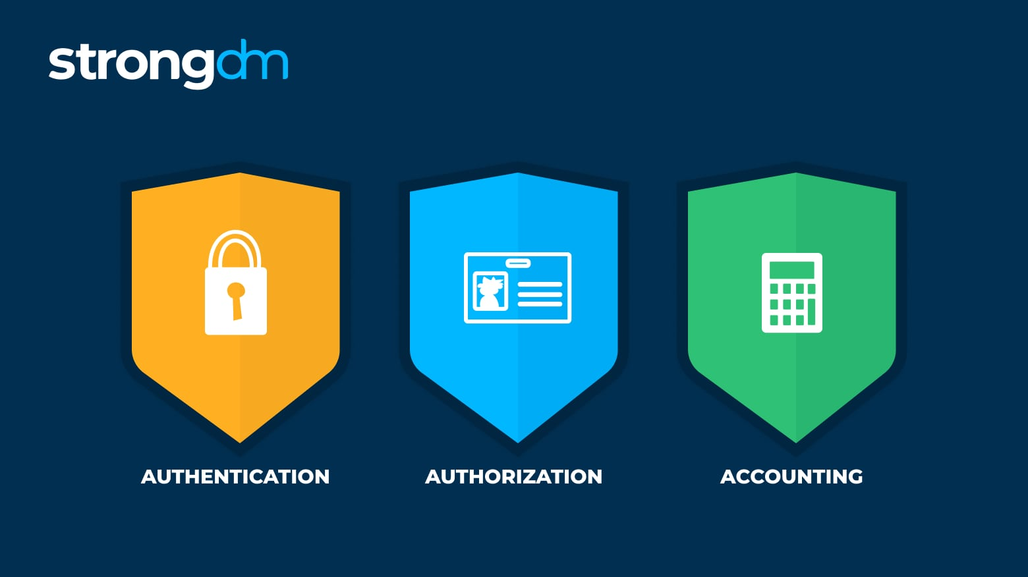
Access Control and Permissions
Authentication
Authorization
Accounting

Slide 17
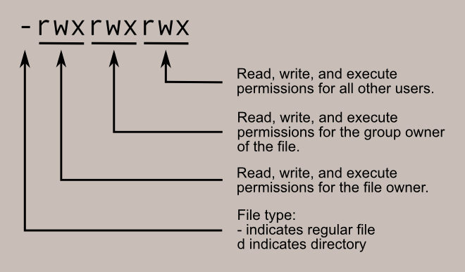
Managing Permissions
User Accounts and Groups
Administrator vs User Accounts
Least Privilege Model

Slide 18
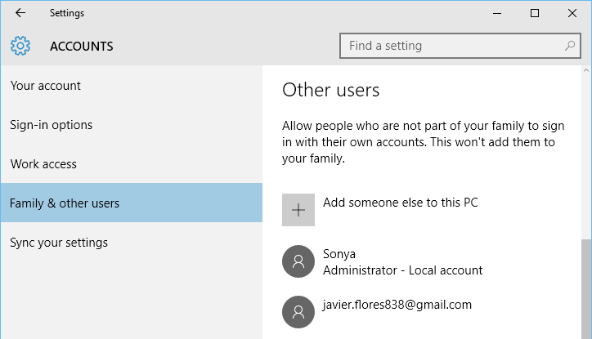
Managing User Accounts
Create User Accounts
Password Management
Disabling or Deleting Accounts
Managing User Profiles

Slide 19
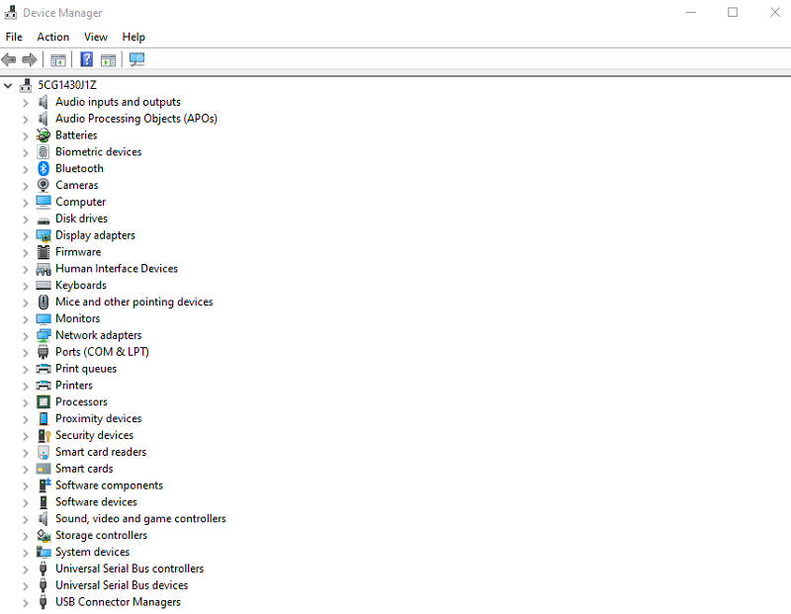
Device Manager
Drivers
Device Installation and Configuration
Monitoring Device Status

Slide 20
KAHOOT!

