Slide 1
Chapter 13
CompTIA Tech+
Web Browsing

Slide 2
Web Browsers
Something most of us use daily
We must know how to use them properly and safely
We need to know some popular features
Some Common attacks we may find

Slide 3
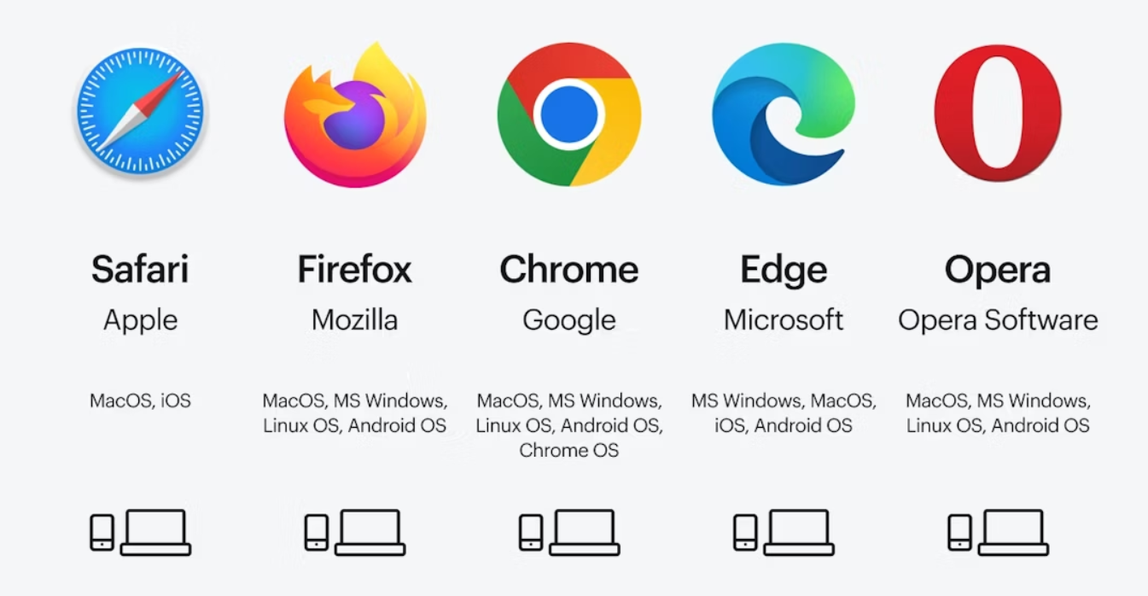
Web Browsers - Examples

Slide 4
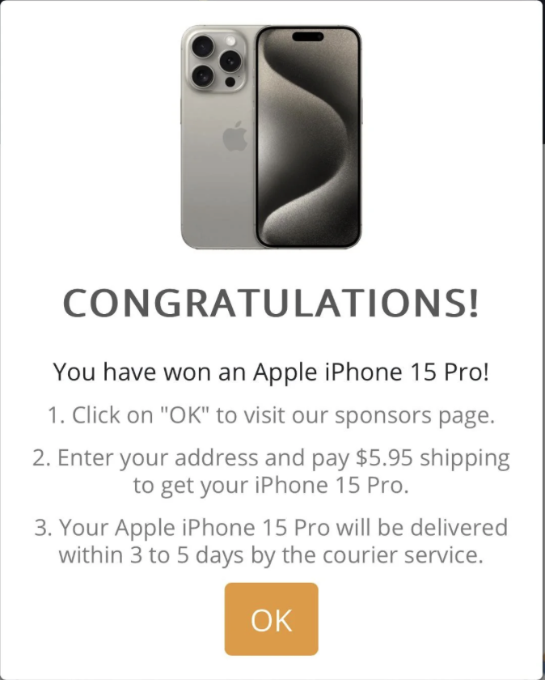
Malware
Can be found on untrustworthy websites
Visiting compromised websites
Clicking on malicious advertisements
Fall for phishing scams

Slide 5
Types Mal’icous Soft’ware
Viruses
Worm
Trojans
Ransomware
Spyware
Adware
Keyloggers
Rootkits

Slide 6
Safe Web Browsing
Be
Be cautious with links and Downloads
Think before your click
Avoid Clicking on suspicious pop-ups
Identify
Identify Secure Websites
HTTPS! (Port 443)
Unser Certificates (Paddle lock!)
Recognize and Avoid
Recognize and Avoid Phishing and Social Engineering
Phishing tricks you into revealing sensitive information
Be skeptical of unsolicited communication

Slide 7
Safe Web Browsing – Cont.
User Strong, Unique Passwords
Follow Best Practices for passwords
Use dedicated password manager
Keep your Browser UPDATED
Security Patches keep you safe
Enable Automatic Updates
Use Reputable Anti-malware Software
Install Anti-malware software
Keep it updated!

Slide 8
Safe Web Browsing – Cont.
Manage
Manage Browser Settings
Enable Pop-up blockers
Use reputable browser add-ons
Be
Be Mindful of Privacy
Be careful what you share on “Social Networking”
Be careful what you share with AI
Avoid
Avoid Unsecured Wi-Fi
Public Wi-Fi like in cafes or airports are often fake
Use VPN’s to keep your traffic safe

Slide 9
Different Features with Browsers
Tabbed Browsing
Organized Features
Address Bar and Search Integration
Pop-up Blockers
Private Browsing
Add-ons/Extensions

Slide 10
Different Features with Browsers Cont.
Caching
Password Management
Profile Synchronization
Accessibility Features
Appearance Customization
Developer Tools
Security and Privacy Controls

Slide 11
Types of ACTIVE Content - Javascript
Mostly widely used
Client-Side Scripting
Embedded into websites
Great for forms, validating input

Slide 12
Types of ACTIVE Content – HTML5 API
New application programming interfaces and elements
Helps give more dynamic content
Client-Based in Browser
JavaScript may enhance capabilities
<canvas> or <audio> tags are good examples

Slide 13
Types of ACTIVE Content - CSS
Cascading Style Sheets
Allow changing color, size, or position of an object
Creates a clean looking website
Can create animations or transitions

Slide 14
Extensions and
Add-ons
Use to give browsers additional abilities
Can be used for many different reasons:
Productivity Tools
Security and Privacy Enhancements
Customization
Shopping Assistants
Accessibility Tools
Developer TOols

Slide 15
Best Practices with Extensions
Add only what you need
Remove any unused extensions
You can also enable/disable extensions without uninstalling

Slide 16
Private Browsing
Why Use it?
Browser History isn’t saved
Cookies and Site data isn’t saved on PC
Great for Public use computers
Clears all files on exit
DOESN’T HIDE YOU ONLINE!

Slide 17
Blockers for Web Browsing
Pop-Up Blockers
Ad Blockers
Tracker Blockers
Script Blockers
Content Blockers

Slide 18

Digital Certificates
Reputation
Authentication
Encryption
Ensures no one is listening in

Slide 19
KAHOOT!

