Slide 1
Chapter 14
CompTIA Tech+
Cloud and Virtualization

Slide 2

What is Cloud?
Cloud refers to resources that are offered over the internet.
We like to joke and say “Cloud is just someone else's computer”
While this is true its more than that!
Its all about on-demand AUTOMATION

Slide 3
Why we use Cloud
On-Demand Self-Service
Broad Network Access
Resource Pooling
Rapid Elasticity (Scalability)
Measured Service (Pay as you go)

Slide 4
Cloud deployment models
Public Cloud
Multi-Tenant
Owned and Operated by a CSP (AWS, AZURE, GCP)
No Hardware Maintenance!
Private Cloud
Often On PREMISE
Organization Owned and Operated
Single-Tenant
Hybrid Cloud:
A little bit of both!

Slide 5
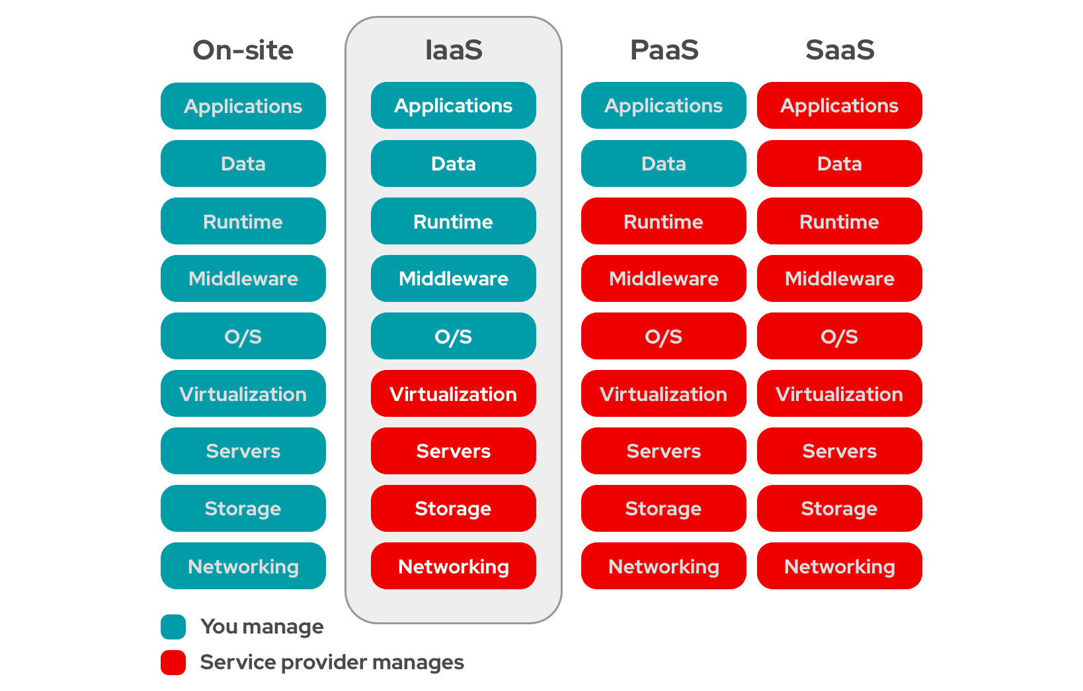
Cloud Service Models

Slide 6

Virtualization Concepts!
We waste so much hardware!
Most of the time servers do not use their full potential
So, we carve it up into MANY machine to utilize

Slide 7
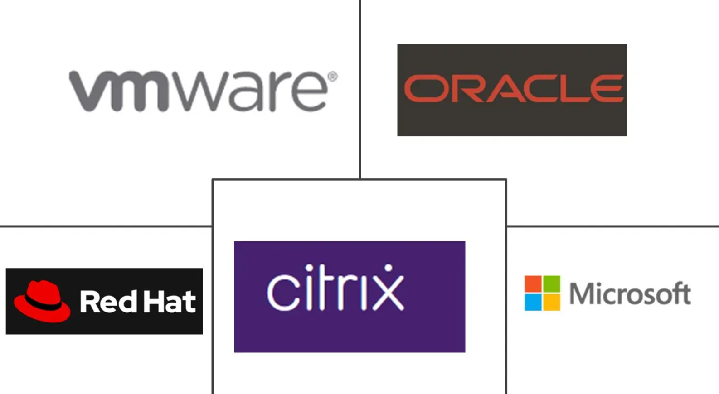
Virtualization Vendors
Host machine
  What hardware we are sharing
Hypervisor
  What software we are using to virtualize
Virtual Machine
  The machine that is on the Host Machine
Guest OS
  The OS installed on our Virtual machine

Slide 8
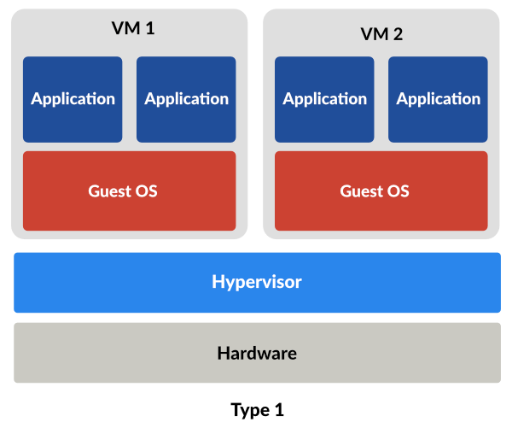
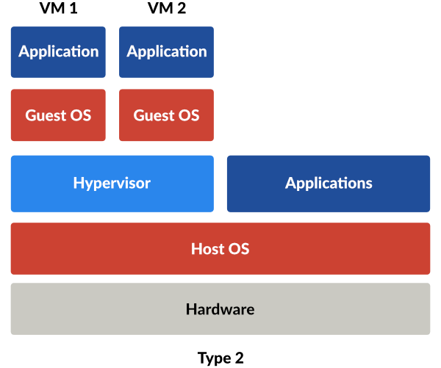
Type 1 vs Type 2? Huh?

Slide 9
Benefits of Virtualization
Server Consolidation
Resource Efficiency
Cost Savings
Isolation
Easy Provisioning and Deployment
Testing and Development
Disaster Recovery

Slide 10
Our Lab
We will install a popular Virtual Server Software
Proxmox!
We will then install a guest OS

Slide 11
KAHOOT!

