Slide 1
Chapter 2
CompTIA Tech+
Notations and Data Types

Slide 2
Input, Output, Processing and Storage
Every computer!
No matter how simple or complex
Four basic operations:
Input
Output
Processing
Storage

Slide 3
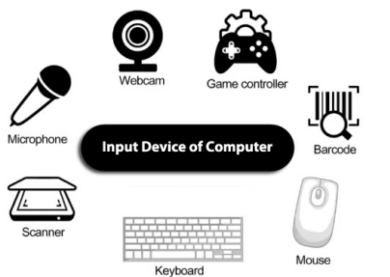
Input
The act of getting data into the computer
Without input the computer wouldn’t have anything to act upon.
Examples
  Keyboard
  Mouse
  Microphone
  Scanner
  Touchscreen
  Sensor

Slide 4
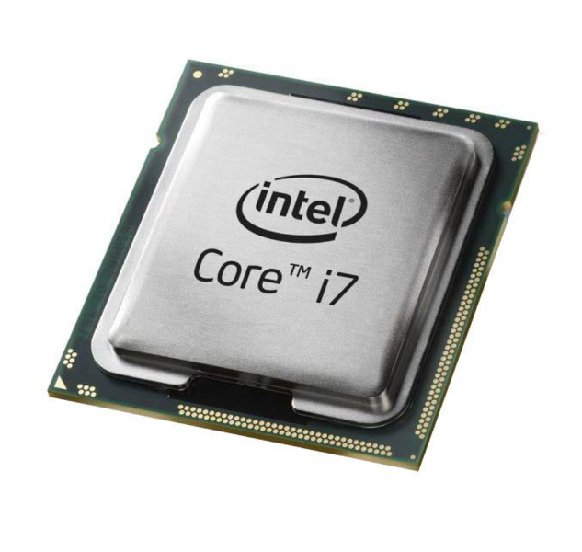
Processing
Set of instructions (a program) to transform data into something meaningful.
This is where the raw data is turned into useable data!
Examples
  Calculating the sum of numbers
  Sorting a list of names
  Applying a filter
  Video Game display on inputs
  Converting voice to text

Slide 5
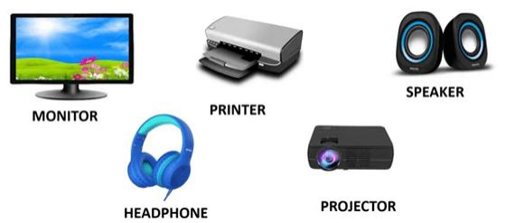
Output
Presentation of processed data in a human understandable form.
Allow you to see the results of the processing phase.
Examples
  Display to Monitor
  Printing to a Printer
  Playing sound through speakers
  Game character moving in game
  Sending data to another computer

Slide 6
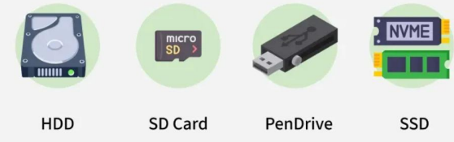
Storage
Saving data and instructions so they can be accessed later.
Allows you to keep work, programs, and data even when computer is turned off.
Examples
  Hard drive
  USB Flash drive
  Random Access Memory
  Cloud Storage

Slide 7
Numbers and Notational Systems
A way of writing down numbers.
How data is stored.
4 Main notational systems
Decimal
Binary
Hexadecimal
Octal

Slide 8
Decimal
Base-10 (Each position is a power of 10)
This is what you are used to in everyday life.
Let's take the number 345 as an example:
  The digit 5 is in the "ones" place (10⁰ ), so its value is 5 × 1 = 5.
  The digit 4 is in the "tens" place (10¹ ), so its value is 4 × 10 = 40.
  The digit 3 is in the "hundreds" place (10² ), so its value is 3 × 100 = 300.
When you add these values together (300 + 40 + 5), you get the total value of the number, 345.

Slide 9
Binary
Base-2 (Each position is a power of 2)
This is what computers talk in natively!
Binary digit can be 1 or 0 (on or off) each digit is called a bit
Let's look at a binary number, for example, 1011: To understand its decimal equivalent, we look at the positions from right to left: 28
  The rightmost digit 1 is in the "ones" place (2⁰ ), so its value is 1 × 1 = 1.
  The next digit 1 is in the "twos" place (2¹ ), so its value is 1 × 2 = 2.
  The next digit 0 is in the "fours" place (2² ), so its value is 0 × 4 = 0.
  The leftmost digit 1 is in the "eights" place (2³ ), so its value is 1 × 8 = 8.
Adding these values together (8 + 0 + 2 + 1), we find that the binary number 1011 is equal to the decimal number 11.

Slide 10
Hexadecimal
Base-16 (Each position is a power of 16)
Hexadecimal Mapping:
0-9 represent their usual decimal values.
A represents decimal 10
B represents decimal 11
C represents decimal 12
D represents decimal 13
E represents decimal 14
F represents decimal 15
https://www.youtube.com/watch?v=0xkP_FQUsuM

Slide 11
Hexadecimal Example
Let's look at the hexadecimal number 1B3. To convert it to decimal:
  The digit 3 is in the "ones" place (16⁰ ), so its value is 3 × 1 = 3.
  The digit B (which is 11 in decimal) is in the "sixteens" place (16¹ ),
  so its value is 11 × 16 = 176.
  The digit 1 is in the "two hundred fifty-sixes" place (16² ), so its value is 1 × 256 = 256.
Adding these values together (256 + 176 + 3), we find that the hexadecimal number 1B3 is equal to the decimal number 435.

Slide 12
Octal
Base-8 (Each position is a power of 8)
Used for permissions (Really good at groups of 3, UNIX!)
Let's look at the octal number 273. To convert it to decimal:
  The digit 3 is in the "ones" place 8⁰ , so its value is 3 × 1 = 3.
  The digit 7 is in the "eights" place 8¹ , so its value is 7 × 8 = 56.
  The digit 2 is in the "sixty-fours" place 8² , so its value is 2 × 64 = 128.
Adding these values together (128 + 56 + 3), we find that the octal number 273 is equal to the decimal number 187.

Slide 13
Units of Measure
Bit
two values, 0 or 1.
Think of it as a light switch
on or off.
Byte
group of 8 Bits. Very important, as each character is 1 byte
(A, 1, #)
Nibble
Half of a byte! 4 bits.

Slide 14
As data grows
Kilobyte (KB)
2¹⁰ bytes = 1KB
1KB =
1024 bytes
Megabyte (MB)
2²⁰ bytes = 1MB
1MB = 1,048,576 bytes
Gigabyte (GB)
230 bytes = 1GB
1 GB=
1,073,741,824 bytes
Terabyte (TB)
240 bytes = 1TB
1 TB=
1,099,511,627,776 bytes
Petabyte (PB)
250 bytes = 1PB
1 PB=
1,125,899,906,842,624 bytes

Slide 15

Data Types
Data type is a classification that tells the computer how to interpret the value of a piece of data.
We will cover
  Character
  String
  Numbers
    Integers
    Floating Point
    Boolean

Slide 16
Characters
Letter
Number
Symbol
Punctuation Mark
A
1
©
.
Letter

Slide 17
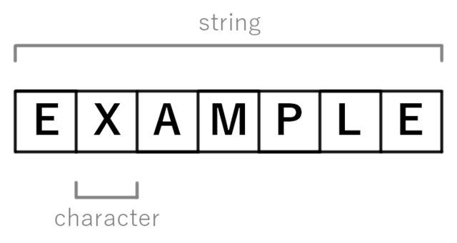
Strings
Sequence of Characters
Text
“Hello World”

Slide 18
Numbers - Integer
Represent whole numbers
They can positive, negative, or zero
Example -5, 0, 42, 1024

Slide 19
Numbers Floating Point
Represents numbers that can have a decimal point
They can also be whole numbers!
Uses more space in memory
Example: 3.14159,
-0.005, 2

Slide 20
Numbers - Boolean
Logical Values
Can be TRUE or FALSE
Example: Is the light switch on? (True or False)

Slide 21
Representing Data
All computers operate in binary
(Bits and Bytes!)
Data types allows the computer know how to use data
Some data types
Text
Images
Sound
Numbers
Program Instructions

Slide 22
Text
Extension: .txt
Human readable text
Will display as it is written
Books, Papers, or anything written in ASCII code

Slide 23
Images
Extension Examples: .jpg, .png, .gif
Translates dots (pixels) into images
Each pixel is setup to be a color
Once stored it can be displayed as an image

Slide 24
Sound
Extension Example: .mp3, .wav, .aac
Represents Sounds
Computers use Digitization or Sampling to create an analog wave
When played back the wave is converted into sound

Slide 25
Numbers
Weve discussed numbers Integers, and Floats
Computers can do MATH on numbers
Telling a computer it is working with a number allows for quick arithmetic.

Slide 26
Programming Instructions
Some software is written in a lower level than human speech
This is programming instructions
This “machine code” can be used by the CPU (processor) of a computer

Slide 27
KAHOOT!

