Slide 1
Chapter 4
CompTIA Tech+
Types of Computers

Slide 2
Overview of a computer
Key hardware every computer may have
  Central Processing Unit
  Random Access Memory
  Storage Devices
  Motherboard
  Input Devices
  Output Devices
  Software (Operating System)

Slide 3
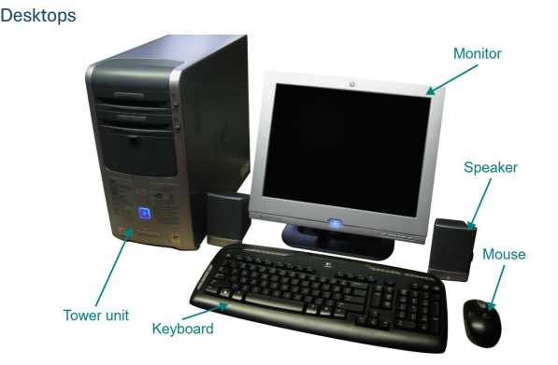
Desktop
Computer designed for a single location
System Tower
Monitor
Keyboard
Mouse
Great for Performance
Lack of Portability

Slide 4
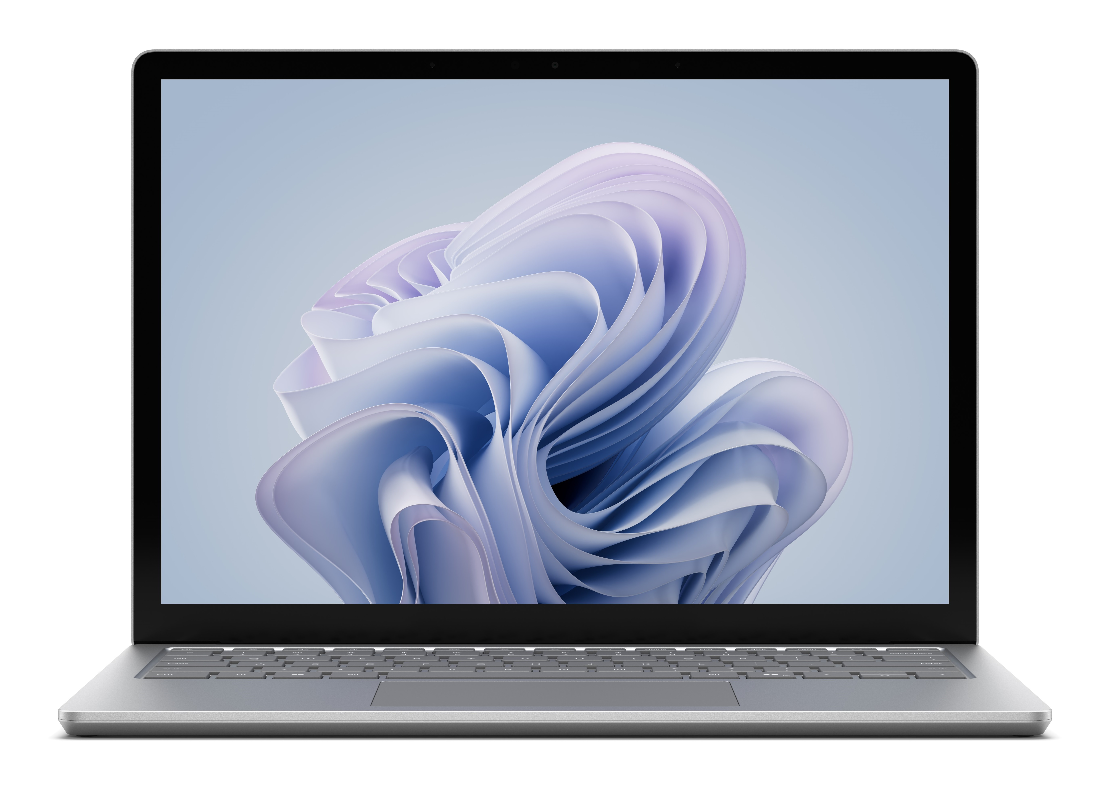
Laptops
Designed for mobile use
Top half contains display
Bottom half contains
  Keyboard
  Touchpad
  CPU
  RAM
  Storage
  Battery
Hard to upgrade or repair

Slide 5
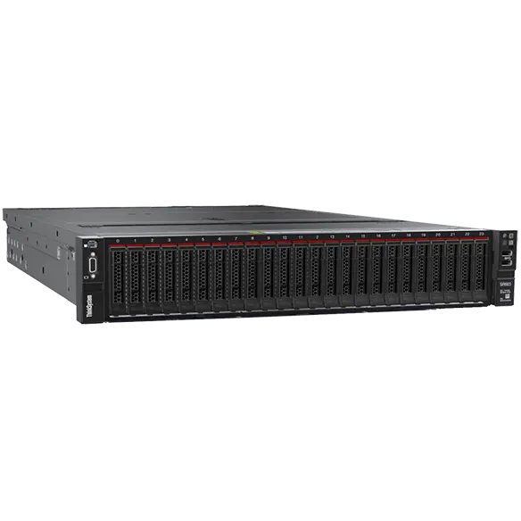
Server
Provides services to clients
Web Servers
File Servers
Game Servers
HIGH performance
Redundant
Expensive

Slide 6
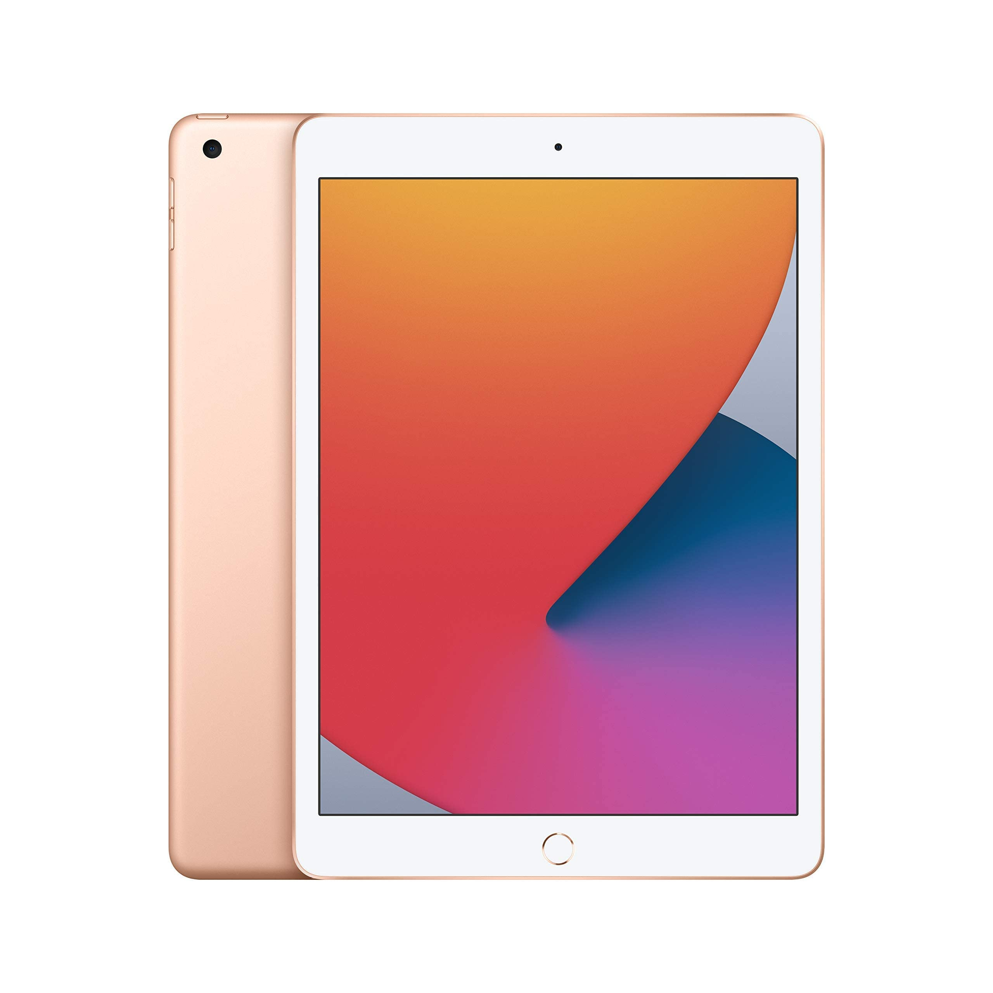
Smartphones and Tablets
Highly portable
Like a laptop
Uses touchscreen for main input
Great for day to day
Usually not very strong
Hard to repair

Slide 7
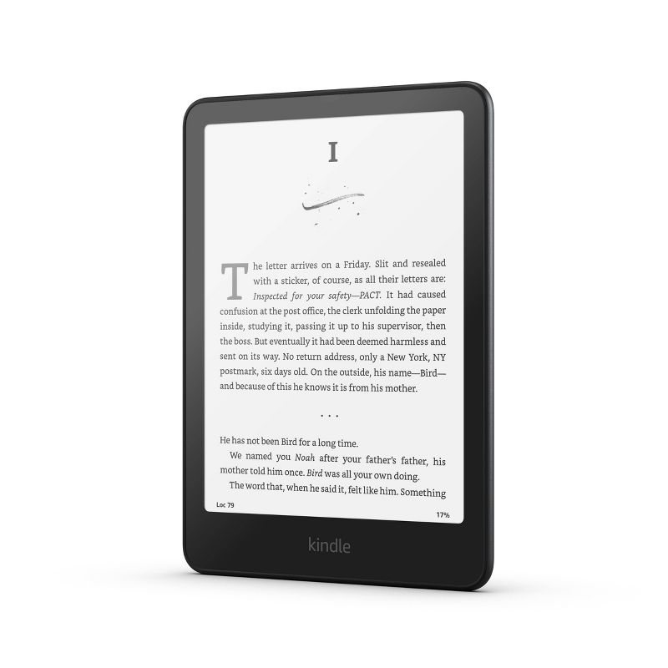
E-Readers
Long battery life
Very portable
E ink screens usually
Single purpose
Slow refresh rate

Slide 8
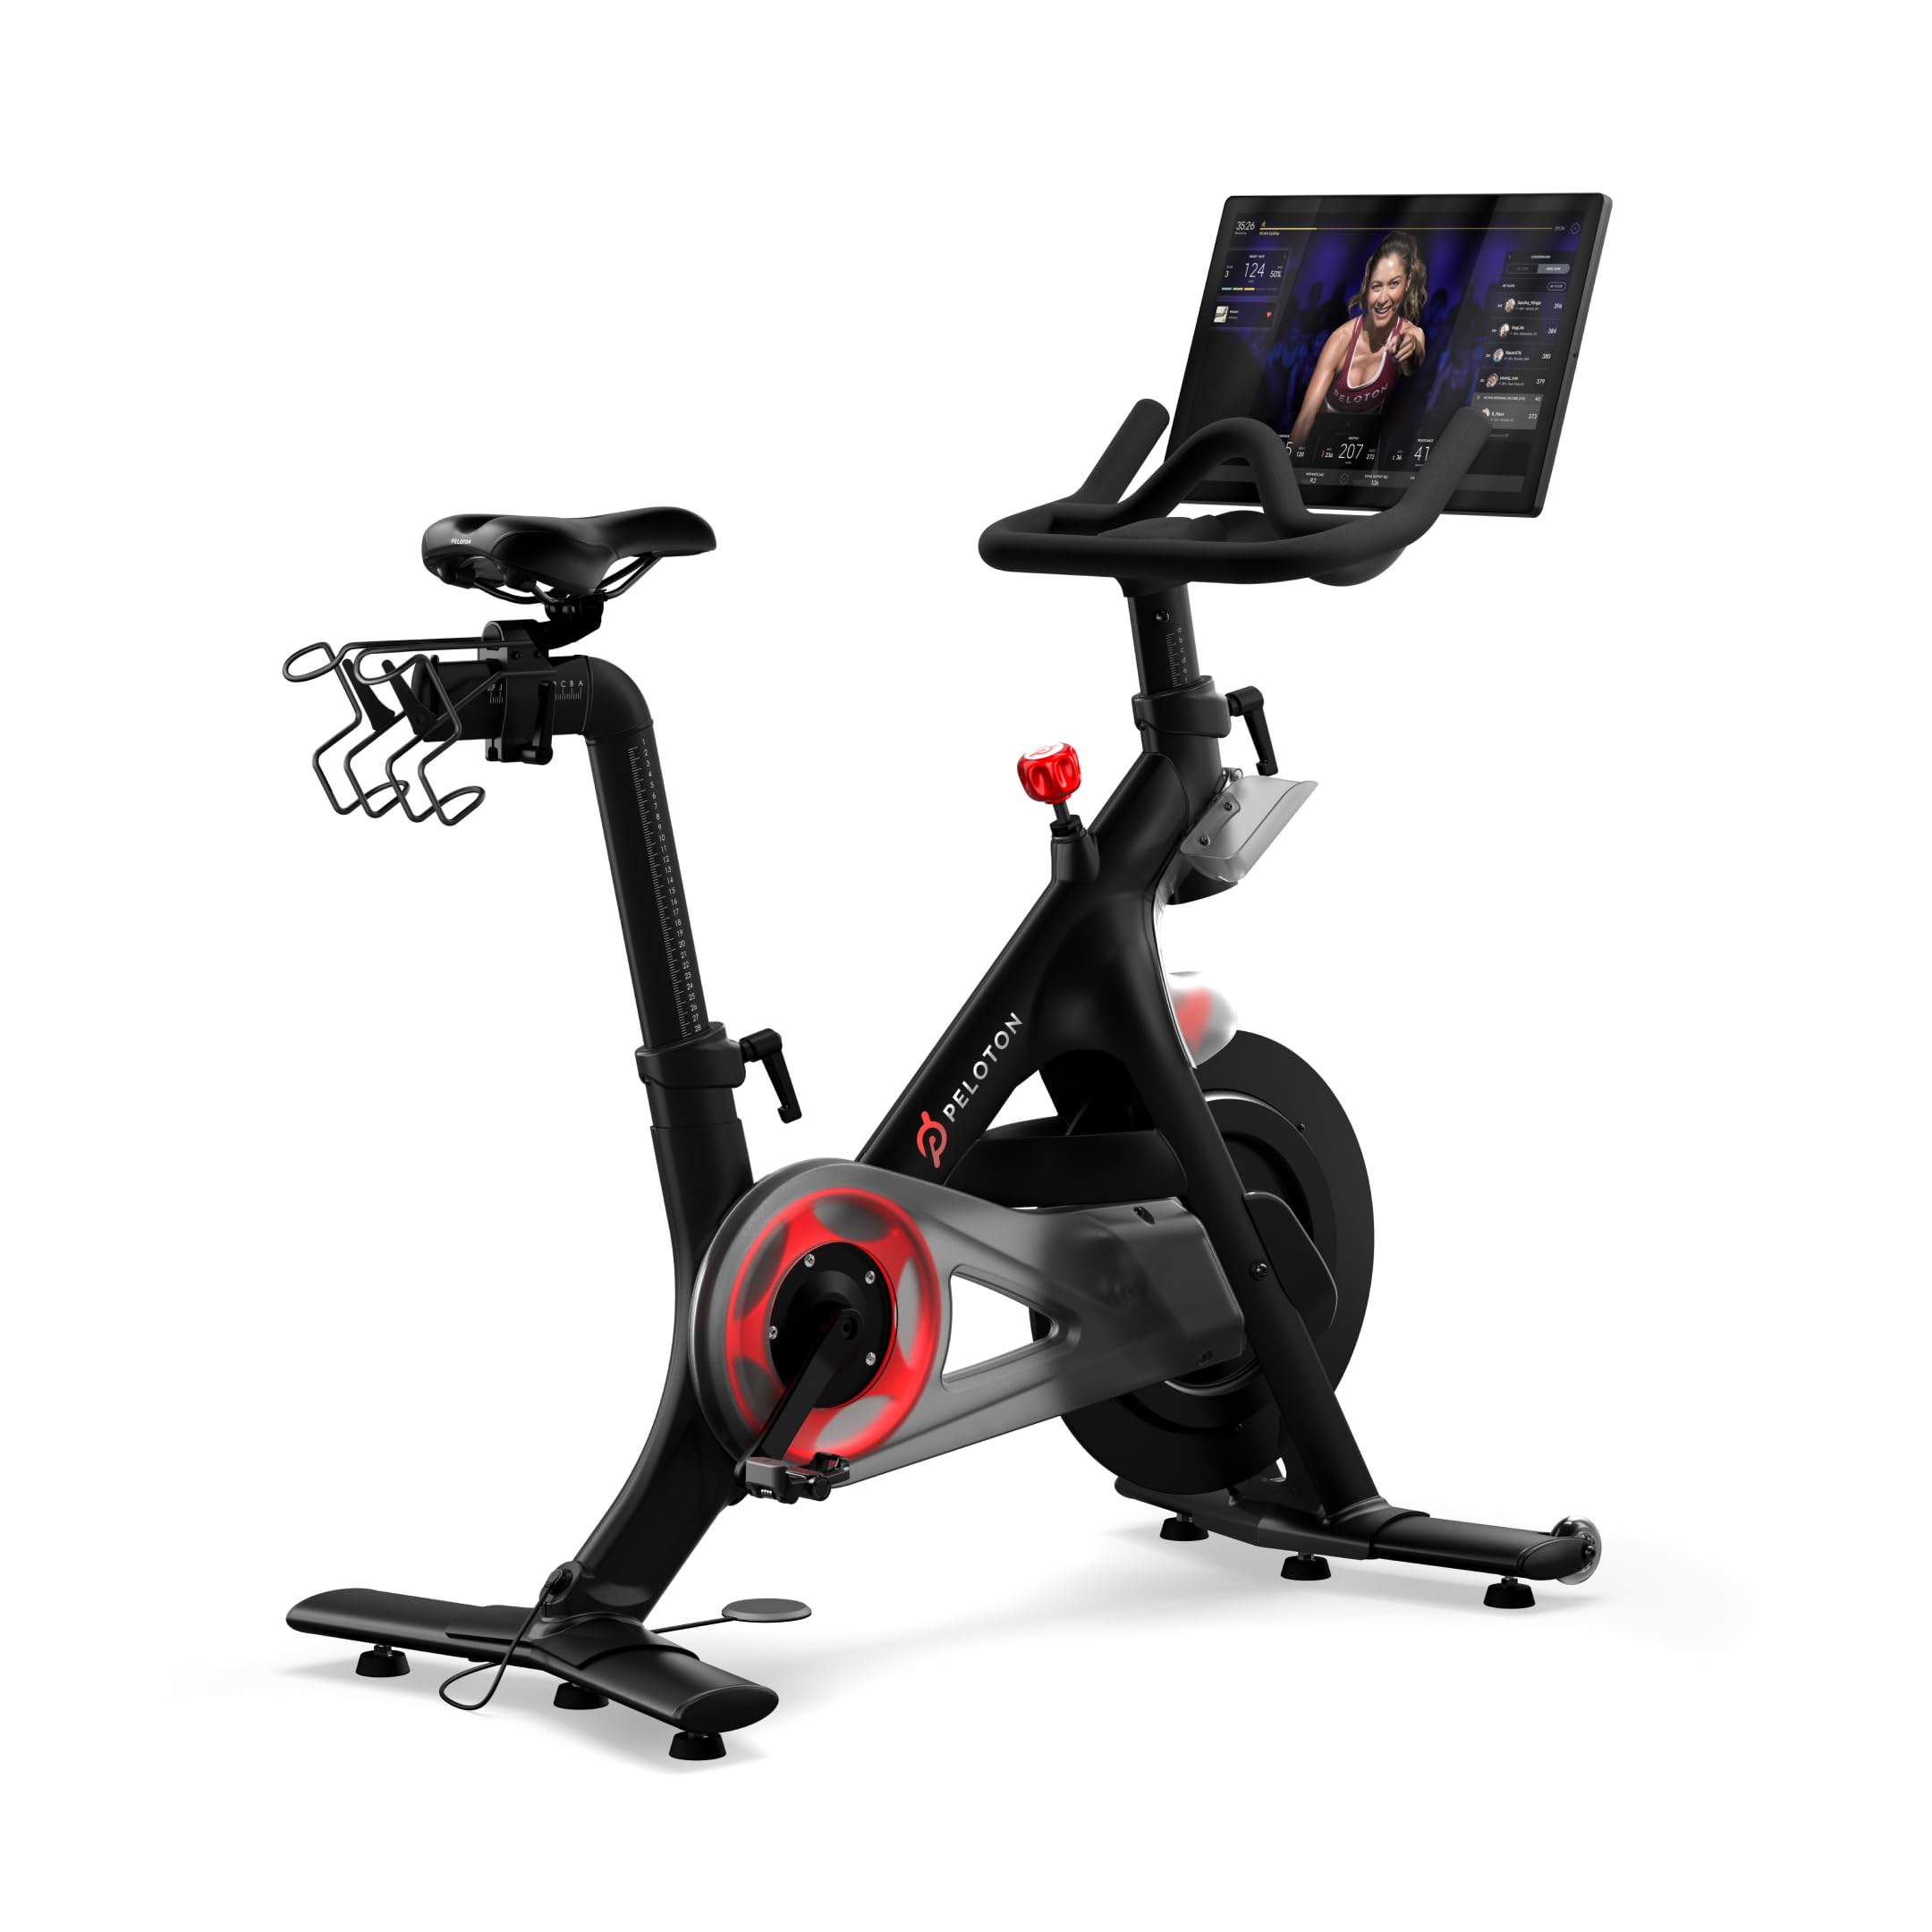
Exercise Equipment
A lot connected to internet
Pre-programmed workouts
Performance tracking
Heart Rate Monitoring
Bad security
Usually doesn’t have updates

Slide 9
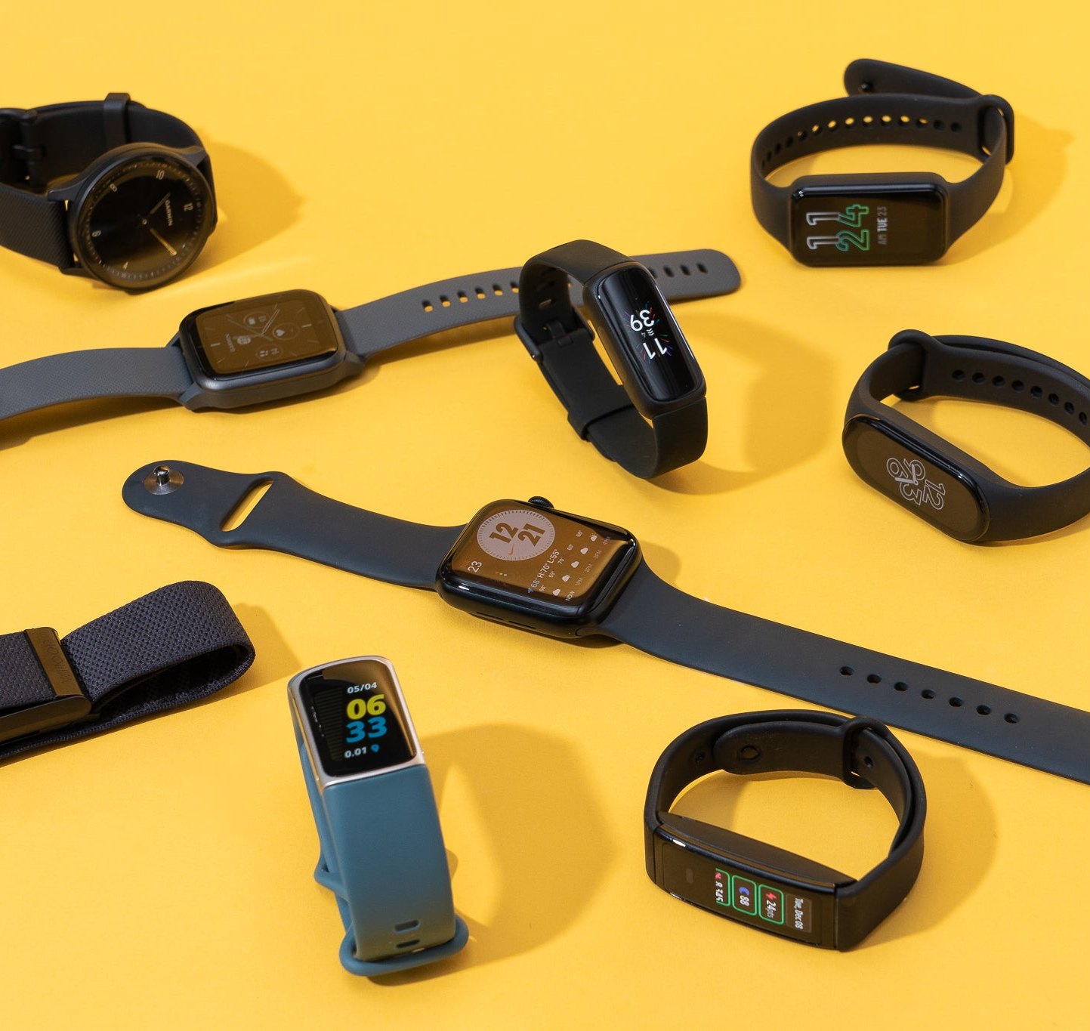
Wearables
Smartwatches
Fitness Trackers
Smart Jewelry
Smart Glasses
Hearables
Bad Security
Easy to crack

Slide 10
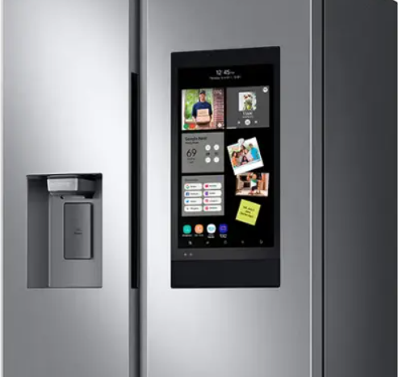
Internet of Things
Everything in house
Light Switches
Microwaves
Stoves
Fridge
Washers
Weak Security
Not updated regularly

Slide 11
KAHOOT!

