Slide 1
Chapter 6
CompTIA Tech+
Devices and Peripherals

Slide 2

Devices and Peripherals
Not everything will be INSIDE our computer
We will want to add devices to the outside of our computer
Storage
Graphic Devices
Network
Printers
Network Devices

Slide 3
Storage Devices
Non-volatile in nature
External Hard drives
Flash Drives
Optical Drives
Internet Locations!

Slide 4
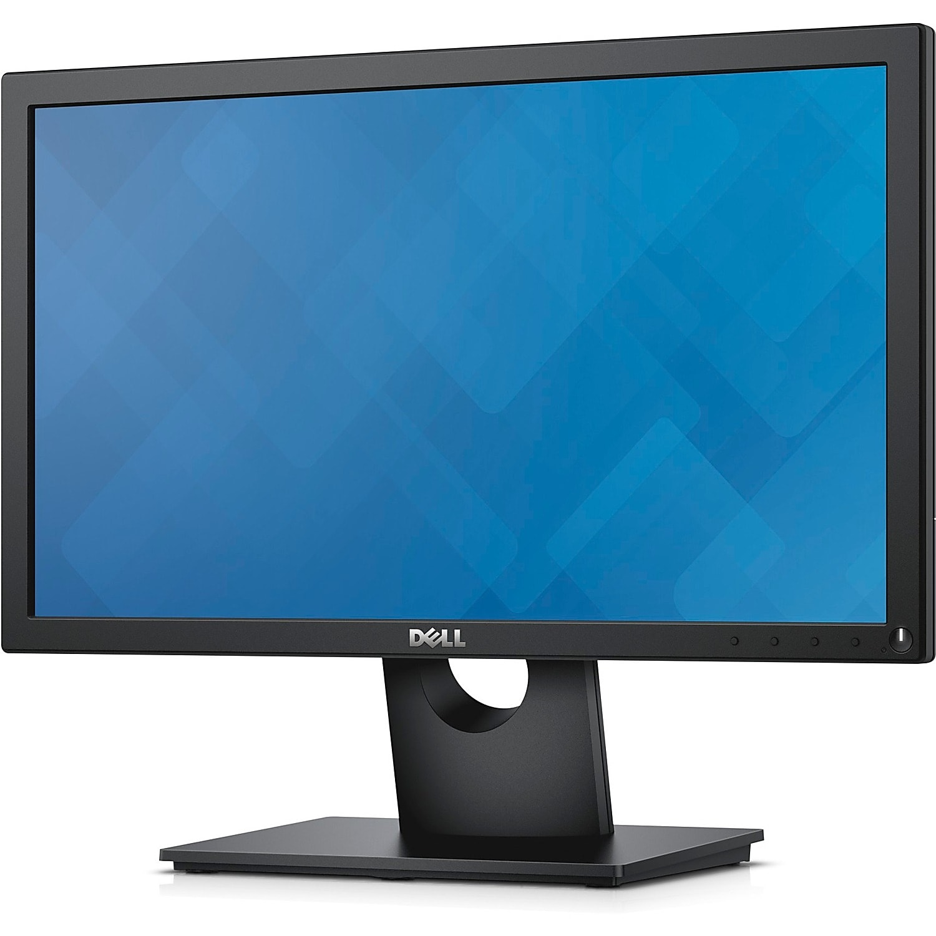
Graphic Devices
Monitors
Provide visual interface between user and computer
LCD (Liquid Crystal Display)
OLED (Organic Light Emitting Diode
Resolution
Refresh Rate
Screen Size
Aspect Ratio
Response Time

Slide 5
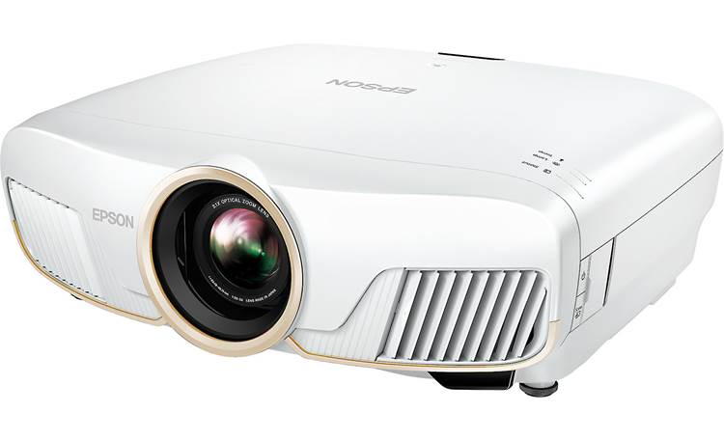
Projectors
Projects image onto a larger surface
Screen or Wall
Larger Screens
Prone to light diffusion
Brightness (Lumens) must be HIGH!

Slide 6
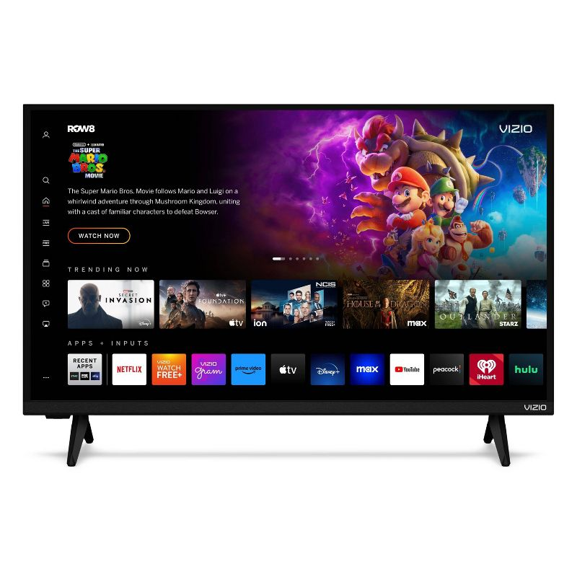
Smart TV’s
TV’s can be Smart
Connected to Internet
Download additional Applications
Stream from multiple sources

Slide 7

Mirroring and Casting
Mirroring
  Duplicates your entire screen
  Good for Presentations
  Demonstrations
  Gaming
Casting
  Usually duplicates application
  Streaming Videos
  Playing Music
  Displaying Photos
  Presenting SPECIFIC apps

Slide 8
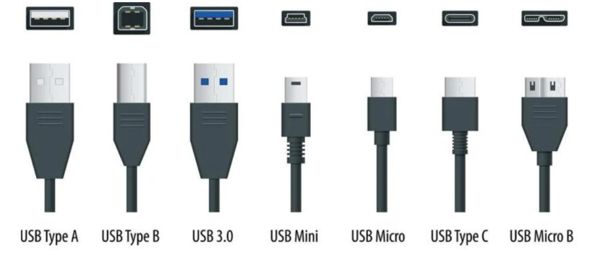
Types of Cables - USB

Slide 9
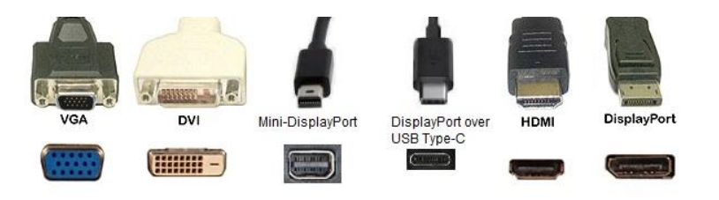
Types of Cables - Display

Slide 10
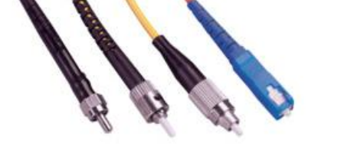
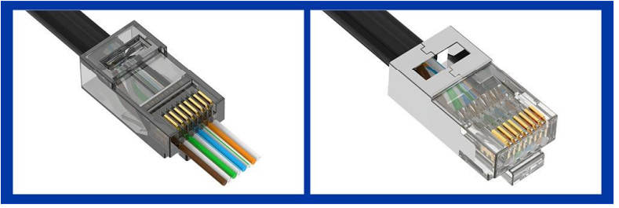
Types of Cables - Network

Slide 11
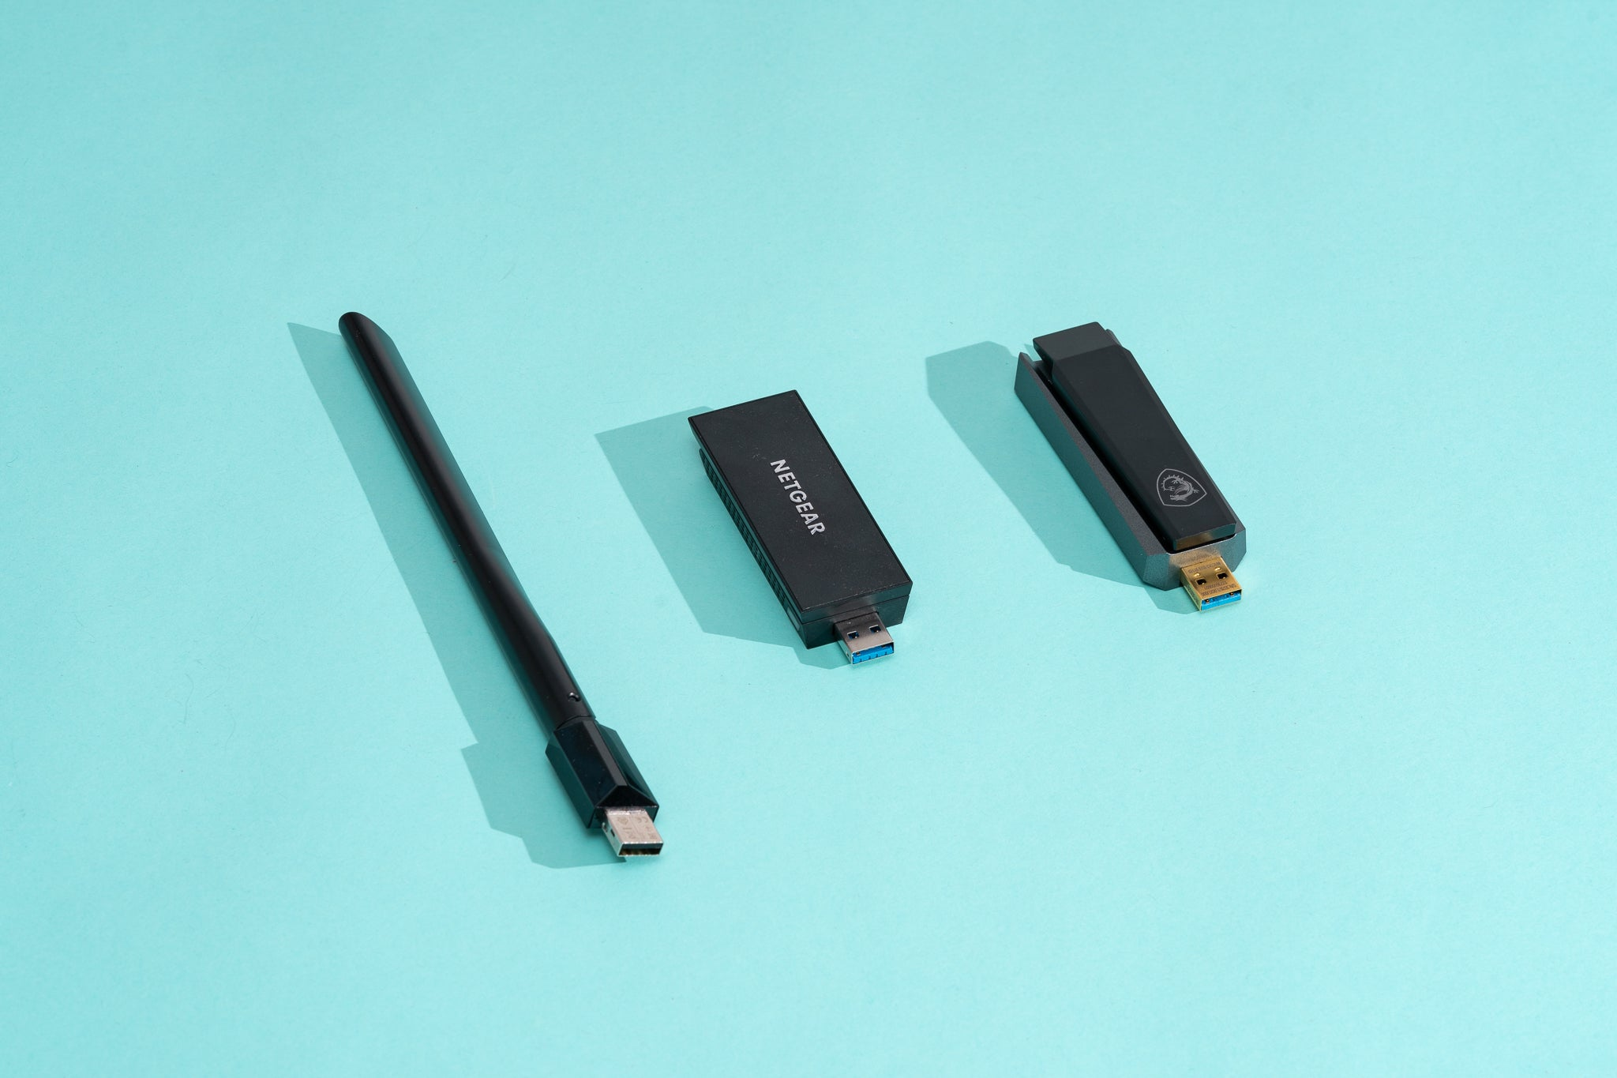
Wi-Fi Adapters
Can be internal or external
Uses standard connections like USB
IEEE designed
  802.11a
  802.11b
  802.11n
  802.11ac
  802.11ax
Different Spectrum
  2.4GHz
  5.0GHz
  6.0GHz

Slide 12

Bluetooth
Short Range wireless
10m (33 Feet) range
Connect different devices
  Keyboards
  Mice
  Headphones
  Speakers
  Different Devices (Smartphones)

Slide 13
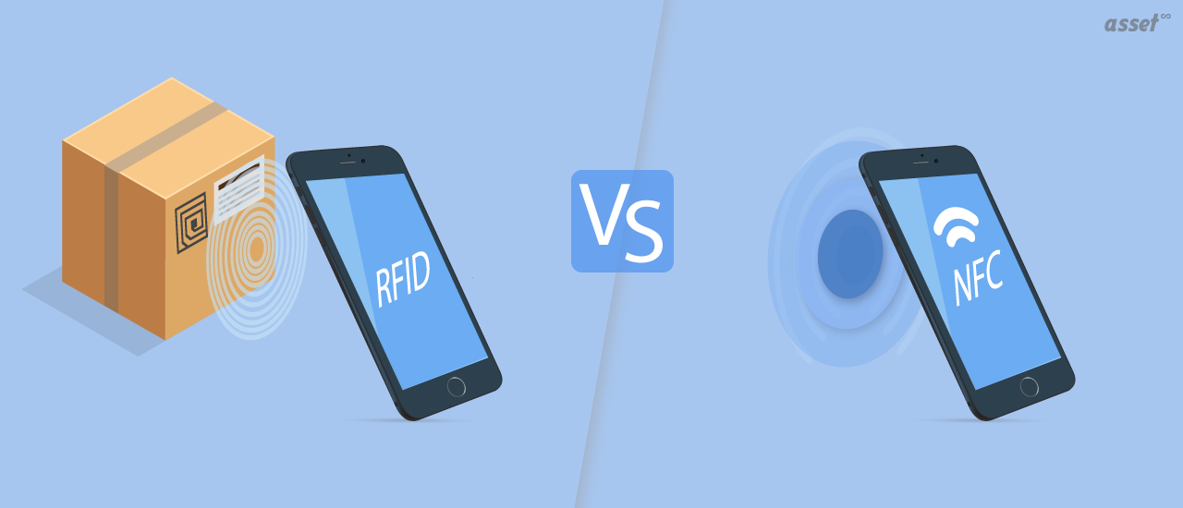
NFC and RFID
Very Short-Range Communication
Tap to Pay
Entry into Buildings
Uses EMF to power data transfer

Slide 14

Internet Service Provider
DSL
Cable
Fiber Optic Internet
Satellite
Cellular
Wireless
RF

Slide 15
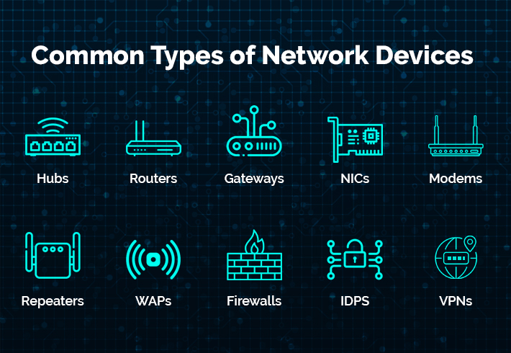
Network Devices

Slide 16
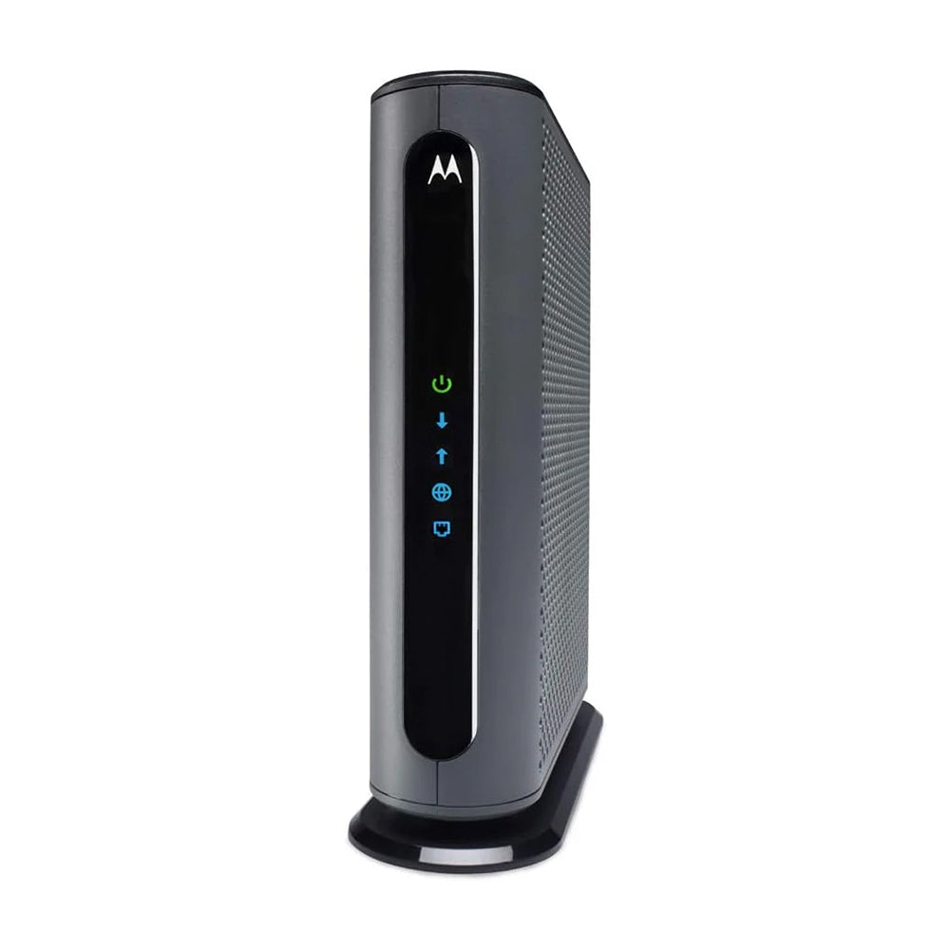
Modem
A modem connects your local network to your ISP
Modulator/Demodulator
Converts Analog and Digital Signals to allow for transmission over DSL or Cable (Coax)

Slide 17
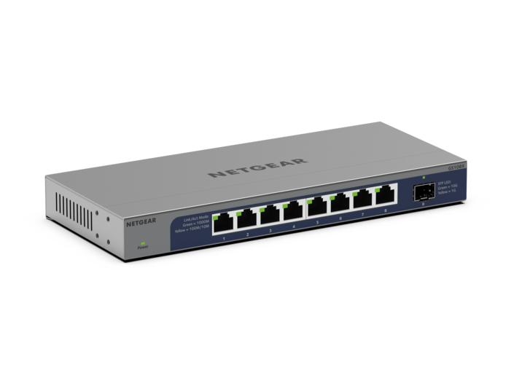
Switch
Connect multiple wired devices
Allows connections with RJ45 (Ethernet Cable)
Allows devices to communicate to each other

Slide 18
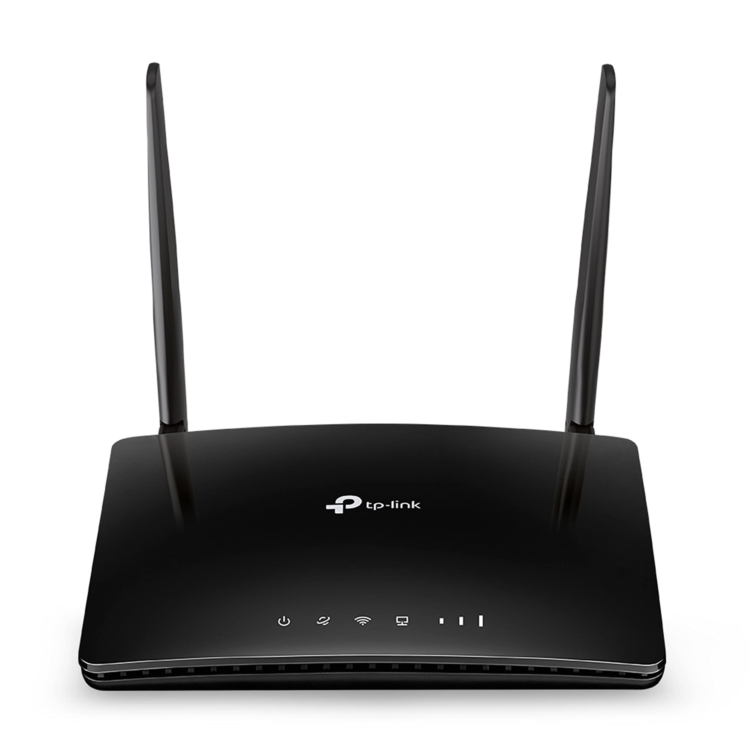
Router
A router directs traffic from one network to another
Common in house holds to connect to an ISP
Looks at packets and decides which neighborhood to send it to

Slide 19

Wireless Access Point
Connect wireless capable devices to a wired network
Laptops
Smartphones
Tablets

Slide 20

Firewall
Security Devices
Monitors Incoming and Outgoing Traffic
Think of it like the security guard to your house
Allow and Block lists

Slide 21
Network Tools
RJ45 Crimper
Cable Tester
Fiber Cleaver
Fiber Fuser

Slide 22
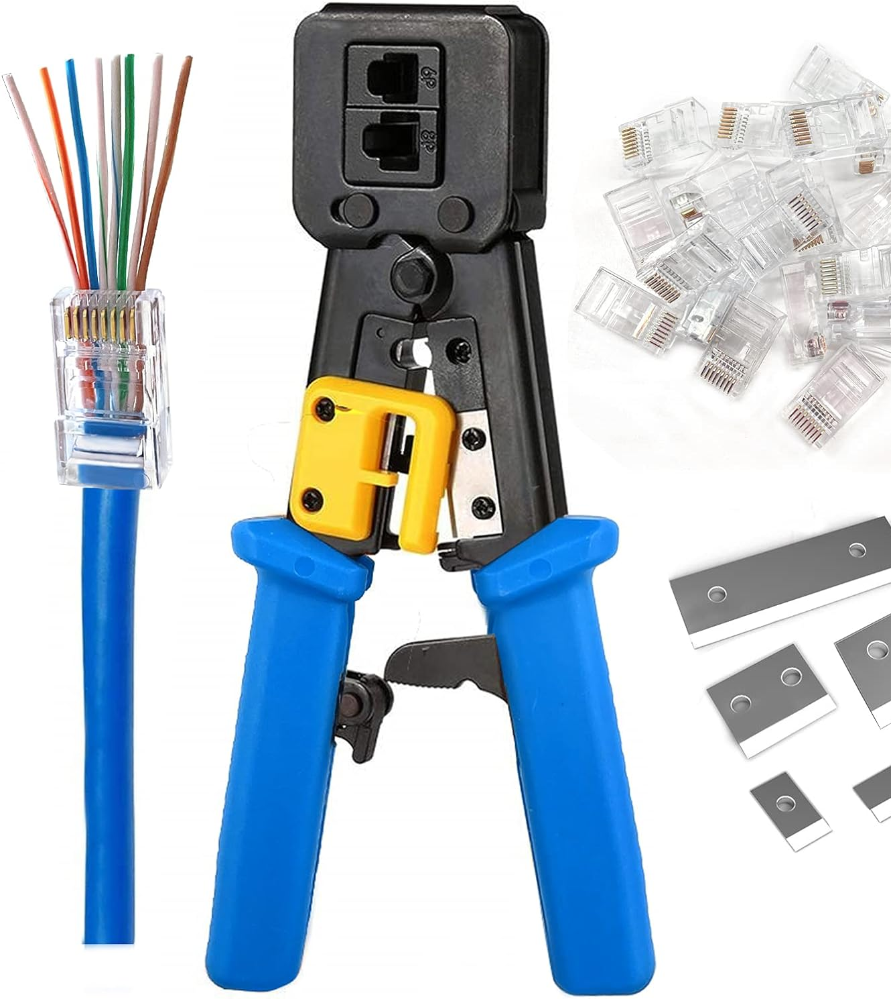
Cable Crimper
Allows technicians to build different length cables
Used for all types of connections
RJ45 (Ethernet) is common in networking

Slide 23
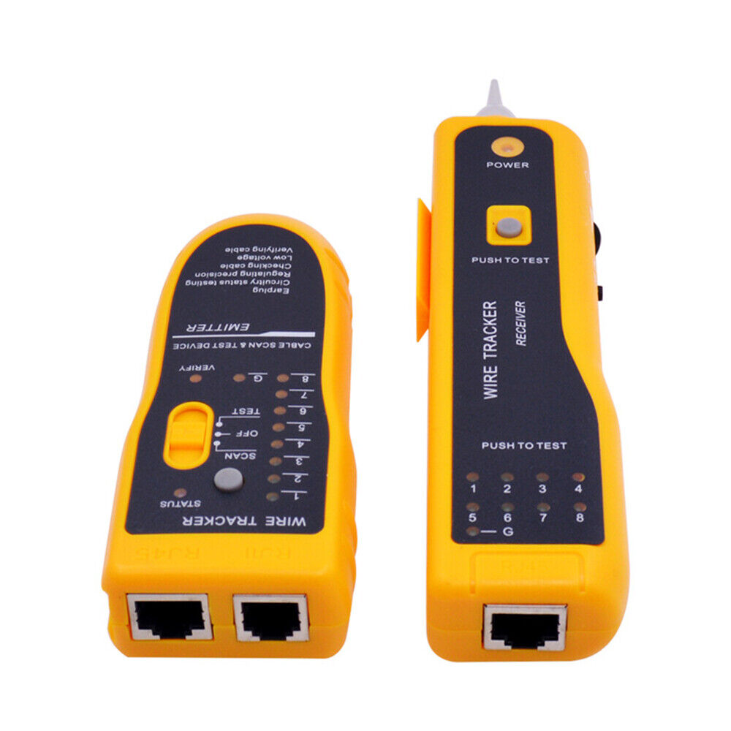
Cable Testers
Comes in all shapes and sizes
Use to test a cable length
Check for connectivity

Slide 24
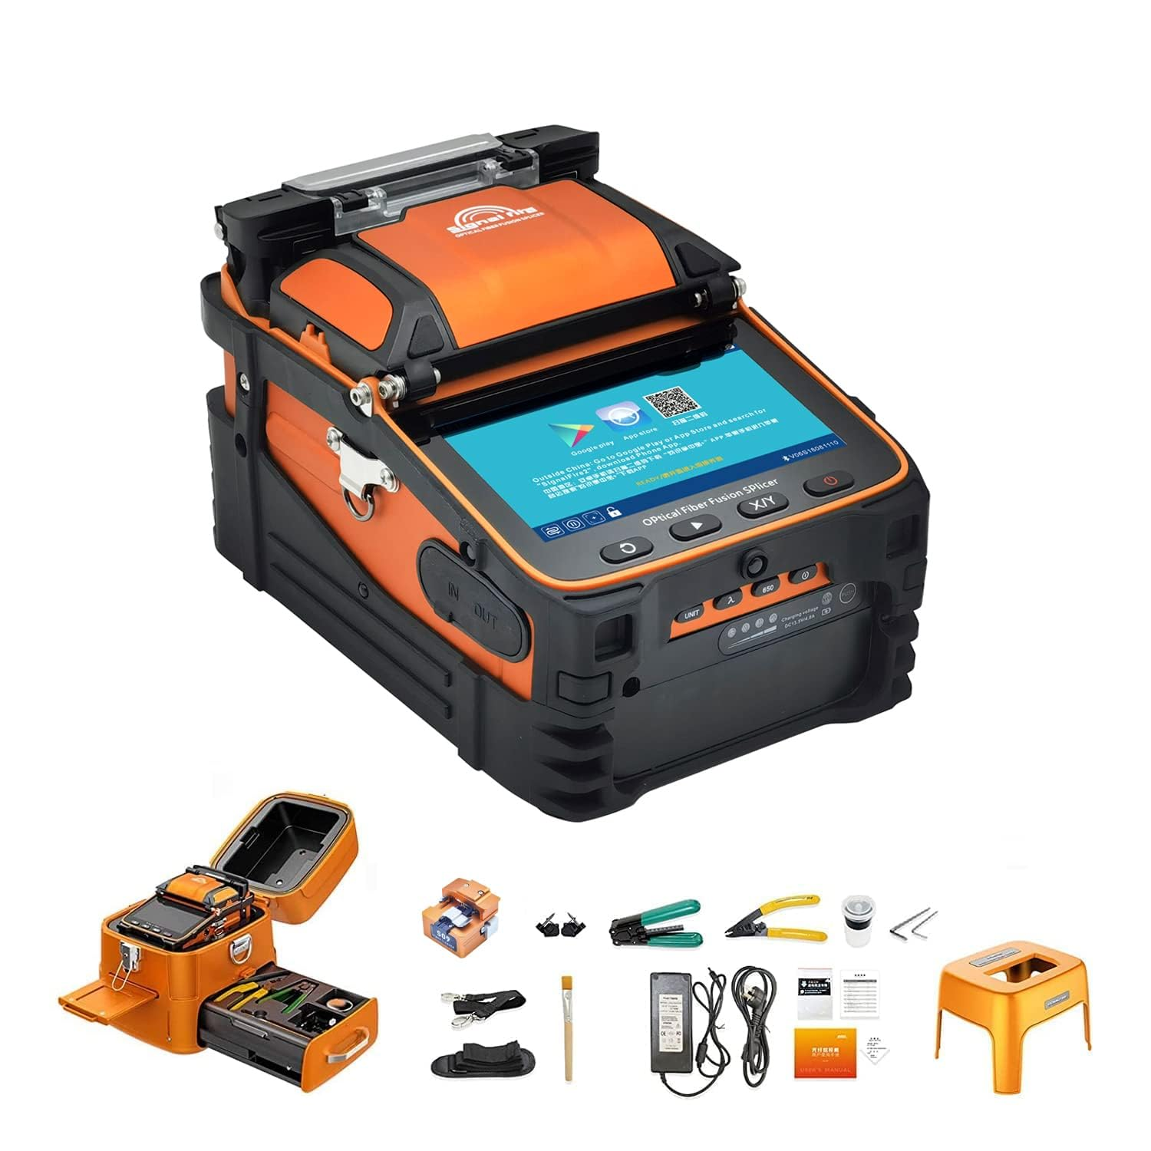
Fiber Cleaver and Splicers
Fiber transports data through light
Special equipment needed
Cleavers cleans and prepares the fiber
Splicers fuse the cable together
Creating a new connection, longer cable, or fixing a break

Slide 25
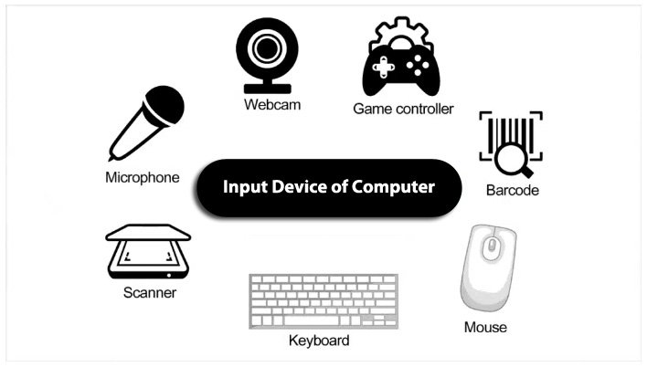
Input Devices
Keyboards
Mice
Scanners
Cameras
Microphones
Touchscreens

Slide 26
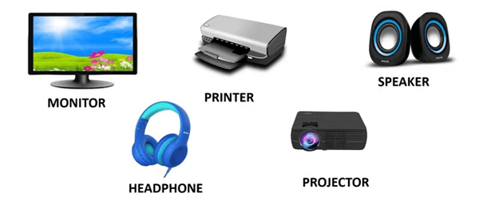
Output Devices
Printers
Displays
Speakers
Headsets

Slide 27
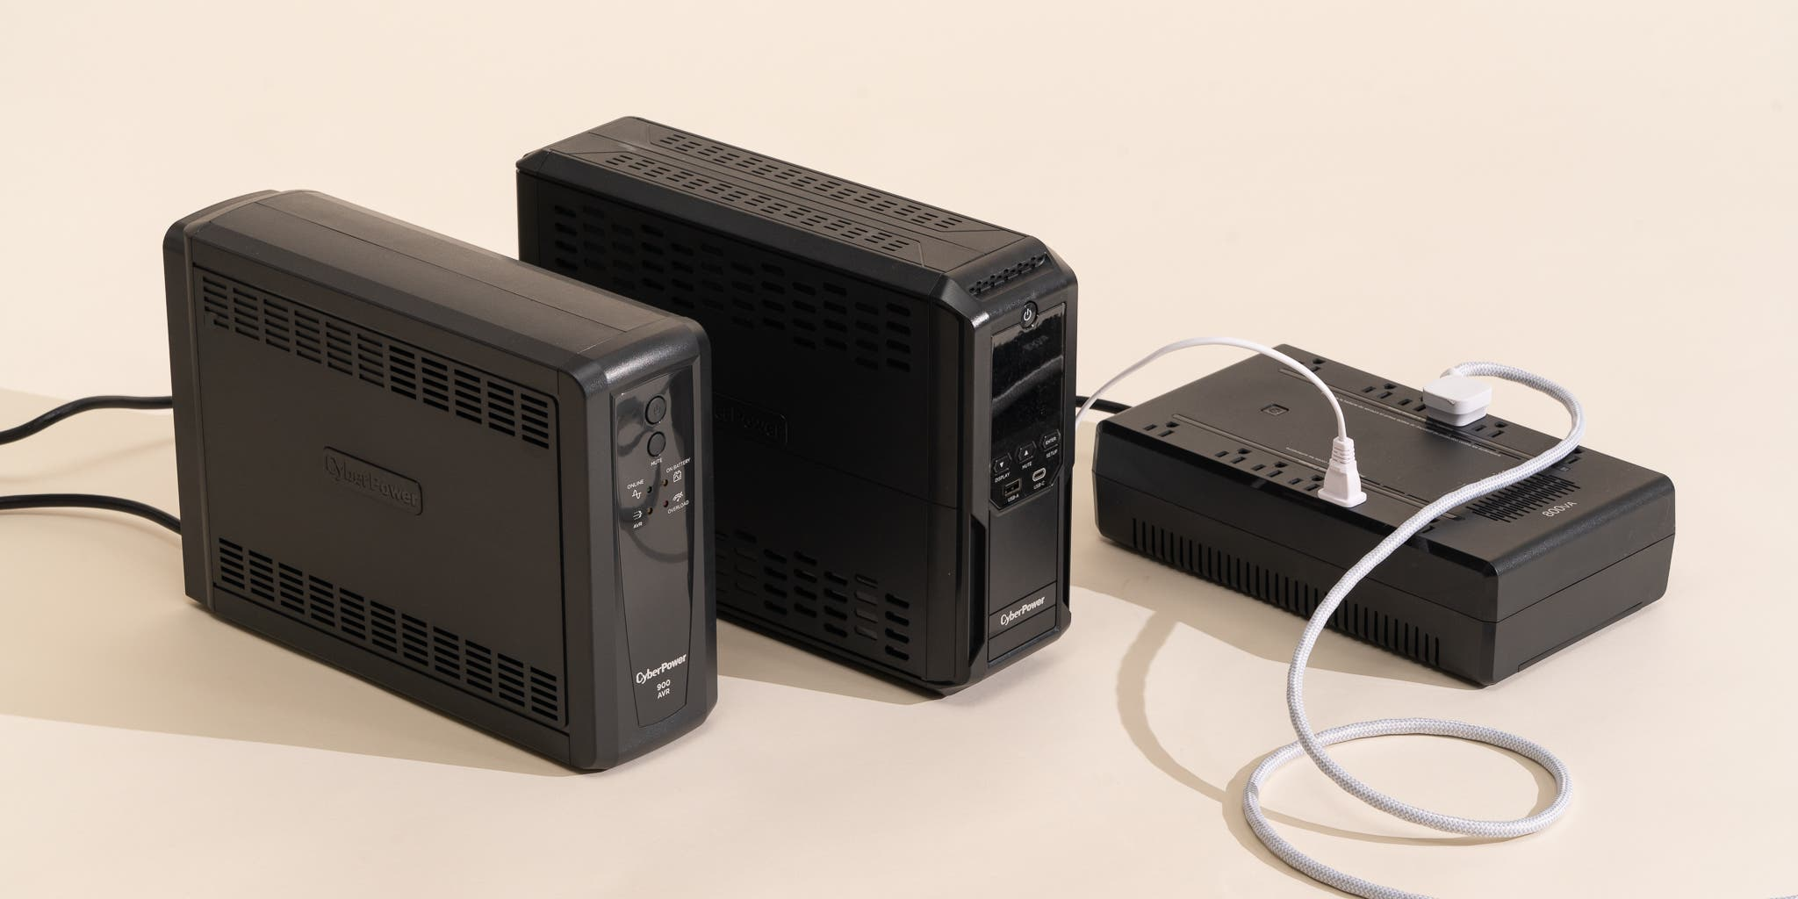
Uninterruptable Power Supply (UPS)
Device that provides emergency power when main power is lost
Bought in WATTs
Can be of any size

Slide 28
KAHOOT!

