Slide 1
Chapter 8
CompTIA Tech+
Implementing Networks

Slide 2
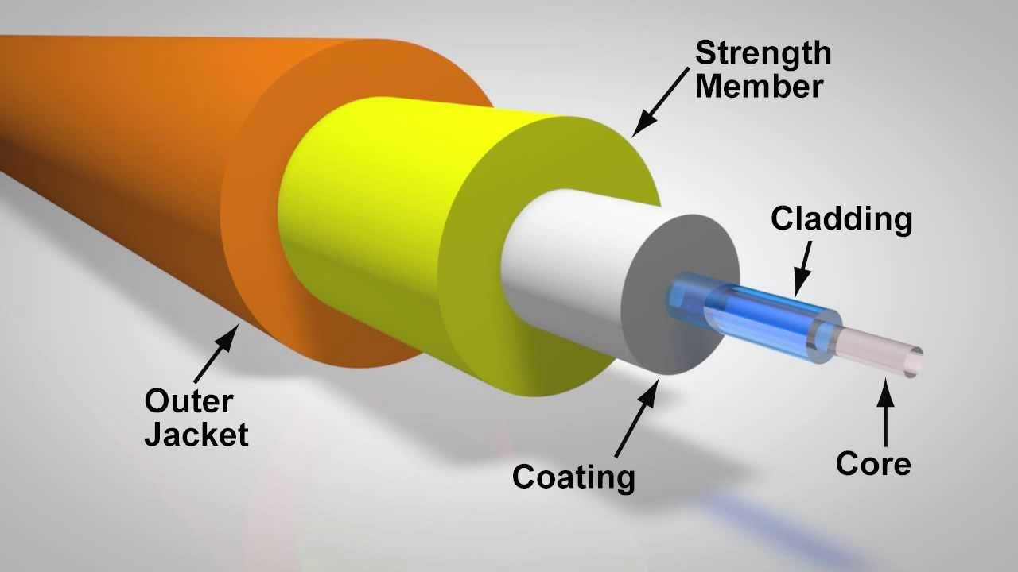
Fiber Optic Internet Service

Slide 3
Fiber Optic Internet Service
Light Pulses
Fiber Optic Cables
Optical Network Terminal
Advantage
  Speed
  Bandwidth
  Low Latency
  Future-Proofing
Disadvantage
  Availability
  Cost
  Installaton

Slide 4
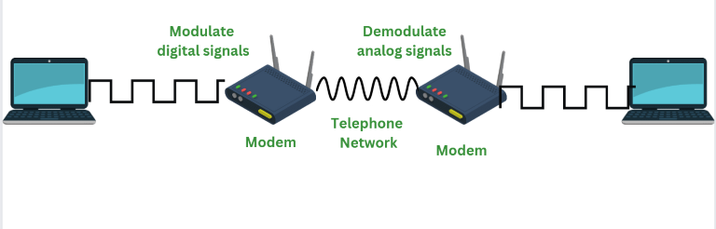
Cable Internet Service

Slide 5
Cable Internet Service
Coaxial Cable Network
Cable Modem
DOCSIS
Cable Modem Termination System
Advantage
  Widely Available
  Good Download Speeds
  Simple Setup
Disadvantage
  Shared bandwidth
  Asymmetrical Speeds
  Local Outages

Slide 6
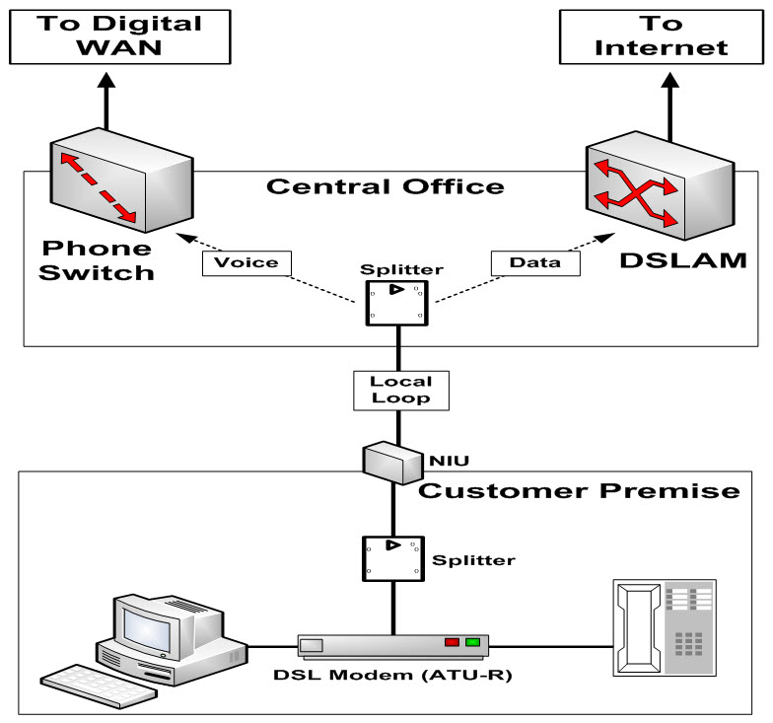
DSL Internet Service

Slide 7
DSL Internet Service
Copper Telephone Lines
DSL Model
DLAM
Frequencies
Advantages
  Wide Availability
  Dedicated Connection
  Cost-Effective
Disadvantage
  Distance Sensitivity
  Lower Speeds
  Asymmetrical Speeds
  Requires a Phone Line

Slide 8
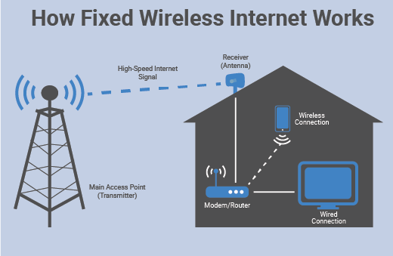
Wireless Internet Service

Slide 9
Wireless Internet Service
Can be WIFI
Cell Towers
Satellite
Advantages:
  Reach underserved areas
  Installation is quick
Disadvantage
  Requires line of sight to tower
  Can be affected by weather
  Speeds can differ

Slide 10
WIFI
Wireless Access Points
Connected to a switch
Allow Wireless NIC to connect
Uses Radio Frequencies

Slide 11
Standardization 802.11x
802.11a, b, g, n, ac, ax
A, b, g not used anymore…
N (Wifi 4) operates on 2.4GHz and 5GHz
AC operates primarily on 5GHz
AX newer 6GHZ! FAST!

Slide 12
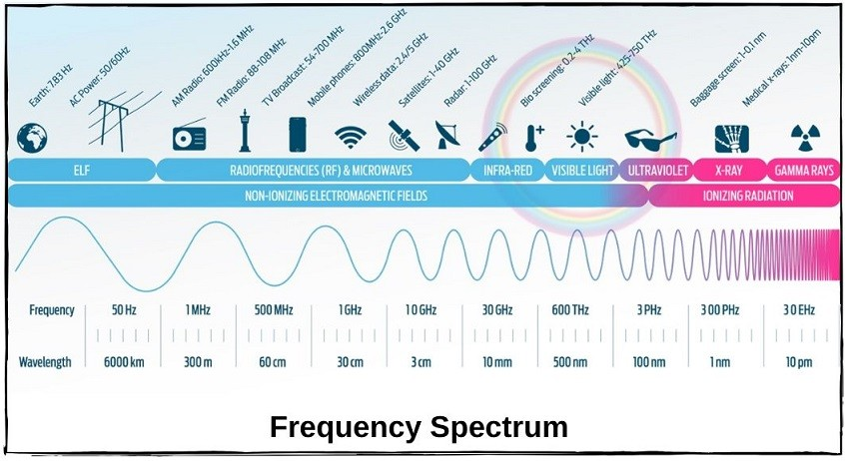
What frequency goes farther?

Slide 13
What to worry about?
Interference
Attenuation

Slide 14
Wi-Fi Security
Open
WEP
WPA
WPA2
WPA3

Slide 15
Other things to DO!
Change default Password
Change Router Password
Change SSID
Update Firmware
MAC filtering?

Slide 16
KAHOOT!

