Slide 1
Integrity and Authentication with an HMAC
Tom Ginader

Slide 2
Basics
CIA of security
Confidentiality
Keeping information secret
Encryption
Integrity
Making sure information can’t be changed
Hashing algorithms
Availability
Backups, uptime, and disaster recovery
RAID
Notes:
Important thing to note: Encryption does not ensure integrity. You can still change data that is encrypted without decrypting it

Slide 3
Basics
AAA
Authentication
Proving someone’s identity
Username and password, shared secret
Authorization
What someone is allowed to do
Access controls, admin privileges
Accounting
Keeping track of what a user does
Logging

Slide 4
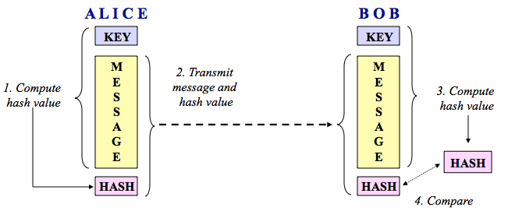
Basics
HMAC
Keyed-hash message authentication code
Notes:
Sort of like symmetric encryption but not encrypting anything. Absolute base form of hmac, as basic as it gets

Slide 5
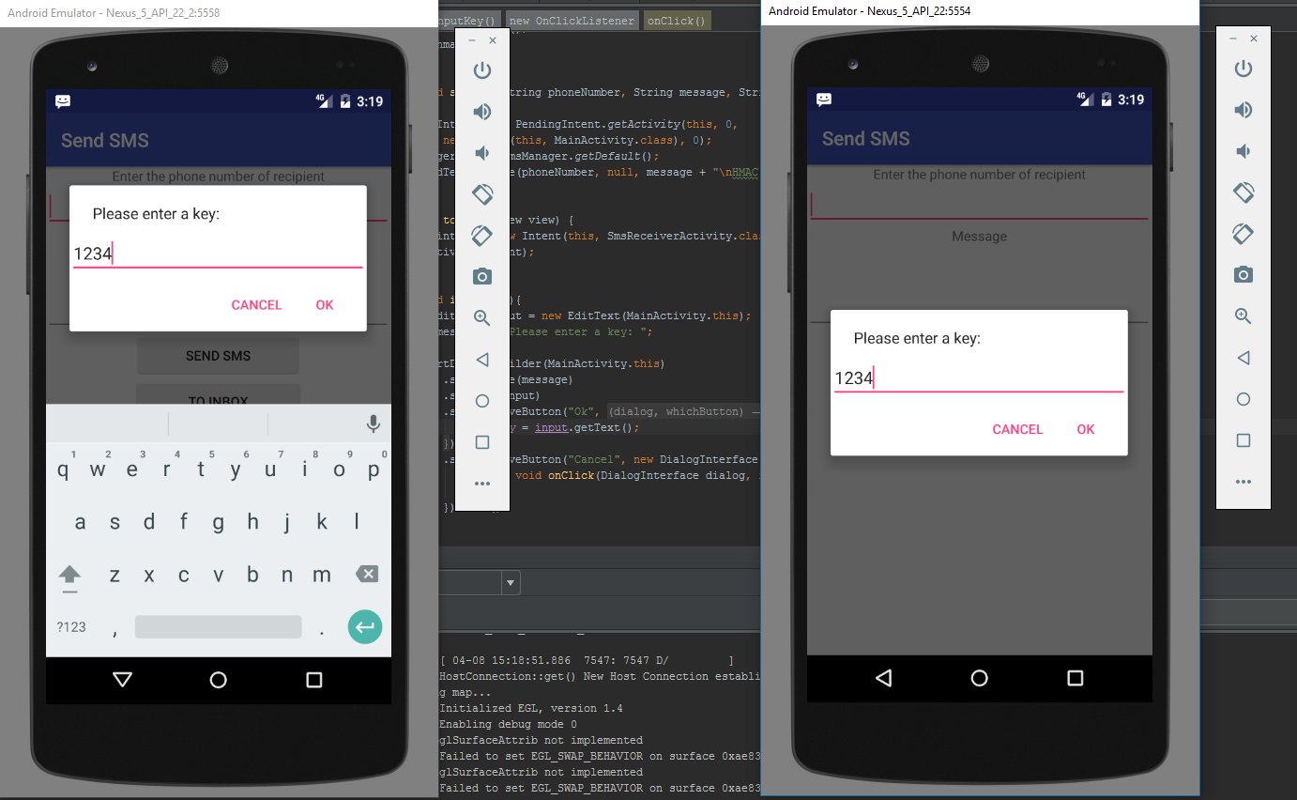
Experiments
Notes:
Providing authentication through the use of the key

Slide 6
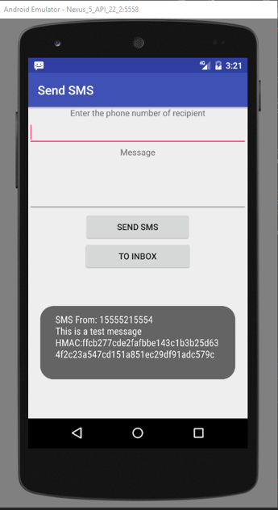
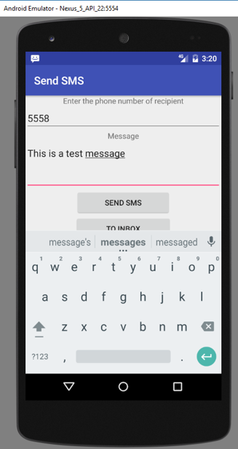
Experiments
Notes:
Hmac is hash digest using SHA-3 256. Probably don’t want the HMAC in the message in a practical setting, but it’s nice to show when demonstrating

Slide 7
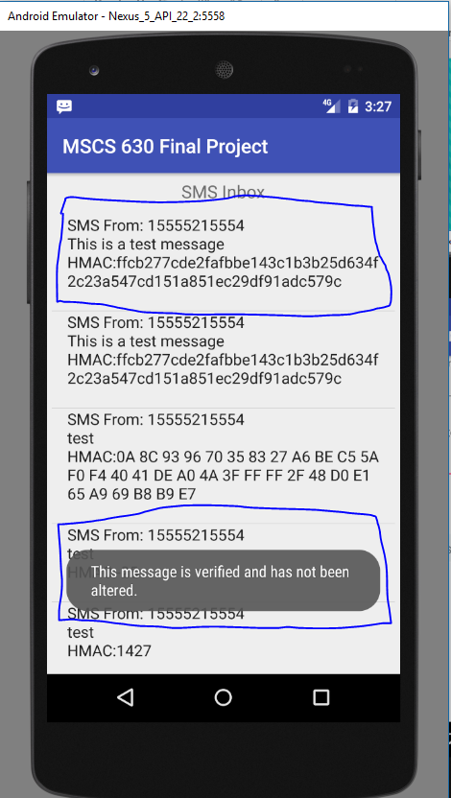
Experiments
Notes:
To inbox view. Can click on the message and it will show another toast. That’s what we want to see

Slide 8
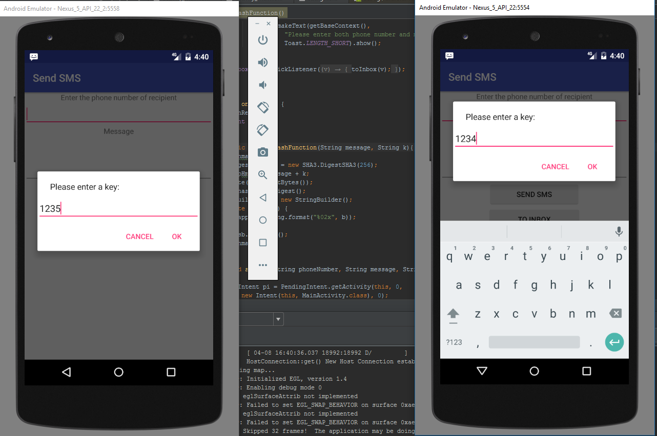
Experiments

Slide 9
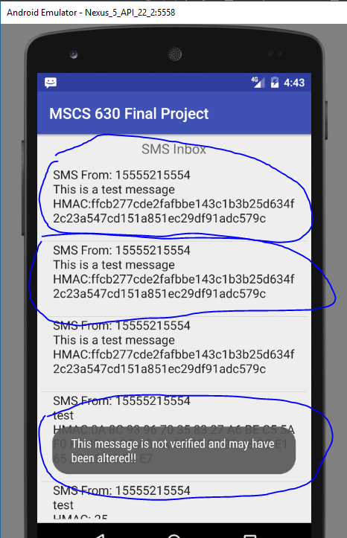
Experiments
Notes:
Same hmac for both messages, but that top one is not verified because the key is different. First message is 2nd one down Doesn’t match receivers hmac because keys are different

Slide 10
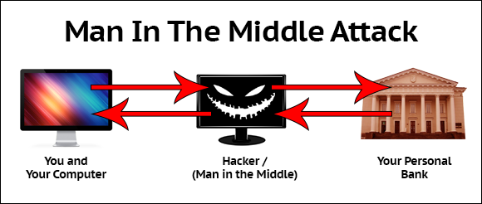
Man in the Middle Attack
When two parties or a client/server try to communicate with one another in a legitimate way, but all of the traffic is unknowingly going through a 3rd party
Notes:
How is this useful? What can this prevent? Basically a hacker can intercept your messages and either look at them or alter them before the get sent to the original receiver

Slide 11
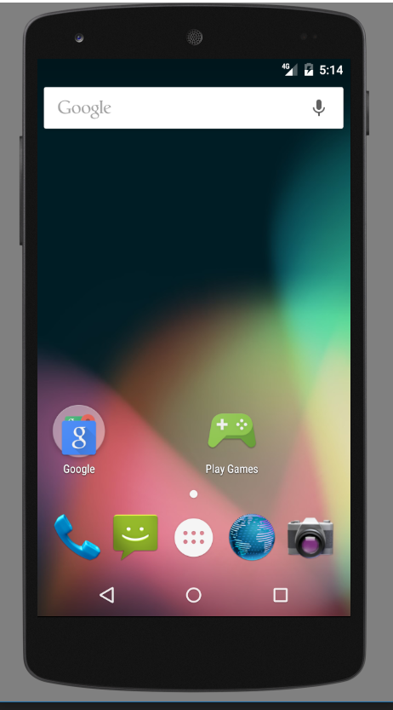
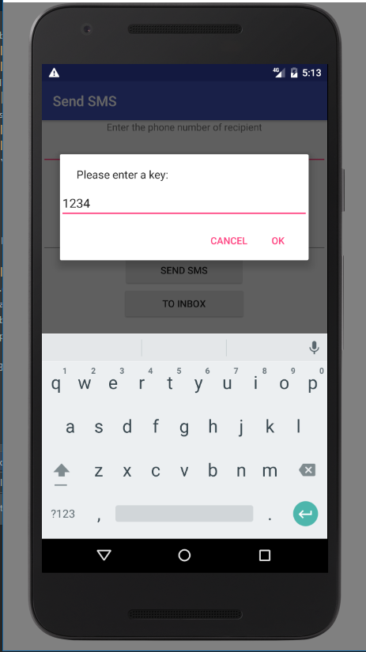




Man in the Middle Attack
Man in the Middle Attack
Man in the Middle Attack
Notes:
Could only get 2 emulators to run at same time so ill have to use some screenshot magic to make it seem like there’s actually 3

Slide 12
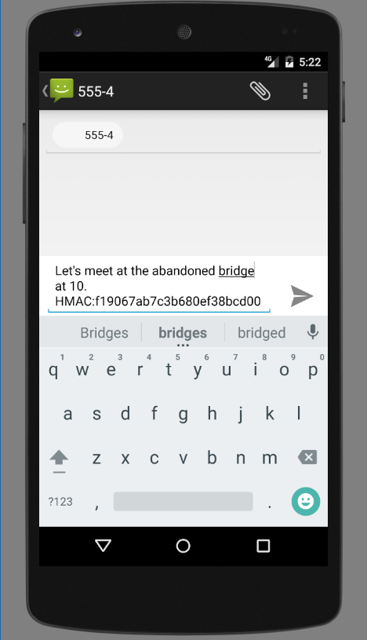
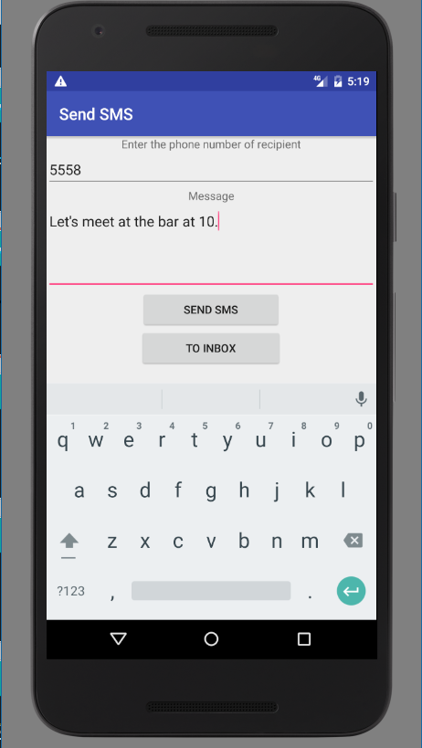
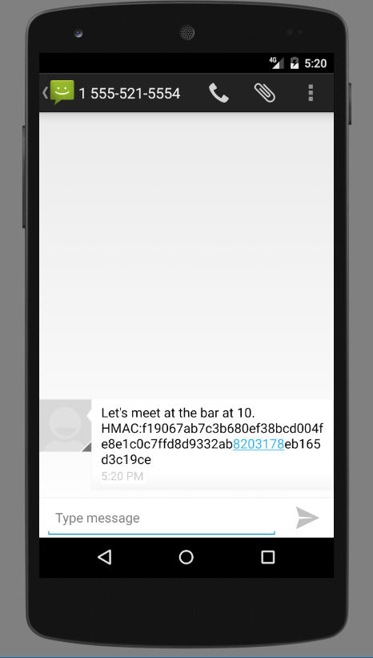
Man in the Middle Attack
Notes:
Hacker intercepts message from A and has it open in the default app. He then changes the message to let’s meet at the abandoned bridge at 10

Slide 13
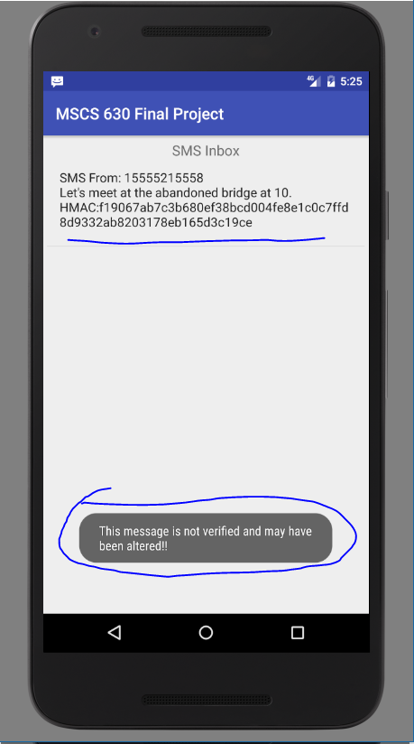
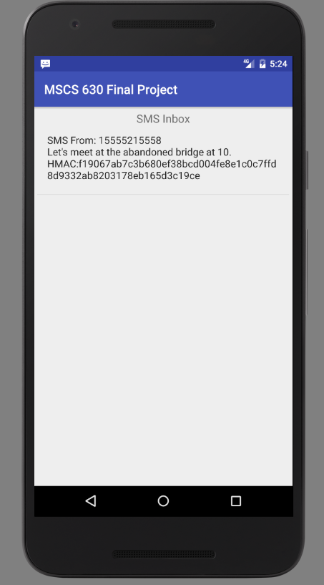
Man in the Middle Attack

Slide 14

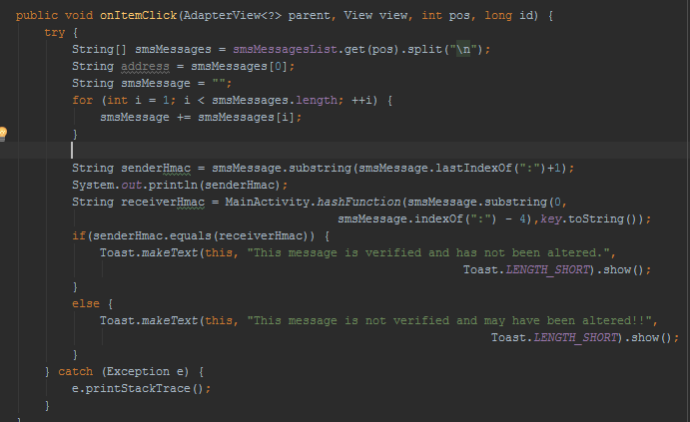
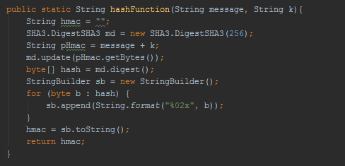
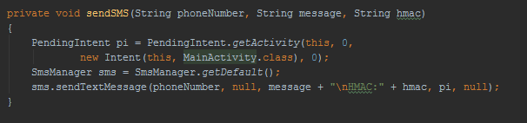
Source Code Algorithm
Notes:
All credit goes to bouncy castle for their SHA 3 algorithm. Didn’t have time to implement by own SHA 3 algorithm. Should check them out, they have all kinds of secure algorithms you can use such as AES, bcrypt, and RSA.
Pictures on left is what the sender is doing. picture on right is what receiver does

Slide 15
Questions?

Slide 16
References
http://www.garykessler.net/library/crypto.html
https://www.deepdotweb.com/wp-content/uploads/2016/10/word-image-19.png
https://www.gohacking.com/wp-content/uploads/2009/01/how-to-become-a-hacker-735x400.jpg

