Slide 1
Integrity and Authentication with an HMAC
Tom Ginader

Slide 2
Basics
CIA of security
Confidentiality
Keeping information secret
Encryption
Integrity
Making sure information can’t be changed
Hashing algorithms
Availability
Backups, uptime, and disaster recovery
RAID
Notes:
Important thing to note: Encryption does not ensure integrity. You can still change data that is encrypted without decrypting it

Slide 3
Basics
AAA
Authentication
Proving someone’s identity
Username and password, shared secret
Authorization
What someone is allowed to do
Access controls, admin privileges
Accounting
Keeping track of what a user does
Logging

Slide 4
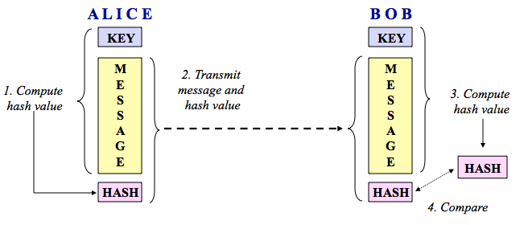
Basics
HMAC
Keyed-hash message authentication code

Slide 5
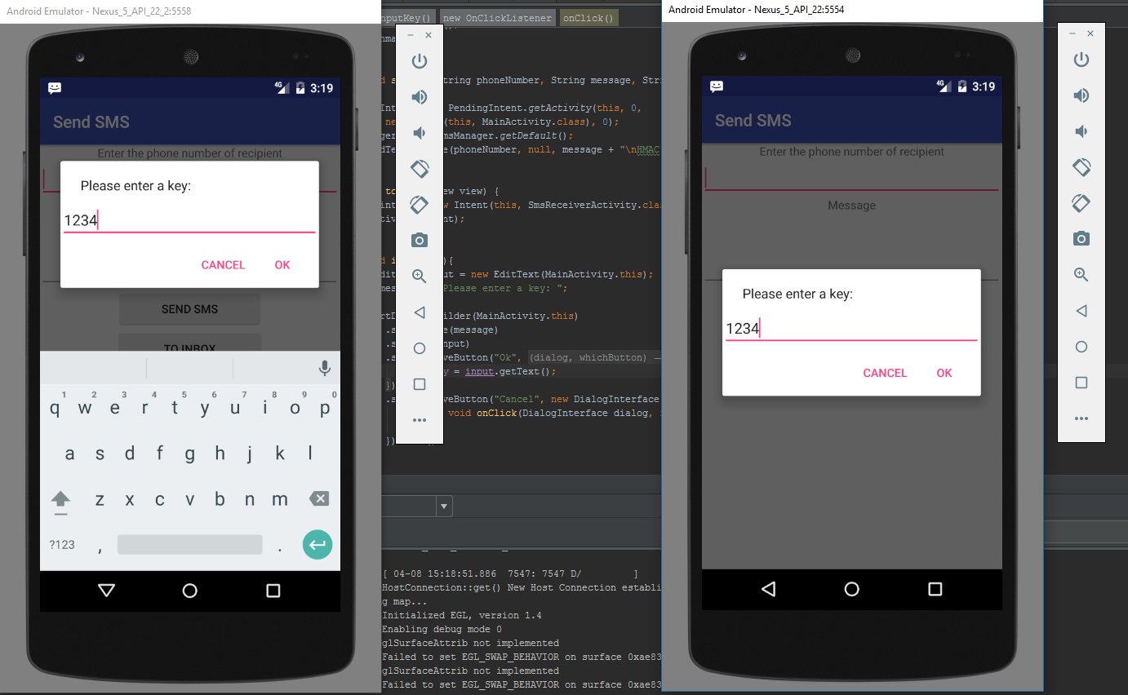
Experiments

Slide 6
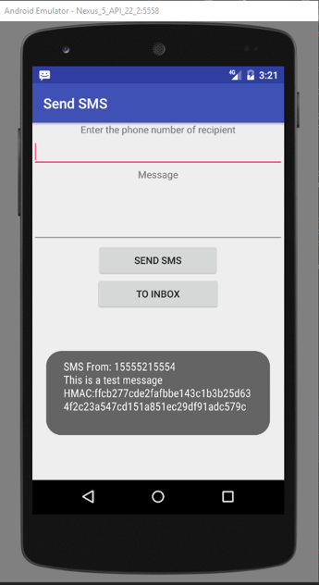
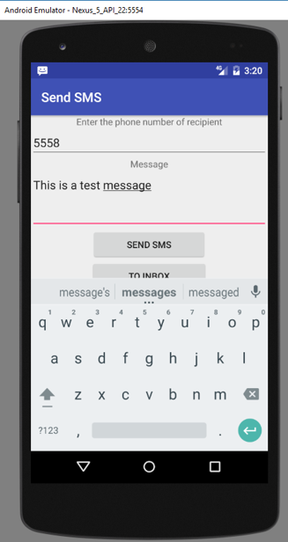
Experiments

Slide 7
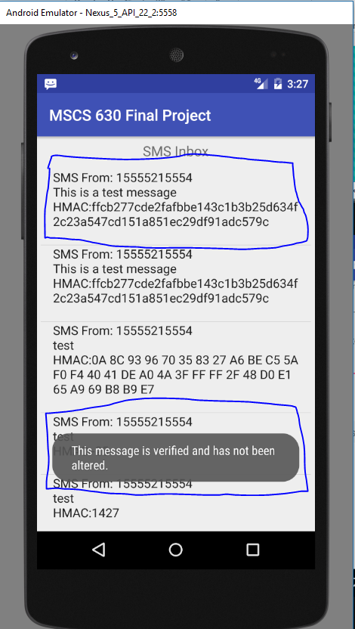
Experiments

Slide 8
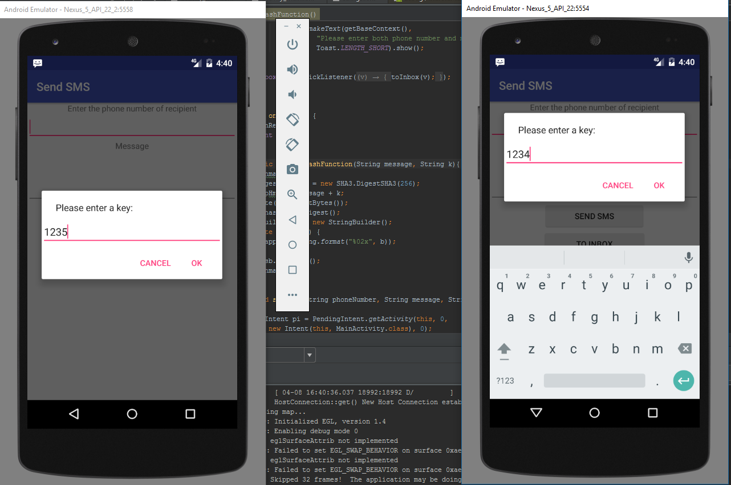
Experiments

Slide 9
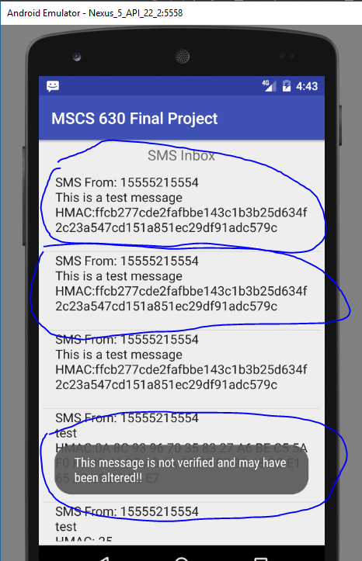
Experiments

Slide 11
Man in the Middle Attack

Slide 12
References
http://www.garykessler.net/library/crypto.html

