Slide 1
Residential Hall Inventory System
CSCD 488

Slide 2
Background
What caused Residential Life to need this new inventory system?
Our Team:
Gina Korn
Jon Roster
Ray FitzGerald
James Pettit
Corey Turner
Benjamin Bennett

Slide 3

Old Inventory System
The old inventory system was 100% pen and paper
This made keeping track of items much more time consuming
Very easy to misplace the log
Almost no “standardization” of items
Overdue items were becoming a problem for Community Advisors (CAs)
No set rules for certain special items

Slide 4
New Inventory System
The new system we were tasked with creating needed to replace the old pen-and-paper system with something much more efficient
It needed to have item standardization, so that we could track popular items
It needed to have a database of residents as well, so that residents who didn’t check things in on time couldn’t continue checking new stuff out
Finally, it needed to have an unsettling amount of rules and exceptions for the way that items can be checked out
The rule is, you can only check out ONE ITEM AT A TIME. PERIOD.
But if you check out a video game console, you get a game, too.
Oh, you want to check out the kitchen? Great, you can check out all the cooking stuff you could possibly imagine, too.
And if you’re a CA who’s checking out items, then none of the rules apply to you.

Slide 5
Problems
No existing architecture in our target res hall
Limited support from OIT for hardware infrastructure
Data vulnerability
Platform choice

Slide 6
Developing Our Product
From concept to completion (almost)

Slide 7
Creating our Database
This was first because a database doesn’t depend on front-end architecture
After input from our client, we had enough information to build a rough ERD, and from there, a relational schema
After having Dr. Li take a look at it, we got the database created and populated and ready for user requirements

Slide 8
Creating our Database
Basic functionality:
Checking items in and out
Adding/removing items and residents
Reports (items currently checked out, most popular items, etc.)
Additional requirements:
Administrator roles
Rules for special items
Reserving items for future check-out
Damaged items

Slide 9
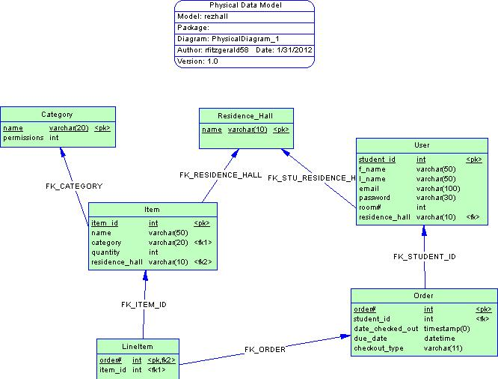
Creating our Database
Database started off small and simple
As requirements were added, the database grew, and became more complex
Adding checkout rules to the database was not easy

Slide 10
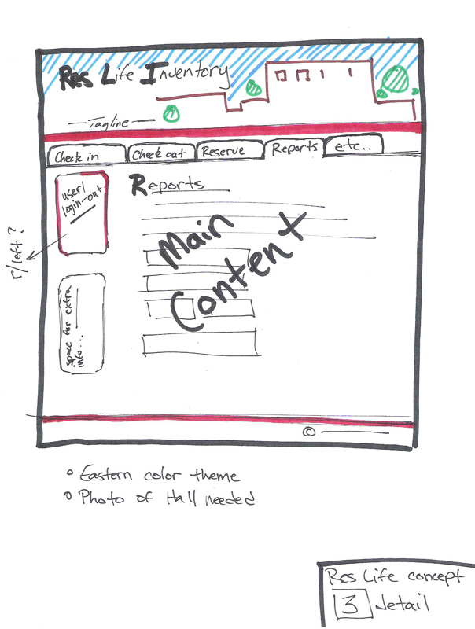
Creating the User Interface
Started off with rough sketch of what we wanted it to look like
Found a hosting server to start developing
Learned PHP
Started adding database connectivity

Slide 11
Implementing features
Added login for administrators
Added reports
Added admin features such as adding new items/removing damaged or lost items
Formatting the entire site to look nice
Added extra tables to the database for extra functionality (logging old transactions, damaged items, etc.)

Slide 12
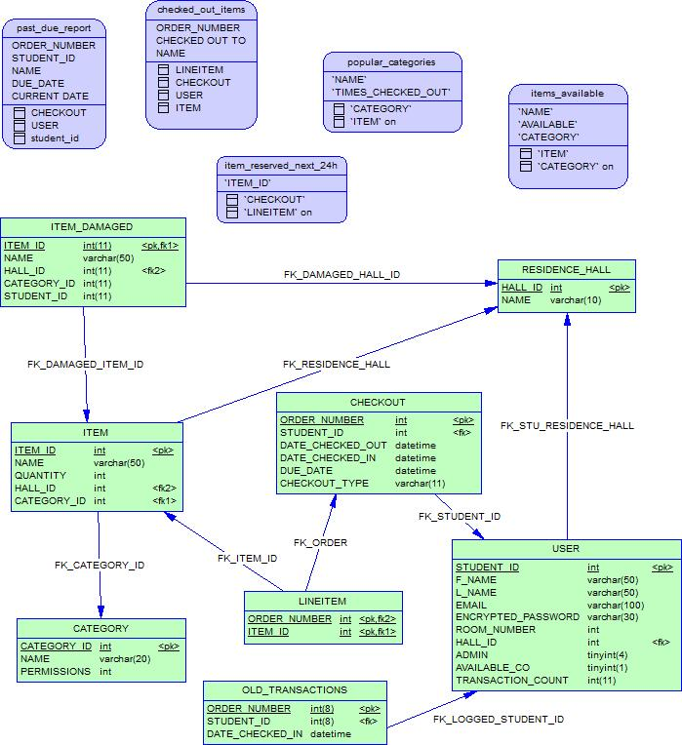
Implementing features
When we started OUt
What it looks like now

Slide 13
Problems
Minimal budget
GoDaddy does not provide support for database triggers
Unable to log old transaction
Unable to update item/user statistics
Should not be a problem on final product, which is a closed system
Multi-day discussion/argument on desktop application vs. web-based application

Slide 14
Problems
Current computers in target res hall are wiped nightly (no data retention)
End-users have little knowledge of SQL and PHP, so everything must be handled behind the scenes
Adding exceptions to the database, allowing for item rules to be broken in certain cases

Slide 15
Results
Completed project

Slide 16
Questions?

