Slide 1
Residential Hall Inventory System
CSCD 488

Slide 2
Background
What caused Residential Life to need this new inventory system?
Our Team:
Gina Korn
Jon Roster
Ray FitzGerald
James Pettit
Corey Turner
Benjamin Bennett

Slide 3

Old Inventory System
The old inventory system was 100% pen and paper
Time consuming
No standardization
No reports on overdue items
No set rules for certain special items

Slide 4
New Inventory System
New system needs to be more efficient
Standardized process
Include a database of residents and CAs with management capabilities
Lots of rules and exceptions to items

Slide 5
Problems
No existing architecture in our target res hall
Limited support from OIT for hardware infrastructure
Data vulnerability
Platform choice

Slide 6
Risks
Authentication is handled with PHP session variables
Community Advisors may forget to logout while their session is still in use.

Slide 7
Developing Our Product
From concept to completion (almost)

Slide 8
Creating our Database
This was first because a database doesn’t depend on front-end architecture
After input from our client, we had enough information to build a rough ERD, and from there, a relational schema
After having Dr. Li take a look at it, we got the database created and populated and ready for user requirements

Slide 9
Creating our Database
Basic functionality:
Checking items in and out
Adding/removing items and residents
Reports (items currently checked out, most popular items, etc.)
Additional requirements:
Administrator roles
Rules for special items
Reserving items for future check-out
Damaged items

Slide 10
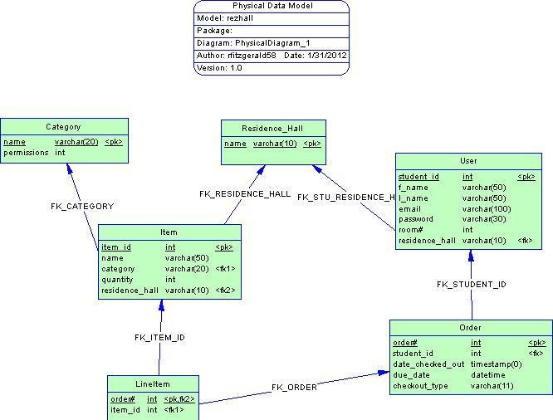
Creating our Database
Database started off small and simple
As requirements were added, the database grew, and became more complex
Adding checkout rules to the database was not easy

Slide 11
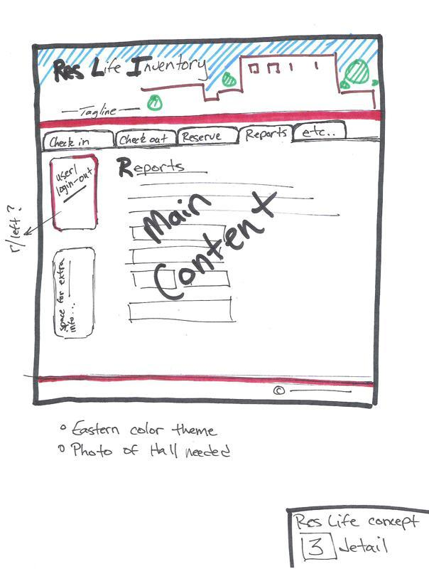
Creating the User Interface
Started off with rough sketch of what we wanted it to look like
Found a hosting server to start developing
Learned PHP
Started adding database connectivity

Slide 12
Implementing features
Added login for administrators
Added reports
Added admin features such as adding new items/removing damaged or lost items
Formatting the entire site to look nice
Added extra tables to the database for extra functionality (logging old transactions, damaged items, etc.)

Slide 13
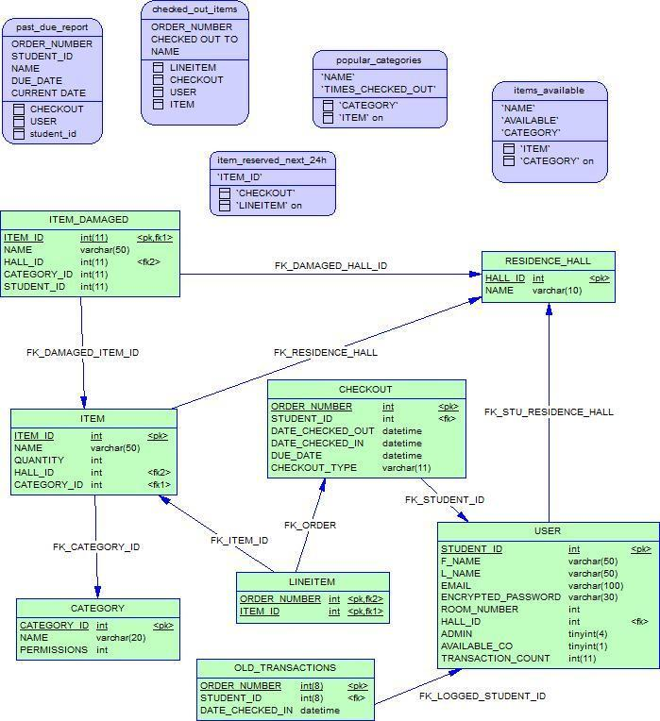
Implementing features
When we started out
What it looks like now

Slide 14
Problems
Minimal budget
GoDaddy does not provide support for database triggers
Unable to log old transaction
Unable to update item/user statistics
Should not be a problem on final product, which is a closed system
Multi-day discussion/argument on desktop application vs. web-based application

Slide 15
Problems
Current computers in target res hall are wiped nightly (no data retention)
End-users have little knowledge of SQL and PHP, so everything must be handled behind the scenes
Adding exceptions to the database, allowing for item rules to be broken in certain cases

Slide 16
Results
Completed project

Slide 17
Questions?

