Slide 1

Hotel Bookings
Presentation of project 1
Group 7.
Bednár Maroš, Escofet González Gina, Foroudian Kimia, Lafuente González Alex, Smyhelskyy Yaskevych Sergio
Data Mining
March 24th 2025

Slide 2

Outline of the presentation
Goals of the work
Overview of BD structure and variables analyzed
Data mining process schema
The descriptive analysis
Preprocessing steps
PCA
Clustering process and resulting dendrogram
Class Interpretation tools
Profiling graphs to be highlighted
Final class profiling
Comparison of conclusions between PCA and clustering
Conclusions of the work
Original and final scheduling

Slide 3

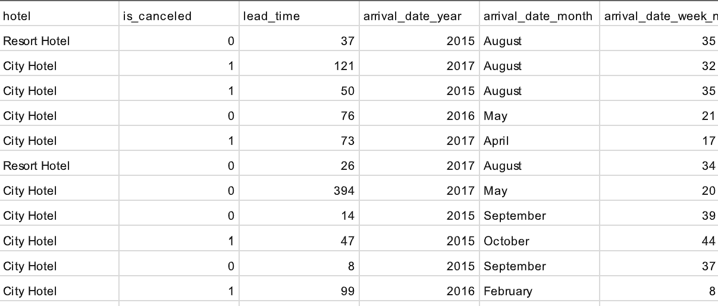
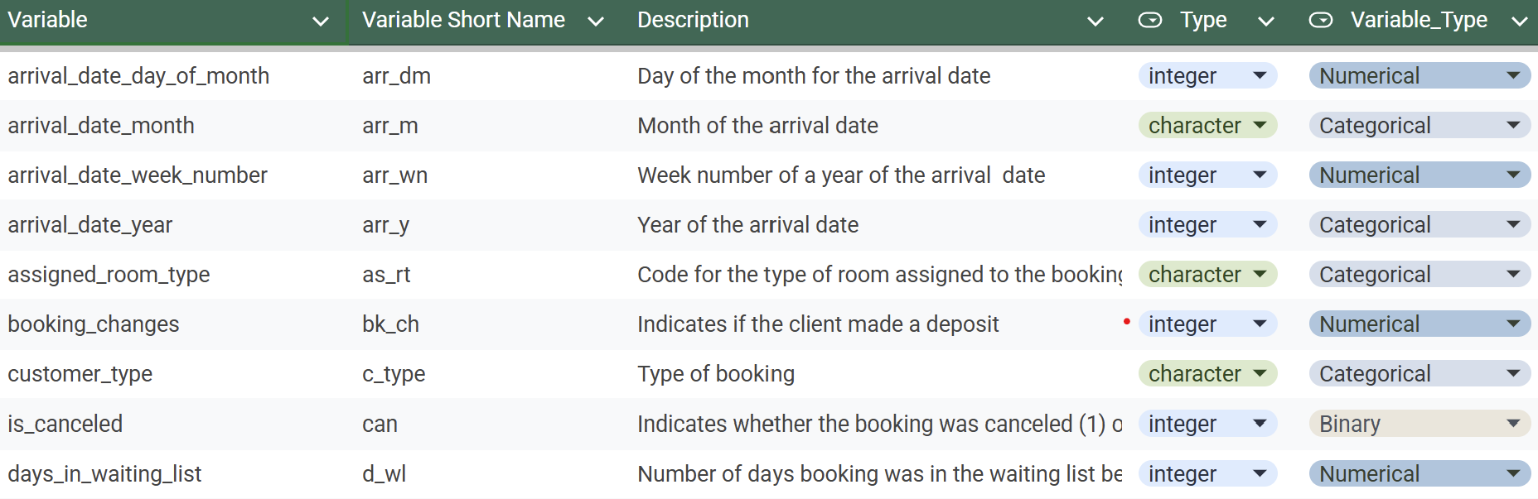
Goals of the work
Explore the factors that may lead to reservation cancellations and to derive meaningful customer segments based on booking behaviors.
Overview of the BD structure
Overview of the variables analyzed
Source of the Database: https://www.kaggle.com/datasets/mojtaba142/hotel-booking
Notes:
gina

Slide 4

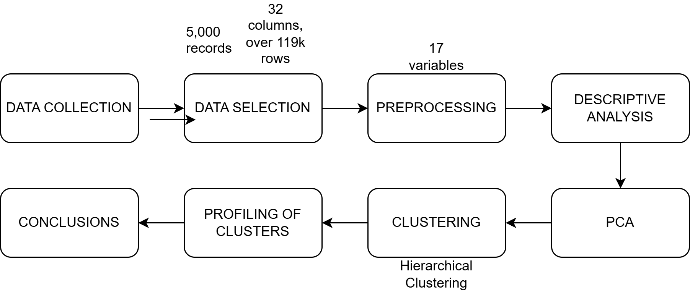
Data mining process schema

Slide 5
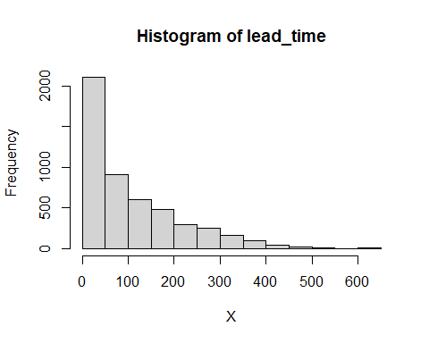
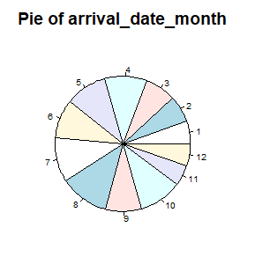
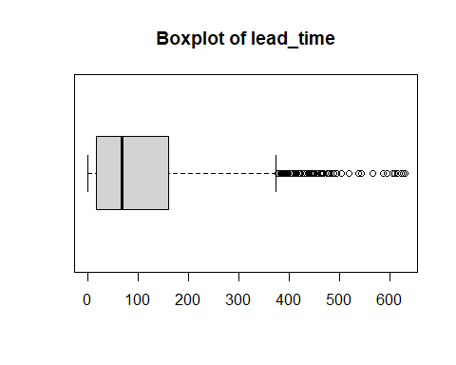
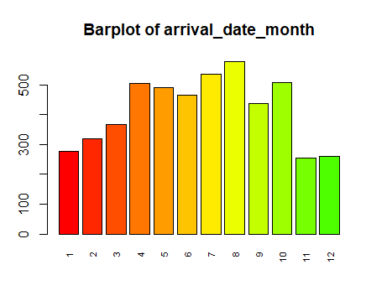
Descriptive analysis
Notes:
gina
En esta diapositiva tienes que hablar específicamente de los resultados de la variable numérica lead time, y de la categórica arrival date month

Slide 6
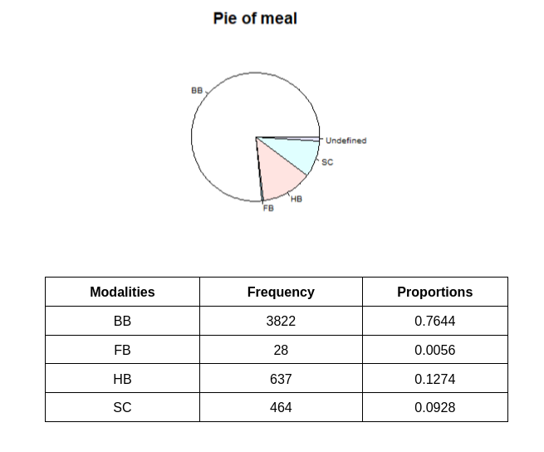
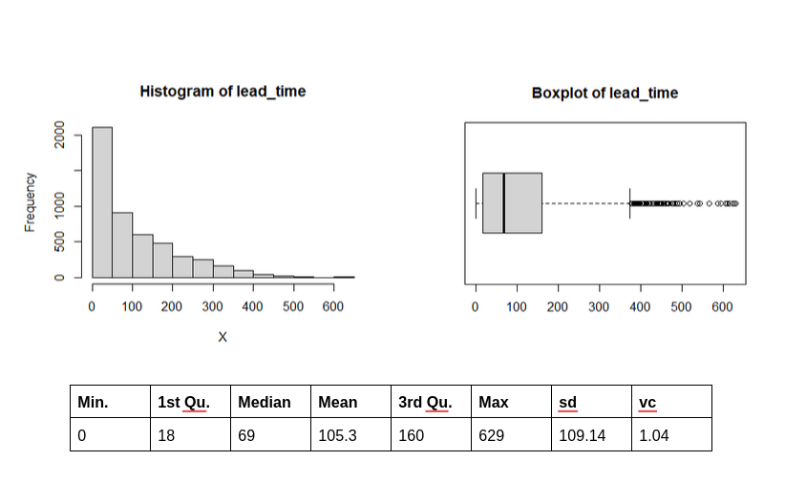
Univariate descriptive analysis
Numerical variable
Qualitative variable
Notes:
gina
En esta diapositiva hay que hablar de la estructura con la que mostramos los resultados para las variables numéricas y categóricas

Slide 7

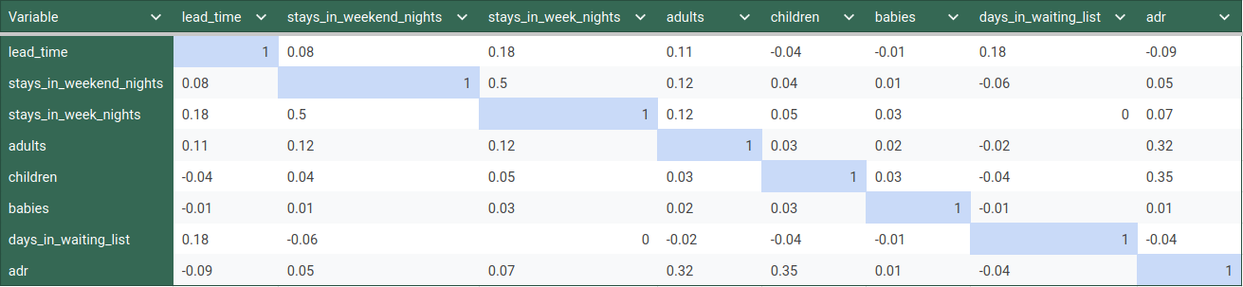
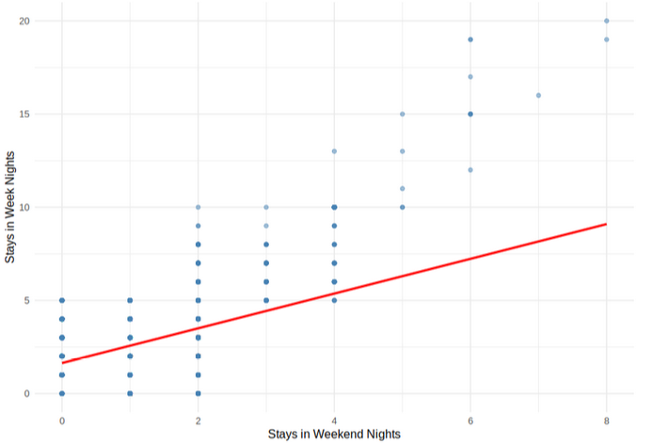
Additional descriptive analysis
Notes:
gina

Slide 8

Preprocessing steps
Select a sample of 5000 rows
Discard irrelevant variables
No missing data on our database
Identification of outliers/errors
Abbreviating the name of the variables for PCA

Slide 9
PCA
Principal Component Analysis is a dimensionality reduction technique used to simplify complex datasets while preserving as much valuable information as possible.
In the context of hotel bookings, datasets often contain many features—some of which may be redundant or highly correlated.

Slide 10
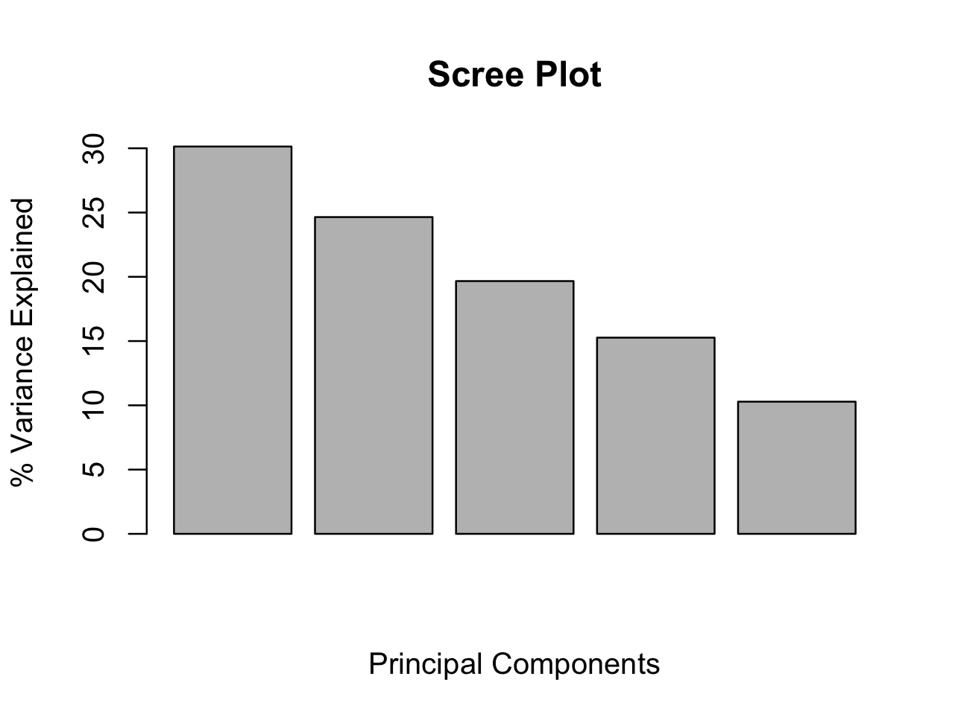
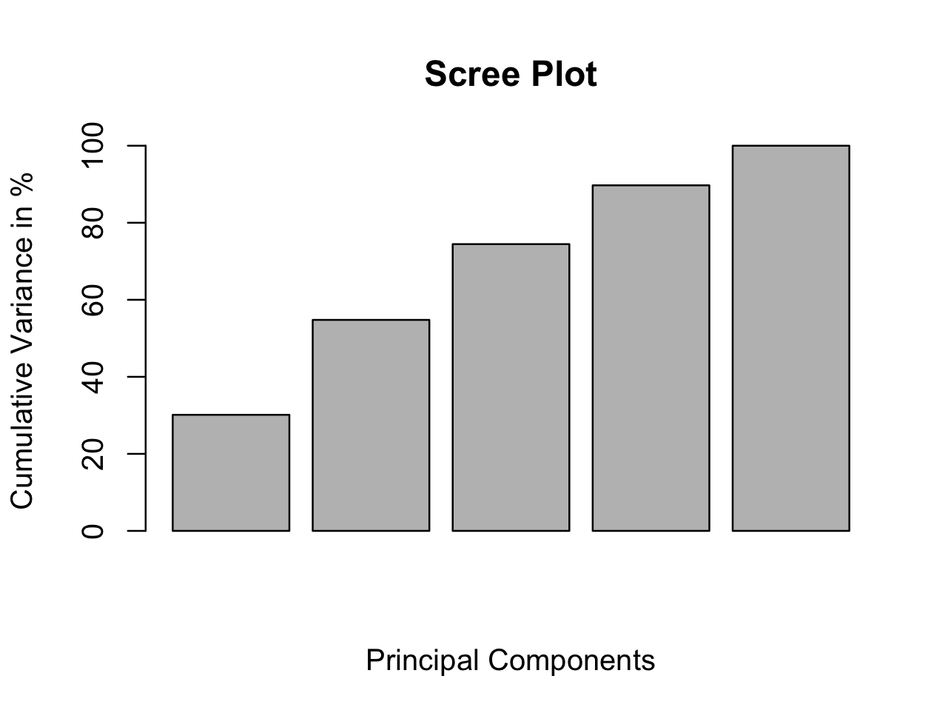
PCA - Factorial Maps

Slide 11
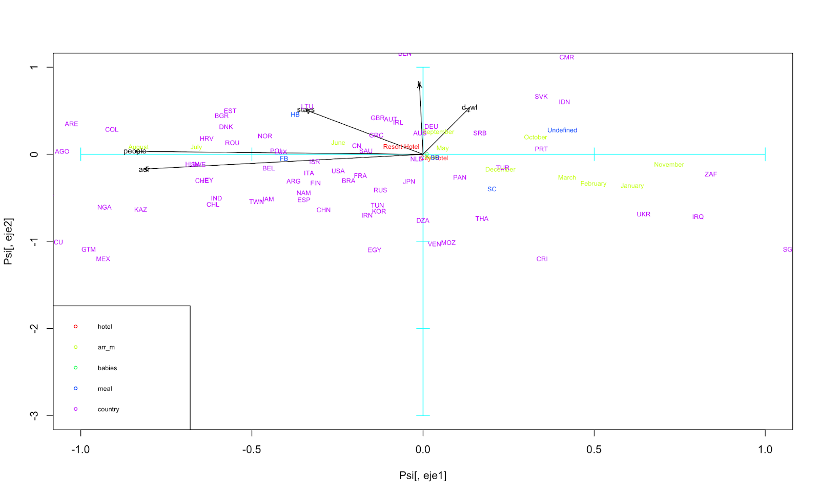
PCA - PCA - Graphs
Following graph displays PC1 vs PC2
Top‐right quadrant is more likely a Resort Hotel booking with a longer stay,
Lower‐left quadrant suggest shorter stays, fewer waitlist days, and possibly lower ADR.
Similar graphs done with PC1 vs PC3 and PC2 vs PC3

Slide 12
PCA - Conclusion
PC1 captures strong seasonal effects on bookings, meanwhile PC2 separates small/simple vs. large/complex booking profiles (party size, total stays, wait‐list days). Furthermore, PC3 highlights whether a booking is driven by length of stay vs. days on the waiting list.
As a whole, these three principal components reveal distinct patterns in how seasonality, booking complexity, and the stay‐length / wait‐list tradeoff all shape the overall structure of the dataset.

Slide 13
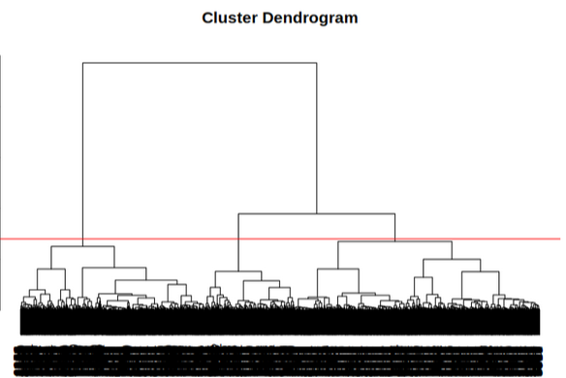

Clustering and dendrogram
Diss. Matrix using Gower metric
Overweighted variables removed (date vars.)
Ward’s method for aggregation
K = 3
Notes:
Add dendogram, explain why gower, clustering with ward’s method…

Slide 14
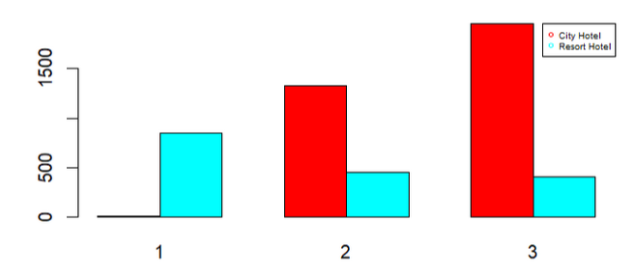
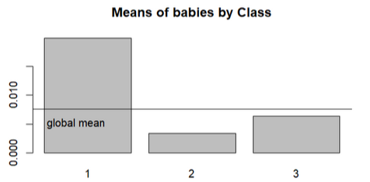
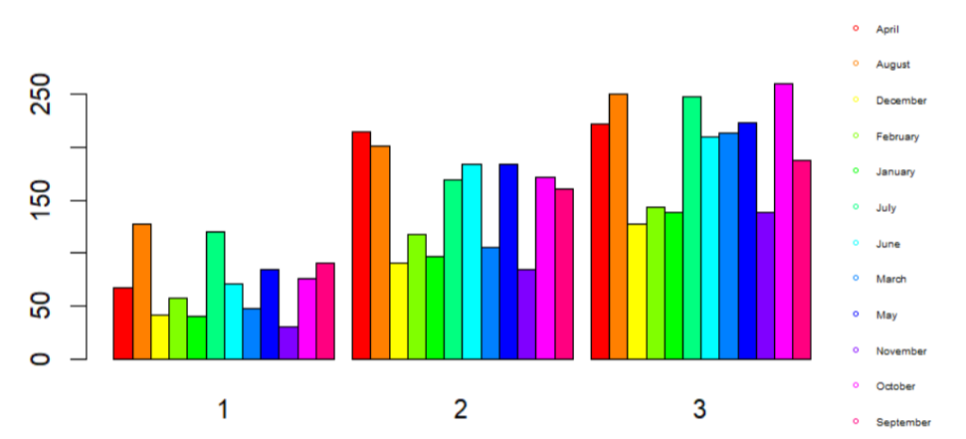
Class Interpretation tools
P-values
Numerical: Anova, Kruskal-Wallis
Qualitative: chi-squared
Both: ValorTestX
Graphs
Notes:
P - Value (and teacher’s photo)

Slide 15
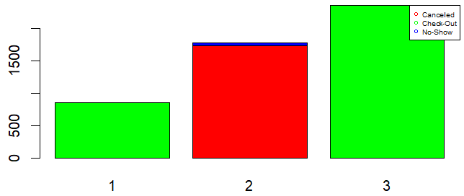
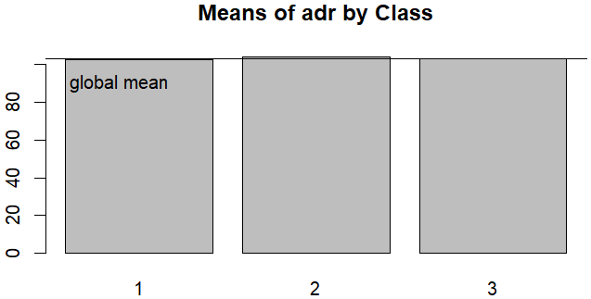
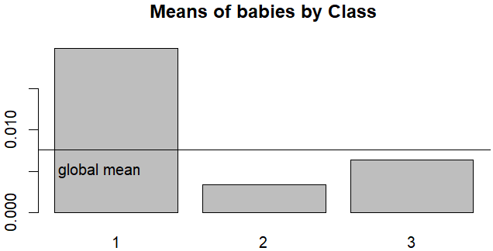
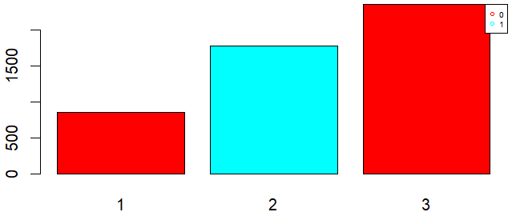
Profiling graphs to be highlighted
Notes:
P - Value (and teacher’s photo)

Slide 16
Final class profiling
 | Cluster 1 | Cluster 2 | Cluster 3
Hotel type | Resort | City | City
Is canceled | Not canceled | Canceled | Not canceled
Lead Time | MID | HIGH | LOW
Arrival Month | Vacation Months | Across Year | Across Year (↑)
Stays week nights | Stay on weekend nights | Few weekdays (↓) | Few weekdays (↑)
Babies | HIGH | LOW | LOW-MID
Meal | Absence SC | Absence FB | Absence FB
Country | Portugal & UK (↑) | Portugal | Portugal && Europa
Days waiting list | LOW-MID | HIGH | MID
Reservation Status | Check-out (↓) | Canceled | Check-out (↑)
Cluster 1: Family
+ Resort Bookings
+ Babies
Cluster 2: Canceled bookings
Exclusive canceled
Longer lead times
+ days waiting list
Cluster 3:Comercial workers
less days week
Urban hotels

Slide 17
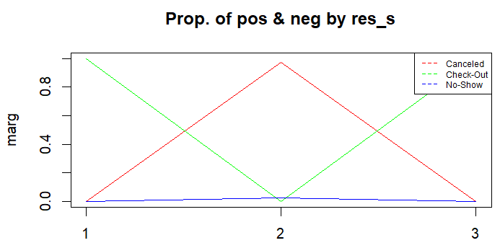
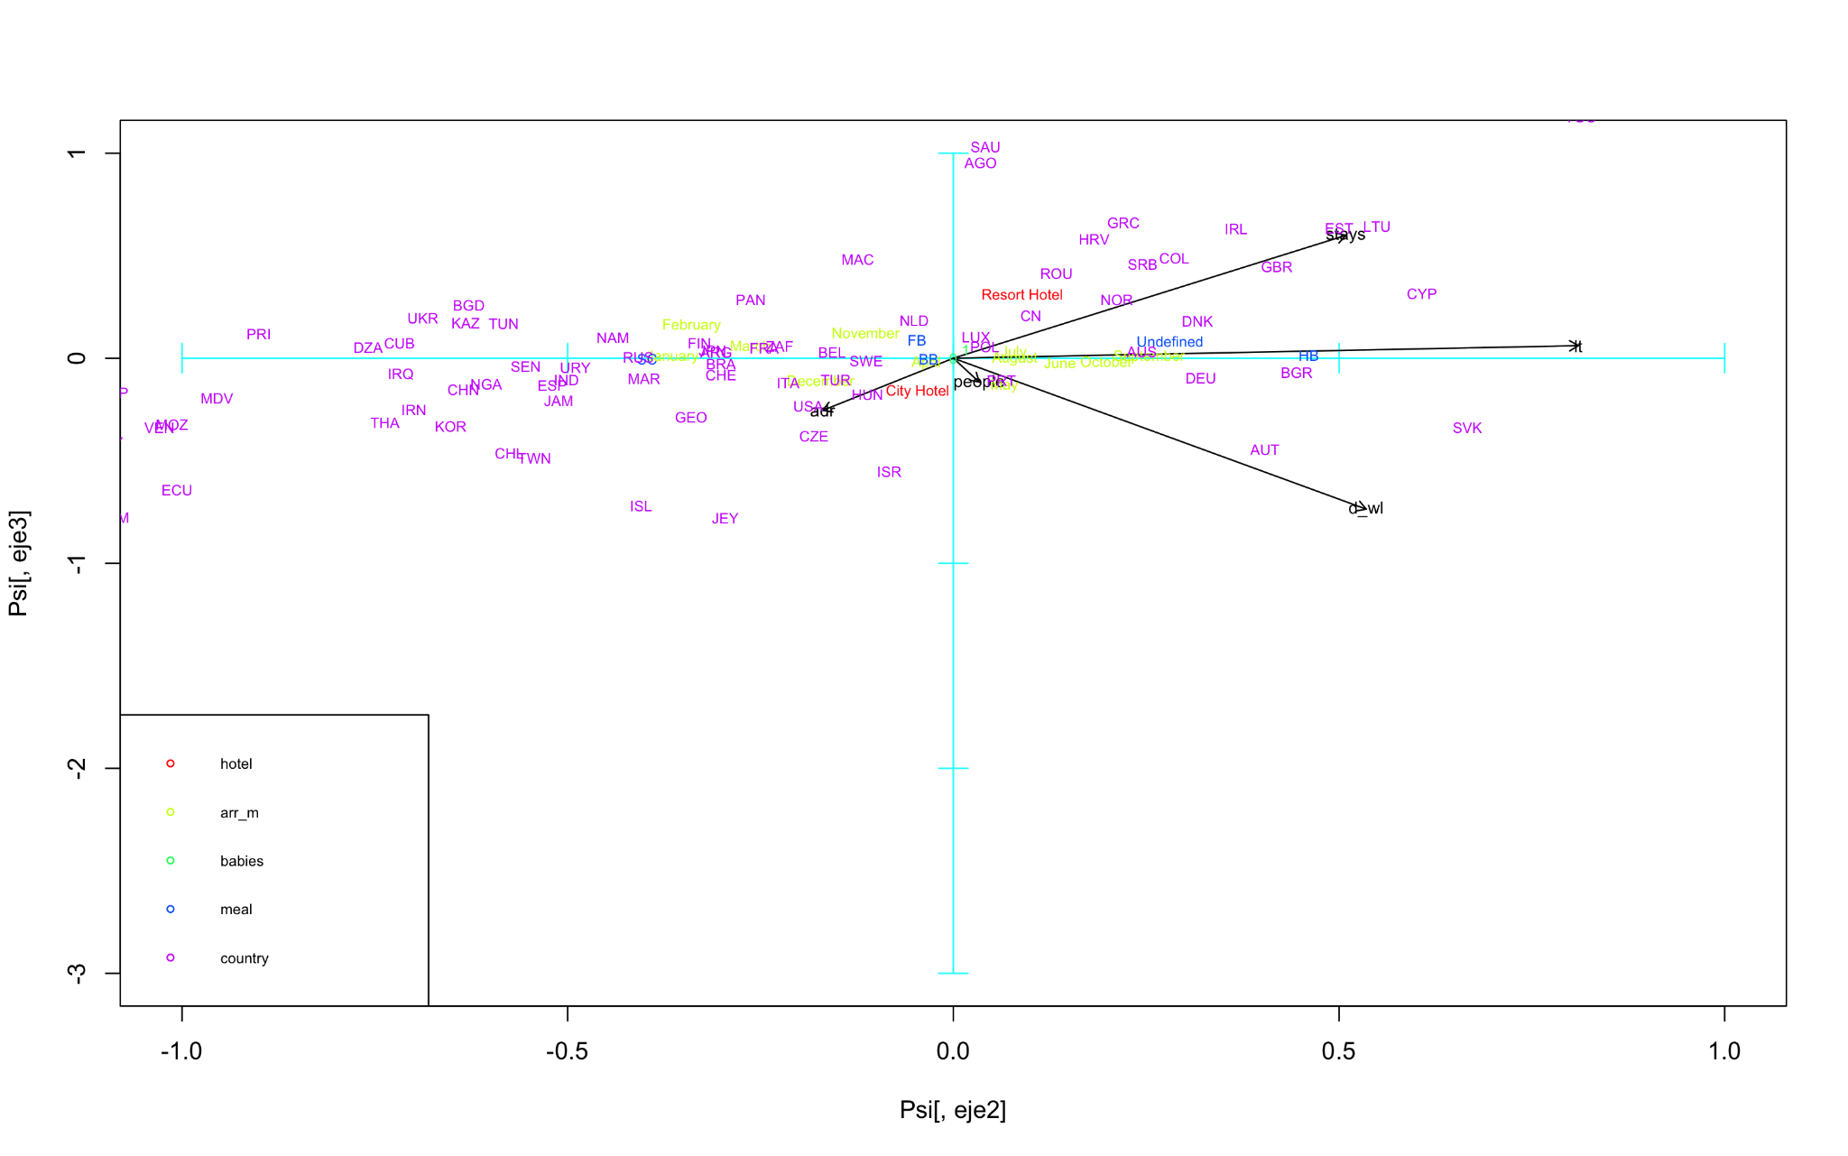
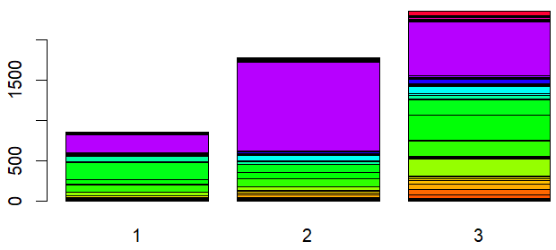
Comparison of conclusions between PCA and clustering

Slide 18
Conclusions of the work
✔ We have learned how to treat the information that the variables of a database can give us (some more than others).
✔ We have seen the importance of cleaning/simplifying our database in order to carry out statistical methods to extract more information.
✔ We have been able to detect patterns between variables in the database that describe the hotel's behaviour, thanks to PCA.
✔ We have been able to identify and classify groups in the database, based on the difference between them, thanks to clustering.
✔ We have learned different statistical methods of DM and how to carry this out with R and how to correctly interpret the generated plots.
Most bookings happen in summer.
Resort bookings are the minority of the database.
This means that city hotels predominate.
Most resort bookings are booked by families on holiday months.
Canceled bookings occur with longer lead times and a lot of days in the waiting list.
Most of the business stays are booked at city hotels.

Slide 19
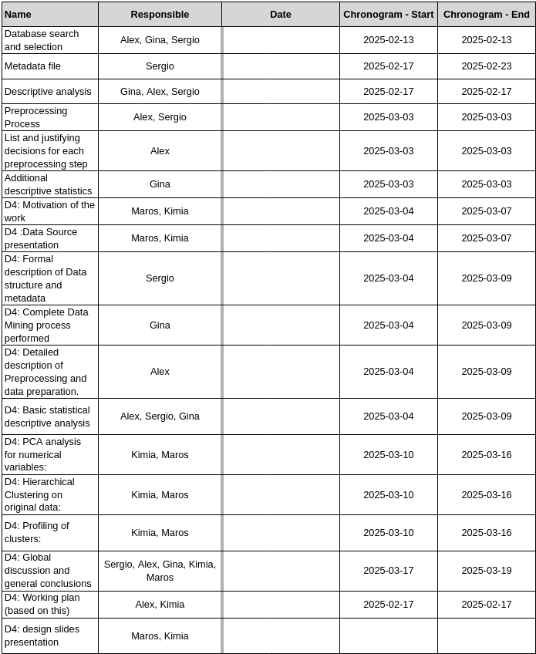
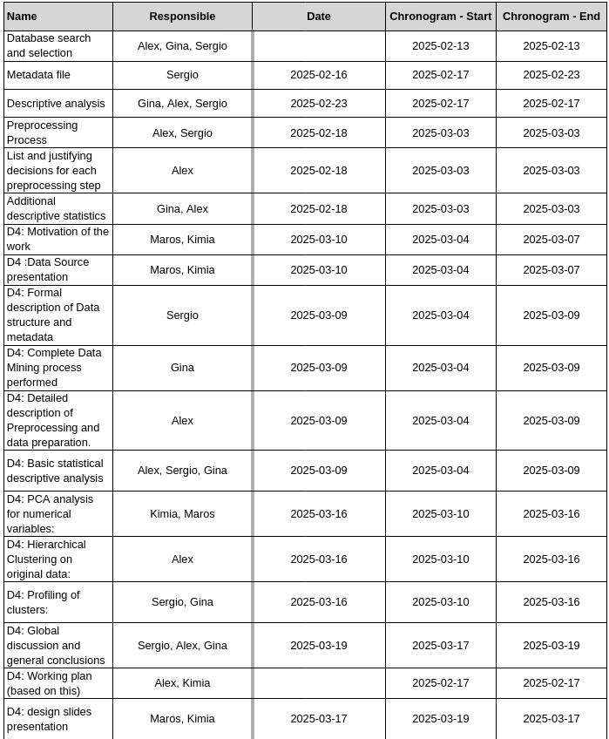
Original and final scheduling

Slide 20
Thank you for the attention!
Group 7.
Bednár Maroš, Escofet González Gina, Foroudian Kimia, Lafuente González Alex, Smyhelskyy Yaskevych Sergio

