Slide 1
Final Project Using Neural Networks for Similarity Shoe Recommendations
Gina Kim

Slide 2

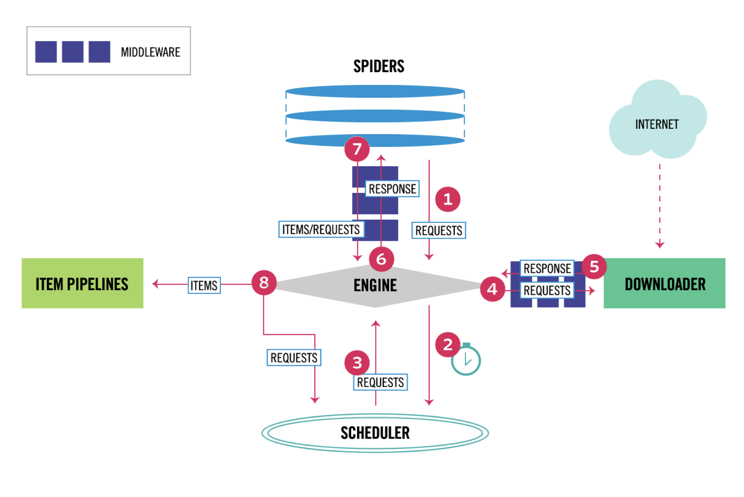
Web Scraping
Python Scrapy
Adidas Website:
https://adidas.com/us/shoes
Downloaded 4500+ shoe images

Slide 3

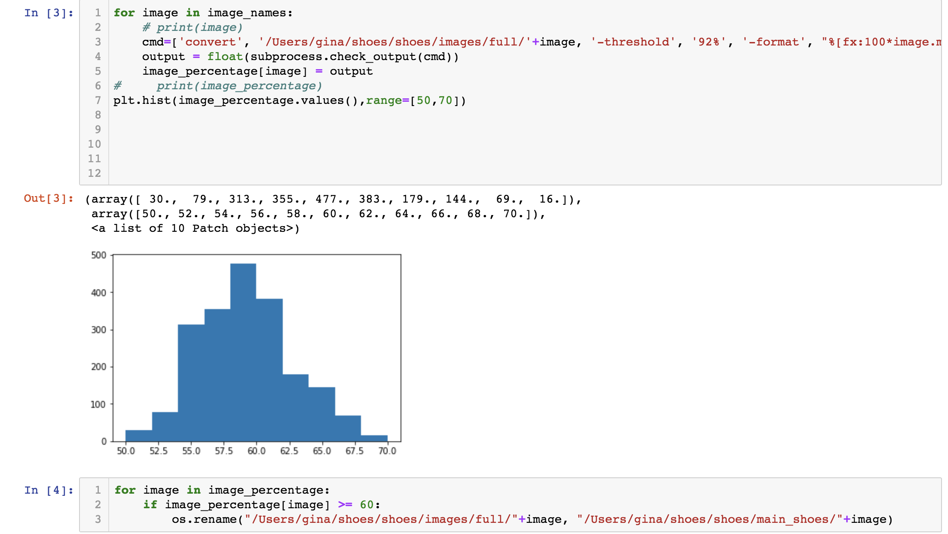
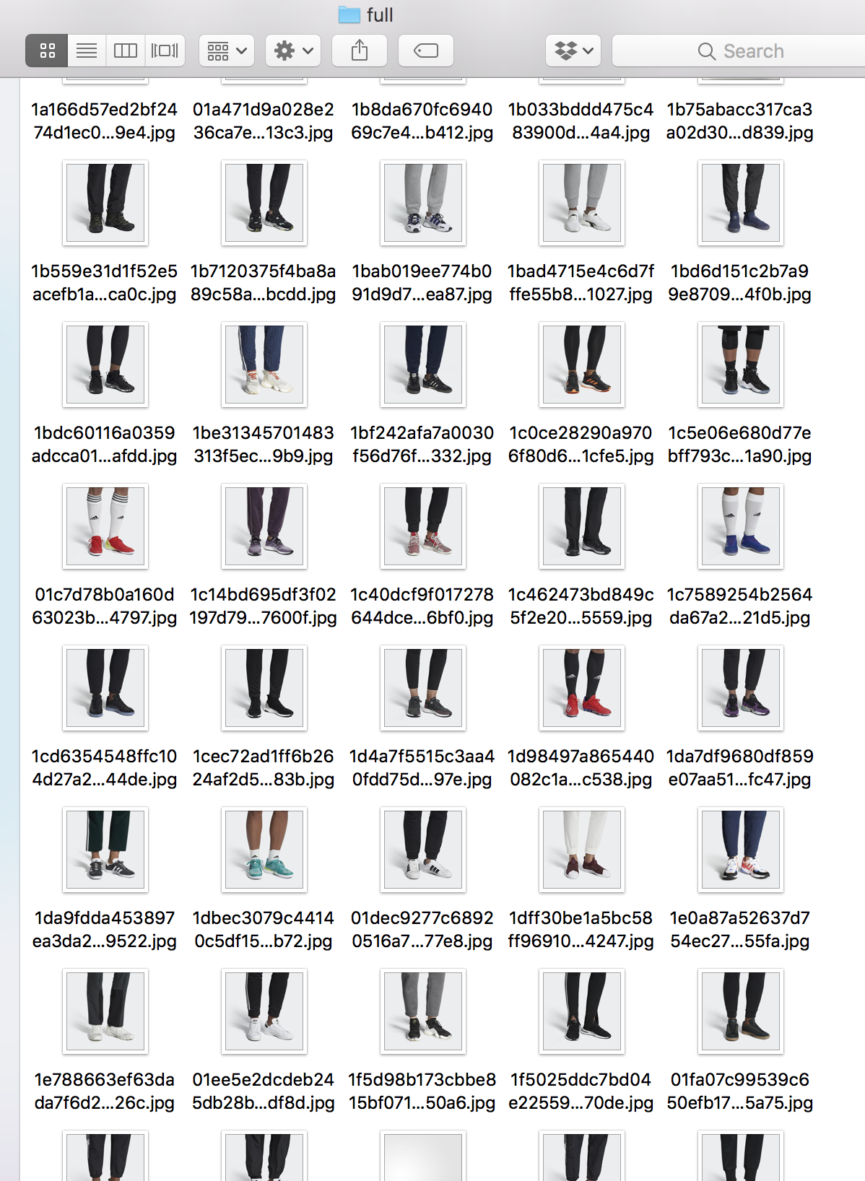
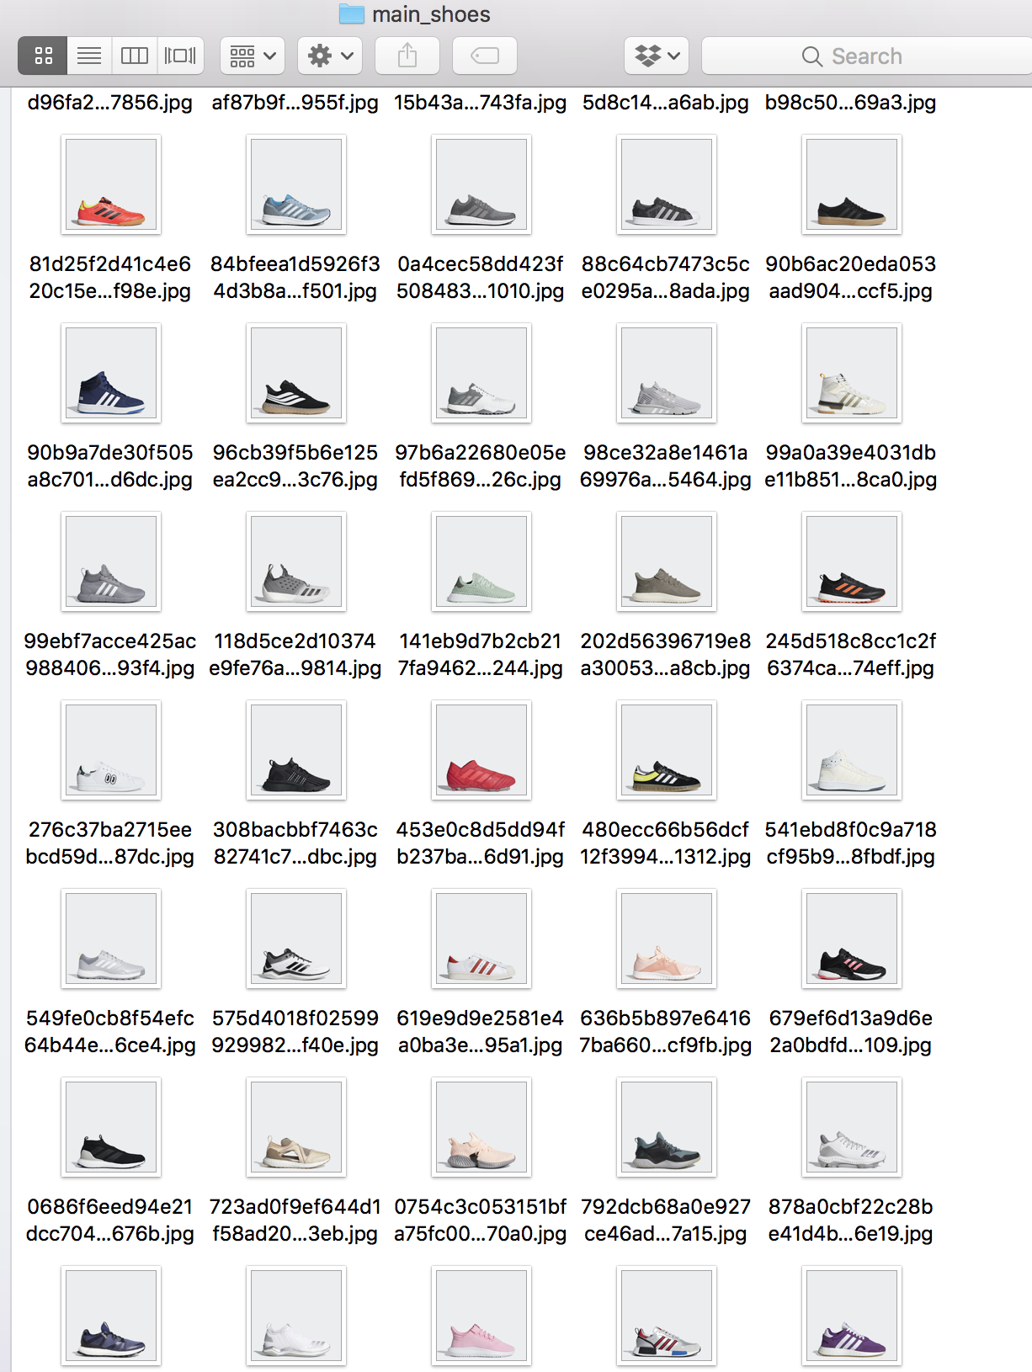
Data Clean-up
ImageMagick
Filter images by percentage of white space
Images with shoes only vs. shoes with legs
Matplotlib
Plot histogram to determine a divide in white space
Using this data, able to separate images: shoes only vs. shoes with legs
Obtained 2564 shoes only images

Slide 4
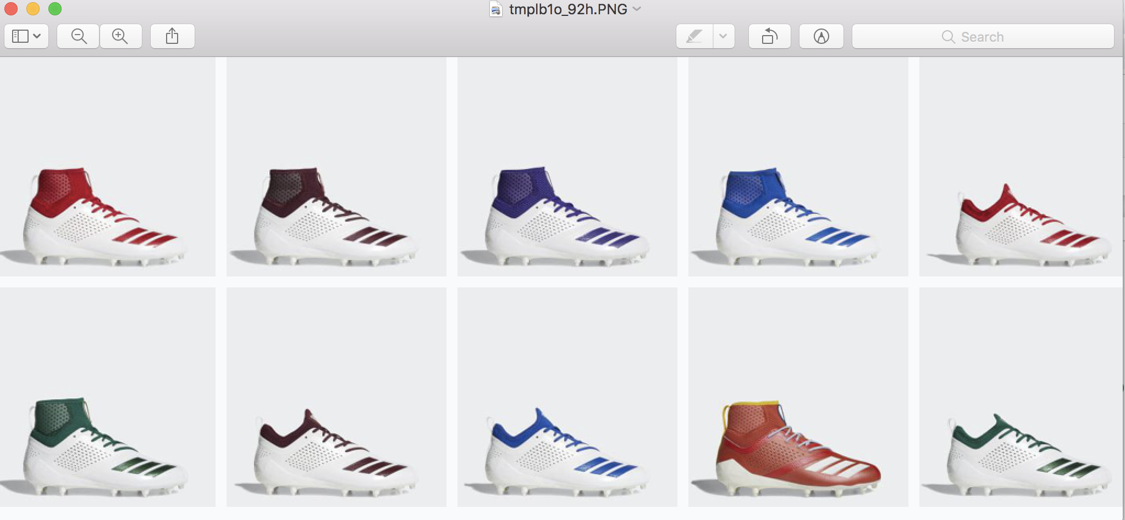
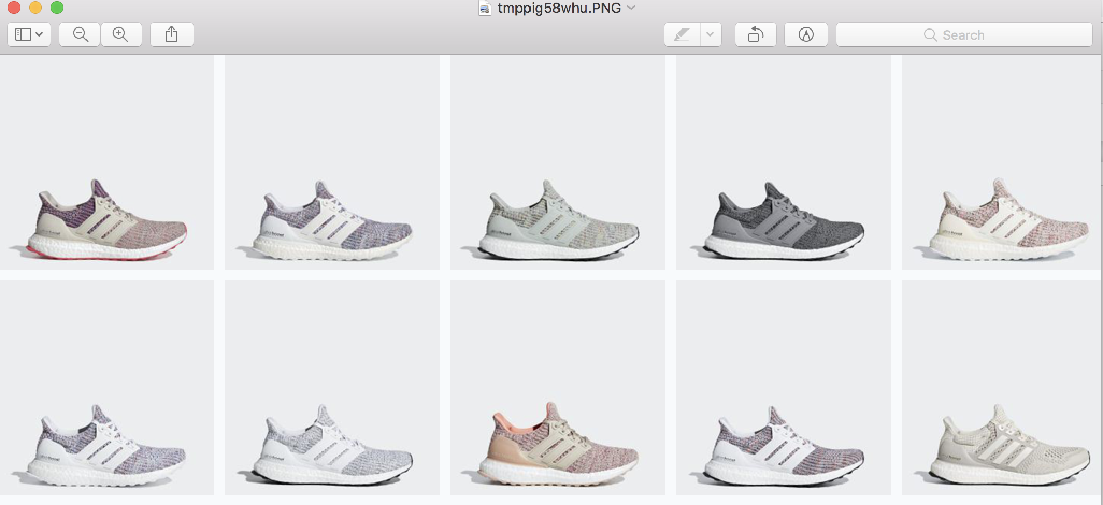
Image Classification
Load and process shoes only images
Keras Applications:
Used the VGG16 model
Feed the images through Neural Network
Calculate image similarities:
To calculate shoe recommendations: convert feature matrix to similarity matrix by calculating the cosine distance of the features
Give shoe recommendations!

Slide 5
Future Improvements & Steps
Deployment:
Be able to take a picture of any shoes and give other similar recommendations
Scrape other shoe brands:
Feed more shoe images, more data
Scrape shoe metadata
Type of shoe, price range, gender, etc.

