Slide 1
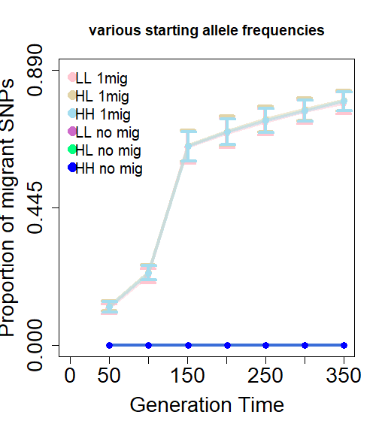
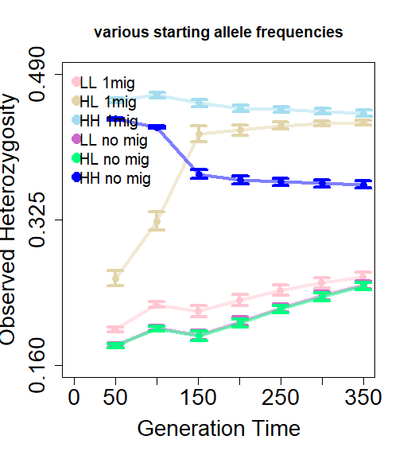
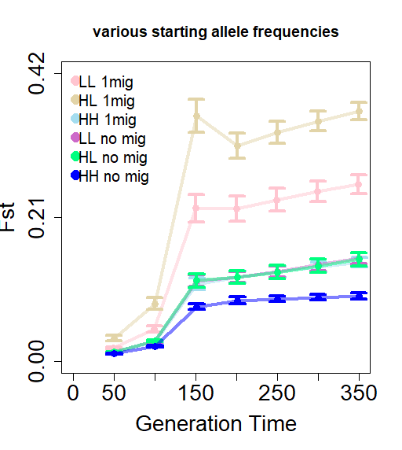
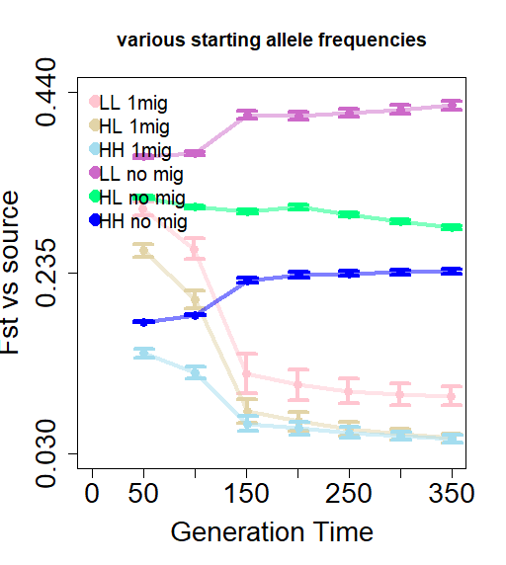
Notes:
Fig 1 – various starting allele frequencies with 1 mig per gen and no migration.
Old caption - Figure 1. Change in population demography with various starting allele frequencies (p_{H} = 0.4, p_{L} = 0.05) over time in connected and unconnected populations. (A) Proportion of migrant SNPs. (B) Observed heterozygosity. (C) Fst vs the initialized recipient population. (D) Fst vs the initialized source population.
In my notes this is proposed Figure 2 (unless you like the overview then I guess it would be 3).

Slide 2
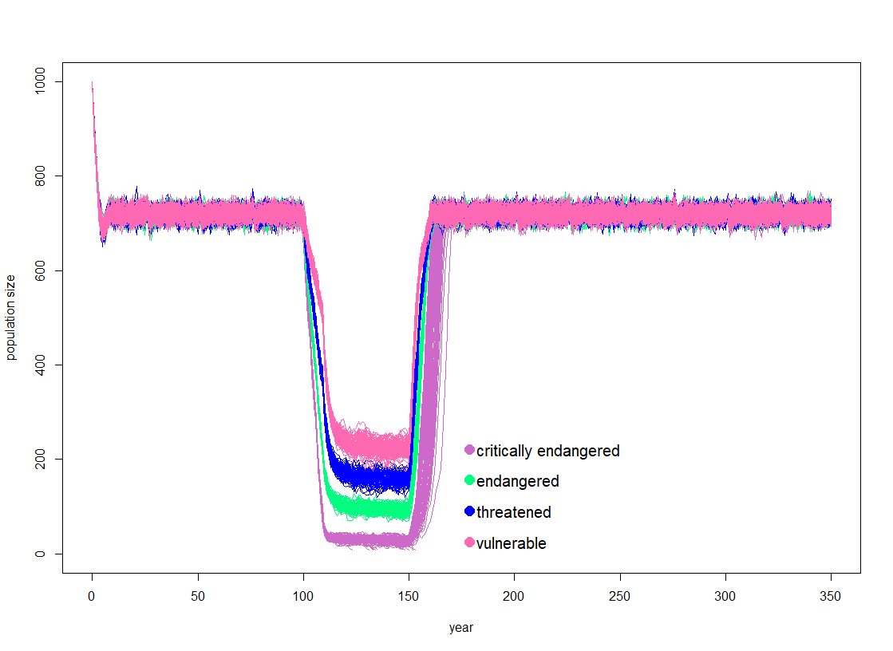
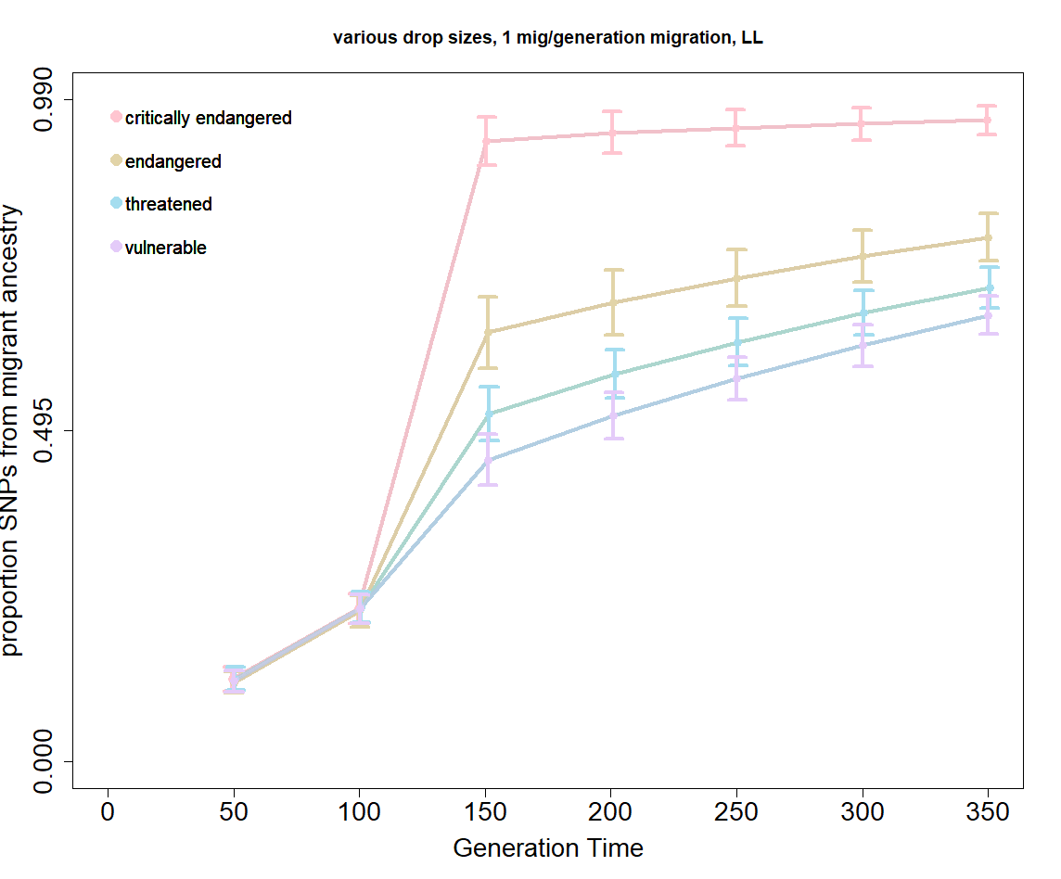
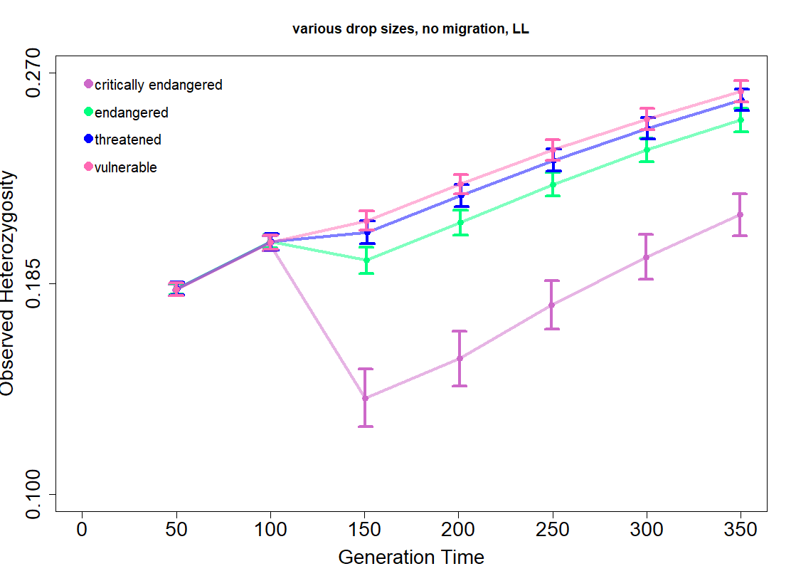
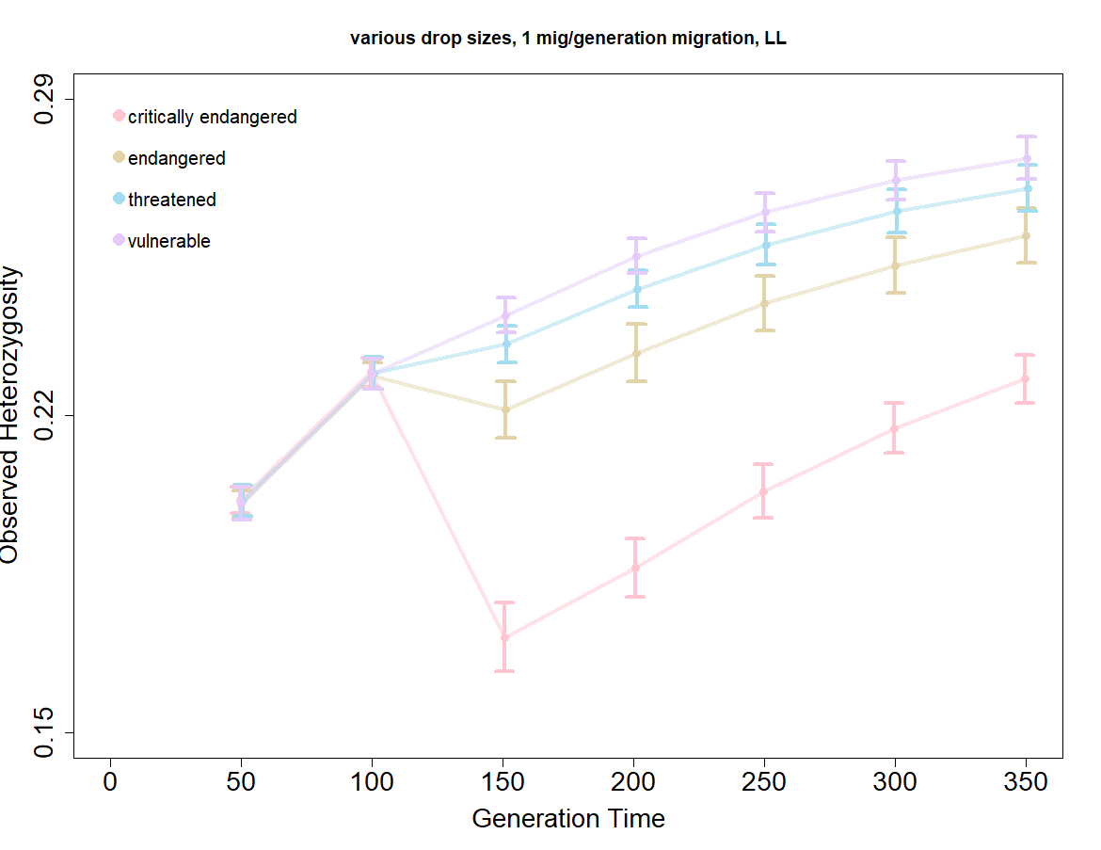
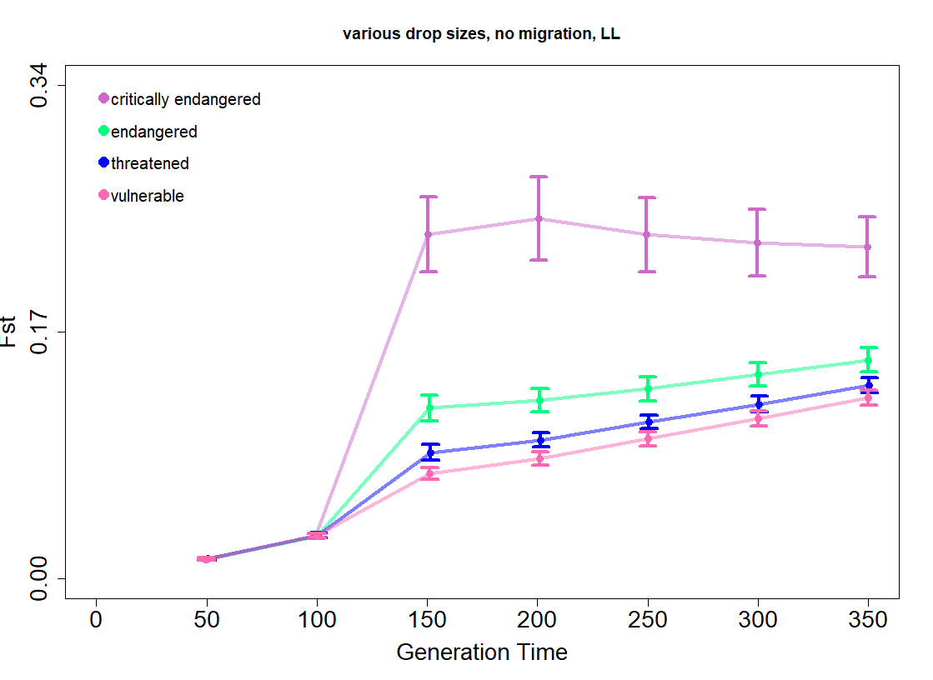
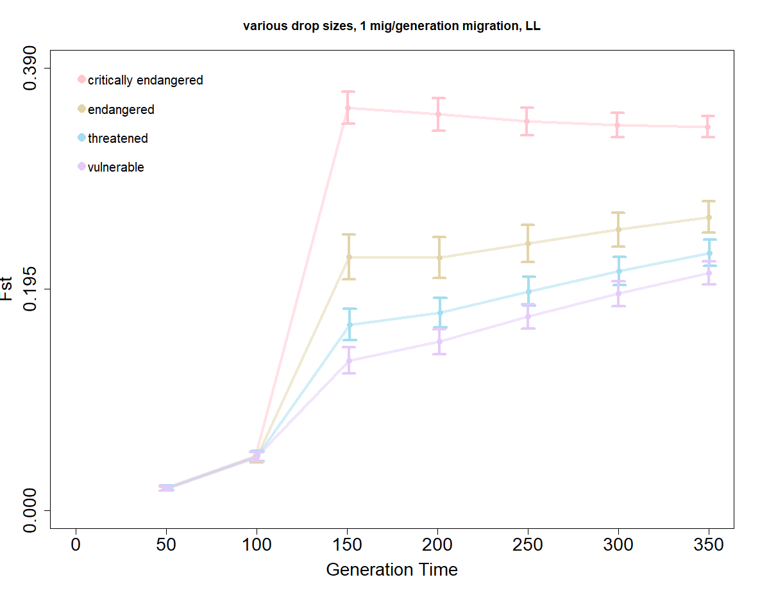
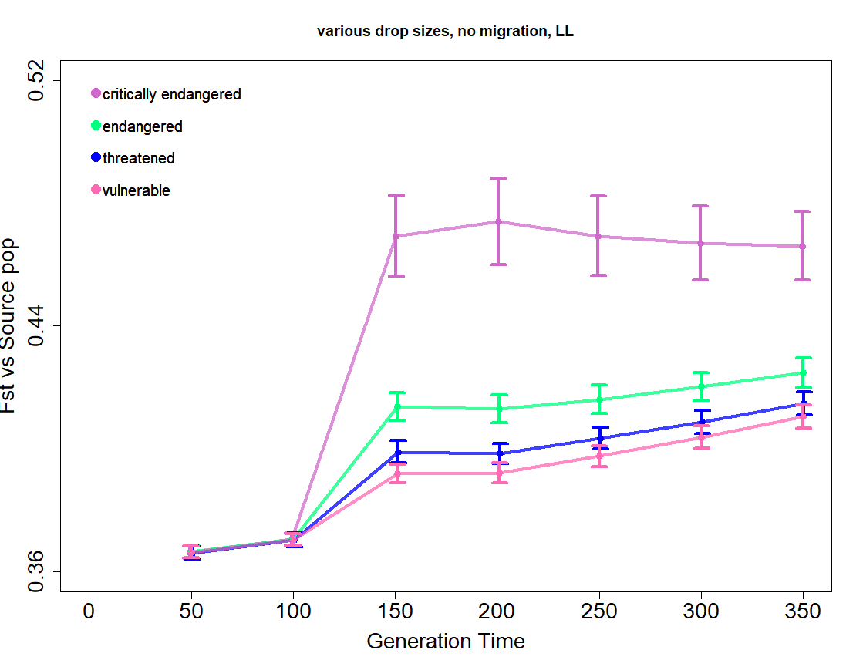
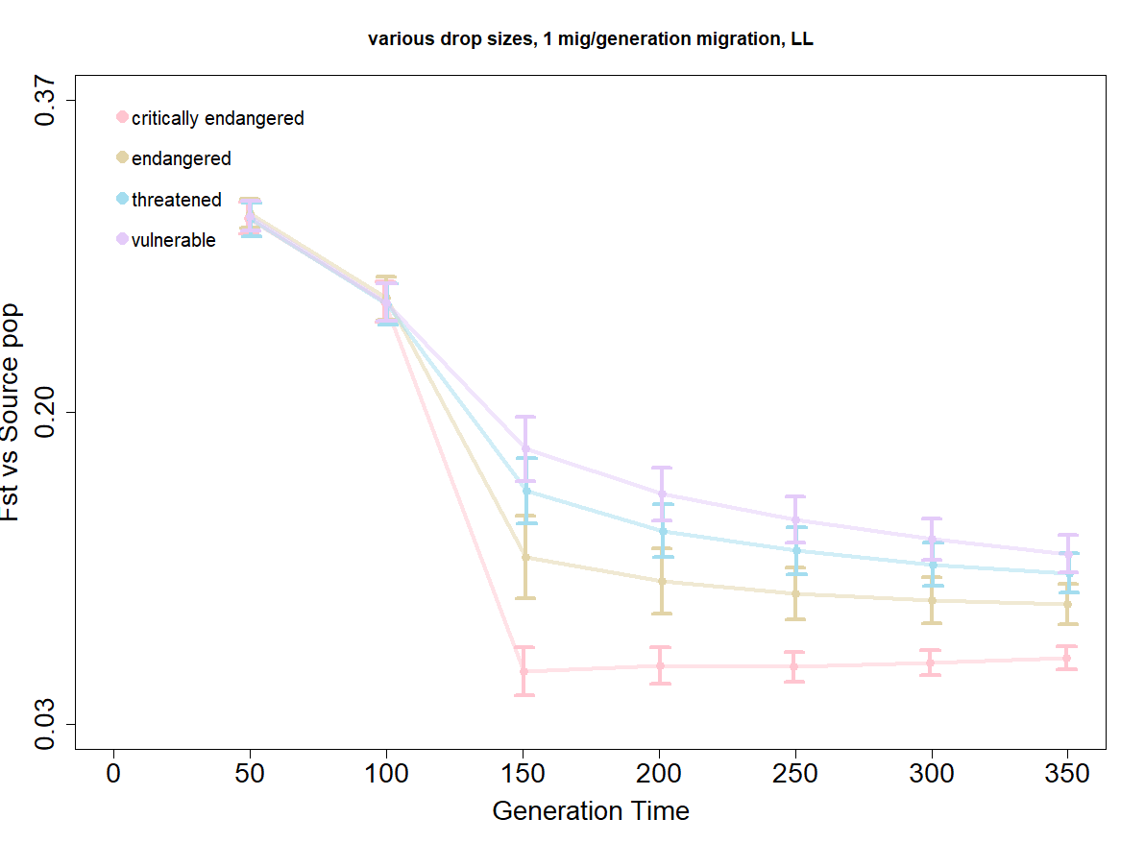
Notes:
Figure 2 – various IUCN extinction risks with 1 mig per gen and no migration.
Old caption - Figure 2. Change in population demography measures in populations of various extinction risk categories over time. (A) Census population size. (B) Proportion of migrant derived SNPs. Observed heterozygosity of neutral SNPs (C) in the absence of migration and (D) when connected with one migrant per generation. Fst as compared to the initialized recipient population (E) without and (F) with migration. Fst as compared to the initialized source population (G) without and (H) with migration.
IUCN has colors for categories, should we use those? https://www.iucnredlist.org/about/faqs#What%20is%20The%20IUCN%20Red%20List

Slide 3
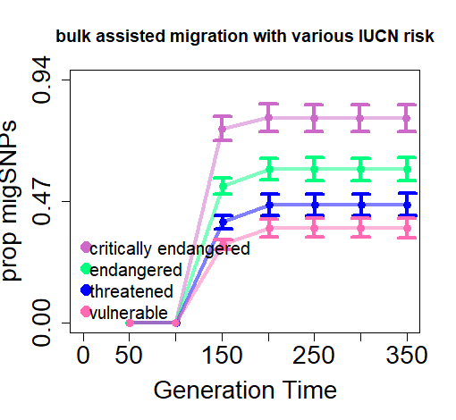
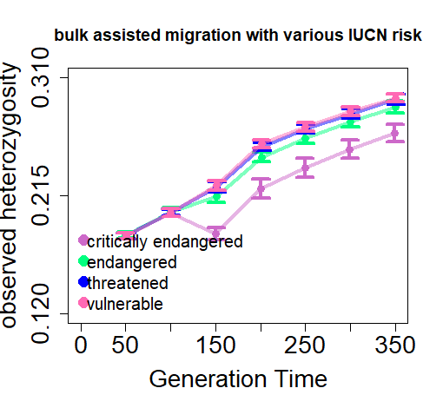
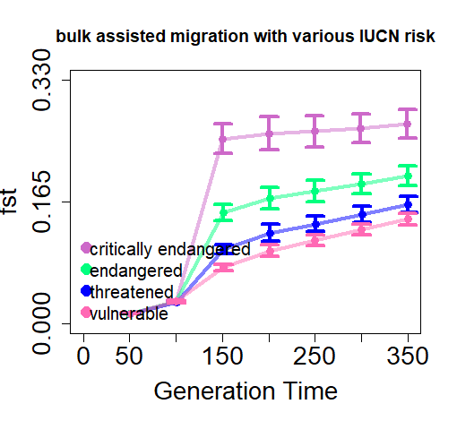
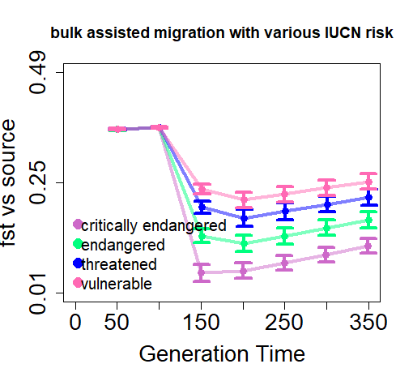
Notes:
Figure 3 (A-D) – a bulk migration with various IUCN extinction risk categories.

Slide 4
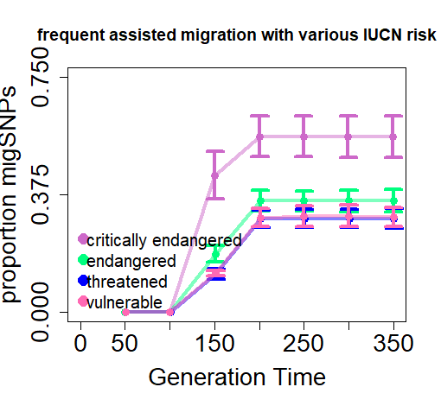
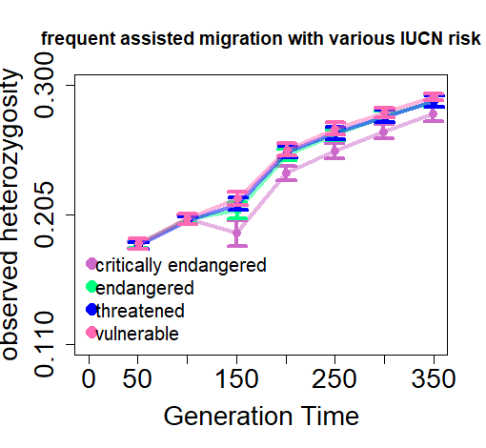
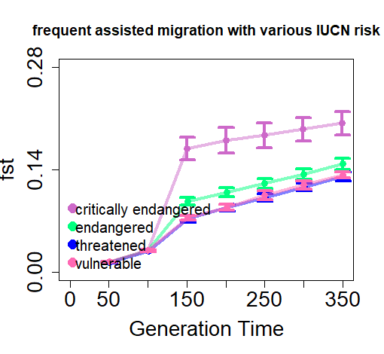
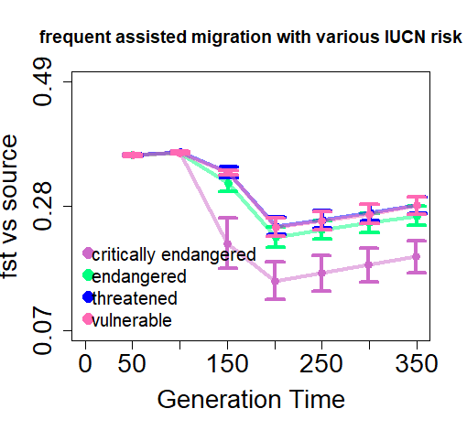
Notes:
Figure 3 (E-H) – 4 assisted migrations with various IUCN extinction risk categories.
Figure 3. Change in population demography responses to bulk and frequent assisted migration events. (A,E) proportion of migrant SNPs (B,F) observed heterozygosity (C,G) Fst (D,H) Fst vs source population.
I think these should be organized by the three IUCN categories (or four if we keep the fourth). I think the most novel part of your work here is the differences between the migration within those categories, but it is so hard to compare with the setup you have here. I scrawled it out in pencil, under proposed figure 4.
Perhaps we keep these as supplementary?

Slide 5
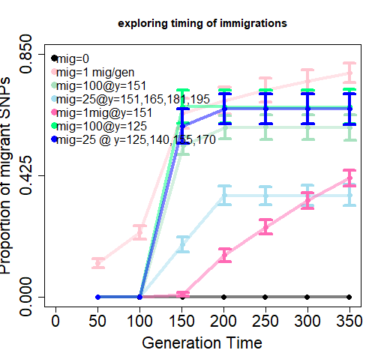
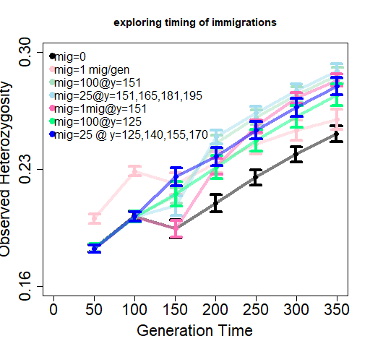
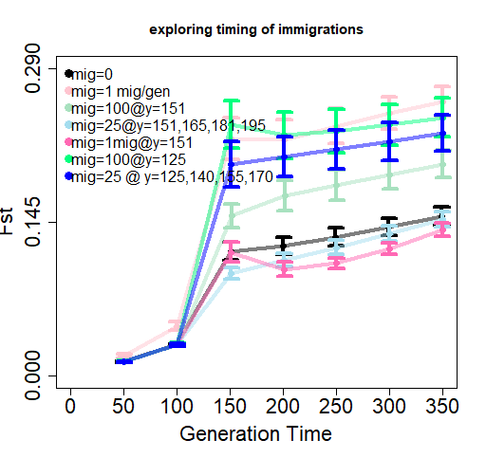
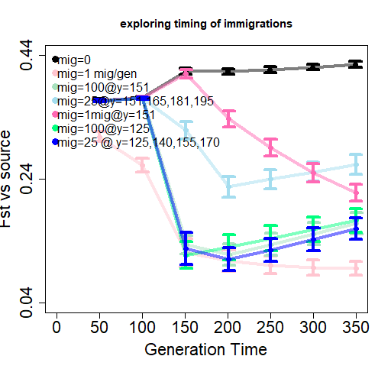
Notes:
Figure 4 – timing of migration events – before or after habitat restoration – in an endangered population.

Slide 6
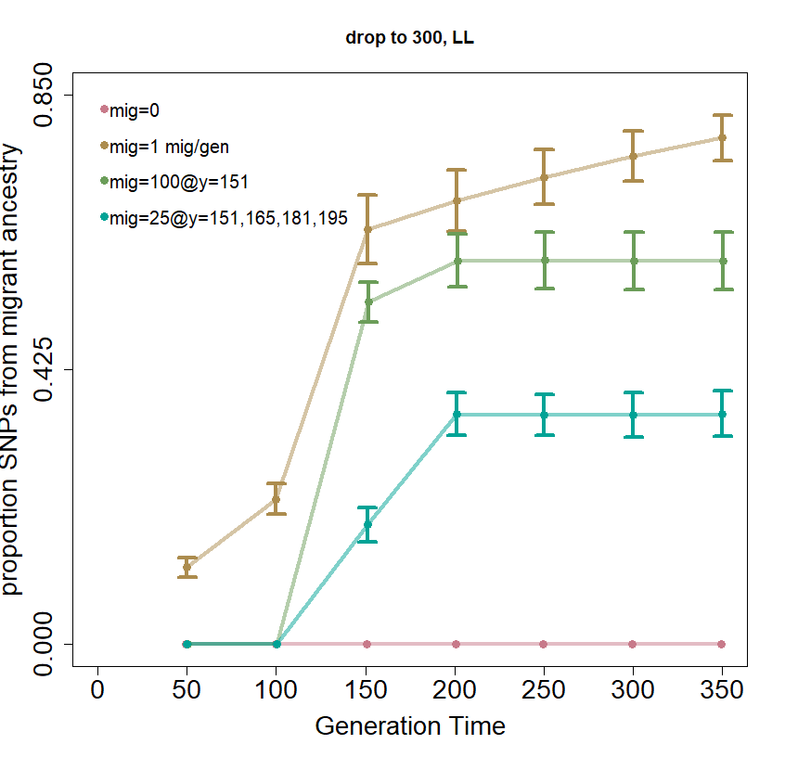
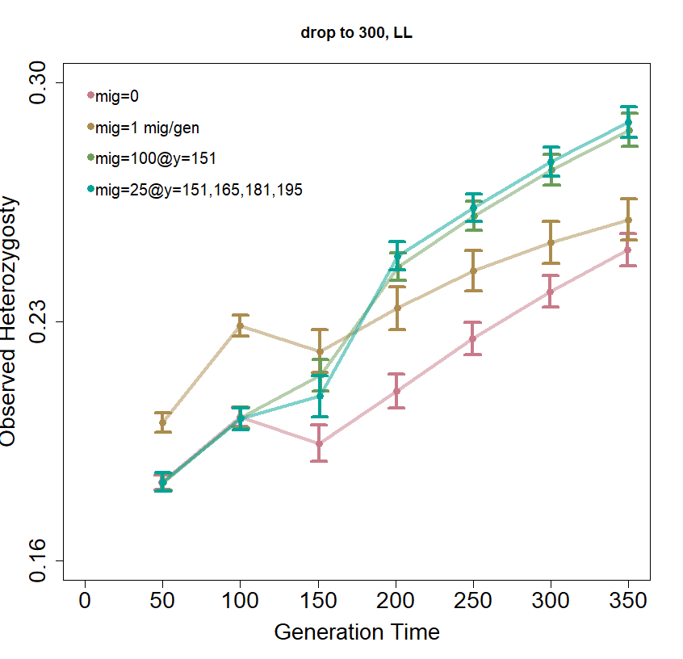
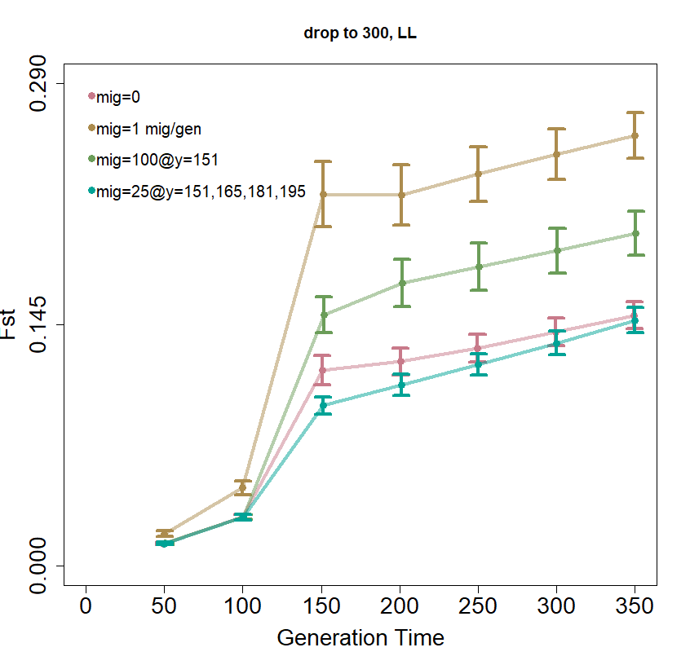
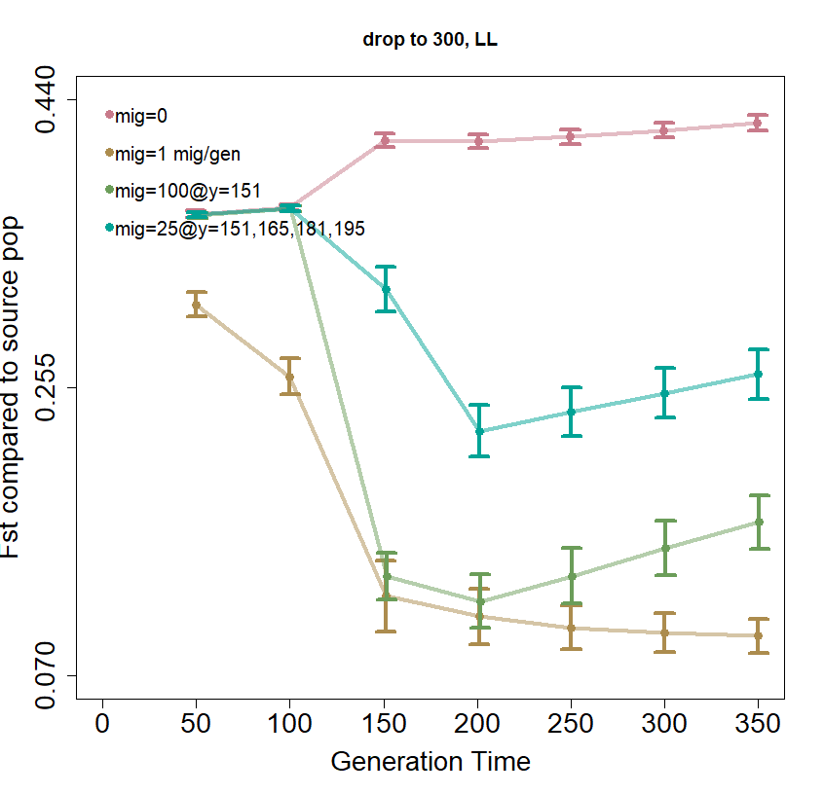
Notes:
Figure 5. various migration rates in an endangered population
Old caption: Figure 5. Change in population demography with assisted migration strategies over time. (A) Proportion of alleles with migrant ancestry. (B) Observed heterozygosity of putatively neutral SNPs. (C) Fst as compared to the initialized recipient population. (D) Fst as compared to the initialized source population.
Really, this gets folded into new figure 4.

Slide 7
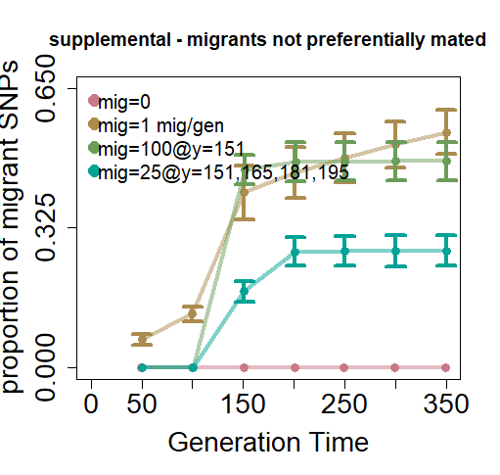
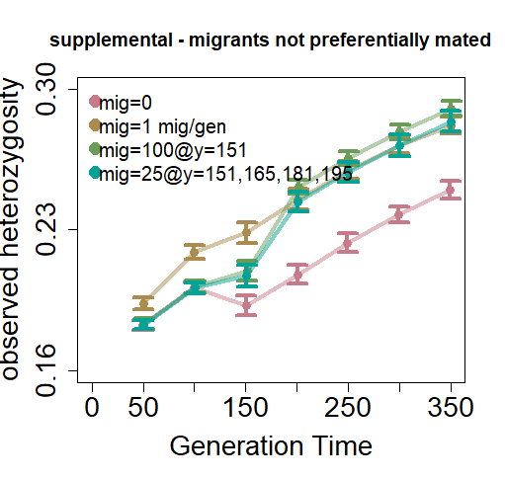
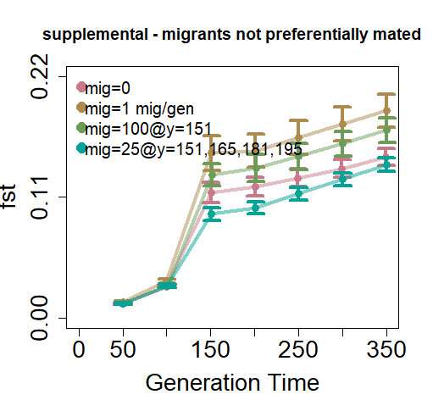
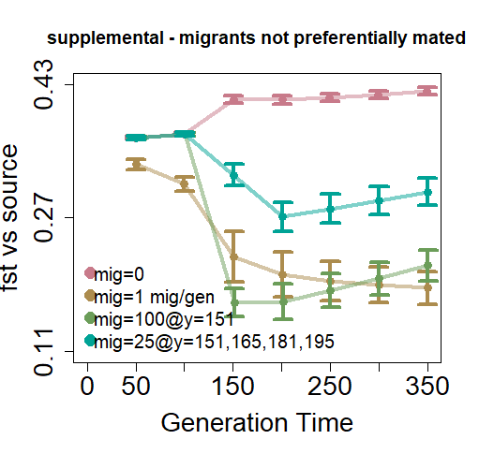
Notes:
Supp. Fig 1. migrants not preferentially chosen in an endangered population.

Slide 8
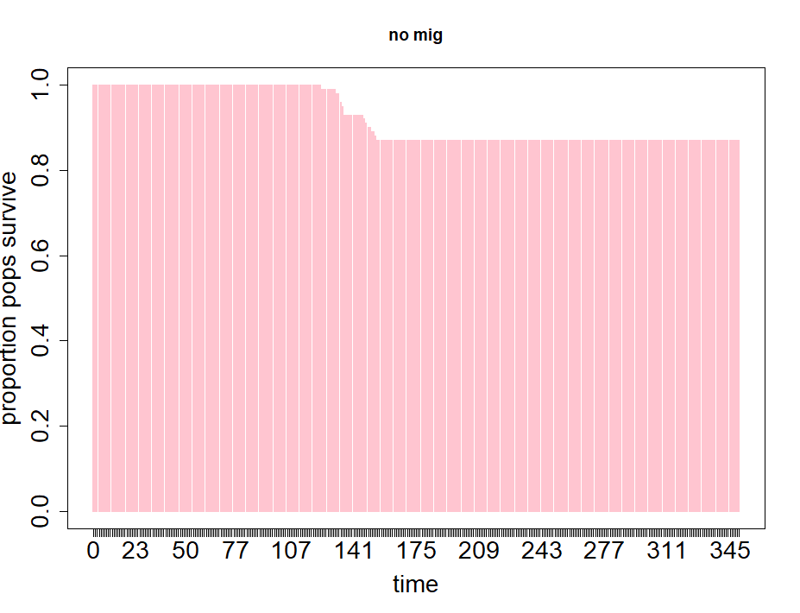
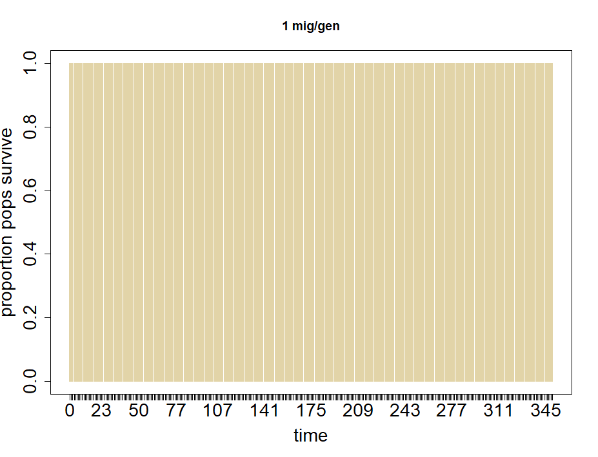
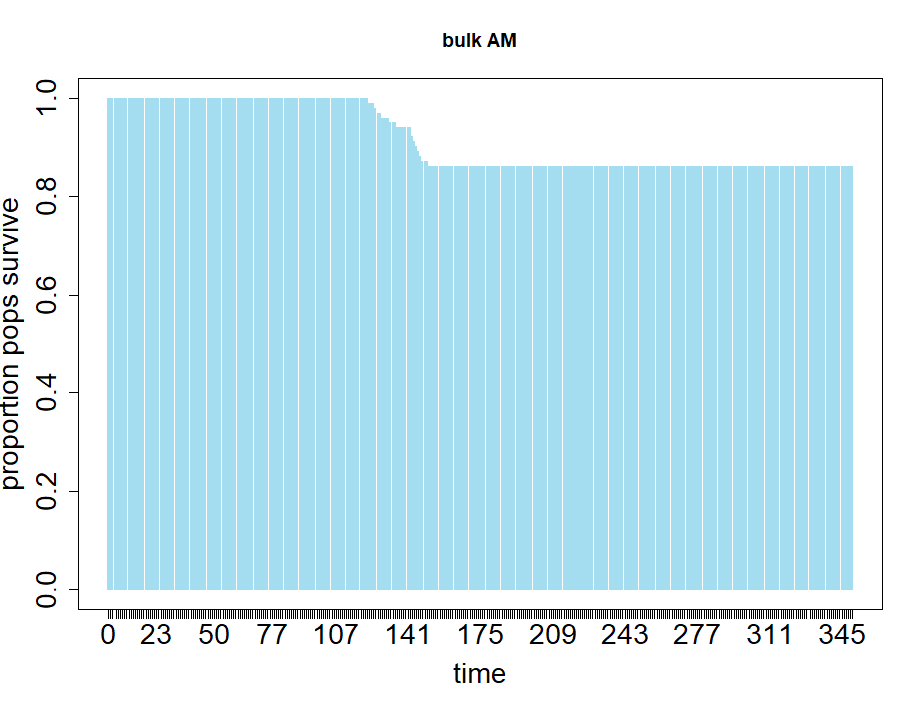
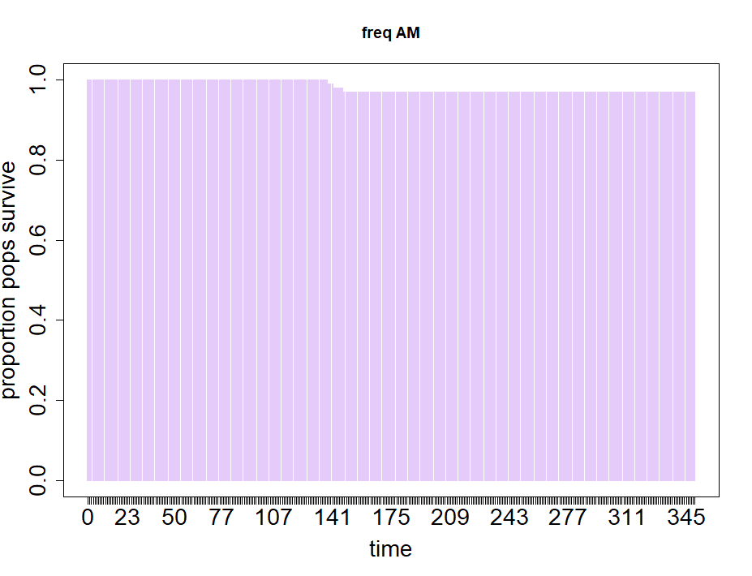
Notes:
Supp. Fig. 2. Prop pops that survived in a critically endangered sp

Slide 9
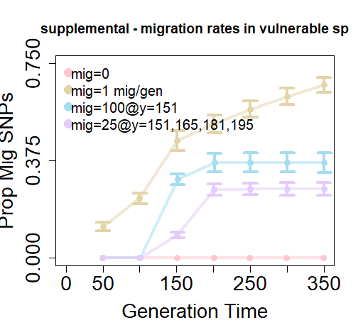
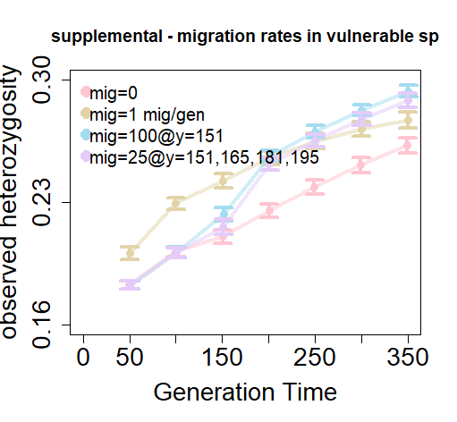
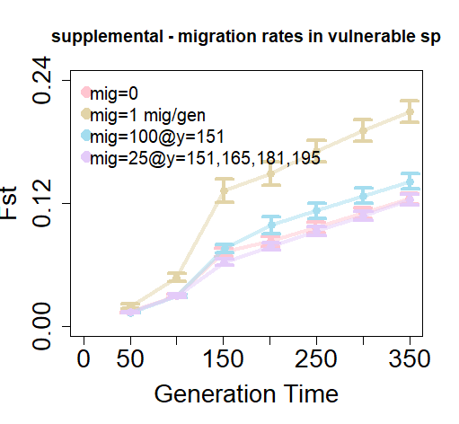
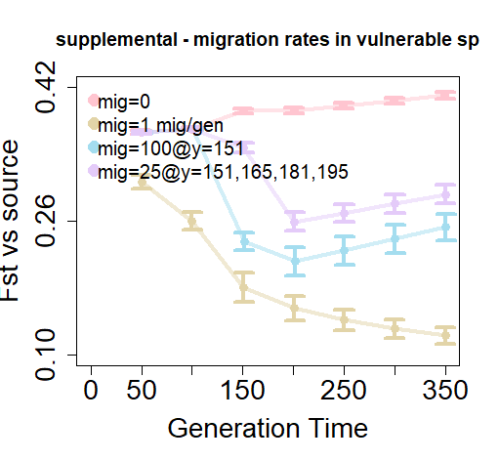
Notes:
Supp. Fig 3. vulnerable population

Slide 10
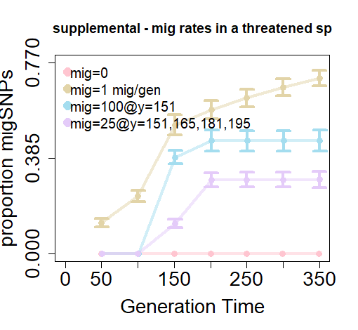
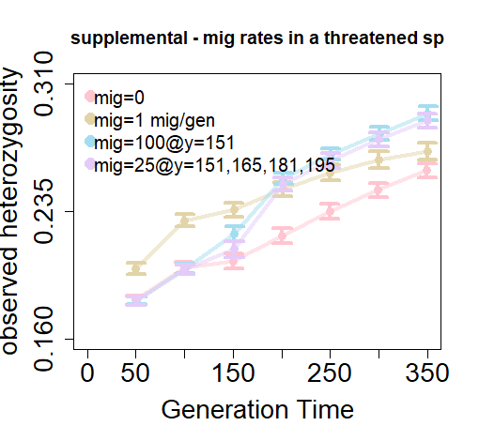
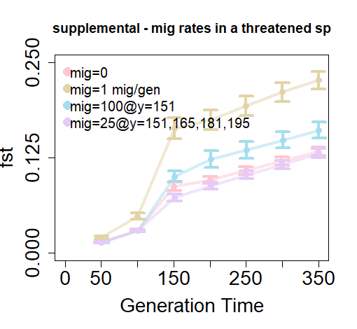
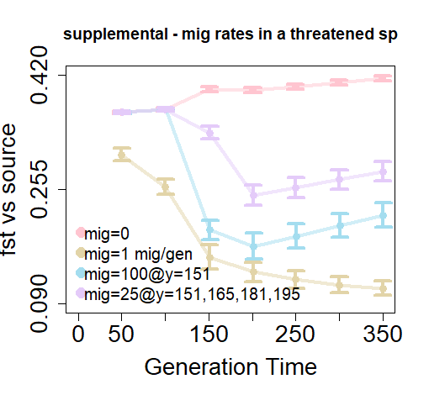
Notes:
Supp. Fig 4. Threatened population.

Slide 11
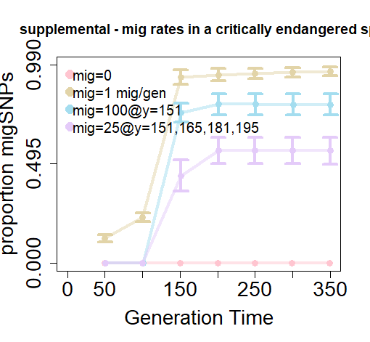
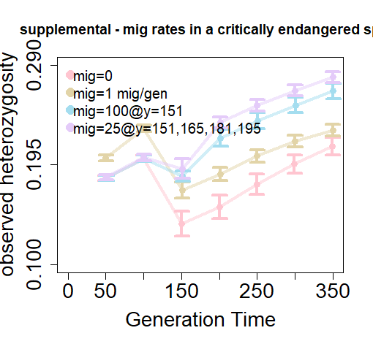
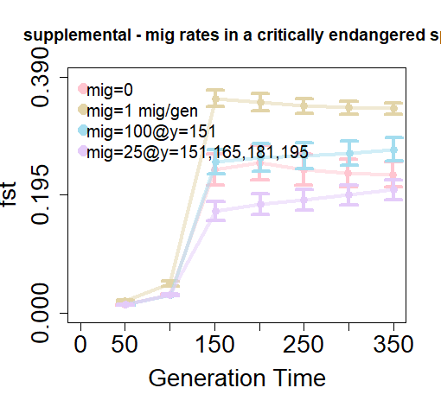
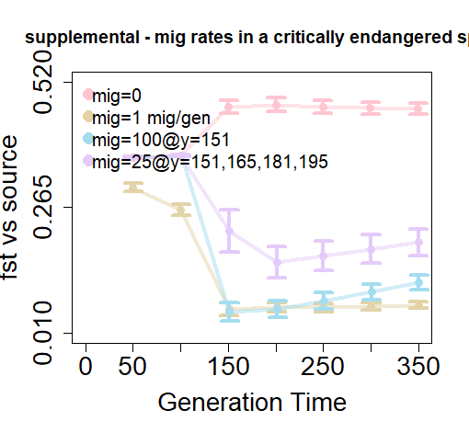
Notes:
Supp. Fig. 5. critically endangered population

Slide 12
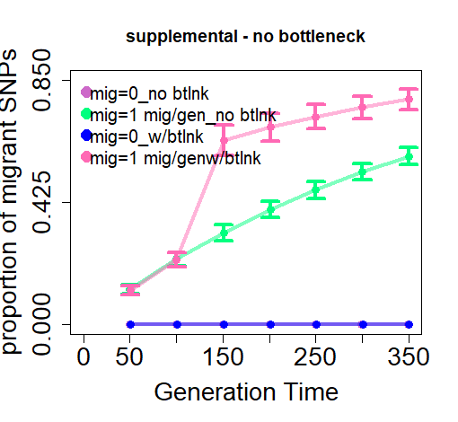
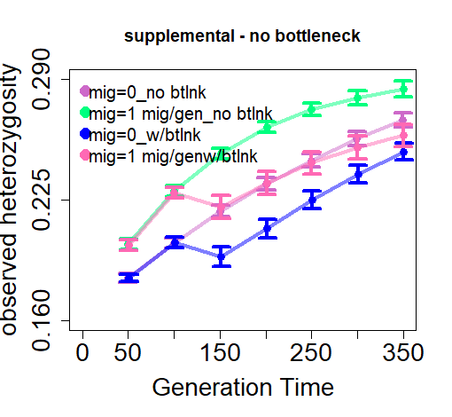


Notes:
Supp. Fig. 6. populations with and without (i.e., pop stayed at 1000 indv entire 350 years) bottlenecks with 1 mig per generation and no migration.

Slide 13
BELOW THIS LINE FIGS ARENT IN MS

Slide 14







Notes:
Trying to visualize how migrant ancestry and LRS are related, if at all.

Slide 16


Slide 17




Slide 18





