Slide 1
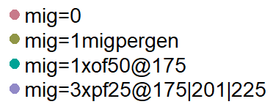
 | summary | repsuc | pop | parameters | nmig | heteroz of source | minor allel freq FOCAL | n replicates | dropK | k | nSNP | drp | dur | maxage | broodsize | maturity | years | r0 | ratemort | nSNP.mig | nSNP.cons
run_a |  |  |  |  | all 4 | 0.07 | 0.45 | 1 | 300 | 1000 | 1000 | 10 | 40 | 9 | 2 | 1 | 350 | 1 |  | 100 | 0
run_b |  |  |  |  | all 4 | 0.45 | 0.45 | 1 | 300 | 1000 | 1000 | 10 | 40 | 15, 3 | 2 | 1 | 350 | 1 |  | 100 | 0
run_c |  |  |  |  | all 4 | 0.45 | 0.45 | 1 | 300 | 1000 | 1000 | 10 | 40 | 9 | 4, 6 | 1 | 350 | 1 |  | 100 | 0
run_d | y | y | y | y | all 4 | 0.45 | 0.45 | 1 | 300 | 1000 | 1000 | 10 | 40 | 9 | 2 | 1 | 350 | 0.5 |  | 100 | 0
run_e | y | y | y | y | a, b, c | 0.45 | 0.45 | 1 | 300 | 1000 | 1000 | 10 | 40 | 9 | 2 | 1 | 350 | 1 |  | 100 | 0
run_f |  |  |  |  | all 4 | 0.45 | 0.07 | 1 | 300 | 1000 | 1000 | 10 | 40 | 9 | 2 | 1 | 350 | 1 |  | 100 | 0
run_g |  |  |  |  | all 4 | 0.07 | 0.07 | 1 | 300 | 1000 | 1000 | 10 | 40 | 9 | 2 | 1 | 350 | 1 |  | 100 | 0

Slide 2
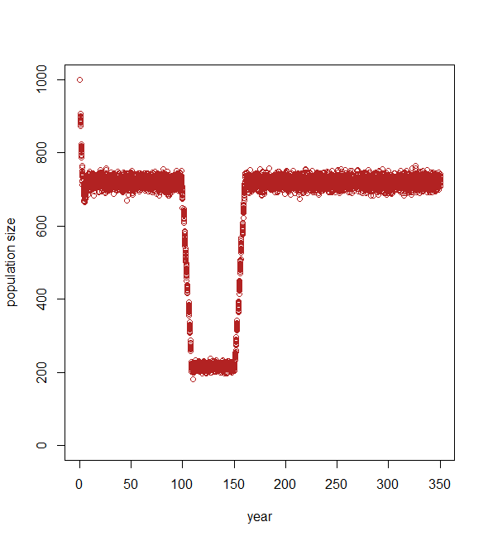
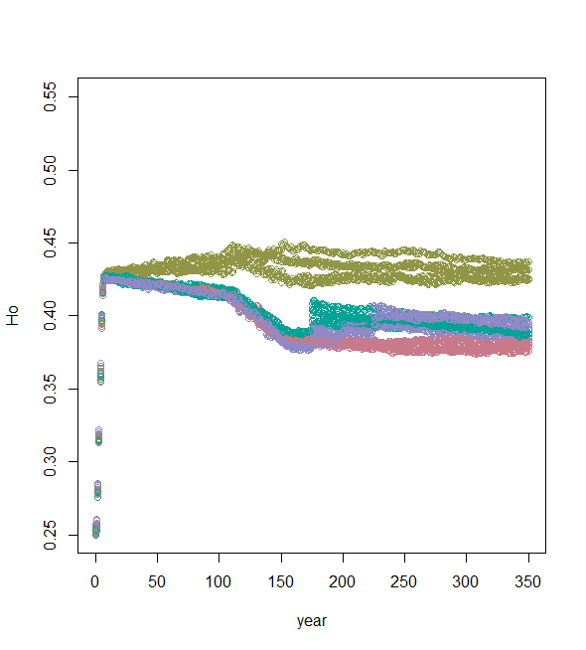
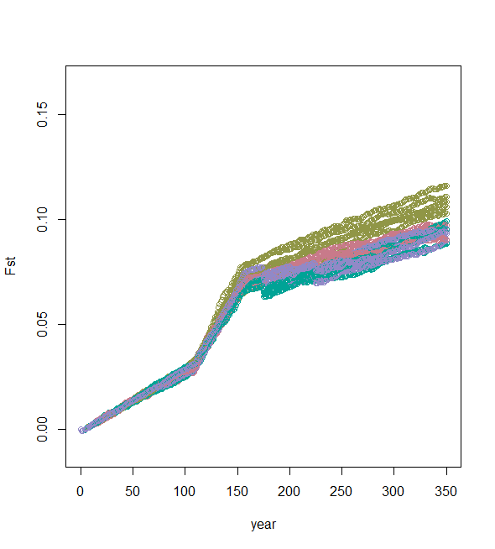
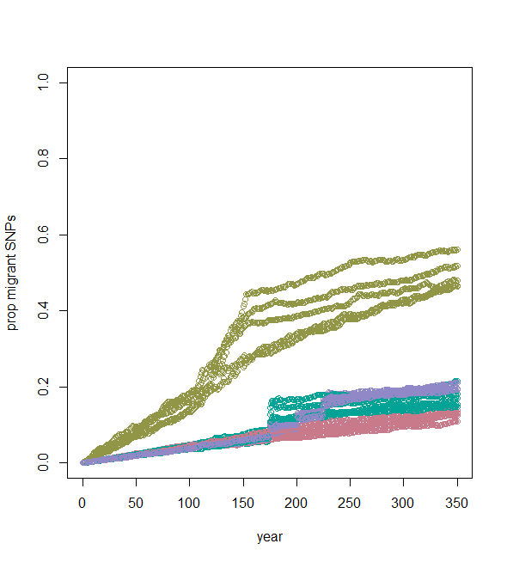
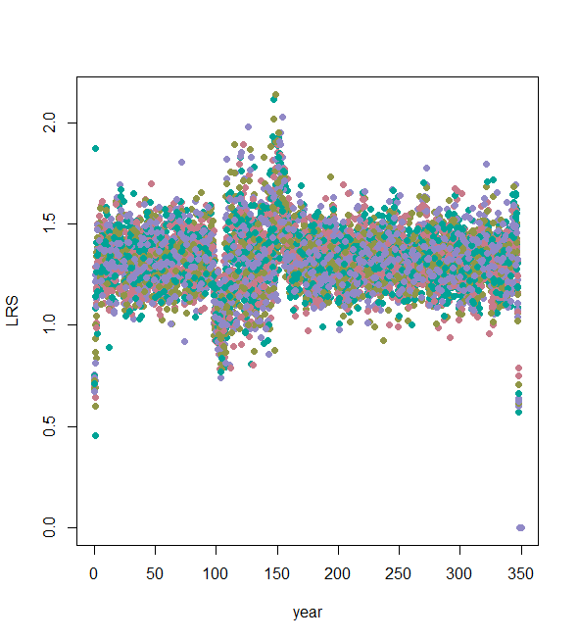
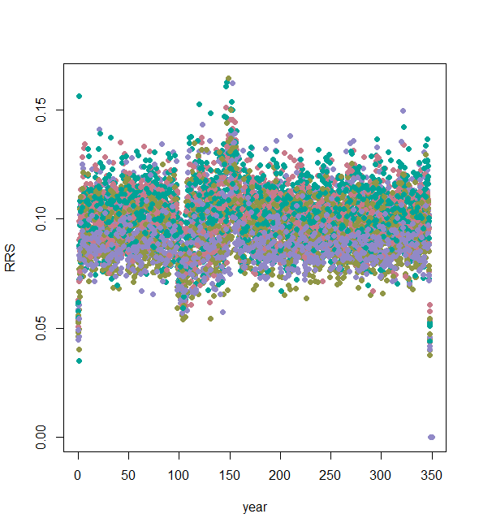
 | summary | repsuc | pop | parameters | nmig | heteroz of source | minor allel freq FOCAL | n replicates | dropK | k | nSNP | drp | dur | maxage | broodsize | maturity | years | r0 | ratemort | nSNP.mig | nSNP.cons
run_a |  |  |  |  | all 4 | 0.07 | 0.45 | 1 | 300 | 1000 | 1000 | 10 | 40 | 9 | 2 | 1 | 350 | 1 |  | 100 | 0

Slide 3
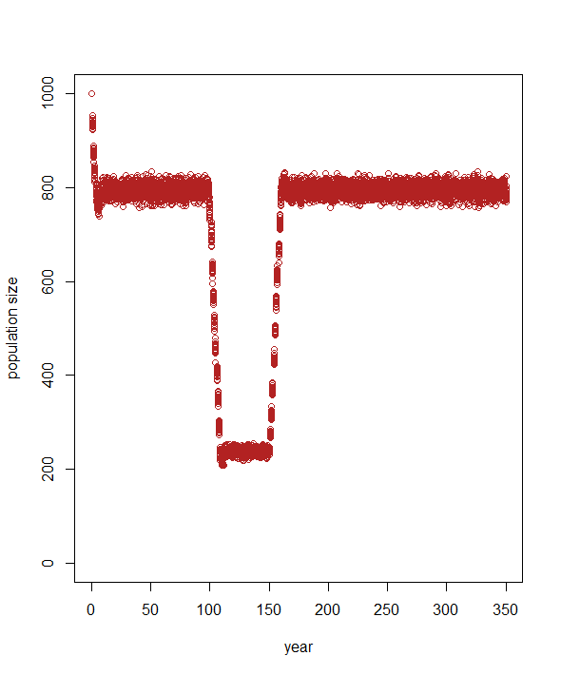
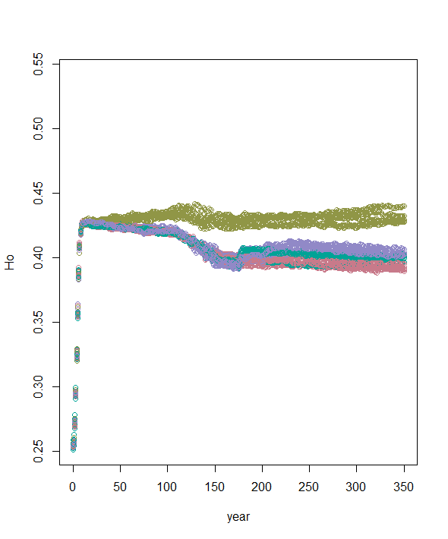
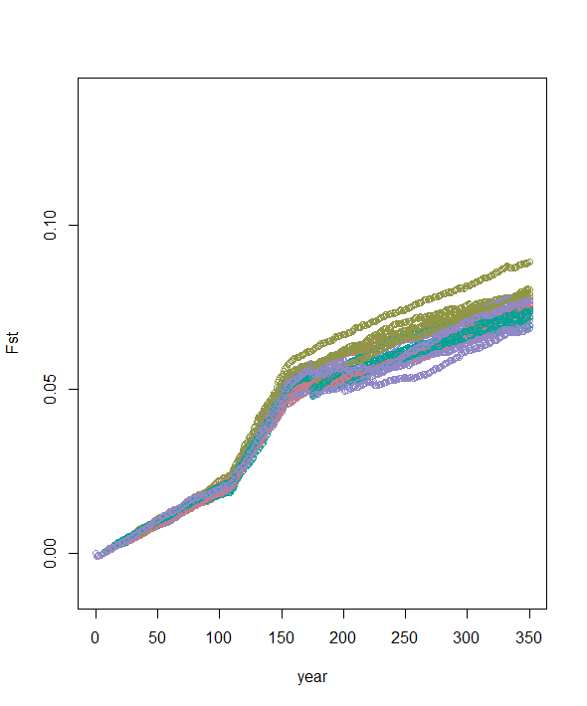
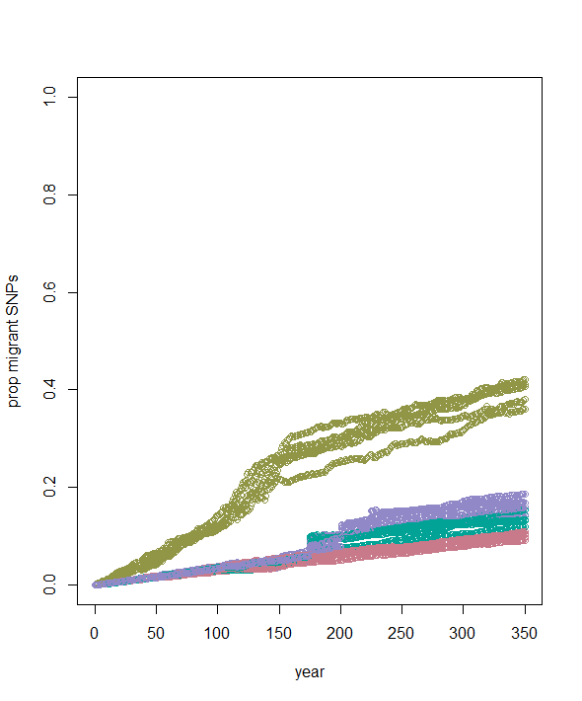
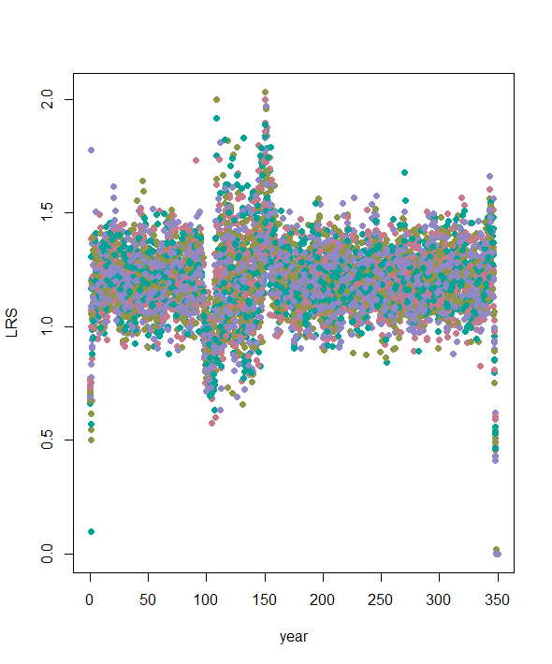
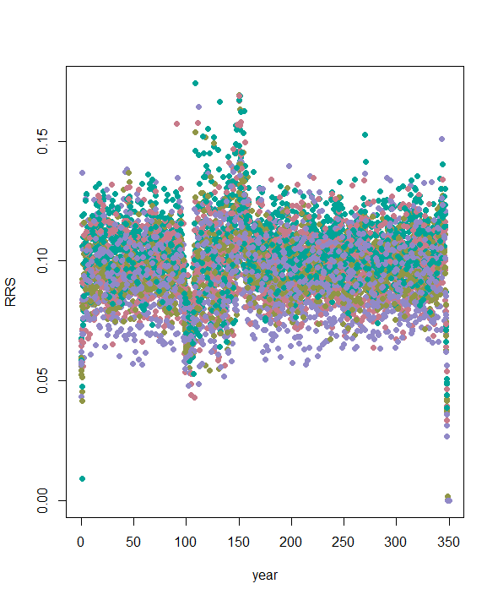
run name | summary | repsuc | pop | parameters | nmig | heteroz of source | minor allel freq FOCAL | n replicates | dropK | k | nSNP | drp | dur | maxage | broodsize | maturity | years | r0 | ratemort | nSNP.mig | nSNP.cons
run_b – part 1 |  |  |  |  | all 4 | 0.45 | 0.45 | 1 | 300 | 1000 | 1000 | 10 | 40 | 15 | 2 | 1 | 350 | 1 |  | 100 | 0

Slide 4
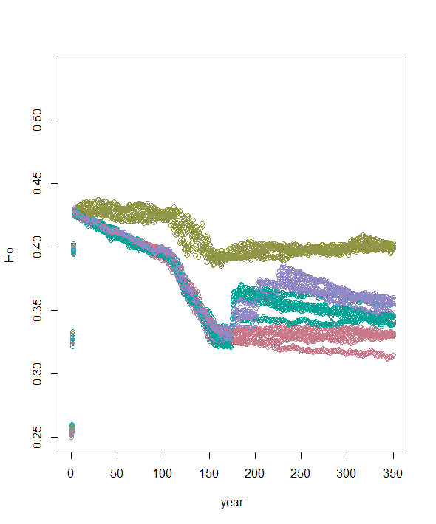
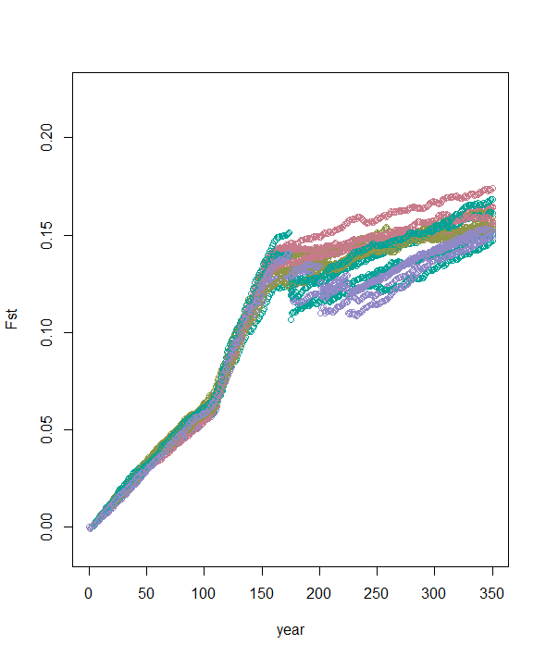
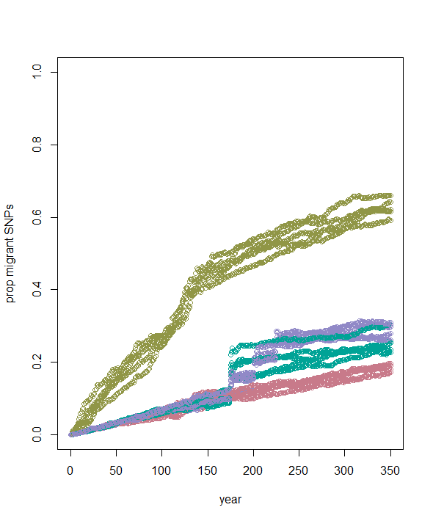
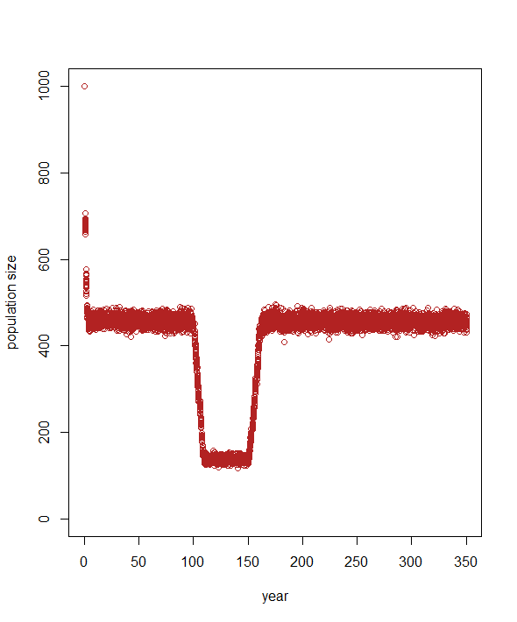
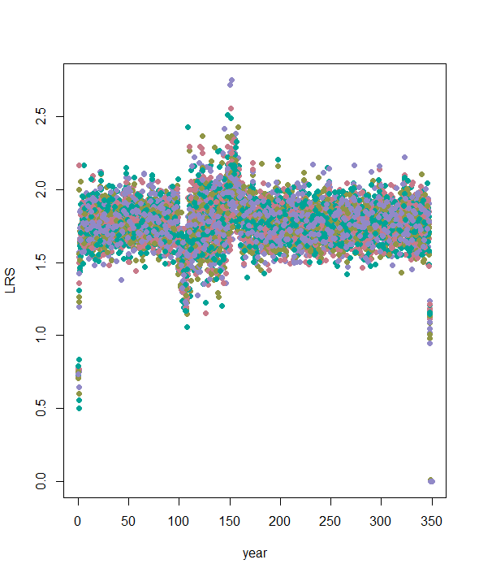
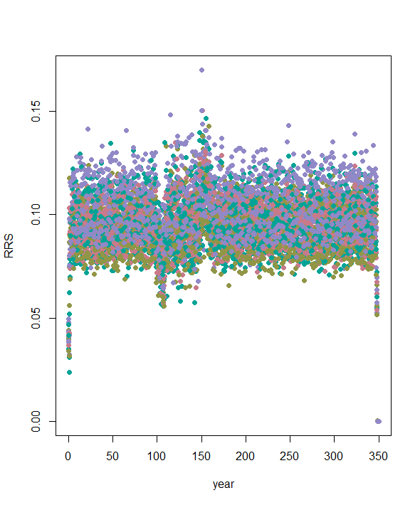
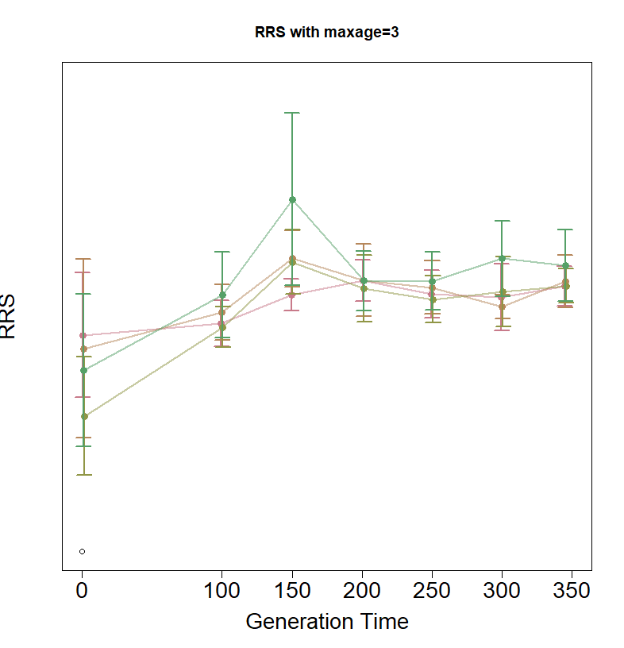
run name | Summary | repsuc | pop | parameters | nmig | heteroz of source | minor allel freq FOCAL | n replicates | dropK | k | nSNP | drp | dur | maxage | broodsize | maturity | years | r0 | ratemort | nSNP.mig | nSNP.cons
run_b – part 2 |  |  |  |  | all 4 | 0.45 | 0.45 | 1 | 300 | 1000 | 1000 | 10 | 40 | 3 | 2 | 1 | 350 | 1 |  | 100 | 0

Slide 5
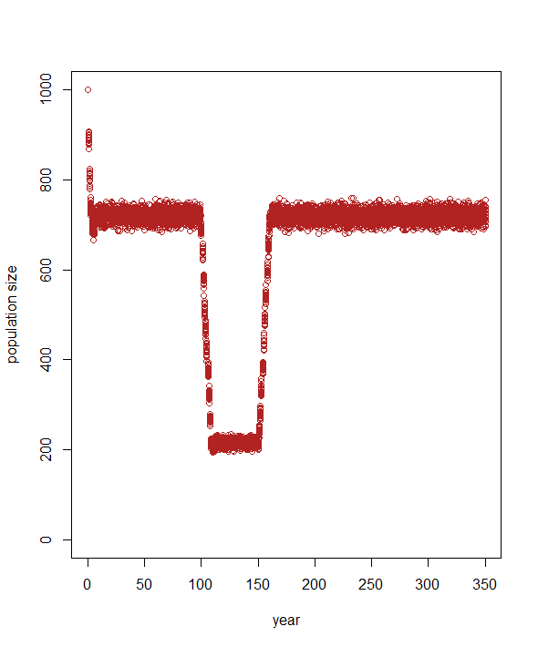
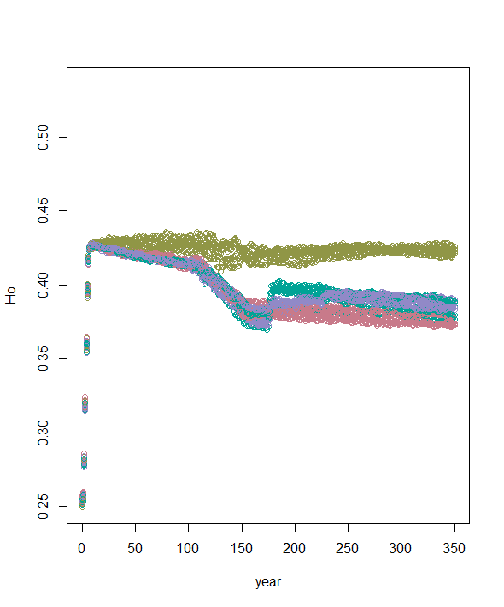
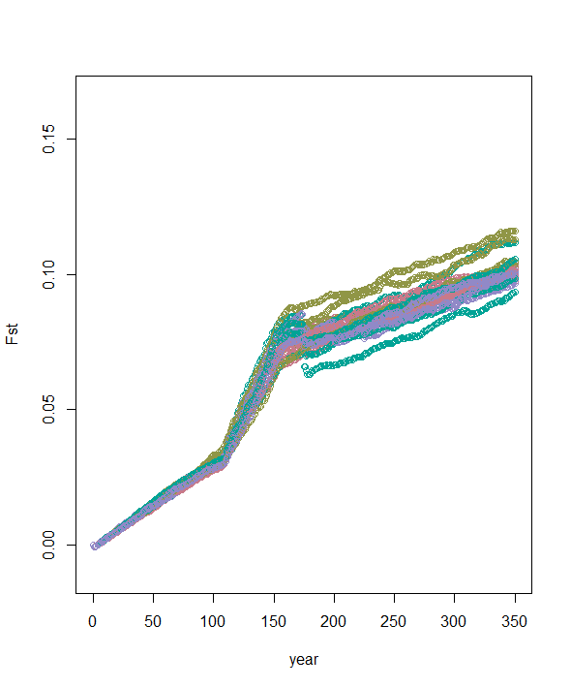
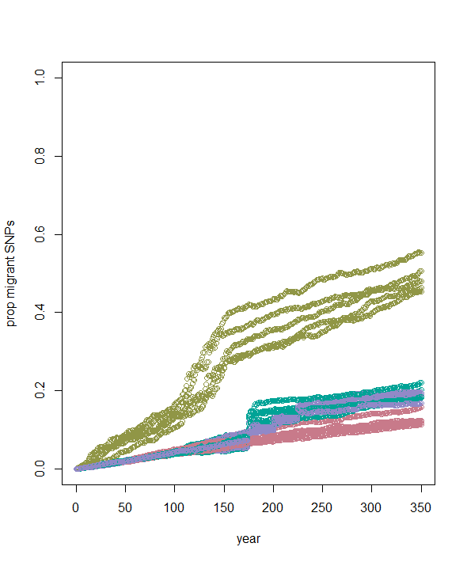
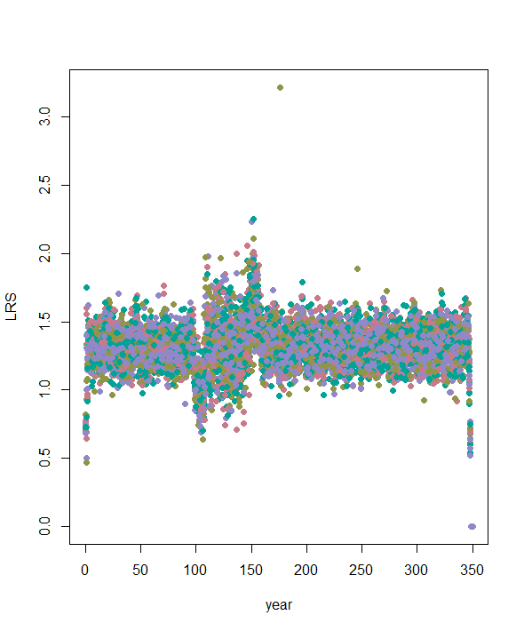
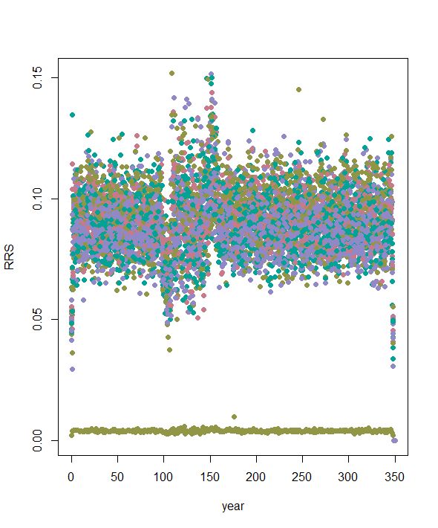
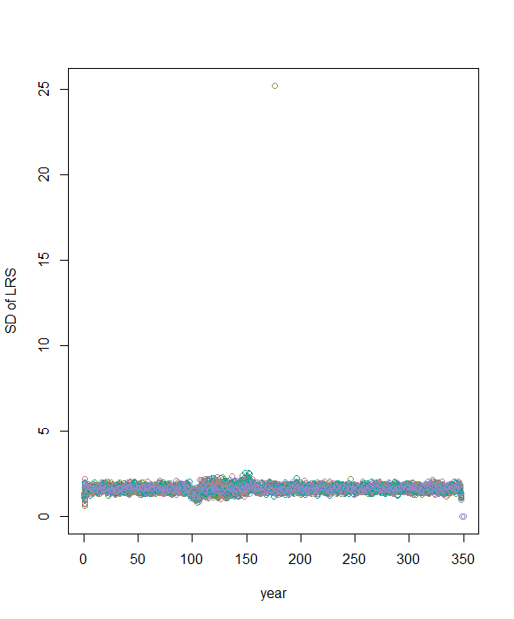
run name | summary | repsuc | pop | parameters | nmig | heteroz of source | minor allel freq FOCAL | n replicates | dropK | k | nSNP | drp | dur | maxage | broodsize | maturity | years | r0 | ratemort | nSNP.mig | nSNP.cons
run_c – part 1 |  |  |  |  | all 4 | 0.45 | 0.45 | 1 | 300 | 1000 | 1000 | 10 | 40 | 9 | 4 | 1 | 350 | 1 |  | 100 | 0
One indv had super high LRS so that run had super low RRS

Slide 6
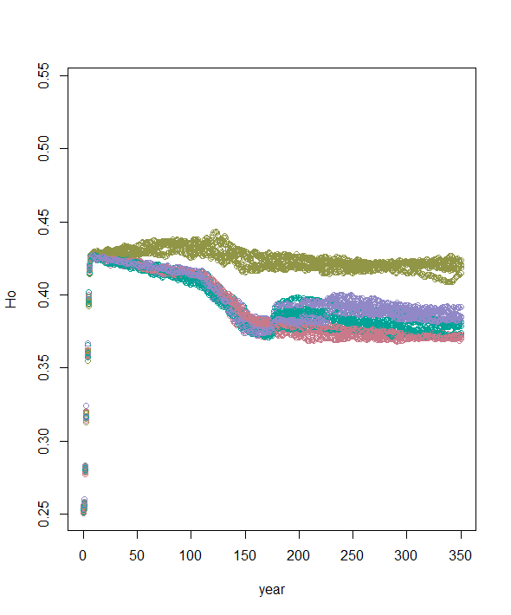
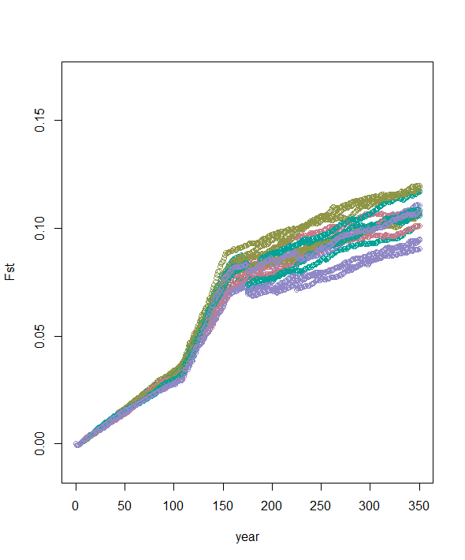
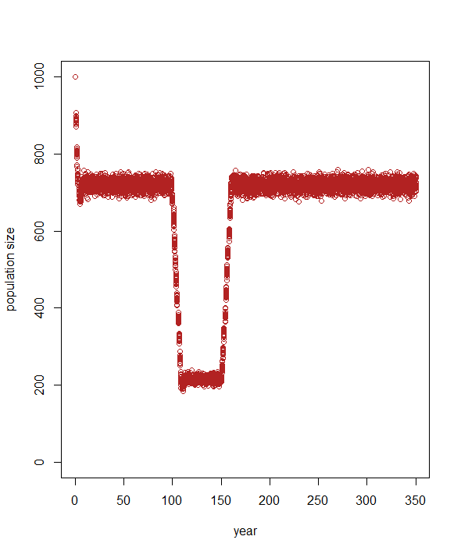
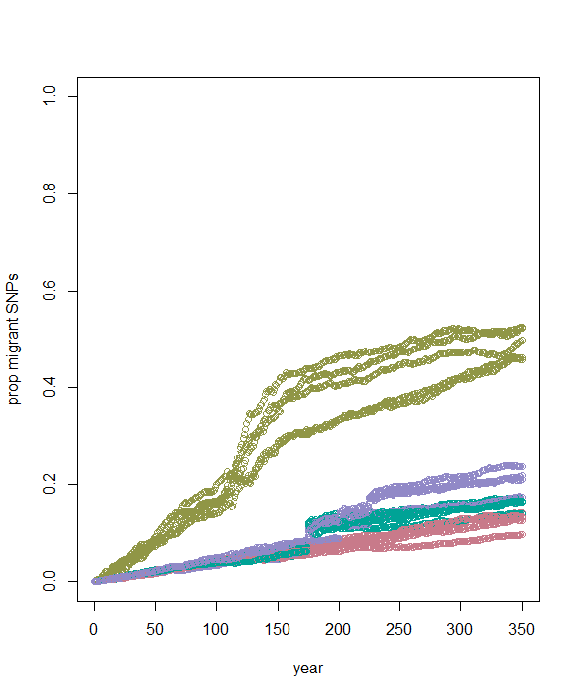
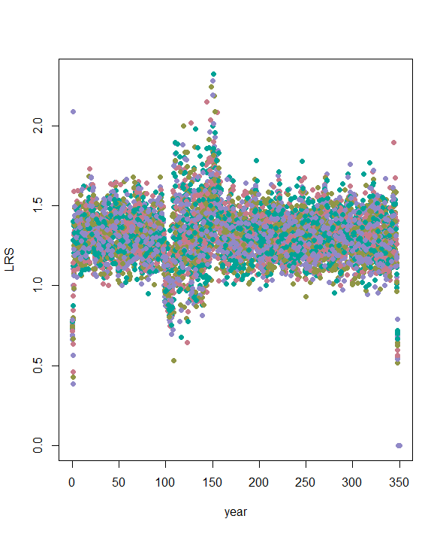
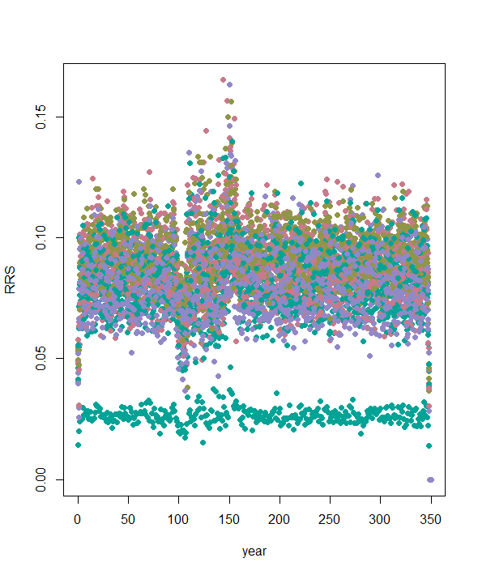
run name | summary | repsuc | pop | parameters | nmig | heteroz of source | minor allel freq FOCAL | n replicates | dropK | k | nSNP | drp | dur | Maxage | broodsize | maturity | years | r0 | ratemort | nSNP.mig | nSNP.cons
run_c – part 2 |  |  |  |  | all 4 | 0.45 | 0.45 | 1 | 300 | 1000 | 1000 | 10 | 40 | 9 | 6 | 1 | 350 | 1 |  | 100 | 0

Slide 7
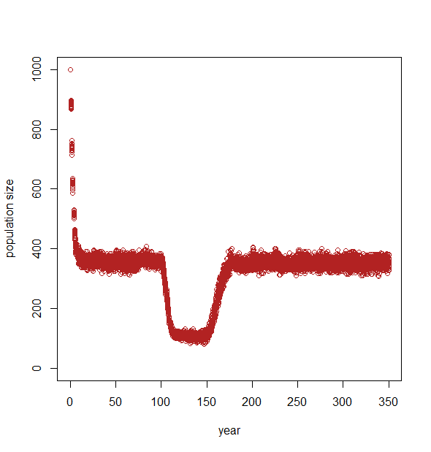
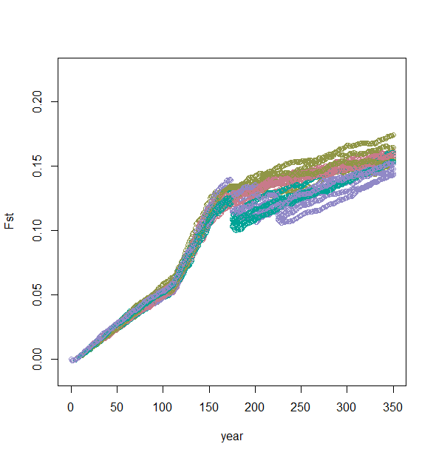
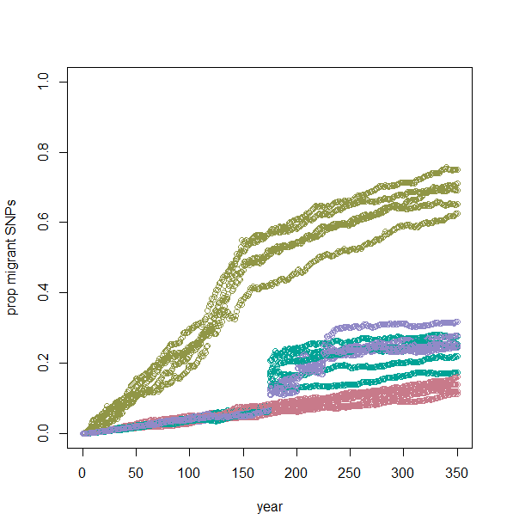
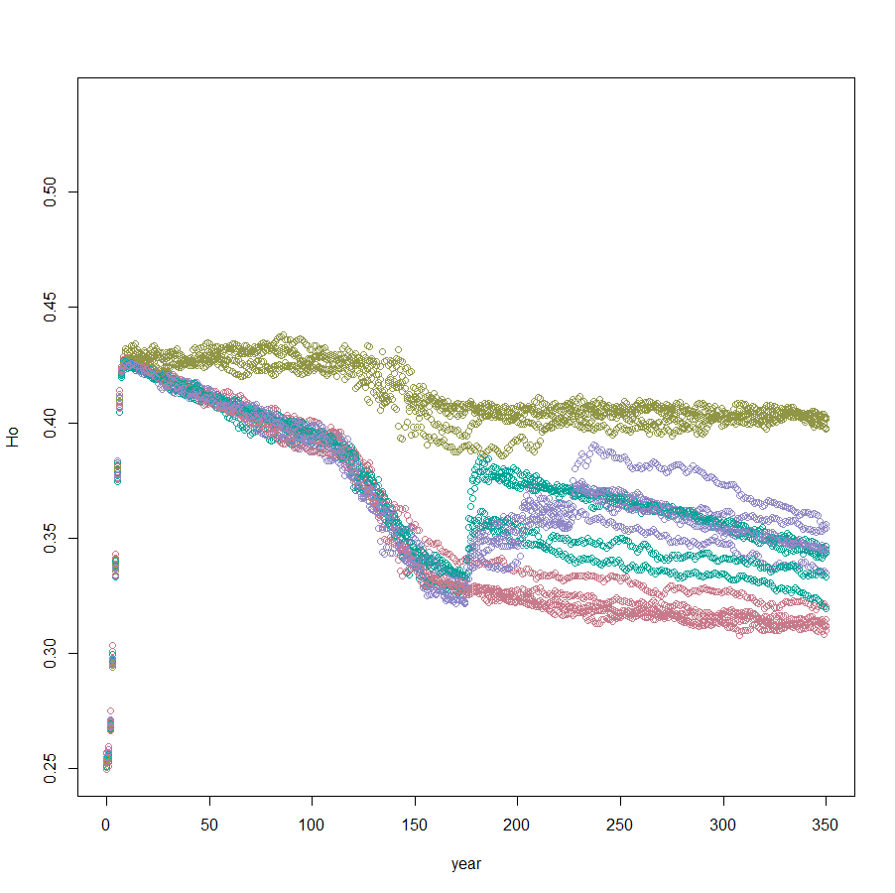
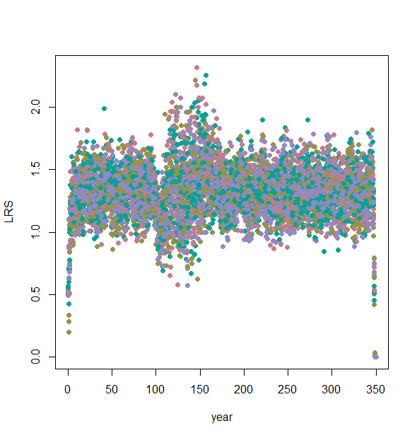
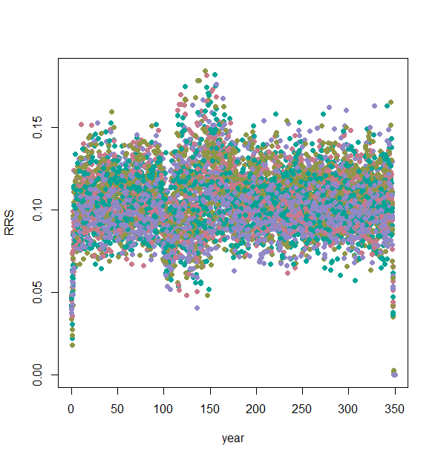
 | summary | repsuc | pop | parameters | nmig | heteroz of source | minor allel freq FOCAL | n replicates | dropK | k | nSNP | drp | dur | maxage | broodsize | maturity | years | r0 | ratemort | nSNP.mig | nSNP.cons
run_d | y | y | y | y | all 4 | 0.45 | 0.45 | 1 | 300 | 1000 | 1000 | 10 | 40 | 9 | 2 | 1 | 350 | 0.5 |  | 100 | 0

Slide 8

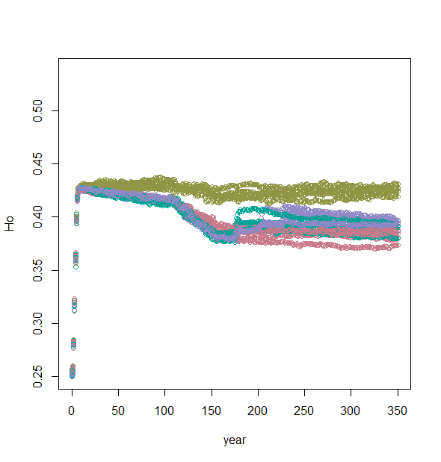
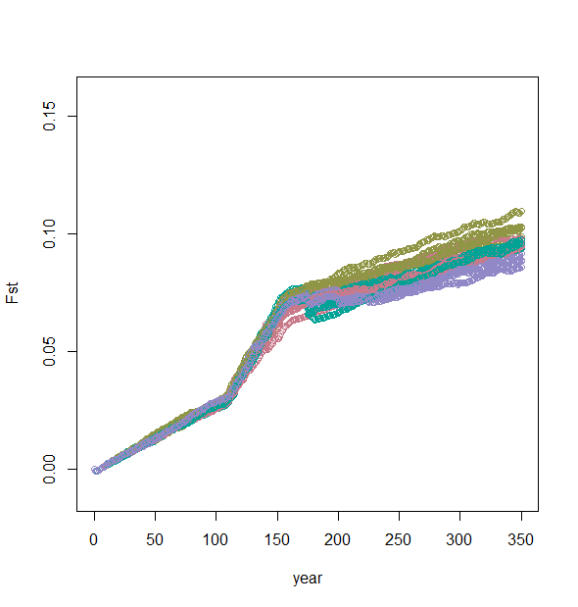
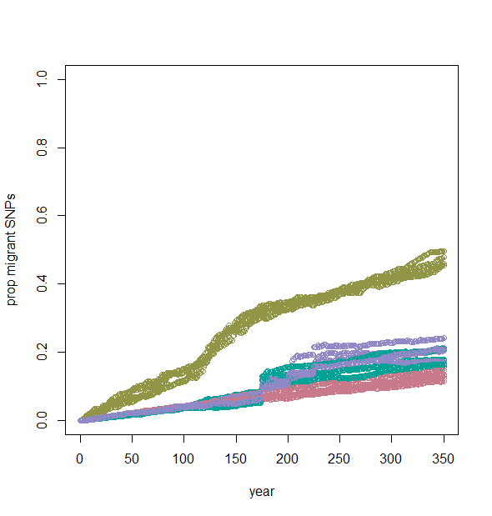

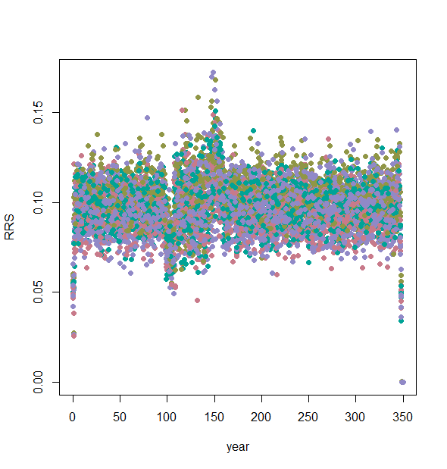
 | summary | repsuc | pop | Parameters | nmig | heteroz of source | minor allel freq FOCAL | n replicates | dropK | k | nSNP | drp | dur | maxage | broodsize | maturity | years | r0 | ratemort | nSNP.mig | nSNP.cons
run_e | y | y | y | y | All 4 | 0.45 | 0.45 | 1 | 300 | 1000 | 1000 | 10 | 40 | 9 | 2 | 1 | 350 | 1 |  | 100 | 0

Slide 9
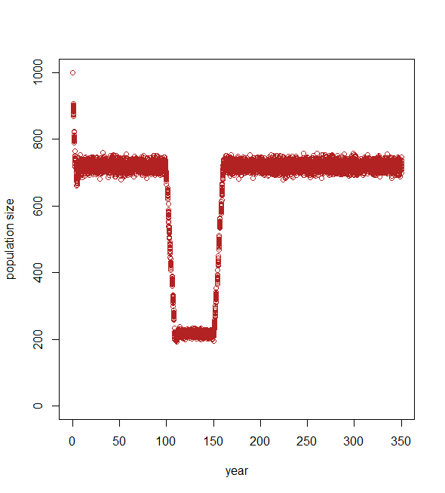
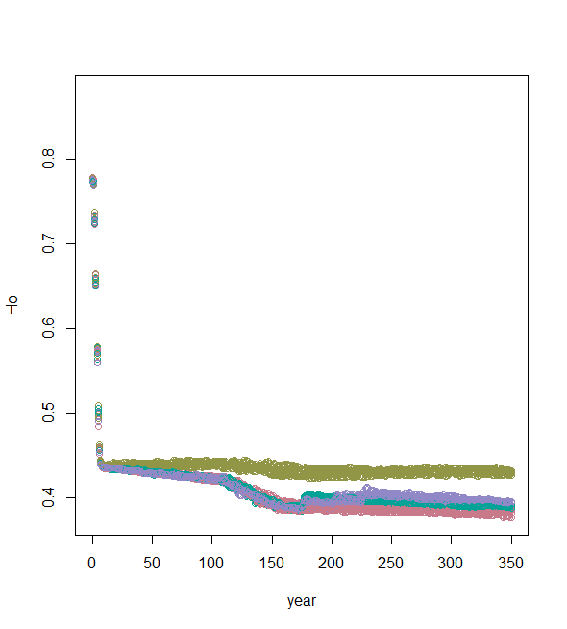
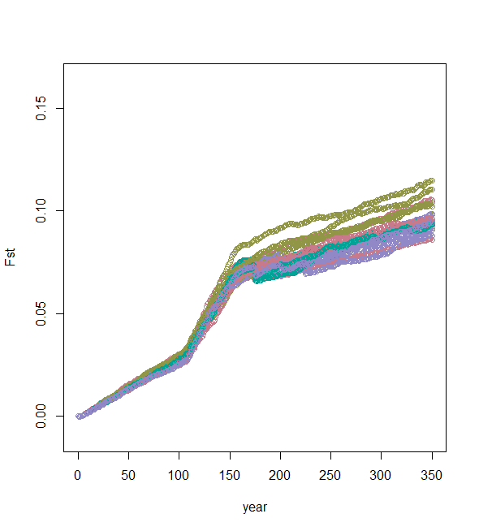
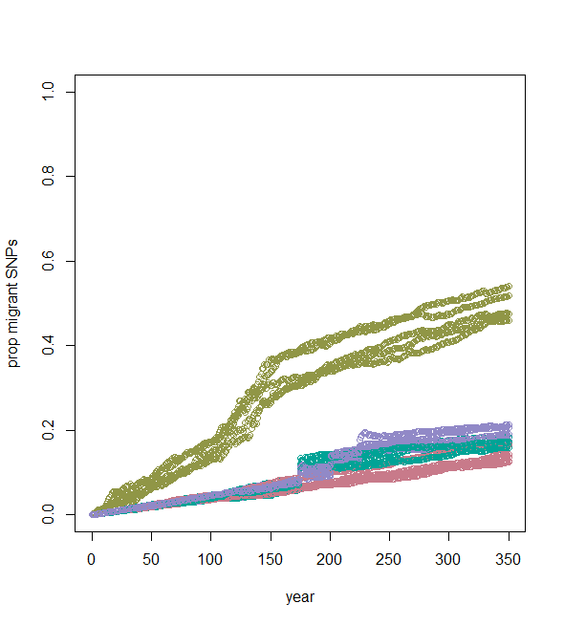
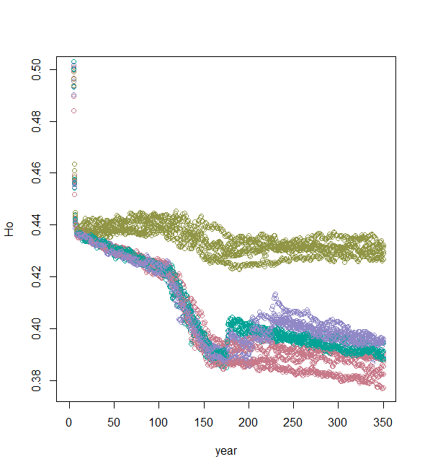
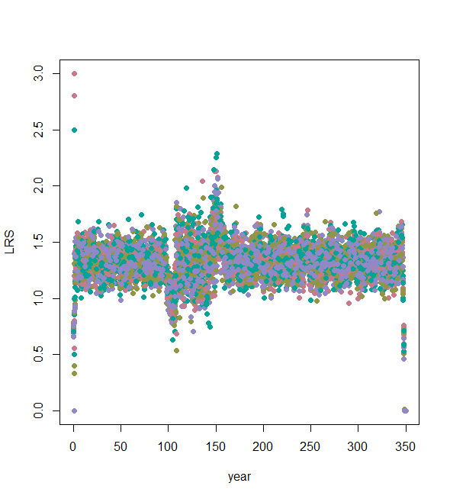
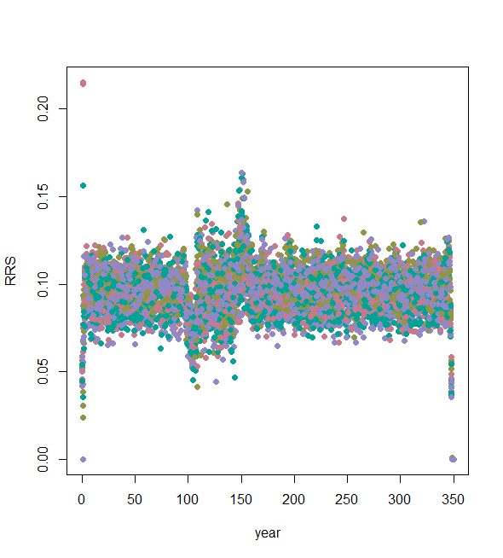
 | run name | summary | repsuc | pop | parameters | nmig | heteroz of source | minor allel freq FOCAL | n replicates | dropK | k | nSNP | drp | dur | maxage | broodsize | maturity | years | r0 | ratemort | nSNP.mig | nSNP.cons
478283:478287 | run_f | y | y | y | y | all 4 | 0.45 | 0.07 | 1 | 300 | 1000 | 1000 | 10 | 40 | 9 | 2 | 1 | 350 | 1 |  | 100 | 0

Slide 10








 | run name | summary | repsuc | pop | parameters | nmig | heteroz of source | minor allel freq FOCAL | n replicates | dropK | k | nSNP | drp | dur | maxage | broodsize | maturity | years | r0 | ratemort | nSNP.mig | nSNP.cons
478289:478293 | run_g | y | y | y | y | all 4 | 0.07 | 0.07 | 1 | 300 | 1000 | 1000 | 10 | 40 | 9 | 2 | 1 | 350 | 1 |  | 100 | 0

Slide 11







run name | summary | repsuc | pop | parameters | nmig | heteroz of source | minor allel freq FOCAL | n replicates | dropK | k | nSNP | drp | dur | maxage | broodsize | maturity | years | r0 | ratemort | nSNP.mig | nSNP.cons
run_h | y | y | y | y | all 4 | 0.45 | 0.45 | 1 | 300 | 1000 | 1000 | 10 | 40 | 9 | 2 | 1 | 350 | 1 | low heterozygosity is better | 100 | 0

Slide 12






run name | summary | repsuc | pop | parameters | nmig | heteroz of source | minor allel freq FOCAL | n replicates | dropK | k | nSNP | drp | dur | maxage | broodsize | maturity | years | r0 | ratemort | nSNP.mig | nSNP.cons
run_i | y | y | y | y | all 4 | 0.07 | 0.45 | 1 | 300 | 1000 | 1000 | 10 | 40 | 9 | 2 | 1 | 350 | 1 | low heterozygosity is better | 100 | 0

Slide 13







run name | summary | repsuc | pop | parameters | nmig | heteroz of source | minor allel freq FOCAL | n replicates | dropK | k | nSNP | drp | dur | maxage | broodsize | maturity | years | r0 | ratemort | nSNP.mig | nSNP.cons
run_j | y | y | y | y | all 4 | 0.45 | 0.07 | 1 | 300 | 1000 | 1000 | 10 | 40 | 9 | 2 | 1 | 350 | 1 | low heterozygosity is better | 100 | 0

Slide 14






run name | summary | repsuc | pop | parameters | nmig | heteroz of source | minor allel freq FOCAL | n replicates | dropK | k | nSNP | drp | dur | maxage | broodsize | maturity | years | r0 | ratemort | nSNP.mig | nSNP.cons
run_k | y | y | y | y | all 4 | 0.07 | 0.07 | 1 | 300 | 1000 | 1000 | 10 | 40 | 9 | 2 | 1 | 350 | 1 | low heterozygosity is better | 100 | 0

Slide 15







run name | summary | repsuc | pop | parameters | nmig | heteroz of source | minor allel freq FOCAL | n replicates | dropK | k | nSNP | drp | dur | maxage | broodsize | maturity | years | r0 | ratemort | nSNP.mig | nSNP.cons
run_l | y | y | y | y | all 4 | 0.07 | 0.07 | 1 | 300 | 1000 | 1000 | 10 | 40 | 9 | 2 | 1 | 350 | 1 |  | 100 | 0

Slide 16







run name | summary | repsuc | pop | parameters | nmig | heteroz of source | minor allel freq FOCAL | n replicates | dropK | k | nSNP | drp | dur | maxage | broodsize | maturity | years | r0 | ratemort | nSNP.mig | nSNP.cons
run_m | y | y | y | y | all 4 | 0.45 | 0.45 | 1 | 300 | 1000 | 1000 | 10 | 40 | 9 | 2 | 3 | 350 | 1 |  | 100 | 0

Slide 17






run name | summary | repsuc | pop | parameters | nmig | heteroz of source | minor allel freq FOCAL | n replicates | dropK | k | nSNP | drp | dur | maxage | broodsize | maturity | years | r0 | ratemort | nSNP.mig | nSNP.cons
run_n | y | y | y | y | all 4 | 0.45 | 0.45 | 1 | 300 | 1000 | 1000 | 10 | 40 | 9 | 2 | 1 | 350 | 1 | mutation rate =0.0001 | 100 | 0

Slide 18






run name | summary | repsuc | pop | parameters | nmig | heteroz of source | minor allel freq FOCAL | n replicates | dropK | k | nSNP | drp | dur | maxage | broodsize | maturity | years | r0 | ratemort | nSNP.mig | nSNP.cons
run_o | y | y | y | y | all 4 | 0.45 | 0.45 | 1 | 300 | 1000 | 1000 | 5 | 45 | 9 | 2 | 1 | 350 | 1 |  | 100 | 0

Slide 19






run name | summary | repsuc | pop | parameters | nmig | heteroz of source | minor allel freq FOCAL | n replicates | dropK | k | nSNP | drp | dur | maxage | broodsize | maturity | years | r0 | ratemort | nSNP.mig | nSNP.cons
run_p | y | y | y | y | all 4 | 0.45 | 0.45 | 1 | 300 | 1000 | 1000 | 25 | 25 | 9 | 2 | 1 | 350 | 1 |  | 100 | 0

Slide 20






run name | summary | repsuc | pop | parameters | nmig | heteroz of source | minor allel freq FOCAL | n replicates | dropK | k | nSNP | drp | dur | maxage | broodsize | maturity | years | r0 | ratemort | nSNP.mig | nSNP.cons
run_q | y | y | y | y | all 4 | 0.45 | 0.45 | 1 | 300 | 1000 | 1000 | 10 | 40 | 9 | 2 | 1 | 350 | 1 | FitBreed - choose based on Ho | 100 | 0

Slide 21






run name | summary | repsuc | pop | parameters | nmig | heteroz of source | minor allel freq FOCAL | n replicates | dropK | k | nSNP | drp | dur | maxage | broodsize | maturity | years | r0 | ratemort | nSNP.mig | nSNP.cons
run_r | y | y | y | y | all 4 | 0.45 | 0.45 | 1 | 300 | 1000 | 1000 | 10 | 40 | 9 | 2 | 1 | 350 | 1 | FitBreed - choose based on prop migrant SNPS | 100 | 0

Slide 22






run name | summary | repsuc | pop | parameters | nmig | heteroz of source | minor allel freq FOCAL | n replicates | dropK | k | nSNP | drp | dur | maxage | broodsize | maturity | years | r0 | ratemort | nSNP.mig | nSNP.cons
run_s | y | y | y | y | all 4 | 0.45 | 0.45 | 1 | 100 | 1000 | 1000 | 10 | 40 | 9 | 2 | 1 | 350 | 1 | FitBreed - choose based on Ho | 100 | 0 | Ne_counts.csv

Slide 23






run name | summary | repsuc | pop | parameters | nmig | heteroz of source | minor allel freq FOCAL | n replicates | dropK | k | nSNP | drp | dur | maxage | broodsize | maturity | years | r0 | ratemort | nSNP.mig | nSNP.cons
run_t | y | y | y | y | all 4 | 0.45 | 0.45 | 1 | 100 | 1000 | 1000 | 10 | 40 | 9 | 2 | 1 | 350 | 1 | FitBreed - choose based on prop migrant SNPS | 100 | 0 | Ne_counts.csv

Slide 24






run name | summary | repsuc | pop | parameters | nmig | heteroz of source | minor allel freq FOCAL | n replicates | dropK | k | nSNP | drp | dur | maxage | broodsize | maturity | years | r0 | ratemort | nSNP.mig | nSNP.cons
run_u | y | y | y | y | all 4 | 0.45 | 0.45 | 1 | 100 | 1000 | 1000 | 10 | 40 | 9 | 2 | 1 | 350 | 1 |  | 100 | 0 | Ne_counts.csv

Slide 25
run name | summary | repsuc | pop | parameters | nmig | heteroz of source | minor allel freq FOCAL | n replicates | dropK | k | nSNP | drp | dur | maxage | broodsize | maturity | years | r0 | ratemort | nSNP.mig | nSNP.cons
run_n | y | y | y | y | all 4 | 0.45 | 0.45 | 1 | 300 | 1000 | 1000 | 10 | 40 | 9 | 2 | 1 | 350 | 1 | mutation rate =0.0001 | 100 | 0
run_o | y | y | y | y | all 4 | 0.45 | 0.45 | 1 | 300 | 1000 | 1000 | 5 | 45 | 9 | 2 | 1 | 350 | 1 |  | 100 | 0
run_p | y | y | y | y | all 4 | 0.45 | 0.45 | 1 | 300 | 1000 | 1000 | 25 | 25 | 9 | 2 | 1 | 350 | 1 |  | 100 | 0
run_q | y | y | y | y | all 4 | 0.45 | 0.45 | 1 | 300 | 1000 | 1000 | 10 | 40 | 9 | 2 | 1 | 350 | 1 | FitBreed - choose based on Ho | 100 | 0
run_r | y | y | y | y | all 4 | 0.45 | 0.45 | 1 | 300 | 1000 | 1000 | 10 | 40 | 9 | 2 | 1 | 350 | 1 | FitBreed - choose based on prop migrant SNPS | 100 | 0
run_s | y | y | y | y | all 4 | 0.45 | 0.45 | 1 | 100 | 1000 | 1000 | 10 | 40 | 9 | 2 | 1 | 350 | 1 | FitBreed - choose based on Ho | 100 | 0 | Ne_counts.csv
run_t | y | y | y | y | all 4 | 0.45 | 0.45 | 1 | 100 | 1000 | 1000 | 10 | 40 | 9 | 2 | 1 | 350 | 1 | FitBreed - choose based on prop migrant SNPS | 100 | 0 | Ne_counts.csv
run_u | y | y | y | y | all 4 | 0.45 | 0.45 | 1 | 100 | 1000 | 1000 | 10 | 40 | 9 | 2 | 1 | 350 | 1 |  | 100 | 0 | Ne_counts.csv

