Slide 1
#Data{
#summary_ABM_run.10.12.22_d_all.csv >> zero migration
#ABM_run.11.8.22_1a_all_summary.csv >> 1 mig per generation, starting heterozy in source pop = .4-.6
#ABM_run.11.7.22_2a_all_summary.csv >> one migration of 50 indv at year 175, starting heterozy in source pop = .4-.6
#ABM_run.11.7.22_3a_all_summary.csv >> three migrations of 25 indv at years 175, 201, 225, starting heterozy in source pop = .4-.6
#ABM_run.11.8.22_4a_all_summary.csv >> 1 mig per generation, starting heterozy in source pop = .8-.9
#ABM_run.11.8.22_5a_all_summary.csv >> 1 mig per generation, starting heterozy in source pop = .1-.2
#ABM_run.11.14.22_6a_all_summary.csv >> one migration of 50 indv at year 175, starting heterozy in source pop = .1-.2
#ABM_run.11.14.22_7a_all_summary.csv >> one migration of 50 indv at year 175, starting heterozy in source pop = .8-.9
#ABM_run.11.14.22_8a_all_summary.csv >> three migrations of 25 indv at years 175, 201, 225, starting heterozy in source pop = .8-.9
#ABM_run.11.14.22_9a_all_summary.csv >> three migrations of 25 indv at years 175, 201, 225, starting heterozy in source pop = .1-.2
}
Q1. For how long can migrant ancestry be detected in populations with varying migration intensities?
Q2. How do migrants with high or low fitness affect the receiving population’s long-term stability?
Q3. What are the differences in population viability following translocations for species with different life history traits?
Notes:
ONLY drift alleles – not any conserved alleles
K = 500, nSNP=1000, maxage=9, broodsize=2, maturity=1, growth rate=1, 250years, crash size=250, dropfor50yrs, durationfor50yrs
Should I add reproductive success values? >>YES (may not really work tho since numboff is so constrained)
relative fitness - defined as repro succ of the indv/max repro succ
Lifetime reproductive success & repro success for males and females separately
How do I get replicate number figured out in Easley?? >> seq(1:250)rep IN R
Also should all these be in cover for additional parameter sets?? >>YES that will make it easier to run later>>WILL need to figure out memory issues in Easley for this
Add the other types of snps!!!

Slide 2
tab | run | mig | Source het
0 | summary_ABM_run.10.12.22_d_all.csv | 0 | .4-.6
1 | ABM_run.11.8.22_1a_all_summary.csv | 1 per gen | .4-.6
2 | ABM_run.11.7.22_2a_all_summary.csv | 1x, 50 indv @ y=175 | .4-.6
3 | ABM_run.11.7.22_3a_all_summary.csv | 3x, 25 indv @ y=175, 201, 225 | .4-.6
4 | ABM_run.11.8.22_4a_all_summary.csv | 1 per gen | .8-.9
5 | ABM_run.11.8.22_5a_all_summary.csv | 1 per gen | .1-.2
6 | ABM_run.11.14.22_6a_all_summary.csv | 1x, 50 indv @ y=175 | .1-.2
7 | ABM_run.11.14.22_7a_all_summary.csv | 1x, 50 indv @ y=175 | .8-.9
8 | ABM_run.11.14.22_8a_all_summary.csv | 3x, 25 indv @ y=175, 201, 225 | .8-.9
9 | ABM_run.11.14.22_9a_all_summary.csv | 3x, 25 indv @ y=175, 201, 225 | .1-.2
Comp

Slide 3
tab | run | mig | Source het
0 | summary_ABM_run.10.12.22_d_all.csv | 0 | .4-.6
1 | ABM_run.11.8.22_1a_all_summary.csv | 1 per gen | .4-.6
2 | ABM_run.11.7.22_2a_all_summary.csv | 1x, 50 indv @ y=175 | .4-.6
3 | ABM_run.11.7.22_3a_all_summary.csv | 3x, 25 indv @ y=175, 201, 225 | .4-.6
4 | ABM_run.11.8.22_4a_all_summary.csv | 1 per gen | .8-.9
5 | ABM_run.11.8.22_5a_all_summary.csv | 1 per gen | .1-.2
6 | ABM_run.11.14.22_6a_all_summary.csv | 1x, 50 indv @ y=175 | .1-.2
7 | ABM_run.11.14.22_7a_all_summary.csv | 1x, 50 indv @ y=175 | .8-.9
8 | ABM_run.11.14.22_8a_all_summary.csv | 3x, 25 indv @ y=175, 201, 225 | .8-.9
9 | ABM_run.11.14.22_9a_all_summary.csv | 3x, 25 indv @ y=175, 201, 225 | .1-.2
Comp 1
Comp1 (m=0,m=1,m=1x,m=3x) @ .4-.6

Slide 4
tab | run | mig | Source het
0 | summary_ABM_run.10.12.22_d_all.csv | 0 | .4-.6
1 | ABM_run.11.8.22_1a_all_summary.csv | 1 per gen | .4-.6
2 | ABM_run.11.7.22_2a_all_summary.csv | 1x, 50 indv @ y=175 | .4-.6
3 | ABM_run.11.7.22_3a_all_summary.csv | 3x, 25 indv @ y=175, 201, 225 | .4-.6
4 | ABM_run.11.8.22_4a_all_summary.csv | 1 per gen | .8-.9
5 | ABM_run.11.8.22_5a_all_summary.csv | 1 per gen | .1-.2
6 | ABM_run.11.14.22_6a_all_summary.csv | 1x, 50 indv @ y=175 | .1-.2
7 | ABM_run.11.14.22_7a_all_summary.csv | 1x, 50 indv @ y=175 | .8-.9
8 | ABM_run.11.14.22_8a_all_summary.csv | 3x, 25 indv @ y=175, 201, 225 | .8-.9
9 | ABM_run.11.14.22_9a_all_summary.csv | 3x, 25 indv @ y=175, 201, 225 | .1-.2
Comp 2
Comp2 (h=.4-6,.8-.9,.1-.2) @ m=1 per gen

Slide 5
tab | run | mig | Source het
0 | summary_ABM_run.10.12.22_d_all.csv | 0 | .4-.6
1 | ABM_run.11.8.22_1a_all_summary.csv | 1 per gen | .4-.6
2 | ABM_run.11.7.22_2a_all_summary.csv | 1x, 50 indv @ y=175 | .4-.6
3 | ABM_run.11.7.22_3a_all_summary.csv | 3x, 25 indv @ y=175, 201, 225 | .4-.6
4 | ABM_run.11.8.22_4a_all_summary.csv | 1 per gen | .8-.9
5 | ABM_run.11.8.22_5a_all_summary.csv | 1 per gen | .1-.2
6 | ABM_run.11.14.22_6a_all_summary.csv | 1x, 50 indv @ y=175 | .1-.2
7 | ABM_run.11.14.22_7a_all_summary.csv | 1x, 50 indv @ y=175 | .8-.9
8 | ABM_run.11.14.22_8a_all_summary.csv | 3x, 25 indv @ y=175, 201, 225 | .8-.9
9 | ABM_run.11.14.22_9a_all_summary.csv | 3x, 25 indv @ y=175, 201, 225 | .1-.2
Comp 3
Comp3 (h=.4-6,.8-.9,.1-.2) @ m=1x,50

Slide 6
tab | run | mig | Source het
0 | summary_ABM_run.10.12.22_d_all.csv | 0 | .4-.6
1 | ABM_run.11.8.22_1a_all_summary.csv | 1 per gen | .4-.6
2 | ABM_run.11.7.22_2a_all_summary.csv | 1x, 50 indv @ y=175 | .4-.6
3 | ABM_run.11.7.22_3a_all_summary.csv | 3x, 25 indv @ y=175, 201, 225 | .4-.6
4 | ABM_run.11.8.22_4a_all_summary.csv | 1 per gen | .8-.9
5 | ABM_run.11.8.22_5a_all_summary.csv | 1 per gen | .1-.2
6 | ABM_run.11.14.22_6a_all_summary.csv | 1x, 50 indv @ y=175 | .1-.2
7 | ABM_run.11.14.22_7a_all_summary.csv | 1x, 50 indv @ y=175 | .8-.9
8 | ABM_run.11.14.22_8a_all_summary.csv | 3x, 25 indv @ y=175, 201, 225 | .8-.9
9 | ABM_run.11.14.22_9a_all_summary.csv | 3x, 25 indv @ y=175, 201, 225 | .1-.2
Comp 4
Comp4 (h=.4-6,.8-.9,.1-.2) @ m=3x,25

Slide 7
tab | run | mig | Source het
0 | summary_ABM_run.10.12.22_d_all.csv | 0 | .4-.6
1 | ABM_run.11.8.22_1a_all_summary.csv | 1 per gen | .4-.6
2 | ABM_run.11.7.22_2a_all_summary.csv | 1x, 50 indv @ y=175 | .4-.6
3 | ABM_run.11.7.22_3a_all_summary.csv | 3x, 25 indv @ y=175, 201, 225 | .4-.6
4 | ABM_run.11.8.22_4a_all_summary.csv | 1 per gen | .8-.9
5 | ABM_run.11.8.22_5a_all_summary.csv | 1 per gen | .1-.2
6 | ABM_run.11.14.22_6a_all_summary.csv | 1x, 50 indv @ y=175 | .1-.2
7 | ABM_run.11.14.22_7a_all_summary.csv | 1x, 50 indv @ y=175 | .8-.9
8 | ABM_run.11.14.22_8a_all_summary.csv | 3x, 25 indv @ y=175, 201, 225 | .8-.9
9 | ABM_run.11.14.22_9a_all_summary.csv | 3x, 25 indv @ y=175, 201, 225 | .1-.2
Comp 5
Comp5 (m=0,m=1,m=1x,m=3x) @ h=.8-.9

Slide 8
tab | run | mig | Source het
0 | summary_ABM_run.10.12.22_d_all.csv | 0 | .4-.6
1 | ABM_run.11.8.22_1a_all_summary.csv | 1 per gen | .4-.6
2 | ABM_run.11.7.22_2a_all_summary.csv | 1x, 50 indv @ y=175 | .4-.6
3 | ABM_run.11.7.22_3a_all_summary.csv | 3x, 25 indv @ y=175, 201, 225 | .4-.6
4 | ABM_run.11.8.22_4a_all_summary.csv | 1 per gen | .8-.9
5 | ABM_run.11.8.22_5a_all_summary.csv | 1 per gen | .1-.2
6 | ABM_run.11.14.22_6a_all_summary.csv | 1x, 50 indv @ y=175 | .1-.2
7 | ABM_run.11.14.22_7a_all_summary.csv | 1x, 50 indv @ y=175 | .8-.9
8 | ABM_run.11.14.22_8a_all_summary.csv | 3x, 25 indv @ y=175, 201, 225 | .8-.9
9 | ABM_run.11.14.22_9a_all_summary.csv | 3x, 25 indv @ y=175, 201, 225 | .1-.2
Comp 6
Comp6 (m=0,m=1,m=1x,m=3x) @ h=.1-.2

Slide 9
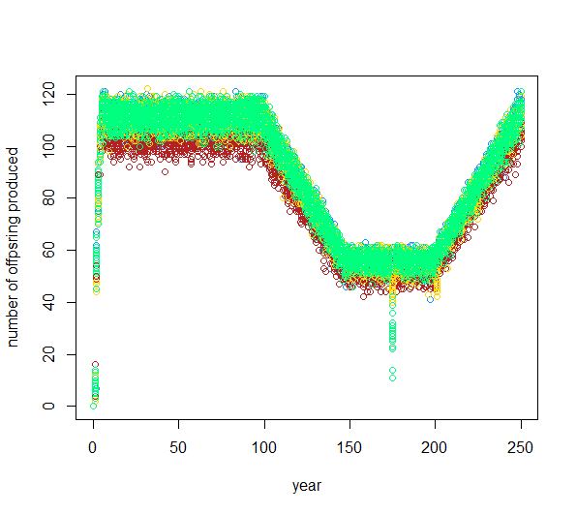
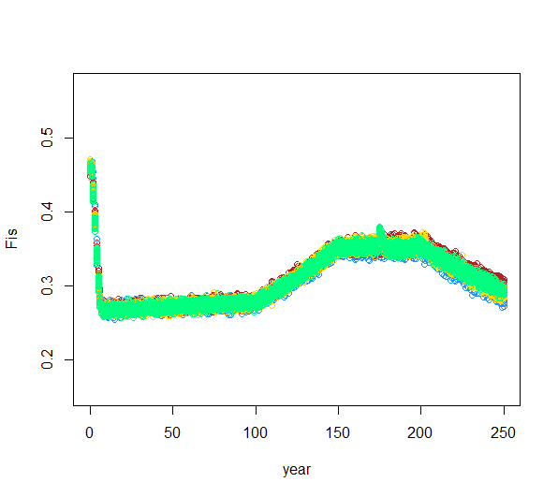
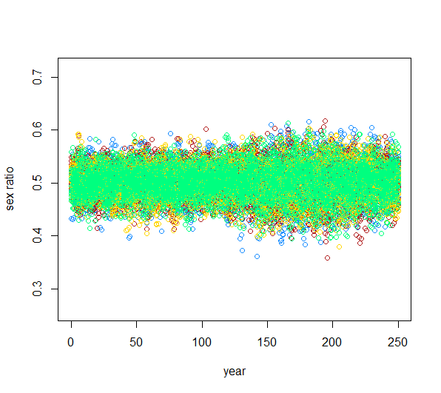
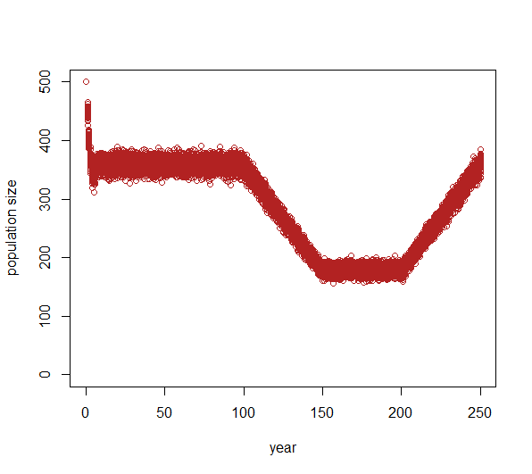
Dif migration intensities
Comp1 (m=0,m=1,m=1x,m=3x) @ .4-.6

Slide 10
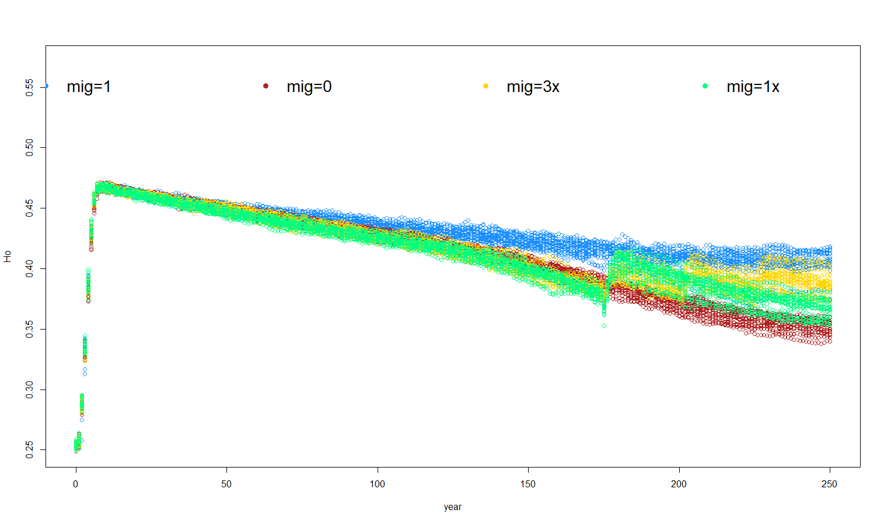
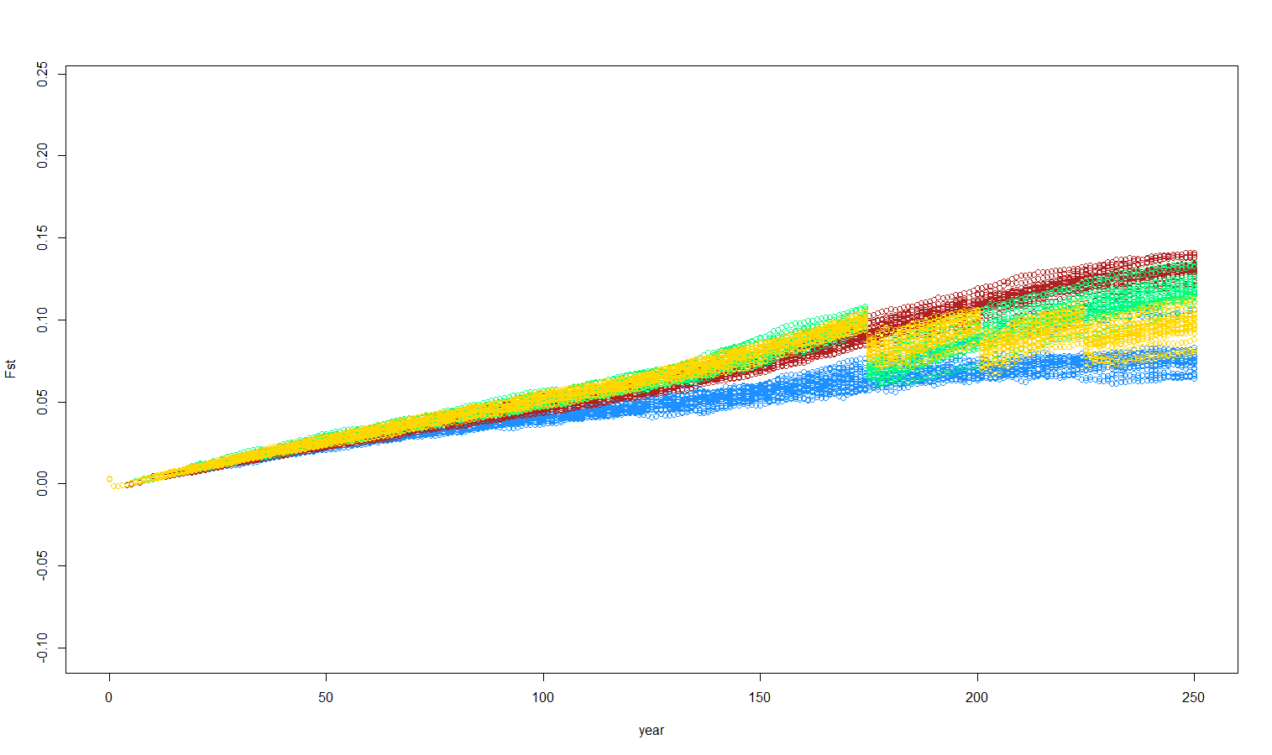
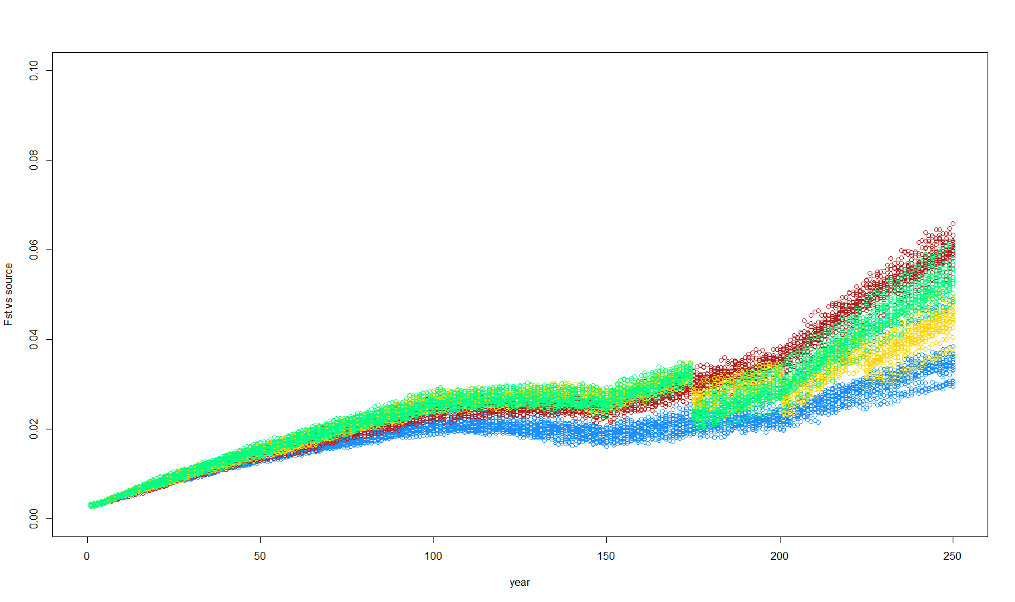
Dif migration intensities
Comp1 (m=0,m=1,m=1x,m=3x) @ .4-.6
Notes:
PCA of 3 pops > starting source, starting pop, evolved pop (would need same original, but vary the migrants)

Slide 11
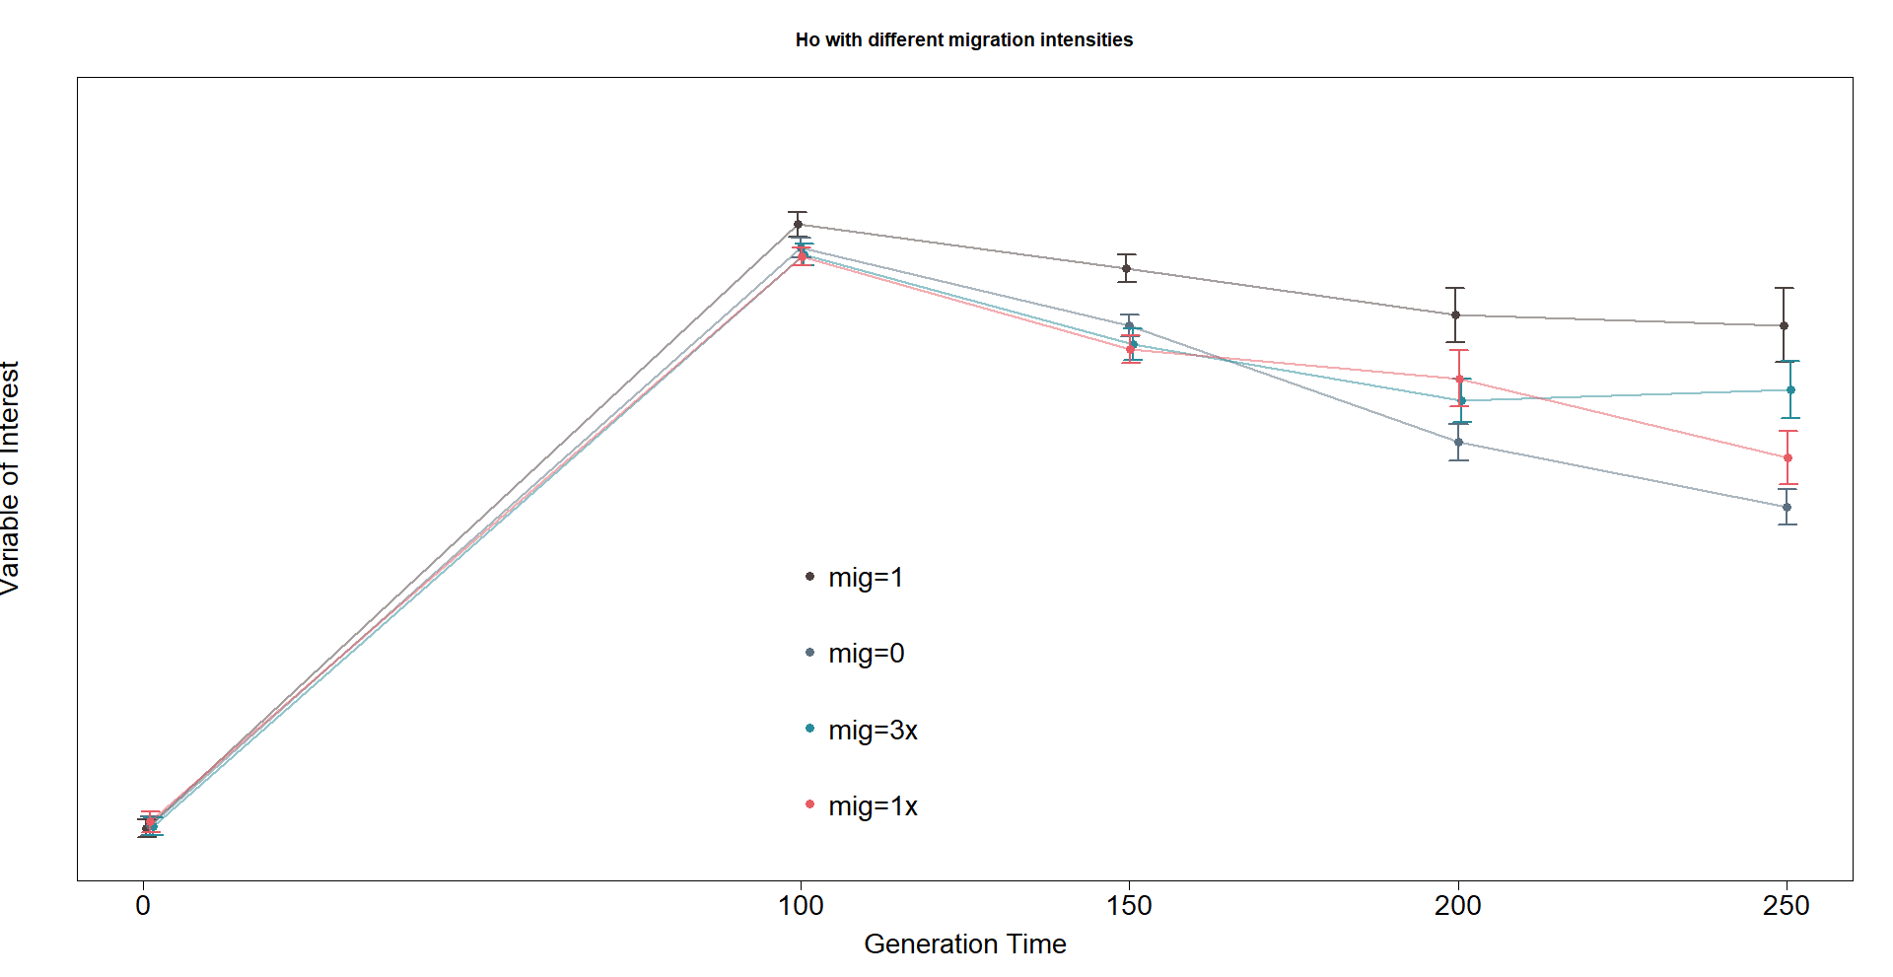
Comp1 (m=0,m=1,m=1x,m=3x) @ .4-.6
Notes:
Could try doing a polygon to look at every year

Slide 12
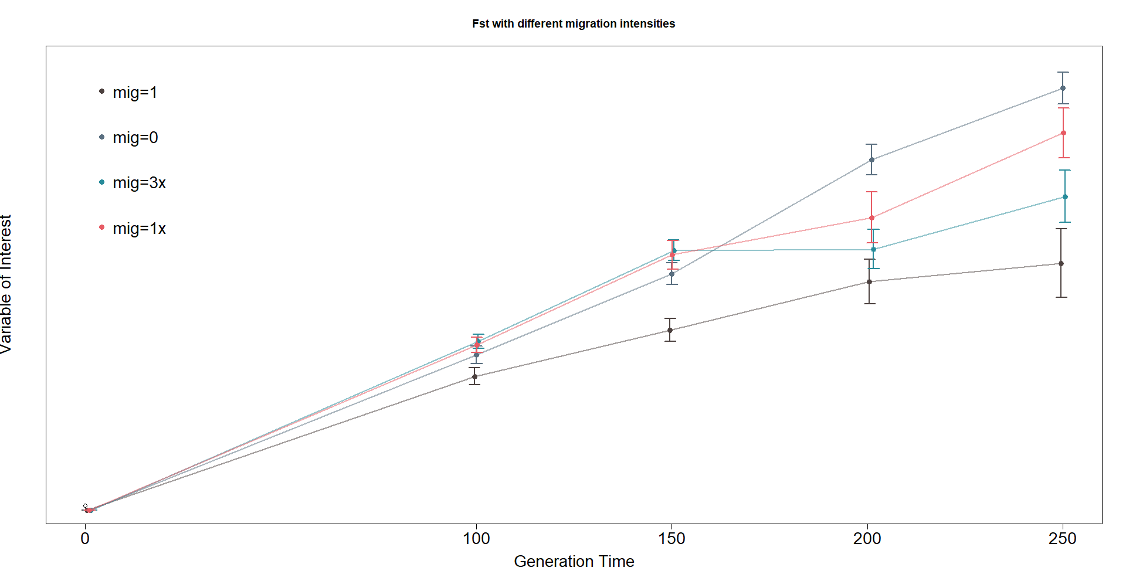
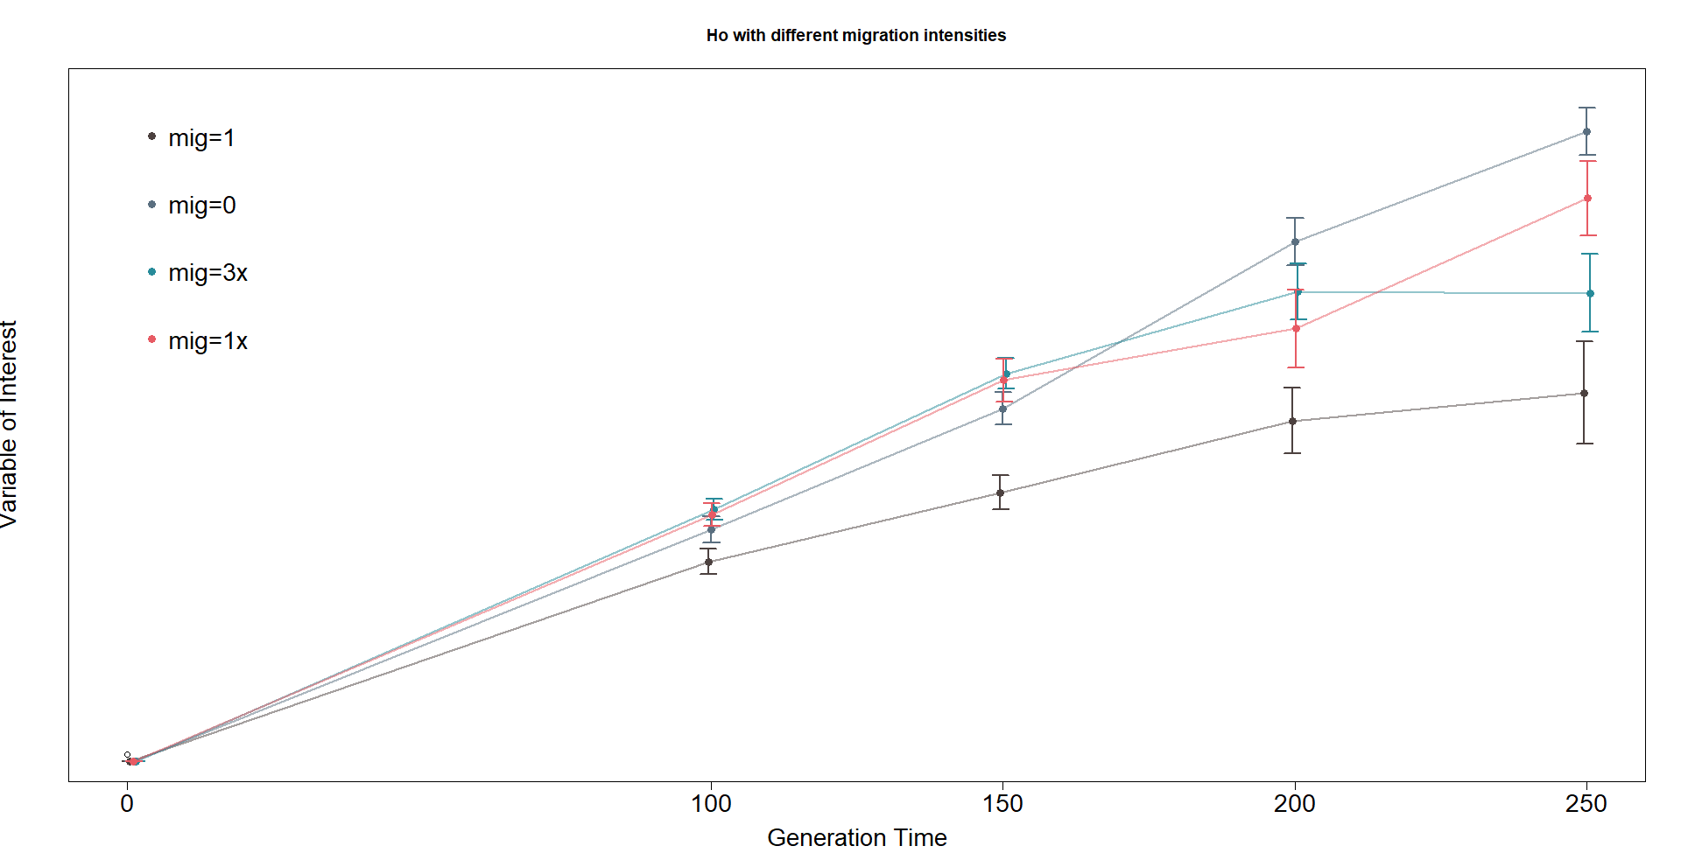
Comp1 (m=0,m=1,m=1x,m=3x) @ .4-.6

Slide 13
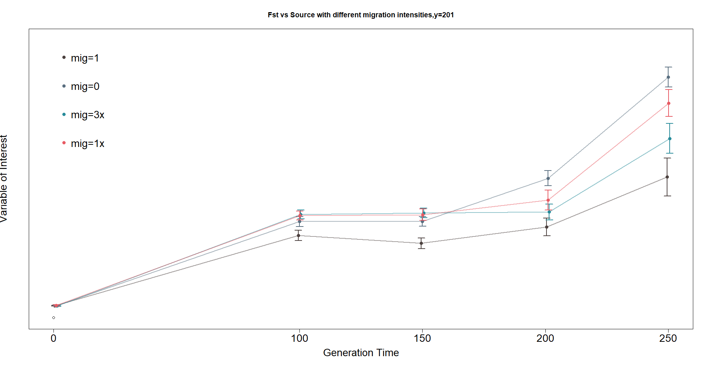
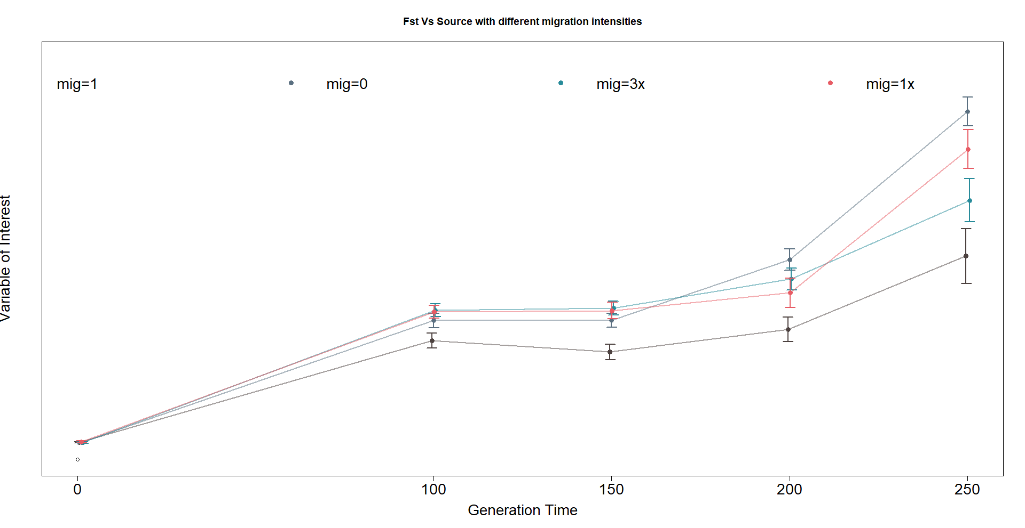
Comp1 (m=0,m=1,m=1x,m=3x) @ .4-.6

Slide 14

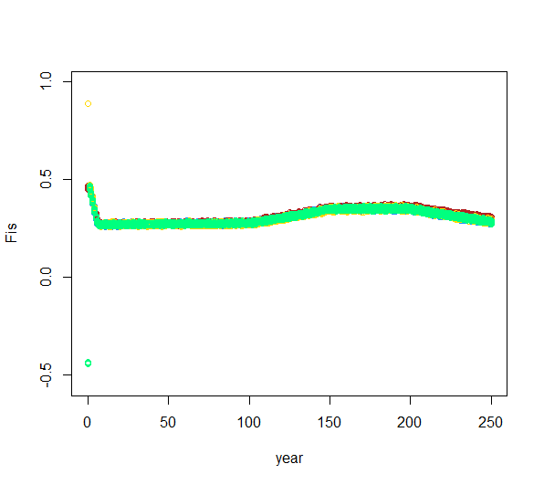
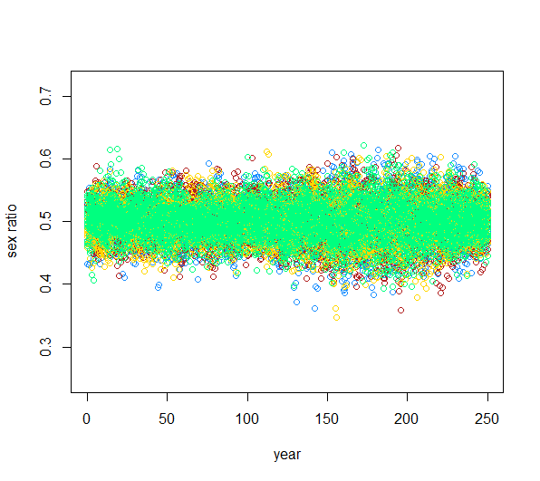
Diff source heterozy
Comp2 (h=.4-6,.8-.9,.1-.2) @ m=1 per gen

Slide 15
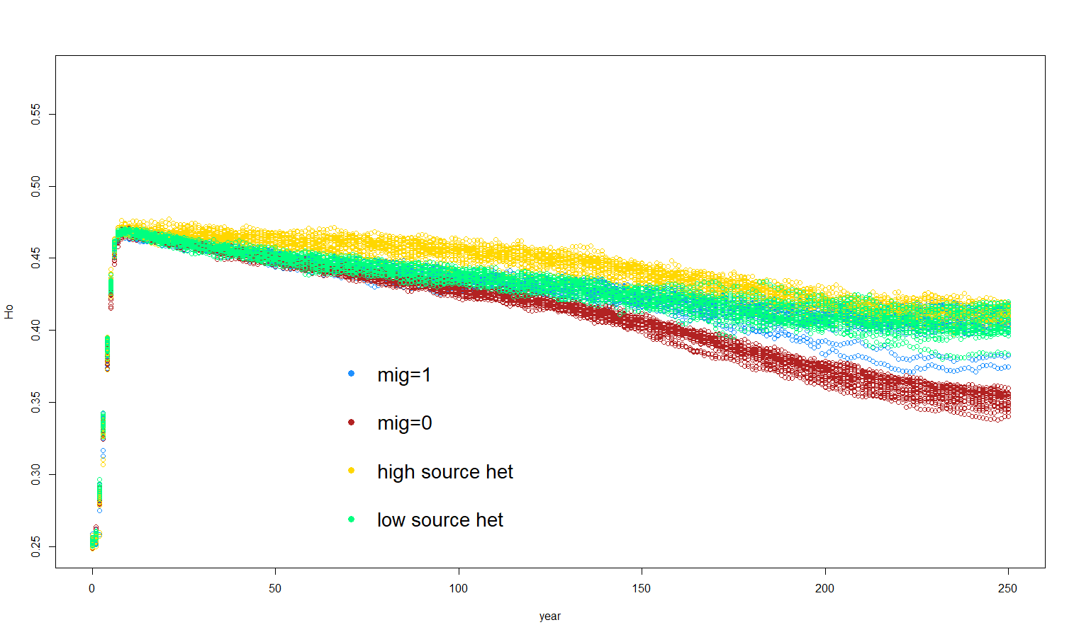
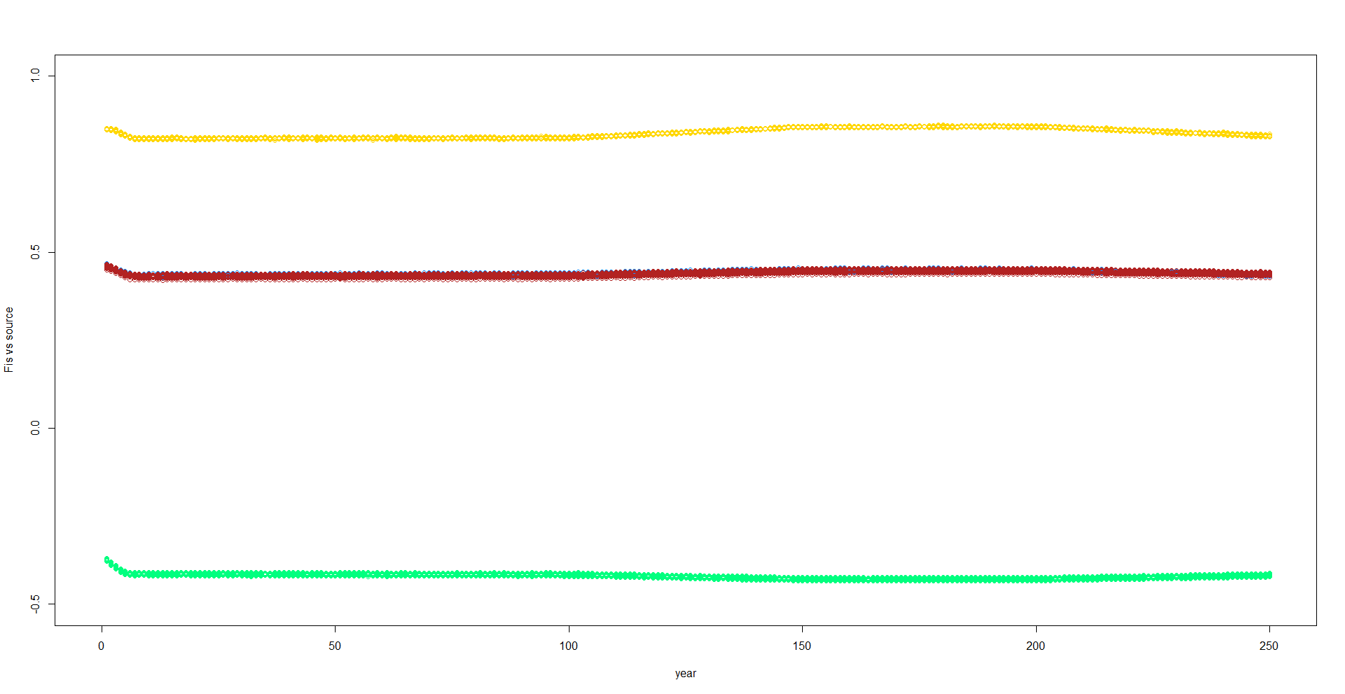
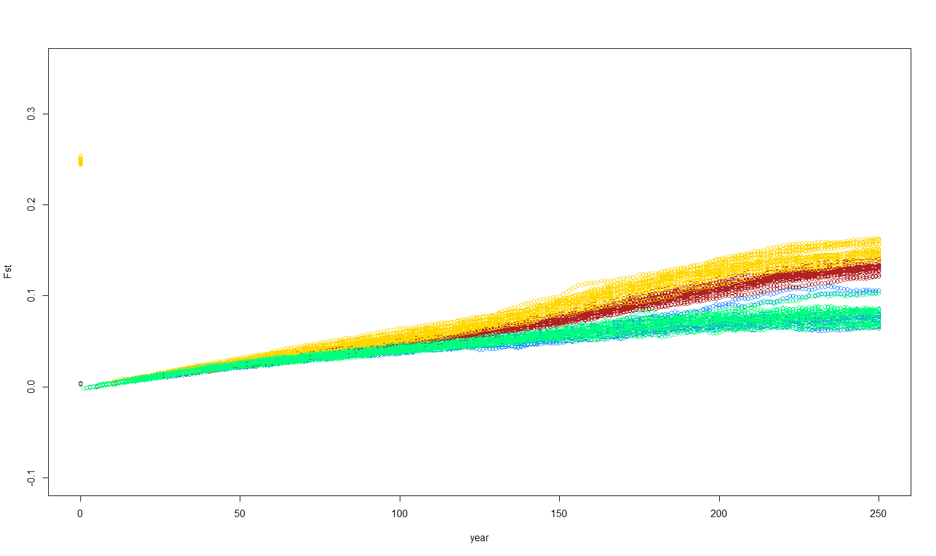
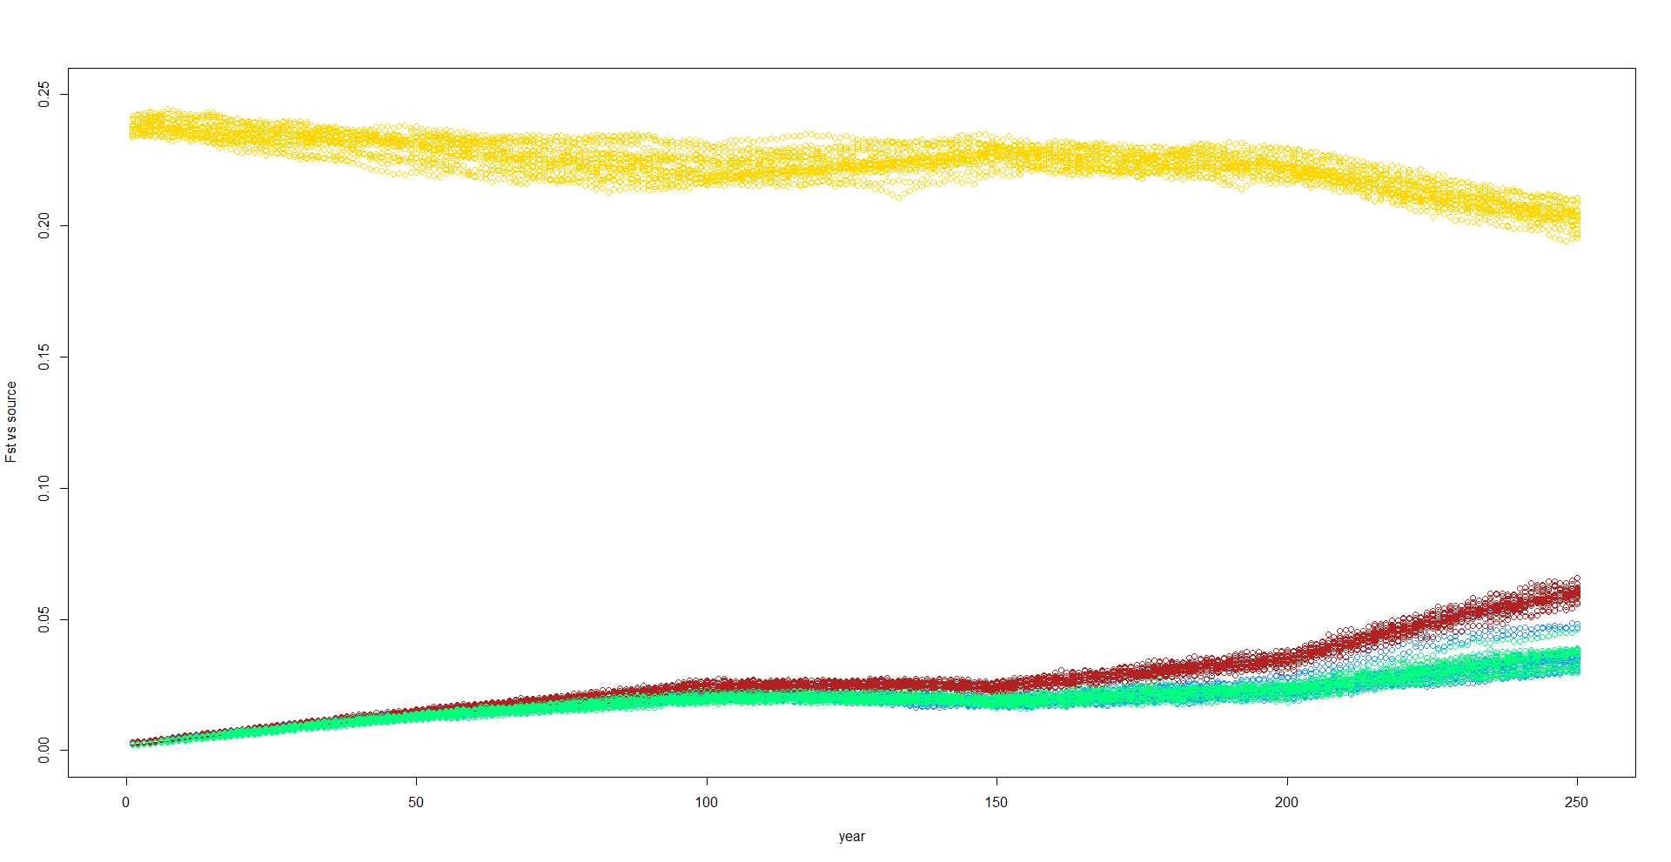
Diff source heterozy
Comp2 (h=.4-6,.8-.9,.1-.2) @ m=1 per gen
Notes:
Might need to have a zero mig per generation for each of the different starting heterozygosities.
Next steps:: add life history (consider not specific species- reintroduction programs) – OR 1 sp with somewhat different changes in values
Add pulses with different heterozy levels
Pick Q^ or Qv (only do life history changes or do crash intensities)
Q: how much should you supplement before you create something new?? –when does something that is supposed to help with management actually CHANGE THE POP TRAJECTORY
(crash pop to 50, add 250 indv in a pulse)– find point where extinction is likely

Slide 16
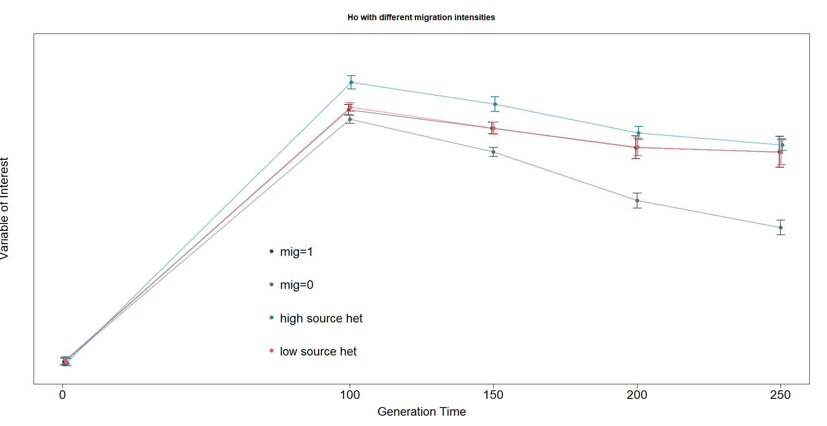
Ho with different source heterozygosities
Comp2 (h=.4-6,.8-.9,.1-.2) @ m=1 per gen

Slide 17
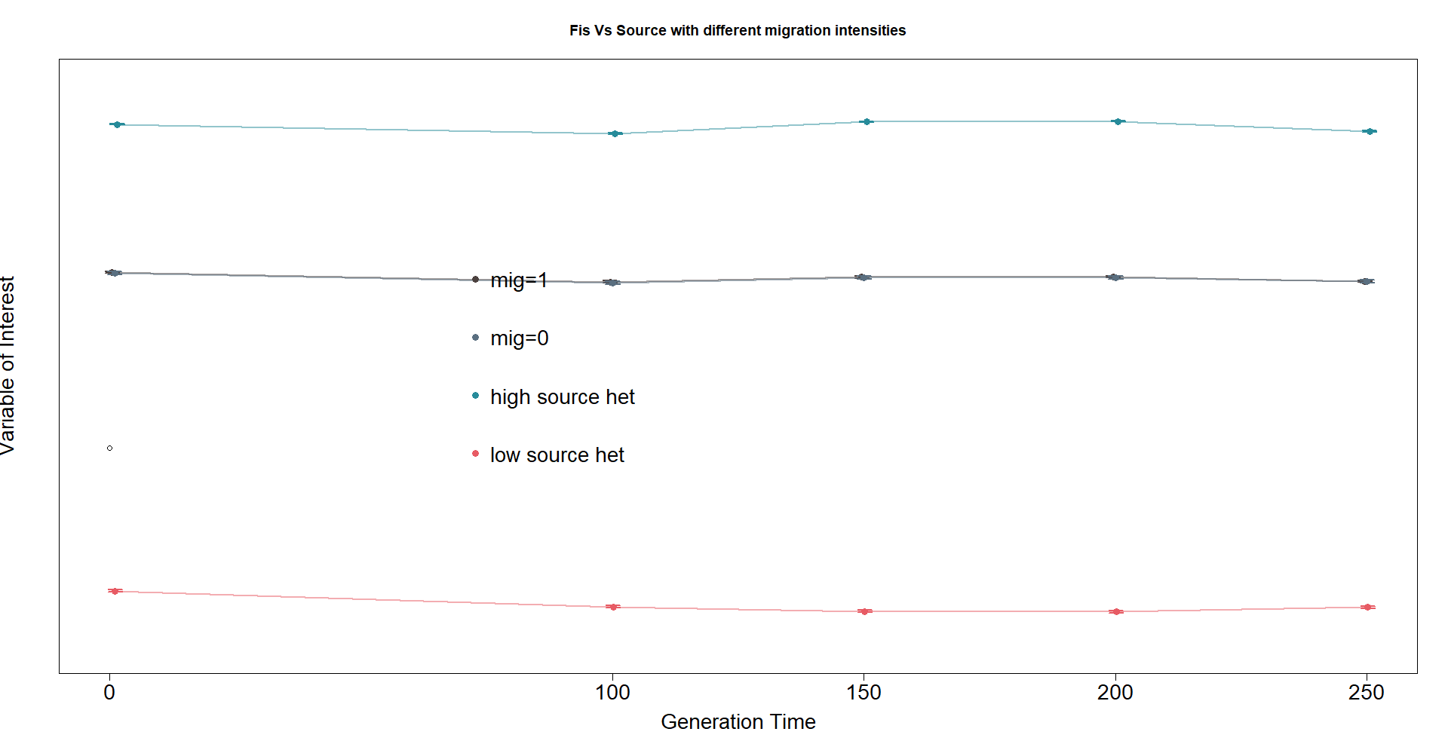
Fis v source with different source heterozygosities
Comp2 (h=.4-6,.8-.9,.1-.2) @ m=1 per gen

Slide 18
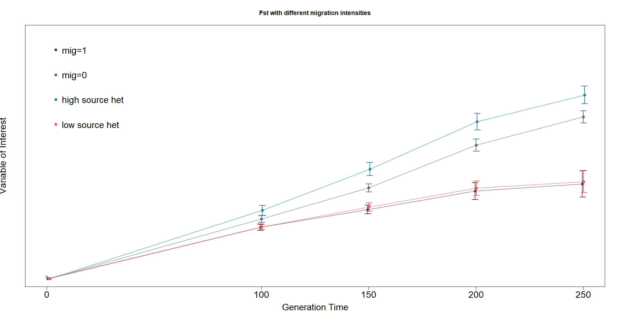
Fst with different source heterozygosities
Comp2 (h=.4-6,.8-.9,.1-.2) @ m=1 per gen

Slide 19
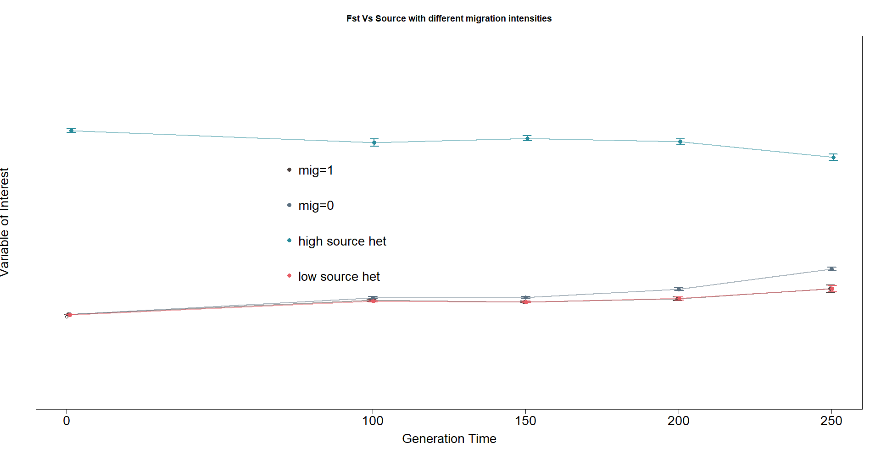
Fst vs source with different source heterozygosities
Comp2 (h=.4-6,.8-.9,.1-.2) @ m=1 per gen

Slide 20
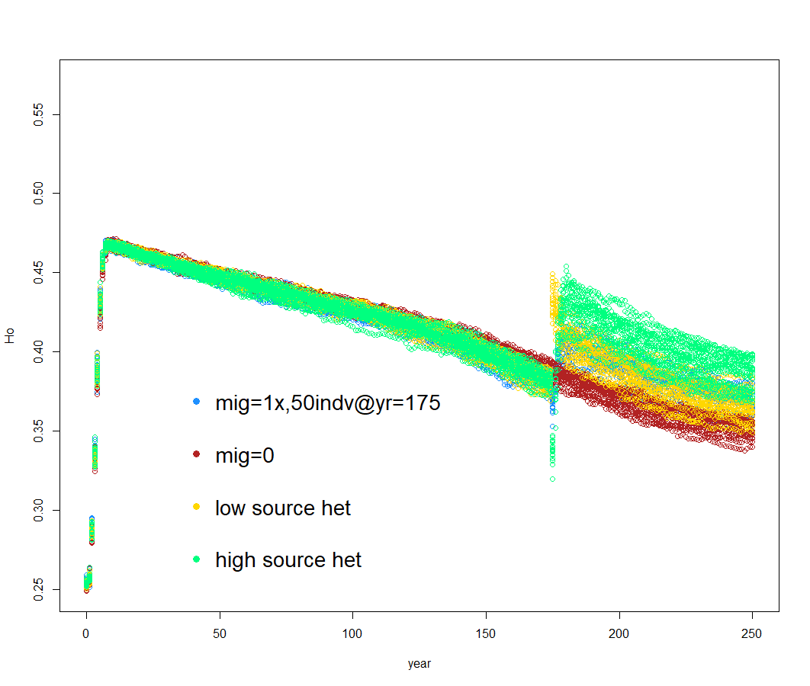
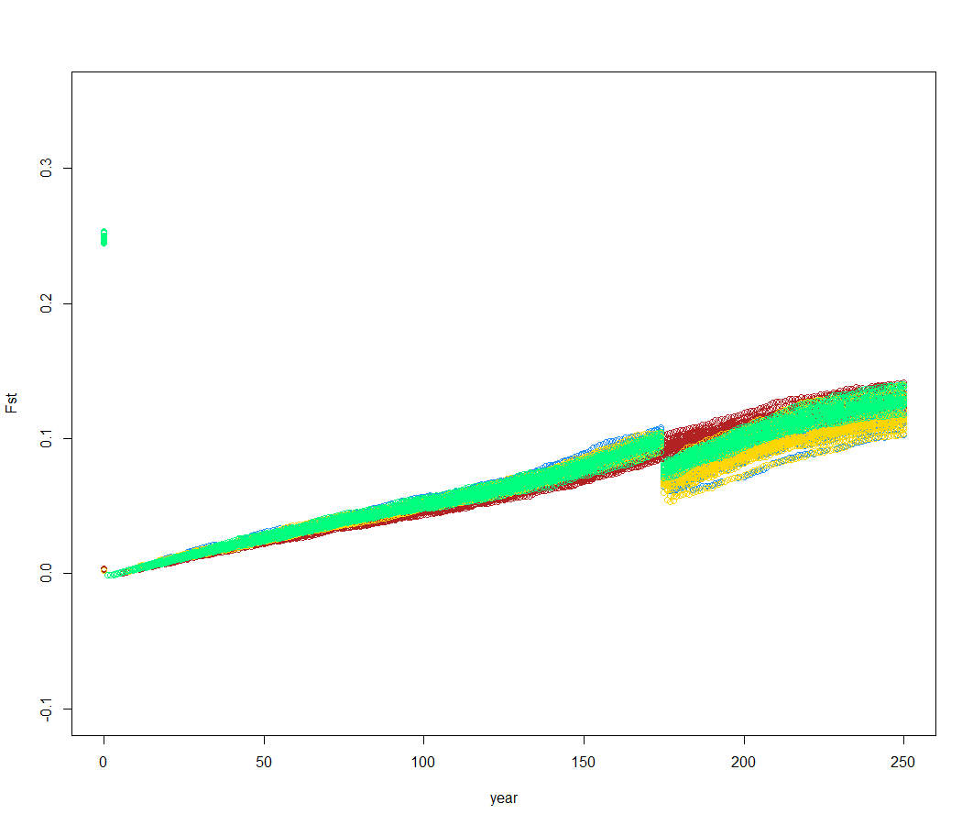
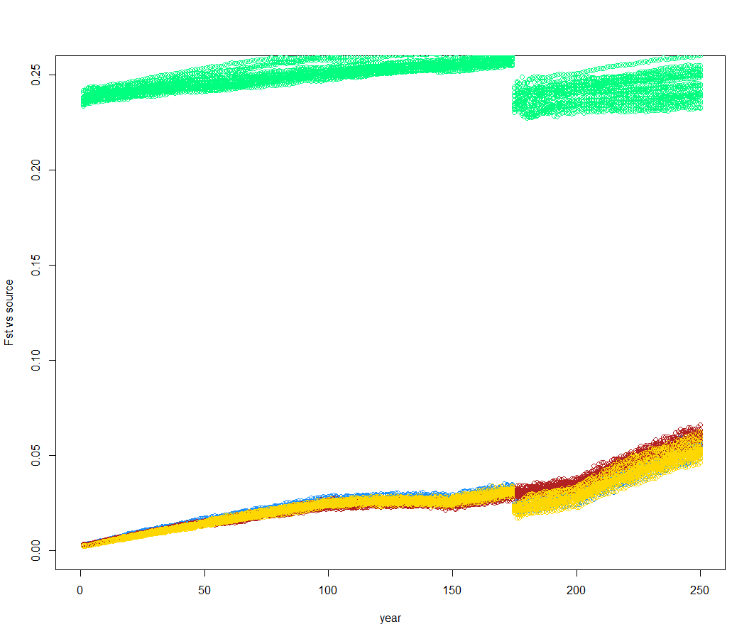
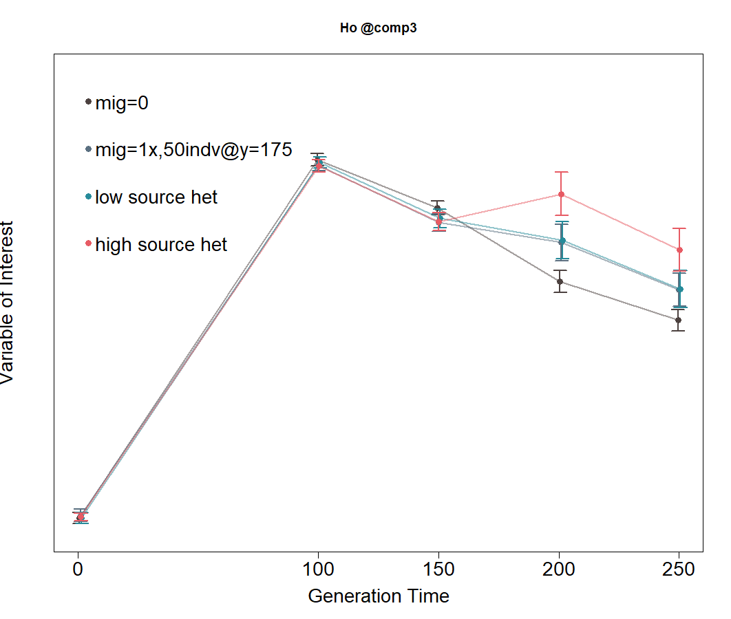
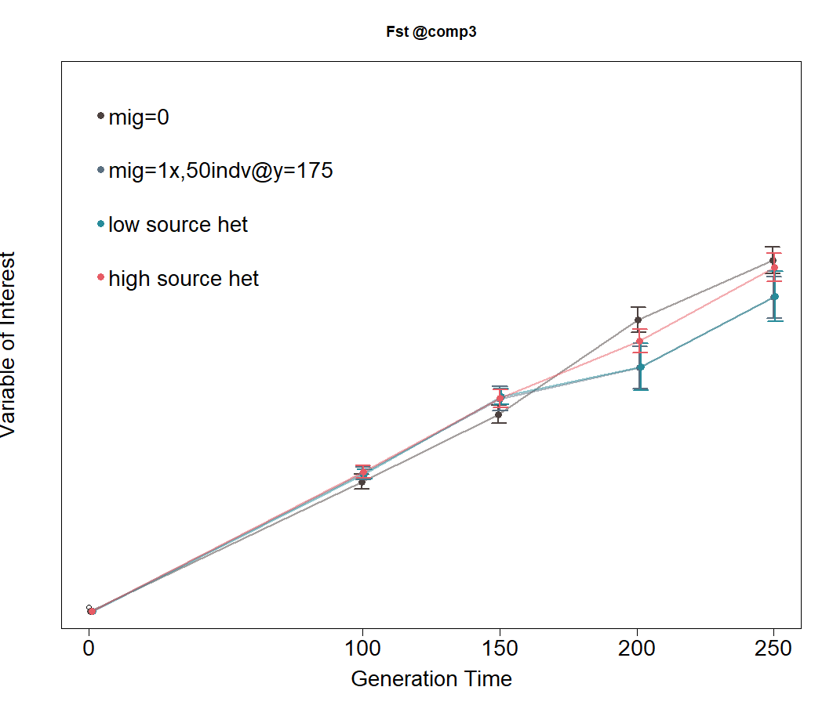
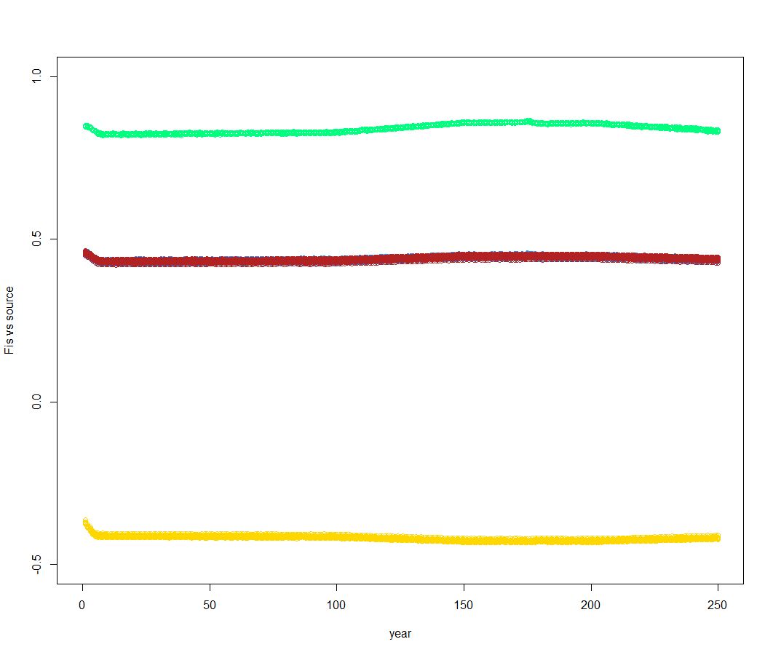
Comp3 (h=.4-6,.8-.9,.1-.2) @ m=1x,50

Slide 21
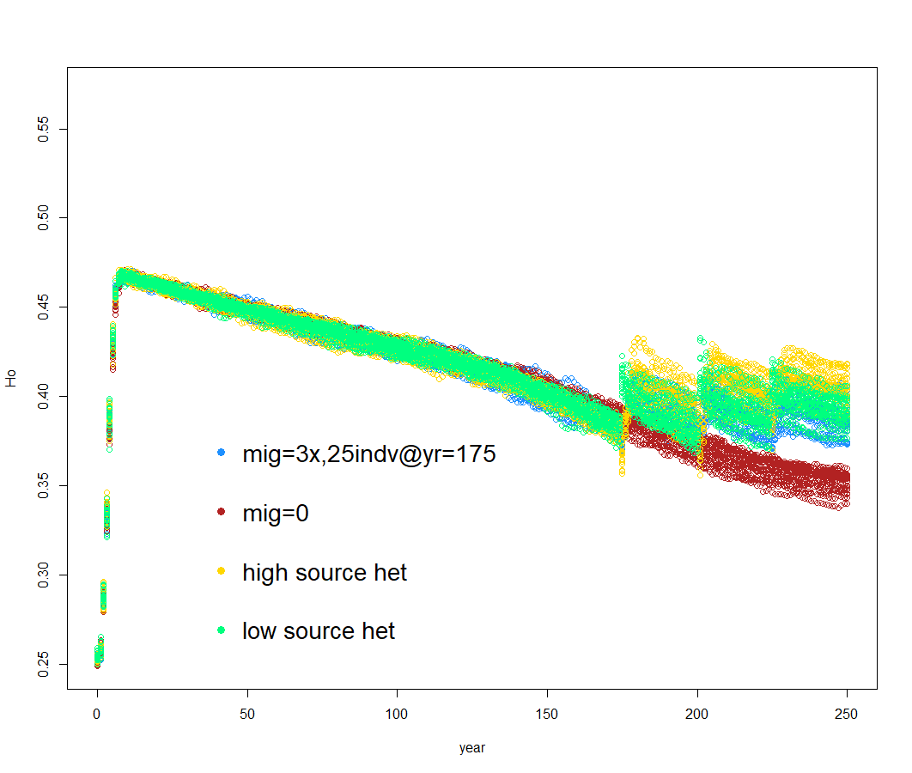
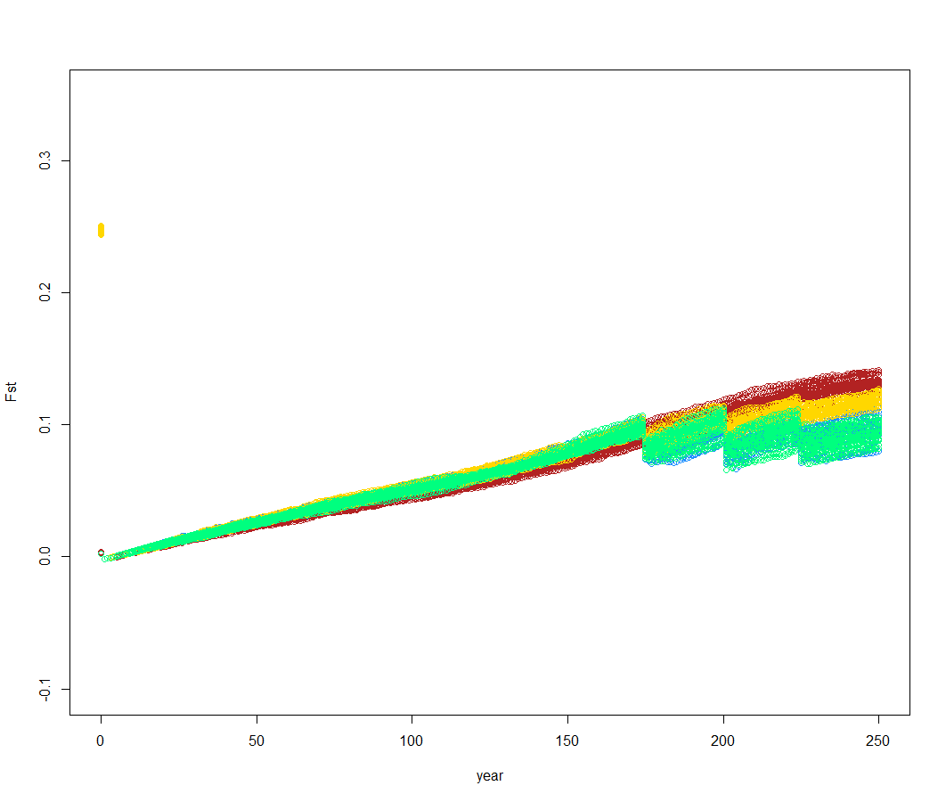
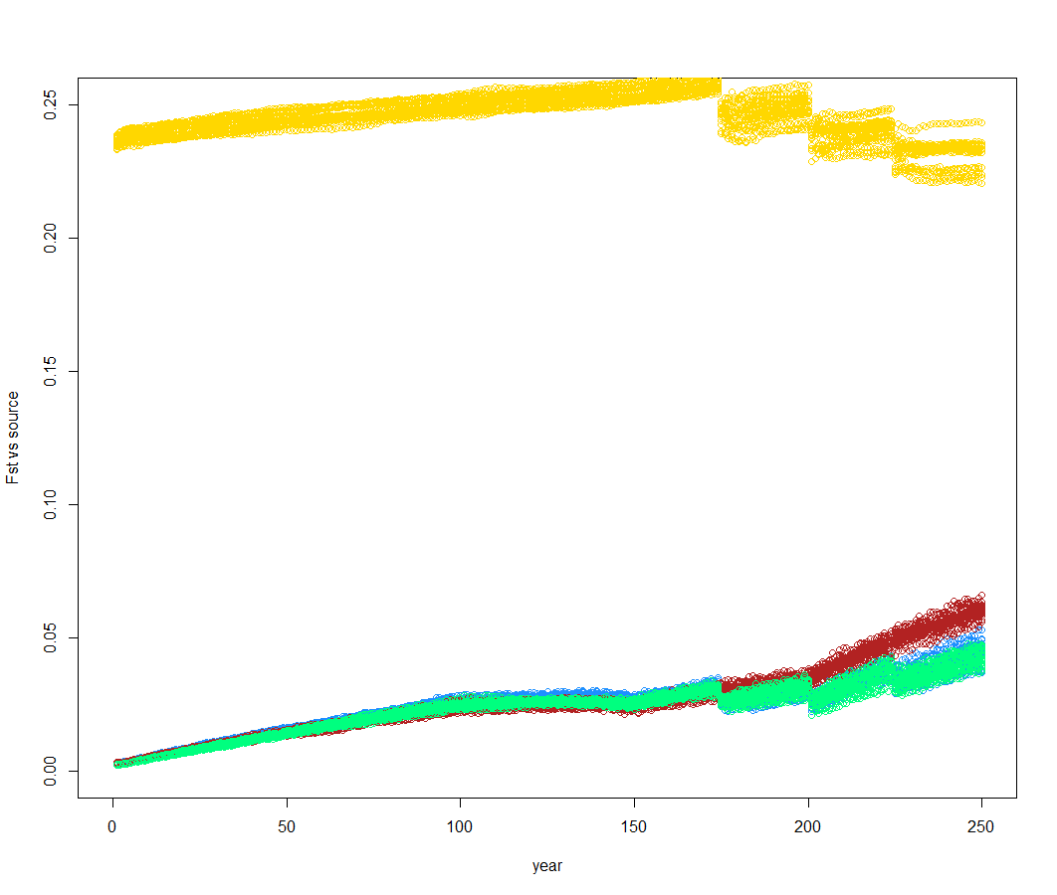
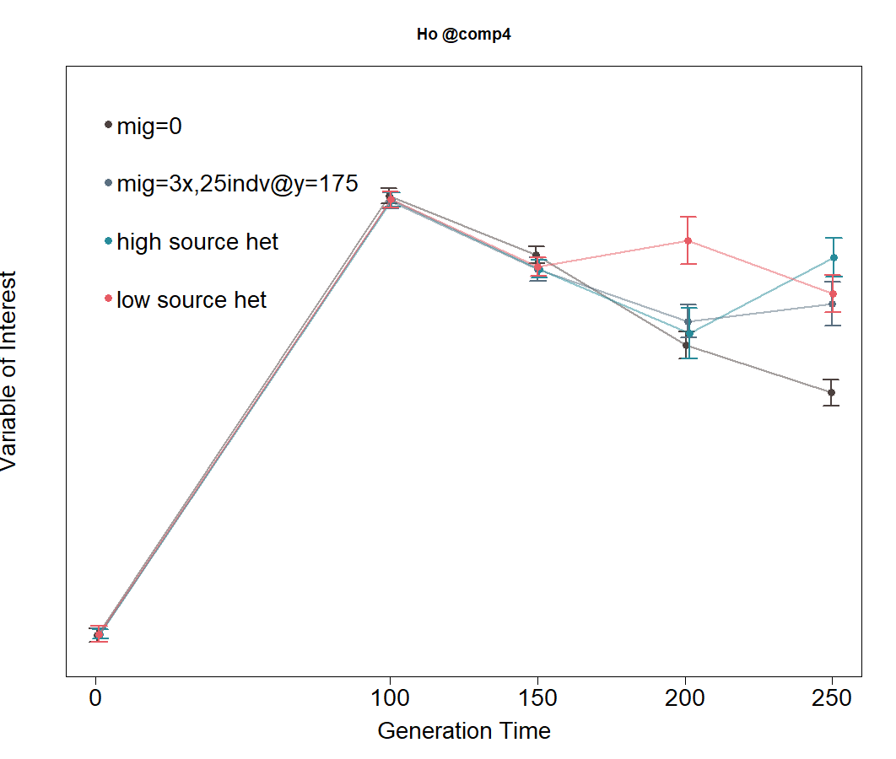
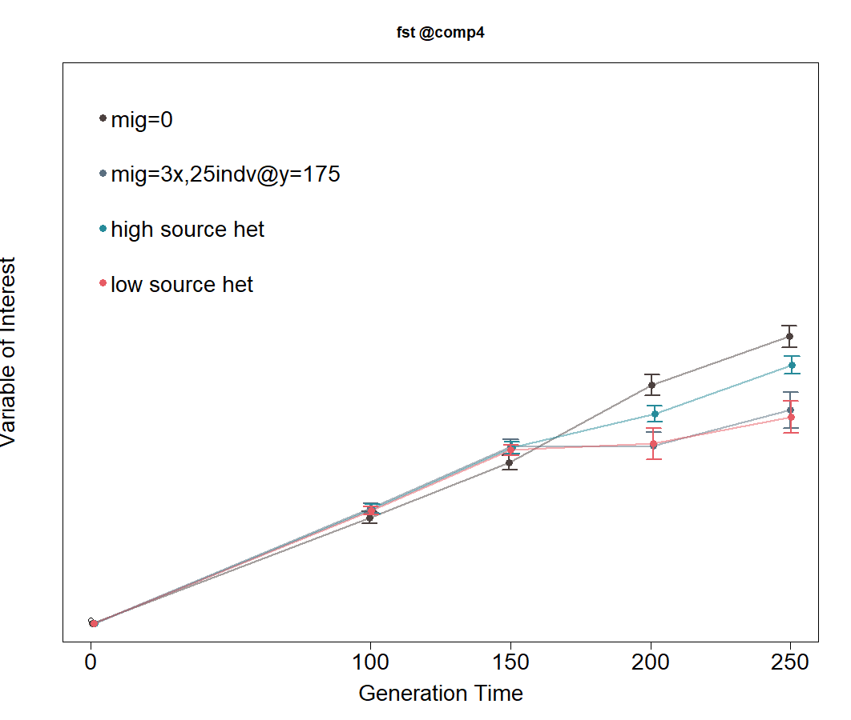
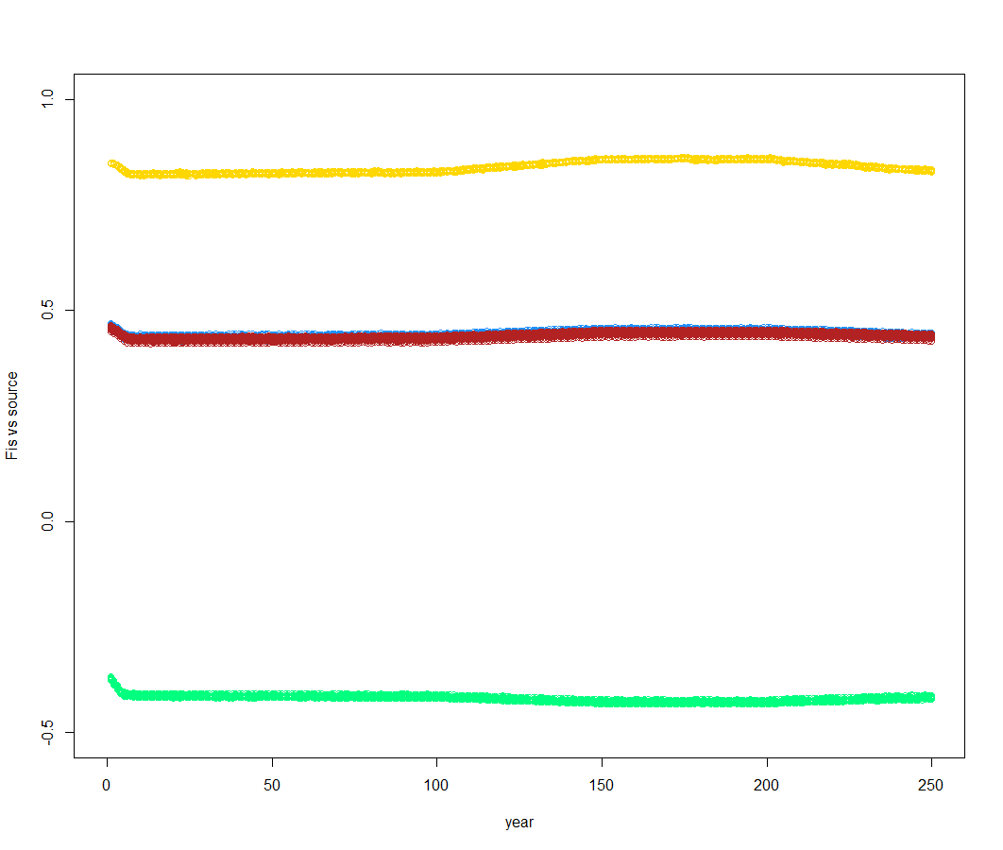
Comp4 (h=.4-6,.8-.9,.1-.2) @ m=3x,25

Slide 22
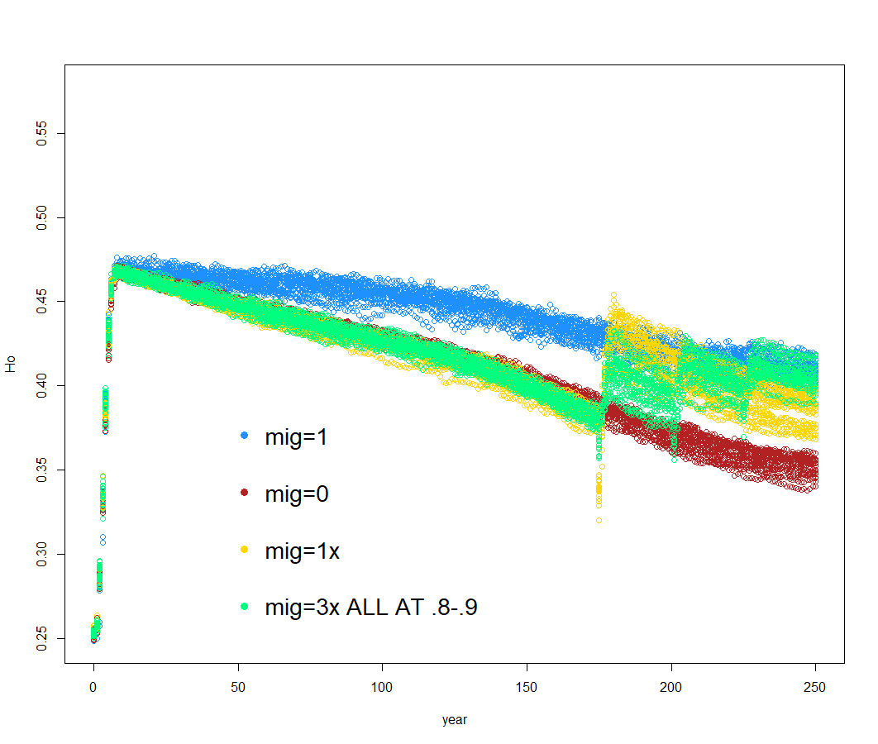
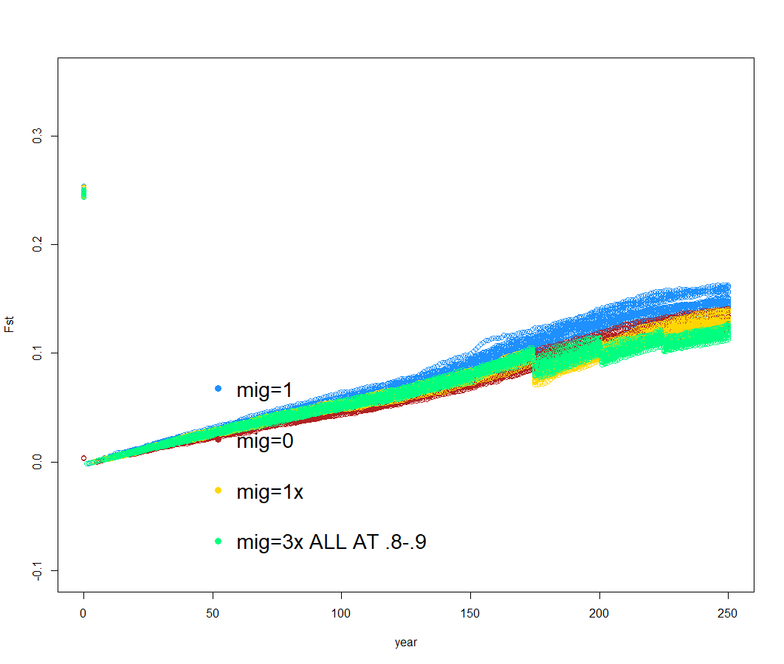
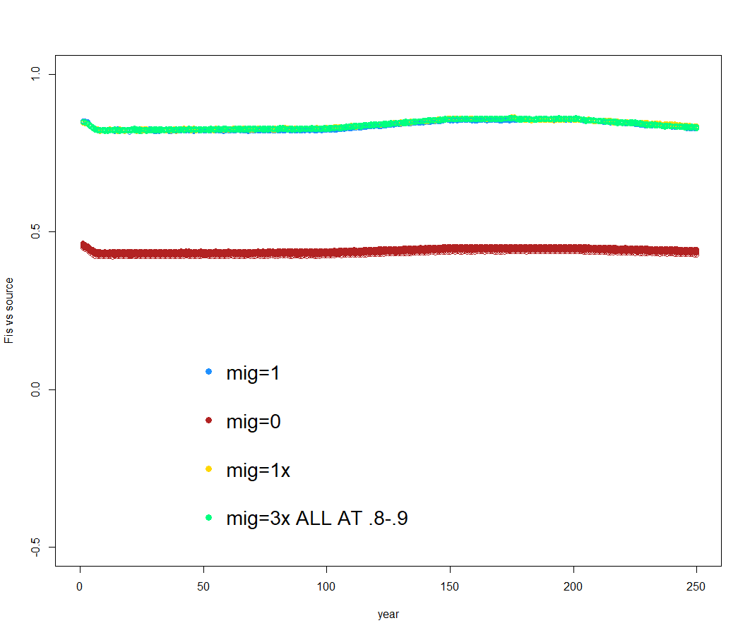
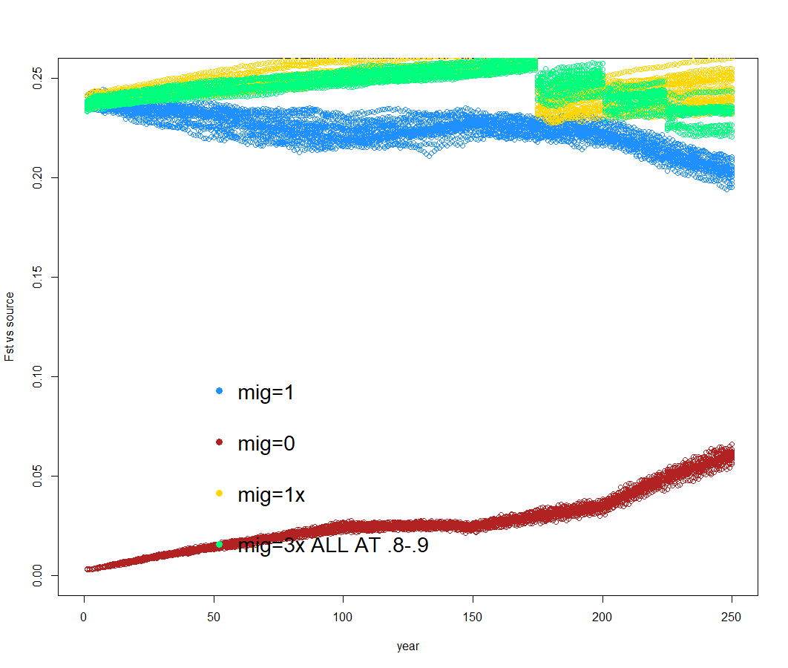
Comp5 (m=0,m=1,m=1x,m=3x) @ h=.8-.9

Slide 23
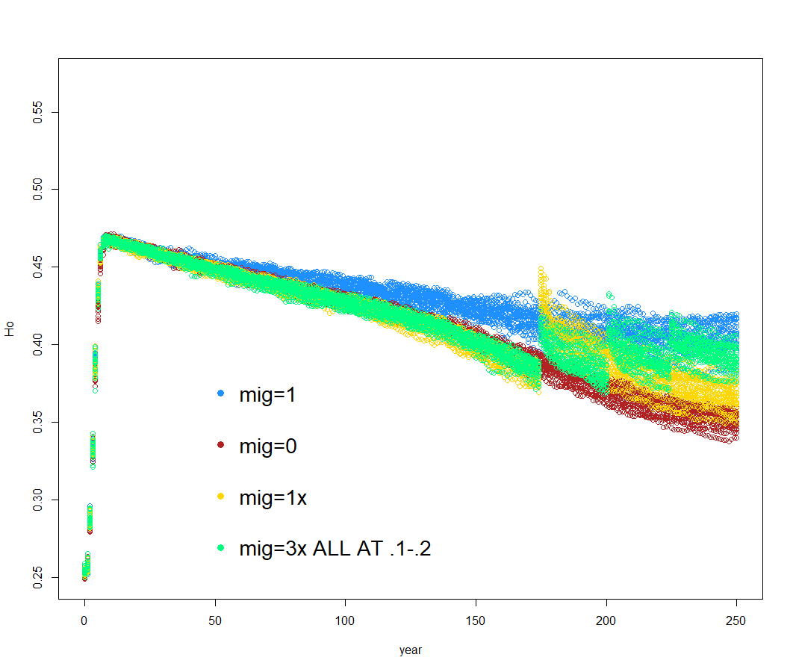
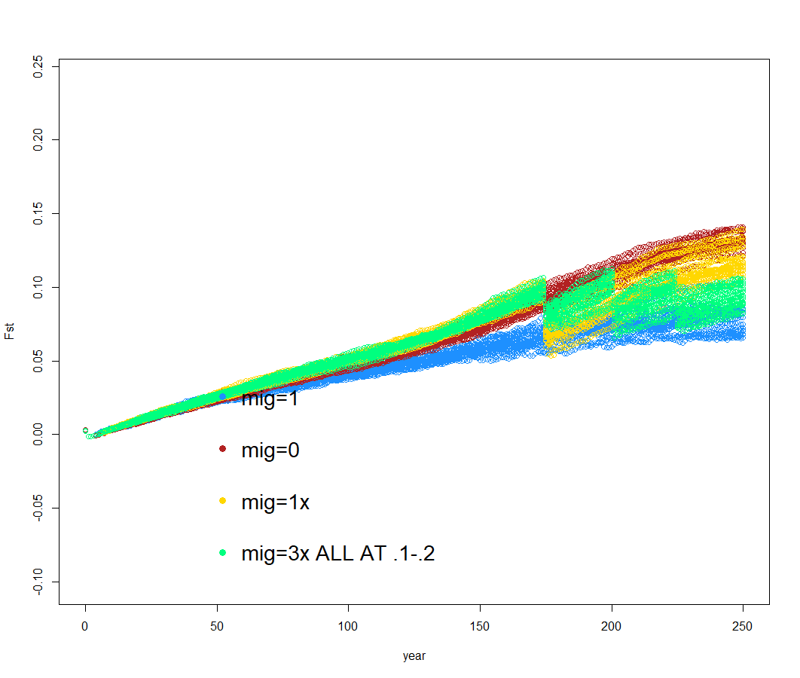
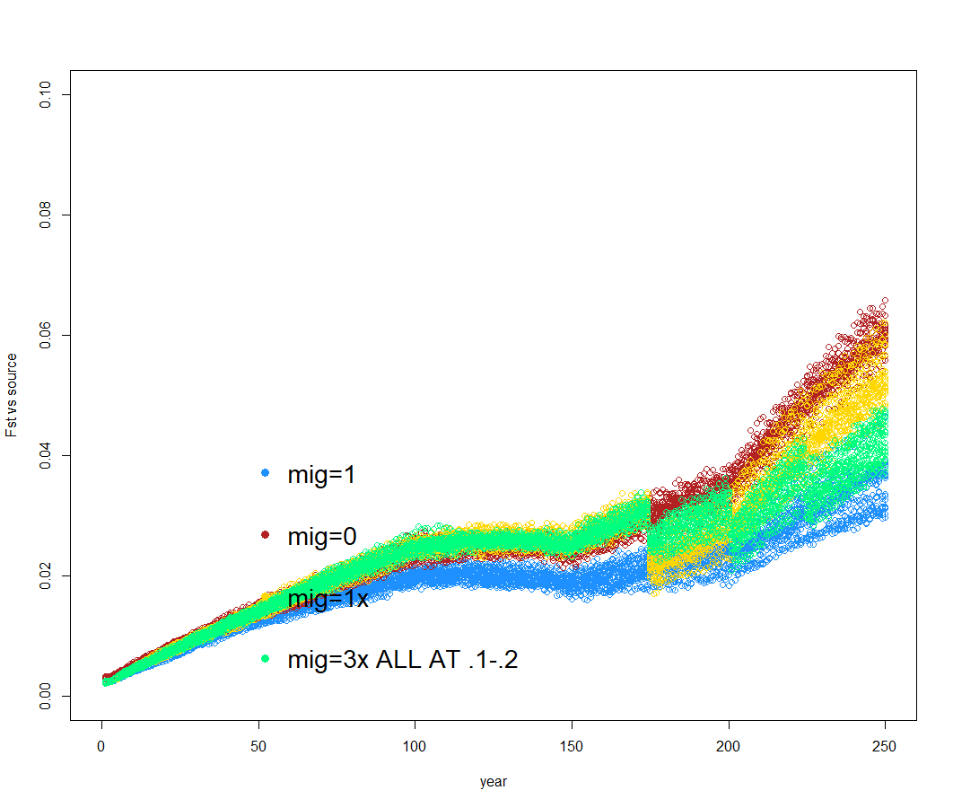
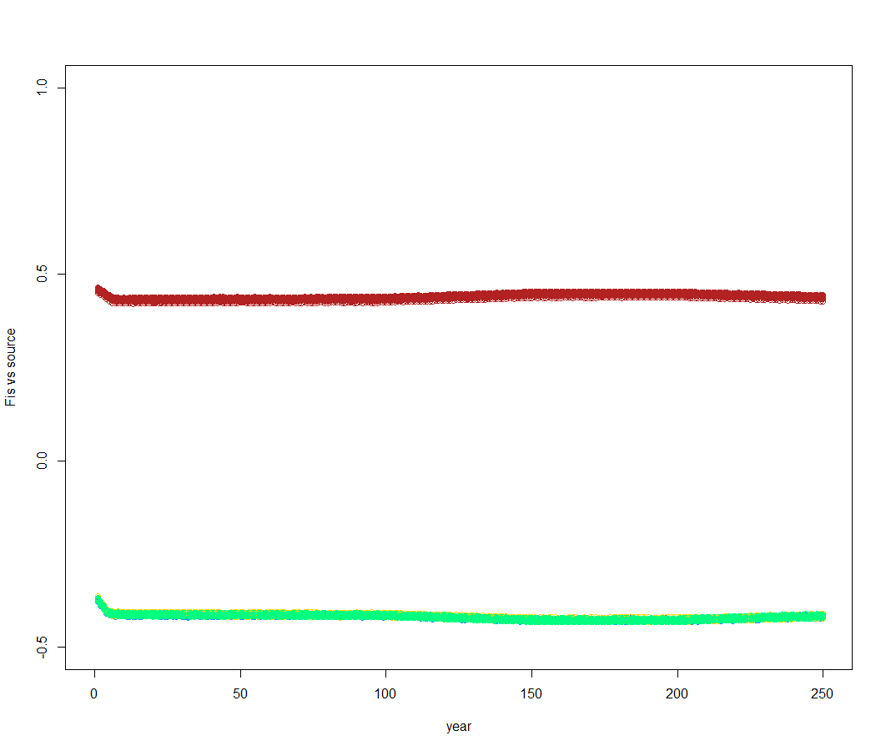
Comp6 (m=0,m=1,m=1x,m=3x) @ h=.1-.2

