Slide 1
In all runs, these parameters have stayed constant
heteroz of source | minor allel freq FOCAL | n replicates | dropK | k | nSNP | drp | dur | maxage | broodsize | maturity | years | r0 | ratemort | nSNP.mig | nSNP.cons
0.45 | 0.45 | 1 | 100 | 1000 | 1000 | 10 | 40 | 9 | 2 | 1 | 350 | 1 |  | 100 | 0
Note that Ho is over drift SNPs only. (I also calc over all SNPs, migrantSNPs too)

Slide 2
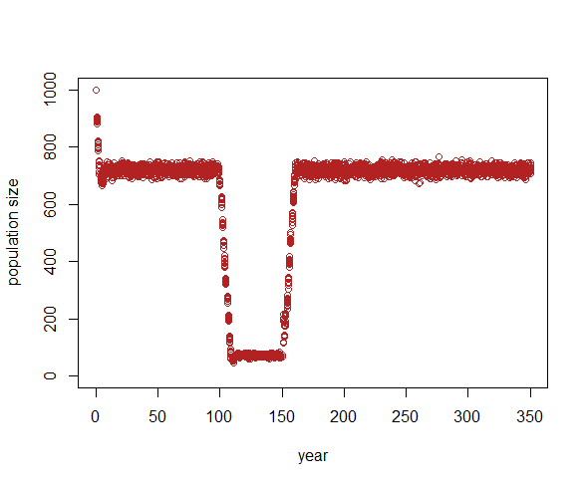
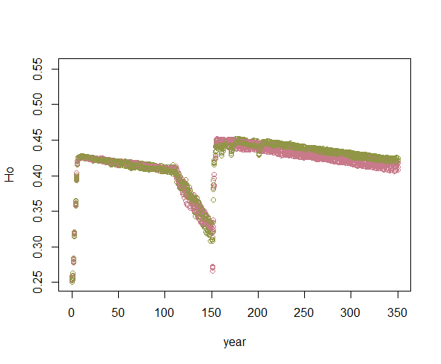
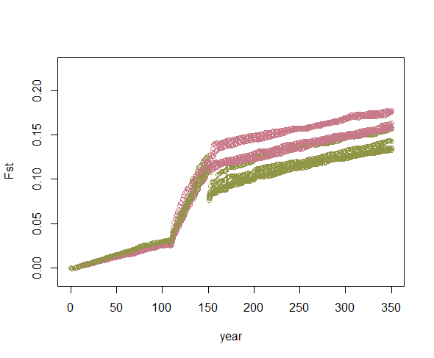
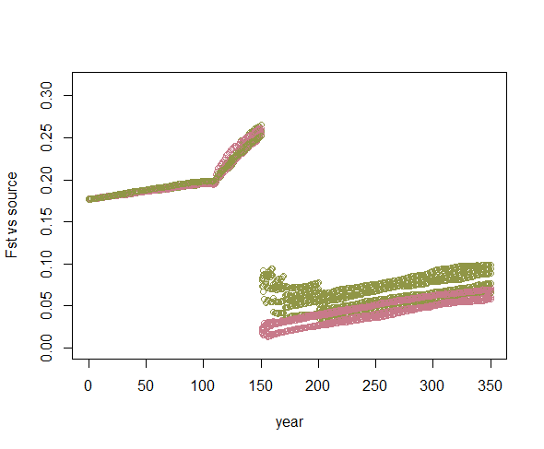
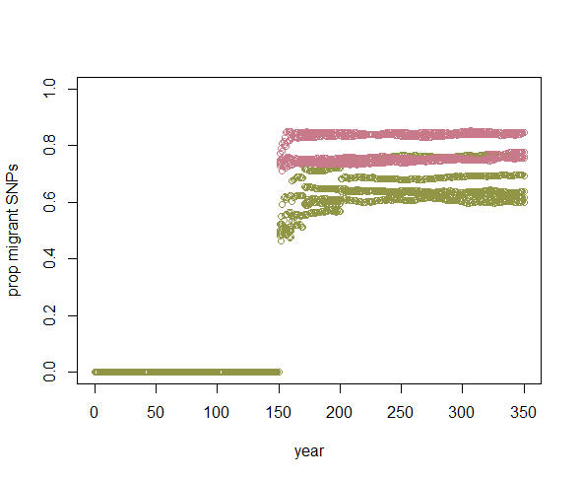
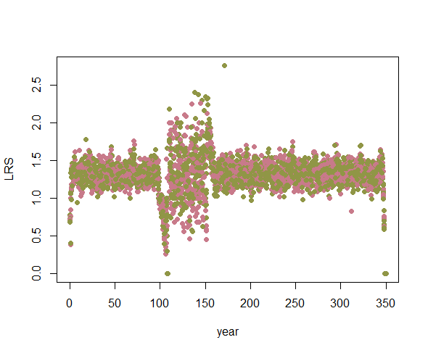
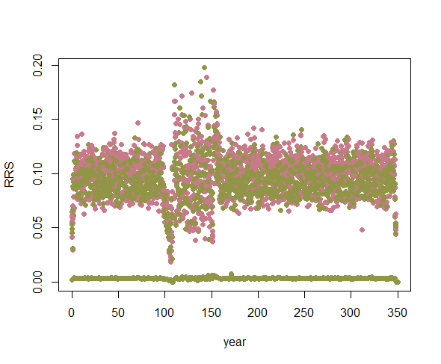
Run_6: miggy b = 300 @ yr 151, miggy c = 100 @ 151, 161, 171, 201

