Slide 1
To understand these long-term effects of migration, we developed an agent-based model that uses genetic diversity and gene flow to determine fitness in small populations. These populations were modeled such that our results will provide insight into how populations persist in the face of stochastic and anthropogenic ecosystem change. Specifically, we examined how dispersal can mitigate the effects of small populations and inbreeding, and the genetic implications of limited gene flow on these effects. Within our simulations, we examined trends following migration events to address three specific questions: 1. Does the increase in genetic variants provided to a population via migration provide a long term influence on individual and population fitness? We hypothesized that extremely small populations will retain more of the migrant-related genetic variants than populations with more moderate population crashes due to the population growth potential in extremely small populations. 2. Do migrants with particularly high fitness affect the receiving population’s long-term stability more so than migrants with moderate or low lifetime fitness? We hypothesize that migrants with high fitness may result in more unstable populations long-term than migrants with lower fitness, since high fitness individuals may cause inbreeding to increase as offspring from high fitness individuals reproduce. 3. Do differences in species lifespan or fecundity influence long term population viability when migrations occur? We hypothesize that species with longer lifespans and lower fecundity will have smaller magnitude of population effects compared to species with shorter lifespans and higher fecundity. 4. Does the long-term viability of the receiving population vary with population growth rate? We hypothesized that migrants will minimally affect the viability of the population in the absence of positive population growth. We considered the effects of changes on the number of individuals in the population, the genetic diversity within the population, and the reproductive success of individuals following immigration events as well as the proportion of simulated populations that persisted after migration ceased. These aims will support future considerations of promoting migration (via corridors or translocations) when managing species on the brink of extinction.

Slide 2
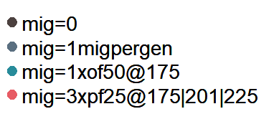
Comparison between the dropped population size (during the bottleneck) and various migration rates

Slide 3
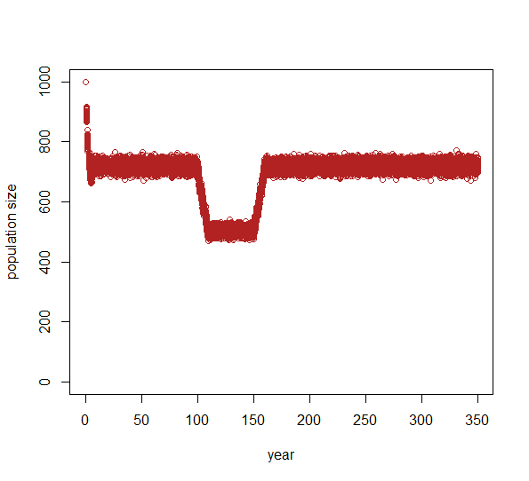
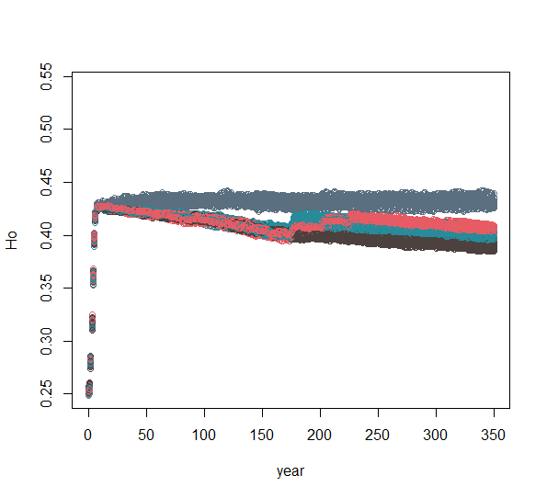
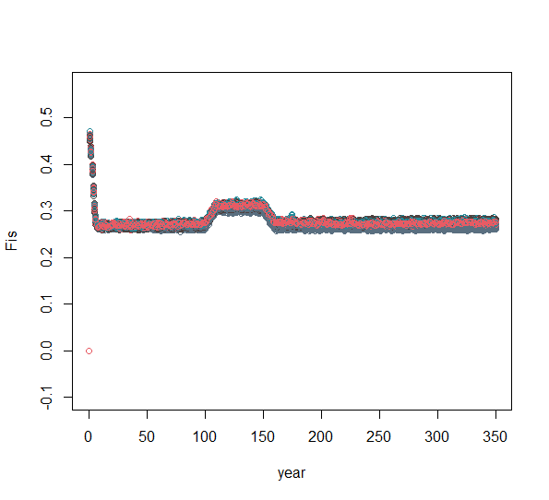
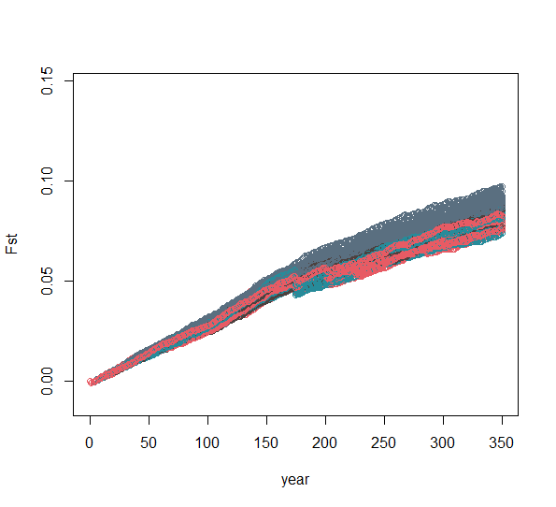
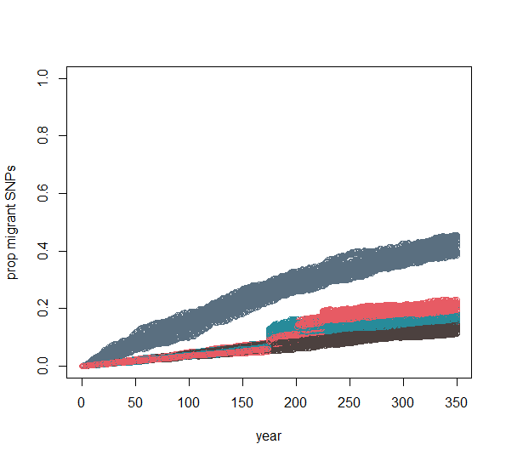
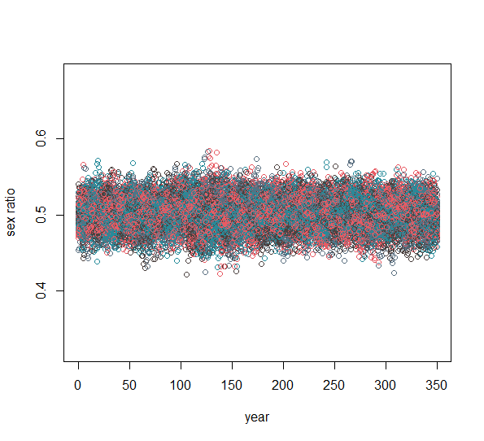
output values among migration rates when simulating a vulnerable pop

Slide 4
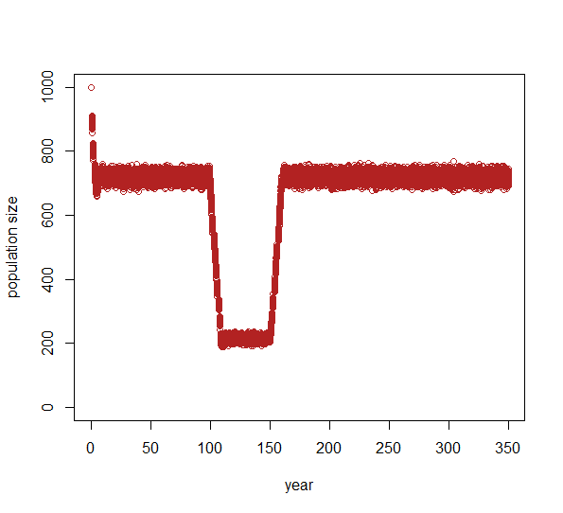
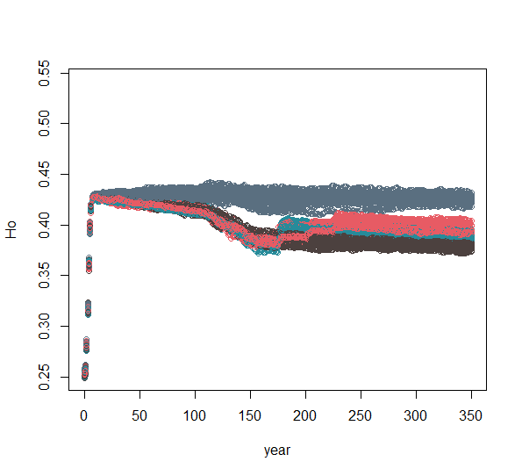
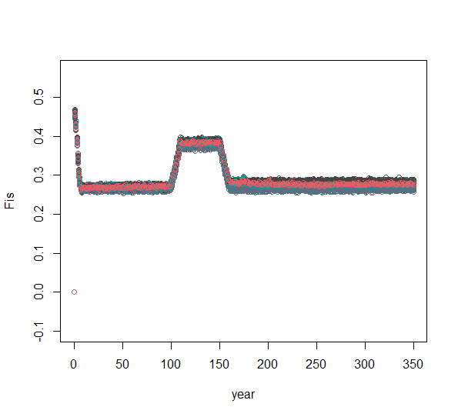
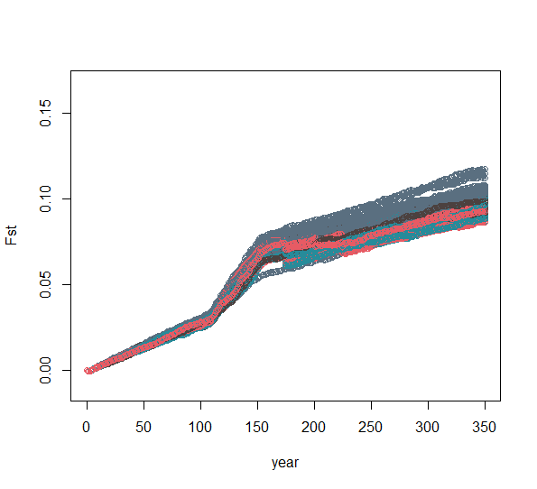
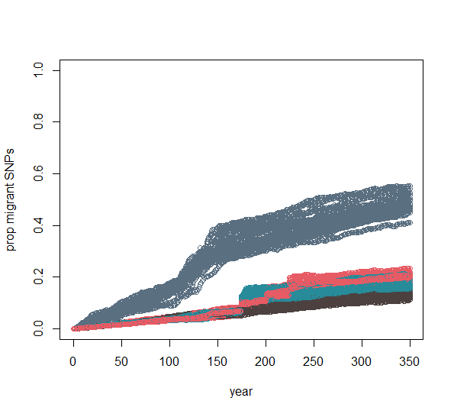
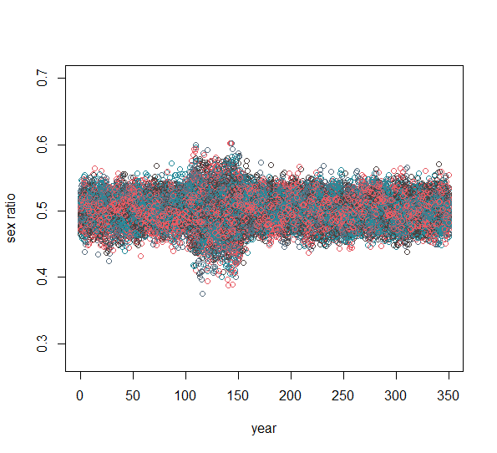
output values among migration rates when simulating an endangered pop

Slide 5
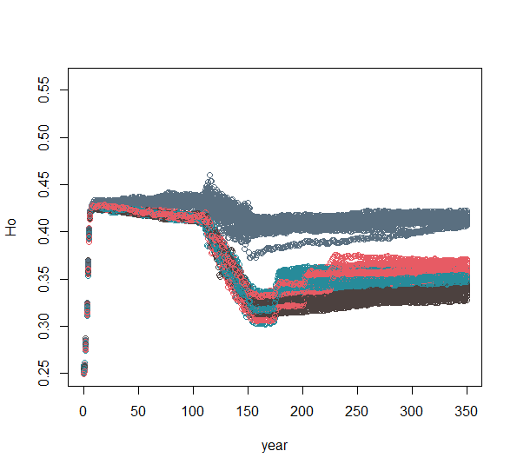
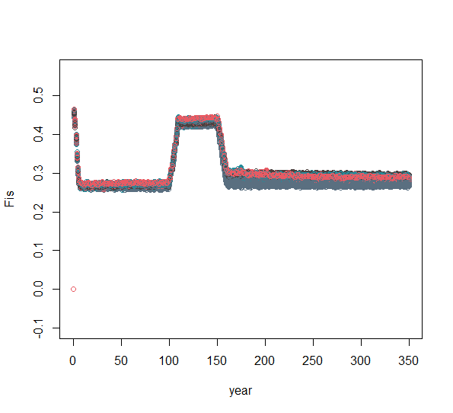
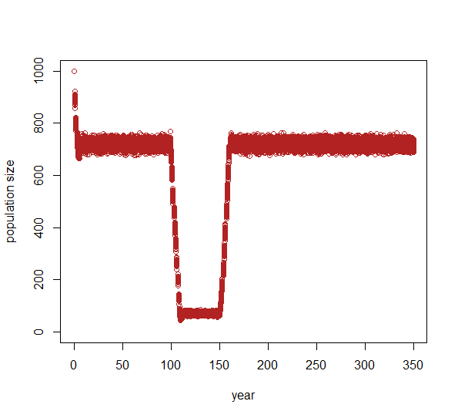
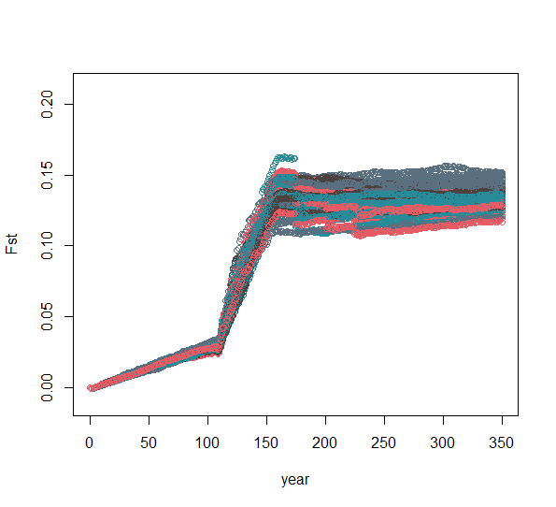
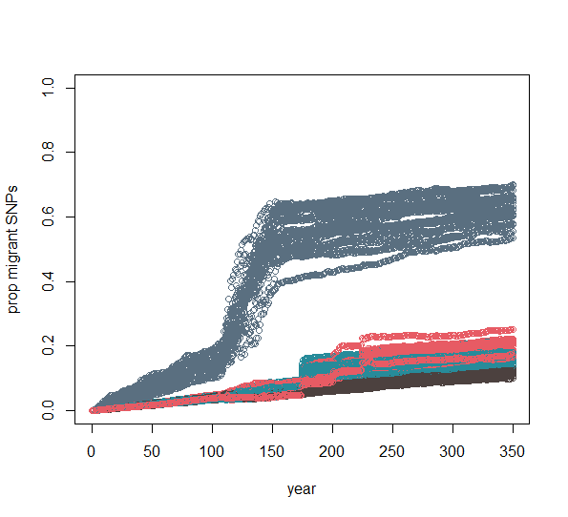
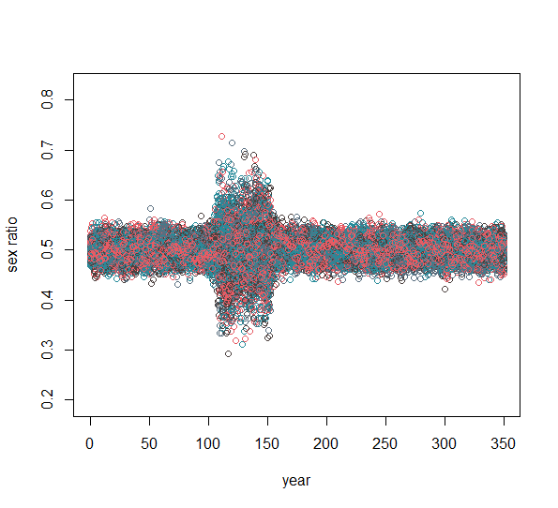
output values among migration rates when simulating a critically endangered pop

Slide 6
Results
____ varies due to Ne but not migration rate
- FIS *except right after migrants introduced
- sex ratio
____ varies due to Ne and migration rate
- Ho
- FST
- migrant SNPs *mostly when 1 mig per gen

Slide 7
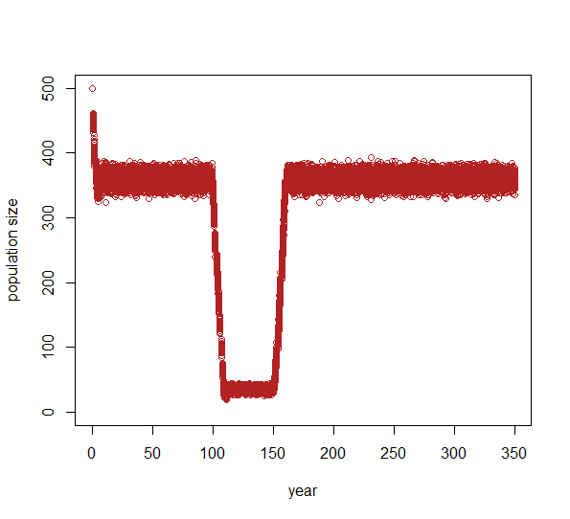
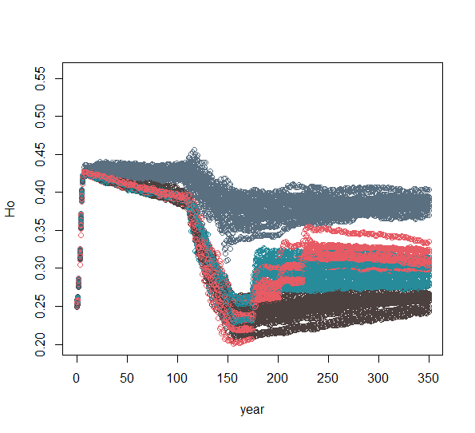
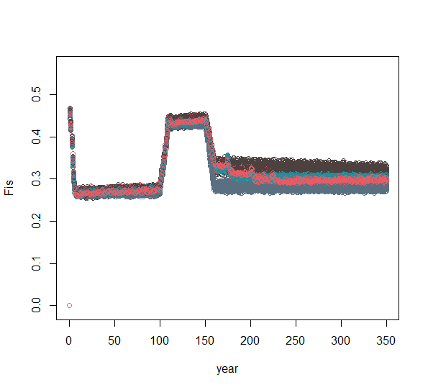
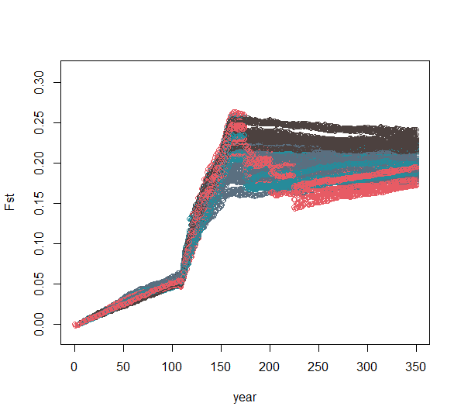
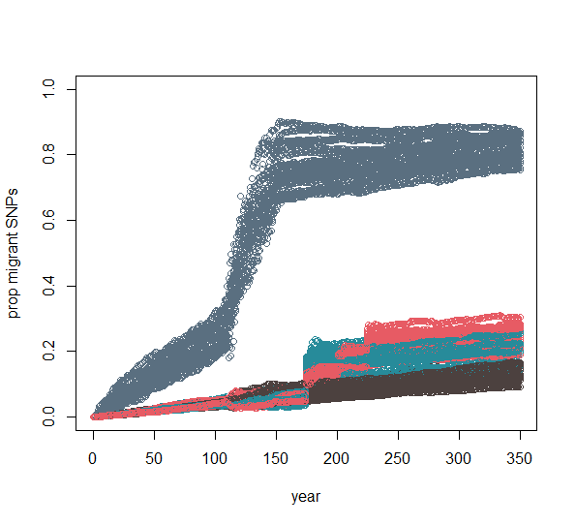
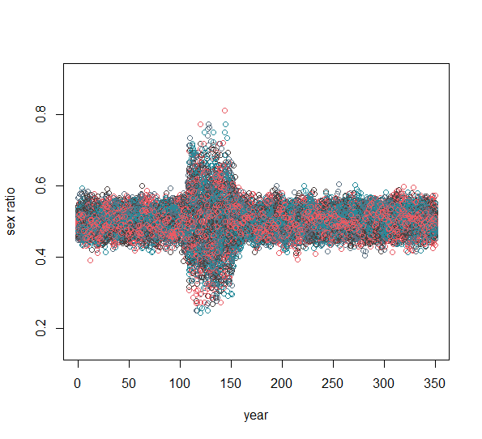
This shows the greater variation in output values among migration rates when K starts at 500 (rather than 1000)

Slide 8
Comparison between the dropped population size (during the bottleneck) and various migration rates

Slide 9
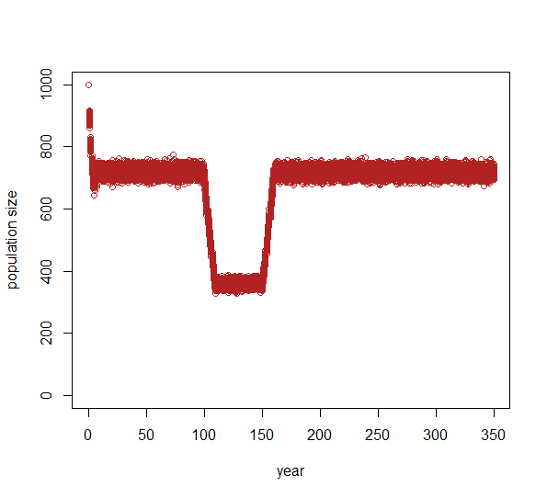
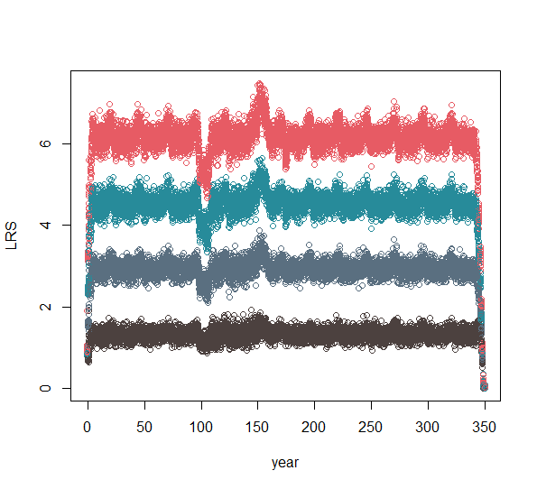
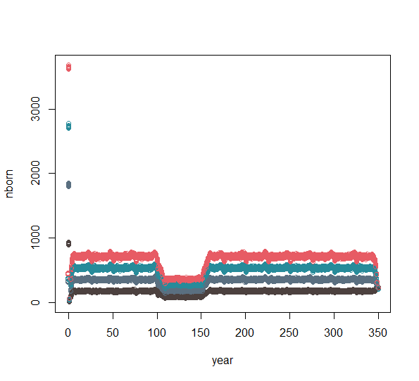
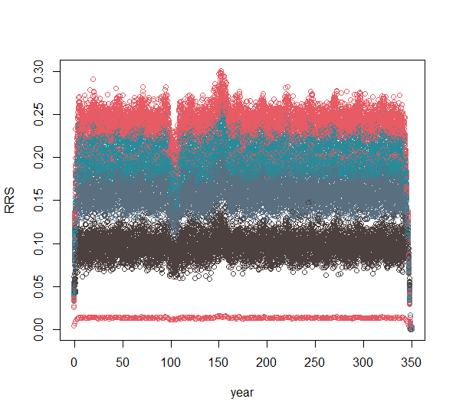
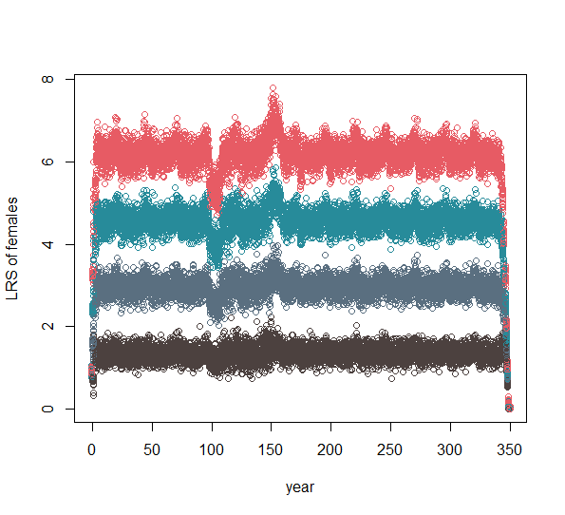
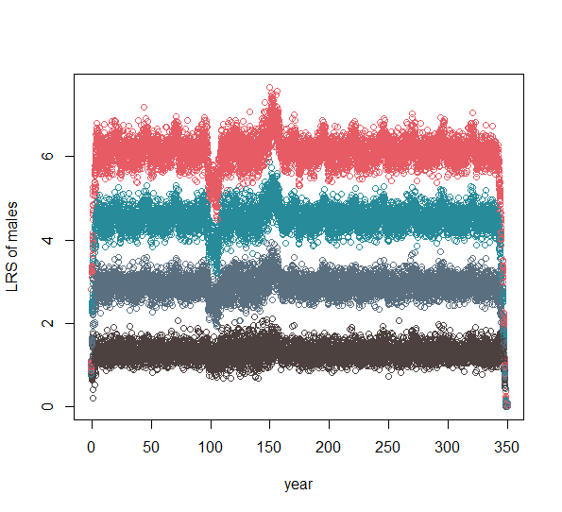
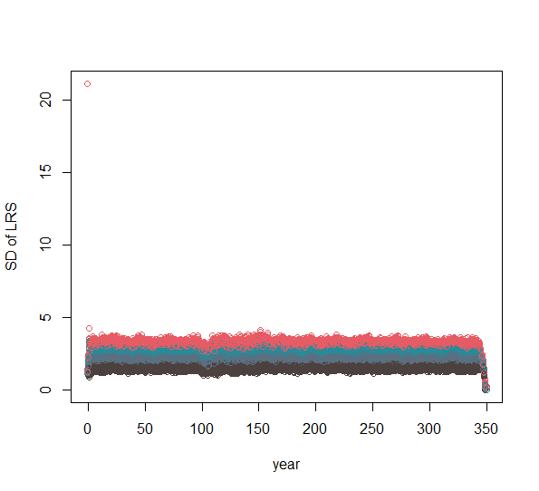
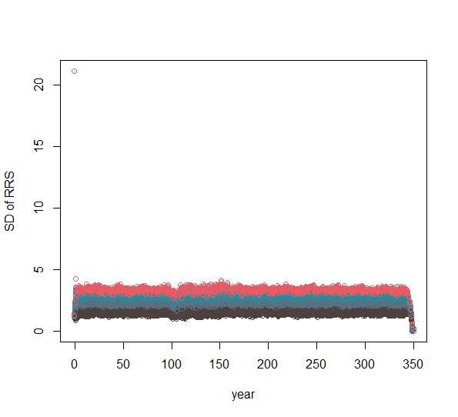
Reproductive output values among migration rates when simulating a pop right at the cusp of becoming endangered

Slide 10
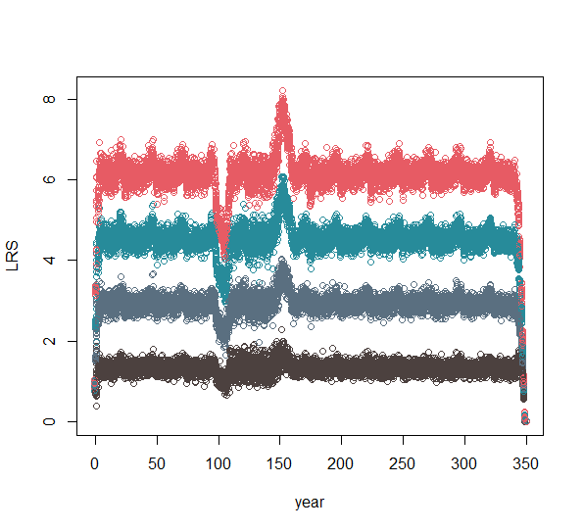
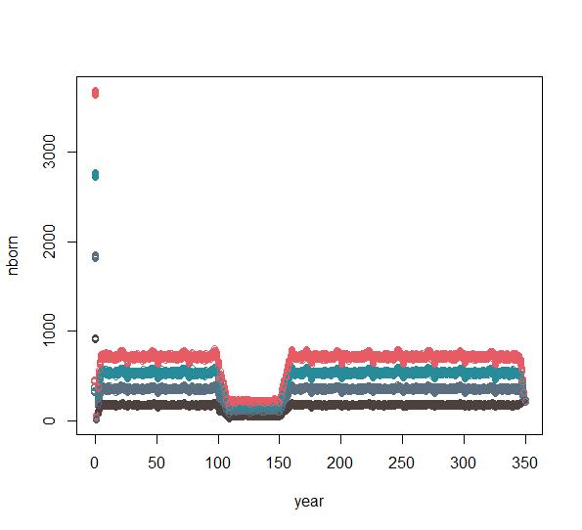
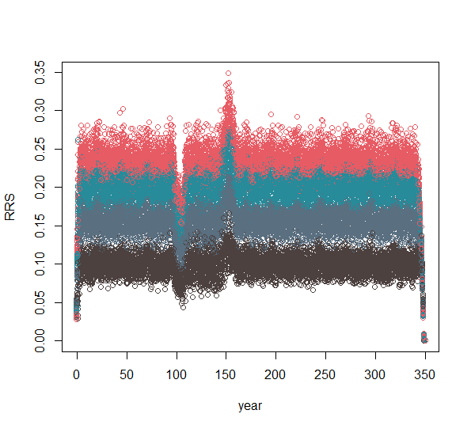
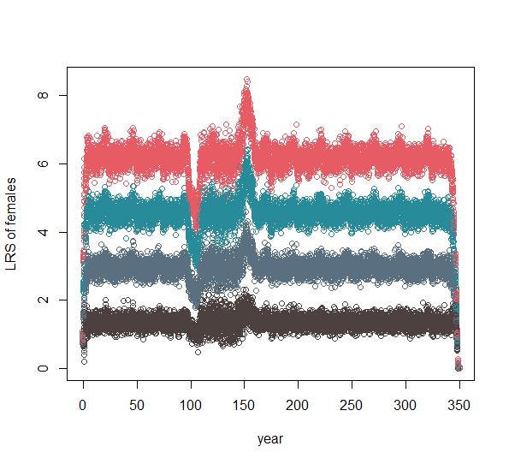
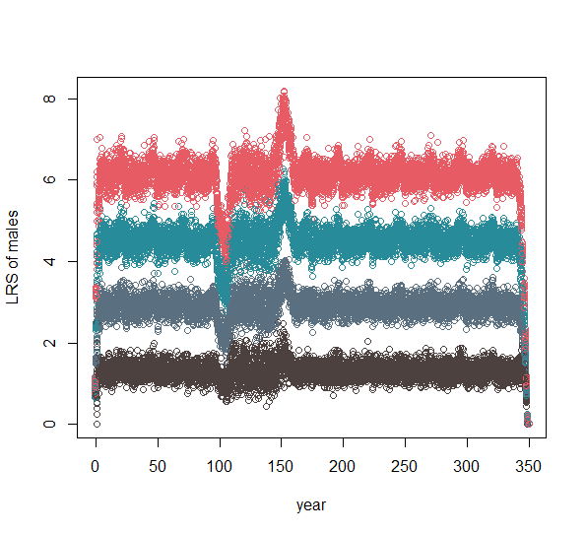
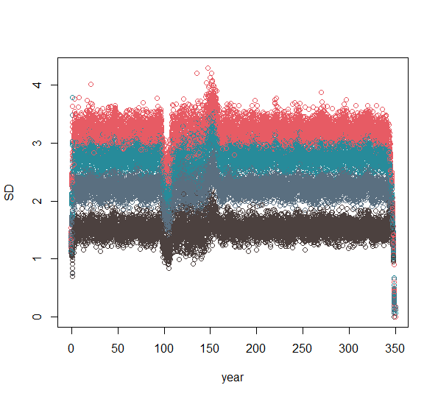
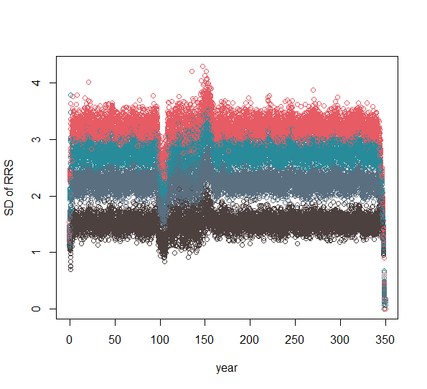
Reproductive output values among migration rates when simulating an endangered pop

Slide 11
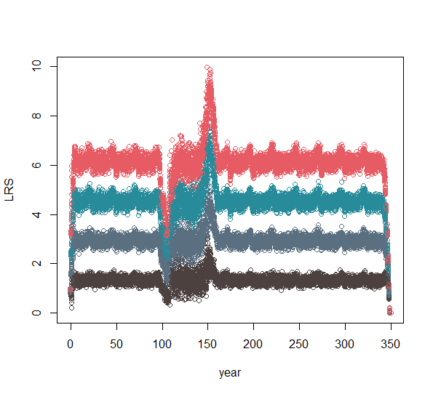
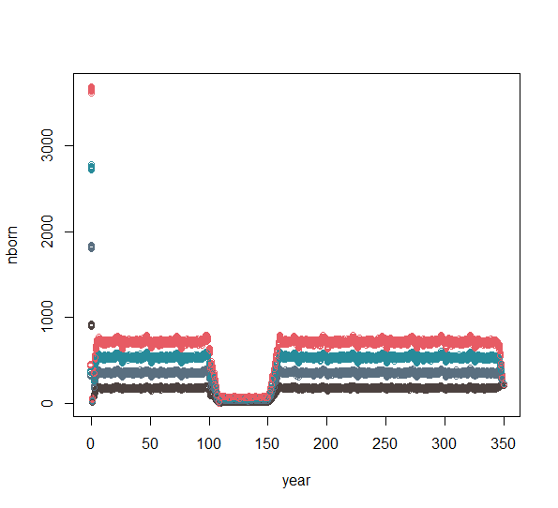
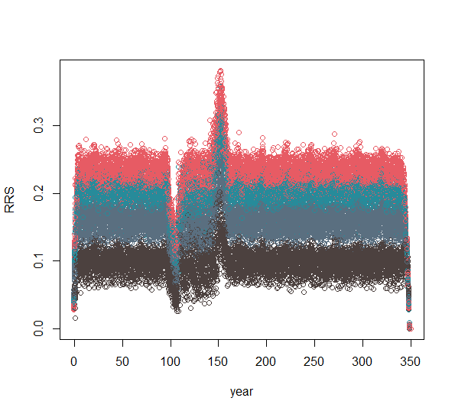
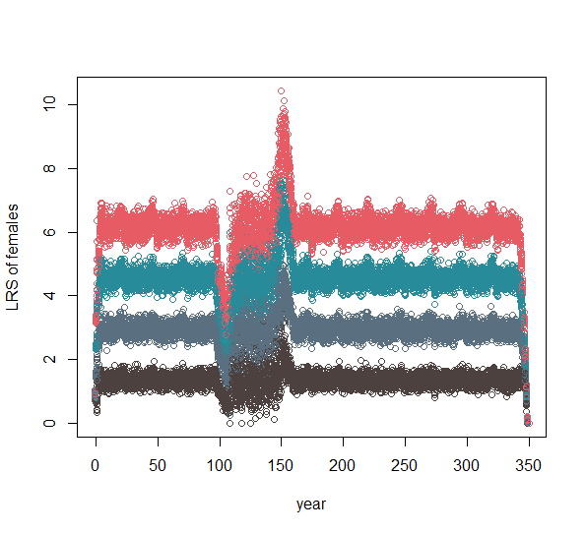
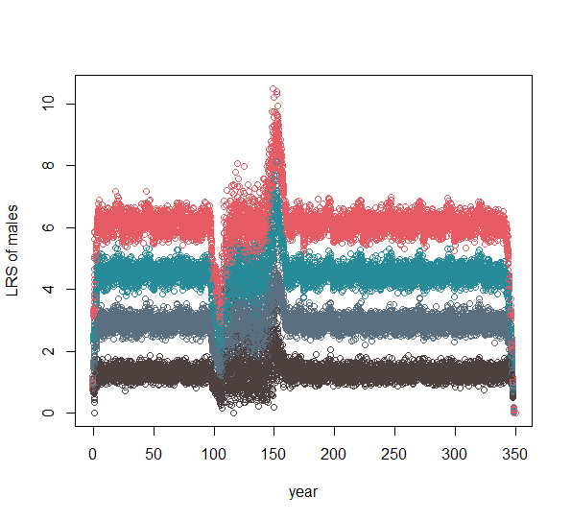
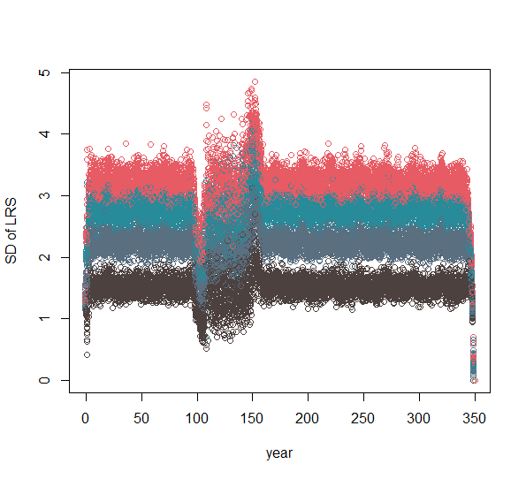

Reproductive output values among migration rates when simulating a critically endangered pop

Slide 12
Results
____ varies due to Ne but *maybe* not migration rate
- variation in LRS at start and end of bottleneck
____ varies due to Ne and migration rate
- LRS
- RRS

Slide 13
Comparison between the minor allele frequency in the source population and various migration rates

Slide 14
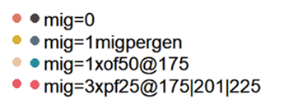
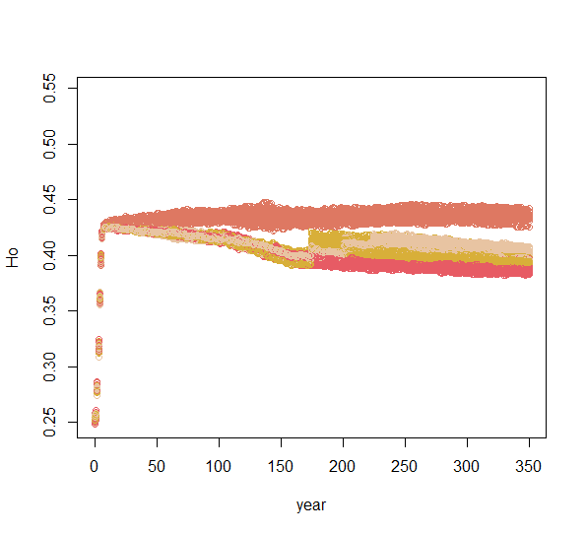
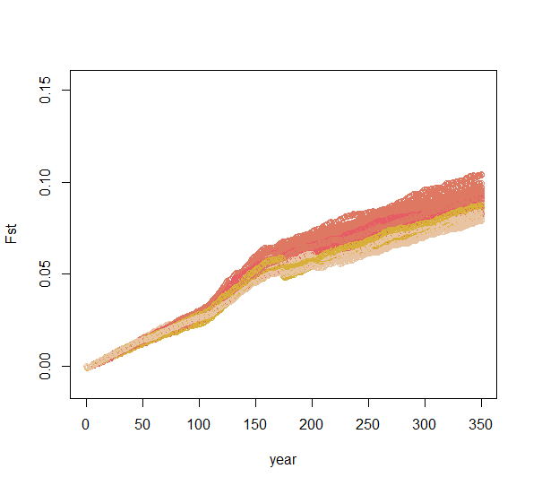
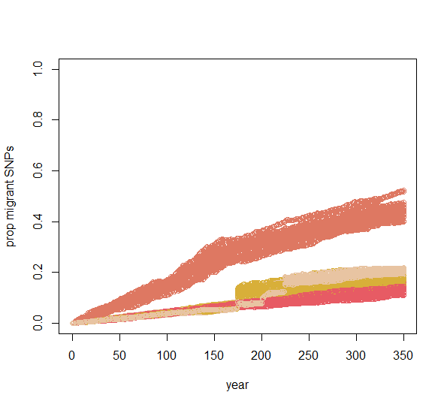



output values among migration rates when simulating a pop right at the cusp of becoming endangered
Minor allele freq = 0.07
Minor allele freq = 0.45

Slide 15







output values among migration rates when simulating a critically endangered pop
Minor allele freq = 0.07
Minor allele freq = 0.45

Slide 16


Reproductive output values among migration rates when simulating a pop right at the cusp of becoming endangered
Minor allele freq = 0.07
Minor allele freq = 0.45

Slide 17




Reproductive output values among migration rates when simulating a critically endangered pop
Minor allele freq = 0.07
Minor allele freq = 0.45

Slide 18
Results
____ varies due to migration rate but not minor allele frequency
- Ho
- Fst
- proportion migrant SNPs *may be slightly different when 1 mig per gen
____ varies due to minor allele frequency and migration rate
- LRS
- RRS

Slide 19
Comparison between the minor allele frequency in the starting focal population and various migration rates

Slide 20








Minor allele freq source of migrants = 0.45
Minor allele freq starting focal pop= 0.07
Minor allele freq source of migrants = 0.07
Minor allele freq starting focal pop= 0.07

Slide 21




Minor allele freq source of migrants = 0.45
Minor allele freq starting focal pop= 0.07
Minor allele freq source of migrants = 0.07
Minor allele freq starting focal pop= 0.07

Slide 22
Comparison between the maxage and broodsize

Slide 23





Maxage = 15, broodsize = 4
Maxage = 15, broodsize = 6
Drop to 100
Maxage = 3, broodsize = 4
Maxage = 3, broodsize = 6

Slide 24




Maxage = 15, broodsize = 4
Maxage = 15, broodsize = 6
Drop to 100
Maxage = 3, broodsize = 4
Maxage = 3, broodsize = 6

Slide 25




Maxage = 15, broodsize = 4
Maxage = 15, broodsize = 6
Drop to 100
Maxage = 3, broodsize = 4
Maxage = 3, broodsize = 6

Slide 26
Comparison between the population growth rate

Slide 27








R0 = 0.5 *note the broodsize is slightly different but I believe differences are due to r0 not broodsize
R0 = 1
Notes:
ABM_run.1.18.23_c y y dead y all 4 0.07 1 300 1000 1000 10 40 9 4 1 350 0.5, 0.1 0.055556 100 0

Slide 28
Up Next:
Comparison between the population growth rate, maximum age and fecundity, the minor allele frequency in the source population, and various migration rates

Slide 29
Results table
 | Ne | Migration rate | Minor allele freq | Growth rate (r0) | Lifespan | Fecundity
Ho | X | X |  | X | X | Eh
Fst | X | X |  | X | X | Eh
Fis | X *except right after migrants introduced
Sex ratio | X *during bottleneck
Proportion migrant alleles | X | X *mostly when 1 mig/gen | *may be slightly different when 1 mig/gen | X | X | eh
LRS | X | X | X
Variation in LRS | X | *maybe* not migration rate
RRS | X | X | X

Slide 30
RepSucc Table (complete)
 | Ne | Migration rate | Minor allele freq | Growth rate (r0) | Lifespan | Fecundity
 | 75, 100, 300, 500, 700 | 0, "a"=one mig per gen, "b"=1xof50@175, "c"=3xpf25@175|201|225 | 0.45, 0.07 | 1, 0.5, 0.1 | 3, 9, 15 | 2, 4, 6
ABM_run.1.5.23_A | 300 | 0 | 0.45 | 1 | 9 | 2
ABM_run.1.11.23_B | 500 | 0 | 0.45 | 1 | 9 | 2
ABM_run.1.11.23_C | 700 | 0 | 0.45 | 1 | 9 | 2
ABM_run.1.9.23_D | 100 | 0 | 0.45 | 1 | 9 | 2
ABM_run.1.11.23_E | 75 | 0 | 0.45 | 1 | 9 | 2
ABM_run.1.18.23_a | 100 | 0 | 0.45 | 1 | 3 | 4
ABM_run.1.18.23_b | 500 | 0 | 0.45 | 1 | 3 | 4
ABM_run.1.18.23_c | 300 | 0 | 0.45 | 0.5 | 9 | 4
ABM_run.1.18.23_d | 300 | 0 | 0.45 **0.07 in focal pop | 1 | 9 | 2

Slide 31
Parameter Table
 | Ne | Migration rate | Minor allele freq | Growth rate (r0) | Lifespan | Fecundity
 | 75, 100, 300, 500, 700 | 0, "a"=one mig per gen, "b"=1xof50@175, "c"=3xpf25@175|201|225 | 0.45, 0.07 | 1, 0.5, 0.1 | 3, 9, 15 | 2, 4, 6
Run_a | 300 | all4 | 0.07 | 1 | 9 | 2
Run_b | 300 | All4 | 0.45 | 1 | 15, 3 | 2
Run_c | 300 | all4 | 0.45 | 1 | 9 | 4, 6
Run_d | 300 | all4 | 0.45 | 0.5 | 9 | 2
Run_e | 300 | A, b, c | 0.45 | 1 | 9 | 2
Run_f | 300 | all4 | 0.45 *.07 in starting focal pop | 1 | 9 | 2
Run_g | 300 | all4 | 0.07 *.07 in starting focal pop | 1 | 9 | 2
ABM_run.1.18.23_d | 300 | 0 | 0.45 **0.07 in focal pop | 1 | 9 | 2
ABM_run.1.18.23_c | 300 | 0 | 0.45 | 0.5 | 9 | 4
ABM_run.1.5.23_A | 300 | 0 | 0.45 | 1 | 9 | 2

Slide 32
Conclusions
1. Does the increase in genetic variants provided to a population via migration provide a long term influence on individual and population fitness? We hypothesized that extremely small populations will retain more of the migrant-related genetic variants than populations with more moderate population crashes due to the population growth potential in extremely small populations.
The proportion of migrant SNPs retained in the population was greater in smaller populations when there was one migrant per generation. Additionally, small populations diverged from the original population and lost heterozygosity at a faster rate than larger populations at all migration rates.

Slide 33
Conclusions
2. Do migrants with particularly high fitness affect the receiving population’s long-term stability more so than migrants with moderate or low lifetime fitness? We hypothesize that migrants with high fitness may result in more unstable populations long-term than migrants with lower fitness, since high fitness individuals may cause inbreeding to increase as offspring from high fitness individuals reproduce.
LRS and RRS were higher in populations where migrants had a lower minor allele frequency (aka lower heterozygosity) with no change in inbreeding values.

Slide 34
Conclusions
3. Do differences in species lifespan or fecundity influence long term population viability when migrations occur? We hypothesize that species with longer lifespans and lower fecundity will have smaller magnitude of population effects compared to species with shorter lifespans and higher fecundity.
TBD

Slide 35
Conclusions
4. Does the long-term viability of the receiving population vary with population growth rate? We hypothesized that migrants will minimally affect the viability of the population in the absence of positive population growth.
TBD

