Slide 1
In all runs, these parameters have stayed constant
heteroz of source | minor allel freq FOCAL | n replicates | dropK | k | nSNP | drp | dur | maxage | broodsize | maturity | years | r0 | ratemort | nSNP.mig | nSNP.cons
0.45 | 0.45 | 1 | 100 | 1000 | 1000 | 10 | 40 | 9 | 2 | 1 | 350 | 1 |  | 100 | 0
Note that Ho is over drift SNPs only. (I also calc over all SNPs, migrantSNPs too)

Slide 2
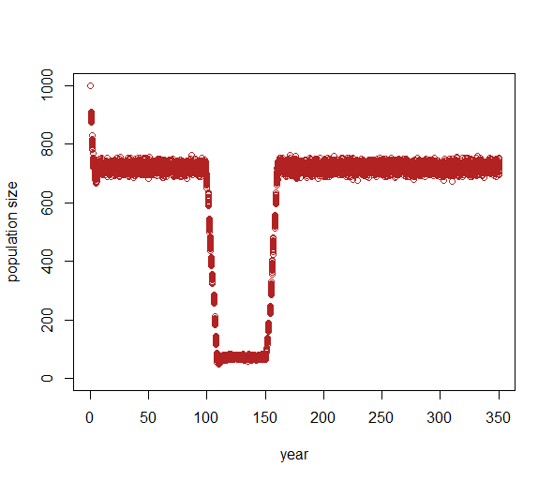
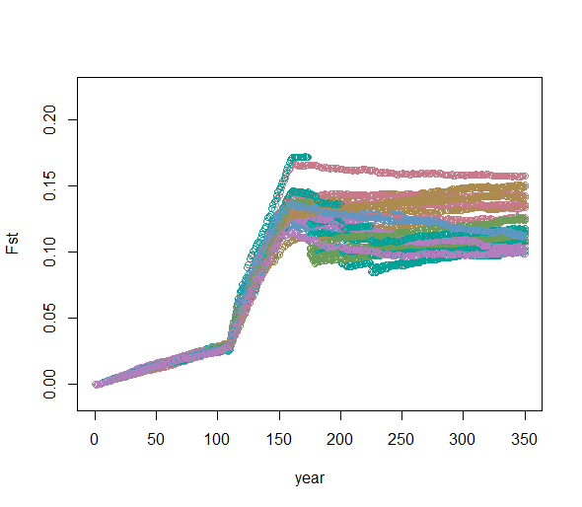
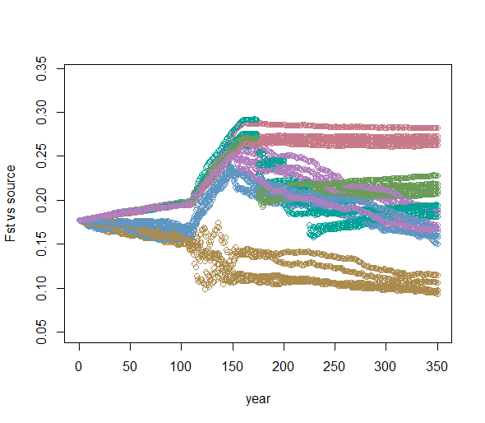
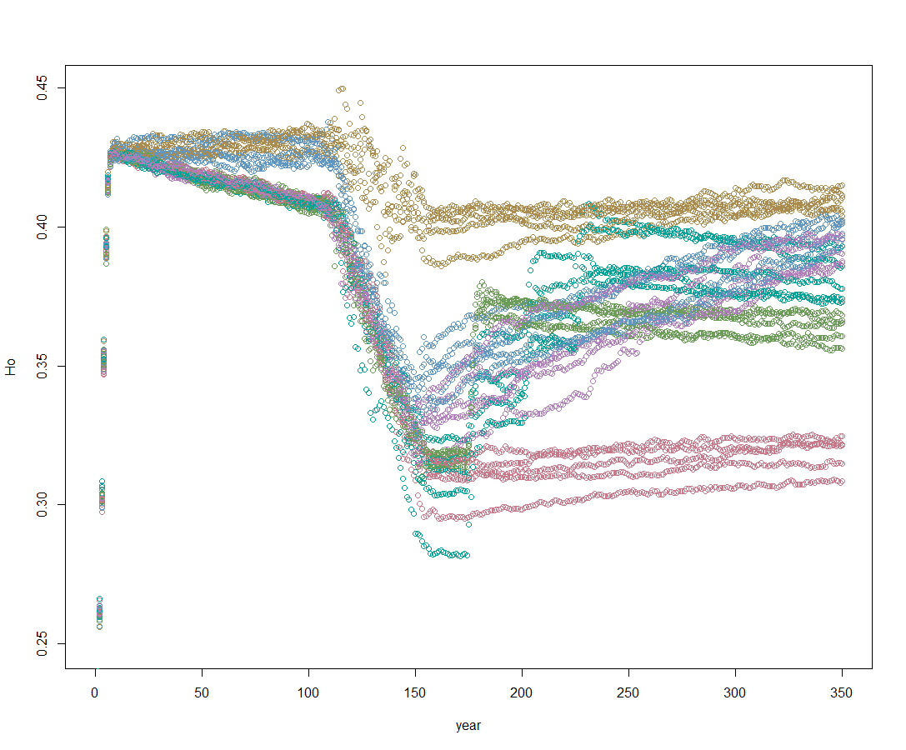
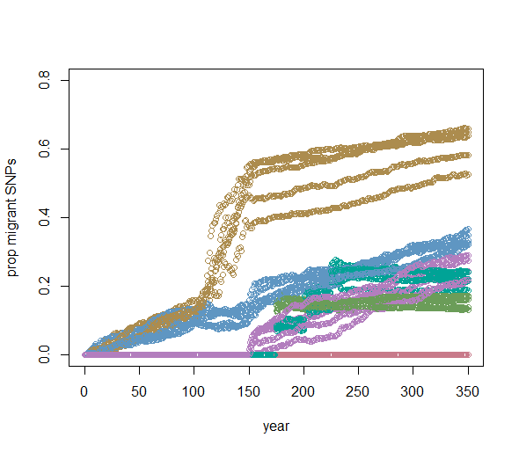
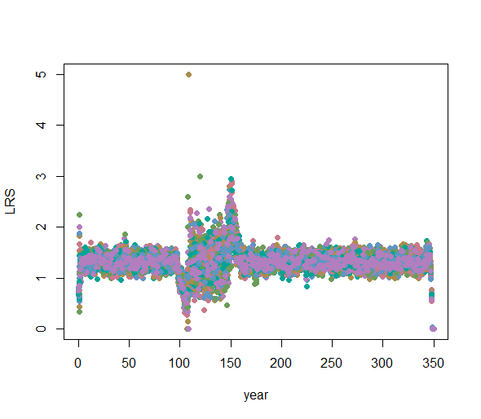
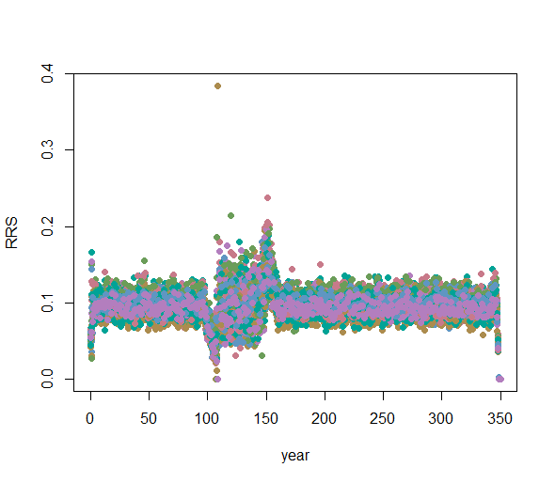
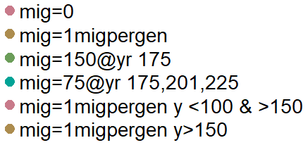
miggy b = 150 @ yr 175, miggy c = 75 @ 175, 201, 225, miggy d = on mig per gen but not during drop or dur, miggy e = one mig per gen starting after drop

Slide 3
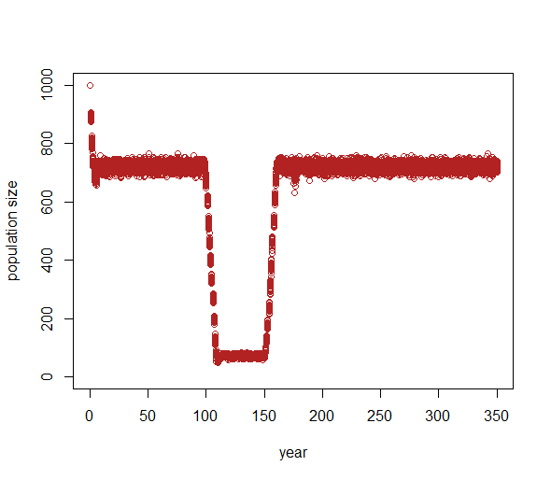
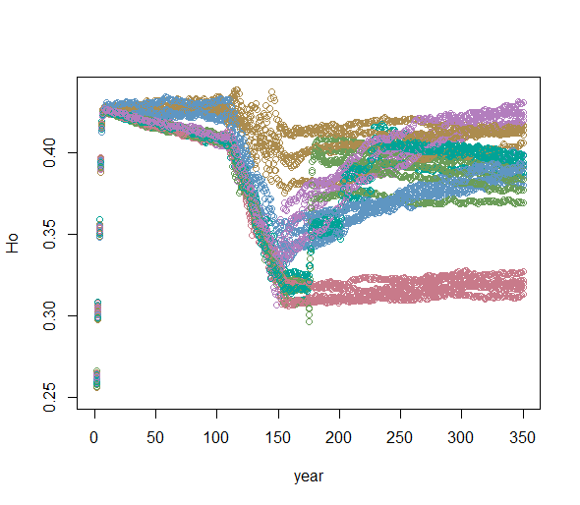
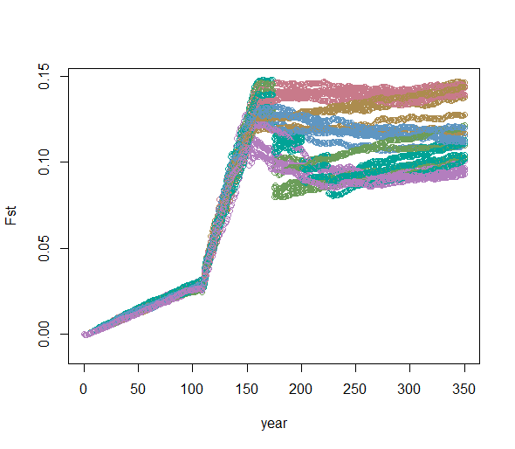
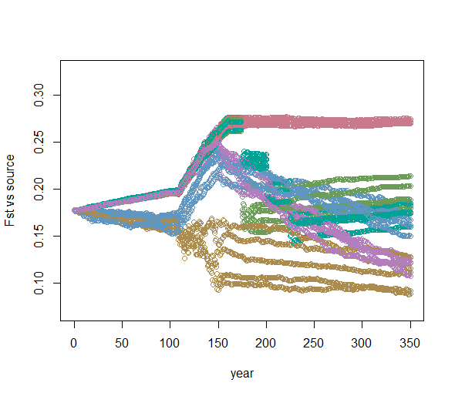
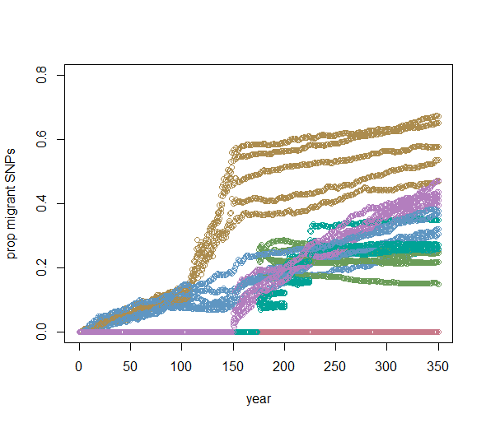
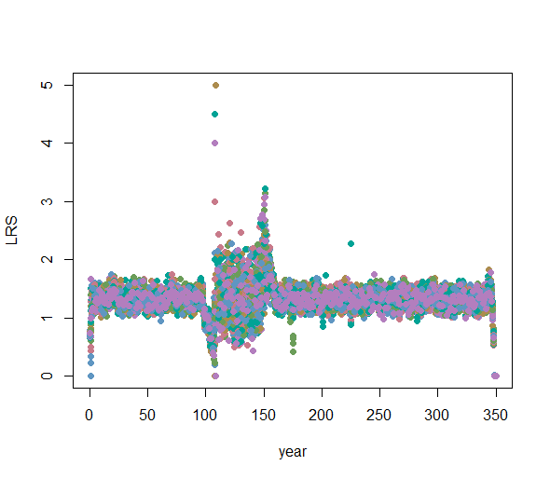
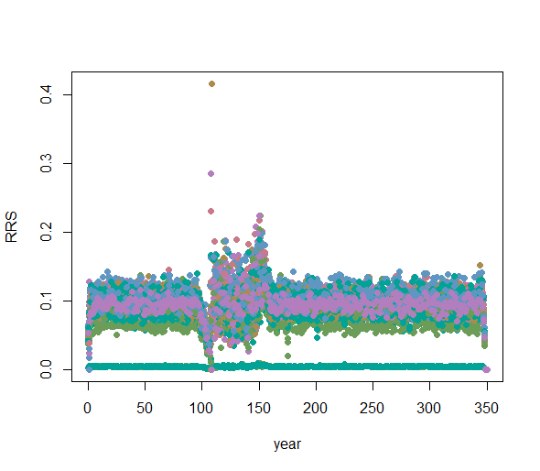
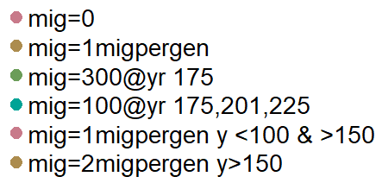
miggy b = 300 @ yr 175, miggy c = 100 @ 175, 201, 225, miggy d = on mig per gen but not during drop or dur, miggy e = two mig per gen starting after drop

Slide 4
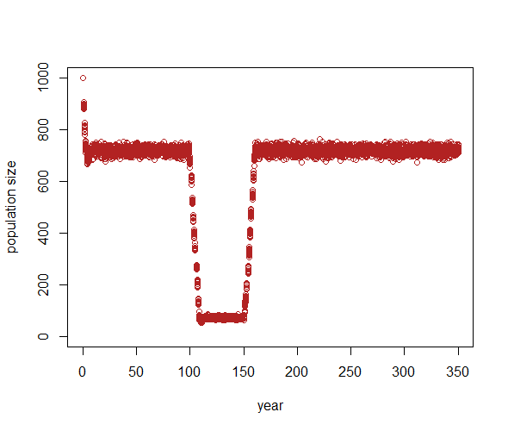
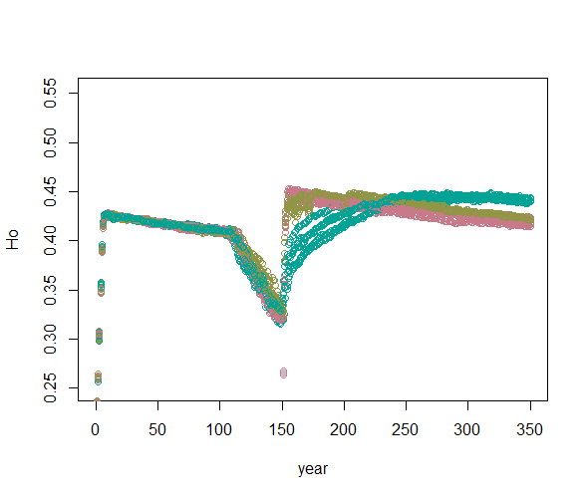
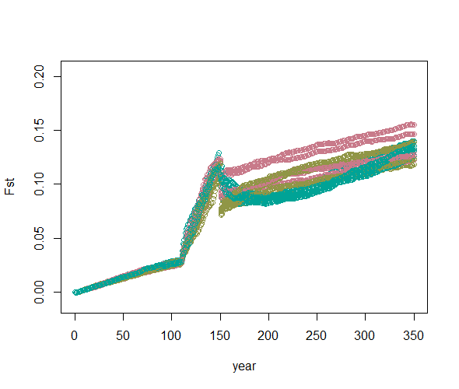
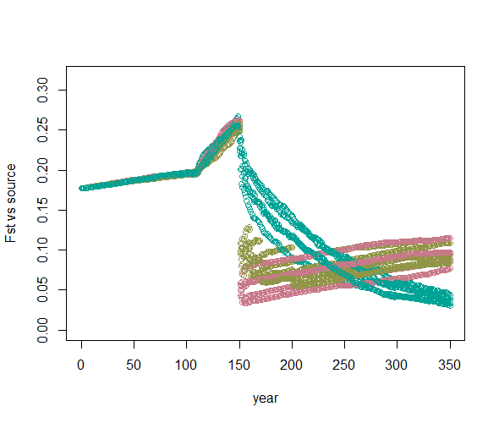
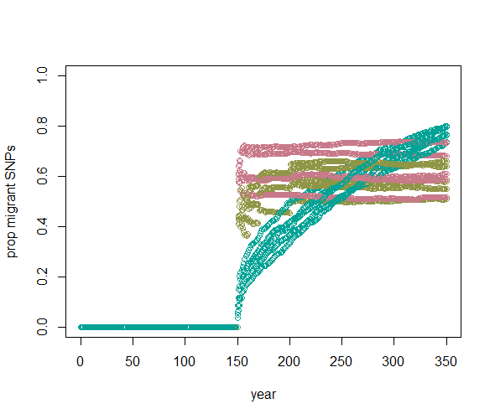
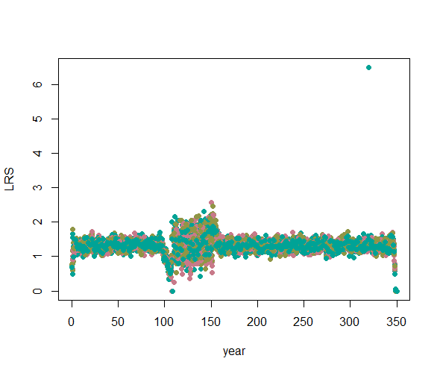
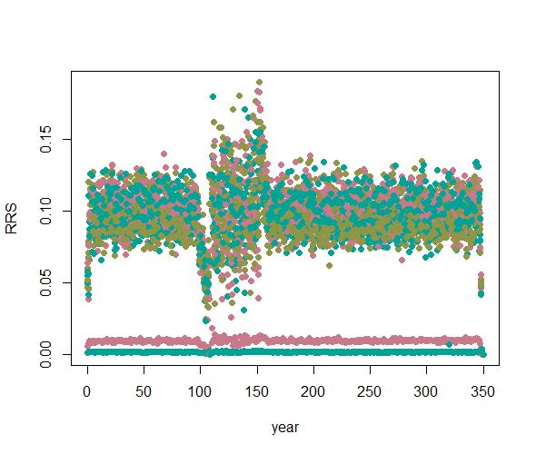
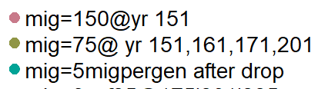
Run_3: miggy b = 150 @ yr 151, miggy c = 75 @ 151, 161, 171, 201, miggy e = five mig per gen starting after drop

Slide 5

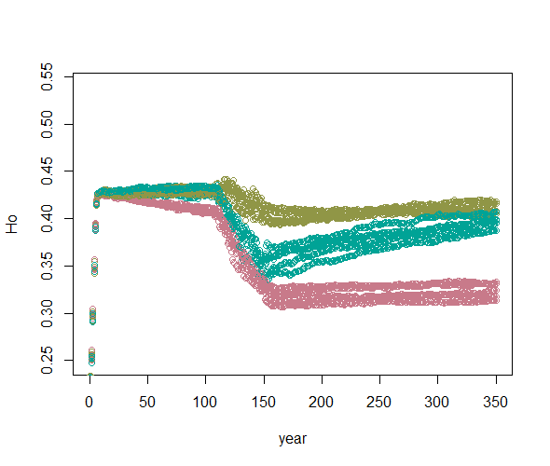
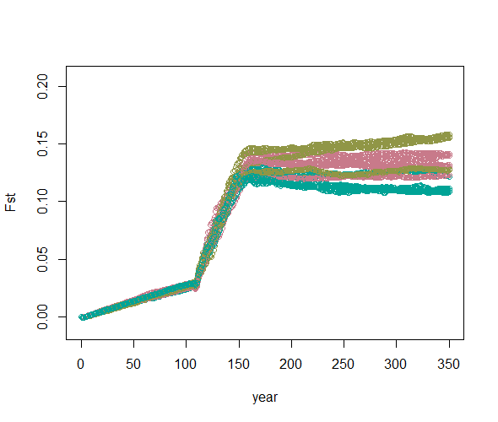
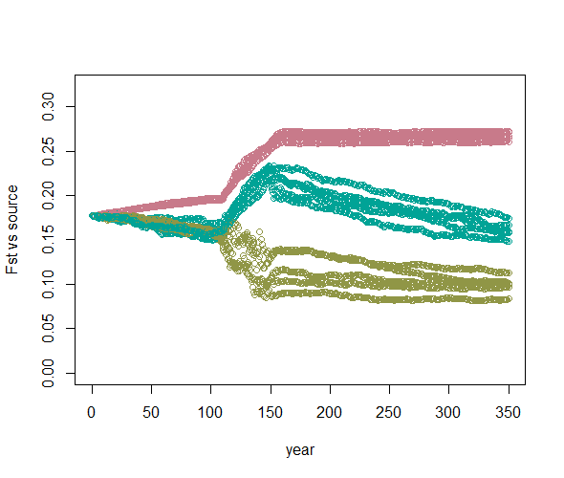
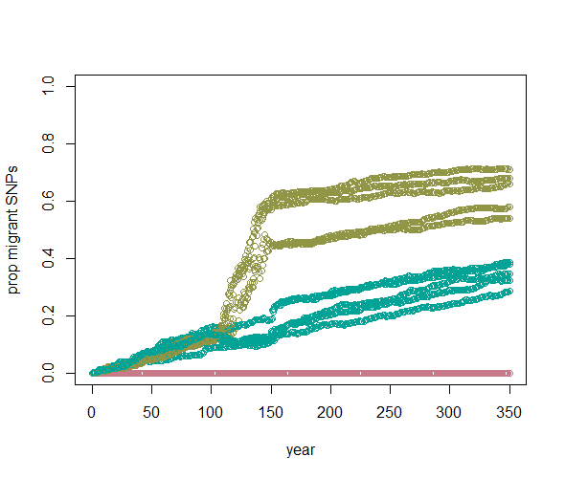
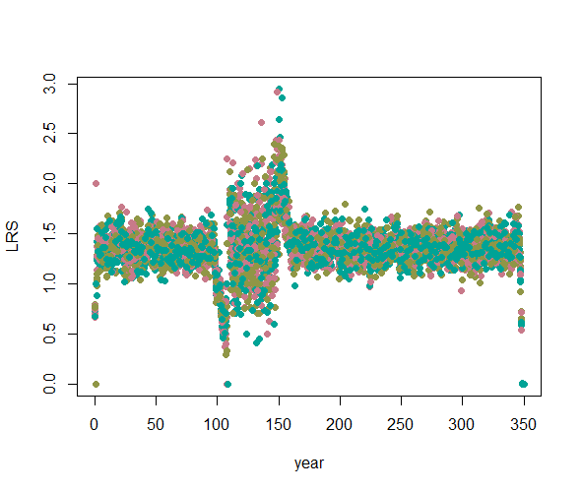
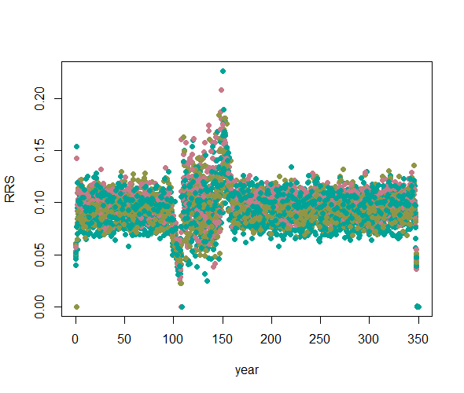
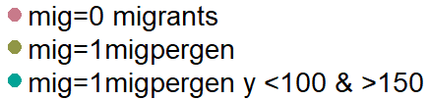
Run_4: removing fitness death to see if it will still result in high Ho -- checking why first couple years are weird -- maybe those older than maturity have lower Ho than the rest of the pop is allowed to get? __ after submitting this run, looks like if heterozygosity is ~0, nearly 100% chance of dying.

Slide 6
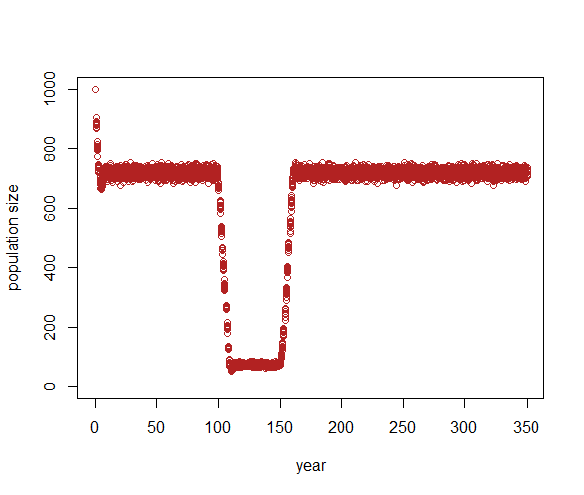
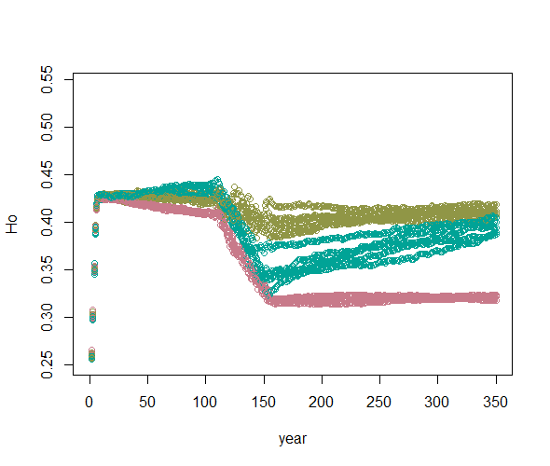
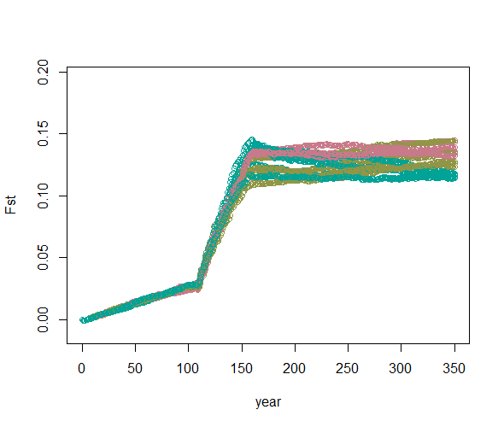
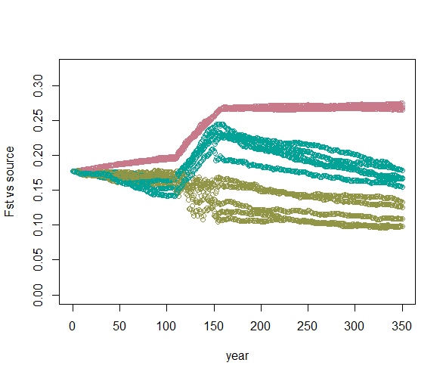
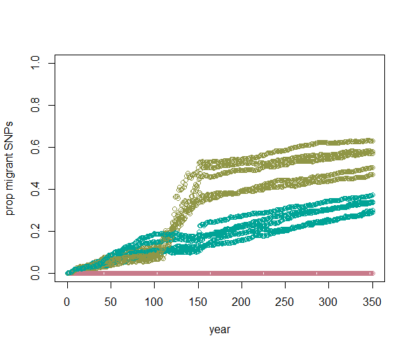
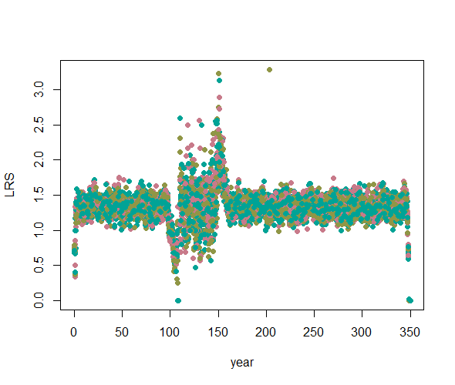
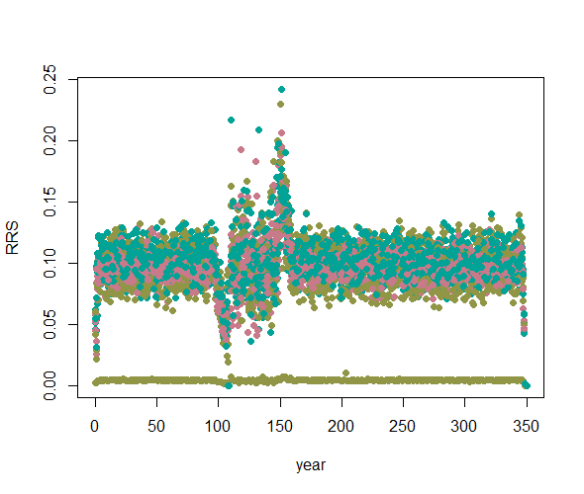
Run_5: looks like if heterozygosity is ~0, nearly 100% chance of dying. Therefore it is now a 50% chance with a probability of prob = c(.5/het/100,(1-(.5/het/100)))

Slide 7
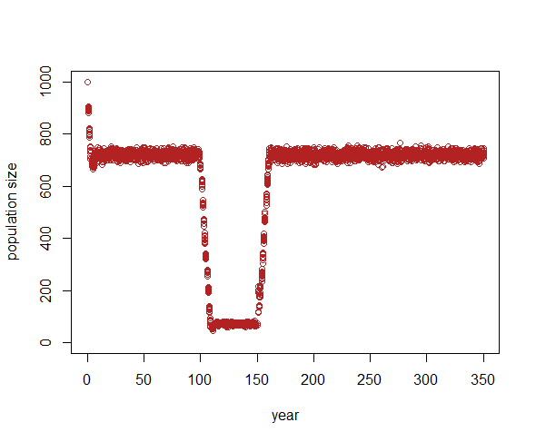
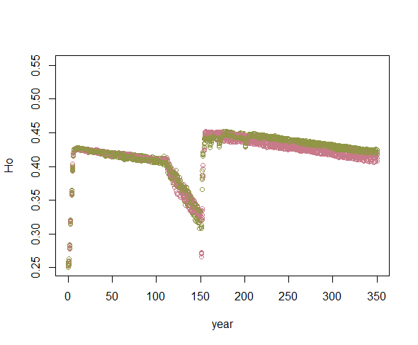
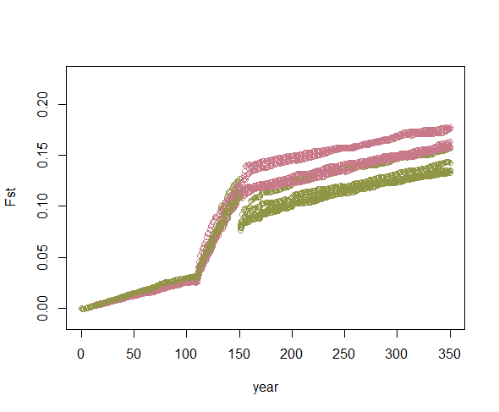
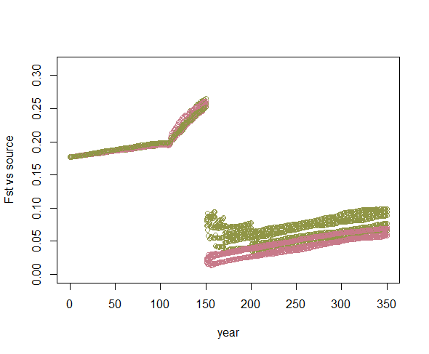
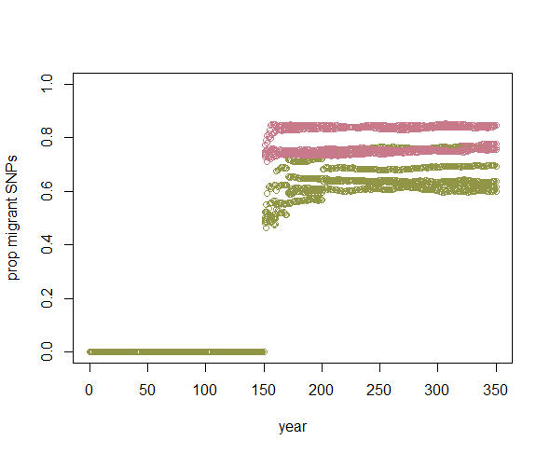
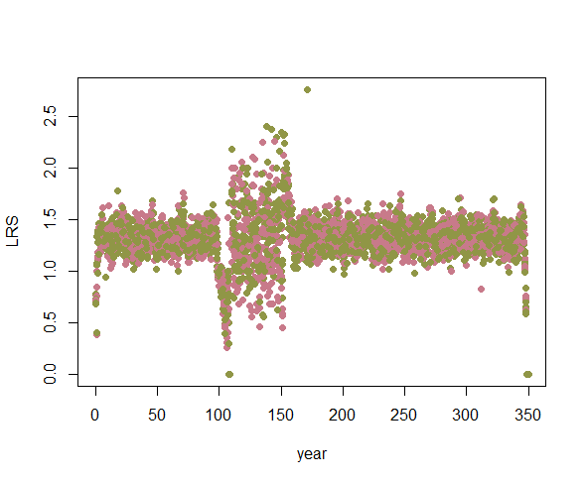
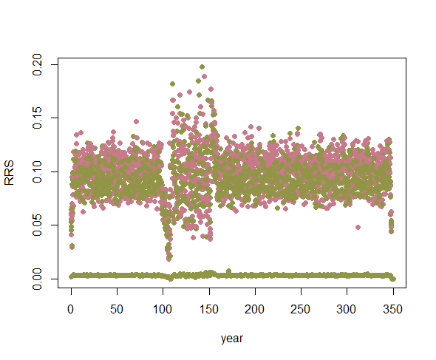

Run_6: miggy b = 300 @ yr 151, miggy c = 100 @ 151, 161, 171, 201

Slide 8
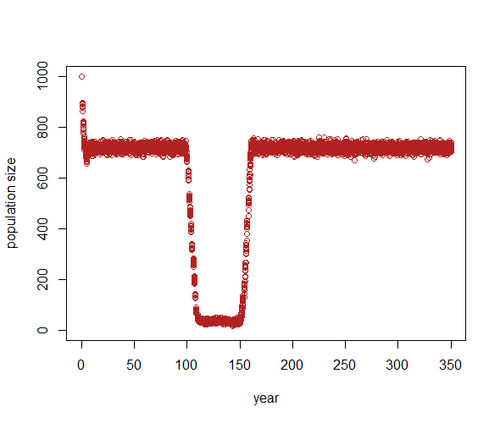
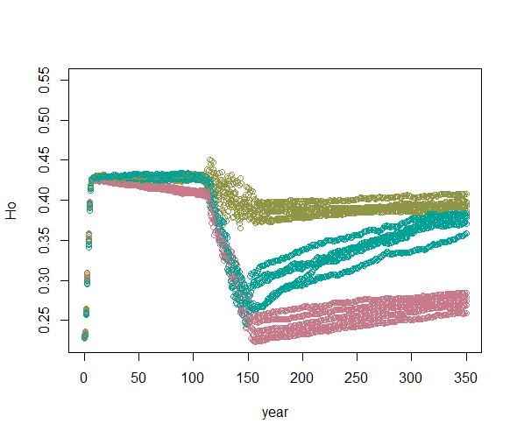
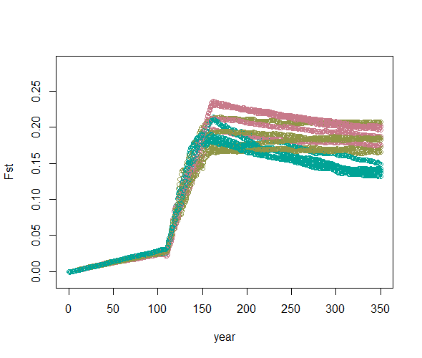
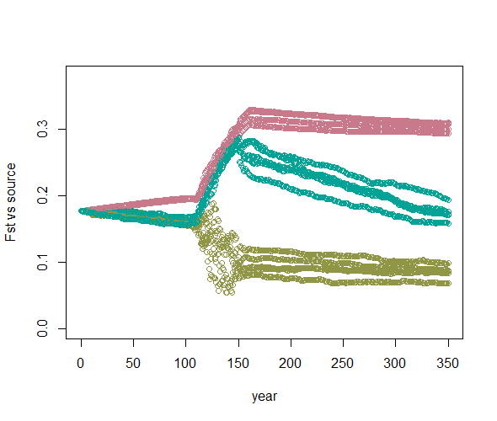
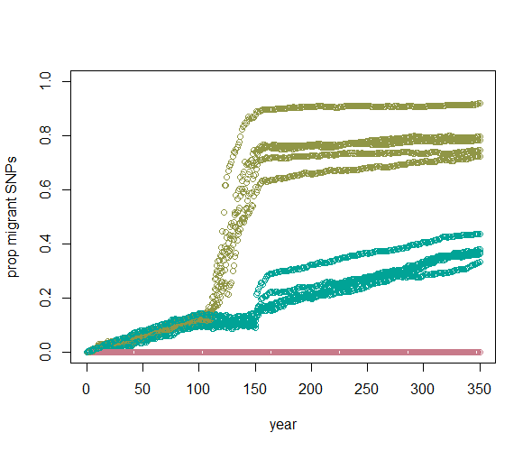


Run_7: introduce allee effect at lowest pop size -- instead of r0 = 1, r0 = .5 at low pop sizes (not during pop decline or growht periods– only for the duration of the lowest pop size)
Notes:
Thinkin the r0 at the lowest pop size is kinda silly since the pop isn’t allowed to grow anyways. Will probs need to extend the low r0 as the pop is increasing..?

Slide 9







Run_8: introduce allee effect when number of alive adults is less than 400, enacted in FitnessDeath.R, where the fitness effect is stronger at low pop sizes

Slide 10







Run_9: introduce allee effect at lowest pop size -- instead of r0 = 1, r0 = .5 at low pop sizes and .75r0 when in decline or growth [i.e., unstable] PLUS introduce allee effect when number of alive adults is less than 400, enacted in FitnessDeath.R, where the fitness effect is stronger at low pop sizes

Slide 11







Run_10: fitdeath is at .5 rate and r0 is only at 1 in stable starting point
[i.e., y < 100 r0 = 1; 0.5 @ duration of lowest pop size; 0.75 at pop increase, decrease, & postbottleneck]

Slide 12
miggy b = 150 @ yr 175, miggy c = 75 @ 175, 201, 225, miggy d = on mig per gen but not during drop or dur, miggy e = one mig per gen starting after drop
miggy b = 300 @ yr 175, miggy c = 100 @ 175, 201, 225, miggy d = on mig per gen but not during drop or dur, miggy e = two mig per gen starting after drop
miggy b = 150 @ yr 151, miggy c = 75 @ 151, 161, 171, 201, miggy e = five mig per gen starting after drop
removing fitness death to see if it will still result in high Ho -- checking why first couple years are weird -- maybe those older than maturity have lower Ho than the rest of the pop is allowed to get? __ after submitting this run, looks like if heterozygosity is ~0, nearly 100% chance of dying.
looks like if heterozygosity is ~0, nearly 100% chance of dying. Therefore it is now a 50% chance with a probability of prob = c(.5/het/100,(1-(.5/het/100)))
miggy b = 300 @ yr 151, miggy c = 100 @ 151, 161, 171, 201
introduce allee effect at lowest pop size -- instead of r0 = 1, r0 = .5 at low pop sizes (not during pop decline or growht periods)
introduce allee effect when number of alive adults is less than 400, enacted in FitnessDeath.R, where the fitness effect is stronger at low pop sizes
introduce allee effect at lowest pop size -- instead of r0 = 1, r0 = .5 at low pop sizes and .75r0 when in decline or growth [i.e., unstable] PLUS introduce allee effect when number of alive adults is less than 400, enacted in FitnessDeath.R, where the fitness effect is stronger at low pop sizes
fitdeath is at .5 rate and r0 is only at 1 in stable starting point

Slide 13









 | 518079:518083 | run_aa | y | y | y | y | a | 0.07 | 0.45 | 1 | 100 | 1000 | 1000 | 10 | 40 | 9 | 2 | 1 | 350 | 1 |  | 100 | 0 | CHANGED THE ERROR IN STARTING HETEROZYGOSITIES
This is the “ideal” in which population connectivity never stops

Slide 14









 | 518107:518111 | run_bb | y | y | y | y | a | 0.45 | 0.07 | 1 | 100 | 1000 | 1000 | 10 | 40 | 9 | 2 | 1 | 350 | 1 |  | 100 | 0 | CHANGED THE ERROR IN STARTING HETEROZYGOSITIES
This is the “ideal” in which population connectivity never stops

Slide 15









 | 518093:518097 | run_cc | y | y | y | y | a | 0.07 | 0.07 | 1 | 100 | 1000 | 1000 | 10 | 40 | 9 | 2 | 1 | 350 | 1 |  | 100 | 0 | CHANGED THE ERROR IN STARTING HETEROZYGOSITIES
This is the “ideal” in which population connectivity never stops

Slide 16









Note that Ne/Nc has same trend as LRS
This is the “ideal” in which population connectivity never stops. Different colors show the different starting allele frequencies

Slide 17
run_11 | y | y | y | y | 0, a, d | 0.45 | 0.45 | 1 | 100 | 1000 | 1000 | 10 | 40 | 9 | 2 | 1 | 350 | 1 |  | 100 | 0 | CHANGED THE ERROR IN STARTING HETEROZYGOSITIES
run_12 | y | y | y | y | 0, a, d | 0.45 | 0.45 | 1 | 300 | 1000 | 1000 | 10 | 40 | 9 | 2 | 1 | 350 | 1 |  | 100 | 0 | CHANGED THE ERROR IN STARTING HETEROZYGOSITIES
run_13 | y | y | y | y | 0, a, d | 0.45 | 0.45 | 1 | 500 | 1000 | 1000 | 10 | 40 | 9 | 2 | 1 | 350 | 1 |  | 100 | 0 | CHANGED THE ERROR IN STARTING HETEROZYGOSITIES
run_aa | y | y | y | y | a | 0.07 | 0.45 | 1 | 100 | 1000 | 1000 | 10 | 40 | 9 | 2 | 1 | 350 | 1 |  | 100 | 0 | CHANGED THE ERROR IN STARTING HETEROZYGOSITIES
run_bb | y | y | y | y | a | 0.45 | 0.07 | 1 | 100 | 1000 | 1000 | 10 | 40 | 9 | 2 | 1 | 350 | 1 |  | 100 | 0 | CHANGED THE ERROR IN STARTING HETEROZYGOSITIES
run_cc | y | y | y | y | a | 0.07 | 0.07 | 1 | 100 | 1000 | 1000 | 10 | 40 | 9 | 2 | 1 | 350 | 1 |  | 100 | 0 | CHANGED THE ERROR IN STARTING HETEROZYGOSITIES
run_14 | y | y | y | y | 0, a, d | 0.45 | 0.45 | 1 | 700 | 1000 | 1000 | 10 | 40 | 9 | 2 | 1 | 350 | 1 |  | 100 | 0 | CHANGED THE ERROR IN STARTING HETEROZYGOSITIES
run_aa2 | y | y | y | y | a | 0.07 | 0.45 | 1 | 500 | 1000 | 1000 | 10 | 40 | 9 | 2 | 1 | 350 | 1 |  | 100 | 0 | CHANGED THE ERROR IN STARTING HETEROZYGOSITIES
run_bb2 | y | y | y | y | a | 0.45 | 0.07 | 1 | 500 | 1000 | 1000 | 10 | 40 | 9 | 2 | 1 | 350 | 1 |  | 100 | 0 | CHANGED THE ERROR IN STARTING HETEROZYGOSITIES
run_cc2 | y | y | y | y | a | 0.07 | 0.07 | 1 | 500 | 1000 | 1000 | 10 | 40 | 9 | 2 | 1 | 350 | 1 |  | 100 | 0 | CHANGED THE ERROR IN STARTING HETEROZYGOSITIES
Note to check ne counts!!!

Slide 18







run_11 | y | y | y | y | 0, a, d | 0.45 | 0.45 | 1 | 100 | 1000 | 1000 | 10 | 40 | 9 | 2 | 1 | 350 | 1 |  | 100 | 0 | CHANGED THE ERROR IN STARTING HETEROZYGOSITIES

Slide 19







run_12 | y | y | y | y | 0, a, d | 0.45 | 0.45 | 1 | 300 | 1000 | 1000 | 10 | 40 | 9 | 2 | 1 | 350 | 1 |  | 100 | 0 | CHANGED THE ERROR IN STARTING HETEROZYGOSITIES

Slide 20







run_13 | y | y | y | y | 0, a, d | 0.45 | 0.45 | 1 | 500 | 1000 | 1000 | 10 | 40 | 9 | 2 | 1 | 350 | 1 |  | 100 | 0 | CHANGED THE ERROR IN STARTING HETEROZYGOSITIES

Slide 21







run_14 | y | y | y | y | 0, a, d | 0.45 | 0.45 | 1 | 700 | 1000 | 1000 | 10 | 40 | 9 | 2 | 1 | 350 | 1 |  | 100 | 0 | CHANGED THE ERROR IN STARTING HETEROZYGOSITIES

Slide 22


run_aa2 | y | y | y | y | a | 0.07 | 0.45 | 1 | 500 | 1000 | 1000 | 10 | 40 | 9 | 2 | 1 | 350 | 1 |  | 100 | 0 | CHANGED THE ERROR IN STARTING HETEROZYGOSITIES

Slide 23







run_aa2 | y | y | y | y | a | 0.07 | 0.45 | 1 | 500 | 1000 | 1000 | 10 | 40 | 9 | 2 | 1 | 350 | 1 |  | 100 | 0 | CHANGED THE ERROR IN STARTING HETEROZYGOSITIES
run_bb2 | y | y | y | y | a | 0.45 | 0.07 | 1 | 500 | 1000 | 1000 | 10 | 40 | 9 | 2 | 1 | 350 | 1 |  | 100 | 0 | CHANGED THE ERROR IN STARTING HETEROZYGOSITIES
run_cc2 | y | y | y | y | a | 0.07 | 0.07 | 1 | 500 | 1000 | 1000 | 10 | 40 | 9 | 2 | 1 | 350 | 1 |  | 100 | 0 | CHANGED THE ERROR IN STARTING HETEROZYGOSITIES

Slide 24









After adding allee effects – compare to run_bb to check if allee effect working ok
run_A | y | y | y | y | a | 0.45 | .07 | 1 | 100 | 1000 | 1000 | 10 | 40 | 9 | 2 | 1 | 350 | 1 |  | 100 | 0
run_B | y | y | y | y | 0 | 0.45 | 0.07 | 1 | 100 | 1000 | 1000 | 10 | 40 | 9 | 2 | 1 | 350 | 1 |  | 100 | 0

