Slide 1
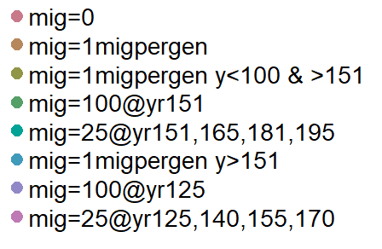
High starting Ho in both source and focal pops
10 years to drop from 1000 –> c(700, 500, 300) : vulnerable, endangered, critically endangered
40 years at low popsize until pop growth allowed
9 year lifespan, 2 as max fecundity, maturity at 1
Allee effect turned on with random mating. Fitness death (due to Ho) imposed.
Worst case – no habitat connectivity
Best case – always pops connected
2nd best – connected > no connectivity > habitat restored
One reintroduction after habitat restored
4 reintroductions after habitat restored
If populations not connected then corridor imposed
One reintroduction before habitat improved
4 reintroductions before/during habitat improved

Slide 2
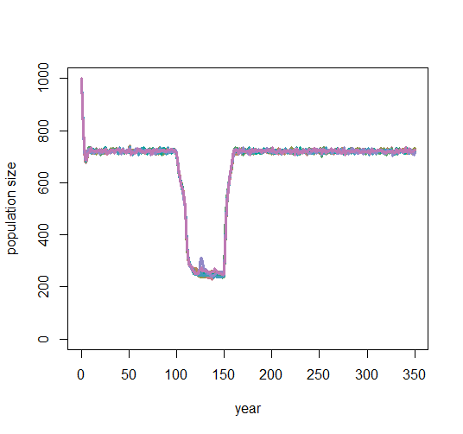
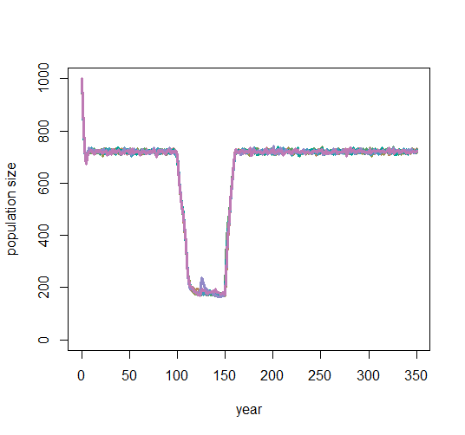
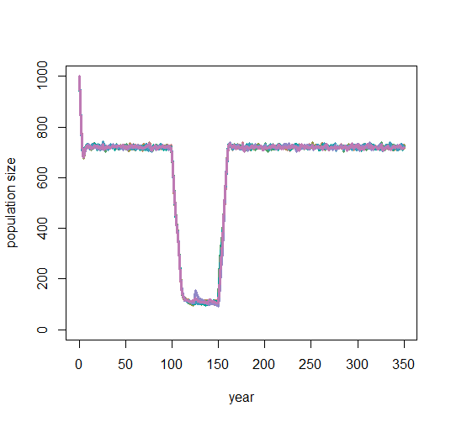
Vulnerable
newK = 700
Endangered
newK = 500
Critically endangered
newK = 300
Because the allee effect is stronger as pop size decreases, the actual K goes below carrying capacity (newK) at lowest pop sizes
Note that because the number of interactions decreases as pop size decreases, those that do mate have a stronger influence on the pop
Notes:
Check if only adults or all adults. See if K goes for all or babies – find a better way to plot these – depends on the final questions.
More management focused questions because that’s the interest.
How to condense and clarify the figures..

Slide 3
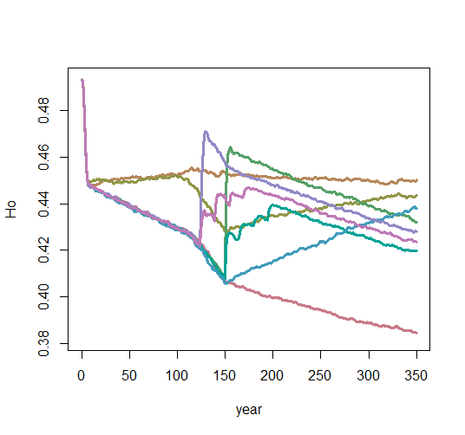
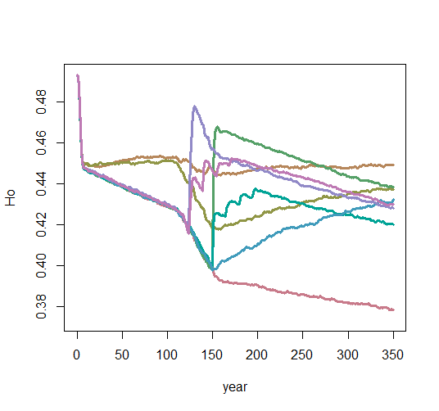
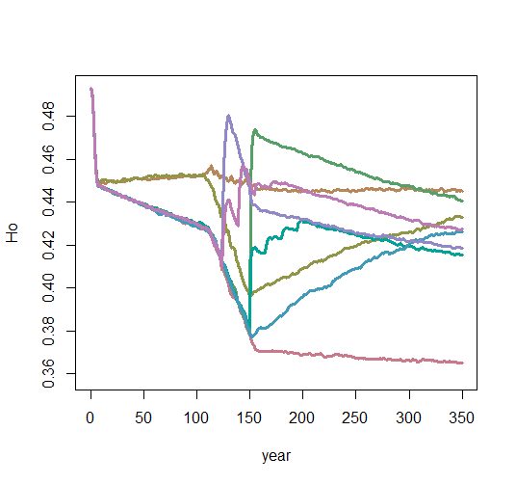
vulnerable
endangered
Critically endangered
Results
The large influx of 100 indv both at low pop size and after habitat restoration give a temporary increase in Ho, though that remains the same
4 intervals of the same number of indv added to pop shows a slower bump in Ho, though overall helps increase Ho less
Restoring habitat so that connectivity returns for 1 mig/gen seems to have the best potential for steady increase of Ho
The range of Ho is largely the same across levels of vulnerability

Slide 4
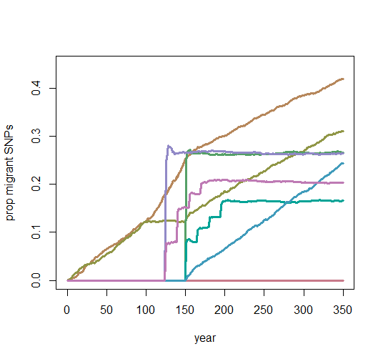
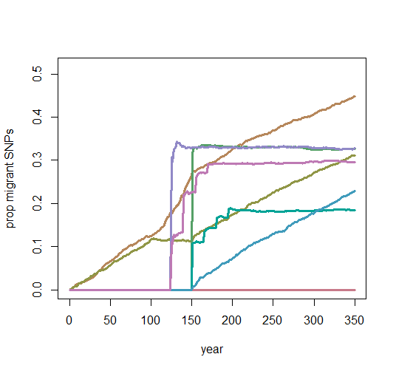
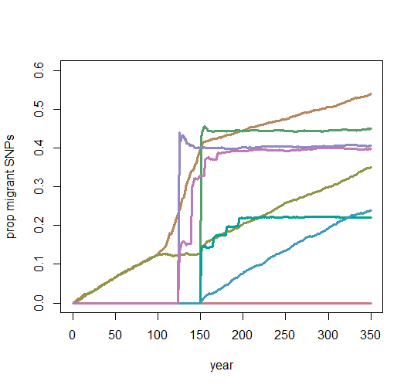
vulnerable
endangered
Critically endangered
Results
The large influx of 100 indv both at low pop size and after habitat restoration give a temporary increase in migrant alleles, though that stays steady
4 intervals of the same number of indv added to pop shows a slower bump in migrant alleles, and keeps more locally adapted alleles
Restoring habitat so that connectivity returns for 1 mig/gen shows more outbreeding/retains more migrant SNPs, especially at lower pop sizes
The migrant SNPs are more present in populations with greater pop drops

Slide 5
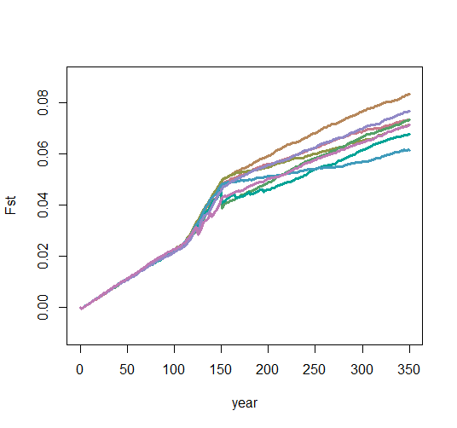
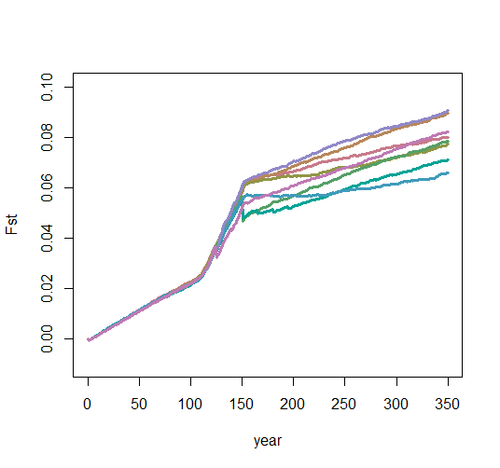
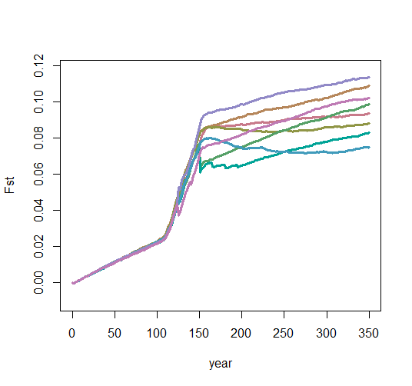
vulnerable
endangered
Critically endangered
Results
Divergence from the original focal pop increases at a faster rate as pop size drops (though similar no matter the migration rate).
After habitat is restored, divergence from original alleles slows.
As pop vulnerability increases, the difference in migration rates and Fst starts to show. (I’d guess not significantly)

Slide 6
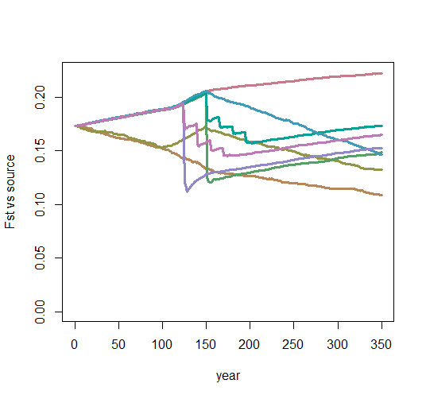
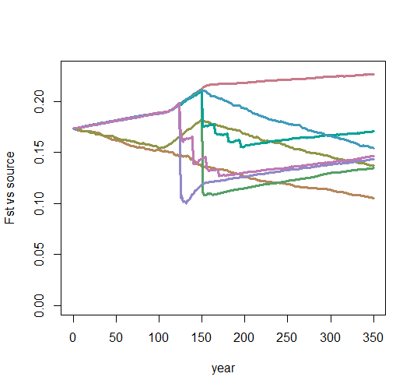
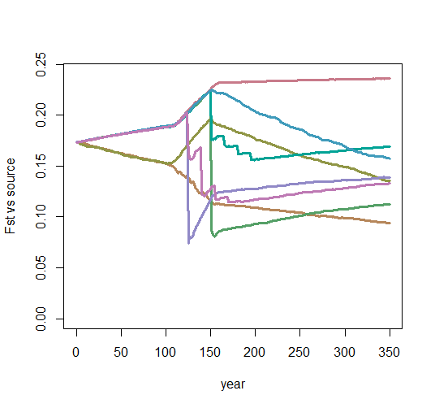
vulnerable
endangered
Critically endangered
Results
Divergence from the source pop decreases with increasing migrants and increases without migrants.
Fst from source ends at near the same value with 1x and 4x reintroductions
Fst decreases to below starting value with habitat connectivity
As pop vulnerability increases, the difference in migration rates and Fst starts to show. (I’d guess not significantly)

Slide 7
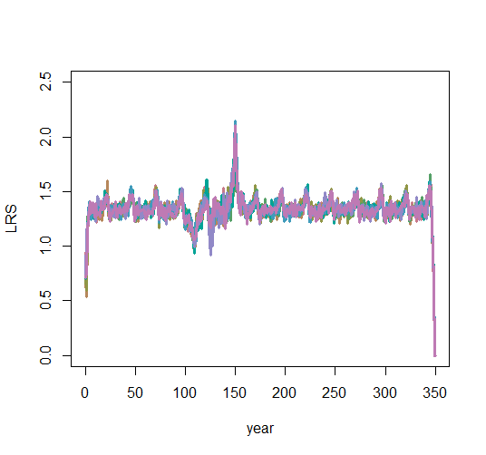
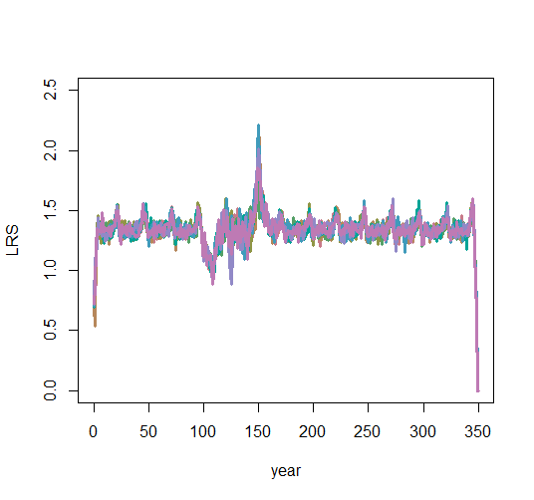
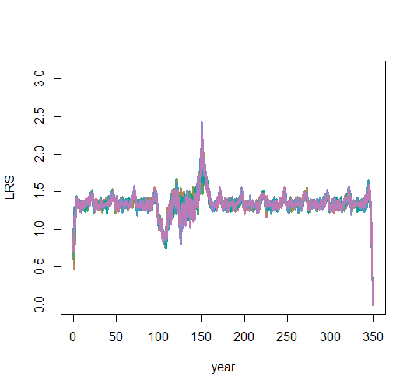
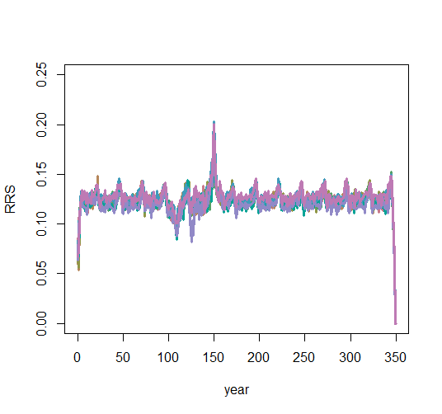
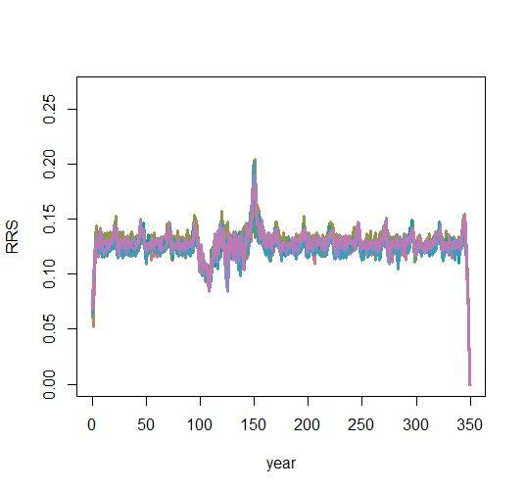
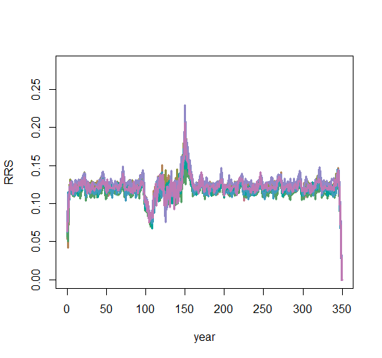
vulnerable
endangered
Critically endangered
Results
LRS and RRS depends on pop size, not migration rate

Slide 8
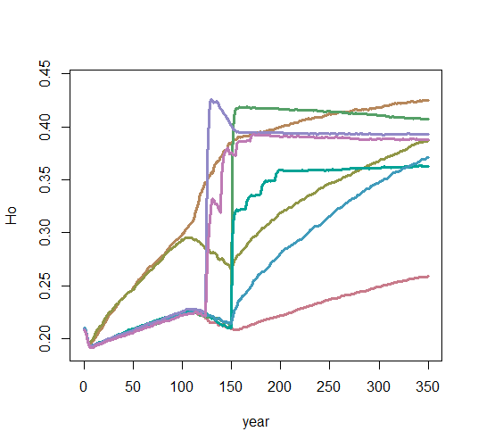
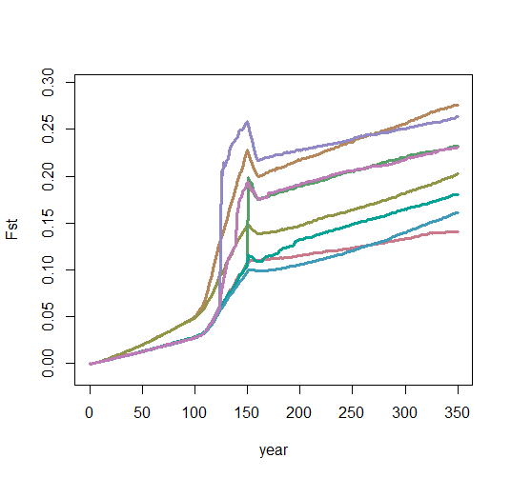
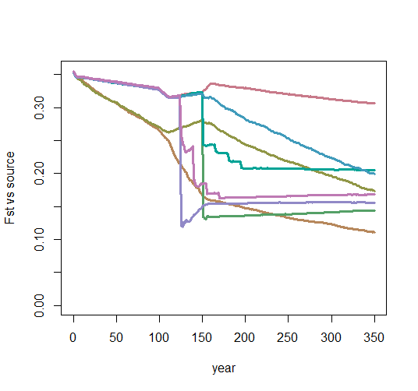
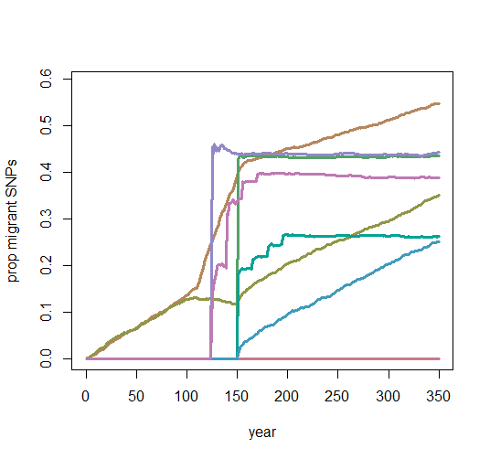
However, when the focal pop has low minor allele frequency, but the source has high minor allele frequency…
the increase is much greater in Ho as migration rate increases
The prop of migrant SNPs remains much the same
The Fst from the focal pop increases nearly twofold
The Fst from the source decreases in all migration rates
these two Fsts suggest that if the source Ho is higher than focal Ho, the focal pop will become more like the
migrants than the original focal pop
Critically endangered,
focal and source pop high minor allele freq
Critically endangered,
focal pop low minor allele freq, source high

Slide 9
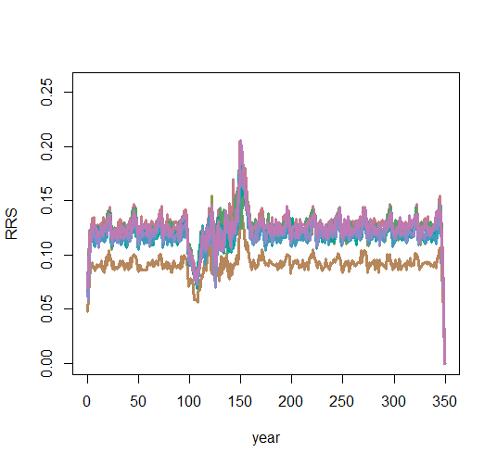
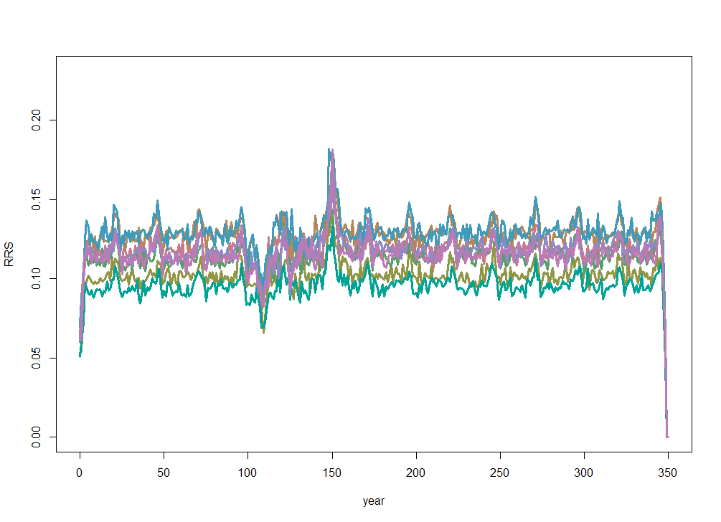
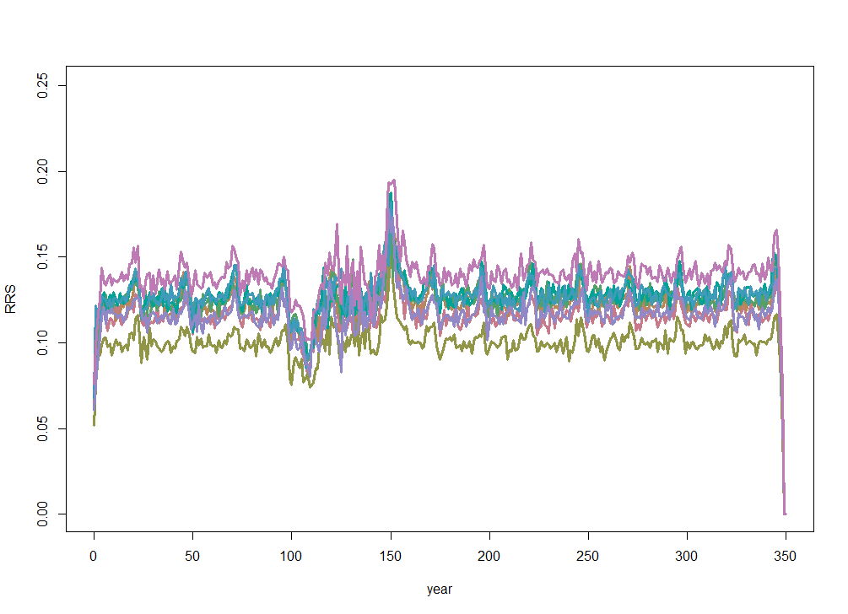
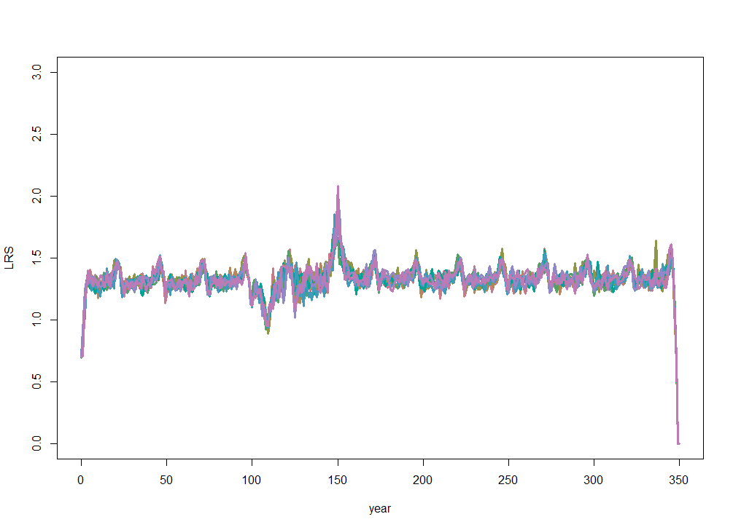
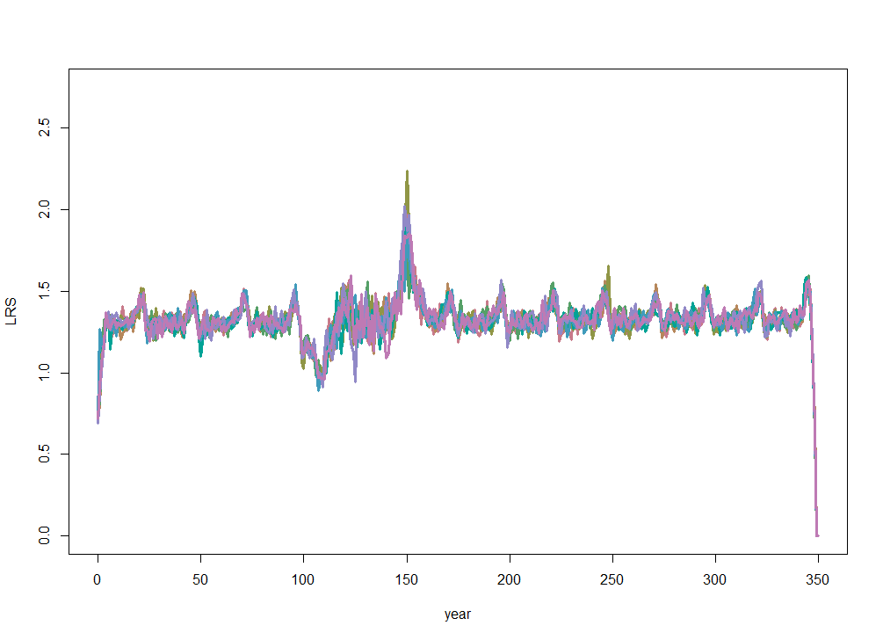
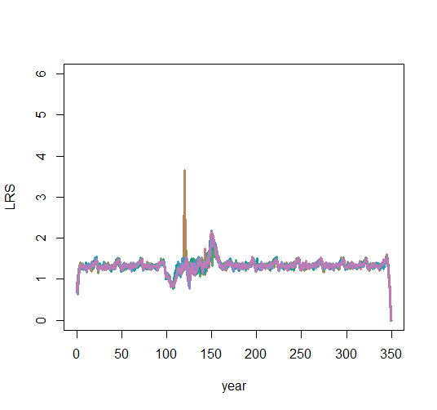
LRS is similar as well, though there is some separation in RRS – not sure why this is the case really.. ?
(probs not significant)
Notes:
Wait on RRS – may need to change this.

