Slide 1
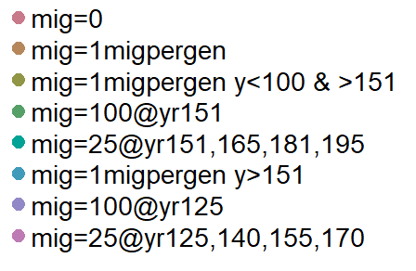
ABMrun_3.1.23_a | y | y | y | y | 0, a, d | 0.45 - 0.55 | 0.07 | 1 | 700 | 1000 | 1000 | 10 | 40 | 9 | 2 | 1 | 350 | 1 |  | 100 | 0
ABMrun_3.1.23_b | y | y | y | y | b, c, e | 0.45 - 0.55 | 0.07 | 1 | 700 | 1000 | 1000 | 10 | 40 | 9 | 2 | 1 | 350 | 1 |  | 100 | 0 | migb = 100@151, migc=25@151, 165, 181, 195; transloc AFTER habitat is restored
ABMrun_3.1.23_c | y | y | y | y | 0, a, d | 0.45 - 0.55 | 0.07 | 1 | 500 | 1000 | 1000 | 10 | 40 | 9 | 2 | 1 | 350 | 1 |  | 100 | 0
ABMrun_3.1.23_d | y | y | y | y | b, c, e | 0.45 - 0.55 | 0.07 | 1 | 500 | 1000 | 1000 | 10 | 40 | 9 | 2 | 1 | 350 | 1 |  | 100 | 0 | migb = 100@151, migc=25@151, 165, 181, 195; transloc AFTER habitat is restored
ABMrun_3.1.23_e | y | y | y | y | 0, a, d | 0.45 - 0.55 | 0.07 | 1 | 300 | 1000 | 1000 | 10 | 40 | 9 | 2 | 1 | 350 | 1 |  | 100 | 0
ABMrun_3.1.23_f | y | y | y | y | b, c, e | 0.45 - 0.55 | 0.07 | 1 | 300 | 1000 | 1000 | 10 | 40 | 9 | 2 | 1 | 350 | 1 |  | 100 | 0 | migb = 100@151, migc=25@151, 165, 181, 195; transloc AFTER habitat is restored
ABMrun_3.1.23_g | y | y | y | y | b, c | 0.45 - 0.55 | 0.07 | 1 | 700 | 1000 | 1000 | 10 | 40 | 9 | 2 | 1 | 350 | 1 |  | 100 | 0 | migb = 100@125, migc=25@125, 140, 155, 170; trans WHILE habitat quality is LOW
ABMrun_3.1.23_h | y | y | y | y | b, c | 0.45 - 0.55 | 0.07 | 1 | 500 | 1000 | 1000 | 10 | 40 | 9 | 2 | 1 | 350 | 1 |  | 100 | 0 | migb = 100@125, migc=25@125, 140, 155, 170; trans WHILE habitat quality is LOW
ABMrun_3.1.23_i | y | y | y | y | b, c | 0.45 - 0.55 | 0.07 | 1 | 300 | 1000 | 1000 | 10 | 40 | 9 | 2 | 1 | 350 | 1 |  | 100 | 0 | migb = 100@125, migc=25@125, 140, 155, 170; trans WHILE habitat quality is LOW
ABMrun_3.3.23_a | y | y | y | y | 0, a, d | 0.45 - 0.55 | 0.4-0.5 | 1 | 700 | 1000 | 1000 | 10 | 40 | 9 | 2 | 1 | 350 | 1 |  | 100 | 0
ABMrun_3.3.23_b | y | y | y | y | b, c, e | 0.45 - 0.55 | 0.4-0.5 | 1 | 700 | 1000 | 1000 | 10 | 40 | 9 | 2 | 1 | 350 | 1 |  | 100 | 0 | migb = 100@151, migc=25@151, 165, 181, 195; transloc AFTER habitat is restored
ABMrun_3.3.23_c | y | y | y | y | 0, a, d | 0.45 - 0.55 | 0.4-0.5 | 1 | 500 | 1000 | 1000 | 10 | 40 | 9 | 2 | 1 | 350 | 1 |  | 100 | 0
ABMrun_3.3.23_d | y | y | y | y | b, c, e | 0.45 - 0.55 | 0.4-0.5 | 1 | 500 | 1000 | 1000 | 10 | 40 | 9 | 2 | 1 | 350 | 1 |  | 100 | 0 | migb = 100@151, migc=25@151, 165, 181, 195; transloc AFTER habitat is restored
ABMrun_3.3.23_e | y | y | y | y | 0, a, d | 0.45 - 0.55 | 0.4-0.5 | 1 | 300 | 1000 | 1000 | 10 | 40 | 9 | 2 | 1 | 350 | 1 |  | 100 | 0
ABMrun_3.3.23_f | y | y | y | y | b, c, e | 0.45 - 0.55 | 0.4-0.5 | 1 | 300 | 1000 | 1000 | 10 | 40 | 9 | 2 | 1 | 350 | 1 |  | 100 | 0 | migb = 100@151, migc=25@151, 165, 181, 195; transloc AFTER habitat is restored
ABMrun_3.3.23_g | y | y | y | y | b, c | 0.45 - 0.55 | 0.4-0.5 | 1 | 700 | 1000 | 1000 | 10 | 40 | 9 | 2 | 1 | 350 | 1 |  | 100 | 0 | migb = 100@125, migc=25@125, 140, 155, 170; trans WHILE habitat quality is LOW
ABMrun_3.3.23_h | y | y | y | y | b, c | 0.45 - 0.55 | 0.4-0.5 | 1 | 500 | 1000 | 1000 | 10 | 40 | 9 | 2 | 1 | 350 | 1 |  | 100 | 0 | migb = 100@125, migc=25@125, 140, 155, 170; trans WHILE habitat quality is LOW
ABMrun_3.3.23_i | y | y | y | y | b, c | 0.45 - 0.55 | 0.4-0.5 | 1 | 300 | 1000 | 1000 | 10 | 40 | 9 | 2 | 1 | 350 | 1 |  | 100 | 0 | migb = 100@125, migc=25@125, 140, 155, 170; trans WHILE habitat quality is LOW

Slide 2
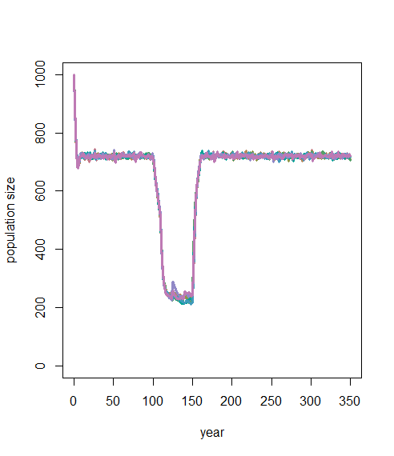
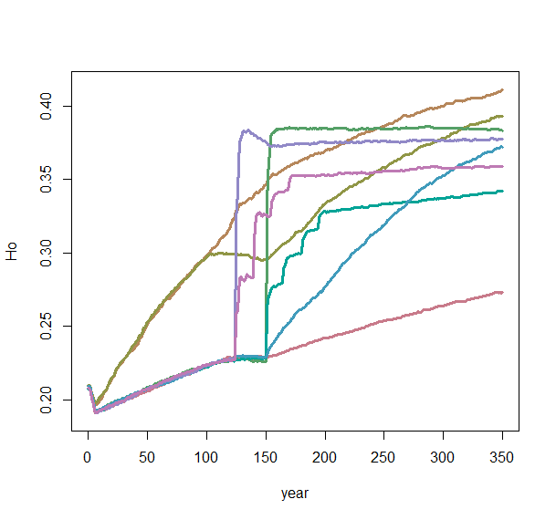
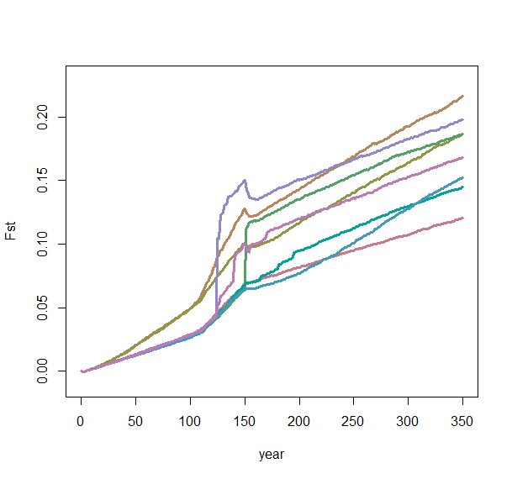
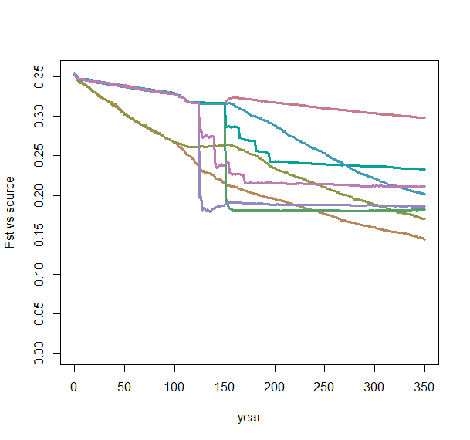
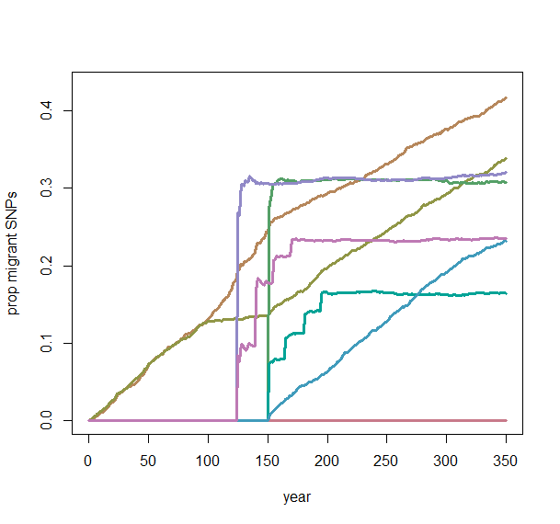
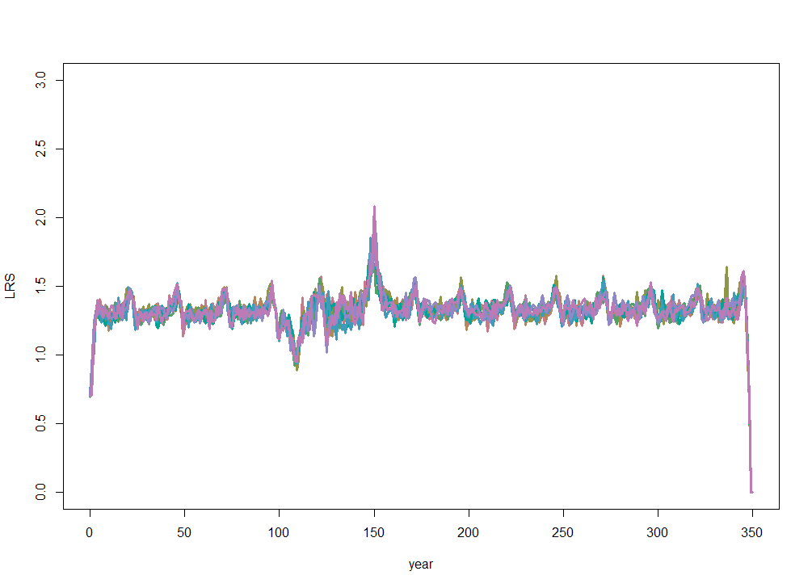
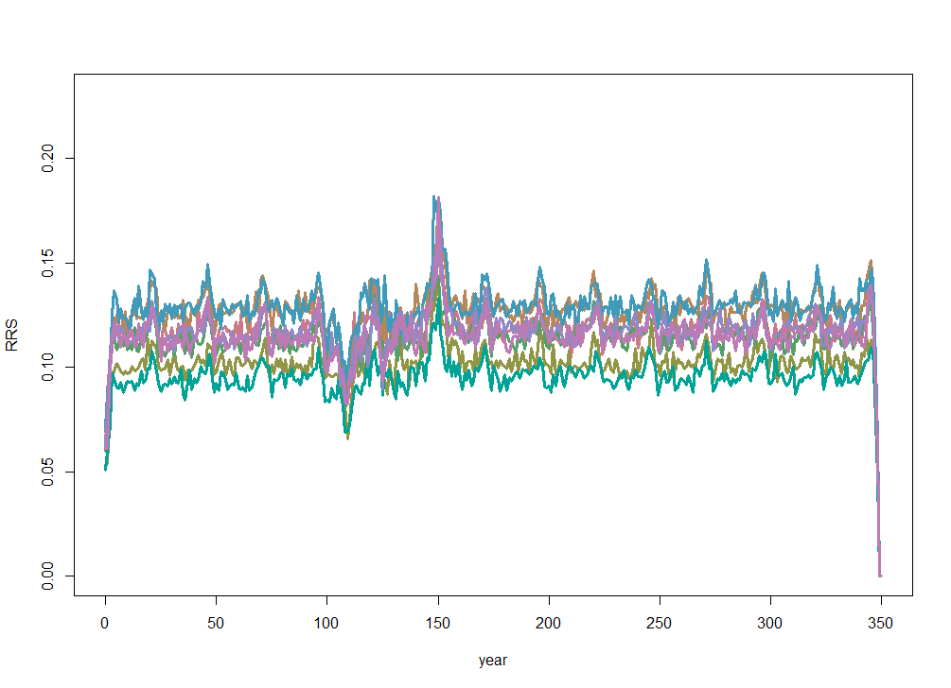
551595:551599 | ABMrun_3.1.23_a | y | y | y | y | 0, a, d | 0.45 - 0.55 | 0.07 | 1 | 700 | 1000 | 1000 | 10 | 40 | 9 | 2 | 1 | 350 | 1 |  | 100 | 0
551600:551604 | ABMrun_3.1.23_b | y | y | y | y | b, c, e | 0.45 - 0.55 | 0.07 | 1 | 700 | 1000 | 1000 | 10 | 40 | 9 | 2 | 1 | 350 | 1 |  | 100 | 0
551650:551654 | ABMrun_3.1.23_g | y | y | y | y | b, c | 0.45 - 0.55 | 0.07 | 1 | 700 | 1000 | 1000 | 10 | 40 | 9 | 2 | 1 | 350 | 1 |  | 100 | 0

Slide 3
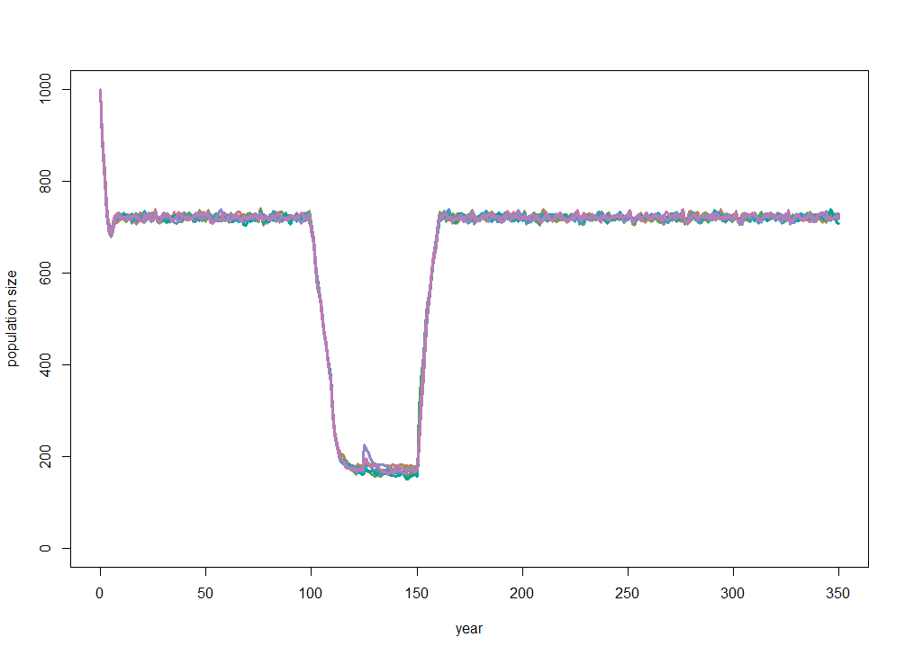
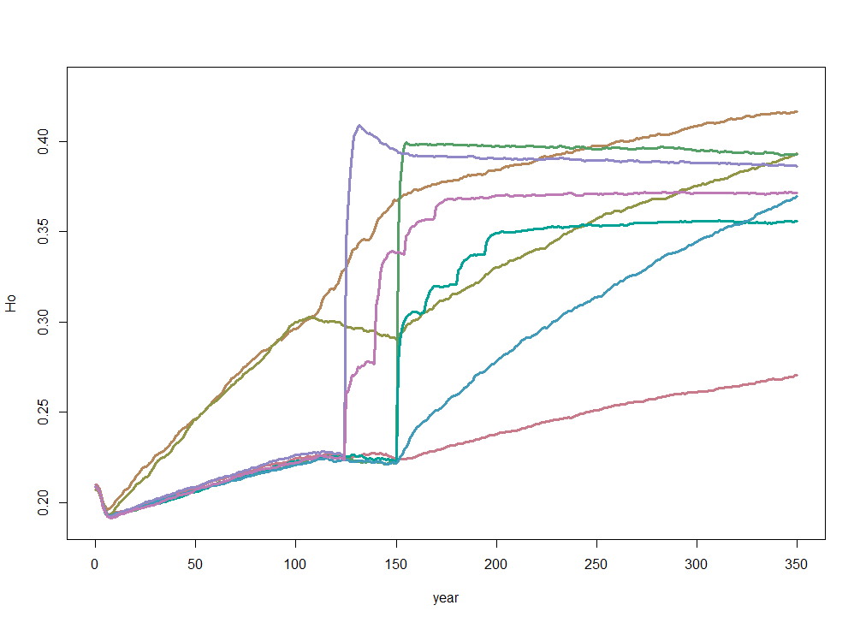
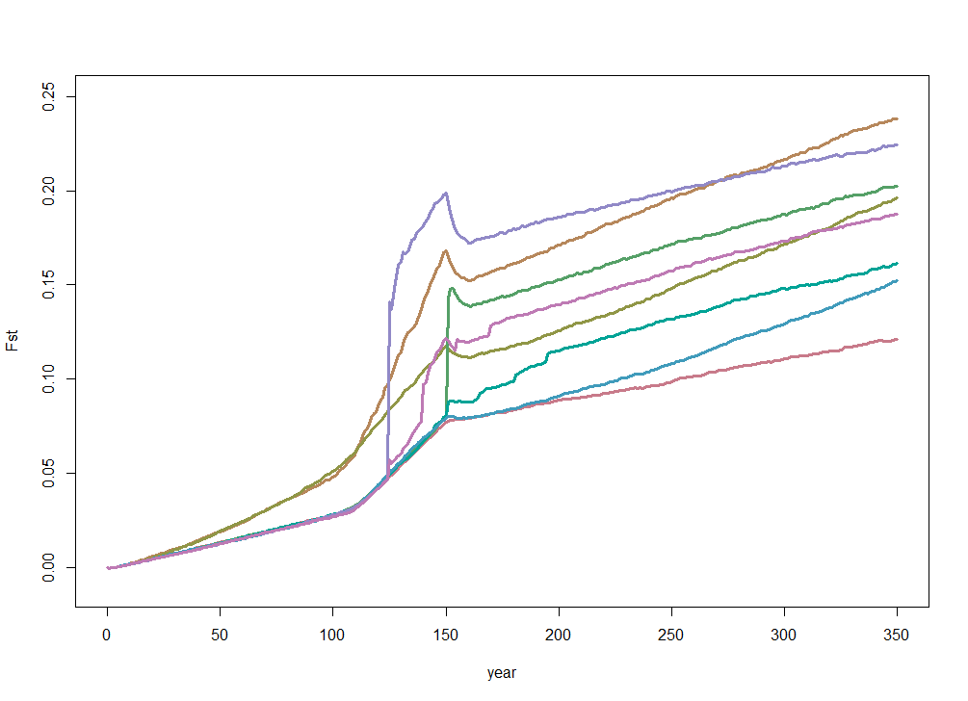
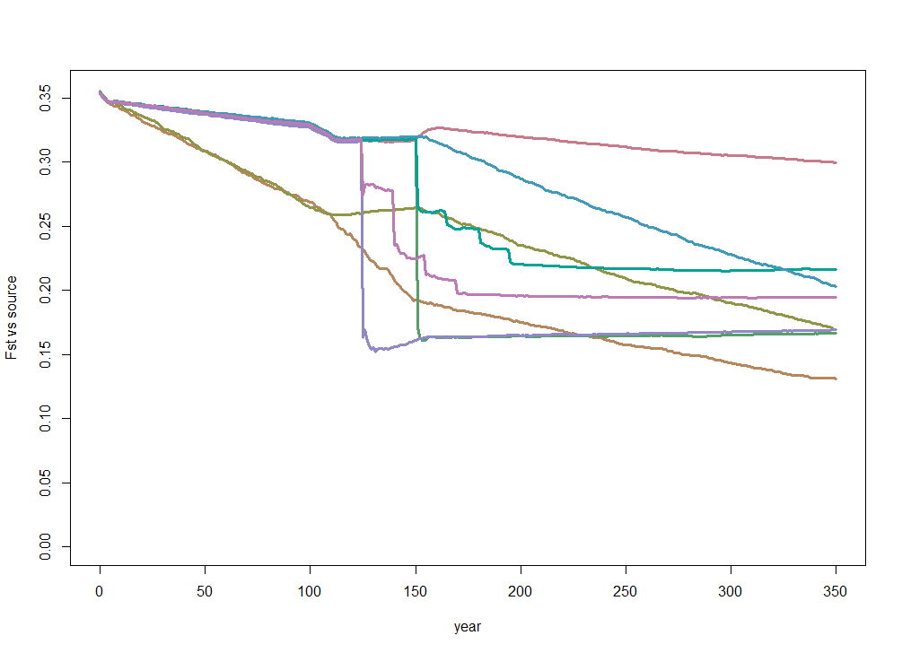
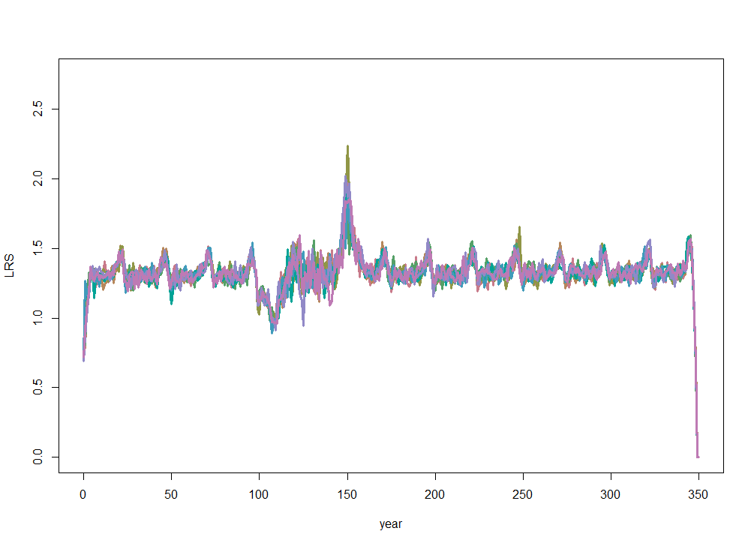
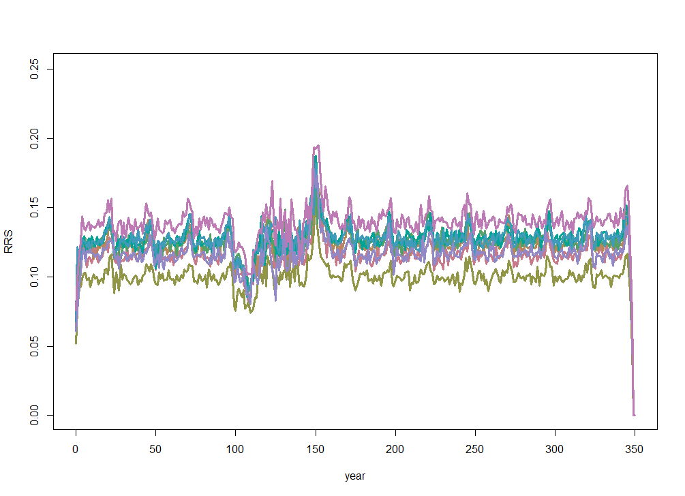
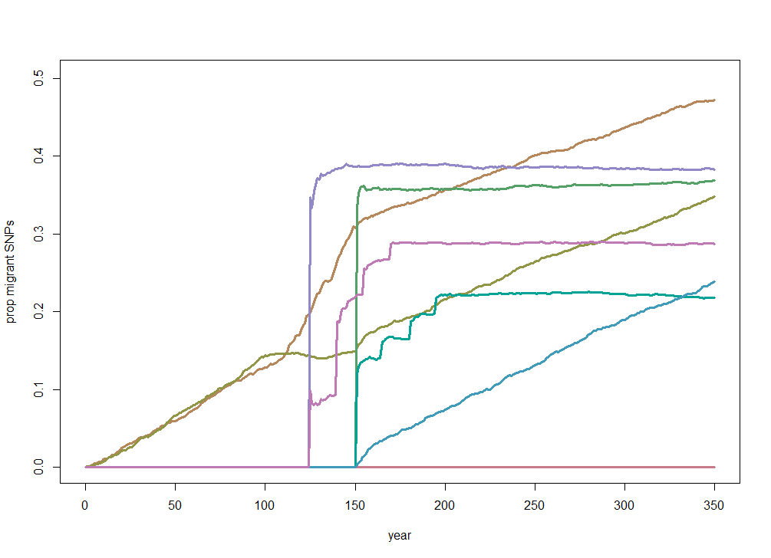
ABMrun_3.1.23_c | y | y | y | y | 0, a, d | 0.45 - 0.55 | 0.07 | 1 | 500 | 1000 | 1000 | 10 | 40 | 9 | 2 | 1 | 350 | 1
ABMrun_3.1.23_d | y | y | y | y | b, c, e | 0.45 - 0.55 | 0.07 | 1 | 500 | 1000 | 1000 | 10 | 40 | 9 | 2 | 1 | 350 | 1
ABMrun_3.1.23_h | y | y | y | y | b, c | 0.45 - 0.55 | 0.07 | 1 | 500 | 1000 | 1000 | 10 | 40 | 9 | 2 | 1 | 350 | 1

Slide 4
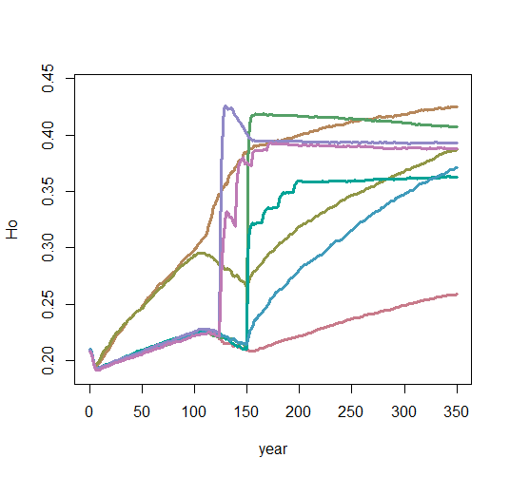
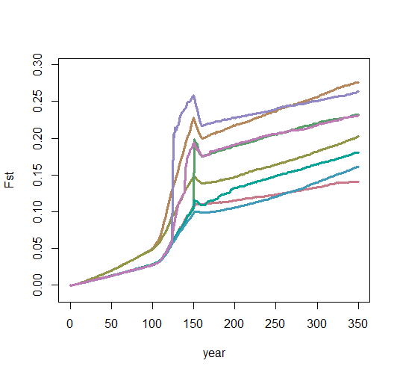
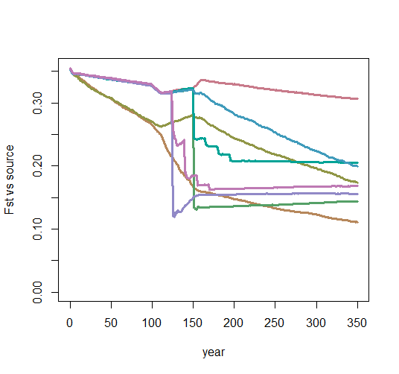
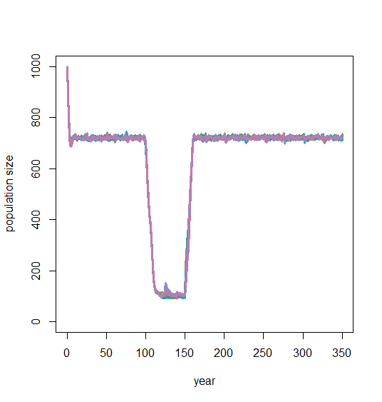
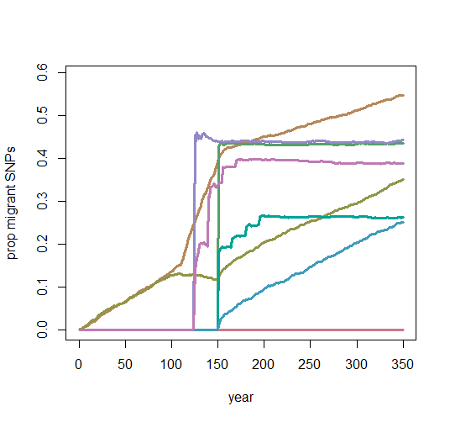
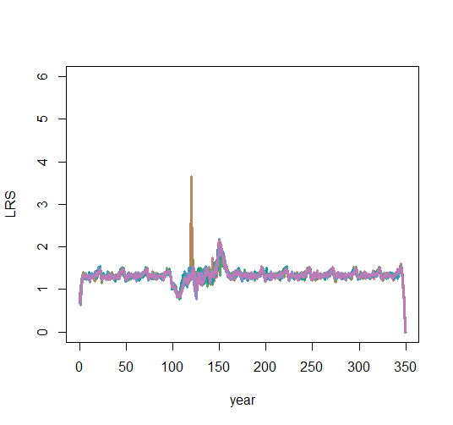
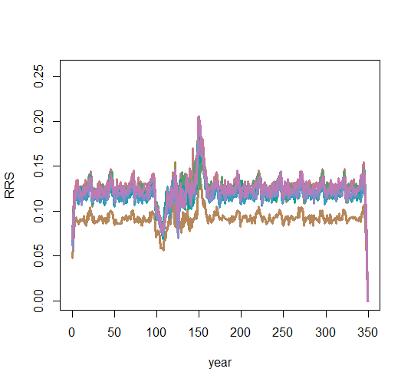
ABMrun_3.1.23_e | y | y | y | y | 0, a, d | 0.45 - 0.55 | 0.07 | 1 | 300 | 1000 | 1000 | 10 | 40 | 9 | 2 | 1 | 350 | 1 |  | 100 | 0
ABMrun_3.1.23_f | y | y | y | y | b, c, e | 0.45 - 0.55 | 0.07 | 1 | 300 | 1000 | 1000 | 10 | 40 | 9 | 2 | 1 | 350 | 1 |  | 100 | 0 | migb = 100@151, migc=25@151, 165, 181, 195; transloc AFTER habitat is restored
ABMrun_3.1.23_i | y | y | y | y | b, c | 0.45 - 0.55 | 0.07 | 1 | 300 | 1000 | 1000 | 10 | 40 | 9 | 2 | 1 | 350 | 1 |  | 100 | 0 | migb = 100@125, migc=25@125, 140, 155, 170; trans WHILE habitat quality is LOW

Slide 5
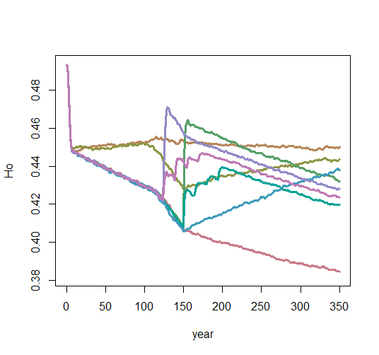
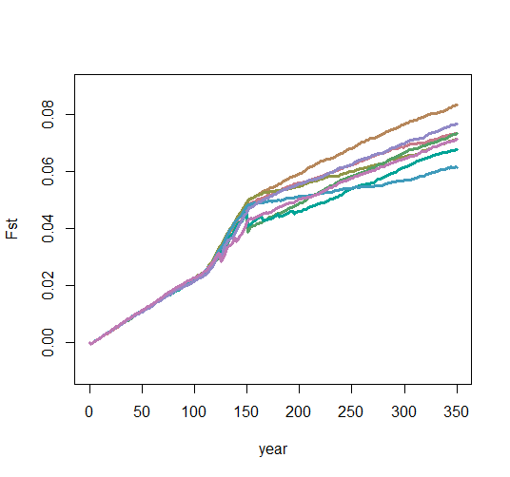
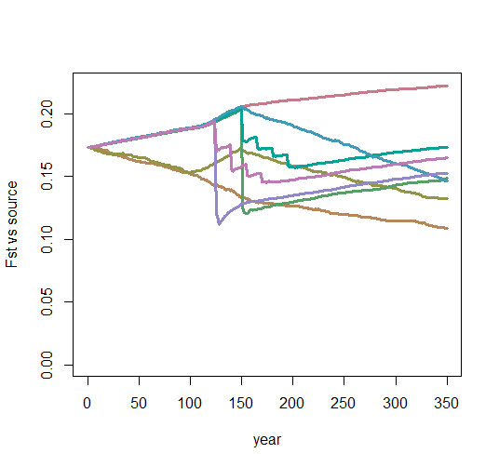
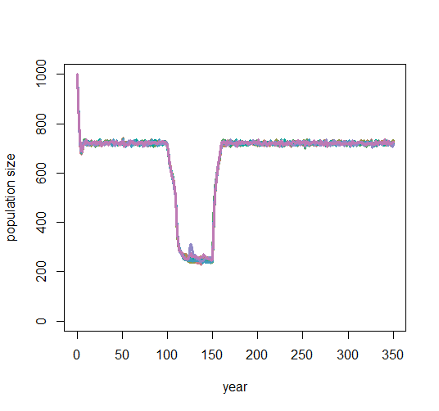
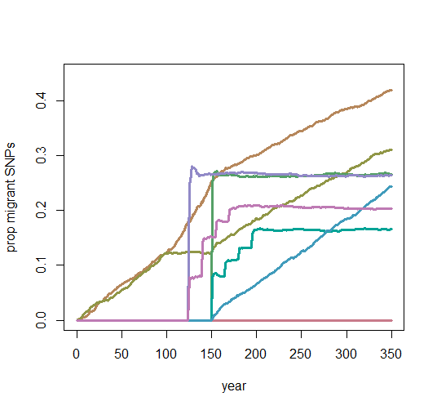
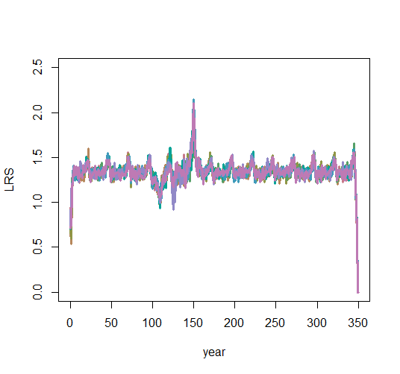
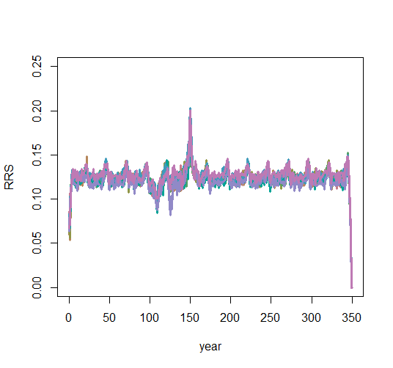
ABMrun_3.3.23_a | y | y | y | y | 0, a, d | 0.45 - 0.55 | 0.4-0.5 | 1 | 700 | 1000 | 1000 | 10 | 40 | 9 | 2 | 1 | 350 | 1
ABMrun_3.3.23_b | y | y | y | y | b, c, e | 0.45 - 0.55 | 0.4-0.5 | 1 | 700 | 1000 | 1000 | 10 | 40 | 9 | 2 | 1 | 350 | 1
ABMrun_3.3.23_g | y | y | y | y | b, c | 0.45 - 0.55 | 0.4-0.5 | 1 | 700 | 1000 | 1000 | 10 | 40 | 9 | 2 | 1 | 350 | 1

Slide 6
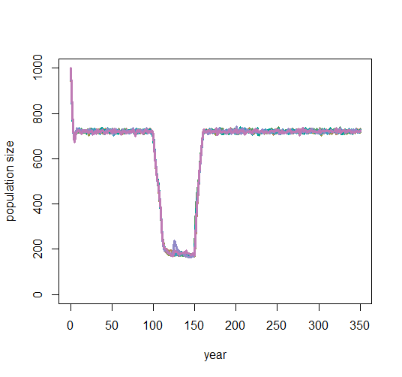
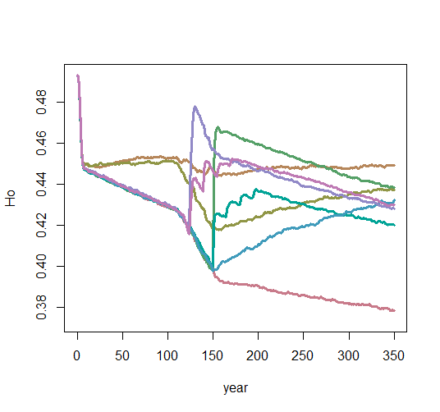
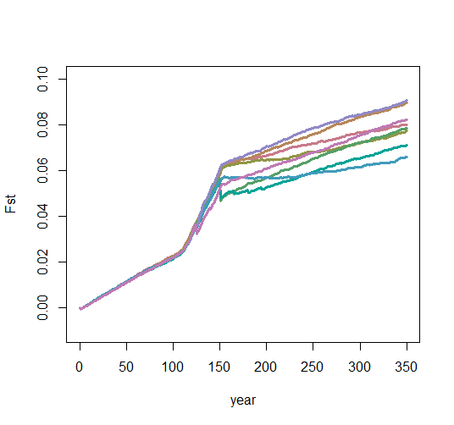
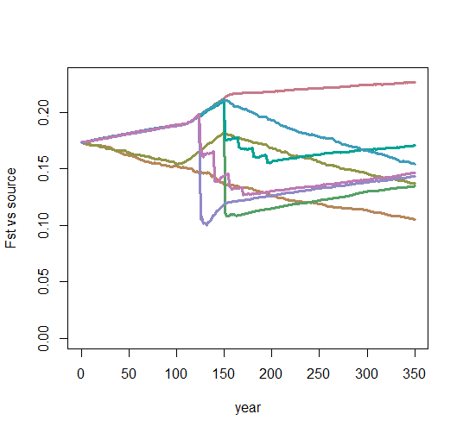
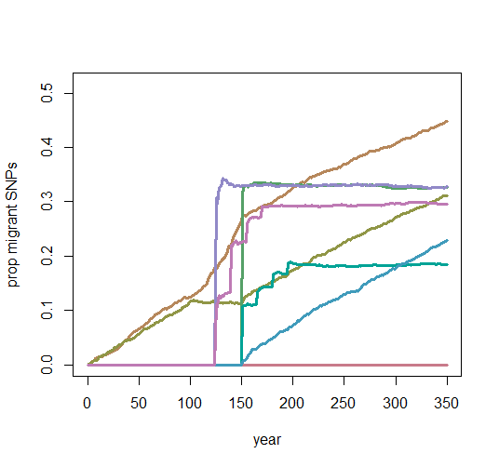
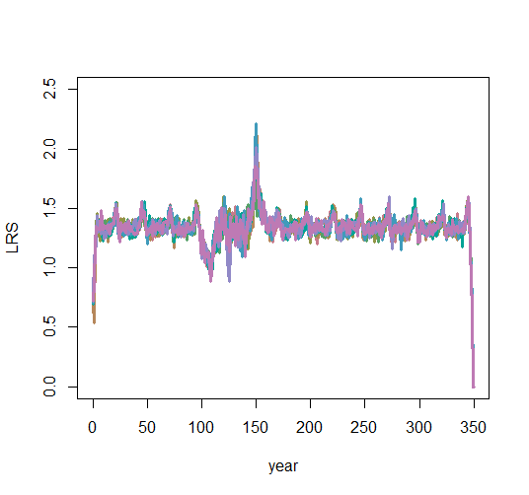
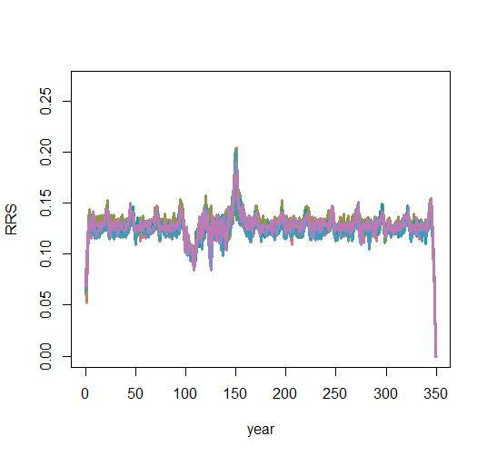
ABMrun_3.3.23_c | y | y | y | y | 0, a, d | 0.45 - 0.55 | 0.4-0.5 | 1 | 500 | 1000 | 1000 | 10 | 40 | 9 | 2 | 1 | 350 | 1 |  | 100 | 0
ABMrun_3.3.23_d | y | y | y | y | b, c, e | 0.45 - 0.55 | 0.4-0.5 | 1 | 500 | 1000 | 1000 | 10 | 40 | 9 | 2 | 1 | 350 | 1 |  | 100 | 0 | migb = 100@151, migc=25@151, 165, 181, 195; transloc AFTER habitat is restored
ABMrun_3.3.23_h | y | y | y | y | b, c | 0.45 - 0.55 | 0.4-0.5 | 1 | 500 | 1000 | 1000 | 10 | 40 | 9 | 2 | 1 | 350 | 1 |  | 100 | 0 | migb = 100@125, migc=25@125, 140, 155, 170; trans WHILE habitat quality is LOW

Slide 7
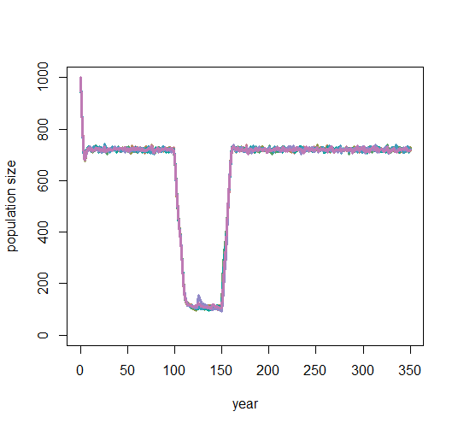
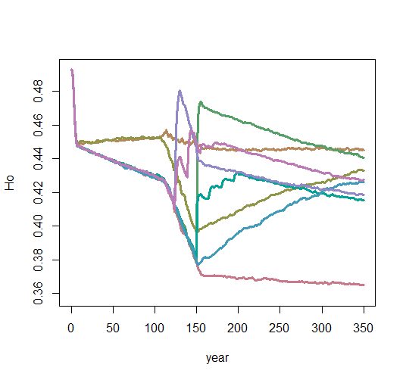
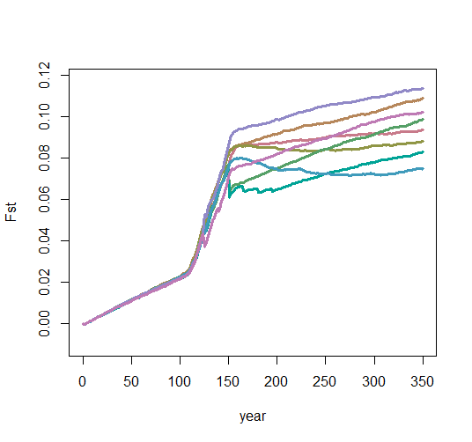
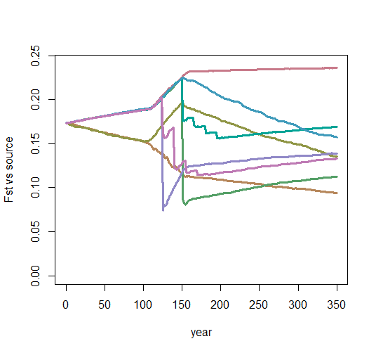
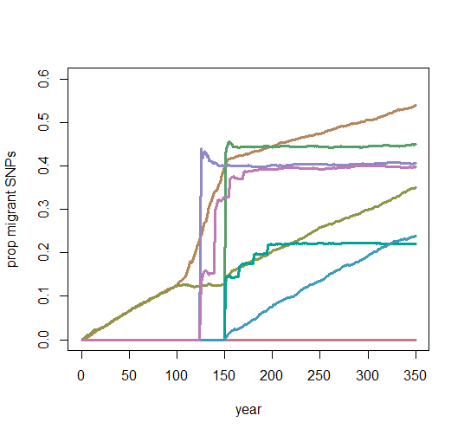
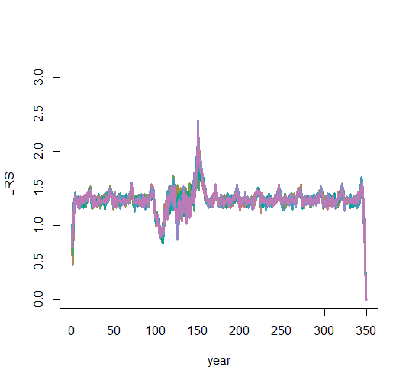
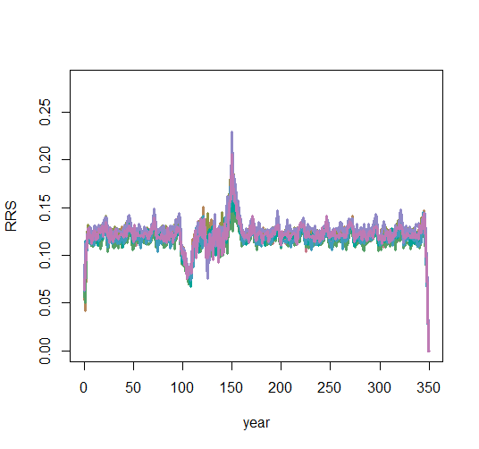
ABMrun_3.3.23_e | y | y | y | y | 0, a, d | 0.45 - 0.55 | 0.4-0.5 | 1 | 300 | 1000 | 1000 | 10 | 40 | 9 | 2 | 1 | 350 | 1 |  | 100 | 0
ABMrun_3.3.23_f | y | y | y | y | b, c, e | 0.45 - 0.55 | 0.4-0.5 | 1 | 300 | 1000 | 1000 | 10 | 40 | 9 | 2 | 1 | 350 | 1 |  | 100 | 0 | migb = 100@151, migc=25@151, 165, 181, 195; transloc AFTER habitat is restored
ABMrun_3.3.23_i | y | y | y | y | b, c | 0.45 - 0.55 | 0.4-0.5 | 1 | 300 | 1000 | 1000 | 10 | 40 | 9 | 2 | 1 | 350 | 1 |  | 100 | 0 | migb = 100@125, migc=25@125, 140, 155, 170; trans WHILE habitat quality is LOW

