Slide 1
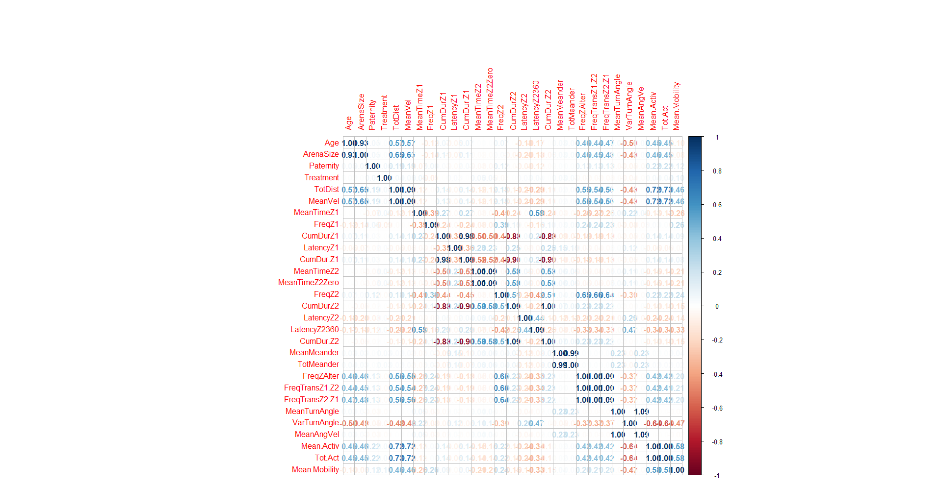
Notes:
Correlation plot – 5.30.23 – goal is to figure out what variables are worth keeping as personality traits, and which are they correlated to

Slide 2
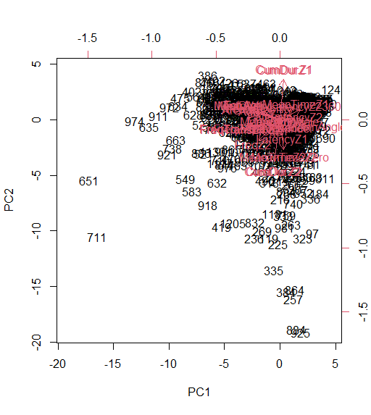
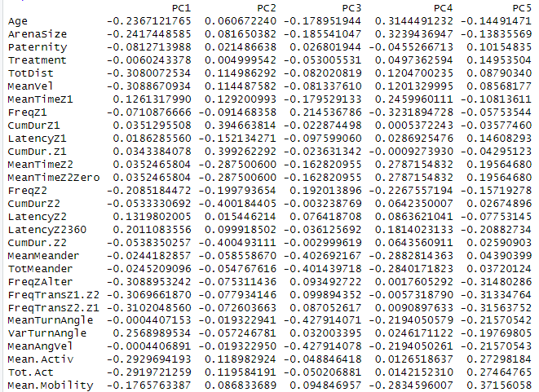
PCA plots – all ages

Slide 3
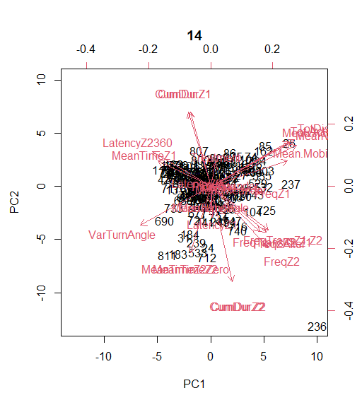
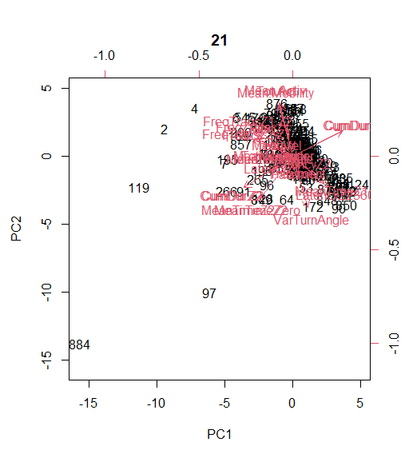
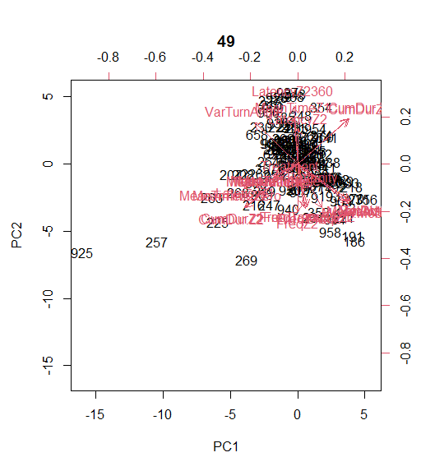
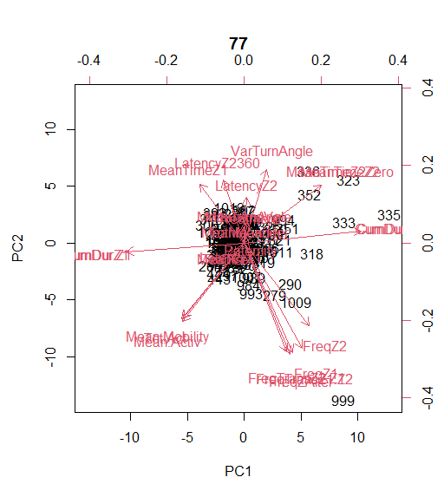
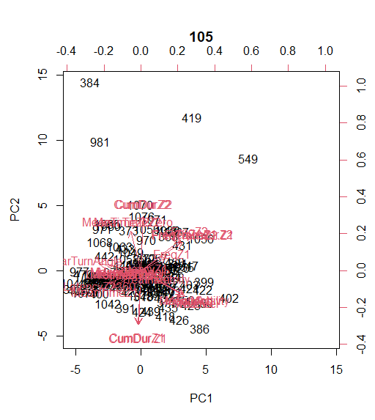
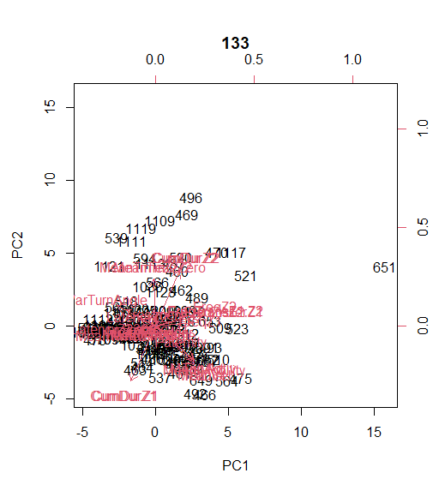
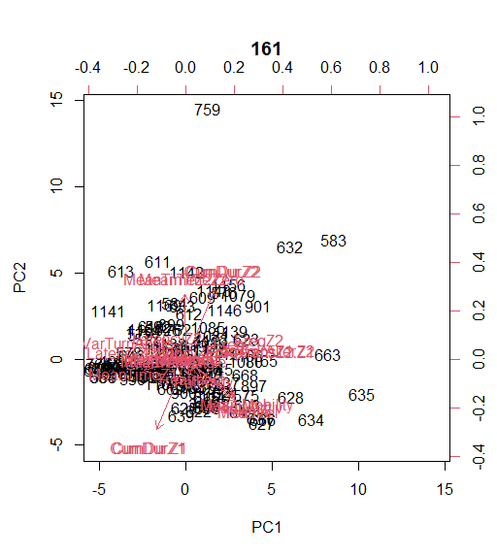
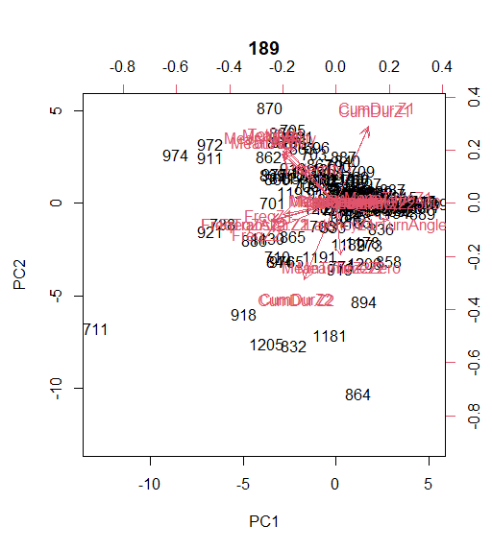
PCA by ages

Slide 4
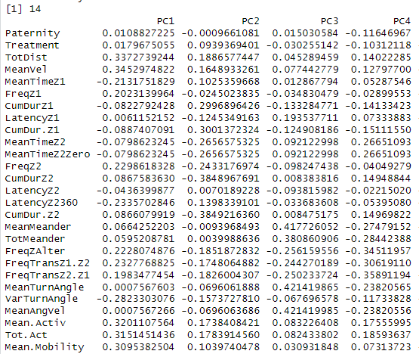
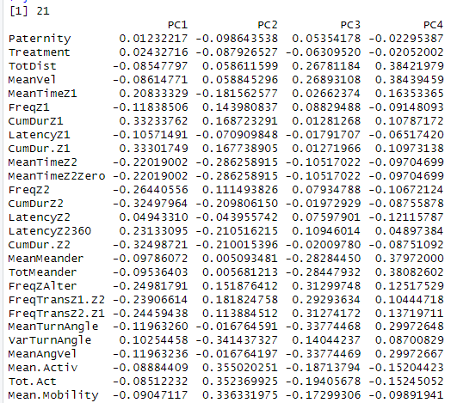
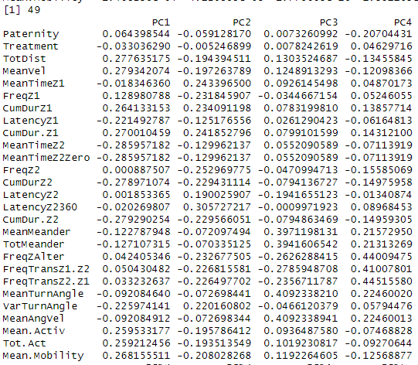
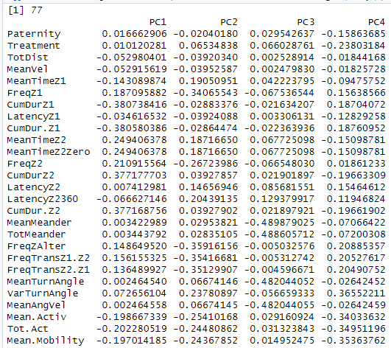
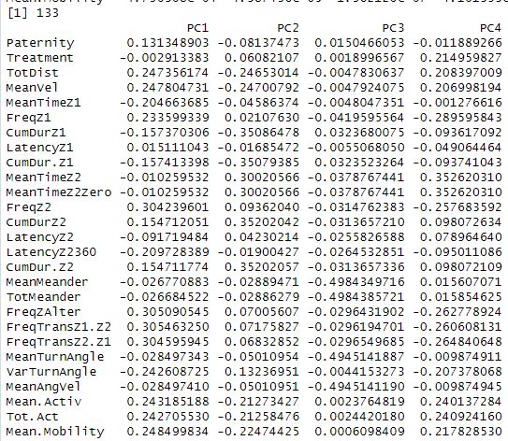
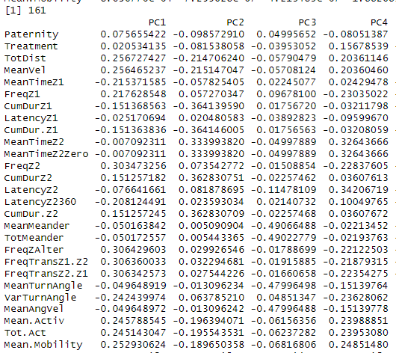
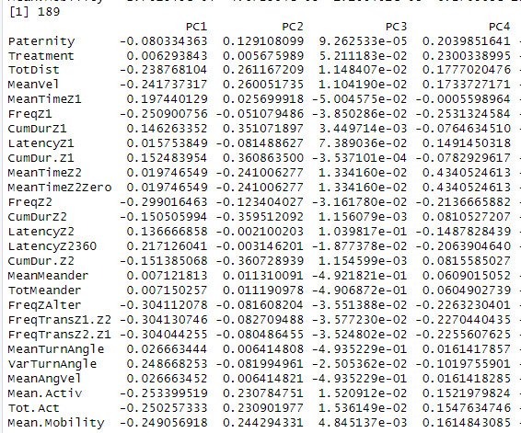
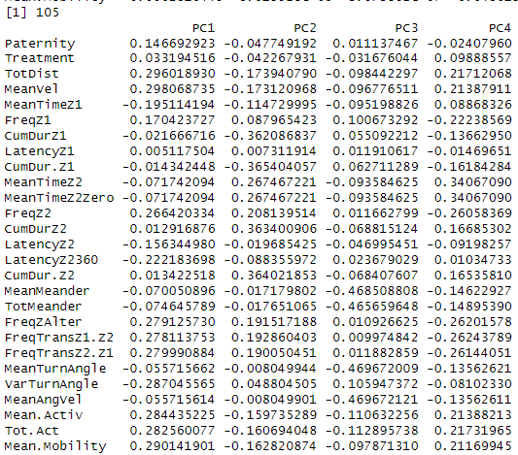

Slide 5
Personality, Spinning, and Embryo Data!
Data taken 2018-2020, reworked in 2023!
R code and Datasets:
Embryo
EmbryoData.R setwd("C:/Users/ginab/Box/Old Computer/Grad School/BALL STATE/Thesis/Embryo") bro=read.csv("BMAA_EmbryoData_Raw2023.csv",header=TRUE)
Spinning
SpinningTask.R setwd("C:/Users/ginab/Box/Old Computer/Grad School/BALL STATE/Thesis/Spinning") sp=read.csv("SpinningTaskV1.csv",header=TRUE)
Etho (personality)
EthoData.R setwd("C:/Users/ginab/Box/Old Computer/Grad School/BALL STATE/Thesis/Etho") etho=read.csv("EthoData.csv",header=TRUE)

Slide 6
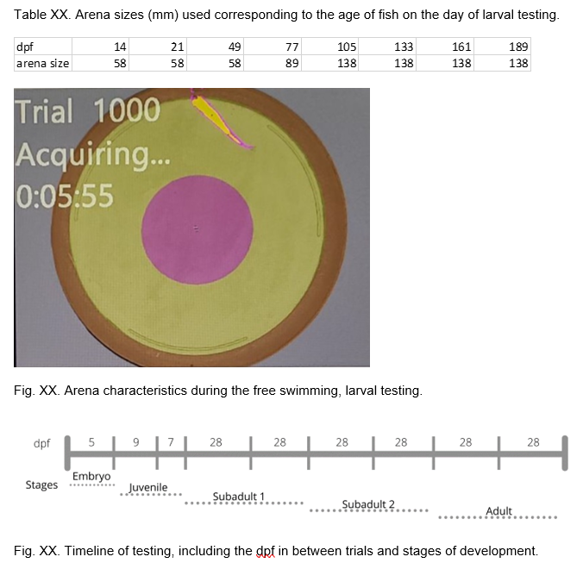

Slide 7
Etho Data
(with all indv, not just those that survived entire experiment)

Slide 8
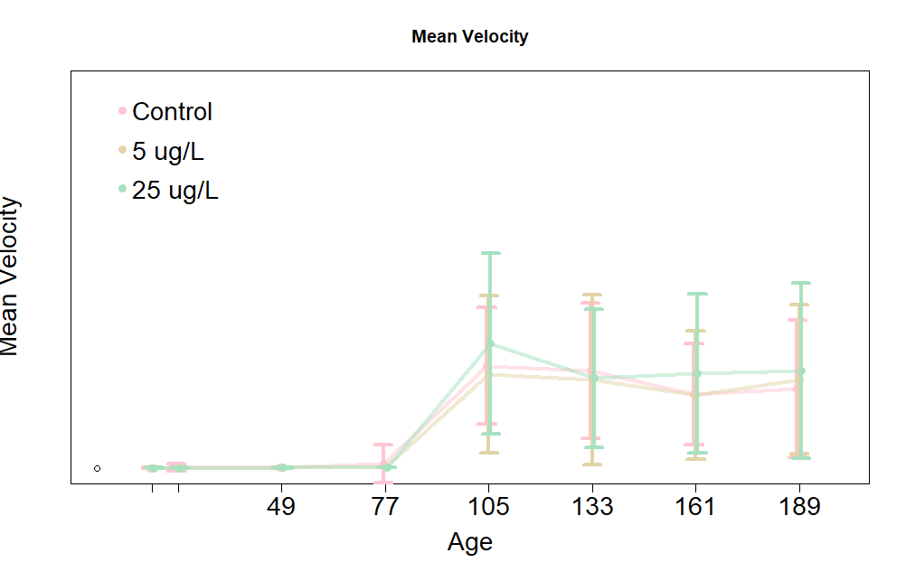
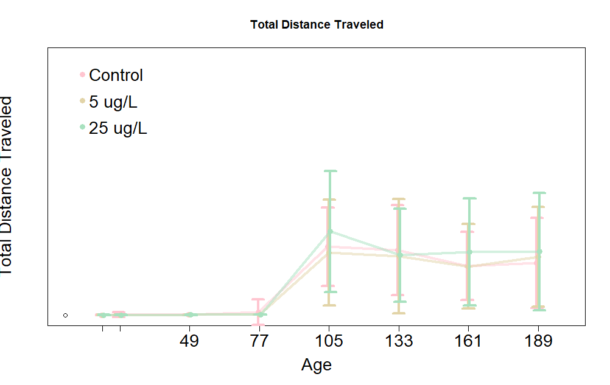
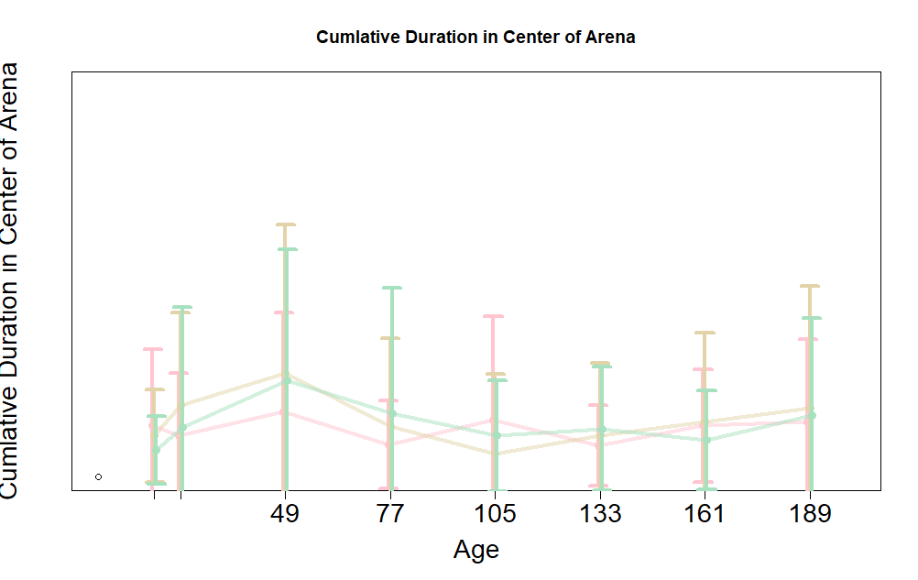
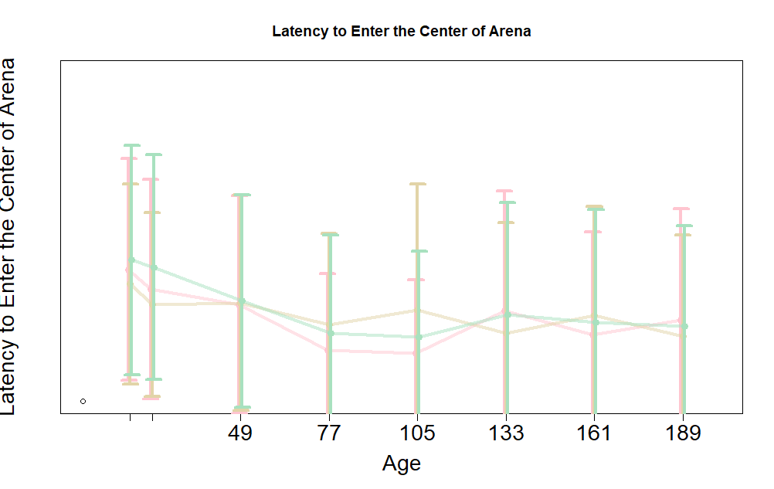

Slide 9
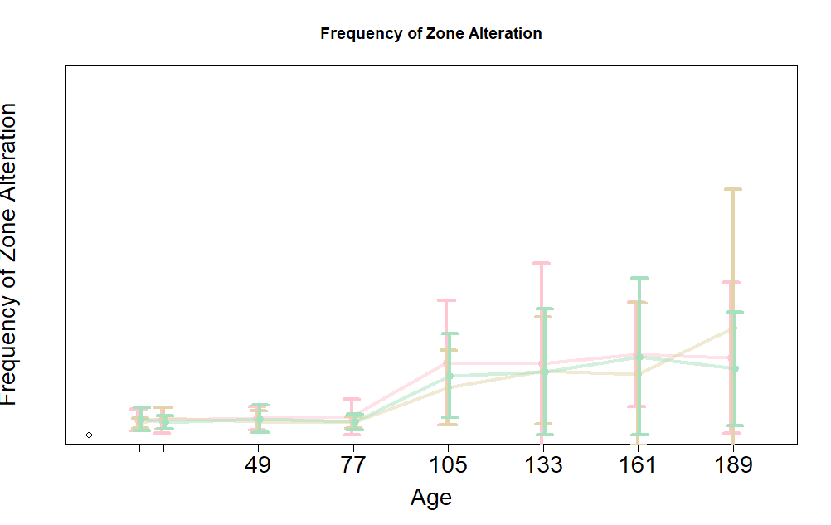
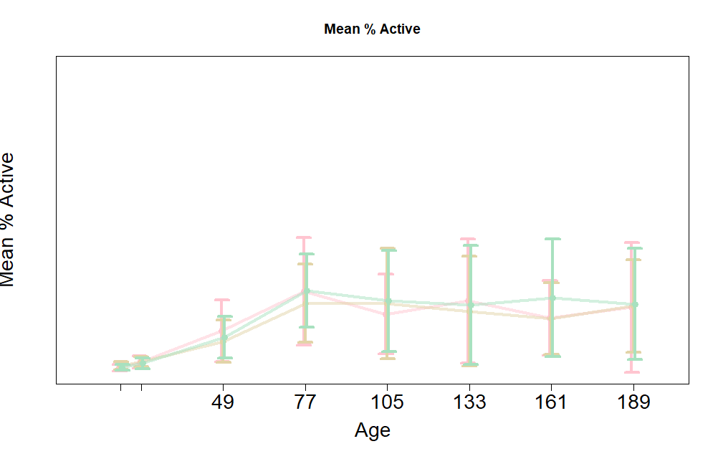
No significant differences due to treatment, significant due to age only
c6 <- lmer( (TotDist)~Treatment+Age+(1|FishName), data = all)
c1 <- lmer(LatencyZ2360~Treatment+(1|FishName)+(Age), data = all)
c1 <- lmer(Tot.Act~Treatment+(1|FishName)+(Age), data = all)

Slide 10
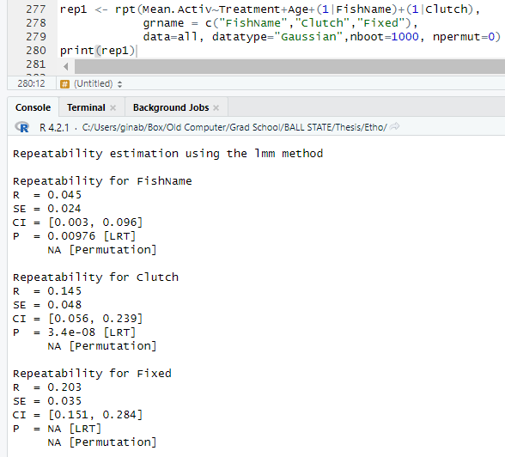
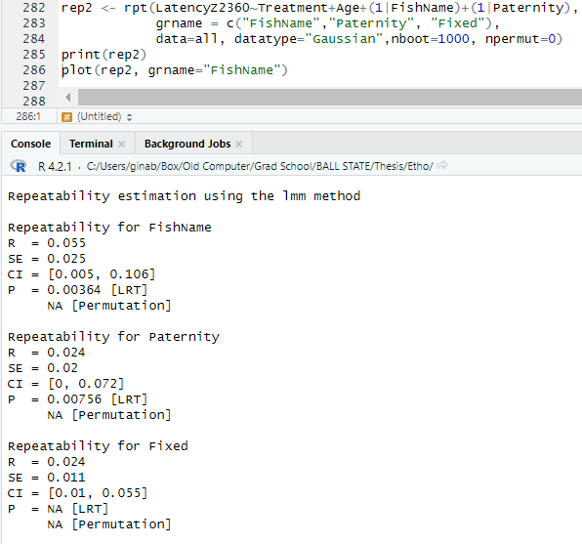
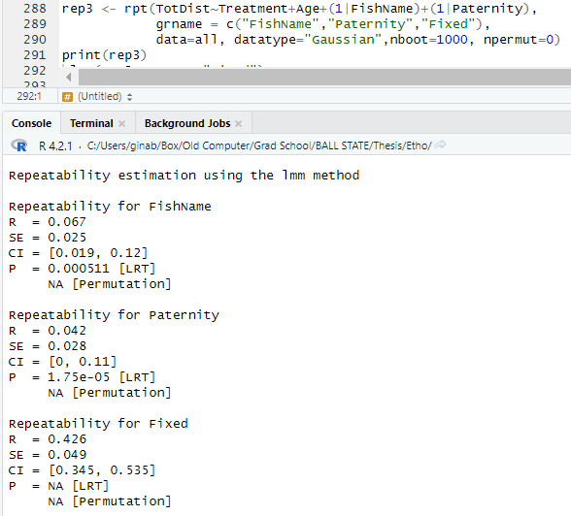

Slide 11
Spinning Task Data
(with all indv, not just those that survived entire experiment)

Slide 12
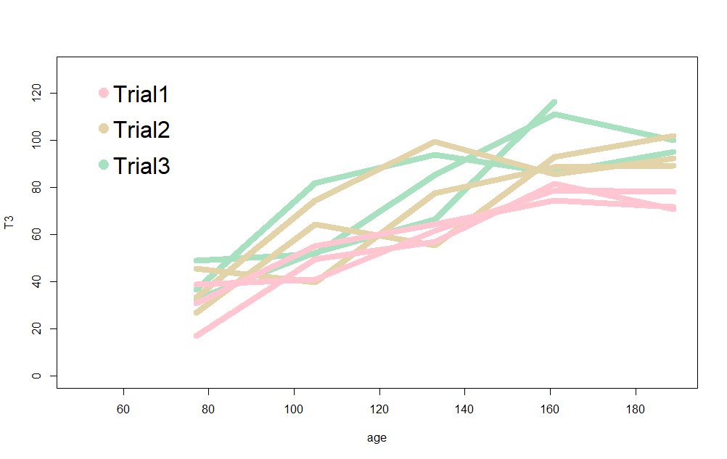
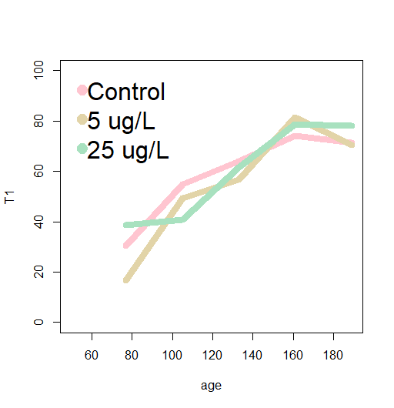
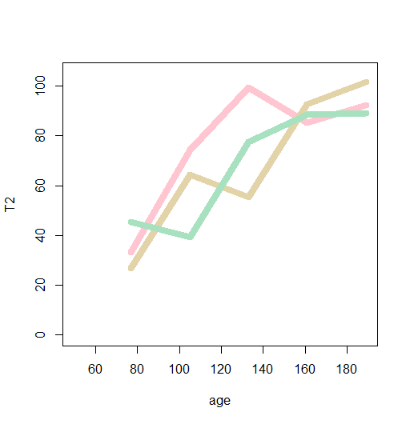
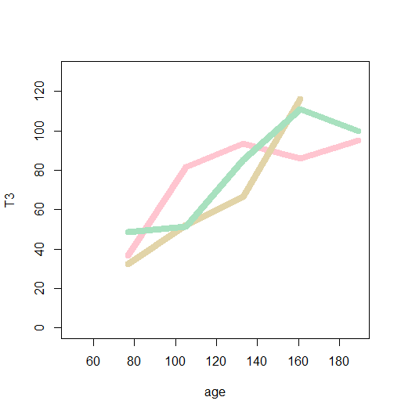

Slide 13
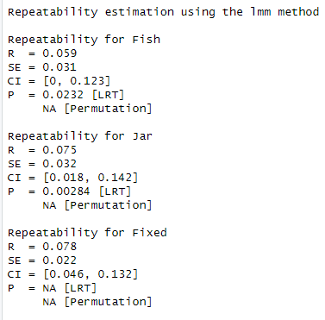
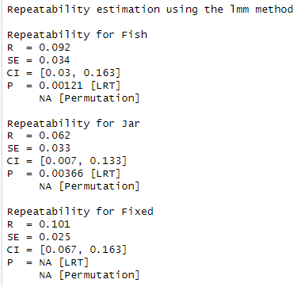
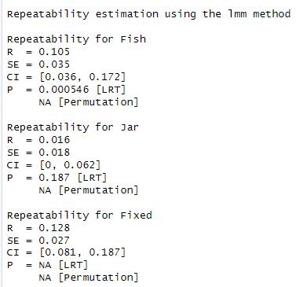
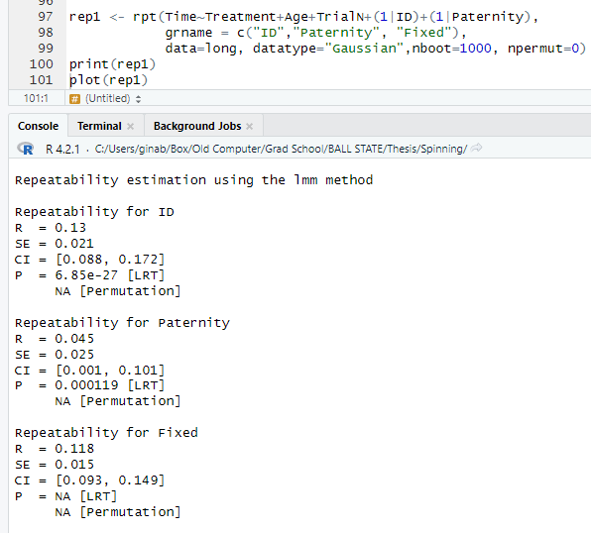
Trial 1
Trial 2
Trial 3

Slide 14
Embryo Data
(with all indv, not just those that survived entire experiment)

Slide 15
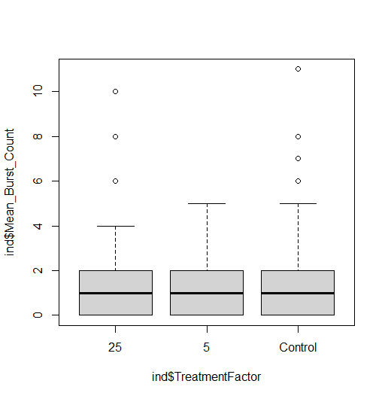
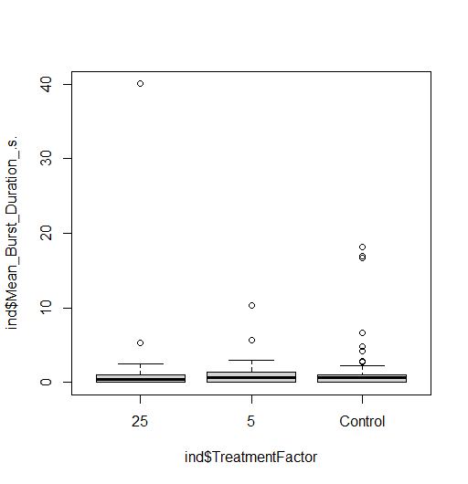
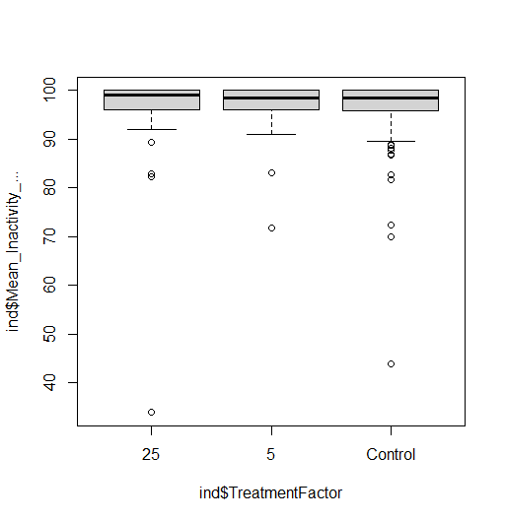
No significant effects of treatment on
Mean Burst Count
Mean Burst Duration
Mean Inactivity %
(this is also true when including
all treatments and all embryos tested,
including those in the group experiments)

