Slide 1
HOUSEHOLD PULSE SURVEY
GKJB

Slide 2
INTRODUCTION
The Household Pulse Survey is a 20-minute online survey, conducted by the Census Bureau, studying how the coronavirus pandemic and other emergent issues are impacting households across the country from a social and economic perspective.
The information we used was scrubbed of all identifiable characteristics to protect to identity of survey respondents and released for public use.

Slide 3
Data Selection and Cleaning
We reviewed survey data from December 29, 2021- January 4, 2023.
Each survey has a 1-4 scale for frequency of anxiety, worry, depression and lack of interest; 4 being the highest.
1: Not at all
2: Several days
3: More than half of days
4: Nearly every day
Anxiety was chosen as our primary variable for study.
Thirteen survey reports were selected that covered the year of 2022.
The data, in the form of CSV’s was trimmed, concatenated, and cleaned prepare for analysis.

Slide 4
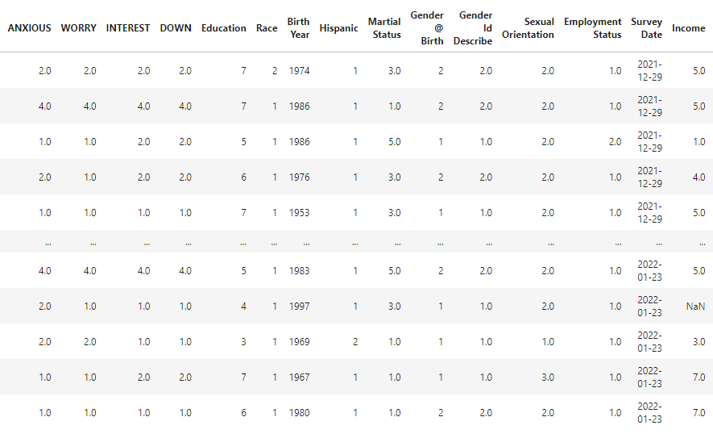
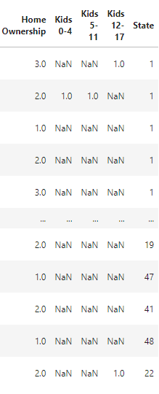
SURVEY

Slide 5
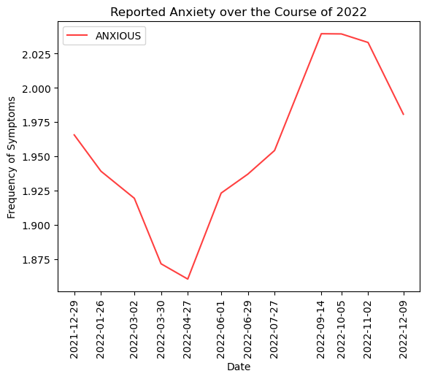
ANXIETY OVER TIME
Does reported anxiety increase during the winter?
Data was aggregated from approx. 660,000 responses over 12 surveys.
Respondents reported experiencing more anxiety between September and January than the rest of the year.

Slide 6
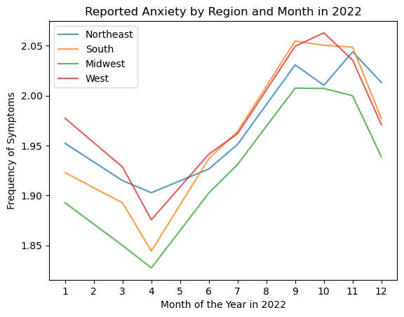
ANXIETY BY REGION
Does the “West is the Best” hold true in regards to experienced anxiety?
Means of survey reports were calculated after splitting data by region and time survey was taken.
The West region of the United States reported higher feelings of anxiety!
The Midwest reported the least.
The Northeast, interestingly, experienced higher lows and lower highs.

Slide 7
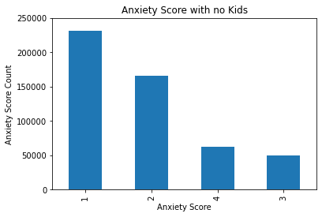
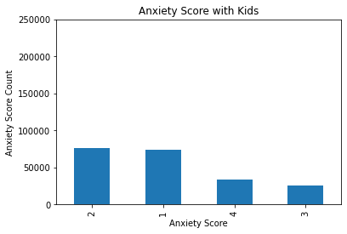
ANXIETY BY KIDS
Do people with kids have higher levels of anxiety?

Slide 8
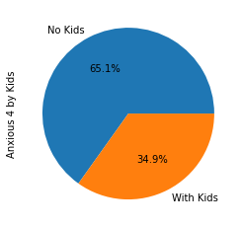
ANXIETY BY KIDS
There was a total of 509,655(70.91%) surveys reported no kids in the household and 209,098(29.09%) kids living at home between the ages of 0-17
We found that 65% people reported feeling anxious nearly everyday did not have any kids.

Slide 9
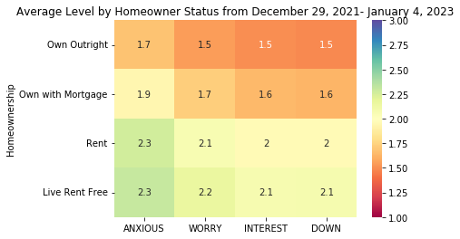
HOMEOWNERSHIP
Does Homeownership impact feelings?
The majority of survey respondents owned a home with a mortgage (308,958), and the fewest live without paying rent (8382). "Rent free" is specified that no one in the home is paying rent, so this includes people experiencing homelessness.
Across all homeownership statuses, feelings of anxiety are experienced more often than feelings of lonely, interest, and down.

Slide 10
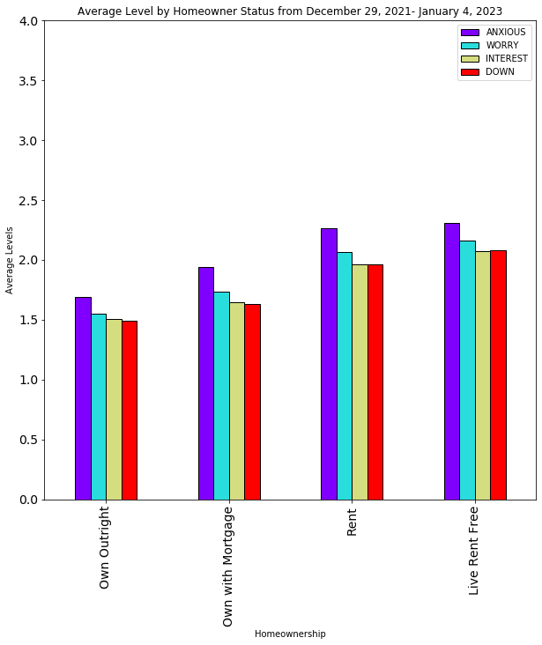
HOMEOWNERSHIP
People who own their homes outright reported feeling anxiety less frequently than others.
People who both rent and live without paying rent experience the highest instances of anxiety.

Slide 11
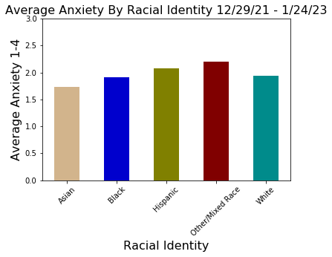
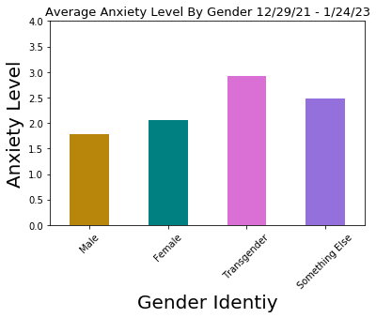
GENDER AND RACIAL IDENTITY
Does Race and Gender have a significant impact on reported anxiety?

Slide 12
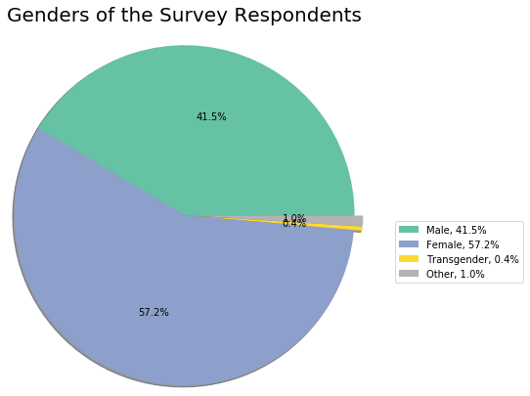
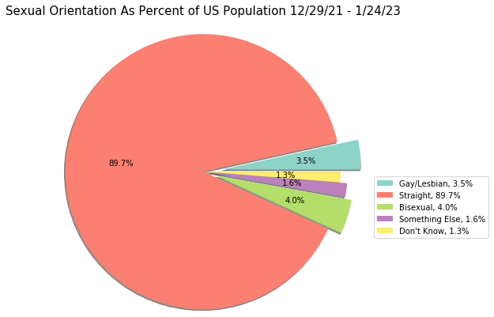
GENDER

Slide 13
SUMMARY
We each found that Anxiety was the Highest reported feeling in all categories.
It is common that symptoms of depression increase during winter/holiday months. The Midwest reported the least amount of anxiety.
The majority of survey takers did not have any children and but also reported more anxiety.
People who rent and live without paying rent experience the highest instances of anxiety.
People who identify as Bi-Racial or Race not listed reported higher feelings of anxiety.
The majority of survey identify as female.
While only 0.4% of survey takers identify as Transgender, they reported the highest levels of anxiety.
Next steps would could include a longitudinal study to include longer periods of time and possibly running surveys in other countries to see what kind of impact culture has on the conclusions we came to.

