Slide 1

Wine regions and reviews
Bootcamp Sep-2020 - March 2021
Team Members:
Georgina Guzman Rasillo
Berenice Nares
Celina Barrera
Jesús Daniel Sánchez Rómo

Slide 2
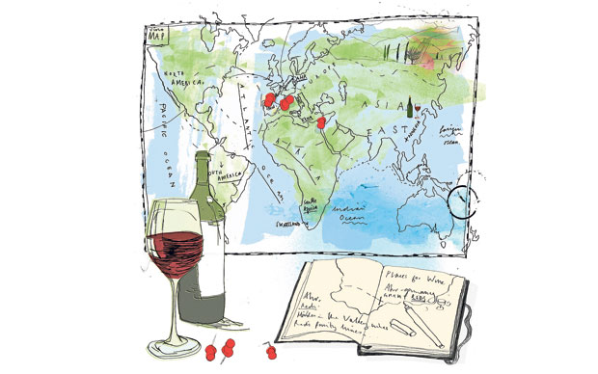
Overview
7 main producer countries
64 Provinces
1,203 wine regions
11,469 wineries around the world
36,338 vineyards
504 different types of wine.
Rated between 86 to 100 points
Min price 8 USD – Max price 478 USD

