Slide 1


Reproducible data visualization using canvasXpress
Ger Inberg - Freelance R developer
g_inberg
ginberg

Slide 2
CanvasXpress
Developed as core visualization component for bioinformatics and systems biology analysis at Bristol-Myers Squibb (Isaac Neuhaus)
Properties
Htmlwidget → Shiny, RMD, flexdashboard
Portable & Scalable
On chart functionality (transform, cluster, zoom, etc)

Slide 3
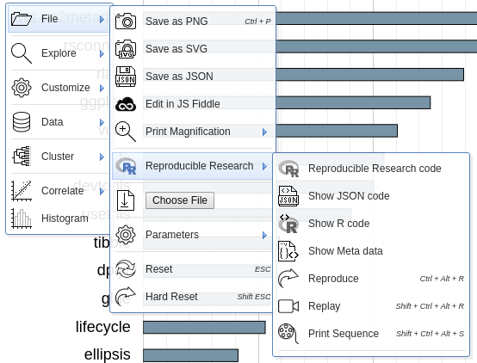
Reproducible Data Viz
Features:
Show R/JS code
Reproduce
Replay
Undo last action (Ctrl+Z)
Reset
Download chart including all actions

Slide 4
Demo & Links
Links:
canvasXpress: canvasxpress.org
github: github.com/neuhausi/canvasXpress
intro blog: bit.ly/30Qm8Us

