Slide 1
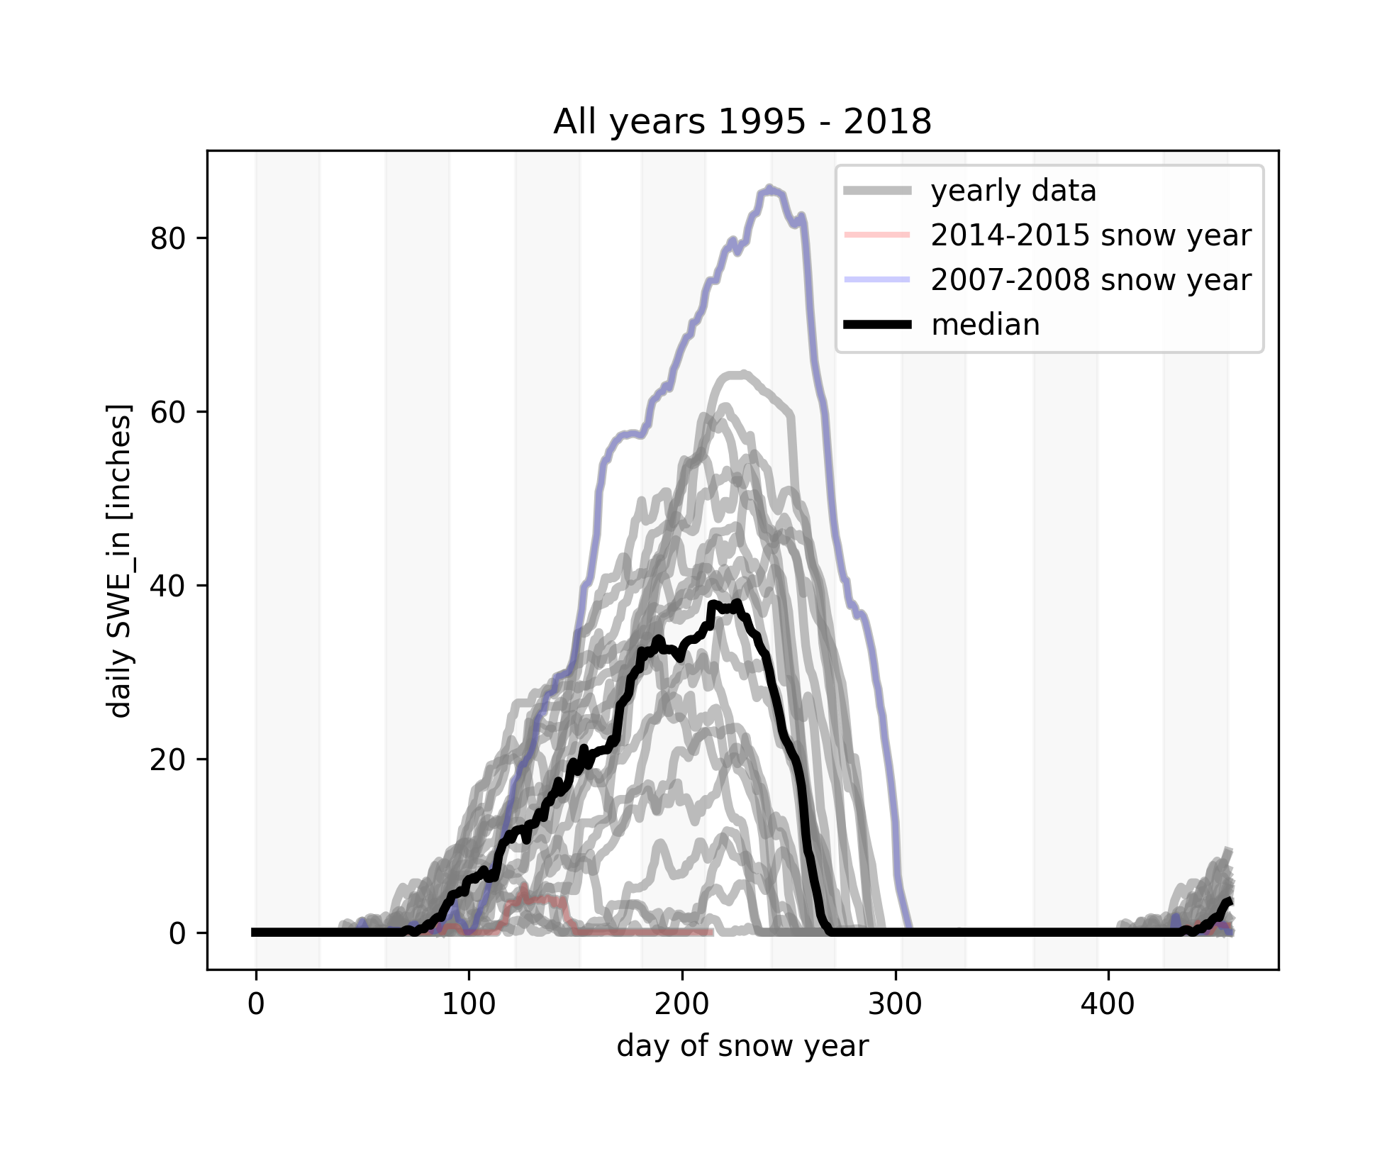
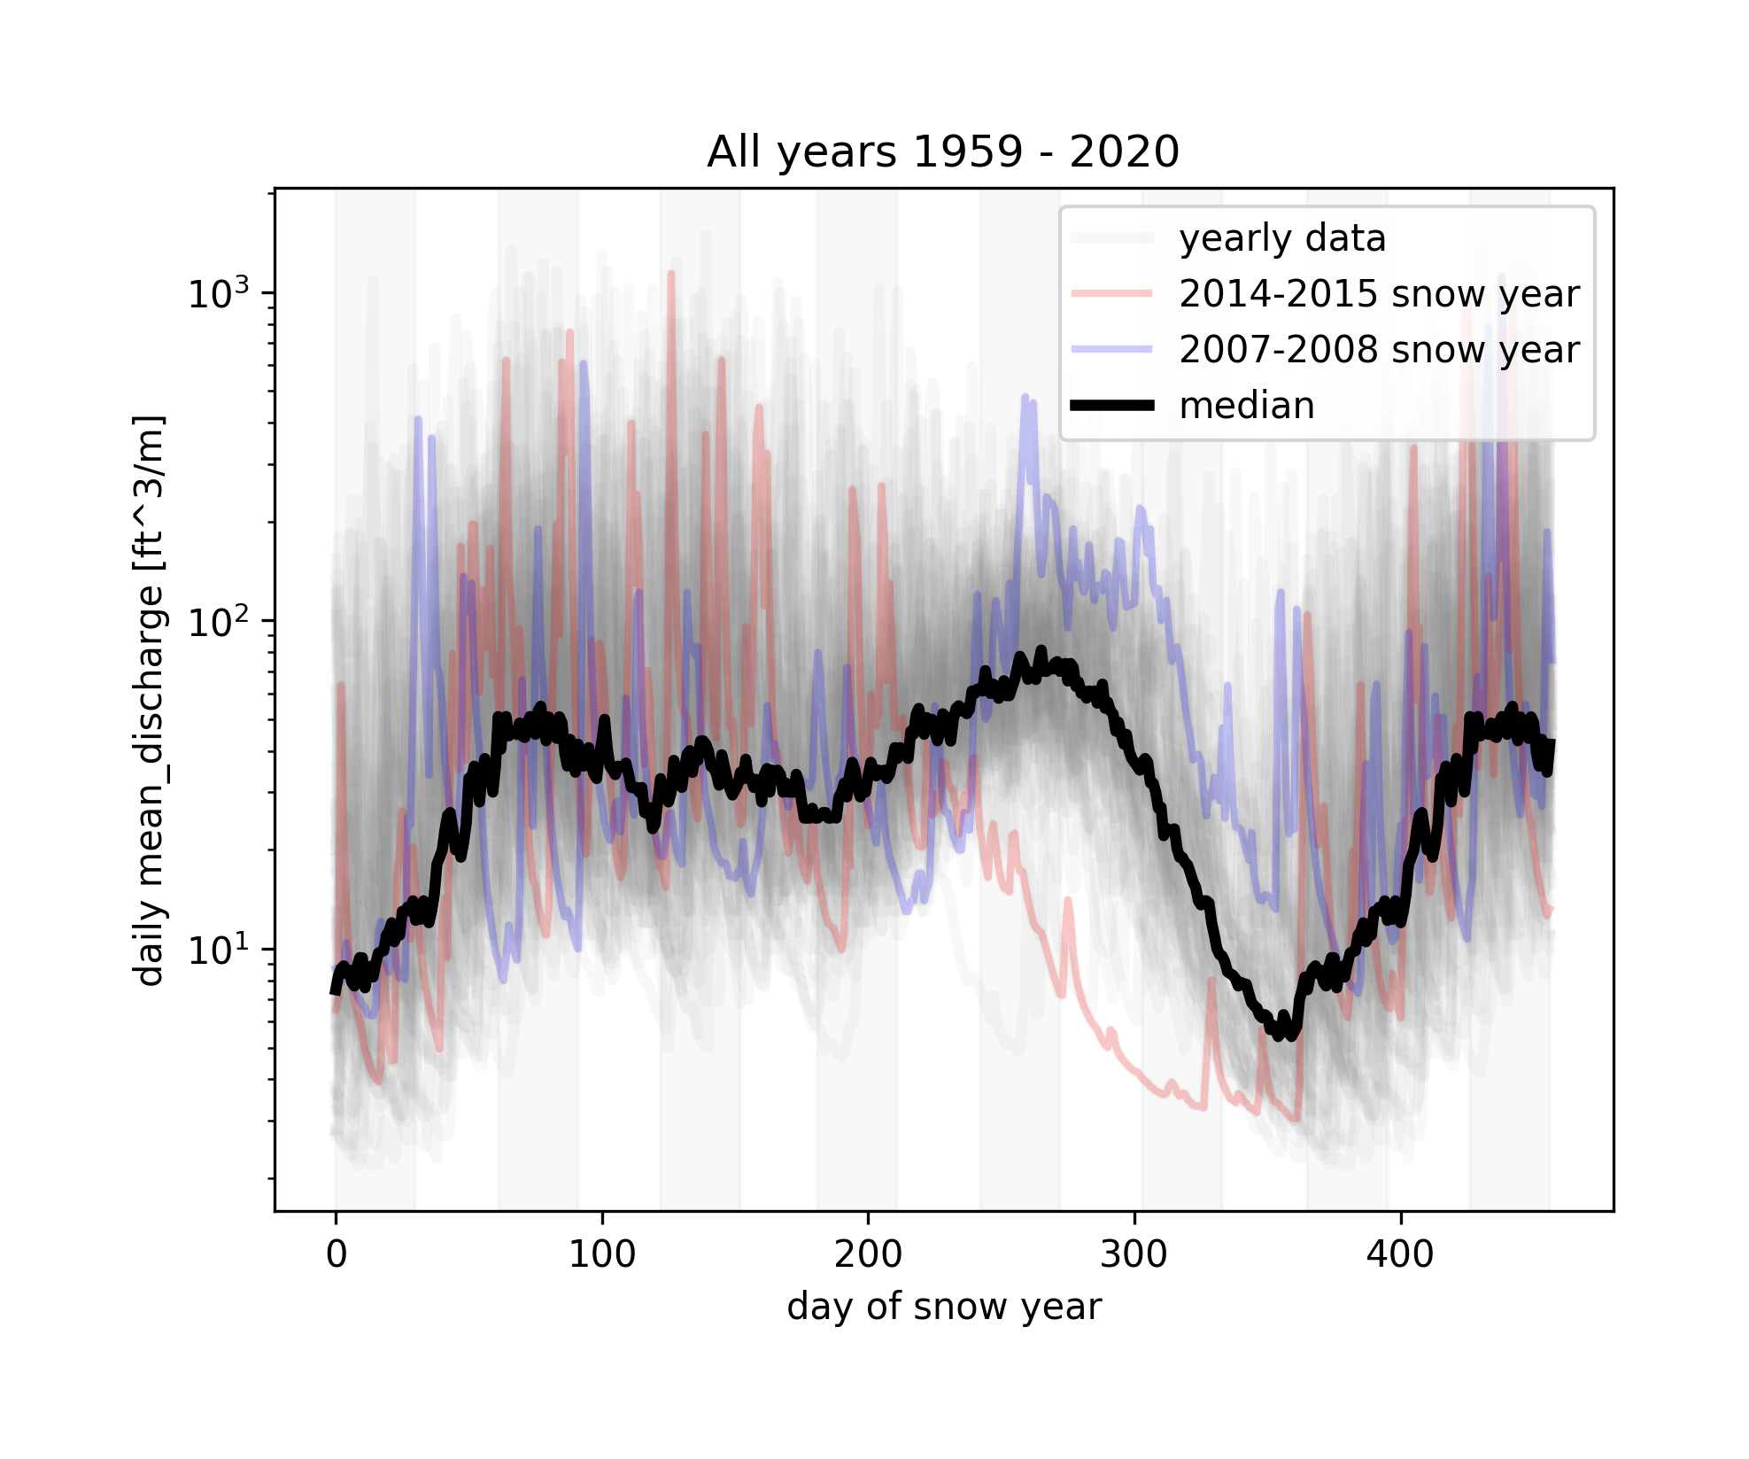
New year
New year
S
O
N
D
J
F
M
A
M
J
J
A
S
O
N
S
O
N
D
J
F
M
A
M
J
J
A
S
O
N
Notes:
python getminmax.py -op minmaxs/09.01.1959-12.01.2020.png -infile_stream /Users/ginevramoore/Desktop/CEWA568/final_project/data/all_data_12147600.csv -infile_snotel ../data/skookum_snotel.csv -b 09.01.1959 12.01.2020 -c1 mean_discharge -u1 [ft^3/m] -plothighyear y -plotlowyear y
python getminmax.py -op minmaxs/09.01.1995-12.01.2020.png -infile_stream /Users/ginevramoore/Desktop/CEWA568/final_project/data/all_data_12147600.csv -infile_snotel ../data/skookum_snotel.csv -b 09.01.1995 12.01.2018 -c1 SWE_in -u1 [inches] -nl y -plothighyear y -plotlowyear y

