Slide 1
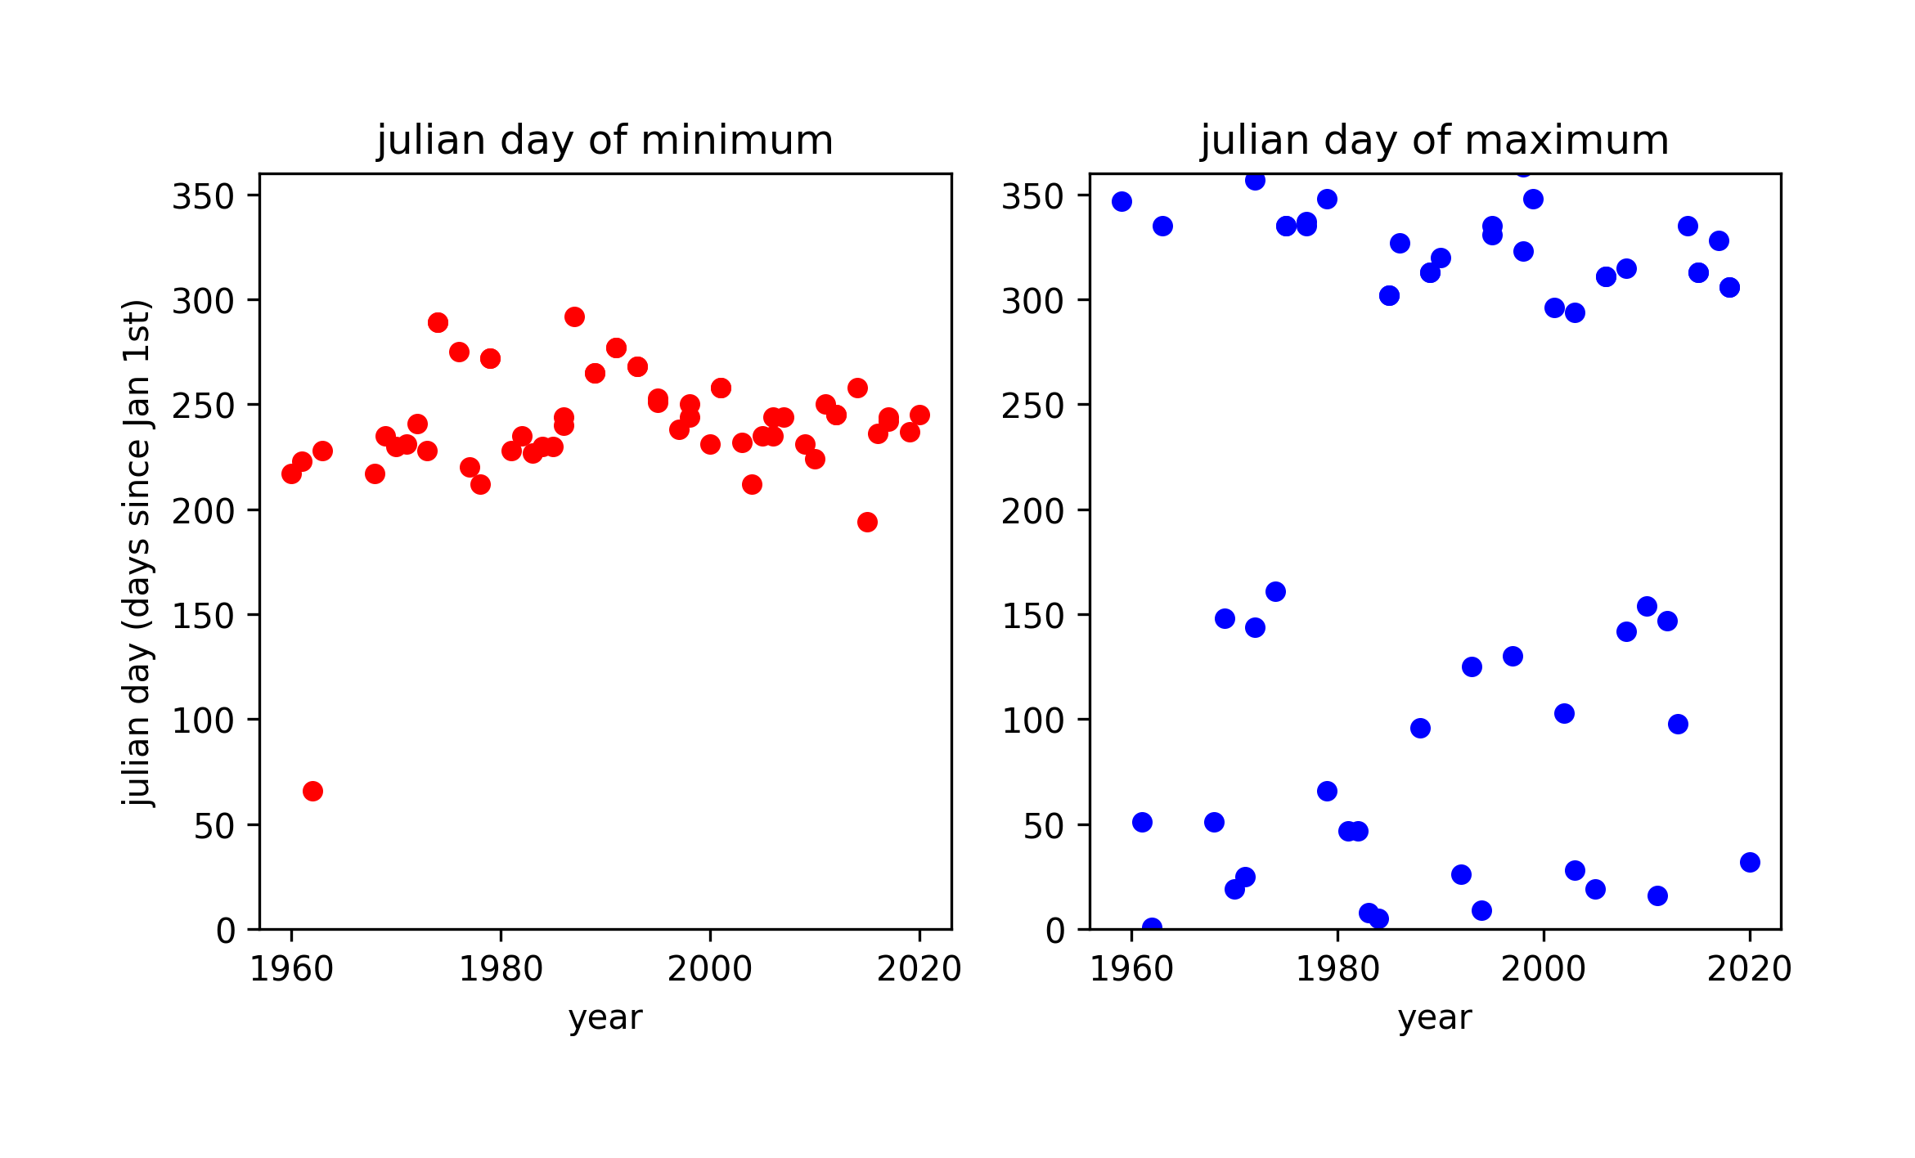
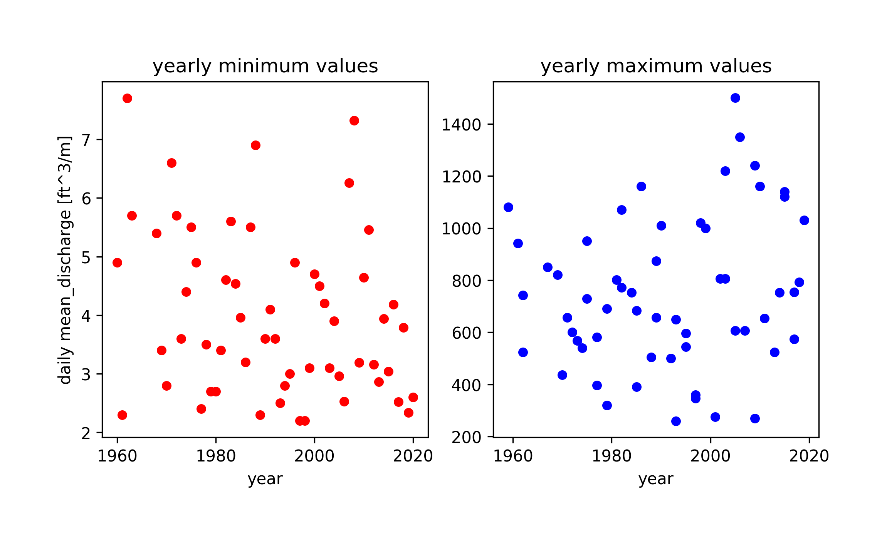
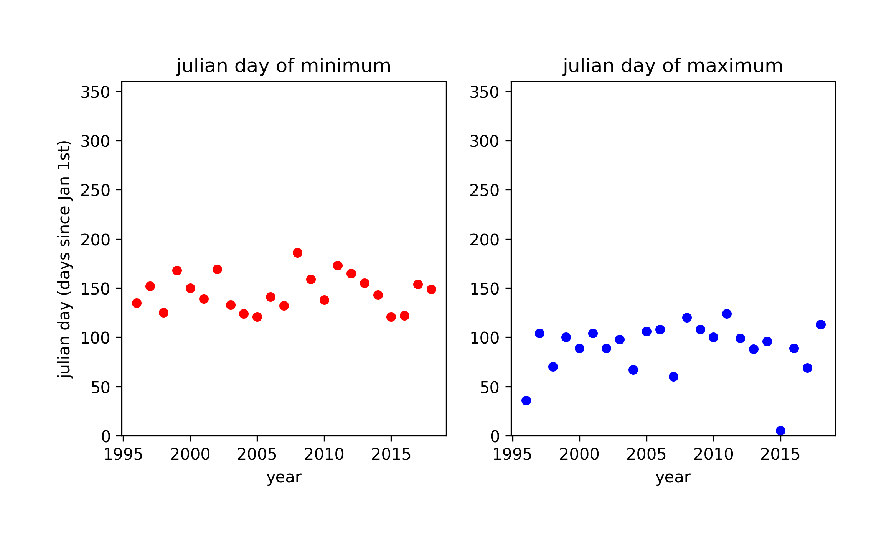
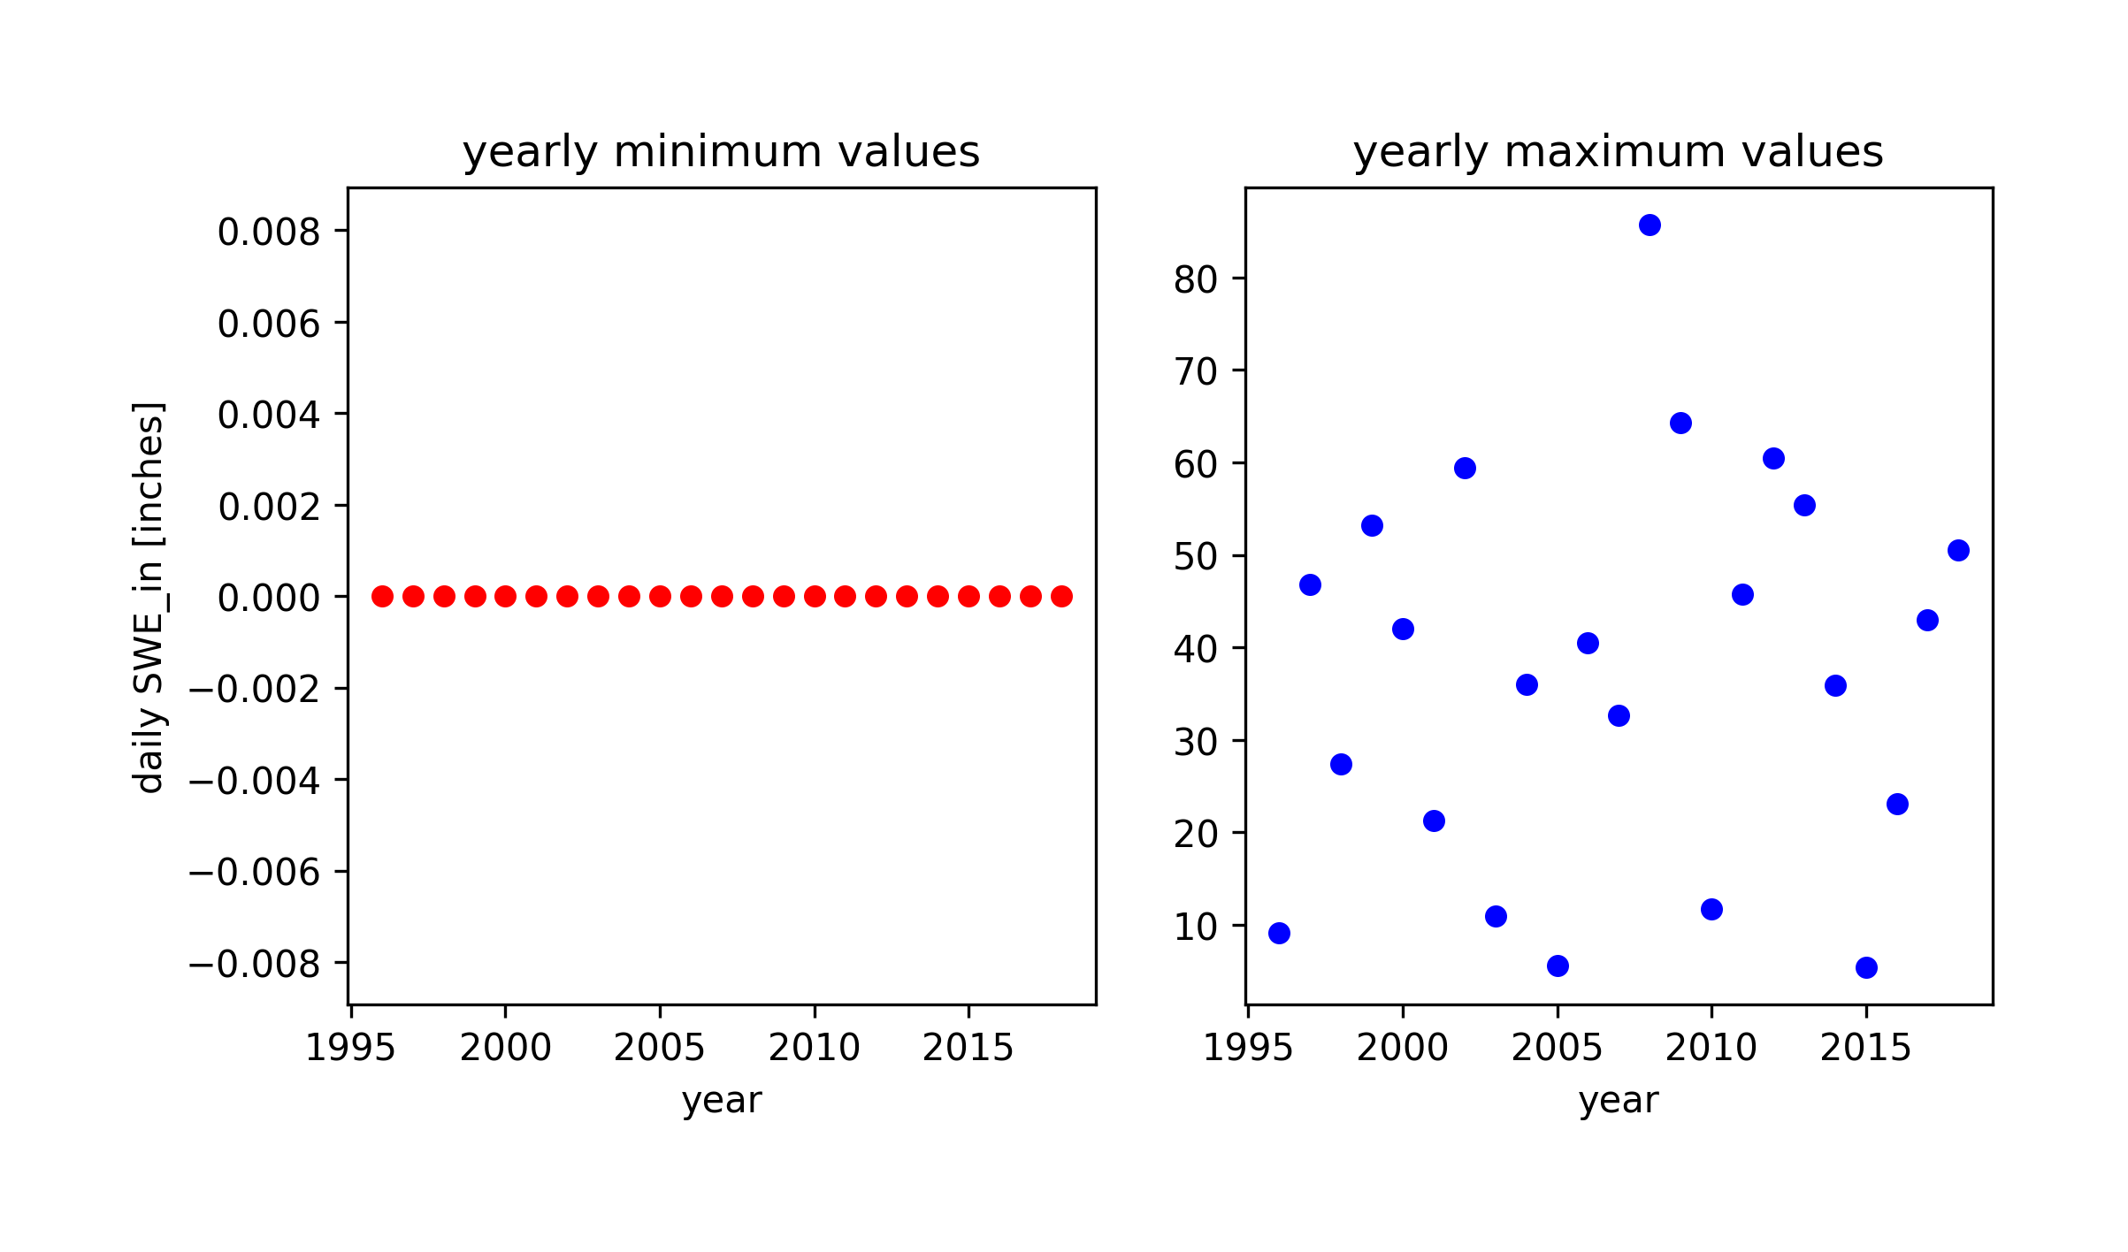
Discharge data: USGS stream gage site no. 12147600
A
B
C
D
?
?
Timing of maximum streamflow rates
Timing of minimum streamflow rates
SWE data: Skookum Creek SNOTEL Site
E
F
G
H
High variability, no distinct trend
End of each snow season (Timing of 0 [in] SWE)
SWE always reaches 0 [in] at the end of the snow year in bias-corrected data
Timing of maximum SWE for each snow season

