Slide 1
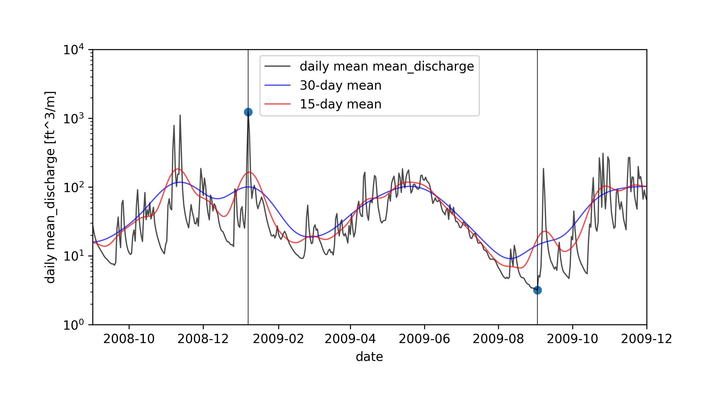
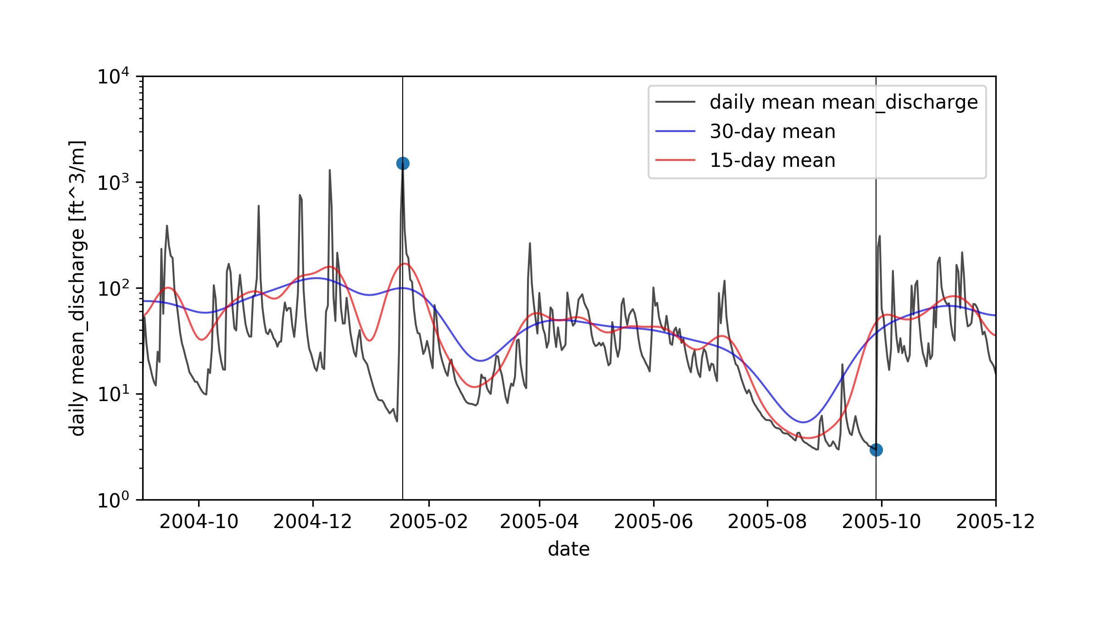
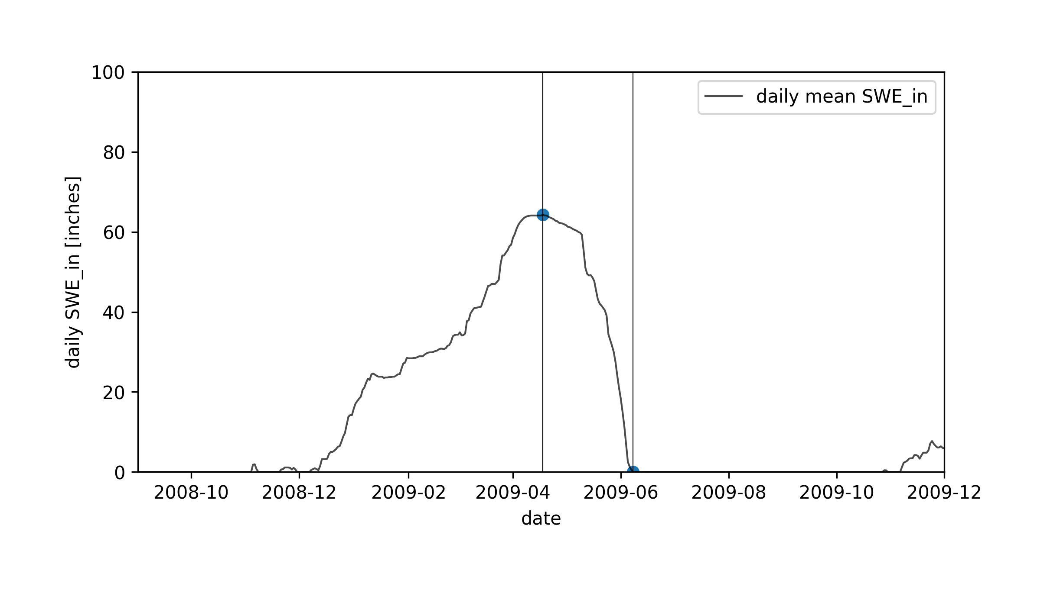
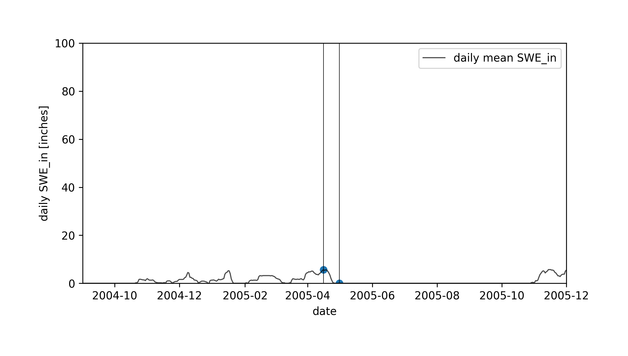
USGS stream gage site no. 12147600
USGS stream gage site no. 12147600
Skookum Creek SNOtel Site
Skookum Creek SNOtel Site
Notes:
python plotyear.py -infile_stream /Users/ginevramoore/Desktop/CEWA568/final_project/data/all_data_12147600.csv -op water_years/12147600_09.01.%s-12.01.%s.png -b 09.01.%s 12.01.%s -p1dm y -p15dm y -p30dm y -c1 mean_discharge -u1 [ft^3/m]

Slide 2
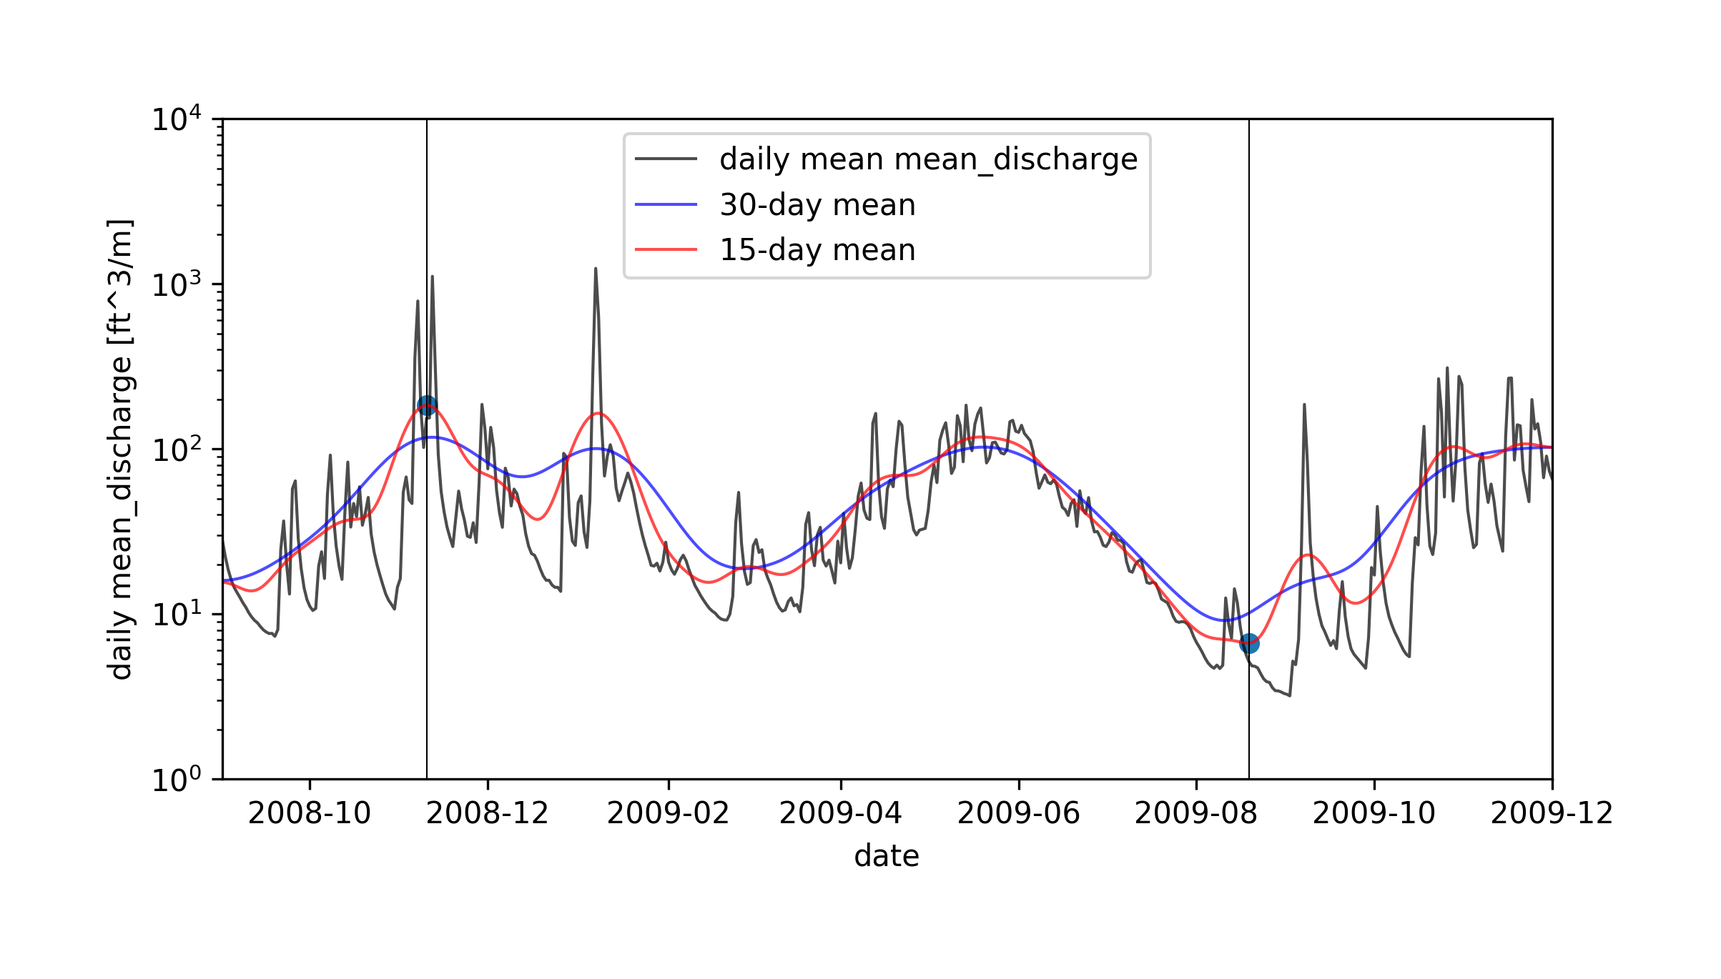
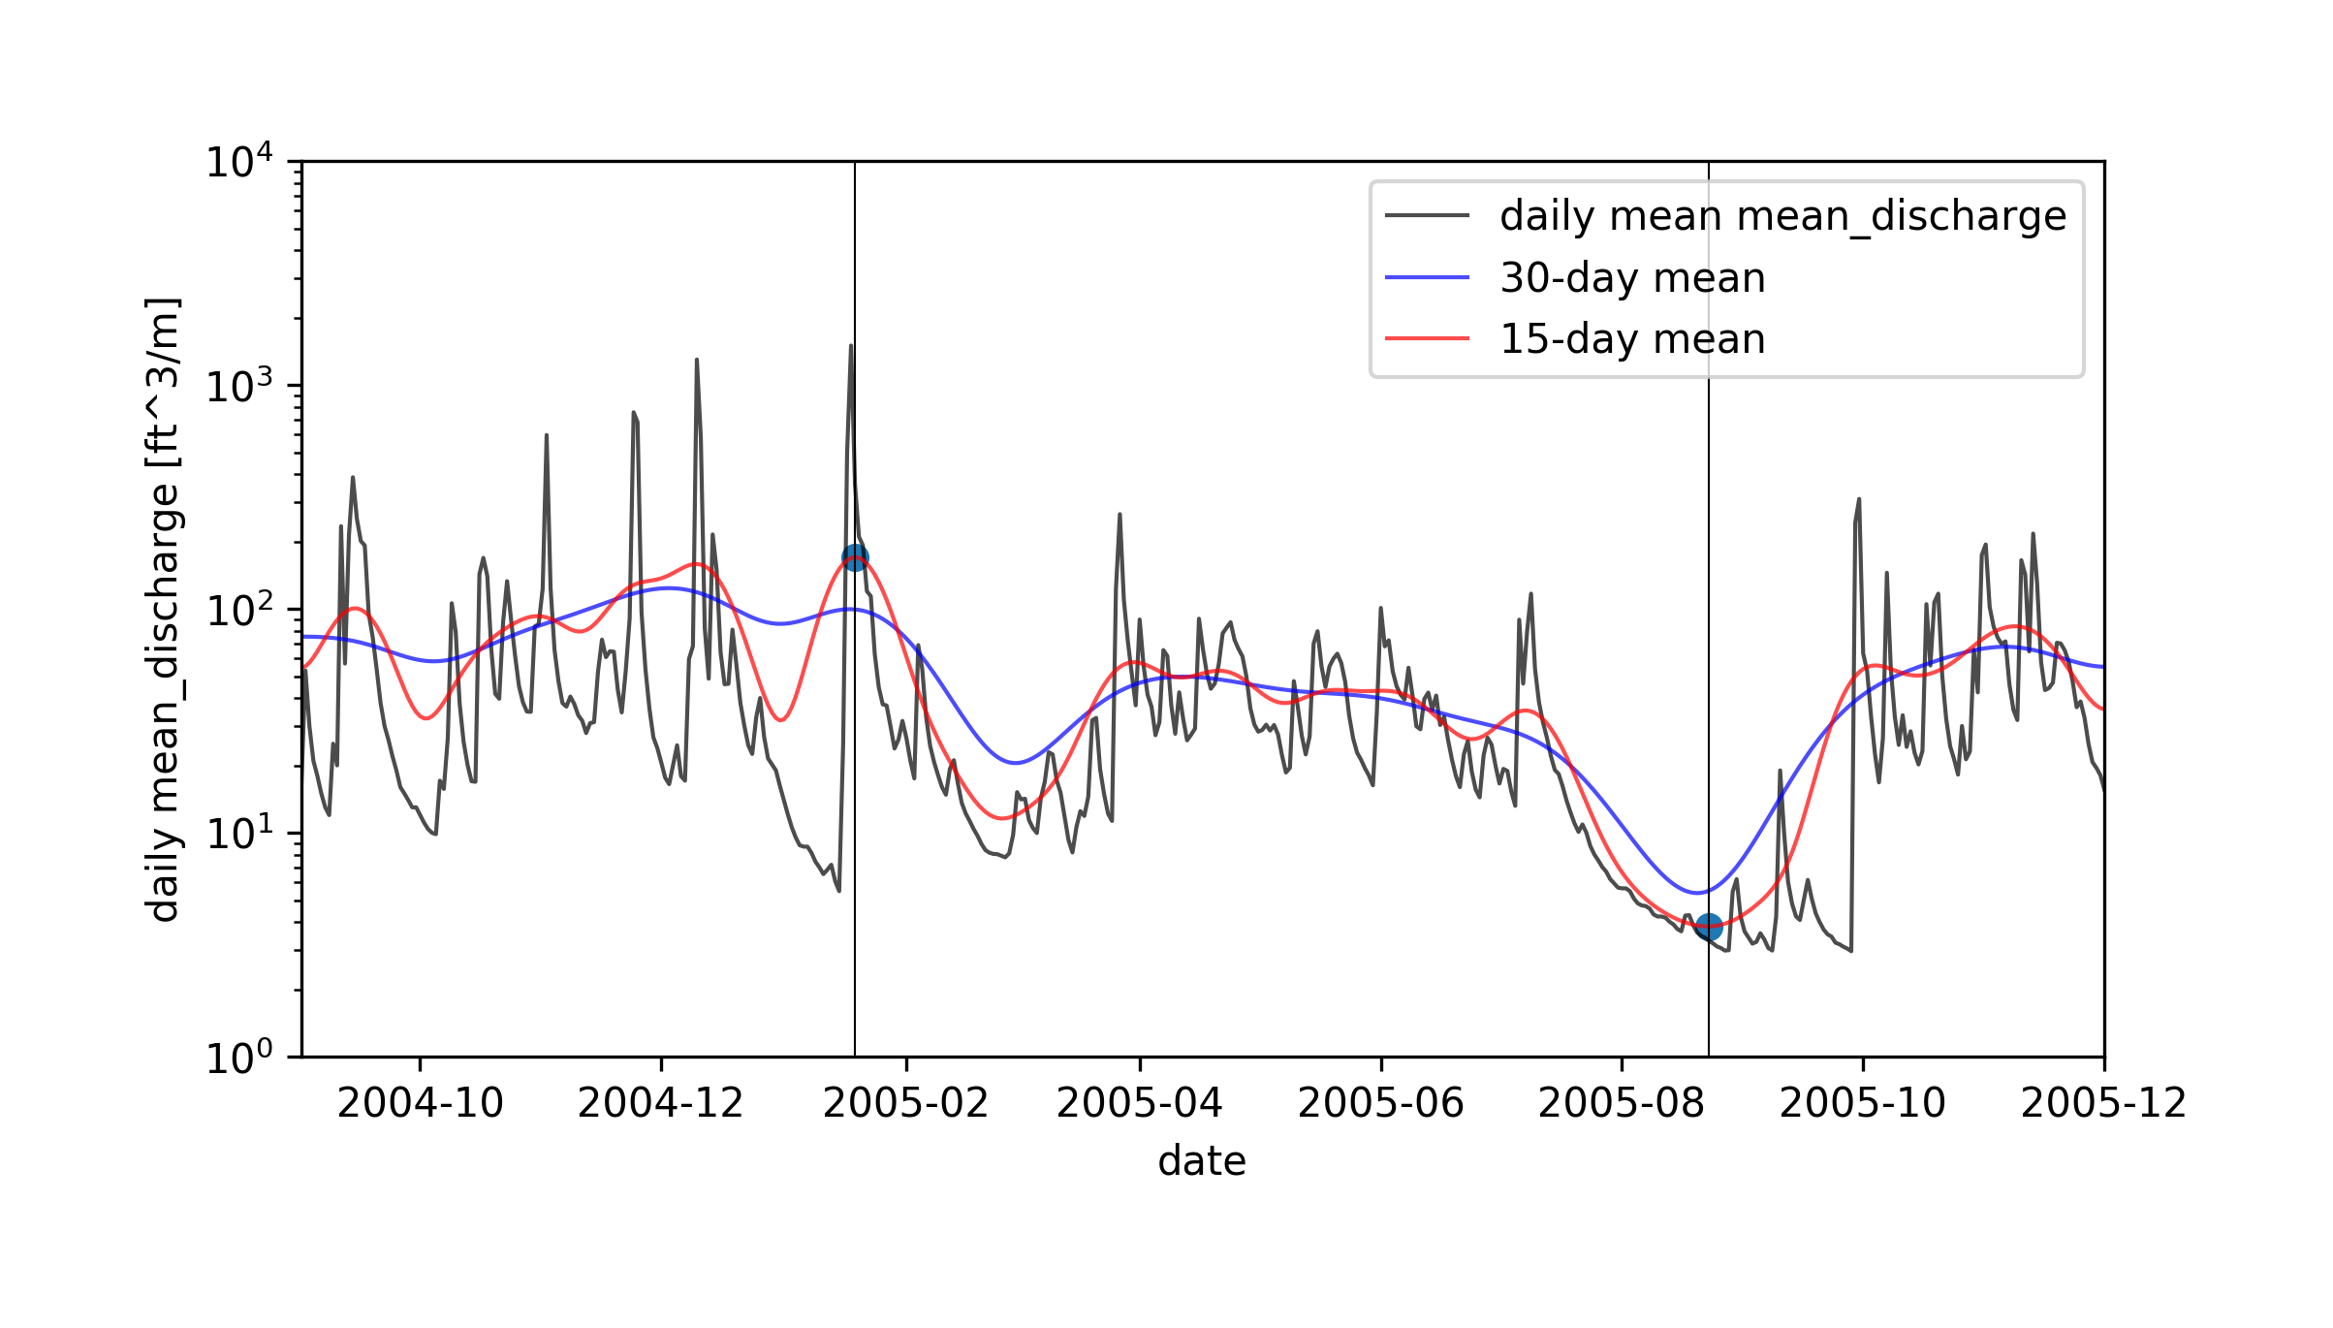
USGS stream gage site no. 12147600
USGS stream gage site no. 12147600
A
B
Skookum Creek SNOTEL Site
Skookum Creek SNOTEL Site
C
D
Mid-winter melt event?
Rain on snow event?
Notes:
python plotyear.py -infile_stream /Users/ginevramoore/Desktop/CEWA568/final_project/data/all_data_12147600.csv -op water_years/12147600_09.01.%s-12.01.%s.png -b 09.01.%s 12.01.%s -p1dm y -p15dm y -p30dm y -c1 mean_discharge -u1 [ft^3/m] -mm 15d

Slide 3
USGS stream gage site no. 12147600
USGS stream gage site no. 12147600
A
B
Skookum Creek SNOTEL Site
Skookum Creek SNOTEL Site
C
D
Mid-winter melt event?
Rain on snow event?
Notes:
python plotyear.py -infile_stream /Users/ginevramoore/Desktop/CEWA568/final_project/data/all_data_12147600.csv -op water_years/12147600_09.01.%s-12.01.%s.png -b 09.01.%s 12.01.%s -p1dm y -p15dm y -p30dm y -c1 mean_discharge -u1 [ft^3/m] -mm 15d

Slide 4
USGS stream gage site no. 12147600
USGS stream gage site no. 12147600
A
B
Skookum Creek SNOTEL Site
Skookum Creek SNOTEL Site
C
D
Notes:
python plotyear.py -infile_stream /Users/ginevramoore/Desktop/CEWA568/final_project/data/all_data_12147600.csv -op water_years/12147600_09.01.%s-12.01.%s.png -b 09.01.%s 12.01.%s -p1dm y -p15dm y -p30dm y -c1 mean_discharge -u1 [ft^3/m] -mm 15d

