Slide 1
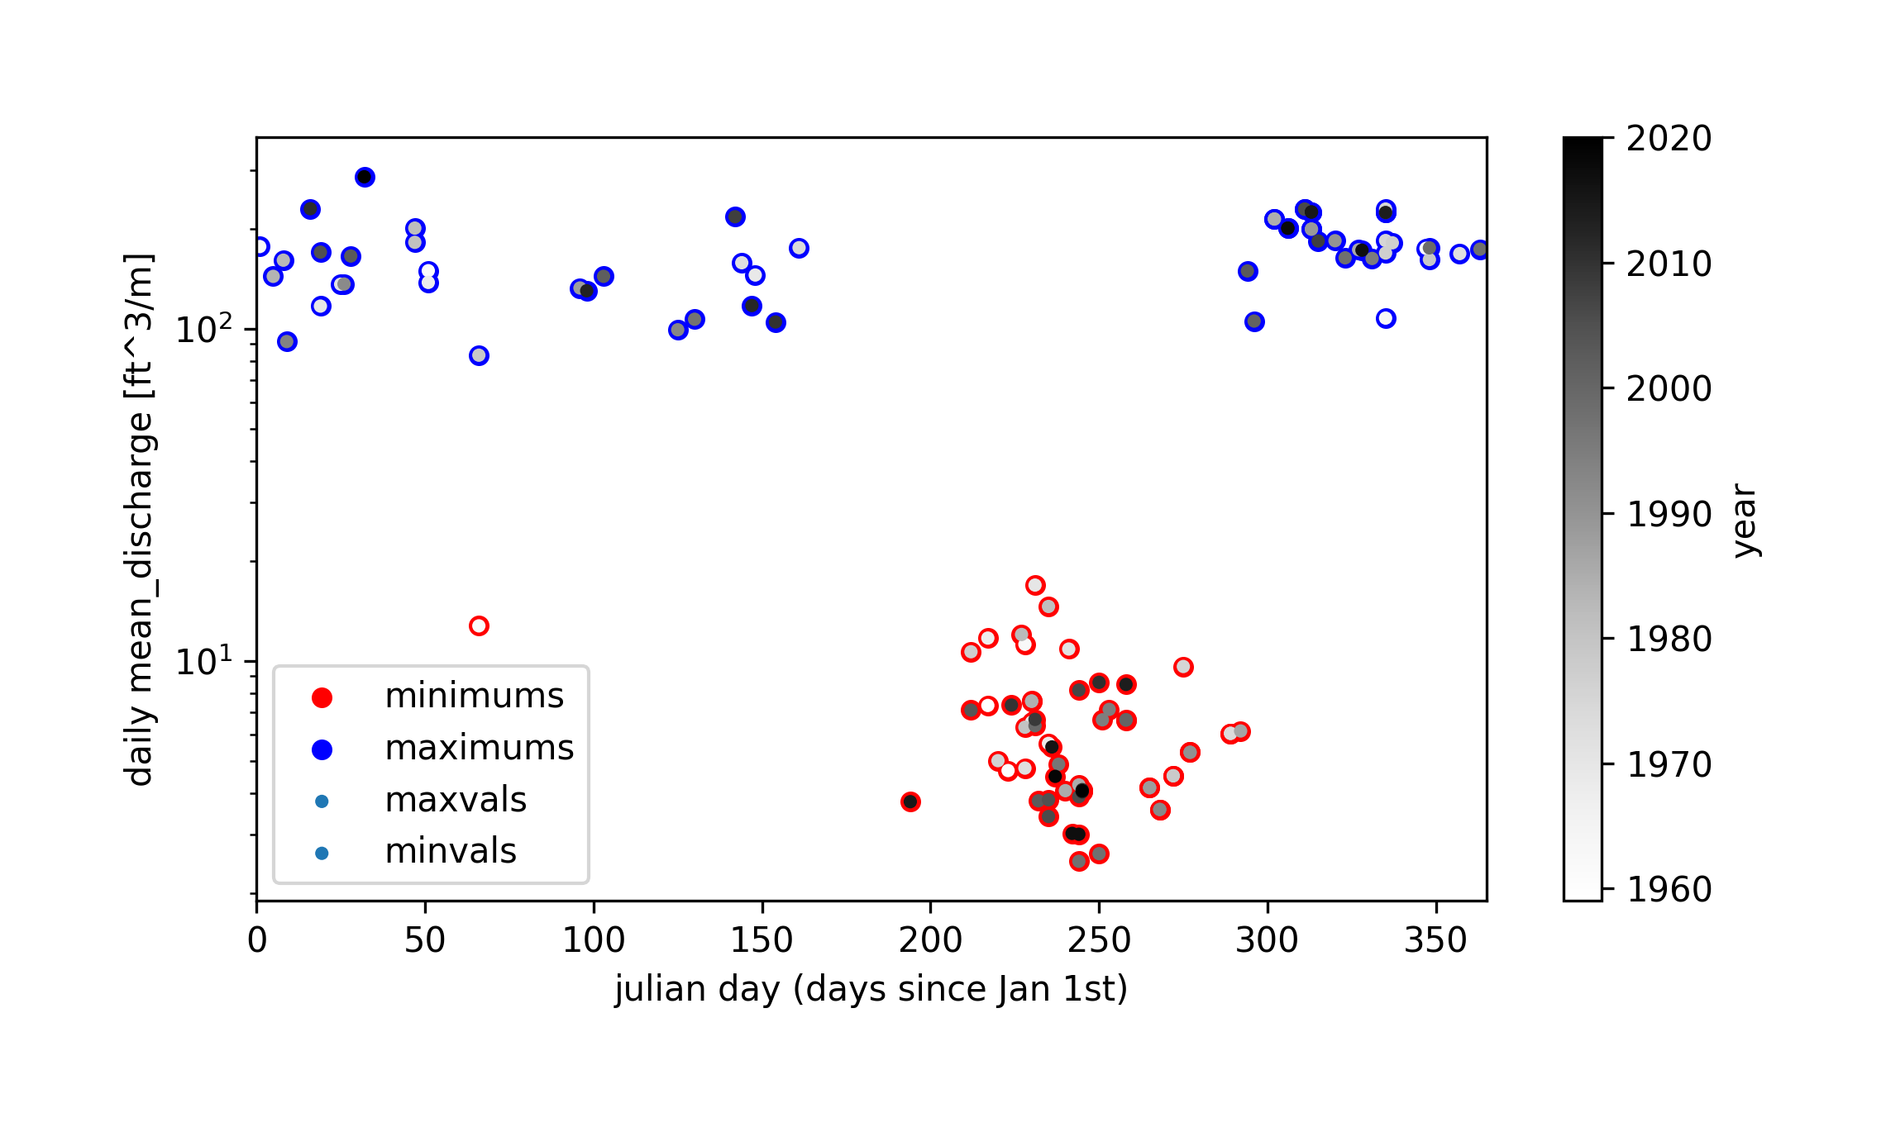
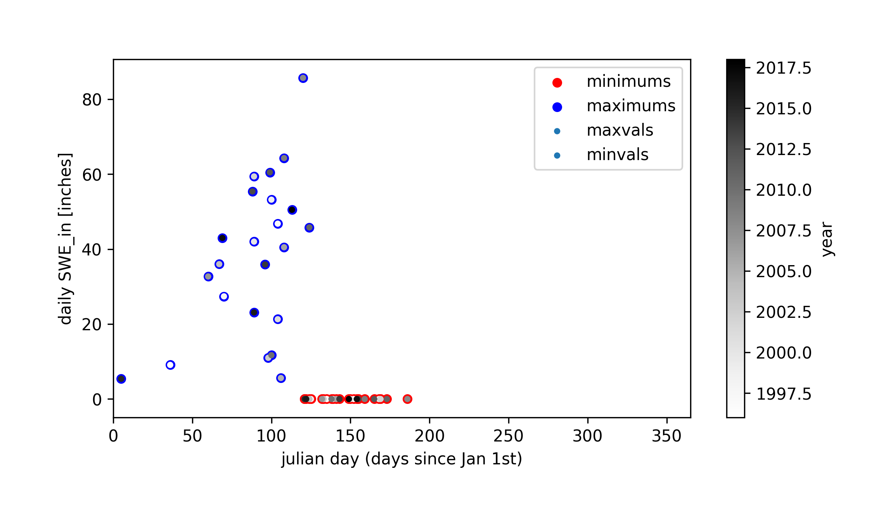
USGS stream gage site no. 12147600
Skookum Creek SNOTEL Site

