Slide 1
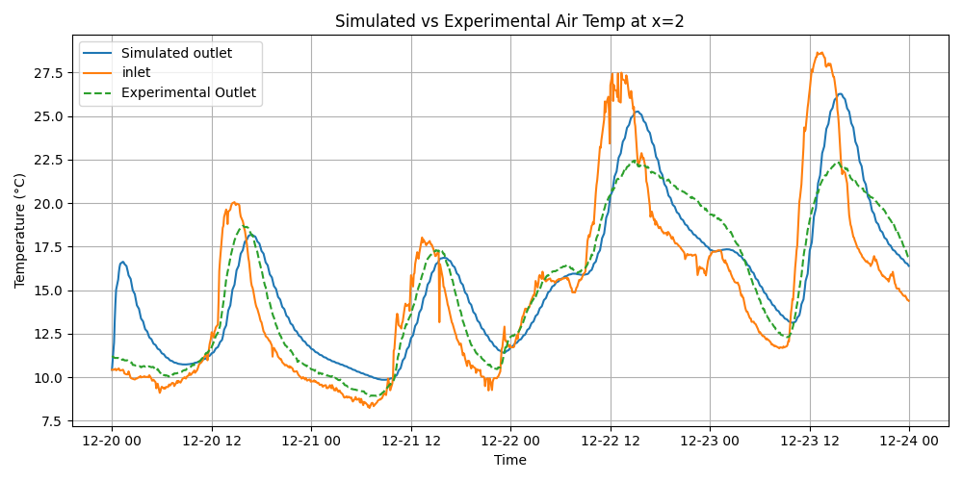

Slide 2
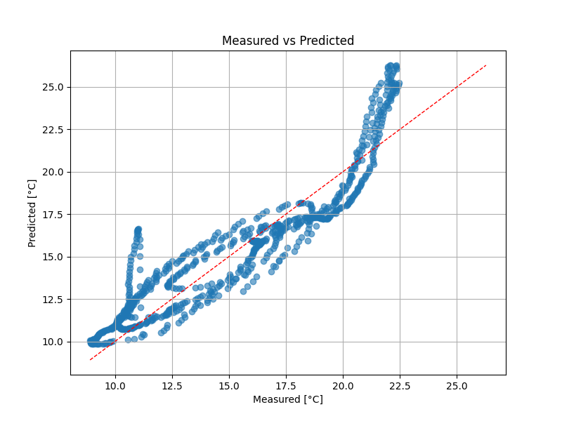
Mean Absolute Error (MAE),1.3665
Mean Squared Error (MSE),2.8203
Root Mean Squared Error (RMSE),1.6794
Mean Absolute Percentage Error (MAPE),9.4886
Mean Bias Error (MBE),0.3645
R² Score,0.8410
Coefficient of Variation of RMSE (CVRMSE),11.0245
Normalized Bias Error (NBE),2.3927

Slide 3
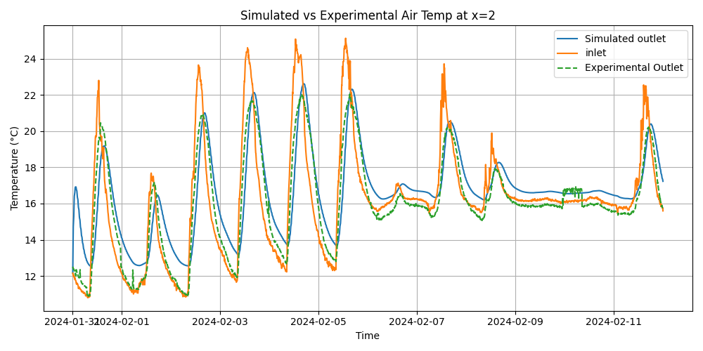

Slide 4
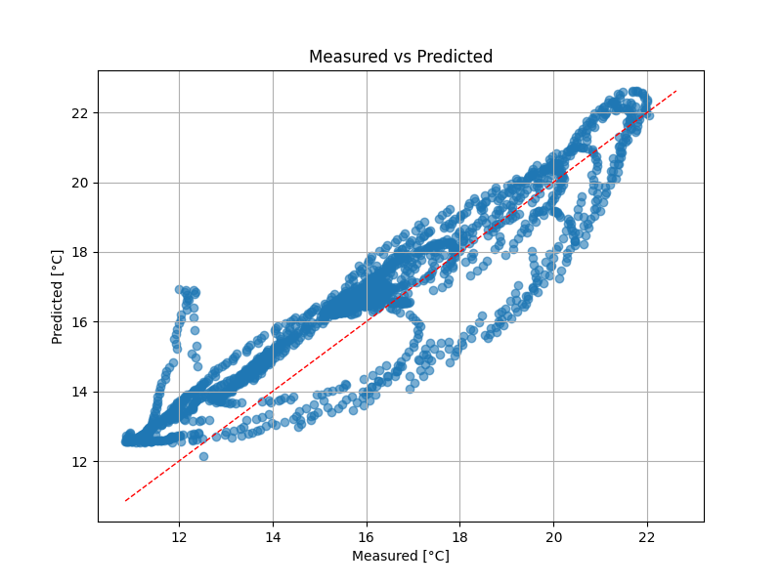
Mean Absolute Error (MAE),1.0149
Mean Squared Error (MSE),1.4348
Root Mean Squared Error (RMSE),1.1978
Mean Absolute Percentage Error (MAPE),6.7570
Mean Bias Error (MBE),0.5868
R² Score,0.7939
Coefficient of Variation of RMSE (CVRMSE),7.4742
Normalized Bias Error (NBE),3.6616

Slide 5
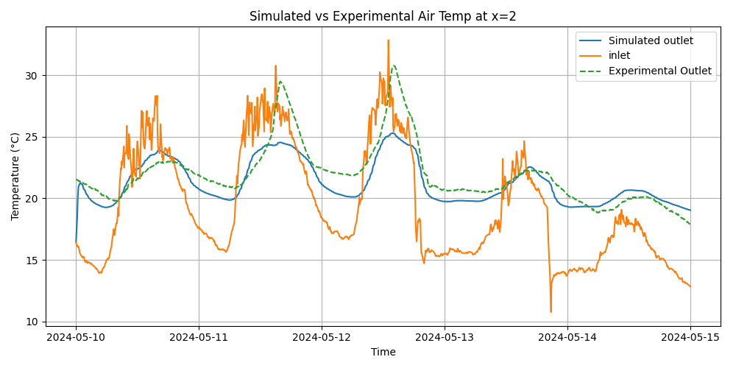

Slide 6
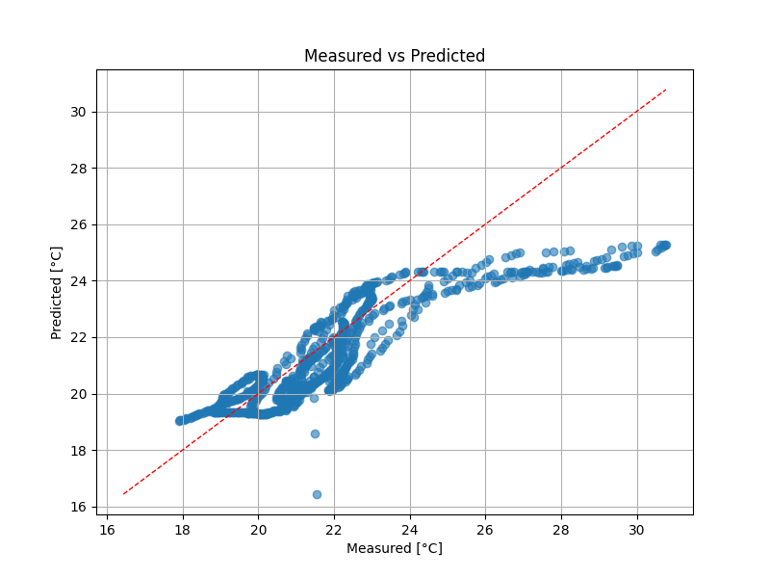
Mean Absolute Error (MAE),1.0334
Mean Squared Error (MSE),2.0181
Root Mean Squared Error (RMSE),1.4206
Mean Absolute Percentage Error (MAPE),4.4556
Mean Bias Error (MBE),-0.6576
R² Score,0.6654
Coefficient of Variation of RMSE (CVRMSE),6.4833
Normalized Bias Error (NBE),-3.0013

Slide 7
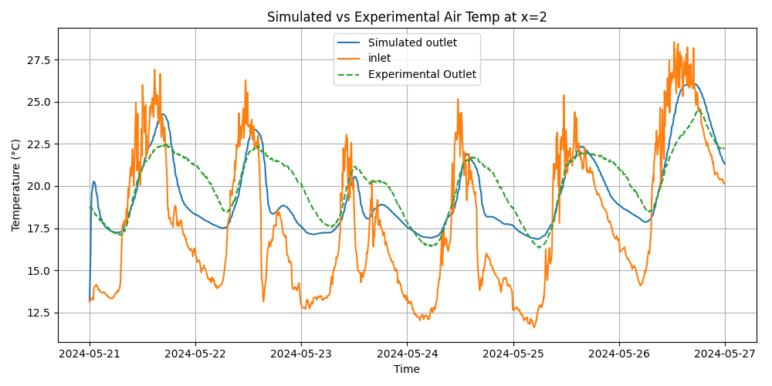

Slide 8
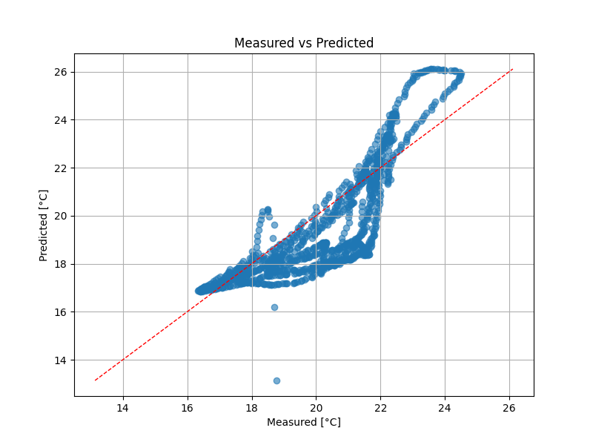
Mean Absolute Error (MAE),1.1056
Mean Squared Error (MSE),2.0558
Root Mean Squared Error (RMSE),1.4338
Mean Absolute Percentage Error (MAPE),5.3621
Mean Bias Error (MBE),-0.5787
R² Score,0.4499
Coefficient of Variation of RMSE (CVRMSE),7.1400
Normalized Bias Error (NBE),-2.8818

