Slide 1
ISABEL Open Gateway

Slide 2
Background
Complex conferences requires elaborated communication protocols.
Isabel uses a proprietary Application Layer Multicast protocol (ALM).
  Proprietary control protocol manages sessions and members.
  Real Time Protocol (RTP) is used to distribute data.
  Different network protocols in the same session (IP Unicast/ ASM / SSM...).

Slide 3
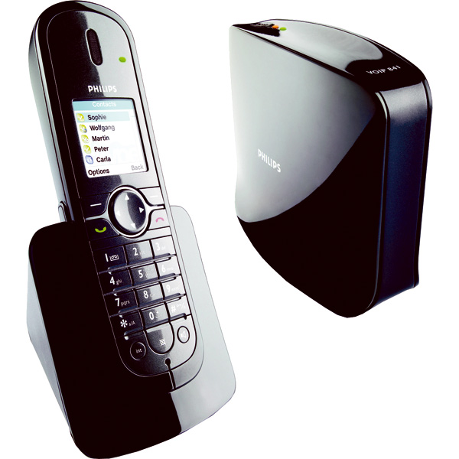
Standard VoIP protocols
We can find in the market a diversity of VoIP devices using different VoIP protocols:
  Session Initiation Protocol (SIP) from IETF.
  H.323 from ITU-T.
  Inter-Asterisk eXchange protocol.
  ...

Slide 4
¿How to connect standard VoIP devices to Isabel? (1)
Must find VoIP protocols requirements:
  Control protocol requirements:
    Multiconference / Uniconference.
    Member management.
    ...
  Data flows requirements:
    Video/Audio codecs and formats.
    Multiple data flows or unique mixed flow.
    Transport protocols.
    ...

Slide 5
¿How to connect standard VoIP devices to Isabel? (2)
Isabel will offer an Open Gateway API (OGAPI) to allow the creation of different protocol gateways.
  Web service?
  Local socket?
  Dynamic link library?
  Static link library?

Slide 6
¿How to connect standard VoIP devices to Isabel? (3)
Isabel gateway host
H.323
host
H.323
Gateway
ISABEL
SESSION
ISABEL
GATEWAY
OGAPI
SIP
Gateway
SIP
host
IAX
IAX
host

Slide 7
OGAPI
Member management.
Flow management.
Messages management.

Slide 8
Member management
Commands (Gateway → OGAPI):
  Connect (info)
  Disconnect(info)
Events (OGAPI → Gateway):
  AddMember(info)
  DelMember(info)

Slide 9
Flow management
Commands:
  Setup(member,flow,data)
  GetFlowInfo(member,flow)
Events:
  ActiveFlows(...)
  FlowInfo(info)

Slide 10
Messages management
Commands:
  QueryRequest(member)
  QueryCancel(member)
Events:
  QueryAccepted(member)
  QueryDeny(member)

Slide 11
Example: SIP sequence diagram
OGAPI
GATEWAY
SIP Device
Invite
Connect
Trying
AddMember
Progress
Setup
OK
ActiveFlows
ACK
Disconnect
BYE
DelMember
OK

