Slide 1

LEVEL 1 / 5
Mission: The Brain Code Game
What If...? The Secret Superpower of Coding! 🚀
🎮 QUICK WARM-UP GAME
👕 IF you are wearing BLUE today...
👉 Raise hand! (ELSE: Wave hands! 👋)
🎮 IF you love Minecraft or Roblox...
👉 Give me your biggest gamer smile! 😁
Meet Pixel the Bear! 🐾
"Hi super-coders! Today I need your brain superpower to make decisions!"
🐾 Part-Time Programming Teacher Demo | Timedoor Academy
Slide 1 of 5
Notes:
[Minute 00:00 - 01:00 | Energy: High & Warm]
Good afternoon, my awesome super-coders! How is everyone doing today? Awesome!
Today, we are on a secret gaming quest: Mission Save Pixel the Bear!
Before we jump in, let's play a super quick brain game! Listen to my magical rules:
IF you are wearing blue today... raise your hand up high!
ELSE (if you're not wearing blue like me!)... give me a big friendly wave! 👋
Now... IF you love playing Minecraft or Roblox... give me a big smile!
Do you know what just happened? Your brain just executed a secret superpower called CONDITIONALS!

Slide 2


LEVEL 2 / 5
Mission: The Weather Dilemma
Real-Life Logic: The Weather Dilemma 🌦️
🌧️ CONDITION: TRUE
IF it is Raining outside...
👉 THEN: Grab an Umbrella! ☂️
Stay dry and safe from the storm!
☀️ CONDITION: FALSE
ELSE (It is Sunny)...
👉 THEN: Wear Sunglasses! 😎
Enjoy the warm golden sunshine!
🐾 Part-Time Programming Teacher Demo | Timedoor Academy
Slide 2 of 5
Notes:
[Minute 01:00 - 02:00 | Energy: Interactive & Real-life]
Now, how do computers and robots make decisions? They do it just like us!
Imagine looking outside your bedroom window:
IF it is raining outside... what do you grab? That's right, an umbrella! ☂️
ELSE... if it's sunny outside... what do you wear? Cool sunglasses! 😎
In coding, IF checks if something is TRUE. And ELSE is our superhero backup plan when it's FALSE!

Slide 3
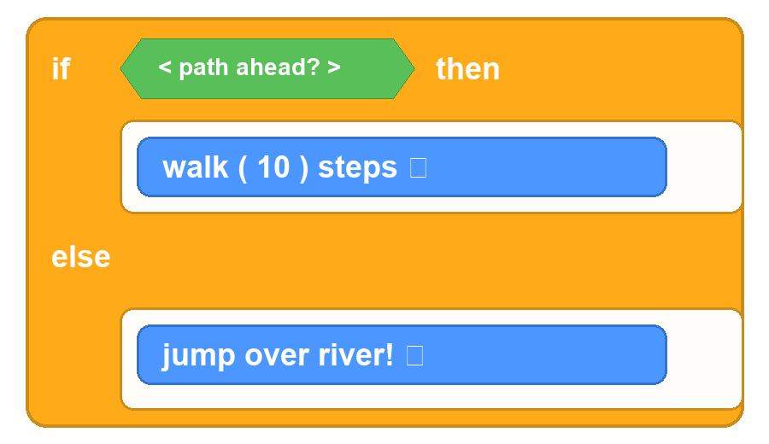
LEVEL 3 / 5
Mission: The Scratch Logic Bridge
Connecting to Scratch: The Super-C Block 🧩
⚠️ The River Dilemma!
Question for Coders:
What happens if we FORGET the ELSE block when Pixel reaches the river?
💡 The ELSE Hero:
Without ELSE, Pixel walks into the river (SPLASH!) With ELSE, Pixel leaps safely across! 🚀
🐾 Part-Time Programming Teacher Demo | Timedoor Academy
Slide 3 of 5
Notes:
[Minute 02:00 - 03:15 | Energy: Curious & Instructive]
In Scratch, this superpower looks like a giant hungry mouth — we call it the C-Block!
Look at Pixel's code:
IF path ahead, THEN walk 10 steps!
ELSE... JUMP over the river! 🚀
Coders, what would happen if we FORGOT the ELSE block when Pixel reaches the river?
He would walk straight into the water! Splash!
That's why ELSE is so important — it's the backup plan that saves our robot!

Slide 4

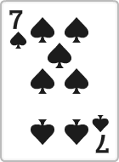
LEVEL 4 / 5
Mission: Mystery Card Quest
Interactive Challenge: The Mystery Cards! 🃏
👉 Code Rule: IF the card is RED ➔ Draw 2 Cards! | ELSE ➔ Jump 3 Times! 🦘
CARD A: RED! (TRUE)
Action: Draw 2 Cards 🎴
CARD B: BLUE! (FALSE)
Action: Jump 3 Times! 🦘
🐾 Part-Time Programming Teacher Demo | Timedoor Academy
Slide 4 of 5
Notes:
[Minute 03:15 - 04:15 | Energy: Playful & Gamified]
Time for our Mystery Card Challenge! Who wants to pick first?
Here is our code rule:
IF the card is RED... you draw 2 cards!
ELSE (if it's not red)... you have to do 3 super jumps! 🦘
Look at Card A... it's RED! Condition is TRUE!
Now Card B... it's BLUE! Condition is FALSE, so we execute ELSE!

Slide 5

LEVEL 5 / 5
Mission: Mission Accomplished!
Mission Accomplished! You Are Master Coders! 🏆
✨ 2 GOLDEN CODING RULES
1️⃣ IF is the Question!
Checks whether something is TRUE or FALSE.
2️⃣ ELSE is the Hero Backup Plan!
Tells the computer what to do when it's NOT true.
✋ VIRTUAL HIGH-FIVE ON CAMERA! ✋
LEVEL 5 UNLOCKED!
Badge: Master of Decision Logic
🐾 Part-Time Programming Teacher Demo | Timedoor Academy
Slide 5 of 5
Notes:
[Minute 04:15 - 05:00 | Energy: Victorious & Celebratory]
Look at that! We reached Level 5, and Pixel the Bear made it safely across!
Let's lock in our 2 golden superpowers today:
1. IF asks the question: Is this TRUE or FALSE?
2. ELSE is the hero backup plan: What to do when it's NOT true!
You all did an incredible job today! Can I get a virtual high-five on the camera? BAM!
Thank you super-coders, see you on our next coding mission!

